Slide 1
Technical Talk
8th of October 2020

Slide 2

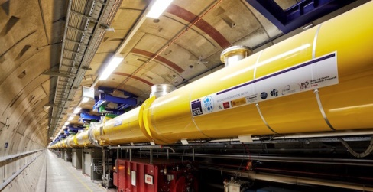

Overview
HPC center, storage provider / developer
Cloud Provider in EGI Federated Cloud
Platform for portal development and integration
Research and Innovation in Computing
Images: Terahertz accelerator modules (right) fit easily between two fingers and achieve accelerating voltages of three times that of the European XFEL cavities (left).
Source: left: Femto 02/17 (picture: DESY, Dirk Nölle), www.xfel.eu; right: Femto 01/19 (picture: DESY, Heiner Müller-Elsner), www.cfel.de; www.desy.de/femto_eng

Slide 3


DESY IT - EGI FedCloud - EOSC
DESY provides resources for PaNOSC
to the EGI Federated Cloud
16 servers, 320 cores, 6 TB RAM
1.3 PB block storage
200 Public IPs
Openstack Federated Cloud Computing
Kubernetes Container Orchestration
Jupyter Interactive Data Science
SLURM HPC Workload Manager
dCache Peta-Scale Storage

Slide 4
The PanOSC Portal test experience
Micro-Service Architecture – Containerized Application
  Adapted and installed HELM Charts
    Backend APIs, DB
  Frontend
Focus at on-site integration
  Keycloak as AAI Provider, mapping federated and local account uid/gid
  Running portal and user instances on Kubernetes
    On Cloud (HPC servers) and HPC Cluster (HPC servers + Infiniband)
    Cloud Cluster hosts additional platforms: Python Dask, Apache Spark, ...
    Rancher provides useful add-ons: metrics, logging, auth, ...
    Kubernetes worker mount scientific data (dCache, GPFS), access uid based

Slide 5
PaNOSC Portal → Jupyter
Integrate local Jupyter Hub as entity and use its API
  Run custom environments on cloud
  (extended Jupyter base images)
  Run on HPC Cluster currently only to DESY users
Serve links to pull git repositories to Jupyter
Single Sign On (OIDC) with portal and Jupyter Hub
uid/gid mapping to local accounts (on Keycloak)
  Group based access managable on federated AAI

Slide 6
PaNOSC Portal → SLURM
Co-exist and integrate Kubernetes with SLURM resources
  Mixed k8s cluster with Docker and Singularity CRI
    github.com/sylabs/singularity-cri
  Slurmjob as k8s API Resource
    github.com/sylabs/wlm-operator
    K8s understands what Slurm resources (partitions) exist
    K8s interacts with Slurm
Upcoming: Slurm REST API to submit jobs

Slide 7
PaNOSC Portal → Openstack
Openstack serves Kubernetes nodes
  Accessible as testbed via EGI FedCloud for PaNOSC
  Images for VMs synced for vo.panosc.eu on EGI FedCloud Sites
As for Jupyter, Kubernetes, Rancher:
  Prefer to link and access Dashboard and API from portal
  Easy cases (start,stop Vms) implementable in portal API
  But more complex demands likely to emerge from use cases

Slide 8

Notes:
1

