Slide 1


Hard X-ray synchrotron radiation Computed tomography in material science
ALBA-ICMAB workshop 24/02/2020
Alberto Mittone
FaXToR Beamline responsible

Slide 2
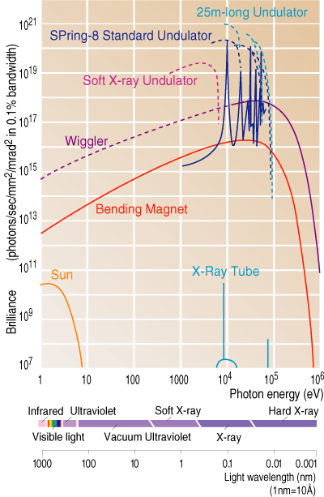
Synchrotron radiation for imaging
Why is SR interesting for imaging?
Several orders of magnitude more intense than conventional X-ray generators
Tunable monochromatic energy
Parallel beam
Apply techniques of “Phase-Contrast”

Slide 3
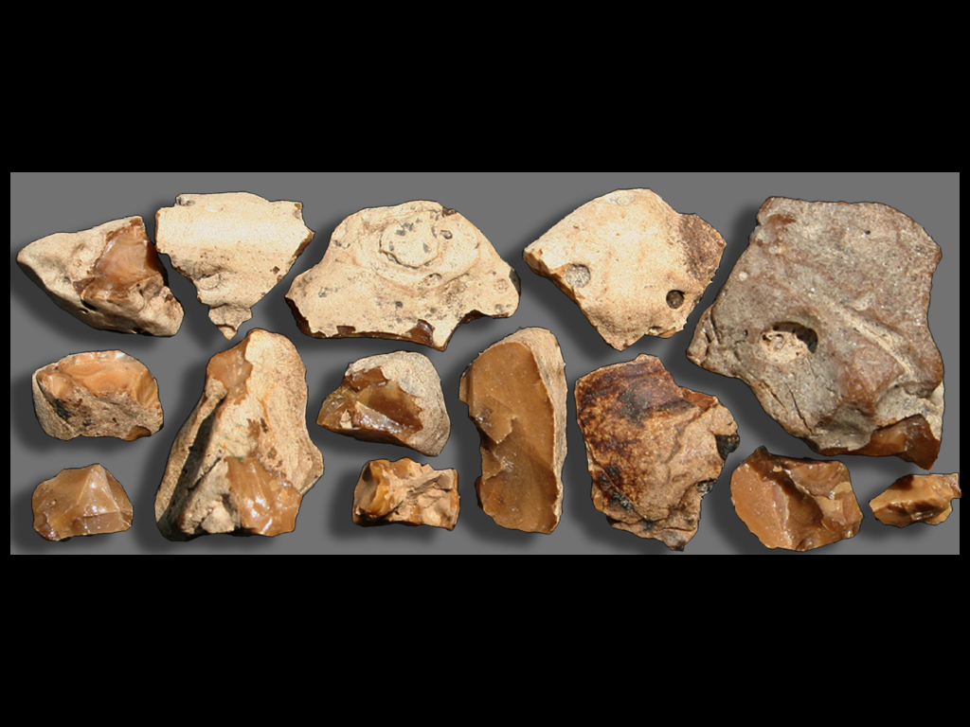
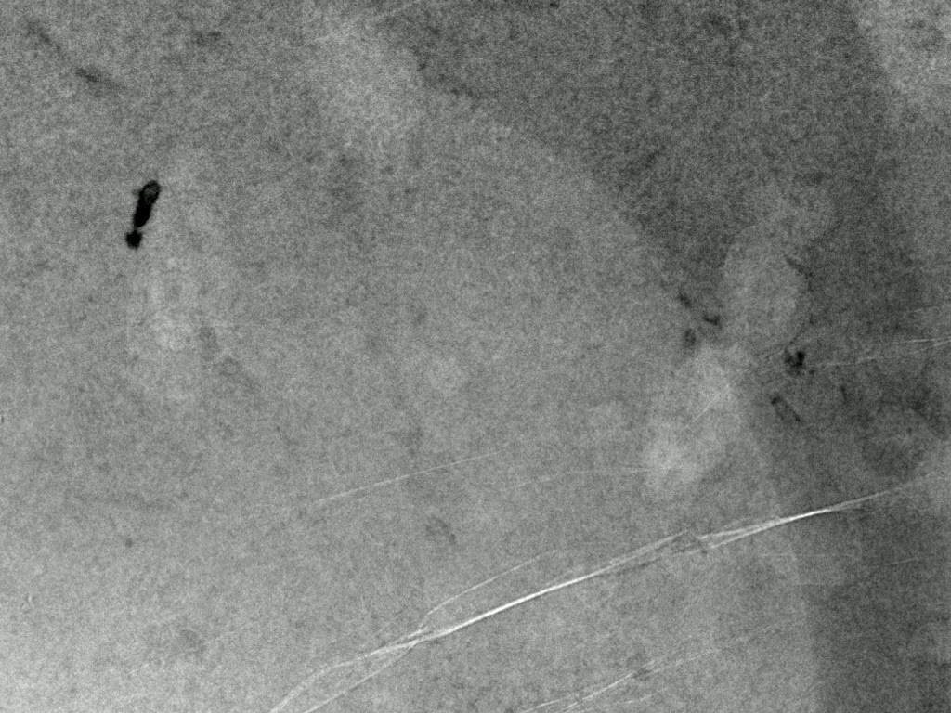
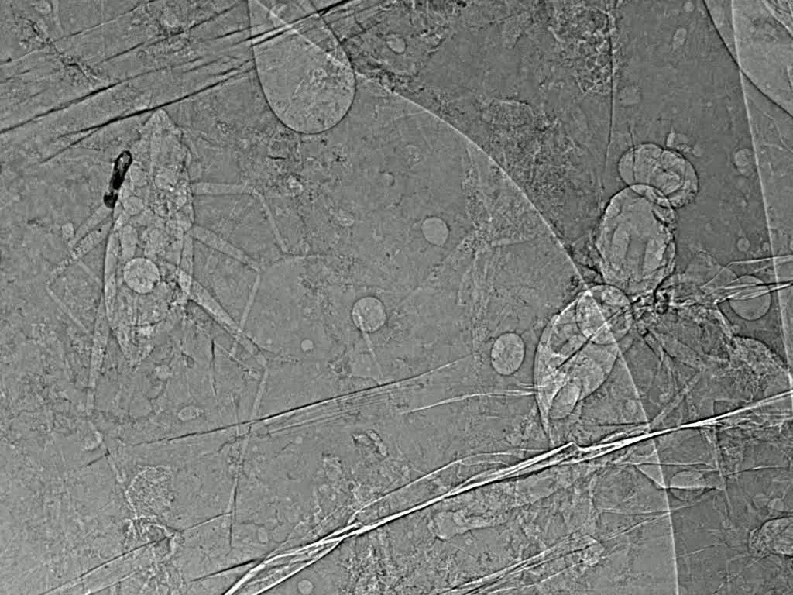

Synchrotron radiation for imaging
Why is SR interesting for imaging?
Several orders of magnitude more intense than conventional X-ray generators
Tunable monochromatic energy
Parallel beam
Apply techniques of “Phase-Contrast”
“Conventional imaging”
Refraction “phase-shift”
$$I=I_{0}e^{−µx}$$
Propagation-based imaging
Absorption Imaging
X-ray phase contrast

Slide 4
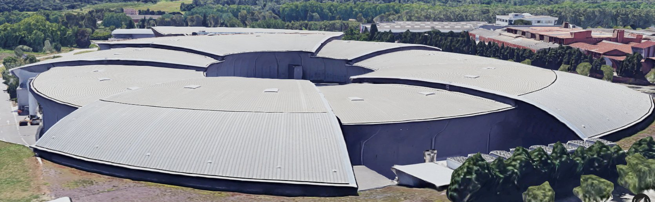

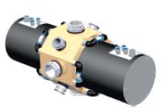
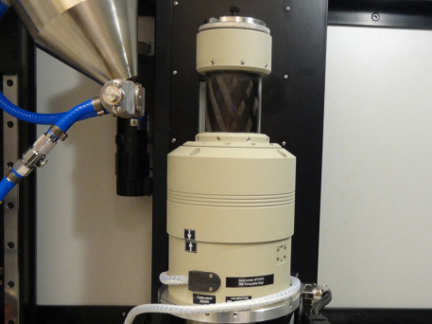


FaXToR: Fast X-ray Tomography & Radiography Beamline
Under design
Material science
Biomedicine
Cultural heritage
…
WHEN
Official starts of user operation: end of 2023
Complex sample environment
Absorption-based Imaging
Radiography and 3D & 4D µTomography
Phase-contrast based imaging (propagation-based imaging)
Characteristics and samples:
Energy range:
  8-30 keV phase-contrast
  8-70 keV absorption imaging
Image pixel size (0.5 – 5 µm)
Sample size, sub- mm to few cm
Challenges:
Extremely large amount of data generated
Radiation damage
Experimental difficulties at high rotation speed
In-situ measurements capabilities

Slide 5
In-situ understanding of pore nucleation and growth in polyurethane foams
Sample preparation:
Bi-component PU: isocyanate + polyol blend with Hydrophobic fumed nanosilica.
In-situ experiment in a 12 mm diameter kapton cup
Neat PU
PU with silica nanoparticles
Experimental parameters:
80 tomographies in 90 sec (156 ms/tomography + dead time)
20 keV;
Voxel size 3.2x3.2x3.2 µm³
Phase-contrast imaging
Time
Increase of density due to reduction of free energy barrier
1) nucleation
2) Growth
3) Wet-dry transition
S. Pérez-Tamarit et al. Polymer, 2019
Notes:
The nucleation and growth of pores in PU foams have been visualized and quantified for the first time in 4D
using in-situ tomographic microscopy. Acquiring sequences of 3D images in 156 ms each, we describe homogeneous
and heterogeneous nucleation and subsequent bubble growth dynamics for materials with and without
nucleating nanoparticles. Exploiting the time resolved tomographic sequences we obtained the bubble nucleation
rate, bubble density and size evolution, based on which the diffusion coefficient of gas molecules in polymer
can be calculated, evidencing the reduction of diffusivity provoked by the inclusion of nanoparticles. We found
that nucleation and growth are in a large extend decoupled in time
Polyurethanes are used in the manufacture of high-resilience foam seating, rigid foam insulation panels, microcellular foam seals and gaskets, durable elastomeric wheels and tires (such as roller coaster, escalator, shopping cart, elevator, and skateboard wheels), automotive suspension bushings, electrical potting compounds, high-performance adhesives, surface coatings and sealants, synthetic fibers (e.g., Spandex), carpet underlay, hard-plastic parts (e.g., for electronic instruments), condoms,^{[1]} and hoses.
Bi-component PU: isocyanate (IsoPMDI 92140) + polyol blend (Elastopor H 1501/1) promotes simultaneous blowing and
gelling reactions that results into a solid cellular polymer after few
minutes (gel time 145 ± 18 s)
In this sense, this work has demonstrated that nucleation and growth
are almost uncoupled mechanisms
Up to our
knowledge, this is the first work quantifying in situ and in three dimensions
polymeric foams.

Slide 6
Thank you for the attention!

Slide 7
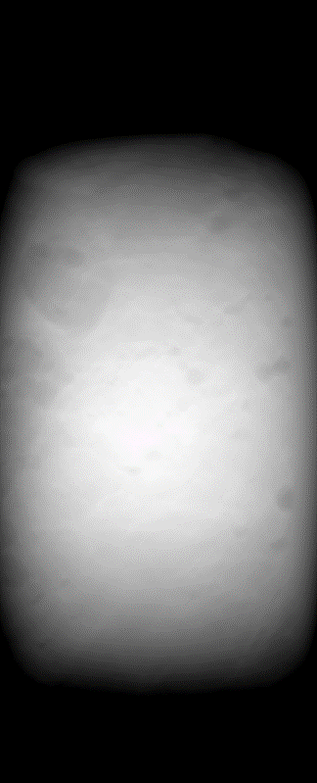
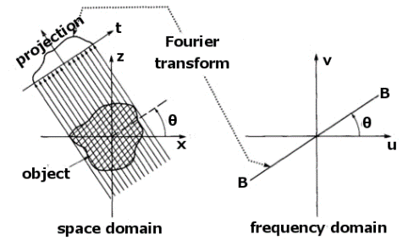
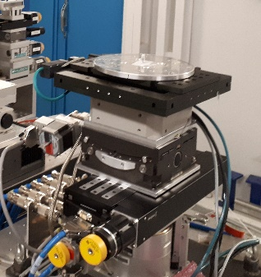
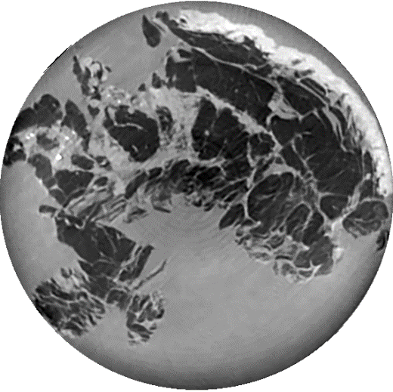
Synchrotron radiation for imaging
Detector
X-ray source
Phase-retrieval
2D
Sample
Reconstructed Volume
+ time
ID17, ESRF
4D
3D

