Slide 1
LOREA: the new ARPES beamline at ALBA for Band structure in complex materials
Massimo Tallarida, Federico Bisti, Debora Pierucci
24.02.2020

Slide 2
LOREA for band structure of complex materials
Quantum materials for spin-charge conversion
Surface vs bulk states
e-ph interaction
correlations
Dirac cones
Fermi arcs
Rashba effect
Band gap
Band alignment

Slide 3
The optical design of LOREA
Flux ~ 10¹² ph. @max resolution
Energy Range 10-1000eV with resolution > 10⁴
Beam spot of the order of 10µm

Slide 4

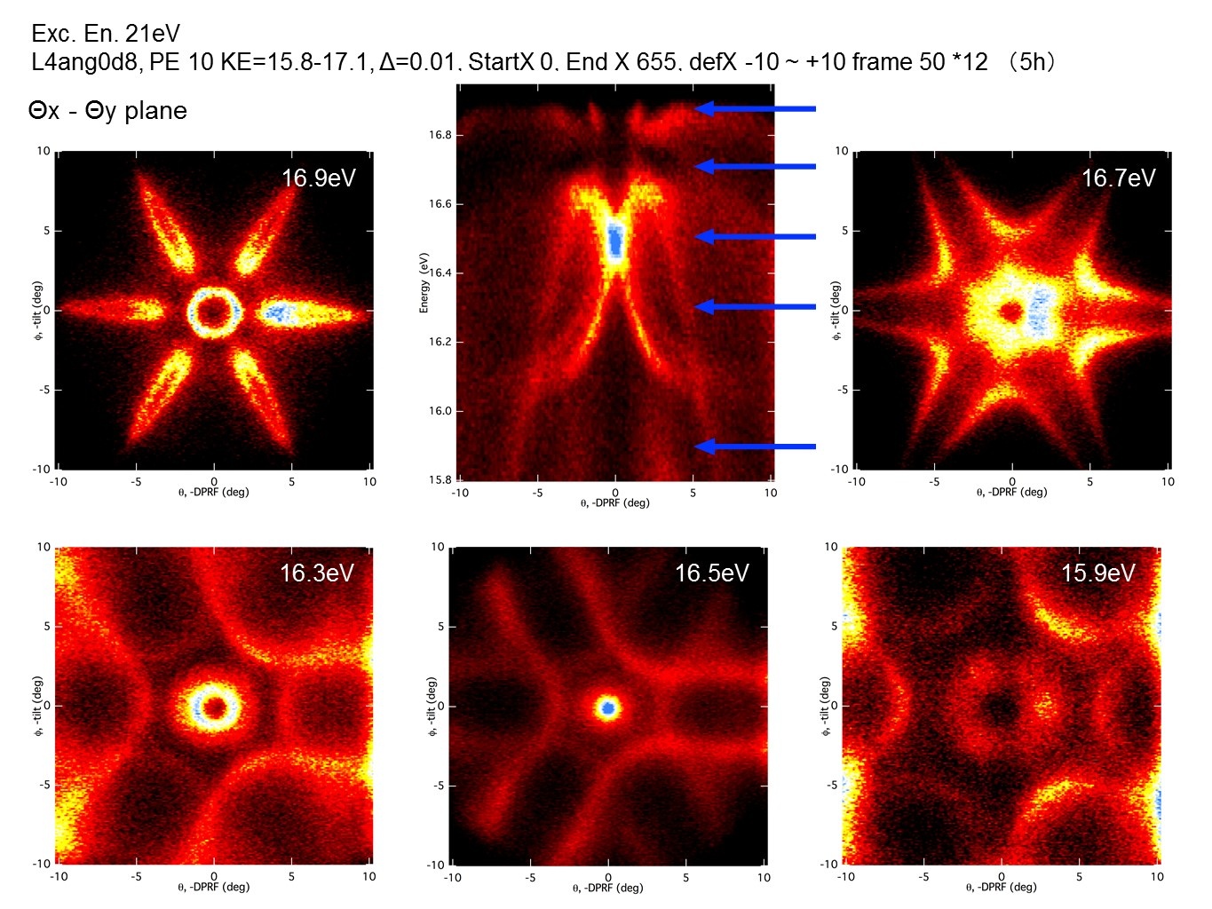
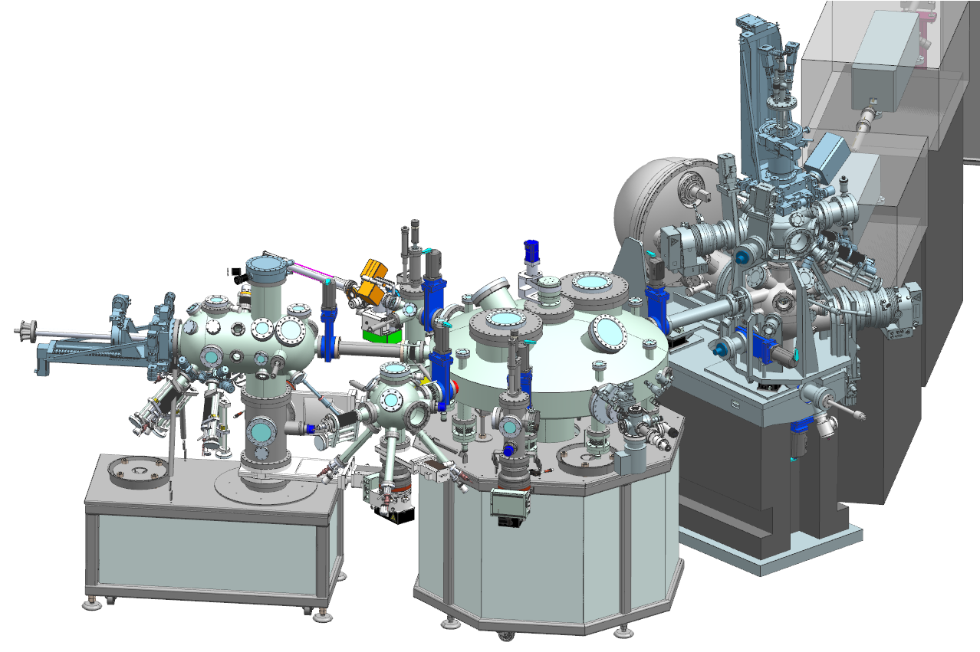
The end-station for LOREA
Specifications
Analyzer:
ΔE ~1 meV @ 20 eV.
Δθ < 0.1°
±3.5° ±7° ±15° 2D modes
MBS A-1_#0004@Saga University Synchrotron Light Application Centre
Bi (111) Data taken by Dr. M.Imamura, Prof. K. Takahashi

Slide 5
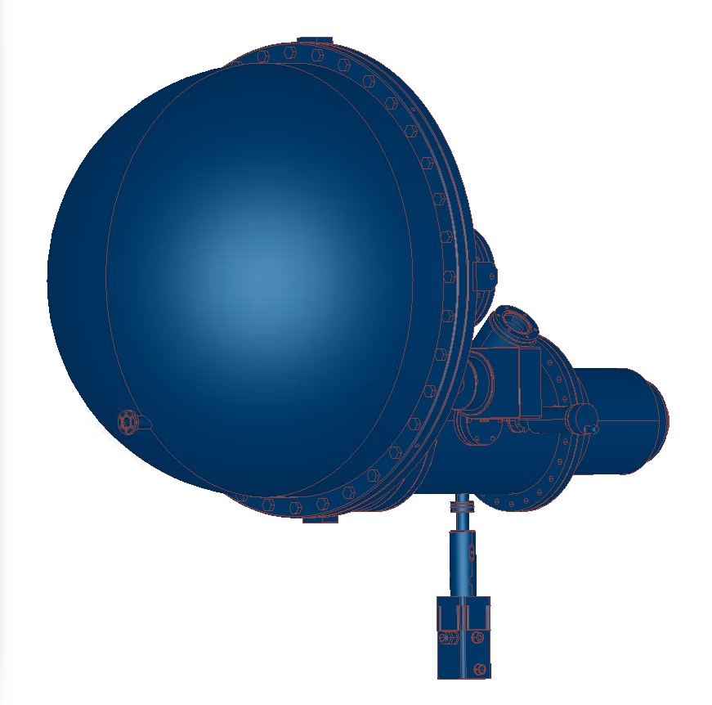
The end-station for LOREA
Aperture for spin detection
Magnetizing coil
O/Fe(100)
MCP
Sample
E_{kin}=6 eV
hν
Spin down
e⁻
Spin up
Upgrade to spin-resolved ARPES: VLEED seems the best option
Entrance Slit
MBS A-1_#0004@Saga University Synchrotron Light Application Centre
Bi (111) Data taken by Dr. M.Imamura, Prof. K. Takahashi
from F. Bisti

Slide 6
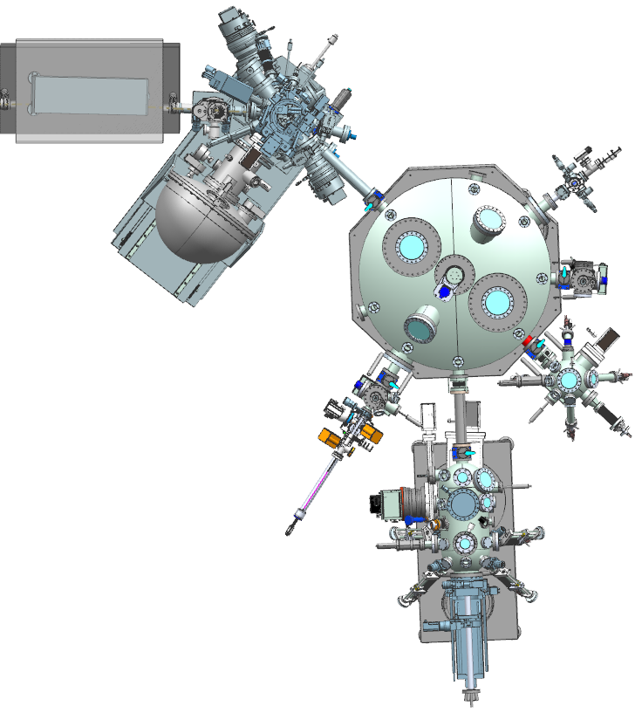
The end-station for LOREA
Photon beam
Atomic Layer Deposition
Load lock
Spin detector
(upgrade in 2021)
Samples storage + UHV suitcase
Organic Molecules Chamber
Specifications
Analyzer: Manipulator:
ΔE ~1 meV @ 20 eV. 6-axes fully motorized
Δθ < 0.1° T < 10 K
±3.5° ±7° ±15° 2D modes Up to 4 electrical contacts
Preparation Chamber

Slide 7
LOREA for band structure of complex materials
Quantum materials for spin-charge conversion
Ag/Bi (Sb) interfaces
LAO/STO
TMD Gr (2D systems)
Bi₂Se₃
Phosphorene
α-Sn
Weyl Semimetals
SmB₆ - Kondo Insulator

Slide 8
Conclusions and acknowledgments
The new ARPES beamline at ALBA is on the way
A good opportunity for the Spanish ARPES community to grow and improve the technical capabilities
Low T, High resolution, wide energy range, 2D measurements, automatization, wide variety of sample preparation tools,…
This project is co-funded by the European Regional Development Fund (ERDF) within the Framework of the Smart Growth Operative Programme 2014-2020

Slide 9
Conclusions and acknowledgments
All ALBA staff for the technical support
Engineering Division: Alejandro Crisol (mechanical design of LOREA and Monochromator); Llibert Ribó (monochromator mirrors), Nahikari Gonzalez, and Joaquín González (NanoBender); Raquel Monge (Vacuum group), Marta Llonch (Alignment), Nuria Martí and Cristina Orozco (Infrastructures), Carles Colldelram, José Ferrer
Computing Division: Bernat Molas (Electronics), Fulvio Becheri (Control System), Jorge Villanueva (Protection Systems), Sergi Pusó (IT), Guifré Cuní, Toni Pérez, Oscar Matilla
Accelerator Division: Pep Campmany (ID), Jordi Marcos (FE), Montse Pont (installations), Francis Pérez
Administration: Vanesa Faro, Edgar Aigner
Debora Pierucci and Federico Bisti (LOREA Group)
Josep Nicolás (Optical design and Project Executive)
This project is co-funded by the European Regional Development Fund (ERDF) within the Framework of the Smart Growth Operative Programme 2014-2020

