Slide 1
Experimental capabilities (Users)
LEEM:
LEEM I-V, wf contrast (MEM-LEEM)
In-situ growth/surface preparation
μ-LEED and dark field LEEM
PEEM:
Spectromicroscopy and micro-spectroscopy (XAS, XPS) down to 20 nm
Dichroic contrast (XMCD, XLD)
μ-ARPES (energy resolution ≈ 100 meV)
Functional sample environments
Research Interests (in-house)
Nanomagnetism and spintronics
> Magneto-elastic effects
Surface science
> in-situ reactive MBE
(L. Aballe, M. Foerster, A. Mandziak,
W. Khaliq, S. Ruiz)
ICMAB collaborators/users
J. Fontcuberta
E. Barrena & C. Ocal
I. Fina
F. Macia
F. Sandiumenge

Slide 2
CIRCE: Photoemission spectroscopy and Microscopy
Soft x-rays (100- 2000 eV)
Fully variable polarization (APPLE II undulator)
High flux (~10¹³ ph/s) & resolution (E/ΔE~7000)
Small spot (~20 um)
Near Ambient Pressure Photoemission - NAPP
PhotoEmission Electron Microscopy - PEEM

Slide 3
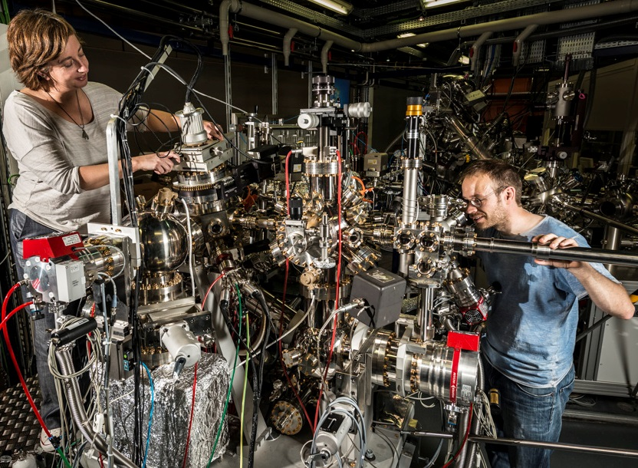
PEEM: sample environment
3
Microscope chamber:
150 K < T < 2100 K
Azimuthal rotation
Small E and B fields
Metal evaporation
Gas exposure < 10⁻⁶ mbar
Mass spectrometer
YOUR SAMPLE:
UHV compatible
Flat
Conductive
  The ALBA spectroscopic LEEM-PEEM experimental station:
  layout and performance
  L. Aballe et al., J. Synchrotron Rad. (2015). 22, 745-752
Preparation chamber:
300 K < T < 2100 K
Ion sputtering, Gas exposure < 10⁻³ mbar
Metal & organics evaporation
Mass spectrometer
Fast load-lock
UHV sample parking
Docking station for vacuum suitcase

Slide 4
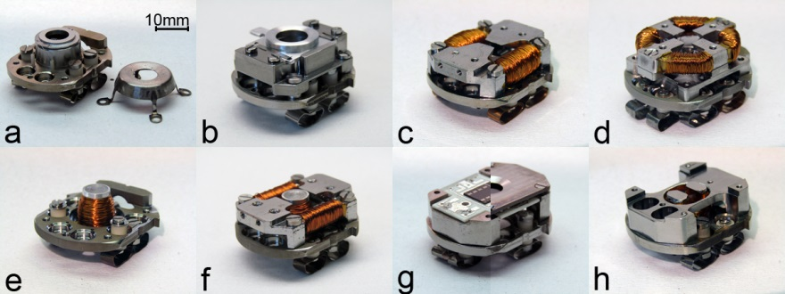
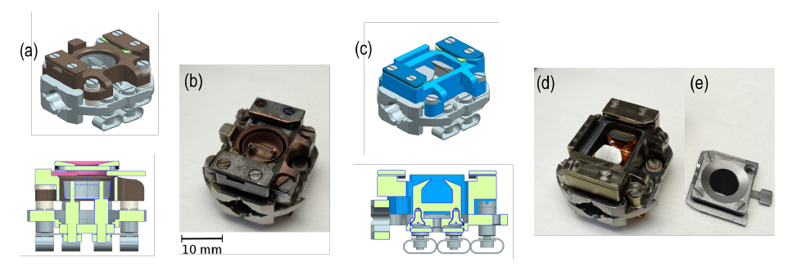
Sample holders
4
Temperature
Magnetic fields
Electrical signals
Combinations
In progress: HF
M. Foerster et al., Ultramicroscopy 171, 63 (2016)
A. Mandziak et al., submitted

Slide 5
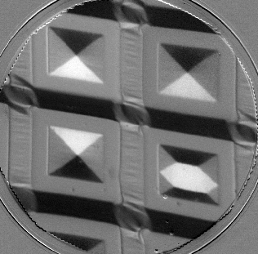
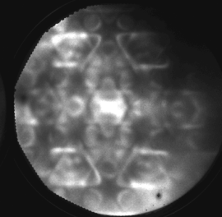
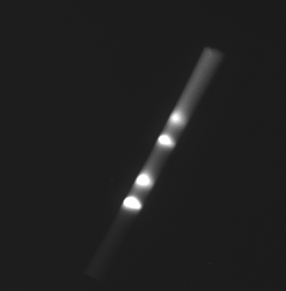
PEEM (LEEM) in a nutshell
5
X-ray beam:
tunable hv (XAS)
tunable polarization (XMCD, XLD)
screen
Photoemission
(electron escape ->
info depth 1-10 nm)
e-gun
x-rays
Electron optics:
imaging
Diffraction (ARPES)
dispersive (XPS)
e⁻
sample
objective
lens
Accl. HV

Slide 6
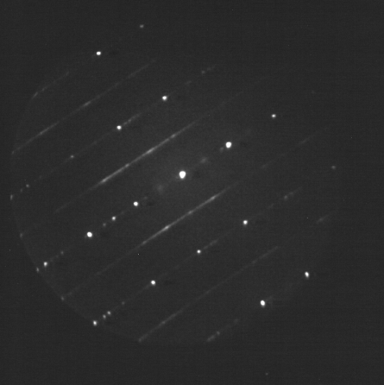
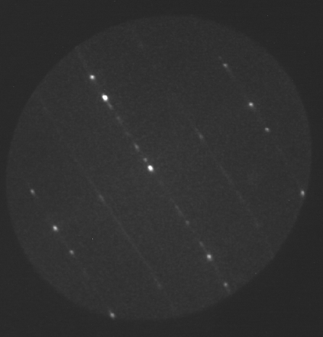
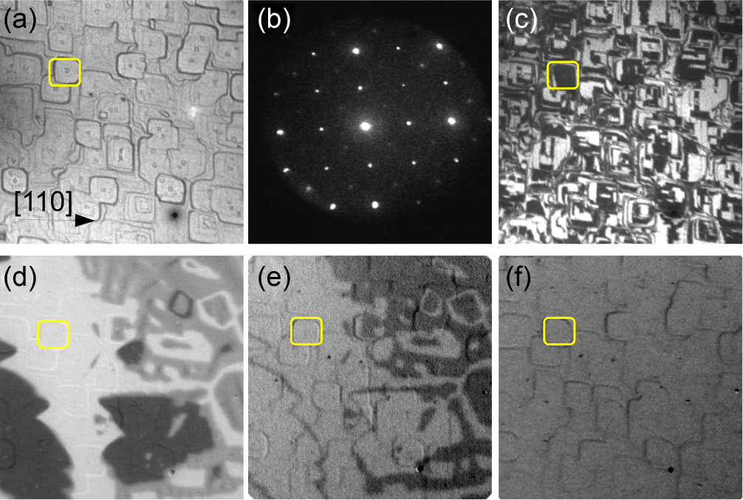
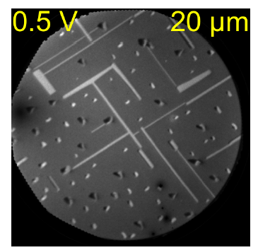
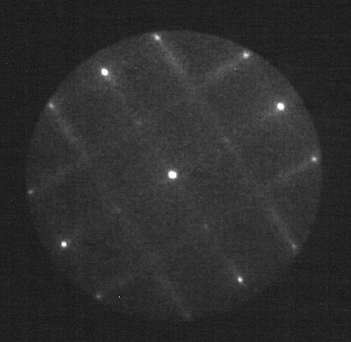
μ−LEED and Dark Field imaging
6
Fe₃O₄
CoGe on Ge
L. Martín-García, R. Gargallo, J. de la Figuera
et al, Phys Rev B91, 020408(R) (2015)
(M. Ewert et al., Nanotechnology 27, 325705 (2016) )

Slide 7
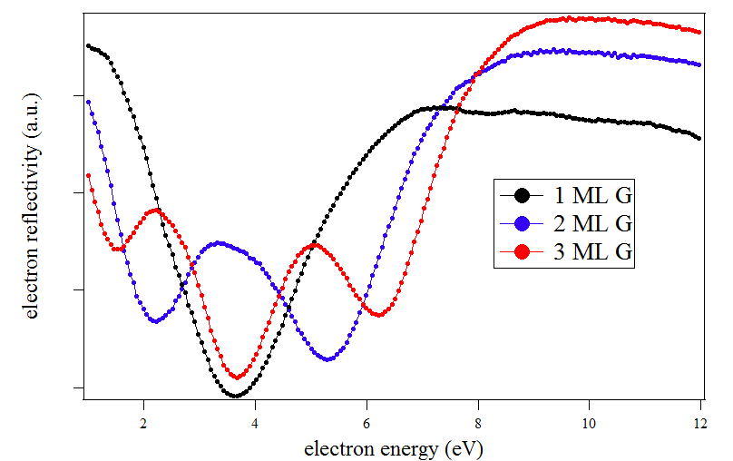
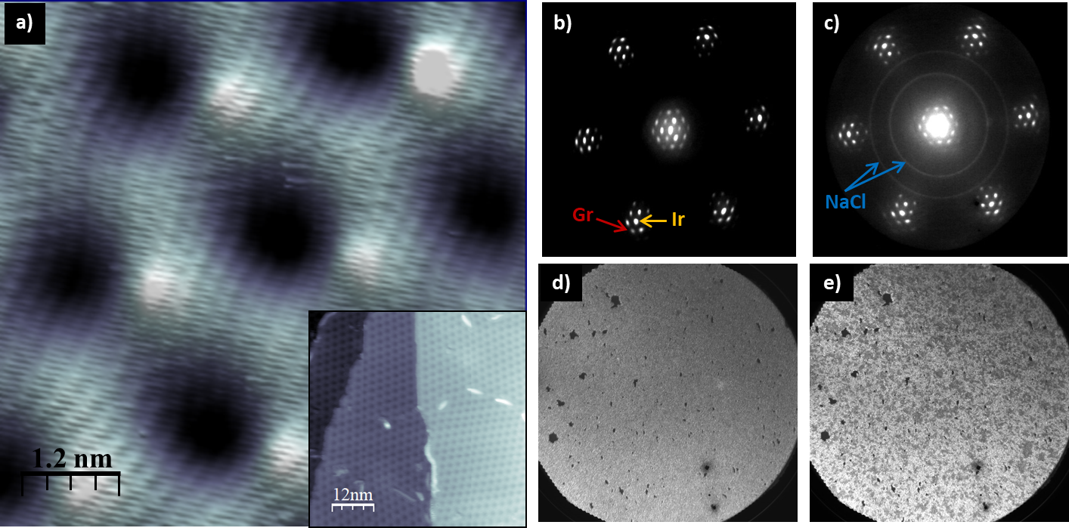
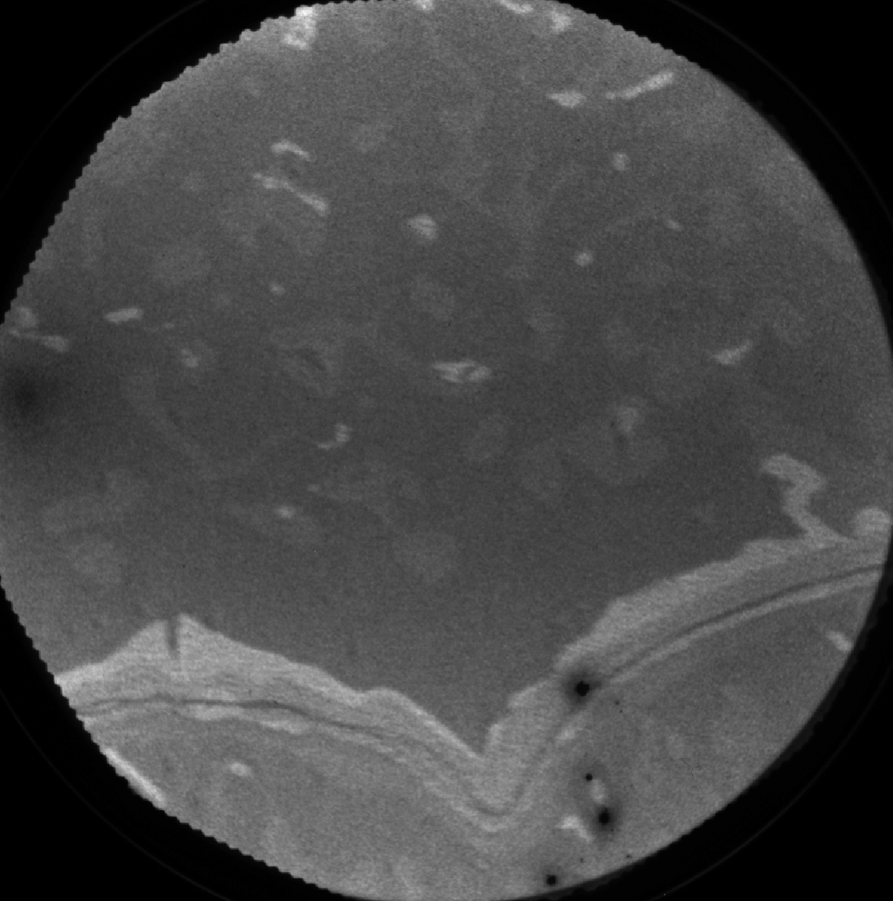
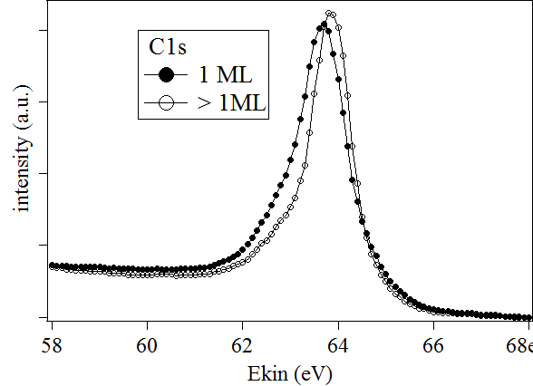
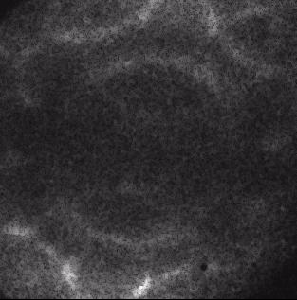
Graphene characterization
7
G/SiC
LEEM 10μm
NaCl/G/Ir
(I. Palacio et al., 2D Materials 6, 025021 (2019)
XPS-PEEM
ARPES
(e.g. in R. A. Bueno et al., Appl. Sur. Sci. 466, 51 (2019)
μ-PED

Slide 8
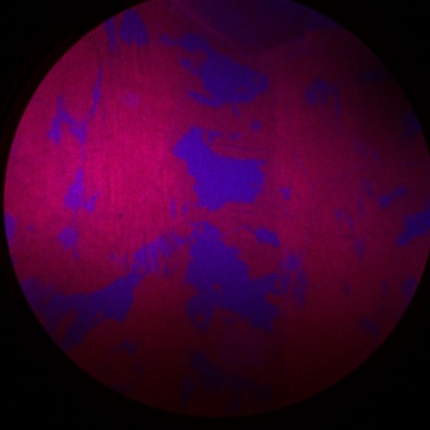
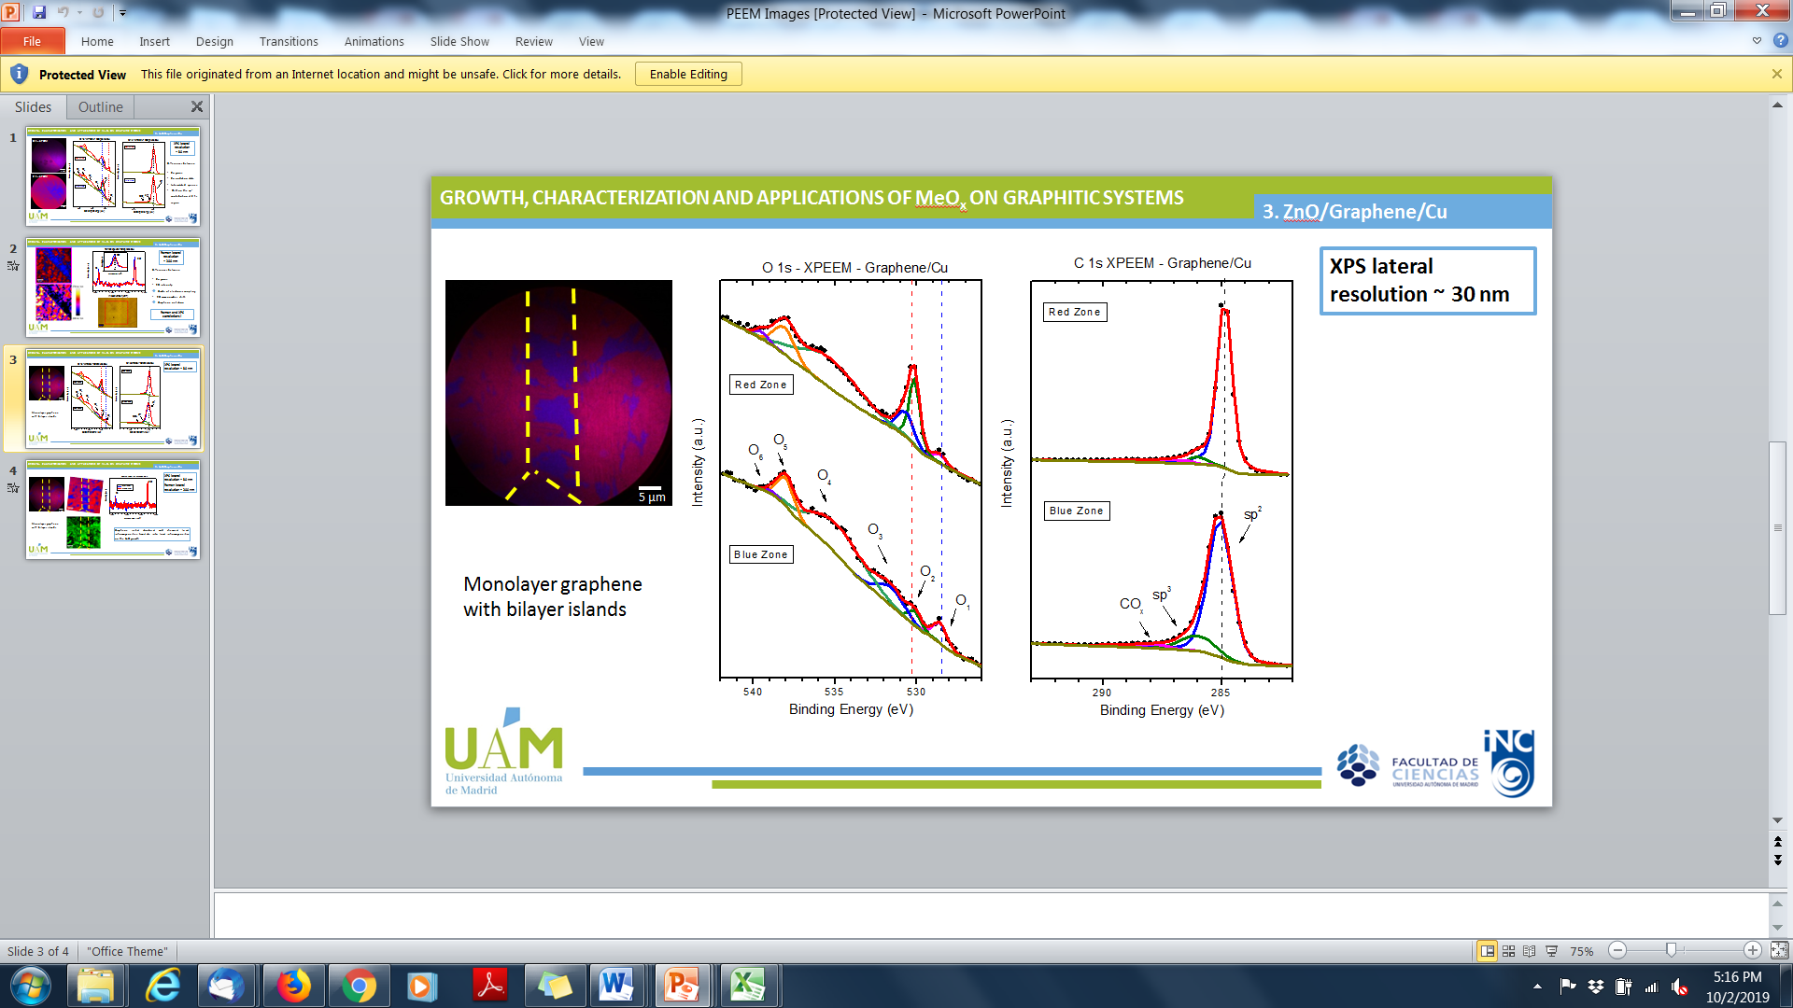
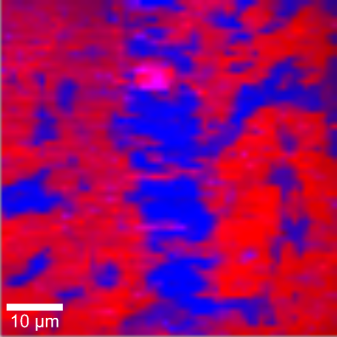
Spectromicroscopy (XPS) correlated with Raman
5 µm
Graphene and ZnO
on cooper foil
C. Morales, L. Soriano, et al., in preparation

Slide 9
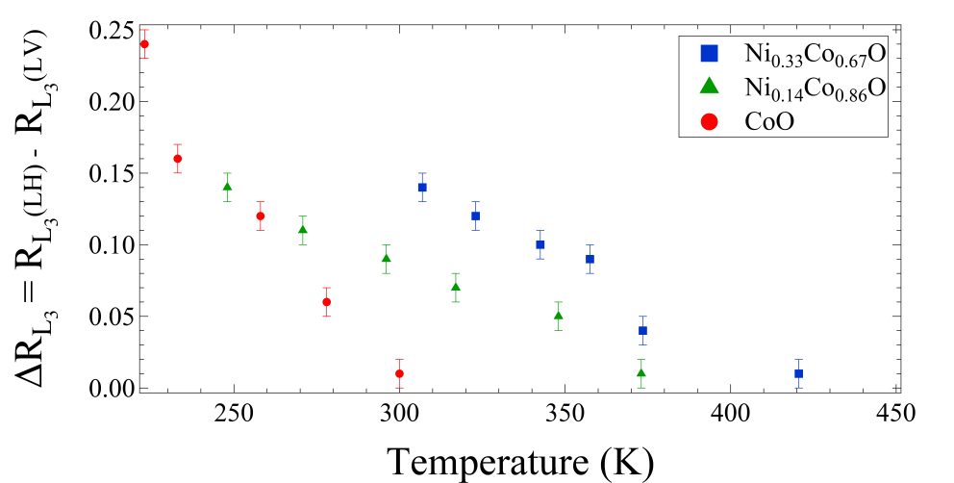
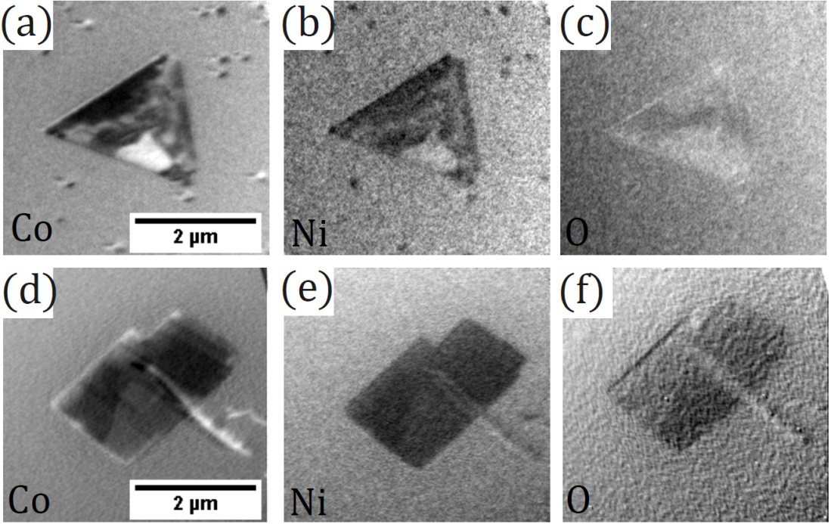
Antiferromagnetic domains (XMLD)
In-situ grown Ni_{x}Co_{1-x}O
(A. Mandziak et al., Sci. Rep. 9, 13584 (2019) )

Slide 10
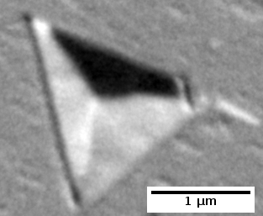
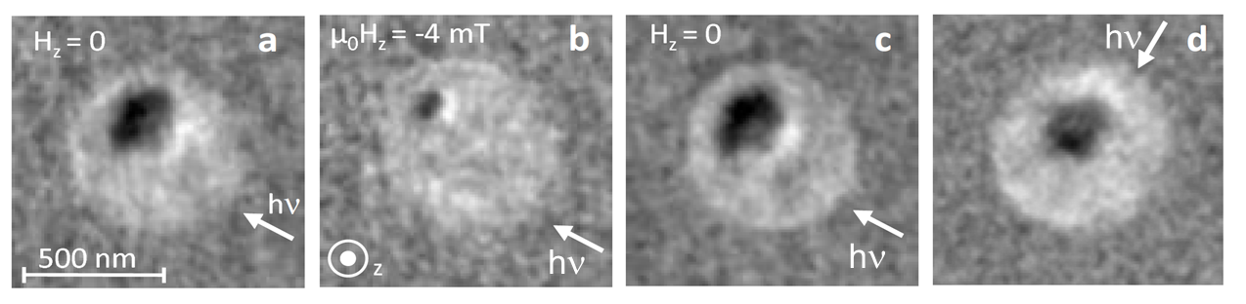
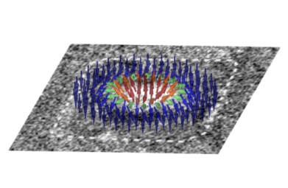
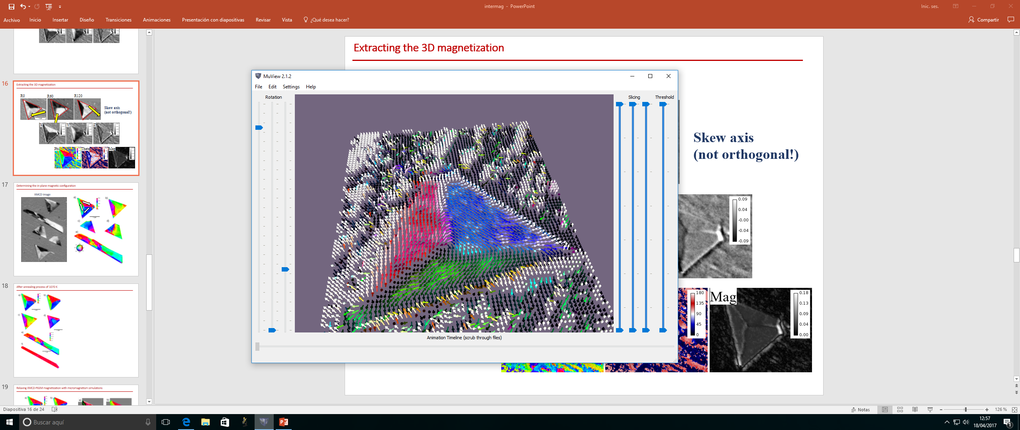

3D magnetic information
Example: Magnetic skyrmion, resolving chiral Néel walls
(O. Boulle et al, Nat. Nano. 11, 449 (2016))
S. Ruiz-Gómez et al., Nanoscale 10, 5566 (2018)

Slide 11
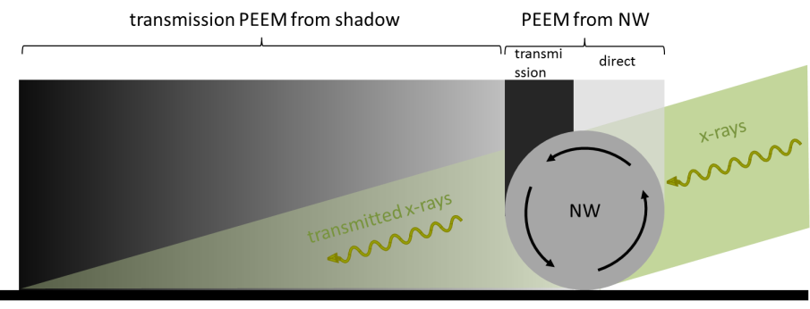
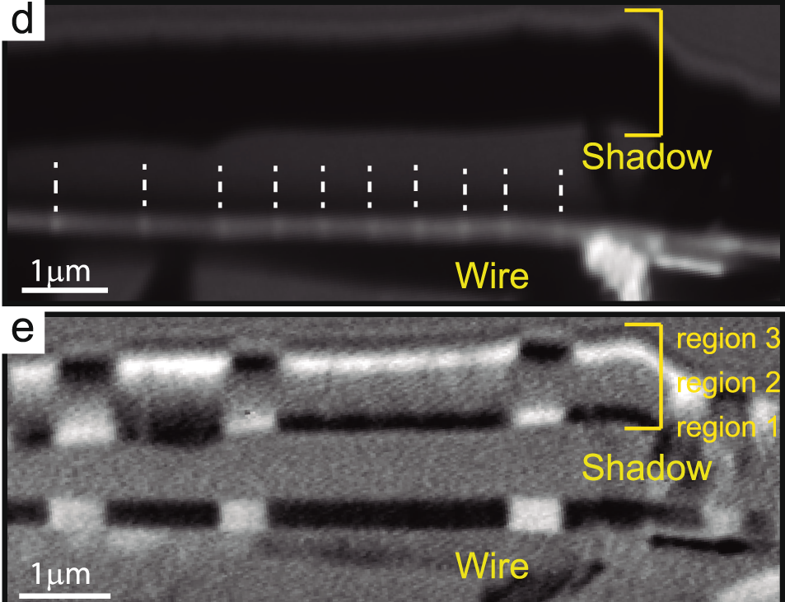
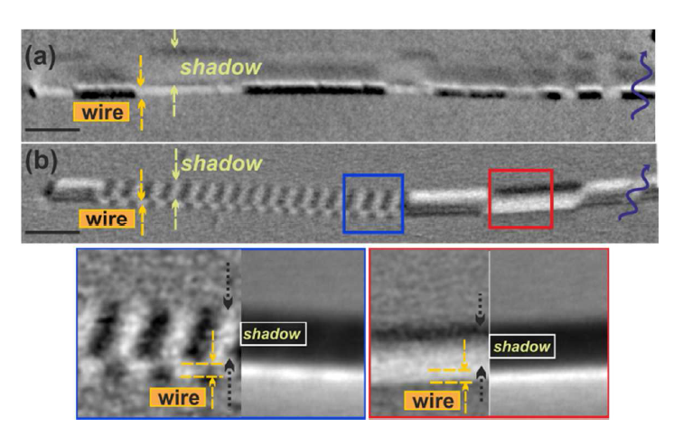
Transmission geometry (shadow PEEM)
for depth profiling
Beyond the “standard” information depth
1-10 nm (electron escape)
Example: Observation of transverse domains
( C. Bran et al., Phys. Rev. B 96, 125415 (2017) )
Example: Correlation of DW pinning sites with chemical notches (Absorption contrast)
( S. Ruiz-Gómez et al., Sci. Rep. 8, 16695 (2018) )

Slide 12
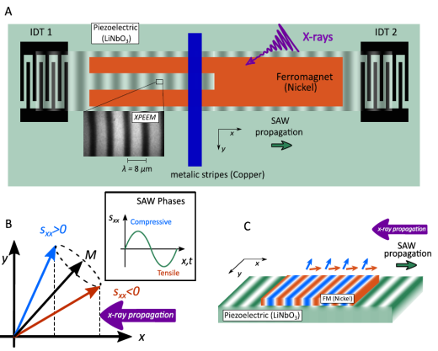
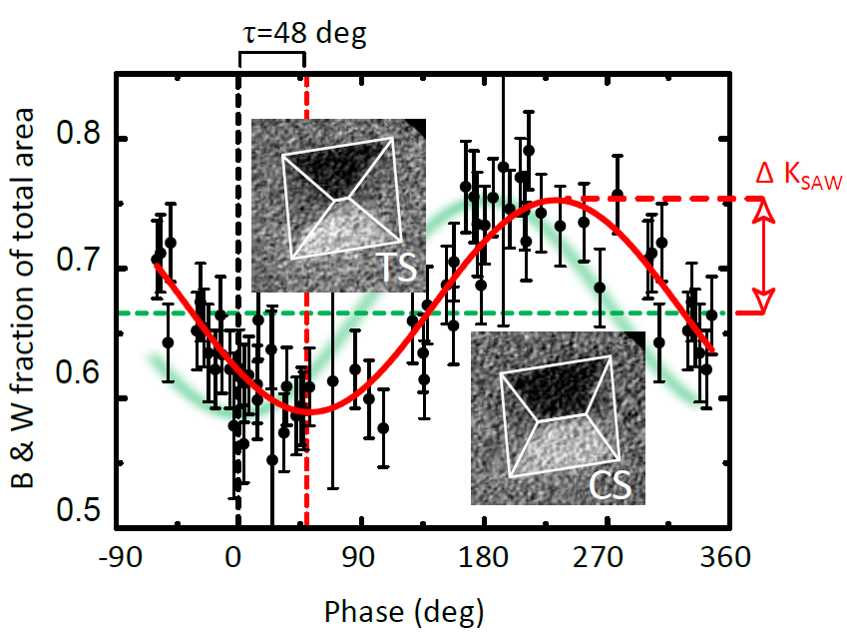
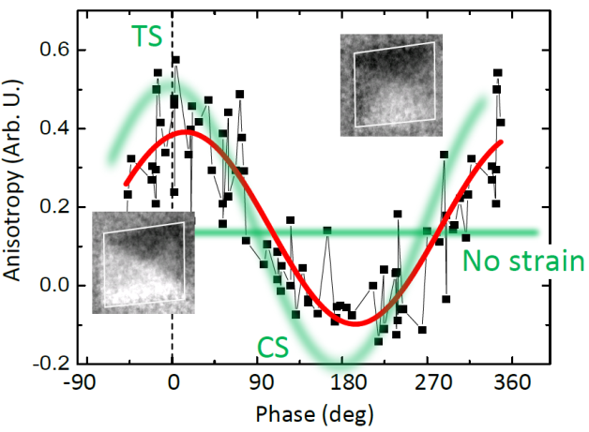
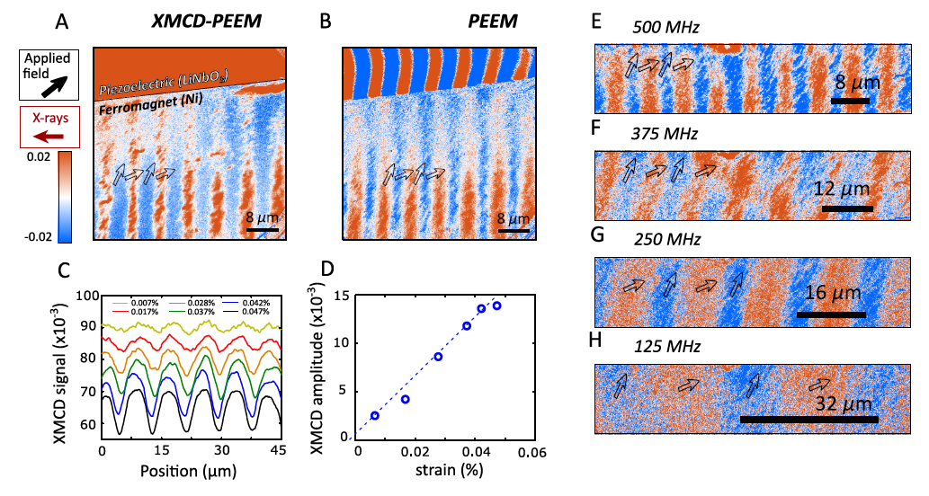
Time resolved: dynamic magnetoelastic effect
(driven by SAW)
Domain wall motion: 270 ps
Coherent
rotation: 90 ps
M. Foerster et al., Nat. Comm. 2017
B. Casals et al., PRL submitted

Slide 13
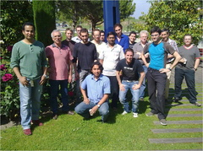
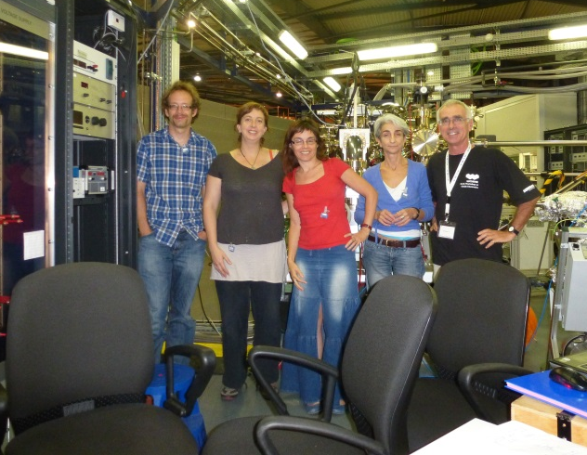
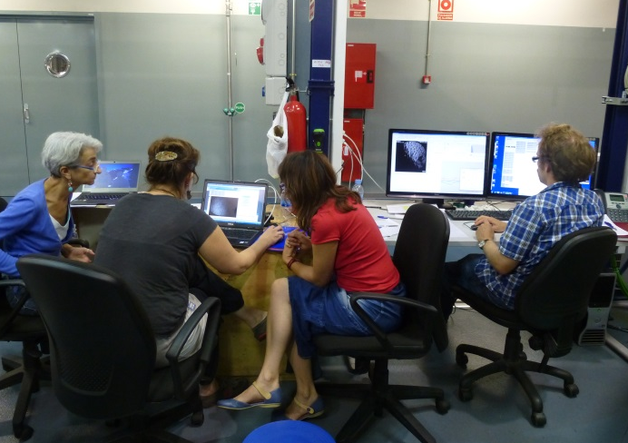
Many thanks for your attention and looking forward to see you at CIRCE-PEEM.
ICMAB 2011
1st CIRCE beamtime
2012

Slide 16
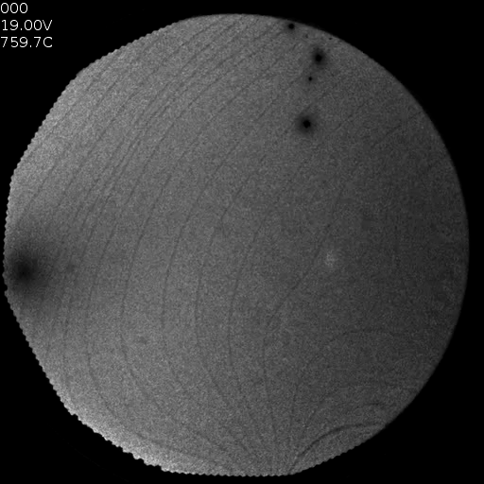
In-situ growth in LEEM
16
Reactive MBE & LEEM
Fe & Co co-evaporation
Ru(0001) @ 780℃
10⁻⁶ mbar O₂
L. Martín-García, A. Quesada, J. de la Figuera, et al. (IQFR-CSIC & ICV-CSIC)

Slide 17
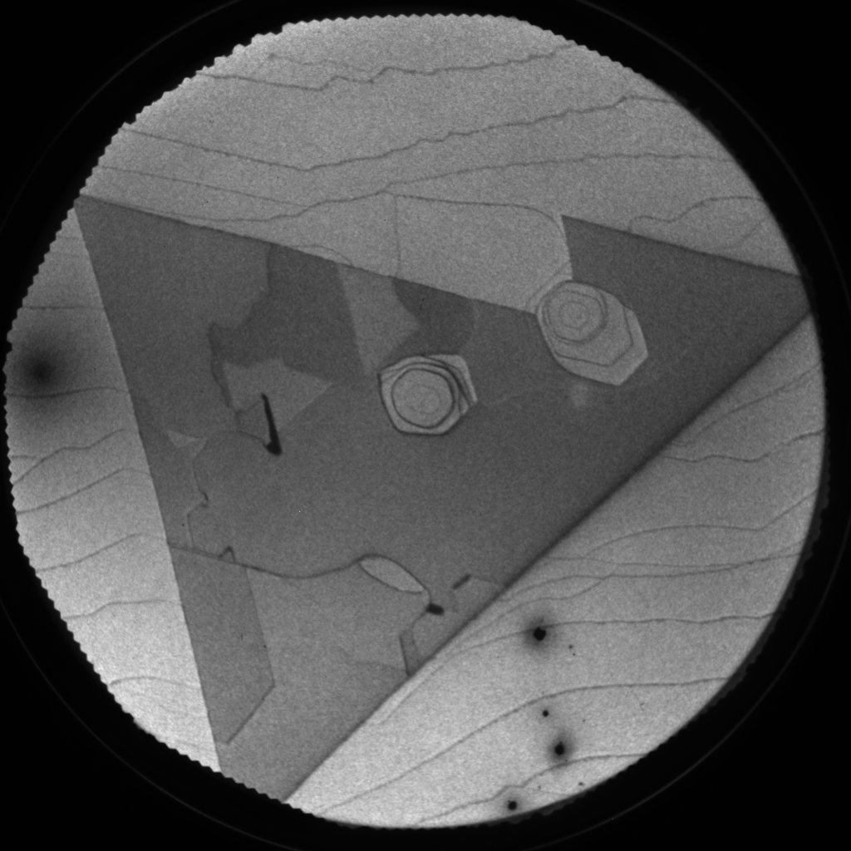
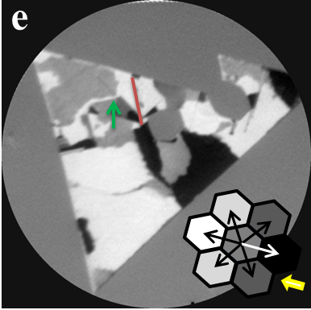
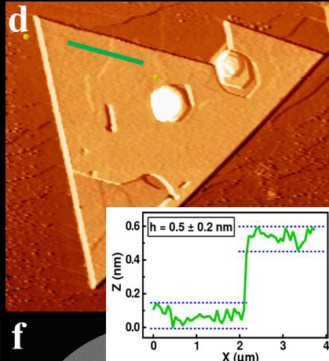
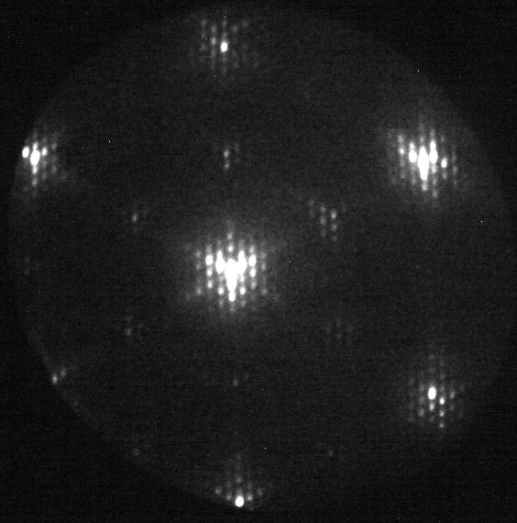
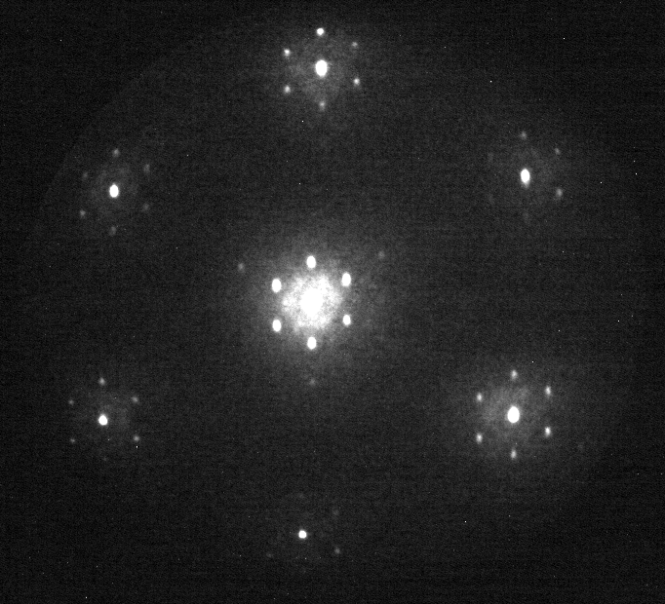
in situ growth & characterization
17
LEEM 10μm
XMCD-PEEM
μ-LEED
Antiphase boundary free cobalt ferrite (CFO) single crystal islands with large magnetic domains
L. Martín-García, A. Quesada, J. de la Figuera, et al. (IQFR-CSIC & ICV-CSIC)
Adv. Mat., DOI: 10.1002/adma.201502799 (2015)

Slide 18
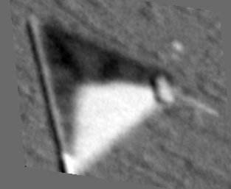
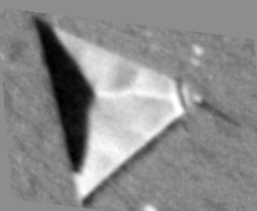
3D magnetic information
Example: Combining images under different azimuthal beam incidence to obtain 3D vector magnetization in Fe₃O₄ islands
(S. Ruiz-Gómez et al., Nanoscale 10, 5566 (2018)

Slide 19
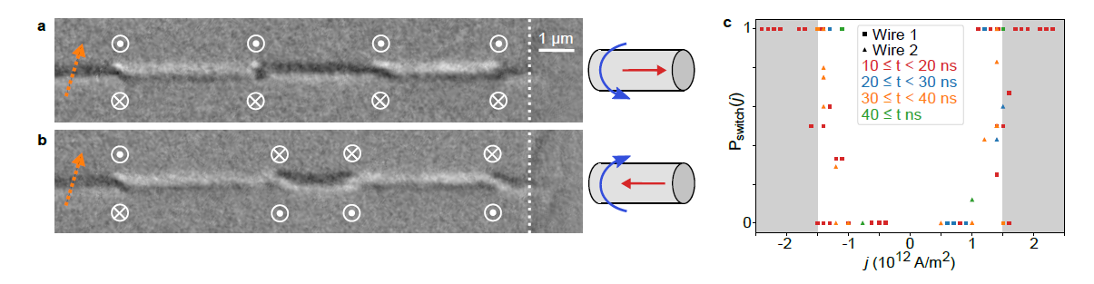
3D magnetic information: transmission/shadow
….. with current injection
19
Example: DW transformation under current driving
(M. Schöbitz et al, PRL 123, 217201 (2019)
OErsted field associated with current pulse favors Bloch Point Domain Walls (BPW) over Transverse-Vortex Wall type.
BPW topology, unique to cylindrical NWs, protects against Walker breakdown, permitting speeds > 600 m/s .

Slide 20
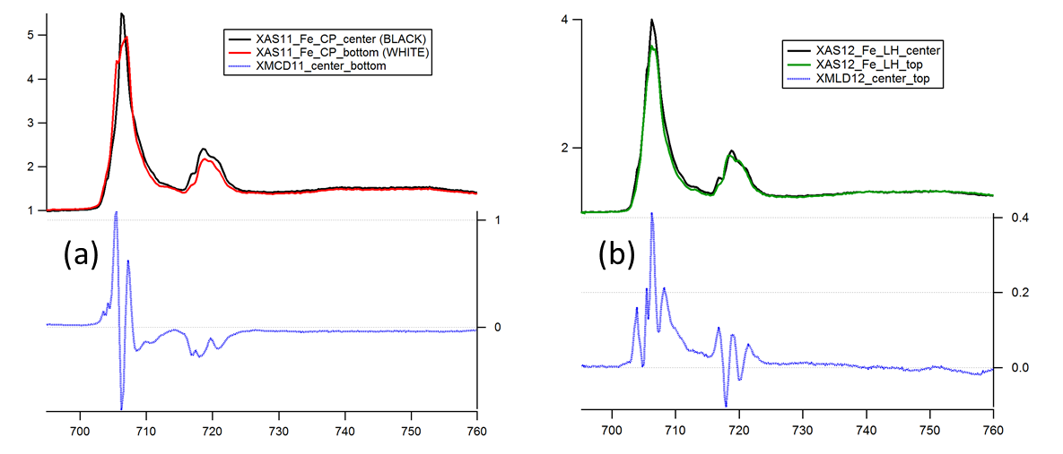
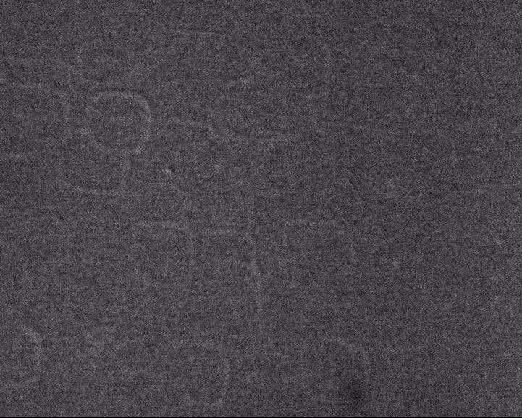
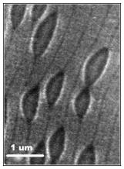
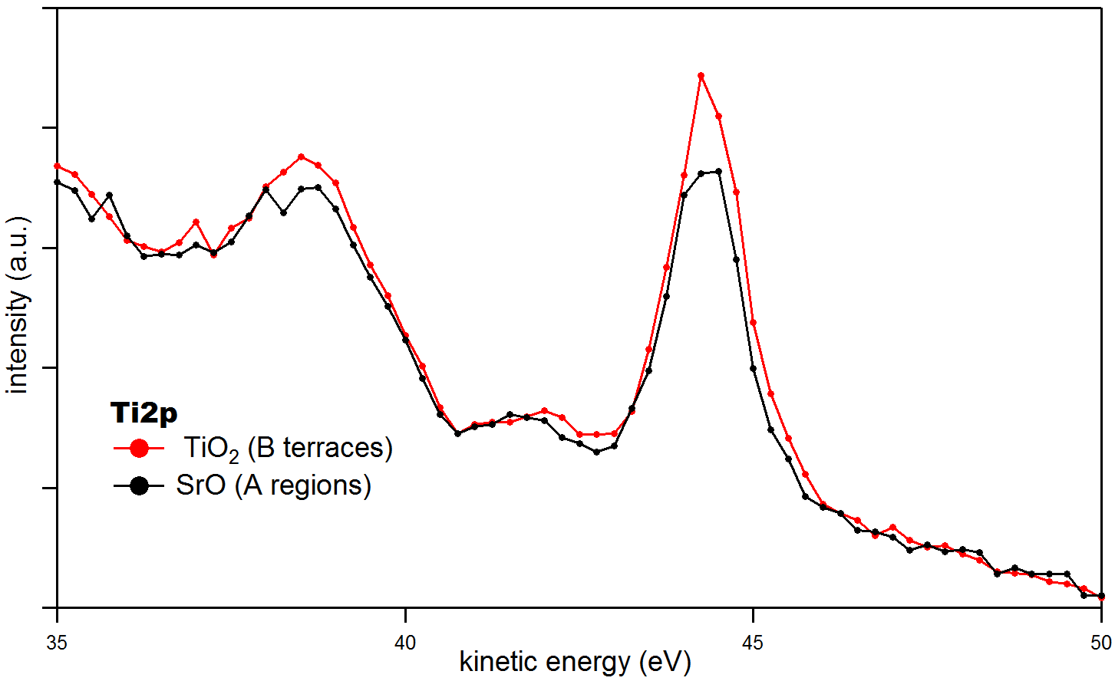
Spectromicroscopy
20
“images with spectral contrast”
“spectroscopy with spatial resolution”
(pixel by pixel)
SrTiO₃
L. Aballe, S. Matencio, M. Foerster, E. Barrena, F. Sánchez, J. Fontcuberta, and C. Ocal, Chem. Mater. 2015

Slide 21
Multi-technique surface analysis
21
LEEM μspot-LEED dark field LEEM:
Surface magnetic moments of √2×√2R45°-Fe₃O₄(001)
XMCD-PEEM XMLD-PEEM XPEEM
L. Martín-García, R. Gargallo, J. de la Figuera et al, Phys Rev B91, 020408(R) (2015)

