Slide 1
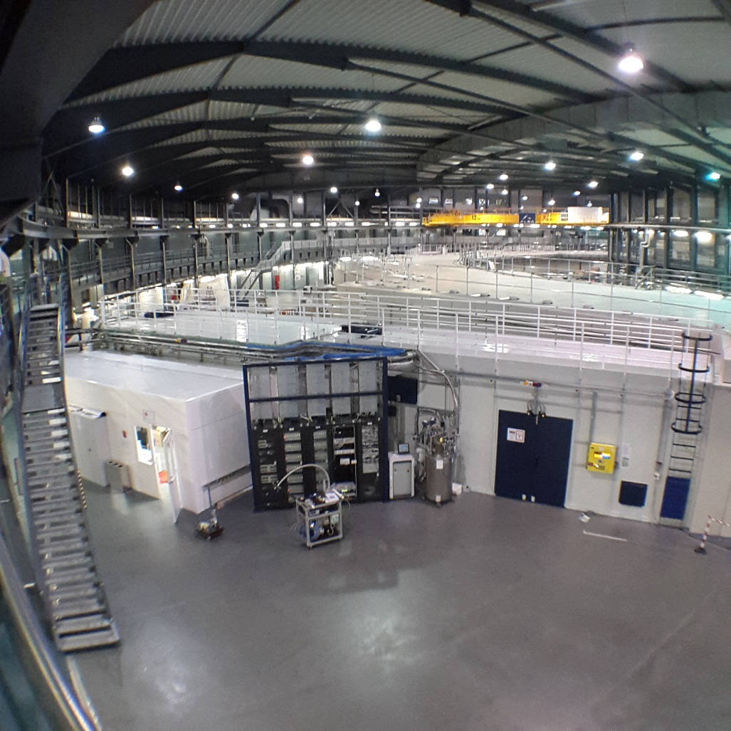
BL04 MSPD
Materials Science and Powder Diffraction
Aleksandr Missiul
Experiments Division CELLS – ALBA
Carrer de la Llum 2-26, 08290, Cerdanyola del Vallès, Barcelona, Spain

Slide 2

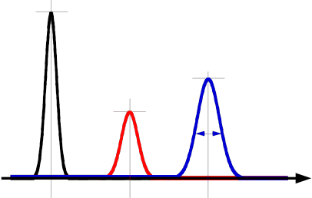




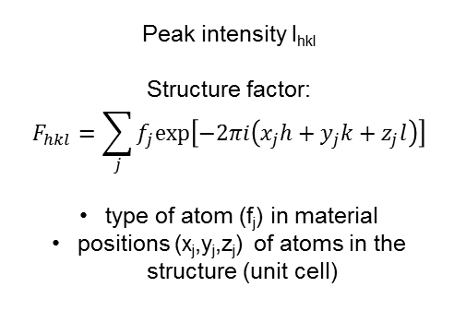




What is powder diffraction?
2
0D detector
2D detector
$$I_{h_{1}k_{1}l_{1}}$$
Incident beam
2θ_{hkl}
$$I_{h_{3}k_{3}l_{3}}$$
$$I_{h_{2}k_{2}l_{2}}$$
Sample
$${FWHM}_{h_{3}k_{3}l_{3}}$$
1D detector
Diffracted beam
$${2θ}_{h_{1}k_{1}l_{1}}$$
$${2θ}_{h_{2}k_{2}l_{2}}$$
$${2θ}_{h_{3}k_{3}l_{3}}$$
Peak position 2θ_{hkl}
Bragg law :
λ=2*d_{hkl}*sinθ_{hkl}
information on overall periodical arrangement of atoms
Peak intensity I_{hkl}
Structure factor:
$$F_{hkl}=\sum_{j}{f_{j}exp⁡\left[−2πi\left(x_{j}h+y_{j}k+z_{j}l\right)\right]}$$
type of atom (f_{j}) in material
positions (x_{j},y_{j},z_{j}) of atoms in the structure (unit cell)
Peak FWHM_{hkl}
microstructural features (strain, size, stacking faults, …)

Slide 3
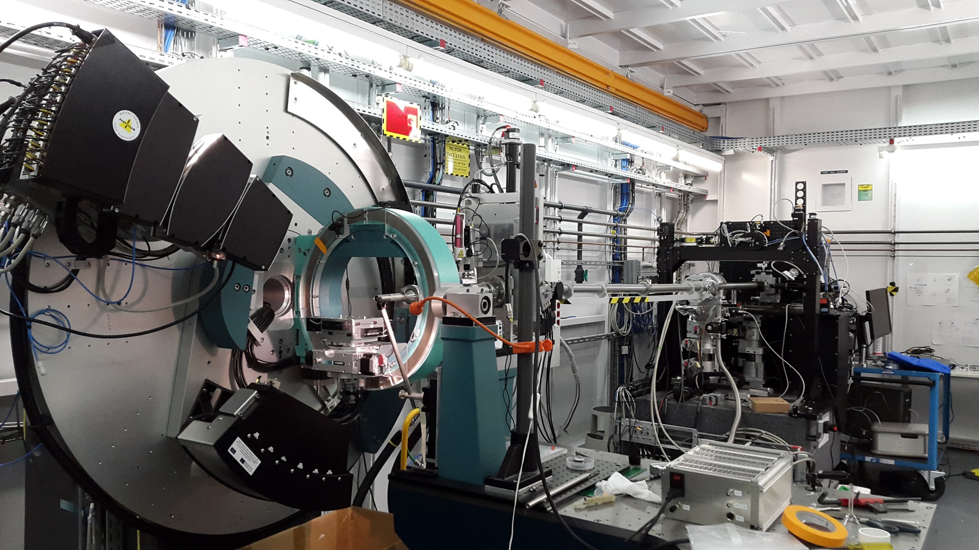
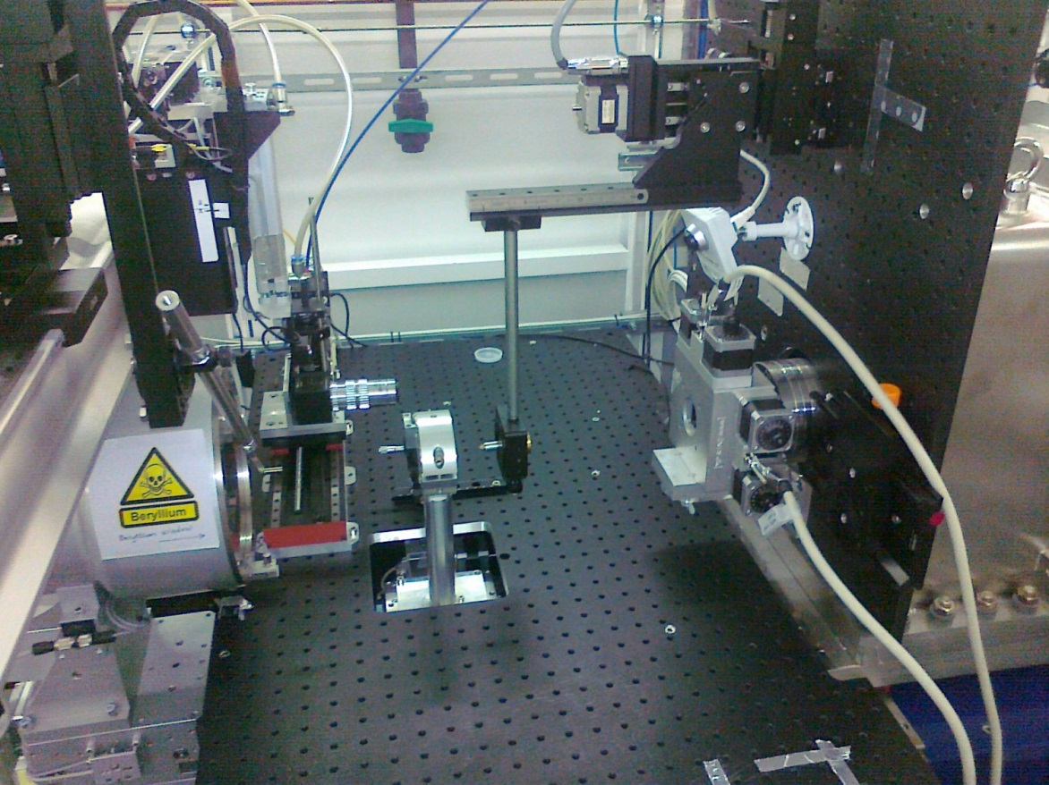
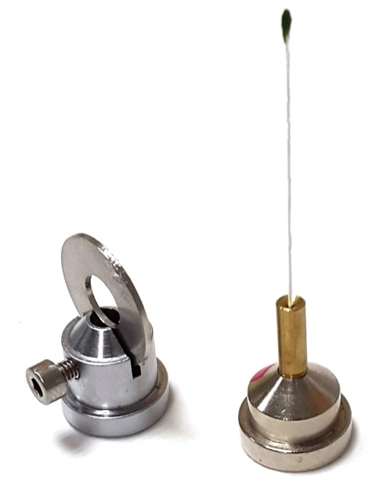
MSPD beamline

Slide 4
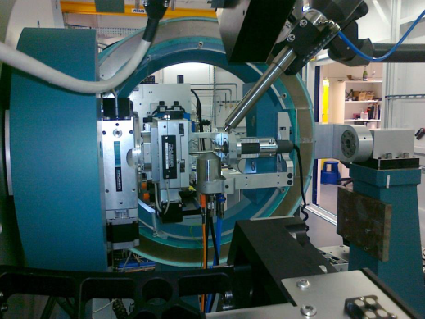
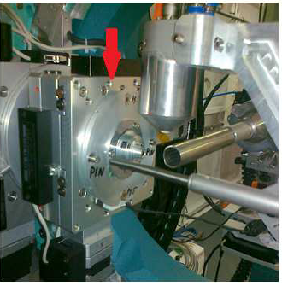
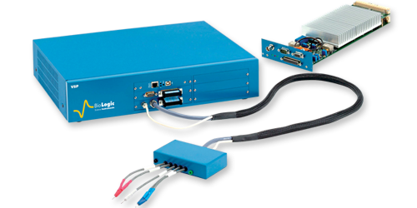
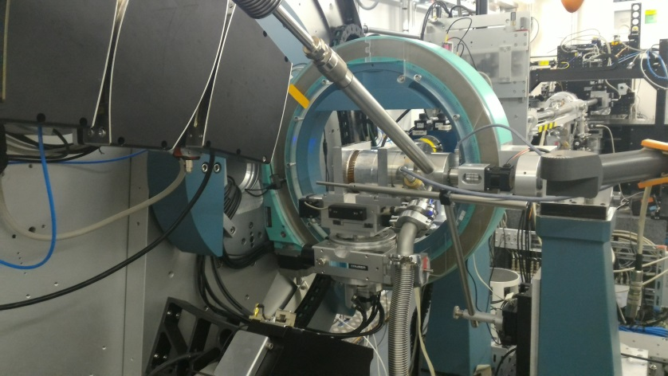
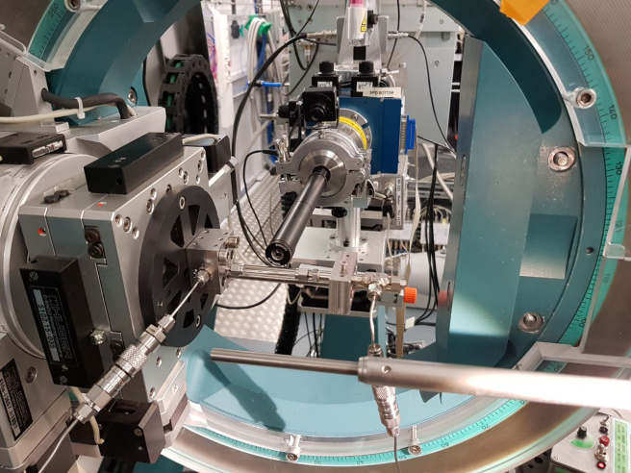
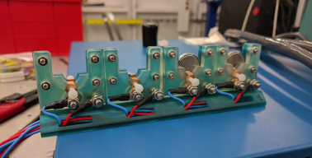
Powder Diffraction Station
Sample Environment:
l-He Dynaflow Cryostat: 5K- RT
700 series lN2 Cryostream 80 – 450 K
FMB Oxford/Cyberstar Hot air blower: RT- 980°C
Capillary flow cell: 80 – 1173K, 0 – 50 bar or 1 – 5 ml/min gas flow
Potentiostat for the electrochemical studies

Slide 5
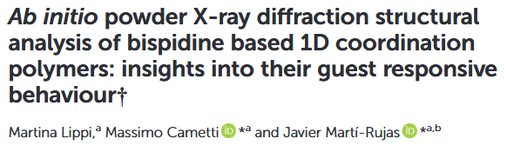
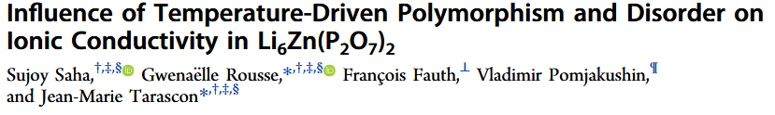
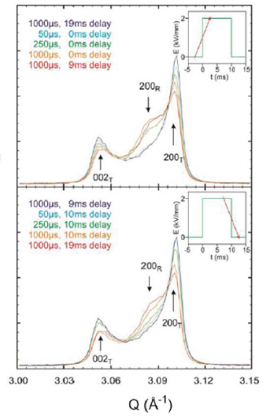
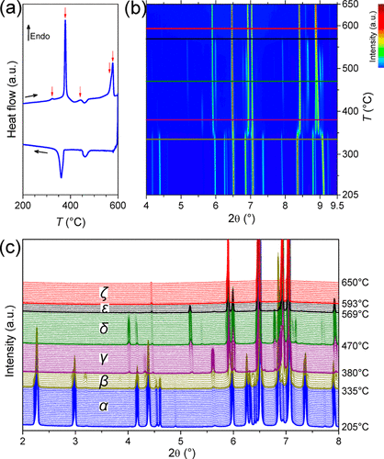
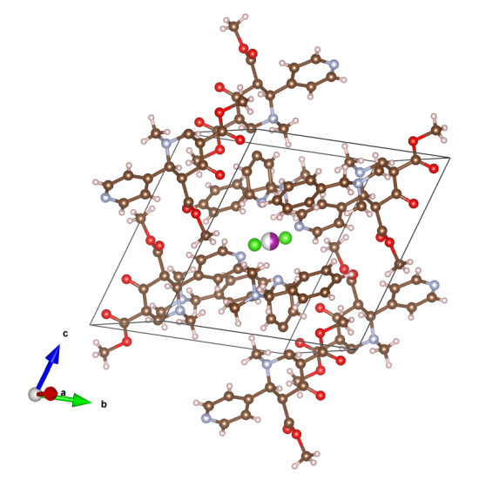
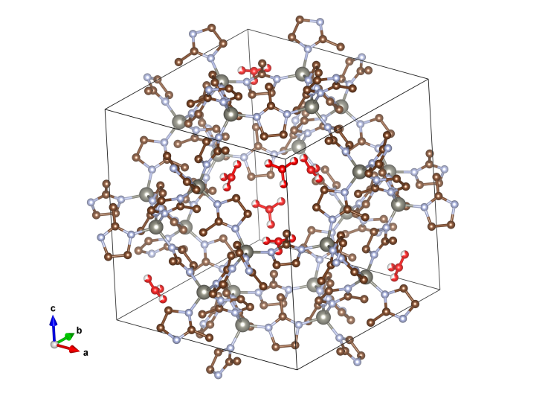
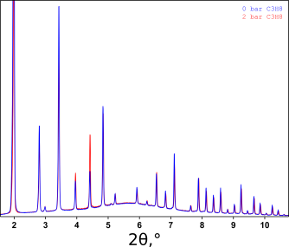
Powder Diffraction Station
Pump-probe measurements:
polarization/depolarization of PZT
Propane sorption by ZIF-8

Slide 6
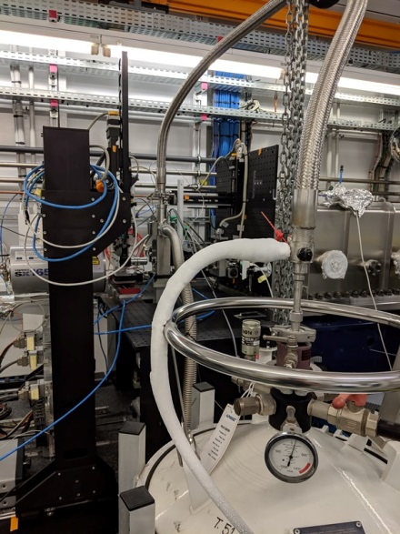
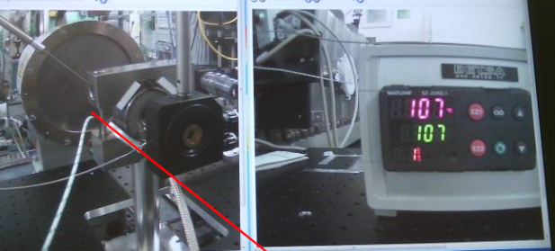
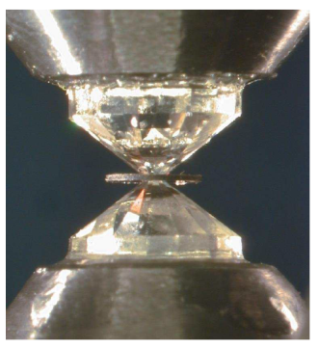
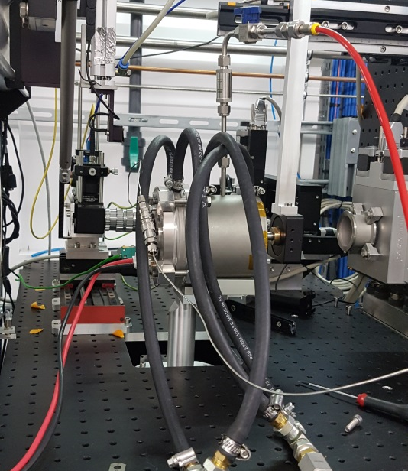
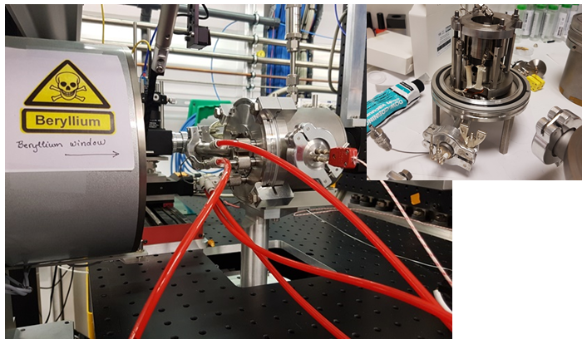
HP/MD Station
High Pressure:
lHe Cryostat: 15K-RT
External heating air-system: RT- 600 K
External heating vacuum system : RT- 900 K
External heating vacuum system : RT- 1300 K

Slide 7

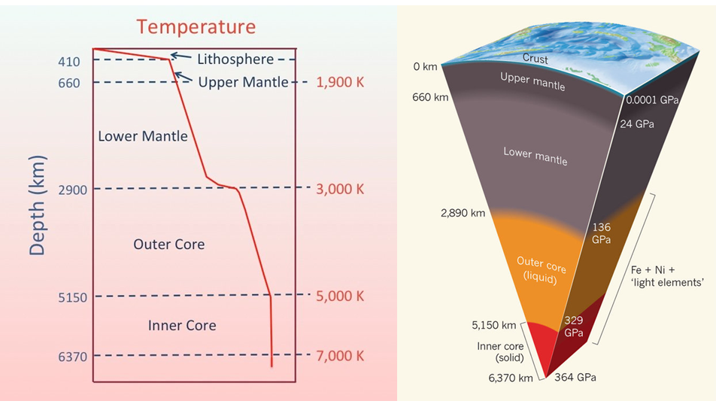
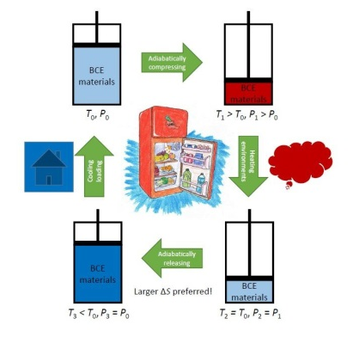
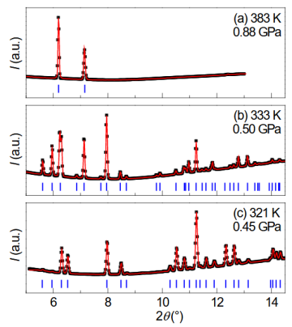
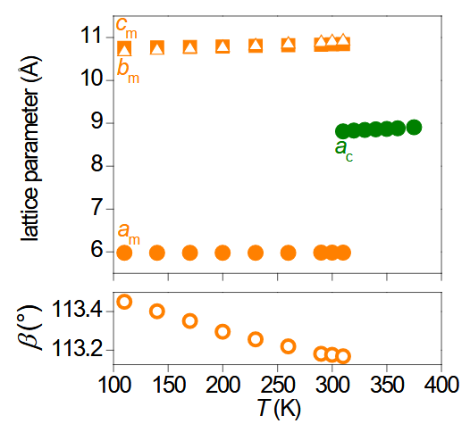
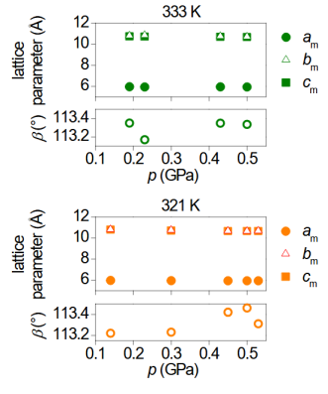
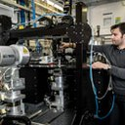
HP/MD Station: HP measurements
Journey to the center of Earth
Pressure makes cooling devices
Catalin Popescu
Beamline Scientist
Tel.: (+34) 93 592 4421
E-mail: cpopescu@cells.es

Slide 8
Q&A
Thank you for attention!

Slide 9
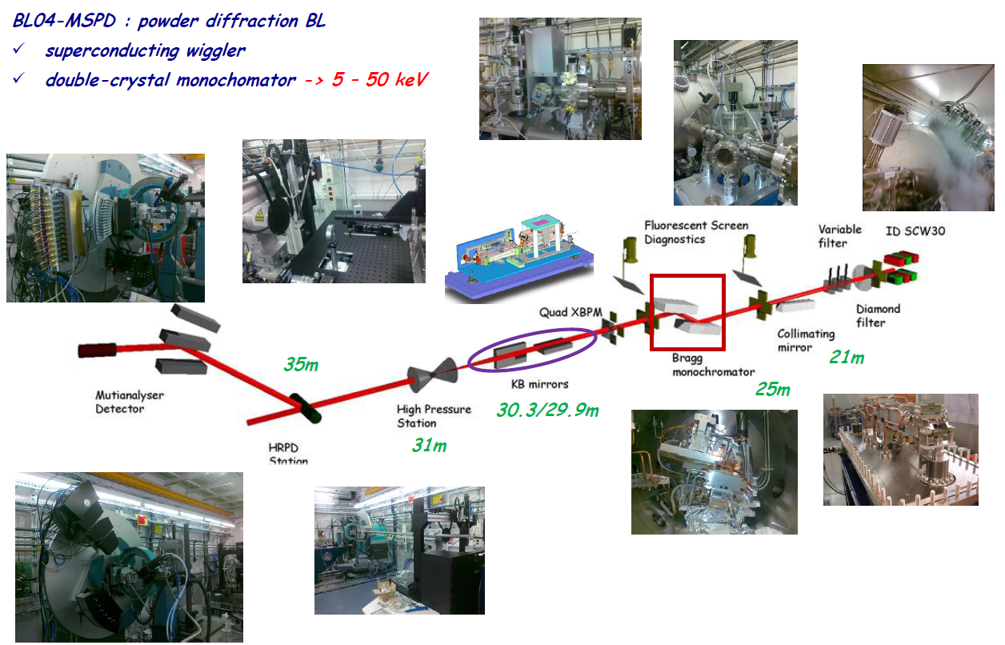

Description of the beamline
9

Slide 10
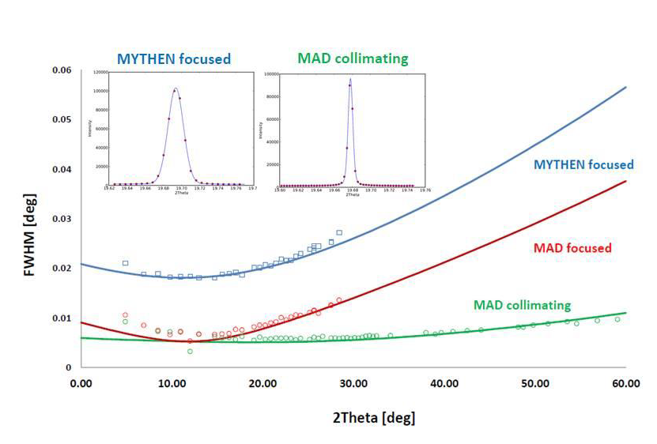
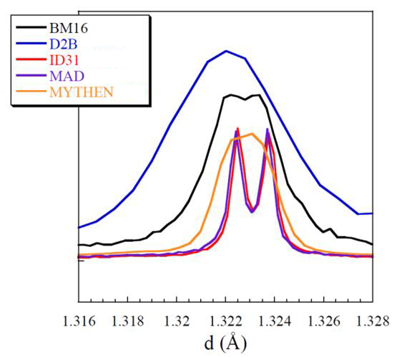
Powder Diffraction Station
NaCaAlF₃, 20keV, Ø0.5 mm
MultiAnalyzerDetector (10 – 50 keV)
13 channels with 1.5 deg pitch
Si₁₁₁ or Si₂₂₀ Bragg reflection
YAP scintillator + PMT
Mirror collimating : beam size 3 x 1.5 mm
Full pattern acquisition : 10 min – 2 hours
Scanning speed : (0.5-1°/min)
-> 0.005° angular resolution
Mythen detector (8 – 30 keV)
Si position sensitive detector
6 modules (1280 channels, 50 μm pitch)
ms time resolution
Mirror focusing: beam size 3 x 0.7 mm
Full pattern acquisition :
  ~ms: 1 position / trigger mode (stroboscopic)
  1-5 sec: 1 position, ~40° range
  1 – 10 min: 5 positions , ~60° range
  ~30min: 20 positions, ~130° range (PDF)
-> ~40° in 0.005 deg pitch
-> 0.02° angular resolution
YNiO₃
90.0754 º monoclinic distortion

Slide 11
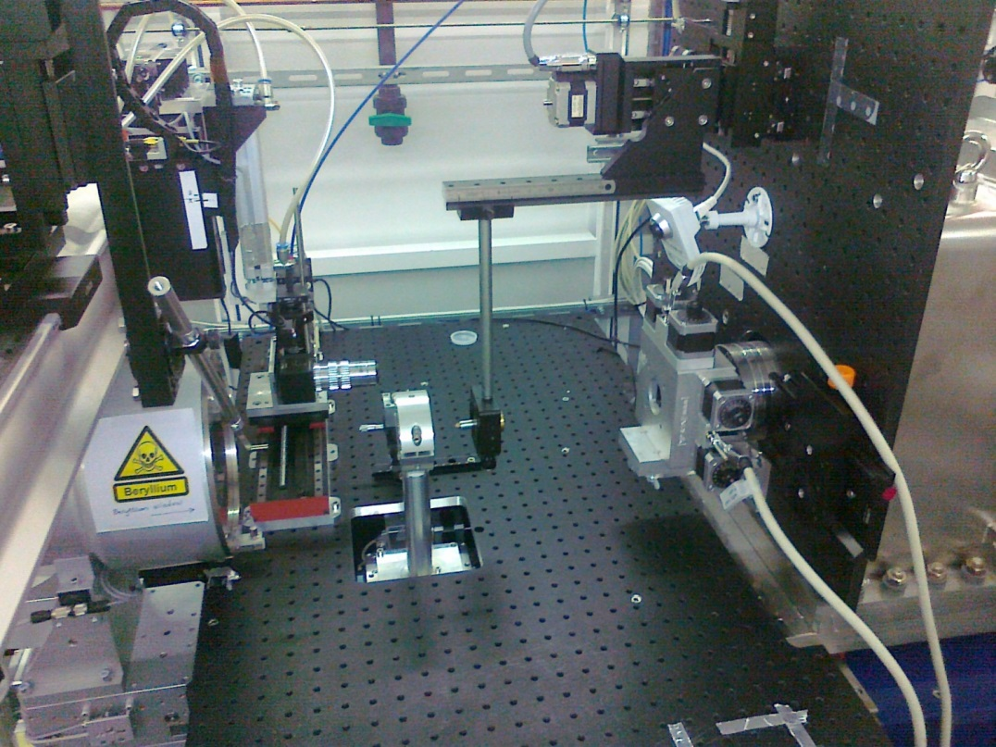
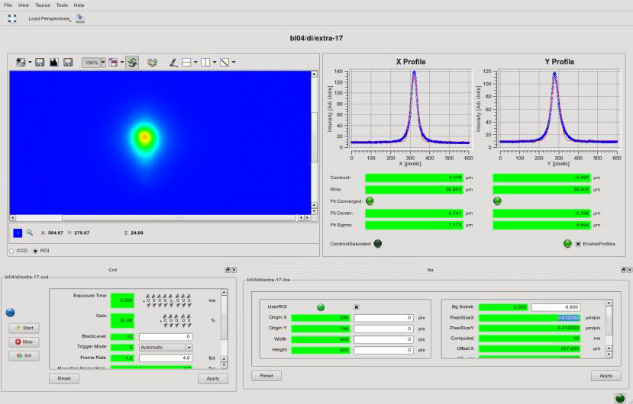
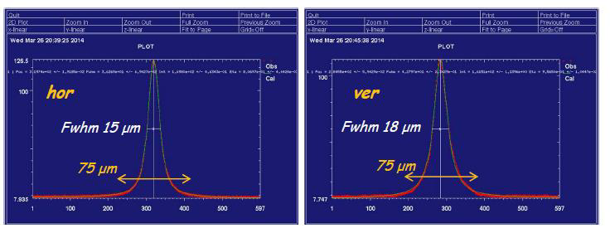
HP/MD Station
HP-MD station (20–50 keV)
2D Rayonix CCD detector ø162 mm
Lorentzian shape focus spot 15x15 μm
150-500 mm sample-detector distance
-> 0.05-0.08° angular resolution

