Slide 1
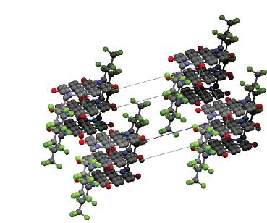
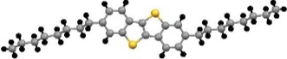
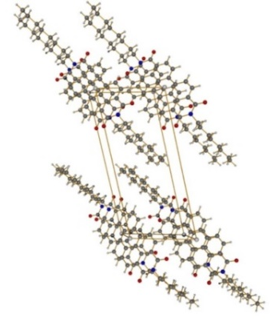
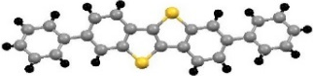
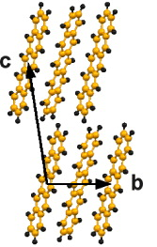
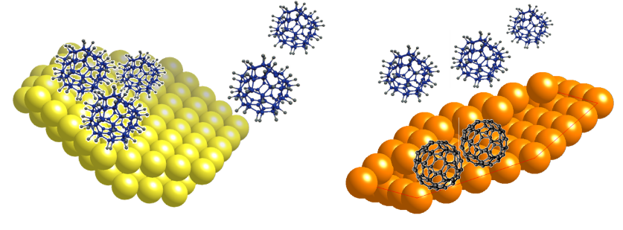

Towards an in-situ and in real-time view of interfaces
involving small molecules
Carmen Ocal
24/02/2020
Workshop ICMAB-ALBA 2020

Slide 2
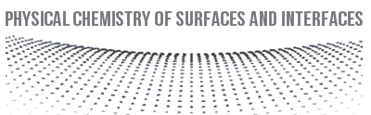
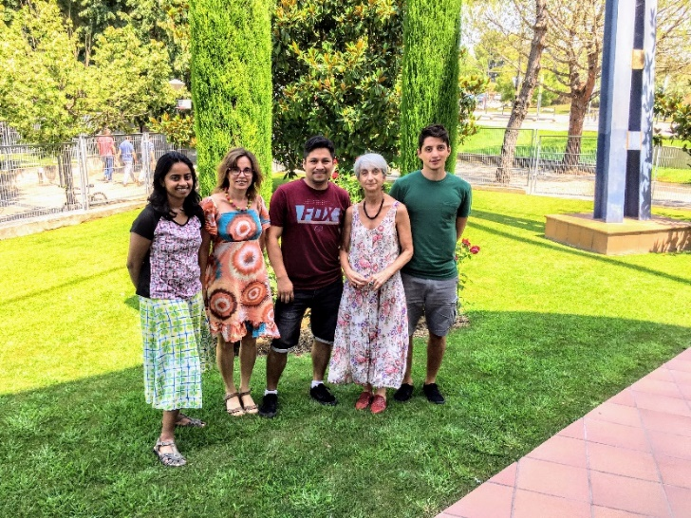



ICMAB Research Unit
Functional Surfaces and Interfaces
- Functional Nanomaterials and Surfaces (NANOSURF)
Physical Chemistry of Surfaces and Interfaces (PCSI)
https://departments.icmab.es/surfaces/
PCSI Group members:
PhD students: Rogger Palacios, Adara Babuji and Francesco Silvestri
Permanent staff: Esther Barrena and Carmen Ocal
EU Horizon 2020 under the Marie Skłodowska-Curie Grant agreement No 722651.
Agreement ICMAB-ALBA since 2011
MAT2016-77852-C2-1-R (AEI/FEDER, UE)

Slide 3
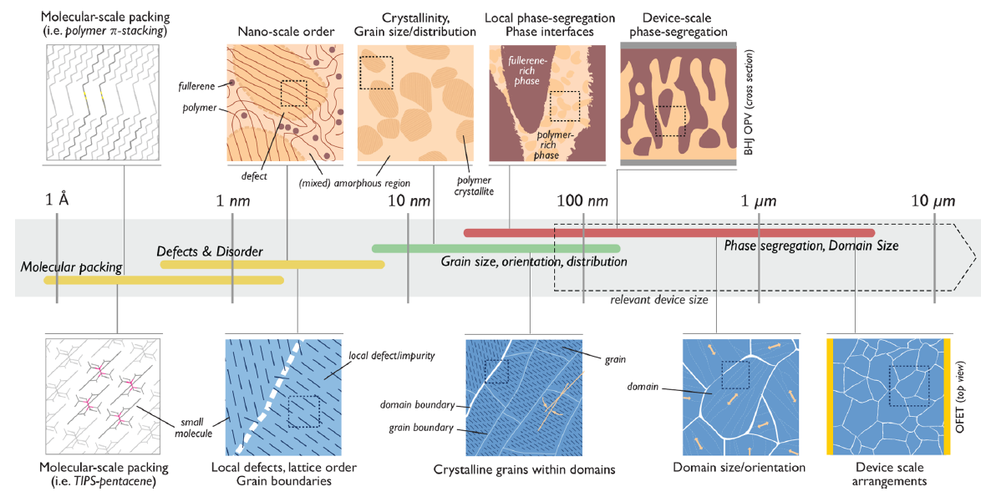
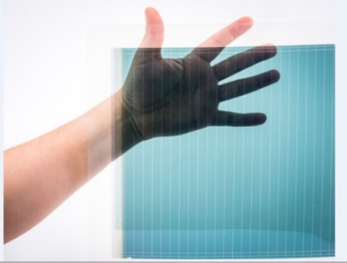
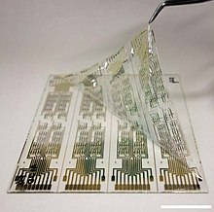
Microstructure and morphology in organic materials for electronic devices
two-component blend film of bulk heterojunctions in organics photovoltaics (OPV)
Photovoltaics
Thin Film Transistors
single component small-molecule semiconductor film used in OFETs
Rivnay et al. Chem. Rev. 2012, 112, 5488
Notes:
Size scales and relevant morphological features in organic electronic devices.

Slide 4
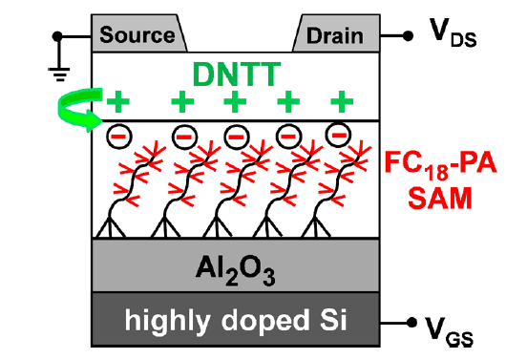
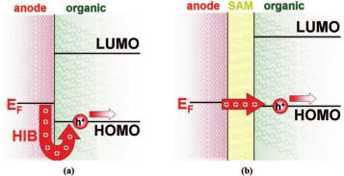
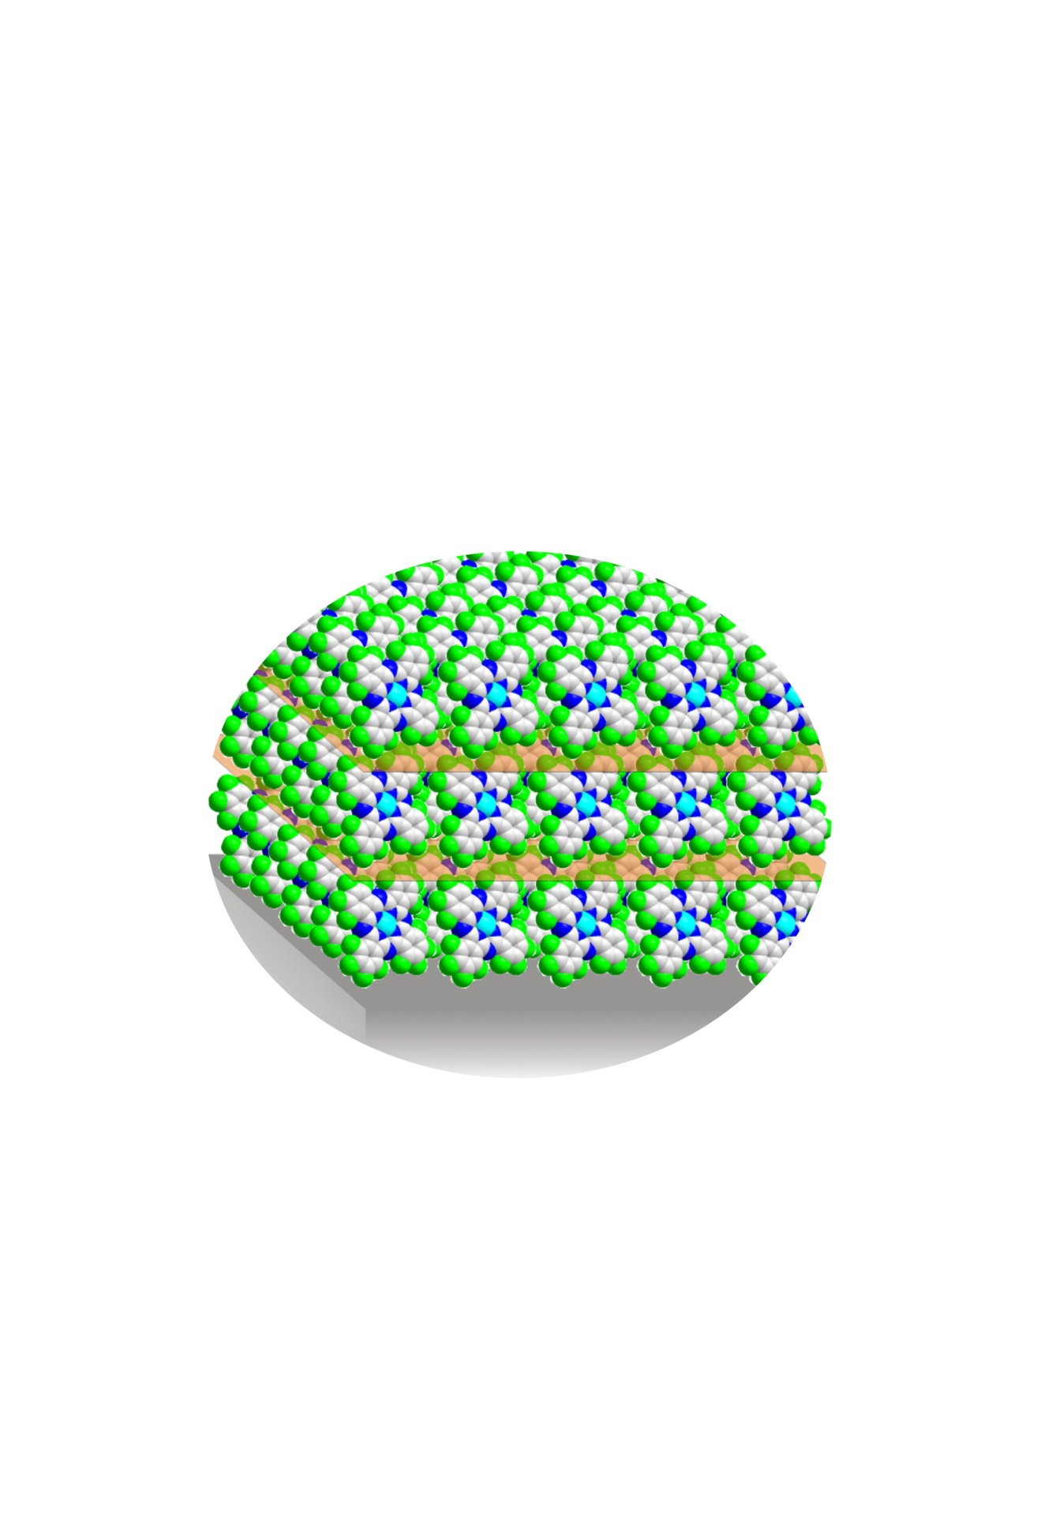

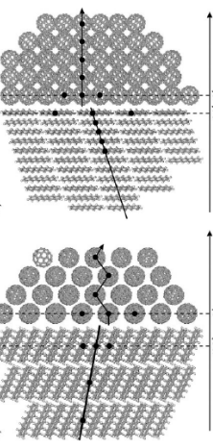
Interfaces in a device Organic Field Effect Transistors (OFETs)
metal
Organic/Dielectric
drain
source
Organic semiconductor
V_{SD}
Organic/electrode
- - - - - - - - - - -
dielectric
gate
V_{G}
Aghamohammadi et al
ACS Appl. Mater. Interf.2015
Liu et al. Materials Today 2015
Organic/organic
- donor/acceptor (orientation)
- dopant/organic semiconductor (OSC)
(polarization, charge transfer …)
Structure & Stability (vs t, T, envir.)
critical issues for properties and performance
Structure determination
Structural/morphological stability over time
Stability of the electronic performance in environmental conditions (O₂ , H₂O …)
Verlaak et al. Adv. Mat. 2009

Slide 5
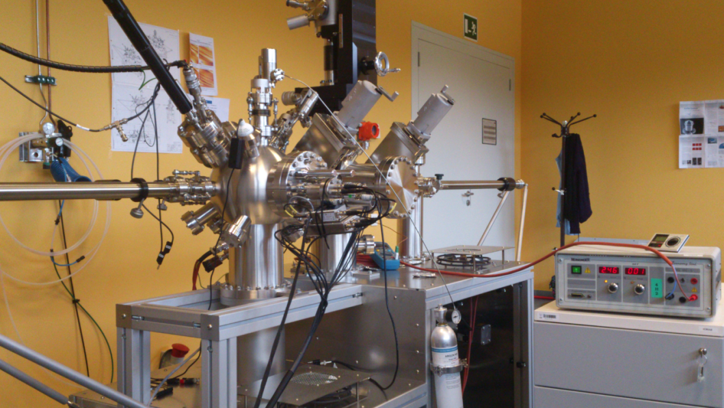
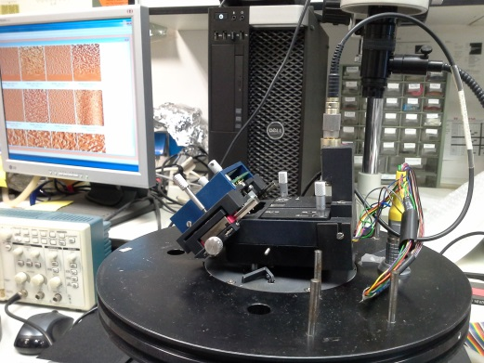
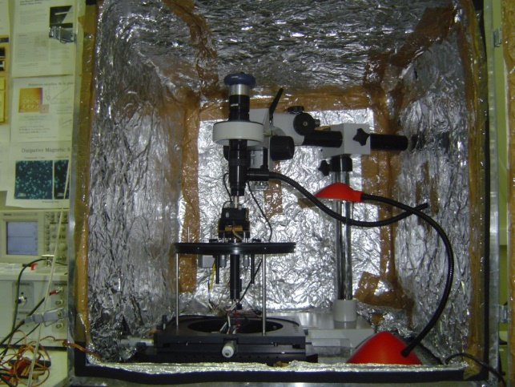
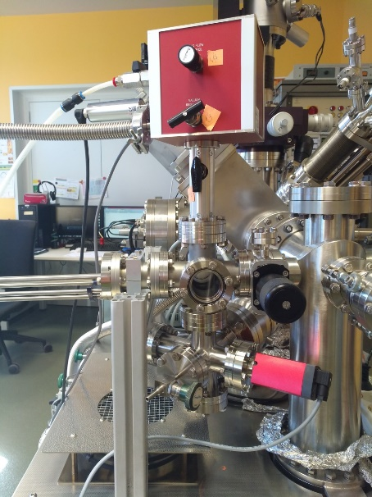
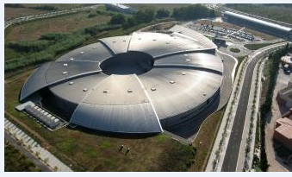
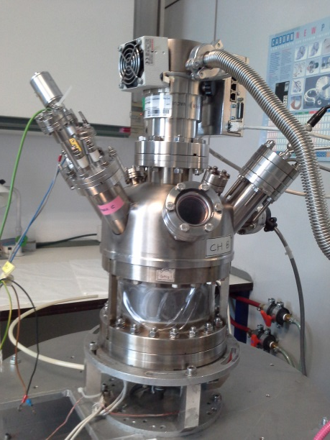
PSCI group Equipment
Atomic force microscopes (AFMs)
(ambient and RH conditions)
Scanning tunneling microscopy/FM-atomic force microscopy
(STM/FM-AFM in UHV 10⁻¹⁰)
-Nanoscale mechanical, electrical, frictional, morphology….
-Properties during device operation (OFETs)
OBME (vapor) and Layer Injection (liquids) in UHV
Atomic structure and local
electronic density of states
Located at ALBA
Growth of ultra thin films
of organic molecules
Agreement ICMAB-ALBA since 2011
Always aware of other needs for deep insight…

Slide 6
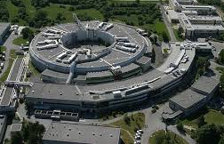
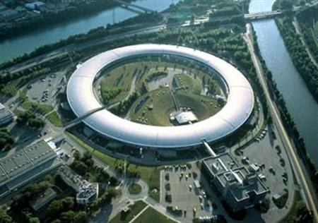
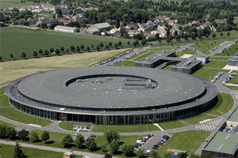
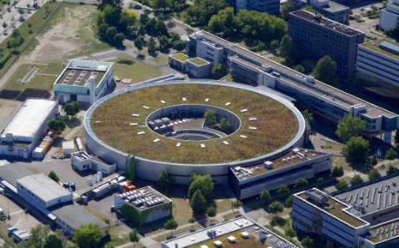
In-situ and/or in real-time studies of organic material
- Evolution of the structure during material deposition under UHV: growth/crystallization
- Phase transformations during annealing/cooling
- Stability/reactivity during interaction with gases: Structural/electronic/compositional changes (oxidation, corrosion, catalysis…)
XRD, XPS, UPS, NEXAFS, XPEEM….with short-time acquisition time: Synchrotron radiation needed
SR-Facilities employed by our group
Elettra (Italy) ESRF (France) Soleil (France) BESSY II (Germany) ALBA (Spain)

Slide 7
Two examples of interfaces for which we employ SR to investigate molecular doping:
Dopant/organic semiconductor (OSC) ultra-thin-films: charge transfer
Dopant/metal interaction: surface mediated reactions and on-surface chemistry
Synergies and common interests & ideas & plans with NCD-SWEET (E. Solano, M. Malfois)

Slide 8
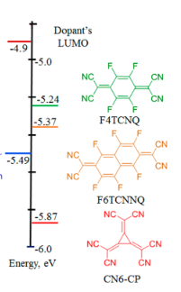
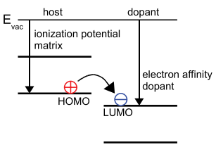
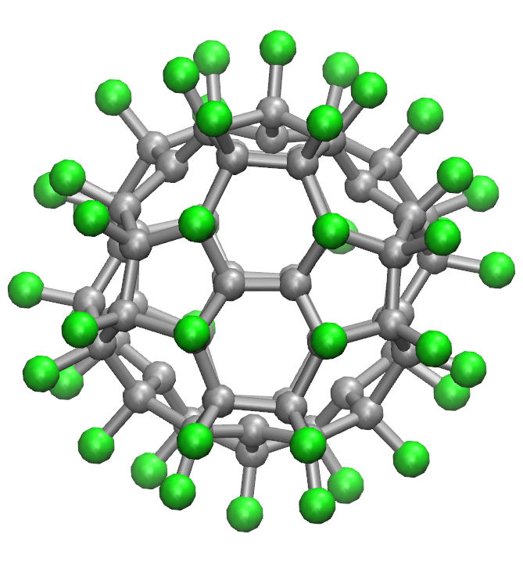
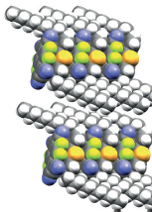
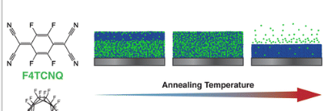
Molecular doping in OSCs
Surface charge transfer doping
Bulk mixture of the OSC and dopant
Improved injection by reduction of the contact resistance
Contact doping
C8-BTBT:PS
Au
Dopant
OSC
SiO₂
Dopants
Si
Ante et al. Small 2011
C₆₀F₄₈
Pérez-Rodríguez et al.
ACS Appl. Mater. Int. 2018
Some issues:
Varying doping efficiency
Adverse effect for crystalline order of OSC film
Some issues:
Diffusion
Intercalation
Jacobs et al. Adv. Mat 2017
Li et al. ACS Appl. Mat.Int. 2015
Mendez et al Ang. Chem. Int. Ed. 2013
Improved properties by interface engineering:
doping with control of structure and nano-morphology

Slide 9
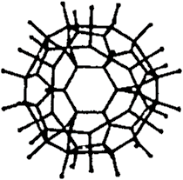
AFM-KPFM
1. Organic/organic interface
Cut-off and Valence Band (UPS)
(a)
(c)
1L
2L
1.5 ML of PEN
on native SiO₂
SiOx
SiOx
SiOx
0.9 eV
E_{vac}
0.2 eV
(b)
+ 14 Å C₆₀F₄₈
3.4 eV
Topography
Surface potential (KPFM)
E_{F}
1L
1.3 eV
0.4 eV
2L
HOMO
HOMO shift of Pentacene and increased work function: proof of charge transfer between PEN and C₆₀F₄₈
-1.1 V -0.2 V
- C₆₀F₄₈ growth depends on the underlying PEN layer and crystallinity.
- C₆₀F₄₈ provokes local variations of work function (φ)
C₆₀F₄₈ grows amorphous or crystalline?

Slide 10
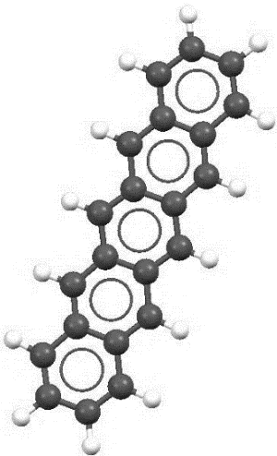
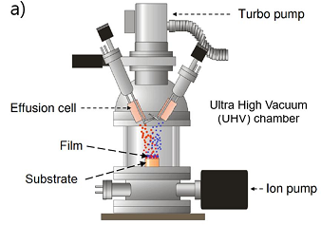

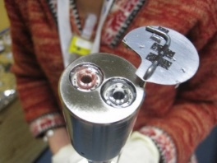
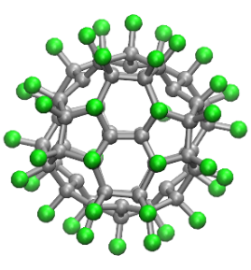
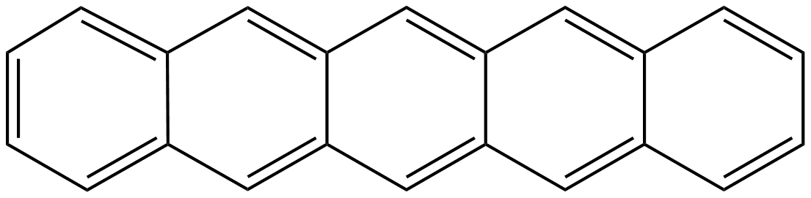
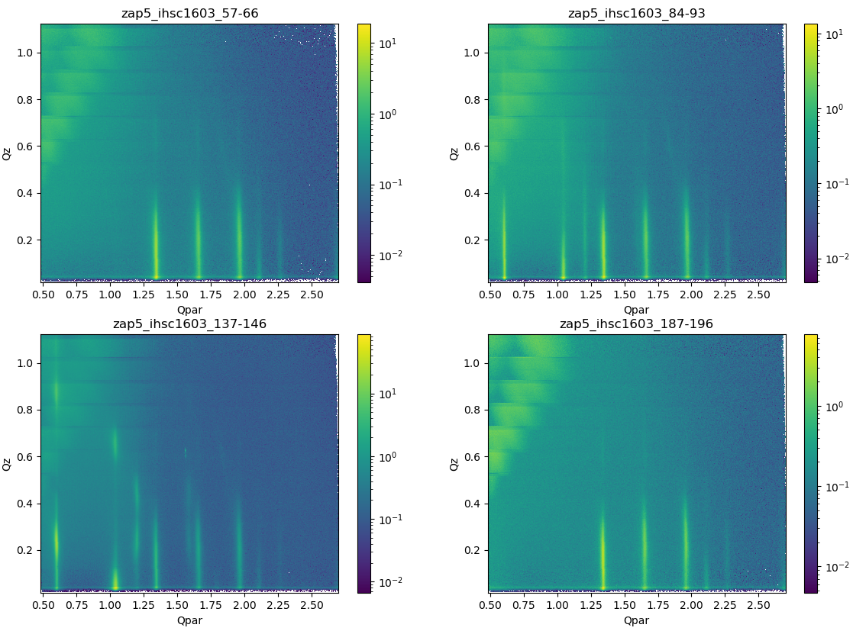
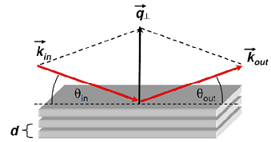
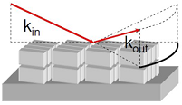
In-situ Structural Investigation
OSC: pentacene
UHV chamber
p-type dopant
C₆₀F₄₈
X-rays
Effusion cell
ID03
Linus Pithan
XRR
Out of plane
Reciprocal space 2D map
GIXD
In plane
Si
Si
δ
Native SiO₂ on Si(001)

Slide 11
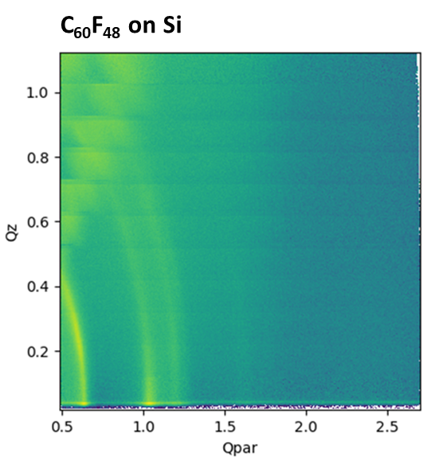
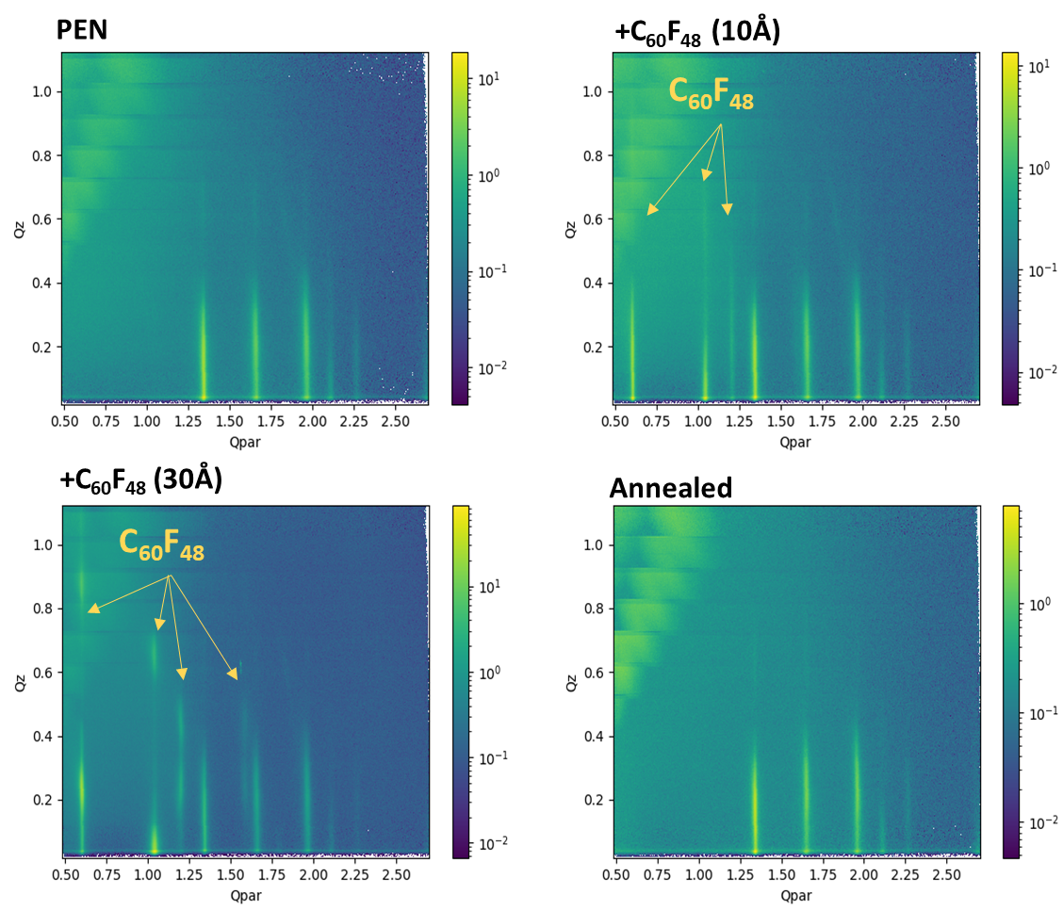
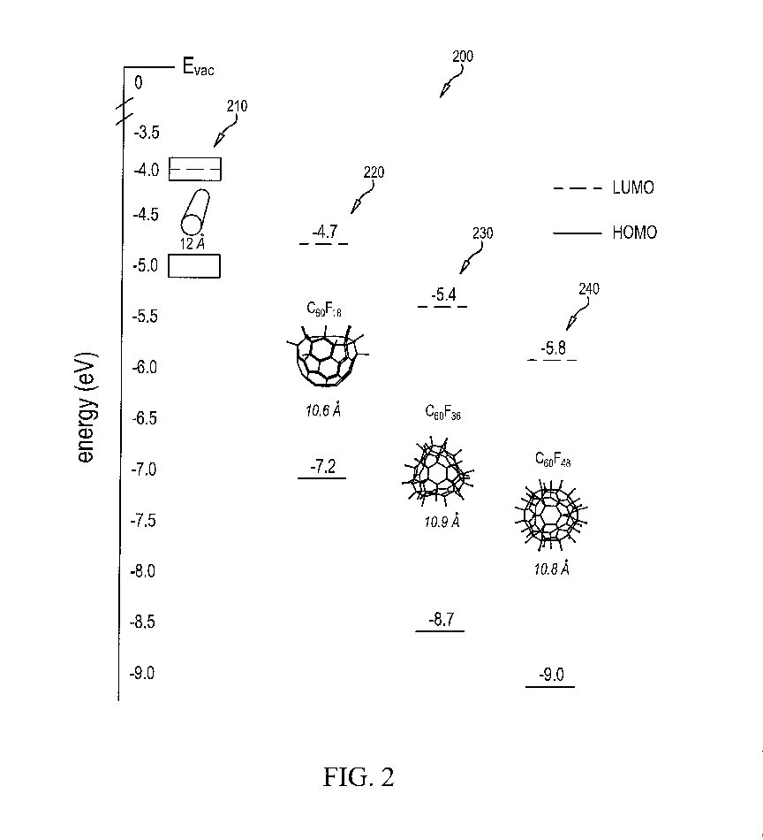
XRD 2D maps
C₆₀F₄₈ on Pentacene
Pentacene
(11)
(02)
(12)
(20)
(21)
Silicon
Silicon
Silicon
Crystalline (111)-oriented fcc C₆₀F₄₈
The underlying Pentacene structure is preserved
Is it possible to “see” where the C₆₀F₄₈ locates?

Slide 12
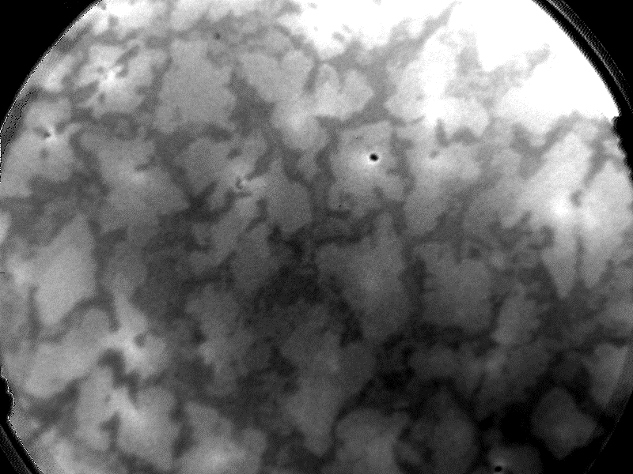
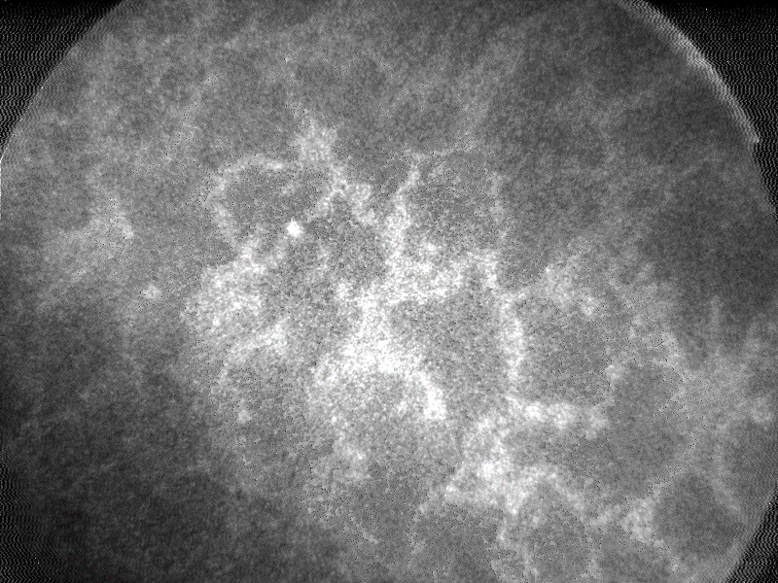

XPEEM/LEEM
LEEM FoV= 15µm, E=2.5eV
NEXAFS PEEM @ F 1s
Space distribution of the dopant?
*Element specific: C₆₀ F₄₈ signature
*Optimized experiments to reduce damage
BESSY II
UE49_PGM SMART
Thomas Schmidt
Fritz-Haber-MPI
F K-edge
AFM
KPFM
0 V
1.2 V

Slide 13
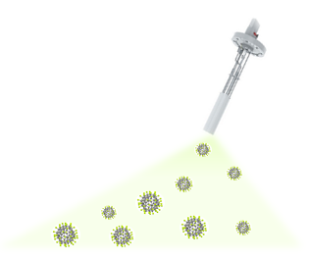
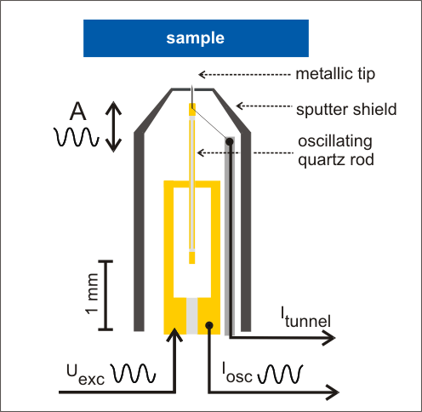
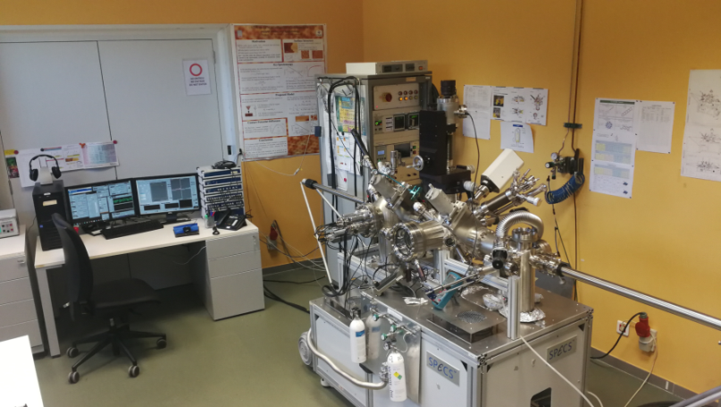
2. Organic/metal interface
Beneficial and detrimental effects
Contact doping
Au(111)
Ni(111)
Cu(111)
C₆₀F₄₈ (dopant)
metal
drain
source
Organic semiconductor
V_{SD}
- - - - - - - - - - -
Metal (contact)
T_{sub}= RT
dielectric
gate
V_{G}
STM (Scanning Tunneling Microscopy)
+
FM-AFM (Frequency Modulation Atomic Force Microscopy)

Slide 14
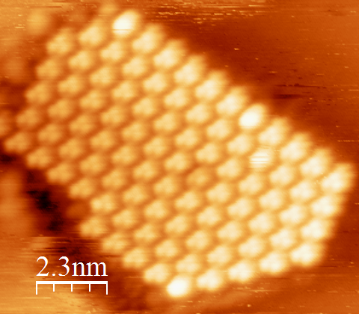
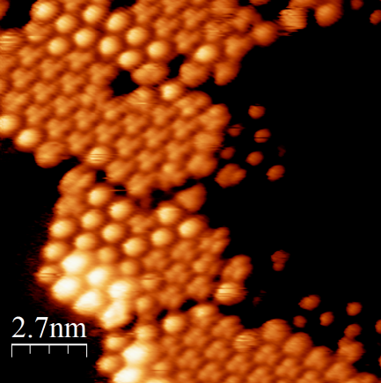
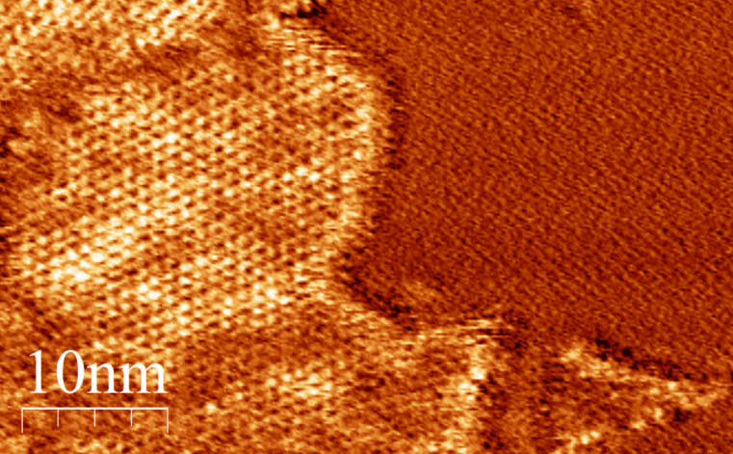



C₆₀F₄₈ on Au(111) STM @RT C₆₀F₄₈ on Cu(111)
Ordered hexagonal lattice
Round and 3-lobed DOS
[11$\overline{2}$]
It looks as C₆₀ !!??
C60 on Cu(111)
[11$\overline{2}$]
Ordered hexagonal lattice
Inhomogeneous DOS
@ 8K
Néel et al. Phy. Rev. Lett. 2007
Motai J.Jap.Appl.Phys. 1993

Slide 15



In-situ chemical analysis by XPS
C₆₀F₄₈ on Cu(111)
C₆₀F₄₈ on Au(111)
C1s
C1s
C1s
C−C
C−C
C−F
C−CF
C−F
C−CF
C ̶ F
C ̶ CF
C₆₀F₄₈ integrity on Au(111)
C₆₀F₄₈ on Cu(111)
defluorinates and
converts into C₆₀ !!
F1s
F1s
F1s
F−C
F1s
F−C
F ̶ C
2 ML
No F
F−Cu
F−Cu
C₆₀F₄₈ is preserved for fully covered Cu(111)
Metal-fluoride forms
2 ML
0.4 ML
0.4 ML
0 ML
Auger tail
0 ML
Auger tail
ICN2_XPS facility (G.Sauthier)

Slide 16




Chemical stability explored in-situ by NEXAFs/XPS
Teo & Simulation @ICMAB
D.Malaspina
Elettra @Aloisa
Luca Floriano
C₆₀F₄₈ over Ni(111)
J.Faraudo
C₆₀F₄₈
Effect of annealing
C₆₀
clear difference in electronic orbitals
Molecular Dynamics (MD) using reactive Force Field (ReaxFF)
In ReaxFF covalent bond creation/breaking and e- transfer are included explicitly. Temperature control is included
As in Cu(111), the C₆₀F₄₈ dopant defluorinates in Ag(111) and Ni(111)

Slide 17






Growth facilities @ PCSI
PCSI-ALBA synergies
Sample transfer in UHV
Suitcase ALBA
BOREAS: soft X-ray (magnetic) circular and linear dichroism (XMCD/XMLD) measurements
M. Malfois, E. Solano
Near-Ambient Pressure Photoemission (NAPP endstation)

Slide 18




Deposition of non-volatile materials in UHV
Atomic Layer Injection (ALI) system_Bihur Crystal
Single molecule solutions
Two or multicomponent solutions
Sequential deposition
Pulse number, pulse duration
Solvent type, concentrations
Substrate temperature

Slide 19





Specific designs for NCD-SWEET beamline (ALBA)
Deposition from vapor phase (sublimation) in UHV for in-situ/real-time GIXD studies
Deposition from liquid solutions in UHV for in-situ/real-time GIXD studies
Expands the catalog to non-volatile materials
Permits sequential deposition as well as co-deposition
Opens the way to on-surface synthesis of functional (engineered pores) 2D covalent organic frameworks (COFs)
Allows exploring new combined strategies (vapor + liquid)
Structural phase transitions
Structural changes arising from interaction with gases
Catalysis, gas storage…
UHV chamber
X-rays
X-rays
-Deposition time
-Temperature sweep
-Exposure to water or gases

Slide 20
Thanks !
Physical Chemistry of Surfaces and Interfaces (PCSI)
https://departments.icmab.es/surfaces/
Rogger Palacios, Adara Babuji and Francesco Silvestri
Esther Barrena and Carmen Ocal
EU Horizon 2020 under the Marie Skłodowska-Curie Grant agreement No 722651.
Agreement ICMAB-ALBA since 2011
MAT2016-77852-C2-1-R (AEI/FEDER, UE)

Slide 22


The role of interface dipoles
Metal-organic interface
Organic-organic interface
Charge transfer
Cation formation
Anion formation
Covalent
bond
cathode
acceptor
-
+
Push-back effect
Permanent dipole
donor
Pillow effect
Anode
Ishii et al. Adv. Mater. 1999, 11, 605–625
Organic-organic: polarization, charge reorganization, charge transfer …
The influence of the molecular dipole orientation on the structural and electronic properties of an organic-organic interface remains poorly understood

Slide 23
Specular intensity XRD for (a) C8-BTBT-C8 film (48nm) and (b) BTBT-C8 film (22nm) before (black line) and after (blue line) a multilayer deposition of C₆₀F₄₈ on top (15nm). The spike at q_{z}=7.8 nm⁻¹ is not a structural feature from the samples.
XRD specular reflectivity of (a) BTBT-C8 (22 nm) and (b) C₆₀F₄₈(15nm)/ BTBT-C8 (22nm). The black curves correspond to the diffraction data acquired at room temperature and the blue curves correspond to the data measured at 80ºC for BTBT-C8 and 100ºC for C₆₀F₄₈/C8-BTBT-C8.
Topography and (b) simultaneously measured KPFM surface potential (SP) map for C₆₀F₄₈ (2 nm)/C8-BTBT-C8(9nm) on a 200nm thick SiO₂. Line profiles along the segments in the (c) surface potential map and (d) topography show the correlation between the increase (decrease) in work function (SP) and the C₆₀F₄₈ crystallites.

Slide 24



Slide 25


Slide 26

C₆₀F₄₈ on Ni(111) XPS
C1s
F1s
C−C
F−Ni
F at the surface
0,7 ML
40% of F
0,3 ML
10% of F
Ni(111)
Full defluorination of the molecules on Ni(111)

