Slide 1
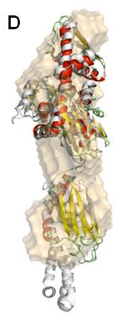
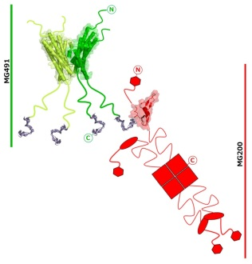
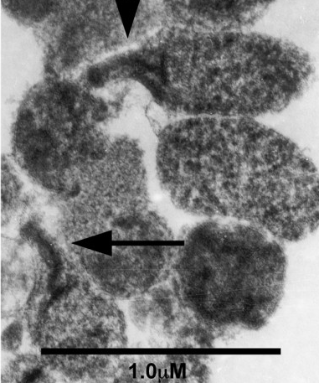
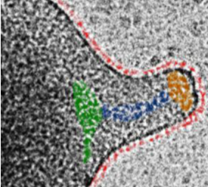
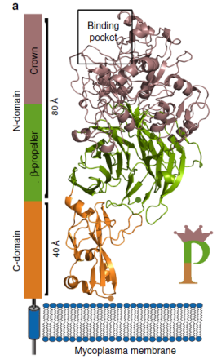
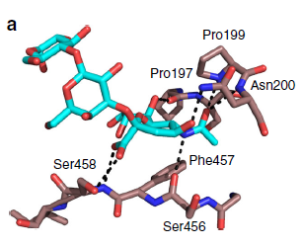
Multi-Scale Imaging Opportunities at ALBA
BACKGROUND
*Causative agent of infectious diseases in humans and cattle herds, with particular severity in immunosuppressed patients.
*M. genitalium has a prevalence of 1-3 % in the general population.
*The increased emergence of antibiotic-resistant mycoplasma strains is a huge threat to public health.
DnaK (MG305)
GrpE (MG201)
MG491
MG200 EAGRb
(Calisto et al., Mol Microbiol 2012)
(Adell et al., Protein Sci. 2018)
(Martinelli et al., JBC 2015)
(Martinelli et al., PLoS Pathogens 2016)
P140 (MG191)
P110 (MG192)
XALOC, MX crystallography
MAIN MOTIVATIONS
* Decipher Mycoplasmas colonization and infectivity mechanisms.
* Identify targets for vaccines or drugs development for new and more effective therapeutics.
Cryo-Electron Tomography
(Aparicio, Fita et al., Nat. Comm 2018)
(Aparicio, Fita et al., under review on Nat. Comm)

Slide 2
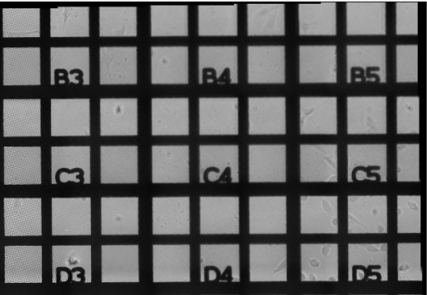
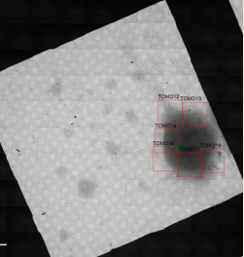
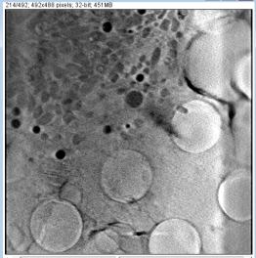
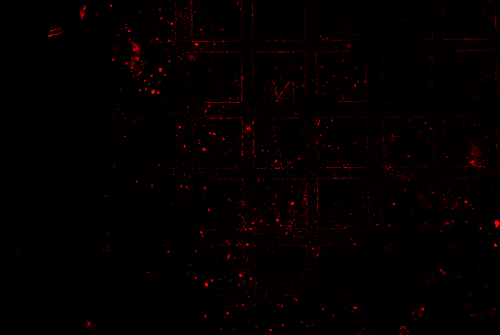
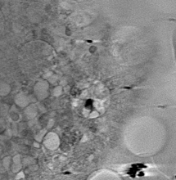
Multi-Scale Imaging Opportunities at ALBA
MISTRAL, cryo-Soft X-ray Tomography
Confocal Microscopy at UAB Microscopy Services
Mycoplasma genitalium cells
TEM
M. genitalium-infected human epithelial cells
COLLABORATORS
Piñol’s group (IBB-UAB)
Fita’s group (IBMB-CSIC)
Ana Pérez-Berná
(MISTRAL, ALBA)
Red fluorescence given by mCherry-labelled protein

