Slide 1
The single crystal diffraction at ALBA: drug development, chemical crystallography and more
Judith Juanhuix
ICMAB-ALBA workshop 2020, Feb 24

Slide 2
The crystallography at Alba
MSPD: Materials Science and powder diffraction beamline
XALOC: Macromolecular crystallography
XAIRA (in construction): microfocus MX
MSPD
XAIRA
Bio lab
2 lab areas
Accept a variety of sample environments:
Pins, capillars
Diamond Anvil cells
Controlled atmosphere
XALOC
The crystallography stations at the Alba synchrotron
F Fauth, R Boer, F Gil-Ortiz, C Popescu, J Benach, and J Juanhuix Eur. Phys J. Plus 130:160 (2015)
Mat sci lab

Slide 3
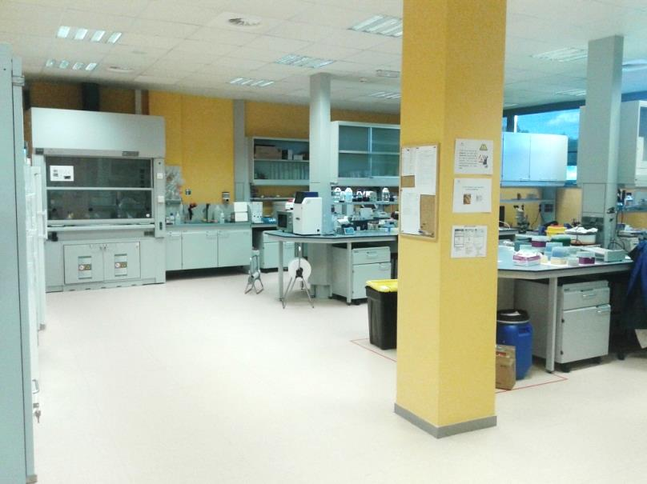
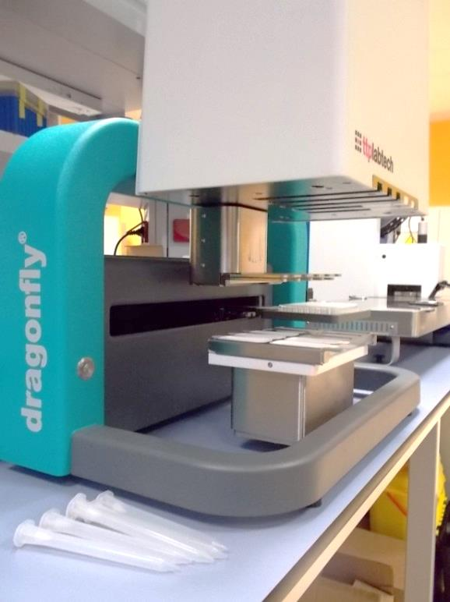
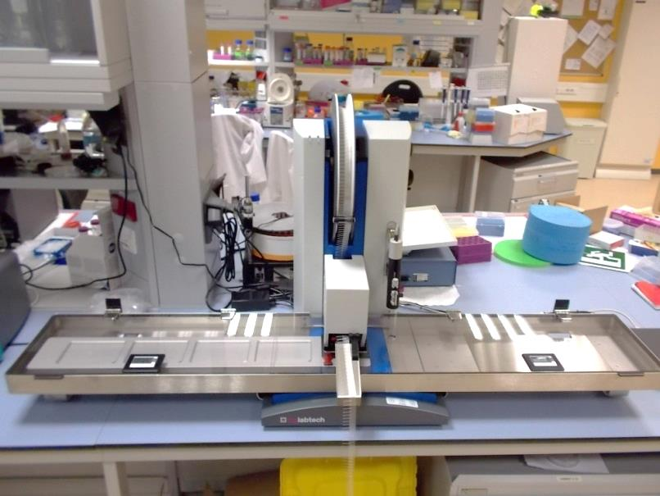
Close-by laboratories
225 m2 of biolab space
Mammalian cell lab
P2 lab
Cold room @4C
Crystallization service available
In-situ preparation on demand
Dragonfly for setting up optimizations
Mosquito LCP for general screening

Slide 4
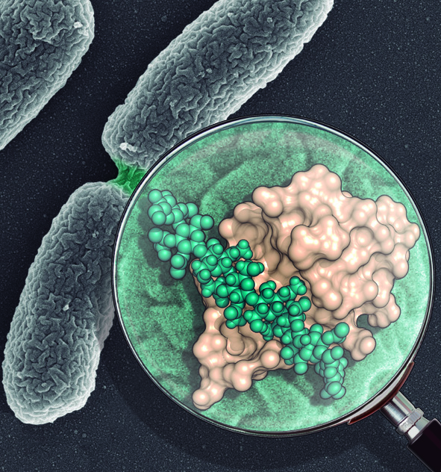
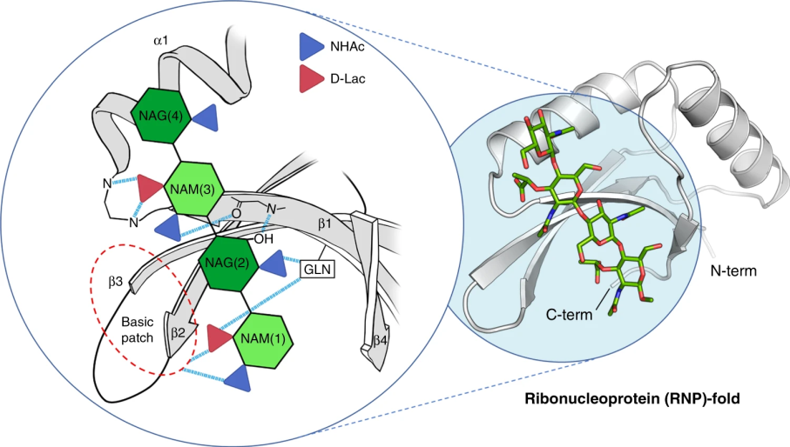
How bacterial wall is built in bacterial division
SPOR domains are key to manipulate the bacterial wall made of peptidoglycans to allow baterial division
Crystal structures of the SPOR domain at 1.2 Å, in the apo state and in complex with different glycans decipher the molecular basis for recognition and delineate a conserved pattern
Many of the protein-ligand interactions involve main-chain atoms rather than side-chain functions
The work solves how SPOR domains, present in almost all bacteria and with very little sequence homology, can bind to the same glycan ligand
Allows the design of future drugs blocking the machanism, without which the bacteria become sensitive to the antibiotic effect
Structural basis of denuded glycan recognition by SPOR domains in bacterial cell division
M Alcorlo, DA Dik, …, JA Hermoso. Nat. Comm 10:5567 (2019)

Slide 5
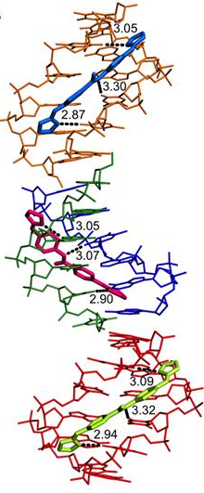
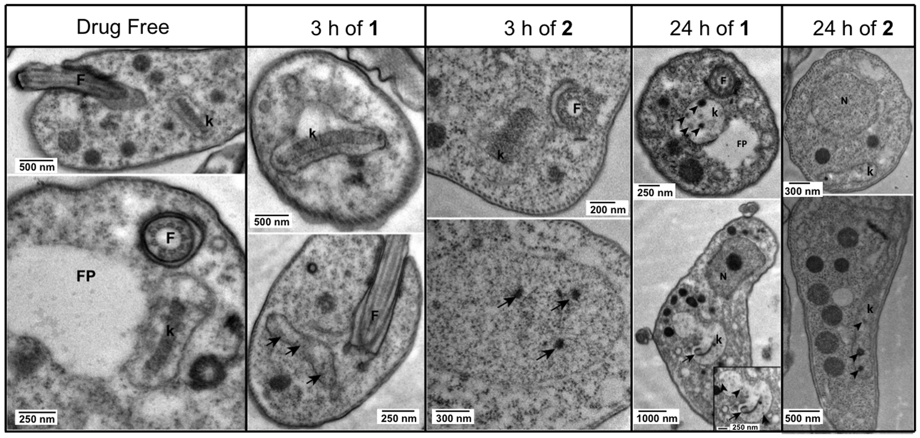
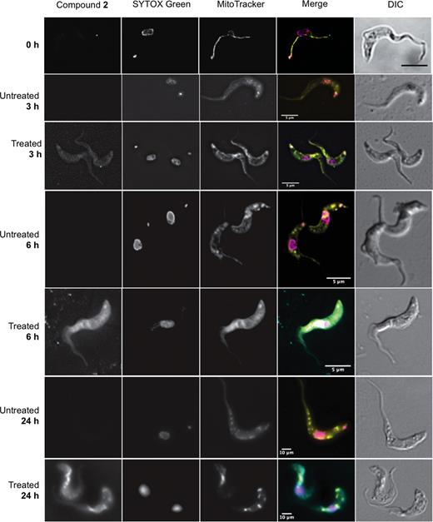
How drugs against sleeping sickness work
Binding of two new chemical compounds against Trypanosoma brucei, parasite of the sleeping sickness disease
Target for both drugs is the minor groove of the kinetoplast DNA, specific to Trypanosoma
TEM images showing normal ultrastructure of bloodstream form for treated and drug-free control cells
Compounds binding to kinetoplast
Fluorescence microscopy
Functional and structural analysis of AT-specific minor groove binders that disrupt DNA–protein interactions and cause disintegration of the T. brucei kinetoplast.
CR Millan, FJ Acosta-Reyes, …, L Campos. Nucl. Ac. Res. 45:8378 (2017)

Slide 6
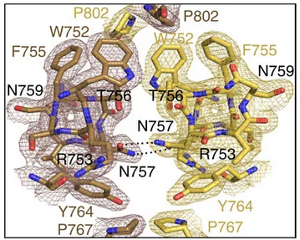
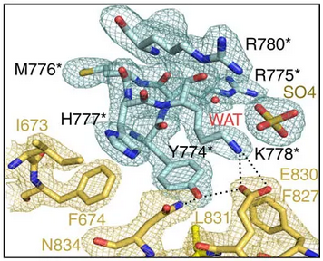
A new key target for the treatment of prostate cancer
Androgen receptor (AR) plays a crucial role in development and metabolism as well as in diverse pathologies such as androgen insensitivity syndromes, male infertility and prostate cancer.
Dimerization through Ligand Binding Dom was controversial
The structure of the human AR-LBD homodimer bound to dihydrotestosterone explains dimerization
Also AR-LBD dimer has been solved by FRET in vivo.
Explains 40 point mutations responsible of either androgen insensitivity syndromes and/or prostate cancer
Small molecules that may interfere with AR dimerization could be potentially useful for PCa treatment
Details of interdomain interactions
Structure of the homodimeric androgen receptor ligand-binding domain. M Nadal, …, P Fuentes-Prior and E Estébanez-Perpiñá Nat. Comm. 8:14388 (2017)

Slide 7
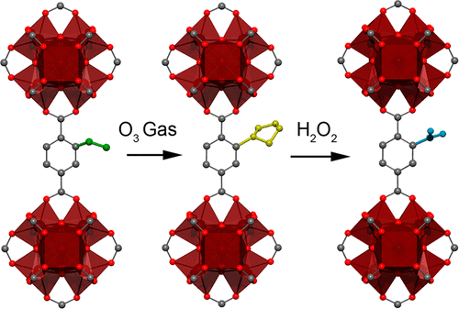
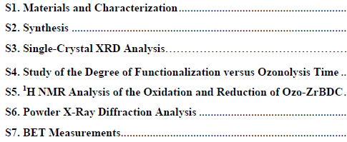
Post-synthetic modifications of MOFs
Solid−gas phase, SXtal-to-SXtal, postsynthetic modifications of a MOF.
Using ozone, the olefin groups of a UiO-66-type MOF quantitatively are transformed into 1,2,4-trioxolane rings
Then selectively are converted into either aldehydes or carboxylic acids.
The methodology may offer new insight into how gas molecules might be exploited for MOF chemistry that transcends common physisorption phenomena
Lab Cu-Kα PXRD, FE-SEM, ¹³C NMR,
XALOC @ALBA, I19 @Diamond
Then selectively are converted into either aldehydes or carboxylic acids.
Single-Crystal-to-Single-Crystal Postsynthetic Modification of a
Metal−Organic Framework via Ozonolysis, Albalad J, …Maspoch D, JACS 2018, 140, 2028

Slide 8
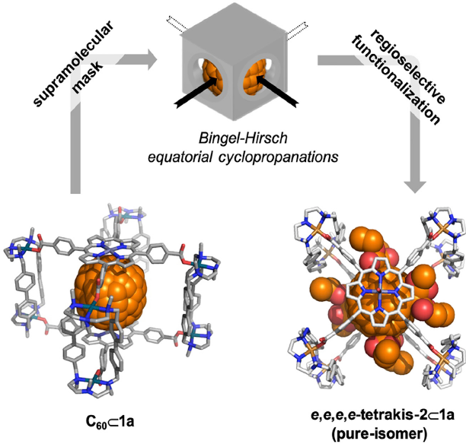
Easier regioselective functionalization of C₆₀
Isomer-pure poly-functionalized fullerenes are required for fullerene chemistry
A nanocapsule is used as a supramolecular tetragonal to exert control on reactivity and equatorial regioselectivity of cyclopropanation of a confined C₆₀ guest
Forms pure-isomer poly-functionalized C₆₀ adducts overcoming chromatographic separations
Allows for direct testing of adducts in solar cells prototypes
The protocol is currently expanded to other functionalization reactions
May help in the discovery of the next generation of organic- or perovskite-based solar cells or new drug candidates
Proof of encapsulated equatorial tetrakis C₆₀ adduct @XALOC
Main Techniques used:
SXD at Synchrotron
NMR
MD
Non-covalent interaction analysis
Supramolecular Fullerene Sponges as Catalytic Masks for Regioselective Functionalization of C60.
C Fuentes-Espinosa, …, X Ribas , Chem 2020, 6:169-186

Slide 9
Thank you

