Slide 1


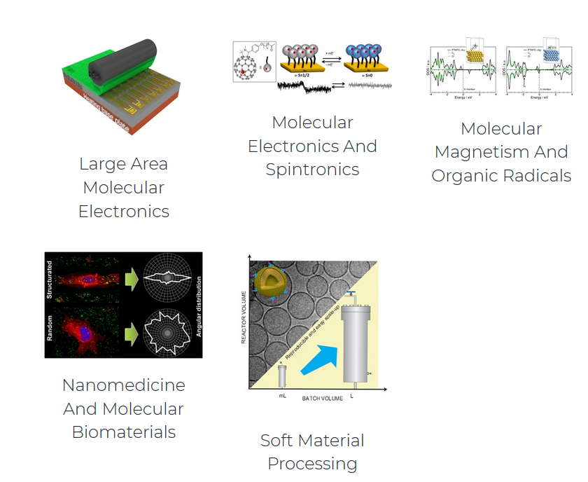
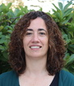

Expertise in the synthesis, processing and study of molecular and polymeric materials with chemical, electronic, magnetic and biomedical properties.
OUR RESEARCH LINES:
Dr. Imma Ratera
Dr. Núria Crivillers
Dr. Marta Mas

Slide 2
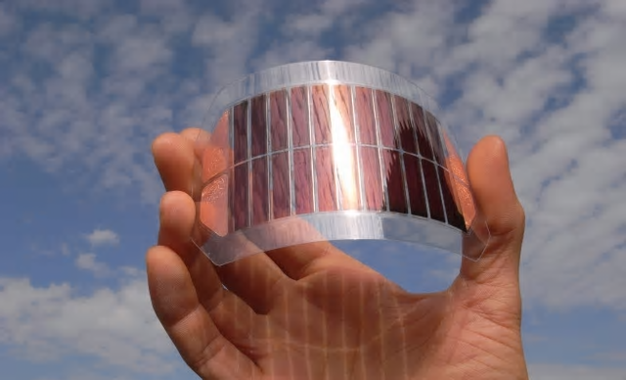
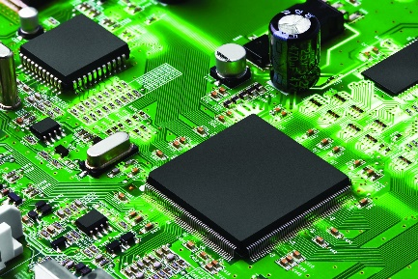
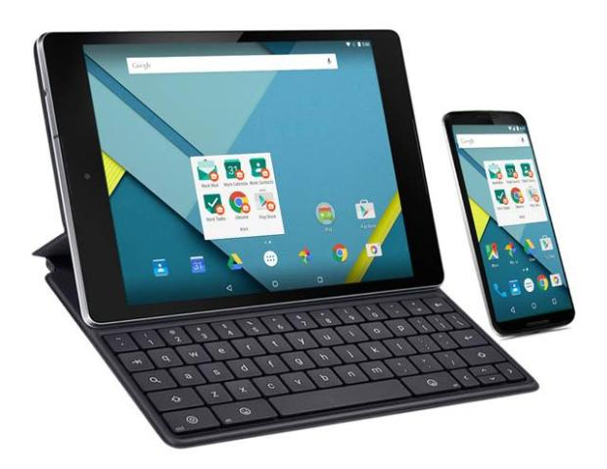
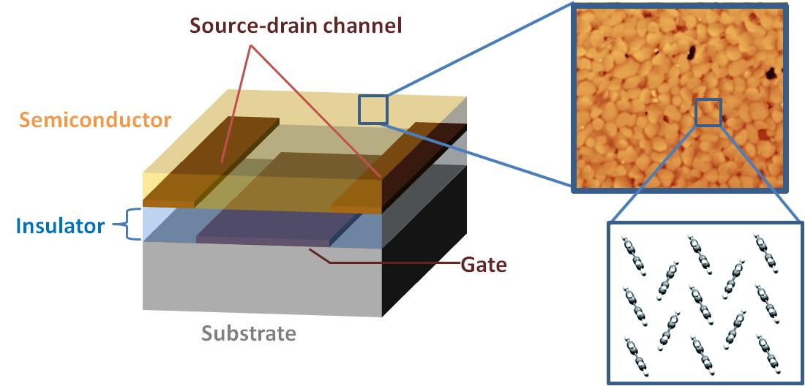
Organic Large Area Electronics :
Silicon based technology
Organic electronics… Why?
Light-weight
Flexibility
Low-cost
Fabrication processes are cheaper and compatible with plastics
Organic Field-Effect Transistors

Slide 3
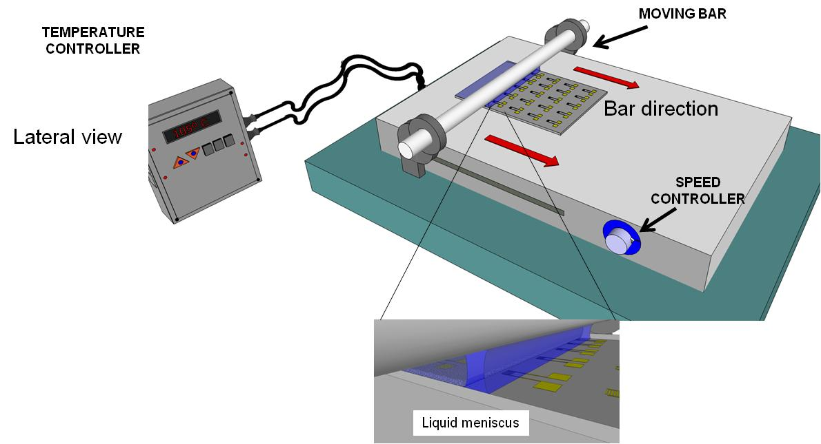
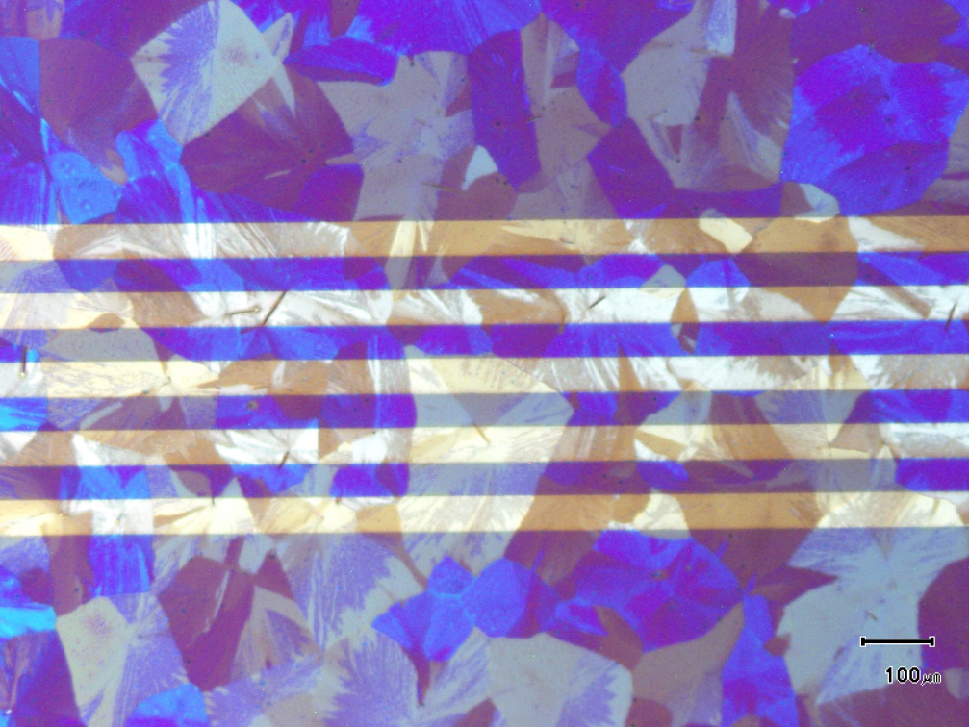
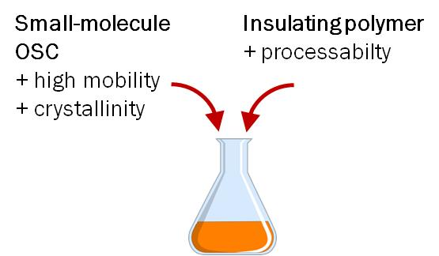
Our strategy to fabricate OFETs
Advantages
Fast (10 mm/s)
In air
One step
Simple
Compatible with plastics
Scalable
Low-cost

Slide 4
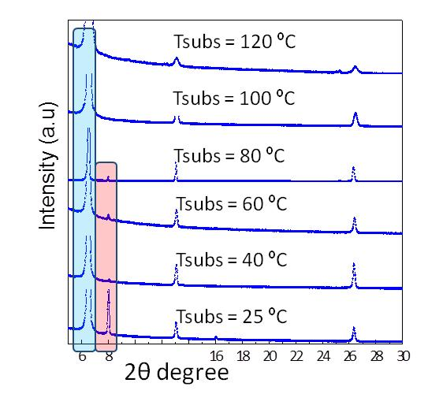
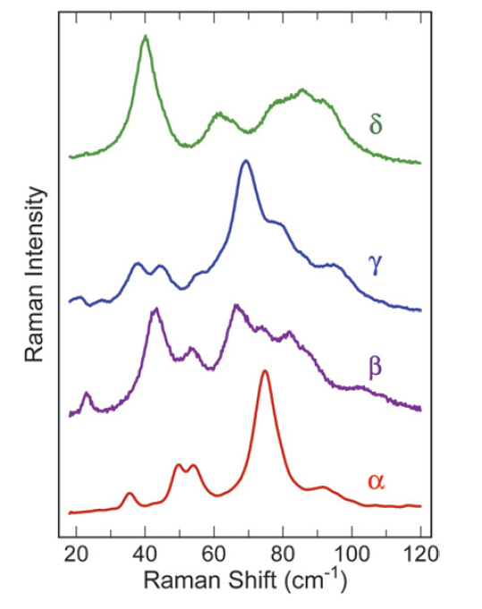
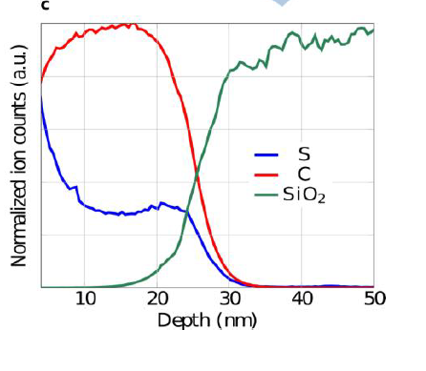
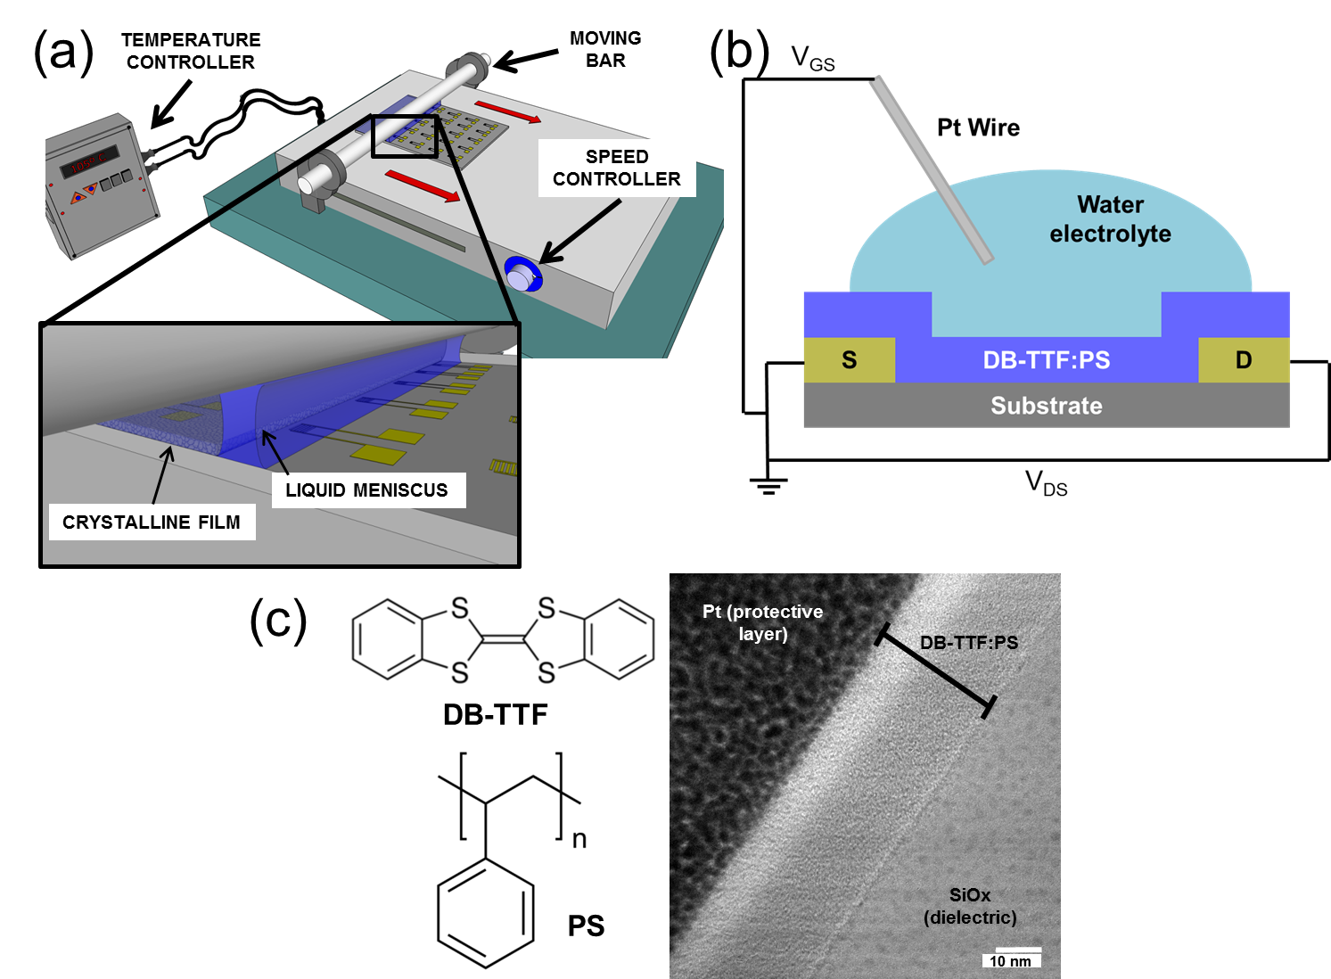
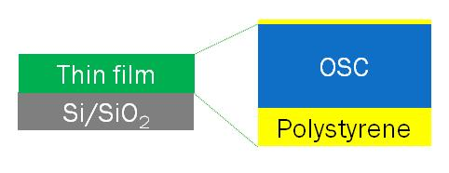
Open Questions
Crystal Structure
and Polymorphism
Film maps-local information
Interfacial layers determine the properties
By X-ray some polymorphs can only be identified at very low angles.
The crystal order determines the field-effect mobility
The control of polymorphism is crucial to achieve high device-to-device reproducibility
X-ray/ Raman /IR
Phase Separation
The vertical phase separation that takes place during crystallisation (insulating polymer and organic semiconductor) has a strong influence on the device performance.
ToF-SIMS / XPS / TEM / Spectroscopy
In situ or in operandi measurements
Crystallisation process
Deformation of films

Slide 5
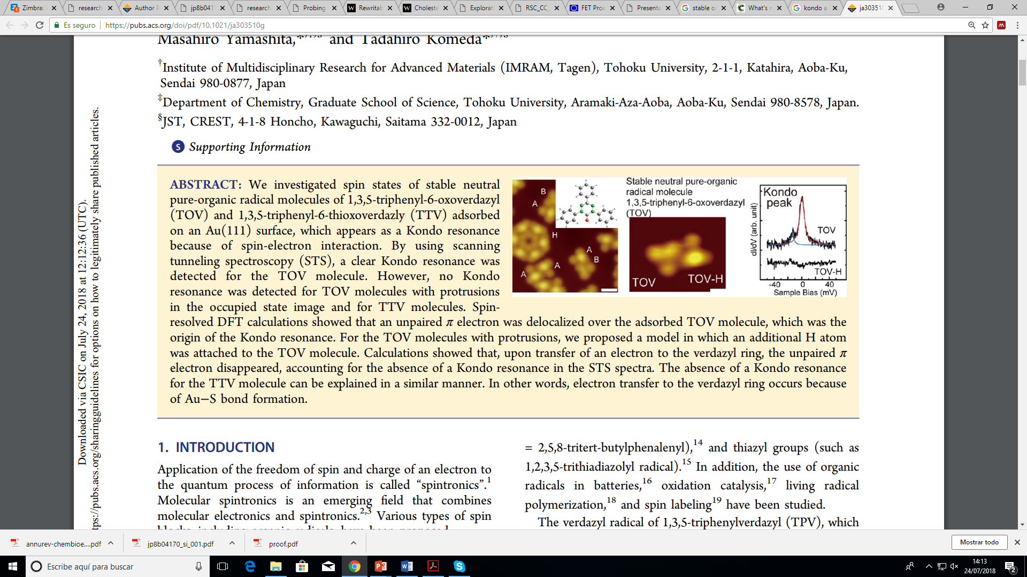
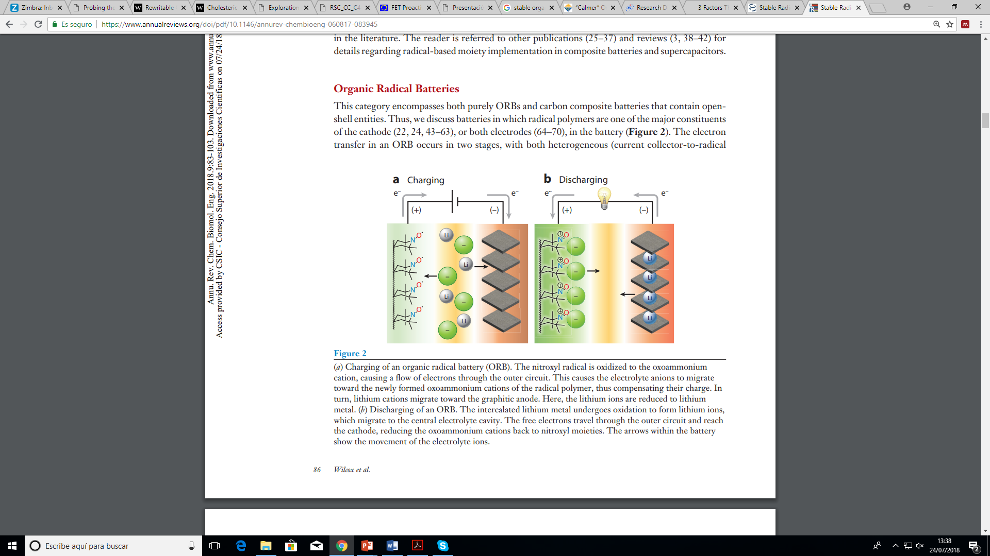
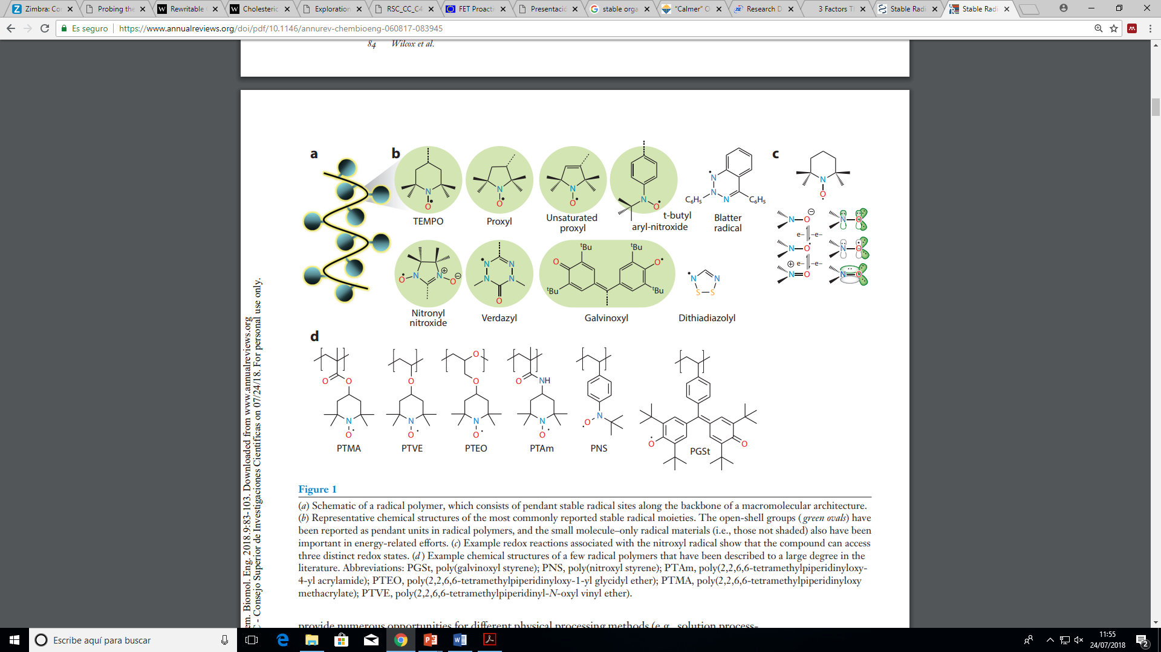
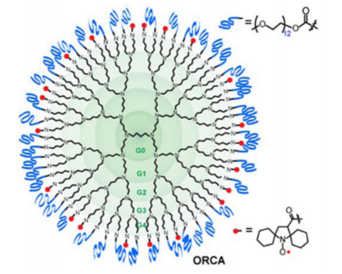
Organic radicals
Molecular spintronics
Organic radical batteries
So persistent and so unreactive to air, moisture that they can be stored and handled under ambient temperature.
J. Am. Chem. Soc. 2013, 135, 651
Annu. Rev. Chem. Biomol. Eng. 2018, 9, 83
Optical properties
Biological and Biomedical
Chem. Sci., 2018, 9, 1996–2007
ACS Appl. Mater. Interfaces 2017, 9, 44316

Slide 6
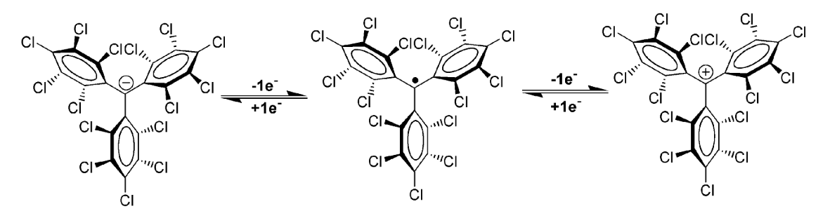
Stable organic radicals: the case of the Polychlorotriphenylmethyl (PTM) radical
Electroactive
Magnetic
Optic
Delocalization of the lone-electron through the aromatic rings.

Slide 7
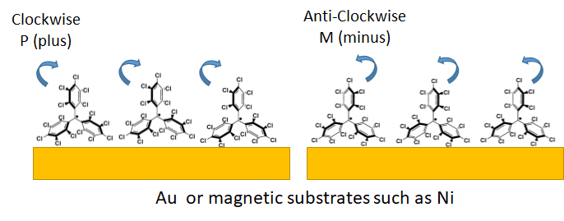
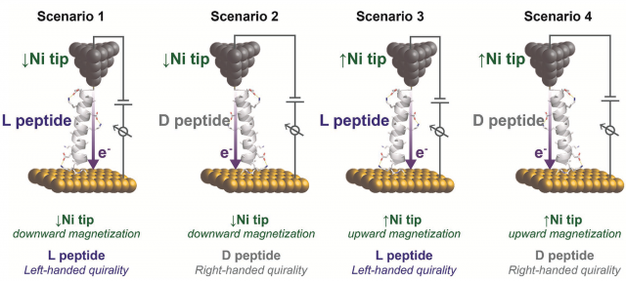
Chiral & magnetic propeller-like trityl-based radical derivatives
CPL spectra
J. Phys. Chem. Lett. 2012, 3, 1559−1564
Angew. Chem. Int. Ed. 2019, 58, 16282 – 16288
Chiral Induced Spin Selectivity (CISS) effect
Electrons go through chiral molecules, one state of spin is preferred over the other. That’s very interesting, because typically you get this spin selection only with ferromagnetic materials.
Small 2017,13,1602519
Open Questions:
Isomer stability on surface. Do the racemise on surface with time or during the layer growth? XMCD (BOREAS)
Molecule-surface interactions

Slide 8
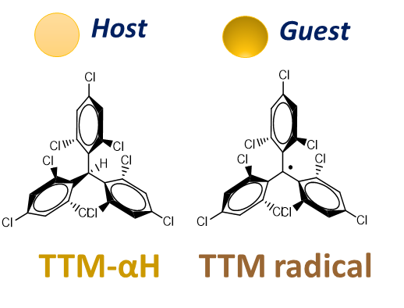
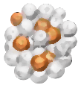
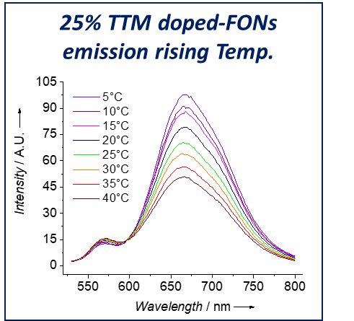
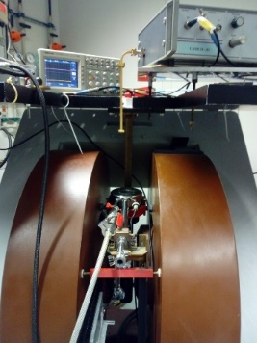
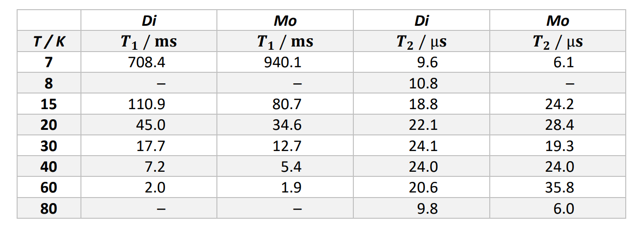
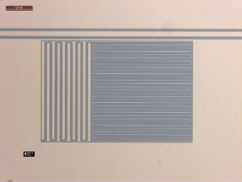
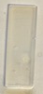
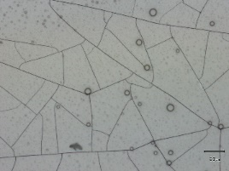
Optic and magnetic properties of organic radicals dispersed in solid matrixes as organic nanoparticles and polymeric films
Solid solution as Organic Nanoparticles
Thanks to their emission in the red-NIR region (650-800 nm) these free-radical excimer-forming materials are promising molecular materials for bioimaging and optoelectronics applications.
PTM radicals as molecular quantum bits of information.
EPR
200µM in CS₂
Polymeric film embedding PTM radicals
Nb-based resonators
Open Questions:
Structural characterization and intermolecular interactions
In collaboration with Fernando Luis (ICMA-CSIC), Joris van Slageren (Uni. Stuttgart)

Slide 9
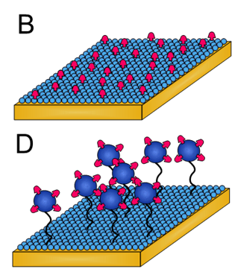
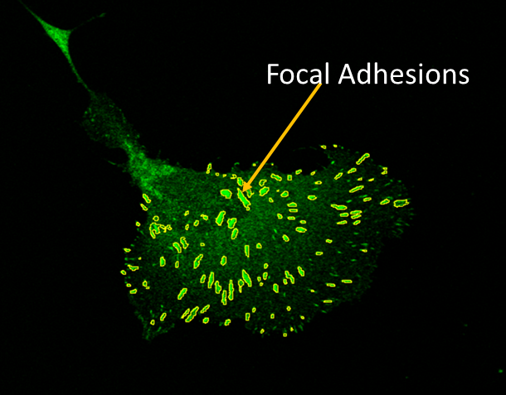
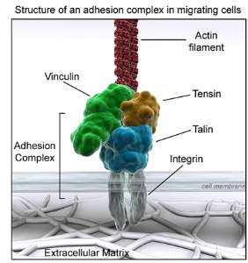
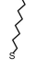
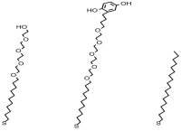


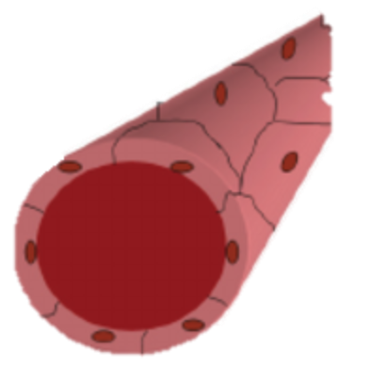
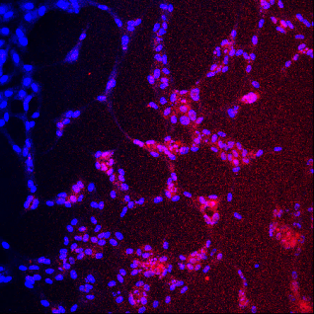
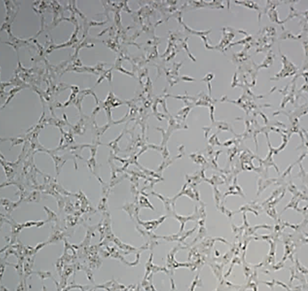
Nanoscale structuration of biomolecules on surfaces (2D) and hydrogels (3D) for cell guidance
Control the binding of specific peptides which promote:
Cell adhesion
RGD
SH
Cell morphology
Qk
SH
Tubulogenesis
Open Questions:
Different structure or observation of Material-Cell Interface; Focal Adhesions (structure and IR microscopy)
Insitu vascularization (microscopy)
Applications:
Fundamental Biological Studies
Biomedical Coatings and Tissue Engineering
Lab on Chip Devices

Slide 10
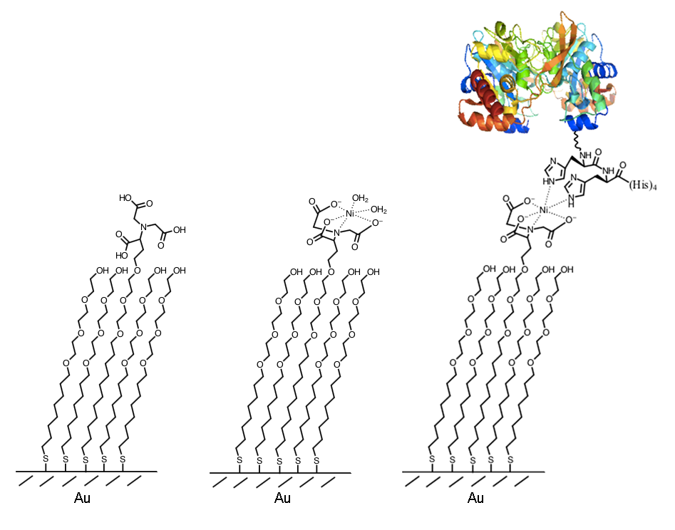
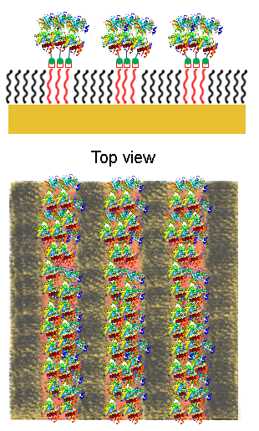
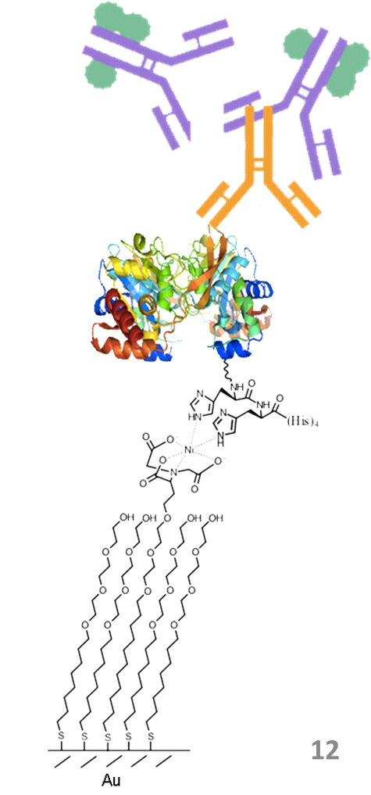
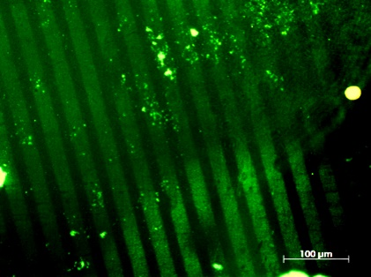
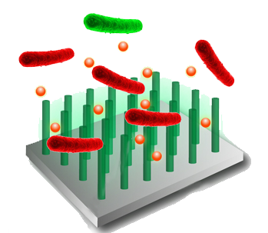
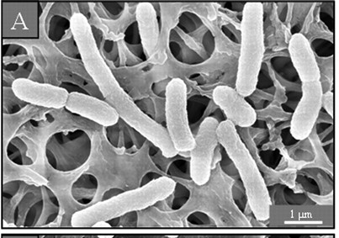

Surface Immobilization of Novel Antimicrobial Protein using SAMs
Novel antimicrobial protein immobilization on SAM by Ni-NTA strategy
Immunostaining strategy for characterization of protein anchoring:
His-tagged antimicrobial protein
Ni²⁺ solution
Two different proteins:
Nanostructured
soluble
Surface multi-characterization and antimicrobial activity test:
Open Questions:
Protein nanostructure on the surface (structure, IR spectroscopy)
Antimicrobial mechanism (microscopy)

Slide 11
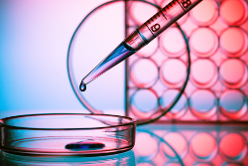
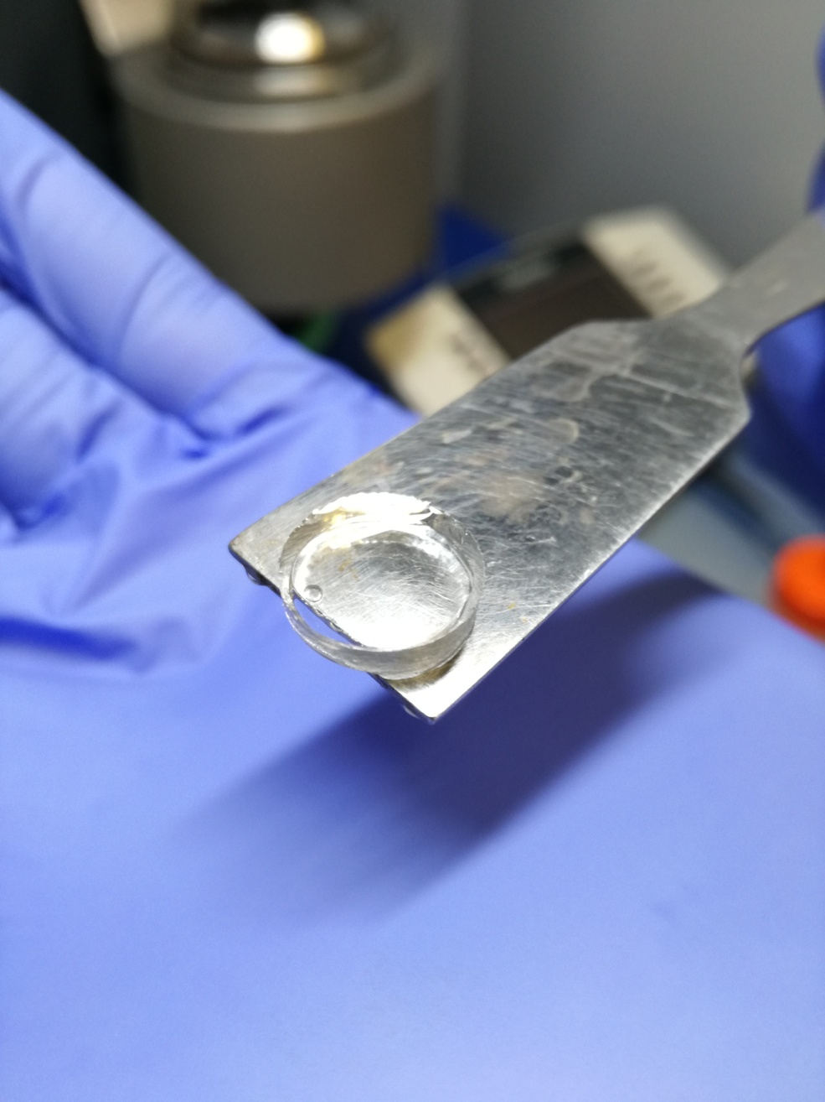

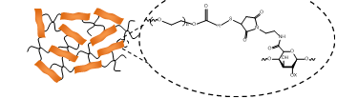
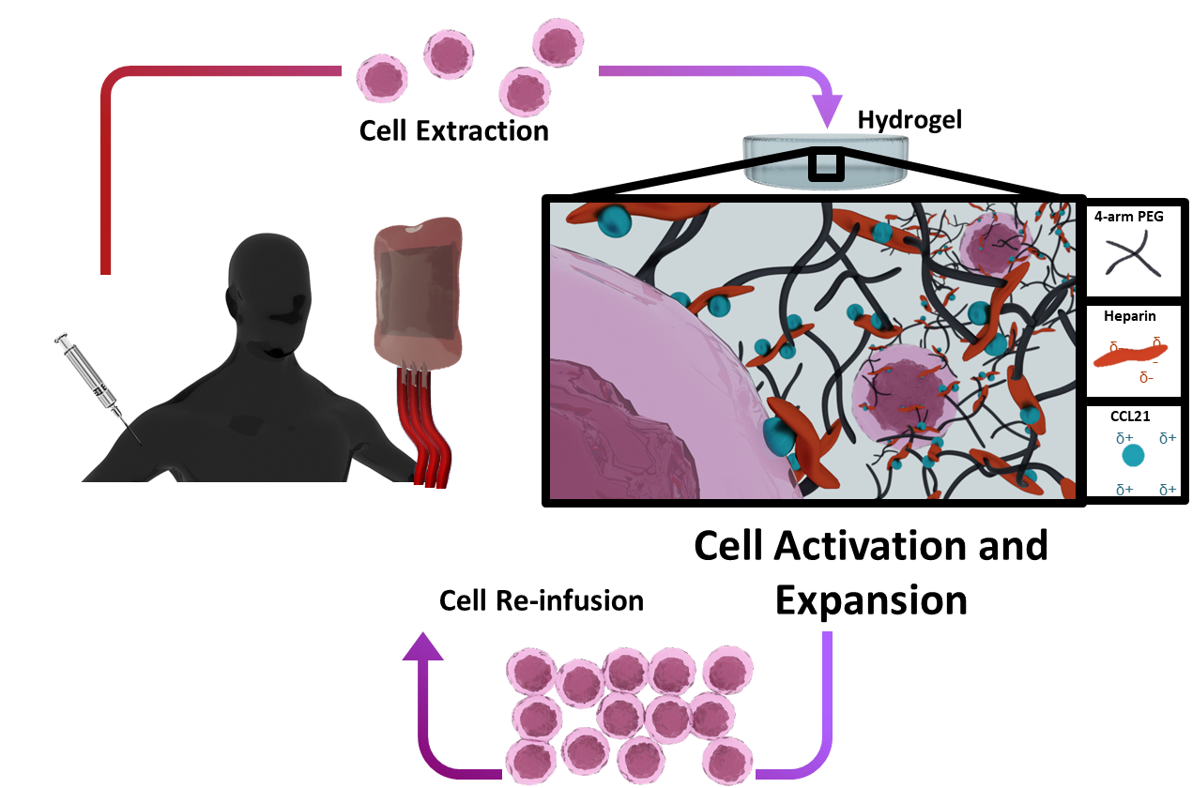
3D synthetic hydrogels to reproduce the original environment of the cells
2D vs 3D
Immunotherapy
Biofunctionaliezed Hydrogels as Artificial lymph nodes
Expansion and activation of cells of the Immune System of patients to be reinjected and fight against cancer
Open Questions:
Synthetic hydrogel 3D structure (tomography, IR spectroscopy)
T Cell interaction with the hydrogel biofunctionalized with cytokines (tomography with T Cells)

