Slide 1
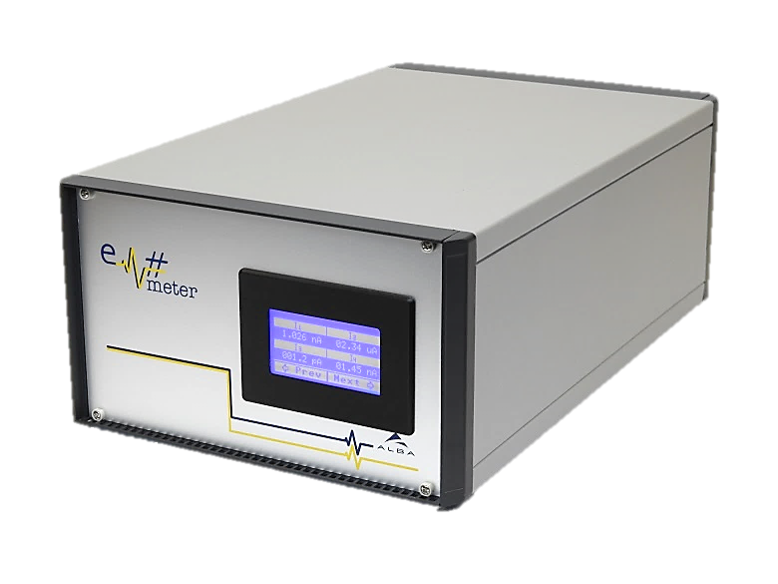
Em#
Collaboration meeting
Components Obsolescence
23 July, 2019

Slide 2
SPEC
NUC

Slide 3
SBC: Risks of the change
More than 2 core can improve the response times and speed with FPGA
Wider PCIe bus from actual PCIe 1x to PCIe 4x could do four times faster data transmition with FPGA
Solve problems with MMC memories
New Linux Driver
New YOCTO project for new CPU
ARM core are very popular and may do heavier the migration
I2C that controls Display and PSB maybe not compatible
PCIe code in FPGA is different

Slide 4
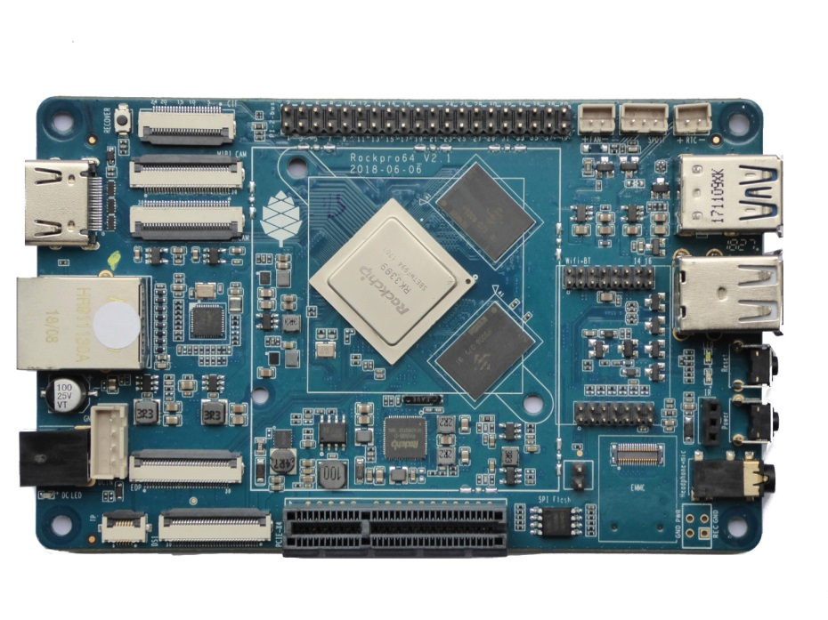
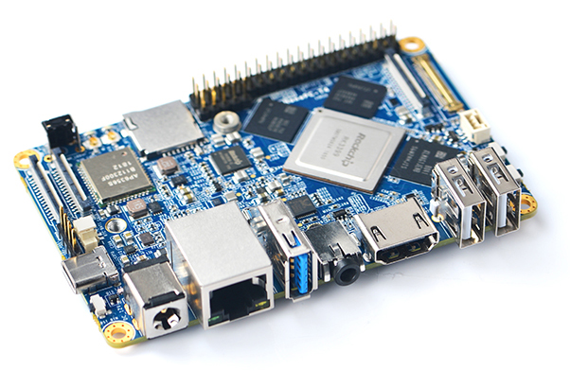
Single Board Computer: NUC
ROCKPro64 from PINE64 for 80$
ARM LTS(2023)
NanoPC-T4 from FRIENDLYELEC for 133eur

Slide 5
FPGA: Risks of the change
New FPGA with more resources
Project must be moved to new FPGA.
Clocks maybe different frequencies
Comunication with SBC: PCIe IP must be adapted

Slide 6
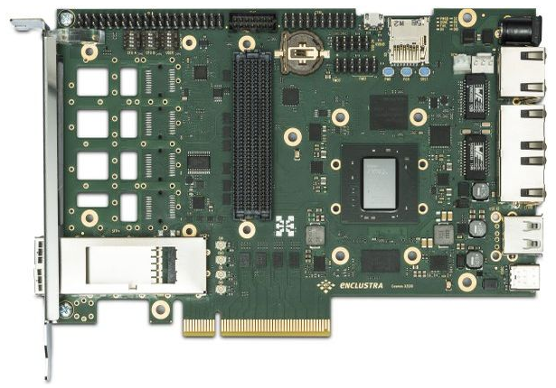
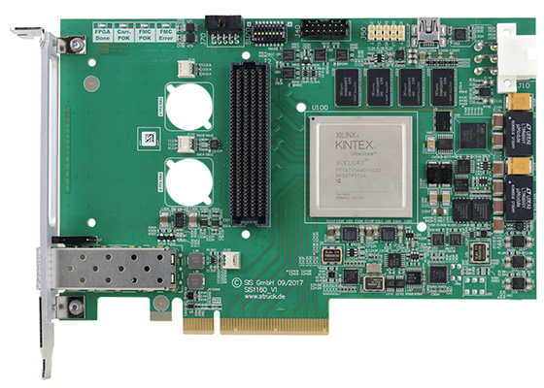
FPGA Card: SPEC
SIS1160 from Struck Innovative Systeme GmbH
CO-XZQ10-111-I from enclustra ~750€

Slide 7
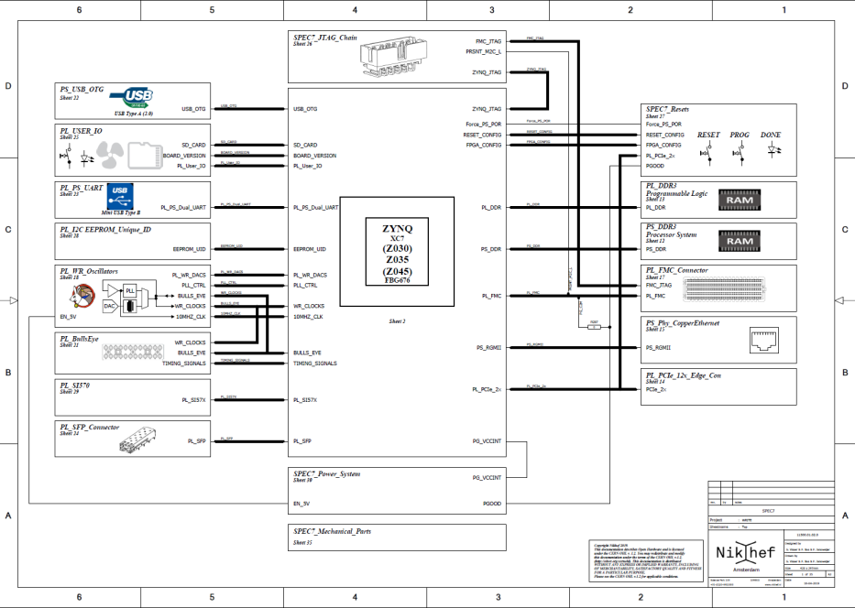
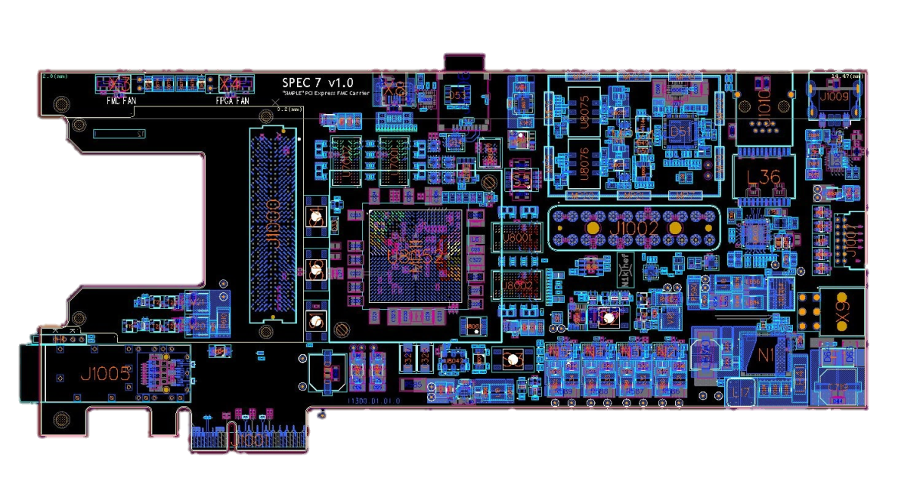
Maybe the best option is waiting for SPEC7
It is powered by Xilinx Zynq FPGA with Dual-Core ARM processor integrated

Slide 8
Future
New developments on FPGA should take care a future migration

