Slide 1
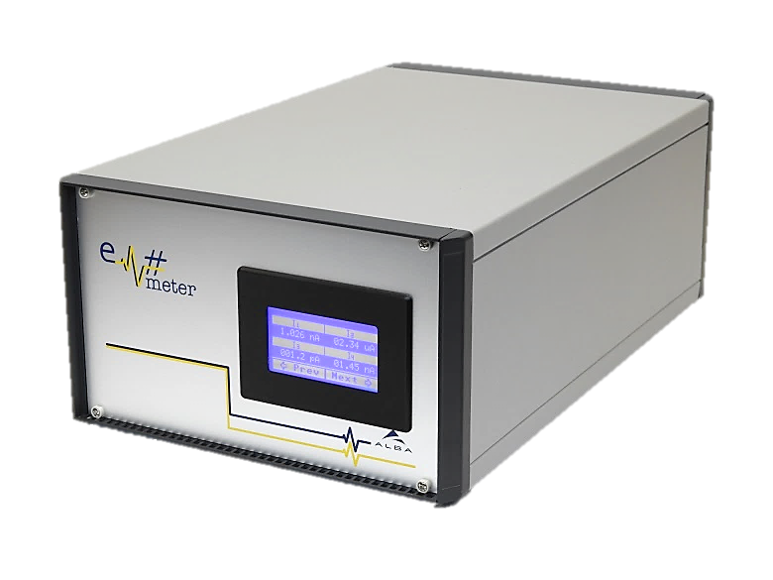
Em# Collaboration Meeting
23rd July, ALBA

Slide 2
Production and installation at MAX IV
Produced to present day
LV 50 31 in use, 19 in stock
HV 25 20 in use, 5 stock
New decision to produce 15 HV during autumn 2019
  Signed by director. OK
  Needs assistance from procurement officer. In proress…
  MAX IV need to submit a formal letter to honor our collaboration and IP fee.

