Slide 1
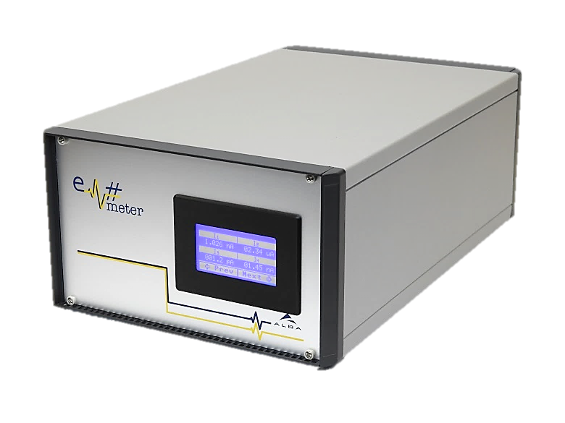
Production and installation at ALBA and feedback from other facilities
24 July, 2019

Slide 2
Production at ALBA
First production batch
  Started in October 2016
  3 Em# LV units
  9 Em# HV units
  Assembly procedure created during the first unit assembly.
  Finished in February 2017
  Tested from February 2017 up to May 2017
    Manual testbench
  No assembly issues found

Slide 3
Production at ALBA
Second production batch
  Started in June 2018
  6 Em# LV units
  6 Em# HV units
  Finished in December 2018
  Assembly issues found
    Supply cables not correctly assembled
    Current Amplifier metallic boxes with incorrect machining
    NUC supports with incorrect machining
    Cold solder joints in some CA (manual process)
    RAM/NUC problem was firstly understood as an assembly problem or a element problem
  Tested from February 2019 up to June 2019 (calibrator testbench)

Slide 4
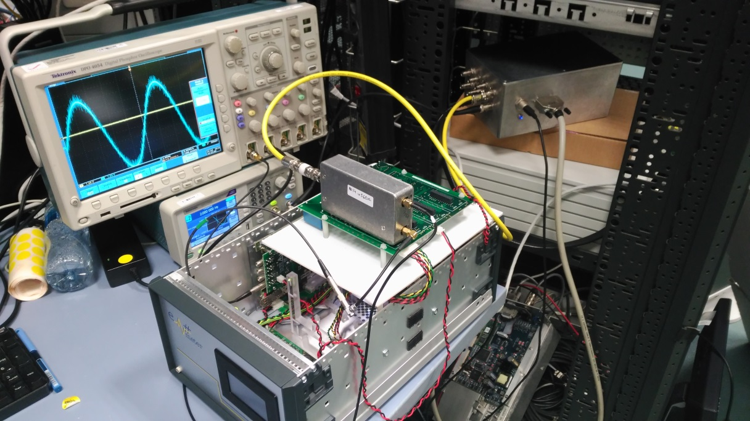
Production at ALBA
Current Amplifier testbench:
  CalibCA.py
  Em# Calibrator
  2-ch Function Generator
  Oscilloscope
  Allows to test CA without without switching ON/OFF the entire Em#

Slide 5
Installation at ALBA
Installed:
  BL13 (Em# HV) in test purpose
  BL22 (Em# LV) in test purpose
  FE20 (Em# HV)
  BL04 (Em# LV)
  BL11 (Em# LV)
  BL24 (Em# HV)
  Two sent to ESRF (Em# LV, Em# HV)
  One sent to SOLARIS (Em# HV)
  Two exchanged with MAXIV
Planned
  FE16 (Em# HV), FE06 (Em# HV)
  BL16 (2 x Em# LV), BL20 LOREA, BL06 XAIRA…

Slide 6
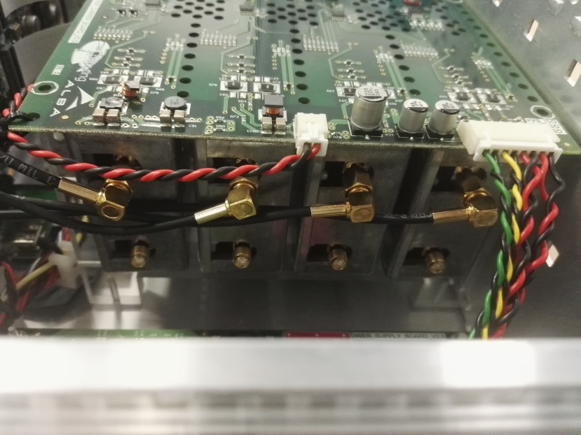
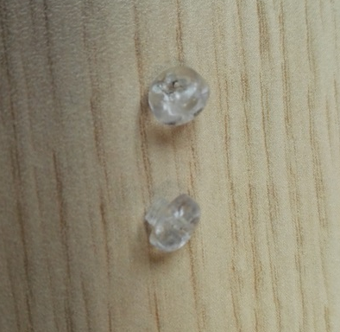
Feedback from other facilities
Solaris:
  CACB fixation screws are broken during transportation
  Positive feedback on Em# performance. They have asked a unit to ALBA!

Slide 7
Feedback from other facilities
ESRF:
  Pending for feedback

