Slide 1
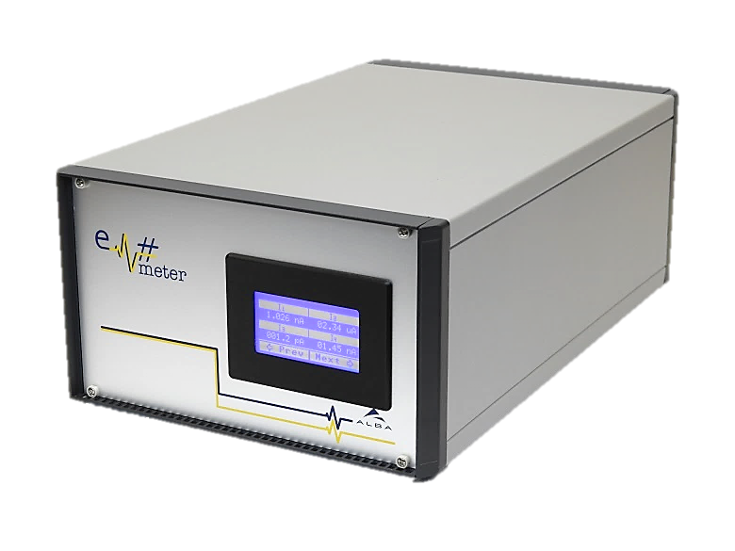
Em#
Collaboration meeting
Wishes and New developments
23 July, 2019

Slide 2
What is writtern in collaboration Agreement
3.6 New Developments
Any Member may consider and propose new developments. All such proposals must be presented in advance to the Steering Committee (cf. § 4.1) and discussed within the frame of the Collaboration in order, notably, to avoid the duplication of efforts and IP conflicts and to ensure the maximum degree of functional compatibility. The modification or development of new Core Components is particularly important and is subjected to additional rules (cf. § 3.6.4 below).
All development costs shall be borne by the Member(s) who develops the new component or functionality.
Any new Em# component or functionality developed in the framework of this Agreement, regardless of whether it is identified as Core or compatible Component, shall be made available to all the members of the Collaboration, included in the list of Em# components if appropriate, and subjected to the rules described in this Agreement.
Modification or development of Core Components
  It is critical to guarantee both the compatibility and stability of Core Components. Therefore, any development concerning the functional enhancement of existing Core Components, shall be discussed and approved by the Steering Committee (cf. §4.1).
  In cases where consensus cannot be obtained, CELLS shall have the final decision.
  New developments which may be classed as new Core Components shall be integrated as such in the revision/extension, if any, of the Agreement upon expiration of the initial Term (cf. Article 2).

Slide 3
Priotity | Issue | Description | Benefit | Version
1 |  | Script to automatically validate the basic SCPI functionality of Em#, to pre-check new versions | Agile developments and test of Em#
2 |  | Increase internal memory to allow longer acquisitions.Two options are available: block memory or internal DDR3 RAM implementation | Allow more samples on fast adquisitions. BL22
none |  | Upgrade HV bias measurements to 3kV. | Chaneltron current reading polarized, in Lorea, Mistral, ....
none |  | Increase the bandwith of current Amplifiers, and allow mesurements at high frequency(300kHz for higher gains 10^8, Some mega-hertzs up to 10^6). | BL22 upgrade plan.(2019-29)

Slide 4
Priotity | Issue | Description | Benefit | Version
none |  | Add timestamp information to triggers | ID Lab.
none |  | Allow to update automatically the operative system by ethernet
none |  | New Calibrator | Fast and easy Calibration
none |  | PID and data processing to generate close-loops(MOCO)

Slide 5
Priotity | Issue | Description | Benefit | Version
none |  | New Current Amplifier design with a range of 10pA | BL29
none |  | Allow to disable channels to increase sampling rate | BL11
none |  | Autotrigger HW. allow to initiate a autotrigguer by a Hardware trigger | BL11. Kind of adquisition needed in a experiment
none |  | Autotrigger with variable integration times. And HW trigger with different integration times | BL22. needed to compensate that some times more resolution zones are needed in some adquisition

Slide 6
Priotity | Issue | Description | Benefit | Version
none |  | Bias Voltage independent for each channel | reduce number of em and issolation between channels
none |  | know by SCPI and web which kind of Em# is (LV or HV)
none |  | Control of FMC EEPROM by I2C | allow calibration of ADC
none |  | Control of SPEC EEPROM by one-wire | Register and control each SPEC board

Slide 7
Priotity | Issue | Description | Benefit | Version
none |  | Increase synchronitzation requeriments

