Slide 1
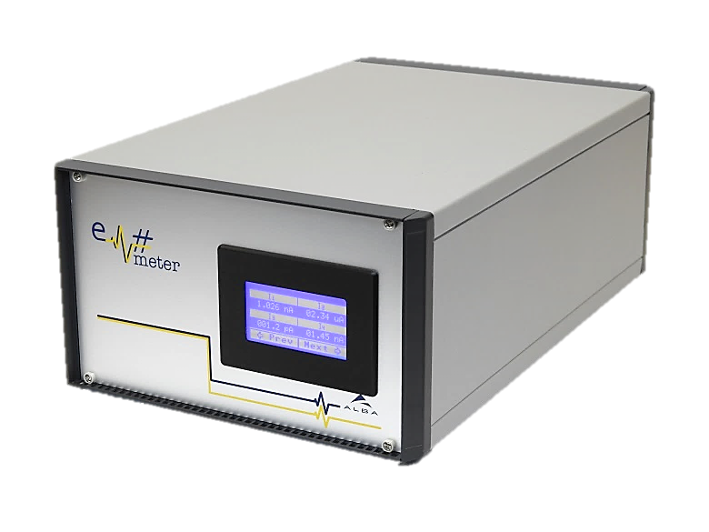
Em# Collaboration Meeting
23rd July, ALBA

Slide 2
Wish list and future needs (MAX IV) Features missing, as requested by users
1 ms as integer for integration time and wait time is not good enough. Need to be able to be shorter than 1 ms but also a fraction, like 1.3 ms. (Should be possible in the future as gated measurement are on the horizon)
Speed… (se separate slide)
Gated measurement, where external hw trigger high level defines the integration time.
PID feedback with a calculated position. Analog output. One channel for x and another channel for y. Most likely it needs to be some filtering on the positioning to prevent jumps in the piezo. Expose variables through tango. Constants in the formulas to make it possible to offset the beam position (calibrate).

Slide 3
Electrometer sampling requirements
The requirements from 2018 09 10 still holds
Nanomax
  Low input impedance (Diamond bpm)
  Ion chambers/Diodes
  Closed loop for beam drift on Diamond BPM readings, 10 Hz controlling a piezo
  Short term goal 2018: 500 Hz continuous (or for 1 hour)
  Long term goal: Fast continuous scans on Diamond/Ion Chamber (Pixel detectors up to 2 kHz) 2 kHz continuously (four million data points as 2000*2000 pixels) 2kHz in 2000 seconds. Trigged externally together with detector.
  If in a measurement sequence (continuous scan), it should be possible to read out from buffer during the measurements. Don’t want to wait more that an hour before results are visible.
Biomax
  Low input impedance (Diamnd bpm)
  Beam drift, 200 Hz 35 seconds is more than enough?
Balder
  1000 points in 1 second, scan mode. There is time to read out the buffer.
Frontend
  Short term (2019): starting at 10 Hz
  Long term: Beam position, 1 kHz-500 Hz continuously, NTP timestamped
  Fast Archive: will be able to receive any data stream. A server needs to be implemented.
  Slow archive: Temperature drift, 1 Hz:

Slide 4
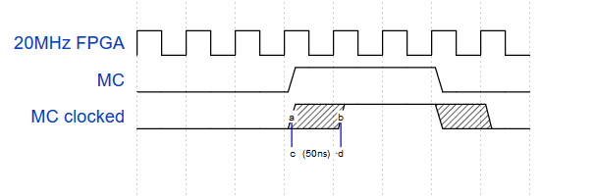
EM# for XBPM acquisition
Aim:
  Use the EM# for XBPM acquisition (diagnostic and probably SOFB)
Requirements:
  At least 10Hz acquisition
  Coherency between XBPM and EBPM (Libera)
  2 weeks data archiving
  Stay as close as possible to ALBA code (as much as possible)
  Coherency between XBPM and EBPM
    Usage of external trigger is not good enough: 1/20MHz = 50ns resolution
    50ns = 1/35 of R3
    50ns = 1/6 of R1

Slide 5
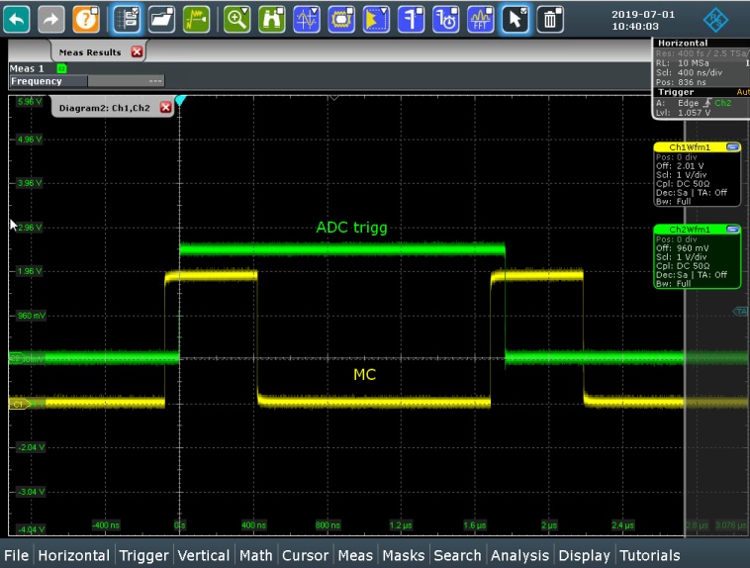
EM# for XBPM acquisition
Requirements:
  Coherency between XBPM and EBPM
    Usage of external trigger is not good enough ➔ direct connexion of the MC to the ADC start conversion pins
What was done
  ALBA code was hacked (mostly AD7608_CRTL.vhd file)
  MC start conversion synchronization verified
  Python code to continuously acquire data written
To do
  A bug in VHDL code to correct (probably RESET asynchronous)
  2 weeks archiving
  Test on Machine (MC cabling required)
  Integration into ALBA code (VHDL, software, web server)

