Slide 1
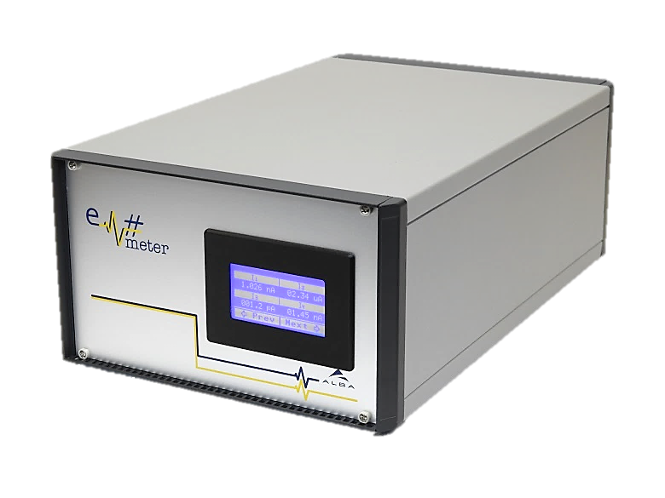
Em# Collaboration Meeting
23rd July, ALBA

Slide 2
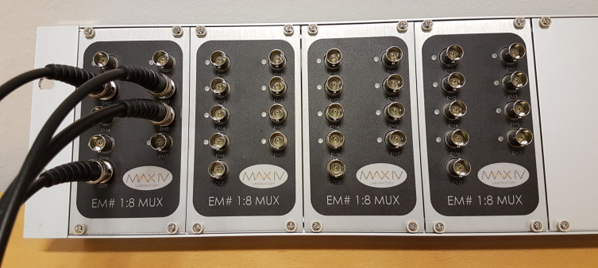
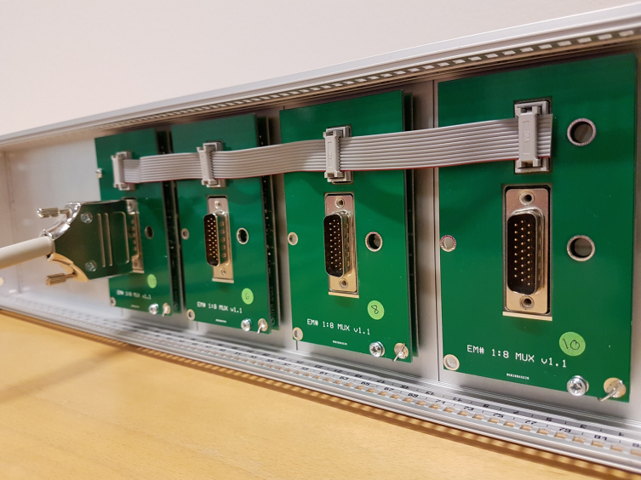
Related projects at MAX IV: Multiplexer
50 units produced
Used by a few beamlines
Controlled by SCPI
To enable Differential IOPorts DIFF_IO_1, DIFF_IO_2, DIFF_IO_3 for output, send SCPI command DIFF:CNFG 504 (504 = 1 1111 1000).
To switch port send send SCPI command DIFF:VALU X (X=0-7)

Slide 3
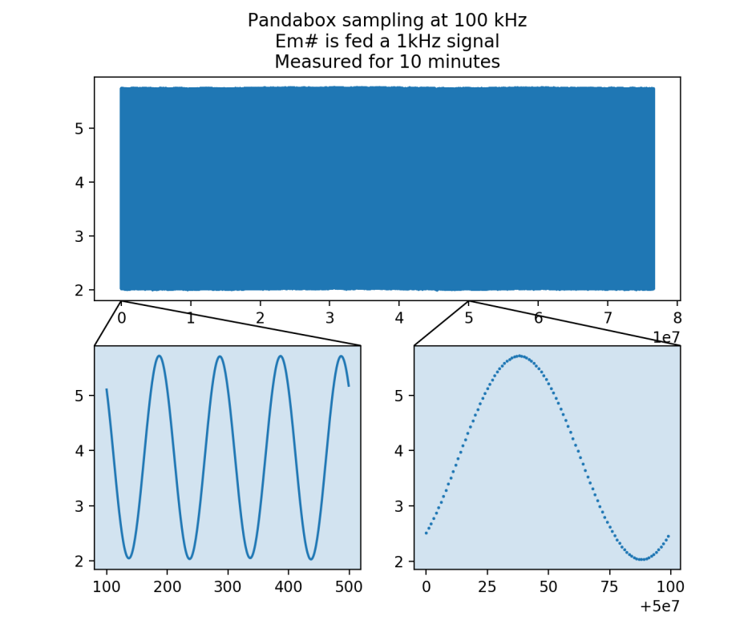
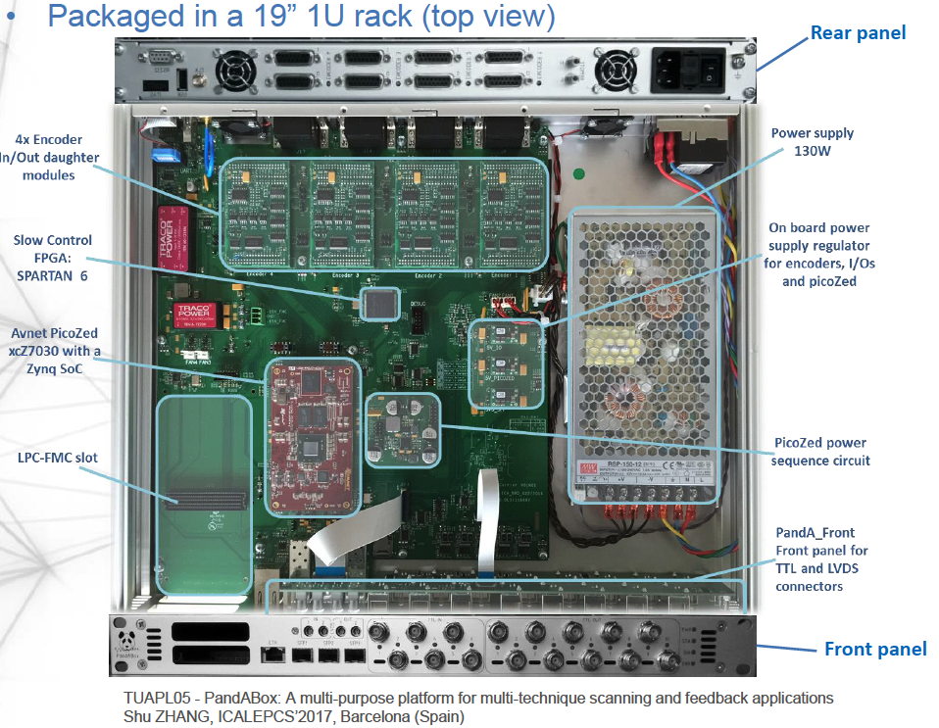
Related projects at MAX IV: Pandabox
Some beamlines need triggering and acusition unit
Pandabox been selected
Tryout integrating Em# positive

