Slide 1
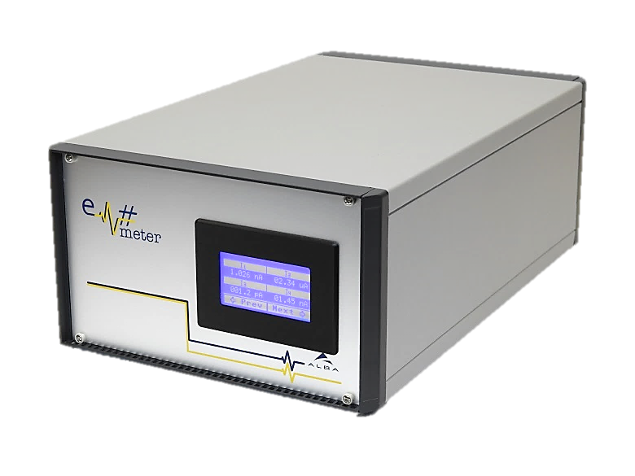
Em# Collaboration Meeting
23rd July, ALBA

Slide 2
FPGA Gateware developments at MAX IV
Orlando’s job on the Electrometer
Aim: 1KHz acquisition
What was done
  1KHz acquisition achieved
  FPGA code has been completely rewrite ; no more compatible with the original ALBA code (Harmony bus removed)
To do
  How to merge Orlando’s code with ALBA’s code ?
  Embedded software to be rewrite ; webserver and application to be rewritten

Slide 3
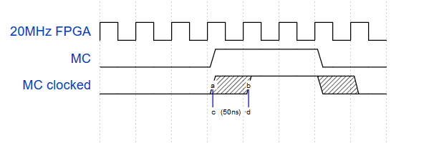
EM# for XBPM acquisition
Aim:
  Use the EM# for XBPM acquisition (diagnostic and probably SOFB)
Requirements:
  At least 10Hz acquisition
  Coherency between XBPM and EBPM (Libera)
  2 weeks data archiving
  Stay as close as possible to ALBA code (as much as possible)
  Coherency between XBPM and EBPM
    Usage of external trigger is not good enough: 1/20MHz = 50ns resolution
    50ns = 1/35 of R3
    50ns = 1/6 of R1

Slide 4
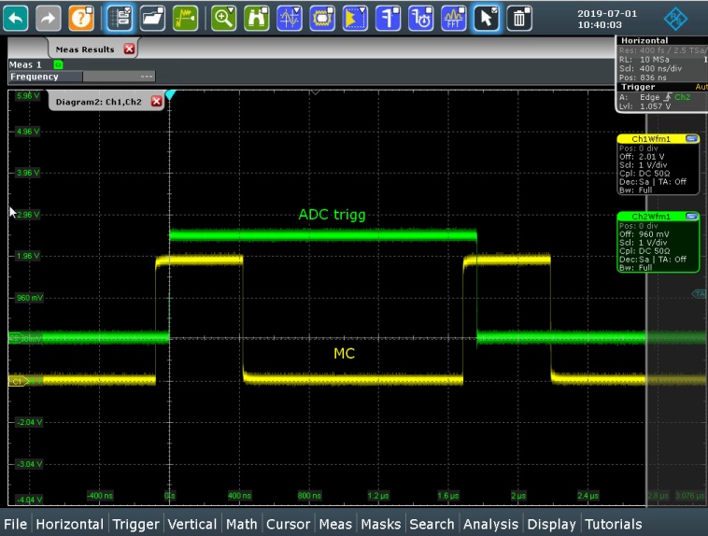
EM# for XBPM acquisition
Requirements:
  Coherency between XBPM and EBPM
    Usage of external trigger is not good enough ➔ direct connexion of the MC to the ADC start conversion pins
What was done
  ALBA code was hacked (mostly AD7608_CRTL.vhd file)
  MC start conversion synchronization verified
  Python code to continuously acquire data written
To do
  A bug in VHDL code to correct (probably RESET asynchronous)
  2 weeks archiving
  Test on Machine (MC cabling required)
  Integration into ALBA code (VHDL, software, web server)

