Slide 1
11. Em# problems & incidents at ALBA
23/7/2019
1

Slide 2
Em# problems & incidents at ALBA
List of problems found at ALBA:
Problem | Description | Found by | Severity | Solved In
Memory Leak using Sardana controller | After several days without using the equipment, it doesn’t responds to controller communications. Power off/on to recover | ALBA MSPD | High | 1.1.06
DDR3 RAM Dead | After update BCN 2nd production units to version 1.2.00, the equipment doesn’t power up. | Computing | High | 1.3.00
Default should be Amps | Electrometer returns current values in mA when scientist was expecting to get the default unit (Amps) | ALBA MSPD | Low | 1.1.03
Broken screws | The polycarbonate screws that tie the CACB get broken during transport to SOLARIS. They are too fragile. | SOLARIS | Medium | 2nd Product.
Bandwidth reduction | It was discovered that wrong selection of Rs and C of CA filter limits the BW | Computing | High | 1st Product.
23/7/2019
2

Slide 3
Em# problems & incidents at ALBA
Memory leak problem
Reported by
First problem reported on 11th Feb in BL04 (François Fauth):
    CS-16813: Investigate BL04 AlbaEm2 unresponsive issues (Em# v1.0.4).
Second problem reported on 22nd March also in BL04:
    CS-17032Data aquisition (ct, ascn) very slow (Em# v1.0.43)
Symptom
The Em# response slows down being very difficult to control or monitor the status of the equipment via sardana, skippy DS or web. It also slows down the rest of the systems, like sardana or the machine where the taurus application runs.
Equipment reboot (and Pool and DS) is needed to recover form these situations.
First hot analysis
  Using the TOP command in the Em#, it is observed a load average too high (above 5) and the AlIn process (main.py) consuming almost all the CPU (above 98% CPU ) and RAM memory (VIRT memory and RES memory)
  The number of communications port 5025 opened is too high. In normal conditions, only 2 communications port should be opened (Sardana controller and DS).
But It was found that when the problem happened there were up to 17 communications port opened:
  13 in CLOSE_WAIT state: client has already closed the port but server is waiting for the application to close the port
  4 in SYN_RECV: A connection request has been received from the network, but waiting for the application to establish.
In error status
~ # netstat -a | grep 5025
Active Internet connections (servers and established)
Proto Recv-Q Send-Q Local Address Foreign Address State
tcp 28 0 dctbl04albaem202.cells.es:5025 ibl0402.cells.es:51240 CLOSE_WAIT
tcp 17 0 dctbl04albaem202.cells.es:5025 ibl0402.cells.es:51235 CLOSE_WAIT
tcp 23 0 dctbl04albaem202.cells.es:5025 ibl0402.cells.es:51249 CLOSE_WAIT
tcp 12 0 dctbl04albaem202.cells.es:5025 ibl0402.cells.es:51242 CLOSE_WAIT
tcp 12 0 dctbl04albaem202.cells.es:5025 ibl0402.cells.es:51244 CLOSE_WAIT
tcp 17 0 dctbl04albaem202.cells.es:5025 ibl0402.cells.es:51234 CLOSE_WAIT
tcp 8 0 dctbl04albaem202.cells.es:5025 ibl0401.cells.es:52749 CLOSE_WAIT
tcp 0 0 dctbl04albaem202.cells.es:5025 ibl0402.cells.es:53263 SYN_RECV
tcp 17 0 dctbl04albaem202.cells.es:5025 ibl0402.cells.es:49567 CLOSE_WAIT
tcp 0 0 dctbl04albaem202.cells.es:5025 ibl0402.cells.es:53265 SYN_RECV
tcp 17 0 dctbl04albaem202.cells.es:5025 ibl0402.cells.es:51238 CLOSE_WAIT
tcp 0 0 dctbl04albaem202.cells.es:5025 ibl0402.cells.es:53261 SYN_RECV
tcp 0 0 dctbl04albaem202.cells.es:5025 ibl0402.cells.es:53260 SYN_RECV
tcp 12 0 dctbl04albaem202.cells.es:5025 ibl0402.cells.es:51251 CLOSE_WAIT
tcp 12 0 dctbl04albaem202.cells.es:5025 ibl0402.cells.es:51248 CLOSE_WAIT
tcp 17 0 dctbl04albaem202.cells.es:5025 ibl0402.cells.es:51237 CLOSE_WAIT
tcp 12 0 dctbl04albaem202.cells.es:5025 ibl0402.cells.es:51246 CLOSE_WAIT
Expected status
~ # netstat -a | grep 5025
tcp 0 0 invalid.cells.es:5025 invalid.cells.es:* LISTEN
tcp 0 0 dctbl04albaem202.cells.es:5025 ibl0401.cells.es:51703 ESTABLISHED
tcp 0 0 dctbl04albaem202.cells.es:5025 ibl0402.cells.es:47186 ESTABLISHED
tcp 0 0 :::5025 :::* LISTEN
23/7/2019
3

Slide 4
Em# problems & incidents at ALBA
Memory Leak: Excessive memory and CPU consumption (Codnition 1)
Every time a new acquisition starts, a new thread is created in the main software that it is read the FPGA memory, empty the harmony messages stored, process them and check for any kind of error in the FPGA blocks.
This process is called the AcquisitionThread and it is executed every 10ms if there are no messages in the FPGA memory.
When there are messages in the FPGA memory, they have to be read as quick as possible to avoid and overflow in the FPGA Memory. The FPGA Memory is read message to message. Cannot be emptied completely with a single read.
To accomplish this requirement, the AcquisitionThread.run process contains a while loop that reads message to message from the FPGA memory until it is empty. Once the memory is emptied, then checks for possible harmony errors.
  For “unknown reasons”, a ROF (Read Overflow) error is reported by the FPGA memory while the buffer is emptying. When a ROF error has occurred, the FPGA memory always returns the maximum size for the LEN_NDATA. So the application stays in this while loop forever empting the FPGA memory buffer with useless data.
  The main application is blocked at this point increasing the read buffer with useless data, that means an increase of the RAM buffer. But also blocking the communication with its tcp clients: SCPI commands are received but cannot be processed.
23/7/2019
4

Slide 5
Em# problems & incidents at ALBA
Memory Leak: Excessive memory and CPU consumption (Codnition 2)
During testing it was found in a very rare condition, several (at least two) AcquisitionThread’s were running at the same time, reading the FPGA Memory buffer, while only 1 AcquisitionThread should exist per acquisition started.
Acquisition start command takes almost 300ms to configure the FPGA and start the AcquisitionThread, responsible to empty the FPGA memory buffer and process the data until the acquisition is completed. Then the AcquisitonThread is deleted.
Expected behavior
0ms ~300ms integration_time
SCPI ➔ ACQU:START
STATE_ON
STATE_RUNNING/STATE_ACQUIRING
STATE_ON
FPGA Blocks configuration
AcquisitionThread.run
(empty FPGA Memory and process data)
FPGA reset
During the configuration of the FPGA after having received an acquisition start command, the CPU can be interrupted by another process. In this case a second CPI command to start a new acquisition is received. This results in two AcquisitionThread’s running and reading at the same FPGA memory buffer. This new acquisition start command triggers another AcquisitionThread that empties the FPGA memory and when the first AcquisitionThread continues, it tries to read data from the FPGA memory which has been already read, causing the ROF error.
Faulty behavior
ROF
0ms ~300ms
SCPI ➔ ACQU:START
STATE_ON
ST_ON
ST_RUNNING/
ST_ACQUIRING
ST_ACQ
STATE_FAULT
SCPI ➔ ACQU:START
STATE_ON
ST_ON
ST_RUNNING/
ST_ACQUIRING
STATE_FAULT
23/7/2019
5

Slide 6
Em# problems & incidents at ALBA
Memory Leak: Too many open communications port…….and for the “unknown reason” problem
The sardana controller uses a socket connection to the Em# with a timeout set to 2 seconds. If within 2 seconds the controller doesn't’ receives any answer, it closes the socket and sends again the command.
Since version 1.0.4, all SCPI commands (READ or WRITE commands) return a value. For the READ commands, it returns the corresponding attribute value and for the WRITE commands it returns ‘ACK’. So the controller always waits for a reply.
Most of the times, this is working well and SCPI commands are processed in less than 2 seconds.
But in very strange conditions and depending on the load of the Em#, the controller can receive a timeout while waiting for the answer of the start command.
  If logs are enabled (worst case delay)
  If channels are in auto range (few delay )
  If correction is enabled (few delay)
  If DS is enabled (significant delay)
  If TaurusGUI is ON (significant delay)
  If WebServer is display (few delay)
  If touchscreen display is showing any channel info (few delay)
…and also depending on the network status, the replay can take longer than those 2 seconds.
In that strange case, the controller receives a timeout, closes the socket and sends again the START command. But….it doesn’t cancel the previous START commands that was received properly and started to be processed. This results in a new START command overlapping the previous START command.
23/7/2019
6

Slide 7
Em# problems & incidents at ALBA
Solution/Actions
  Error check has been added to the AcquisitionThread responsible to empty the buffer. In case of error, it exits the loop and the acquisition is stopped.
Em# software has been modified adding a flag during the FPGA configuration that discards a new START command while a previous START command is being processed. The second START command is rejected.
Workaround was installed in BL04 for testing. So far, no more reports about this problem.
Em# software has been patched to avoid the same problems occurs again but sardana controller needs to be also improved to avoid multiple connections.
23/7/2019
7

Slide 8
Em# problems & incidents at ALBA
DDR3 RAM EEPROM problem
Found when updating new production to v1.2.00
Originally it was considered as a HW problem or defective units
After investigation, it was found the problem occurs with versions higher than 1.1.09
Root cause:
  Alin software is writing by mistake Em# configuration data in the DDR2 EEPROM instead of the PSB board EEPROM.
  Both EEPROM's are configured by hardware with the same I2C address (0x50).
  In normal conditions, this is not a problem due to they are in different I2C buses.
  The number of I2C buses available in the NUC depends on the BIOS version installed and the BIOS configuration.
  ALIN has a config file were the i2c bus number for each module is defined. But if the module is not found in the predefined bus, it has an autoscan routine scans for a device in all available i2c busses.
  The PSB EEPROM i2cbus was incorrectly configured in the ALIN config file.
  The autoscan was detecting the DDR3 EEPROM as if it was the PSB EEPROM
23/7/2019
8

Slide 9
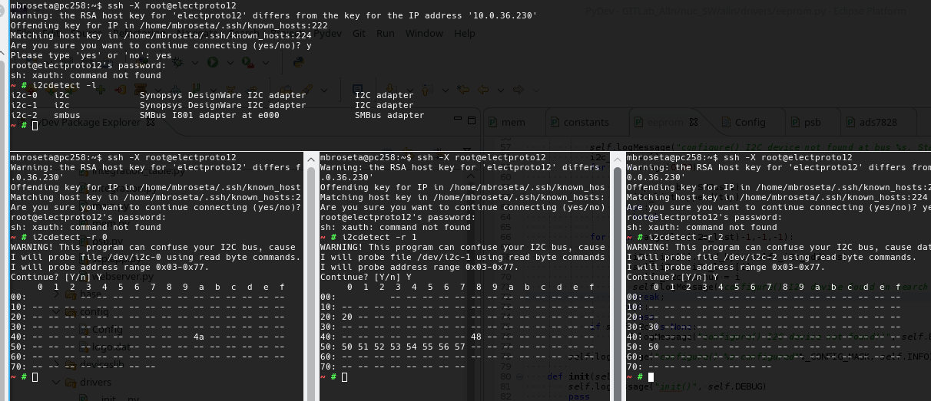
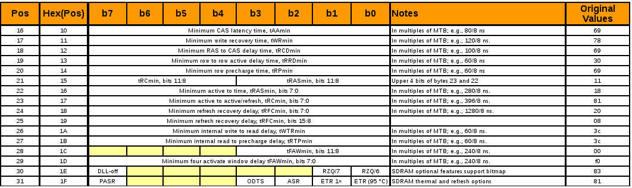
Em# problems & incidents at ALBA
  The overwritten area in DDR3 EEPROM contains the configuration parameters of the DDR3.
23/7/2019
9

Slide 10
Em# problems & incidents at ALBA
Solution/Actions:
  Version from 1.1.09 to 1.2.03 were automatically cancelled
  New release 1.3.00 was released on 1st July with:
    Change in the I2C address of PSB EEPROM (0x53)
    Added Manufacturer check, when searching for PSB EEPROM
    Select proper I2C bus in ALIN configuration file for the PSB EEPROM
  Additional actions were taken to recover 14 damaged DDR3 RAM
    Use of special PC with 2 DDR3 RAM slots
    Special software using i2ctools driver to rewrite the default memory map
23/7/2019
10

Slide 11
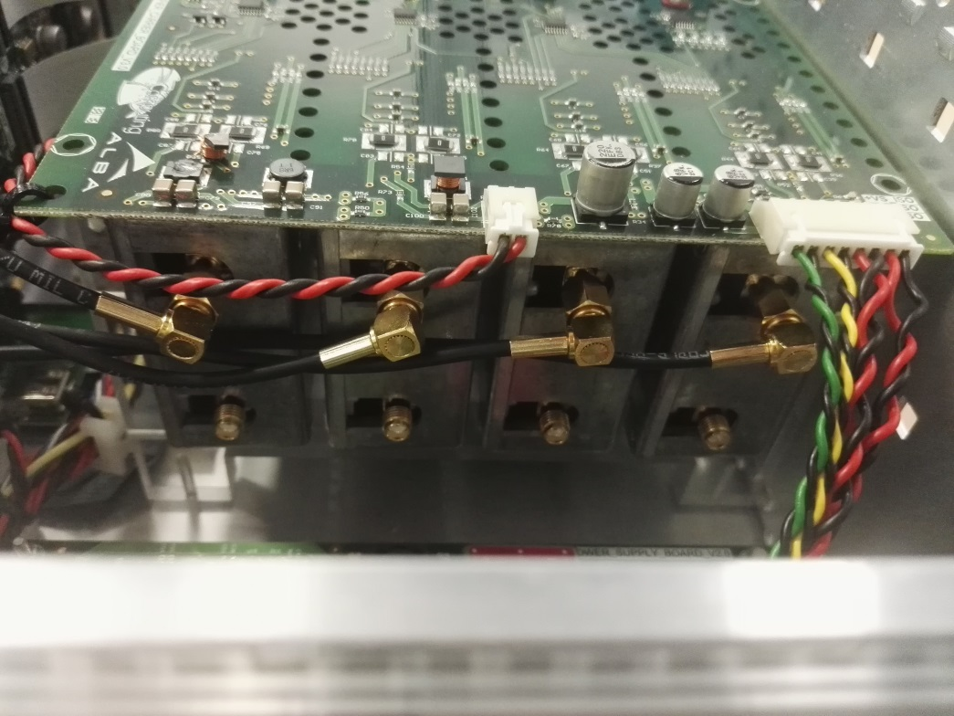
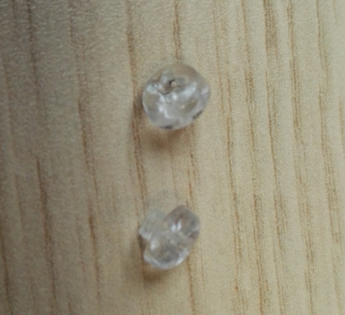
Em# problems & incidents at ALBA
Broken Screws on CACB
Found in Em# send to SOLARIS
Resolved changing them by inox screws. But has needed to check isolation distances of the mechanics
23/7/2019
11

Slide 12
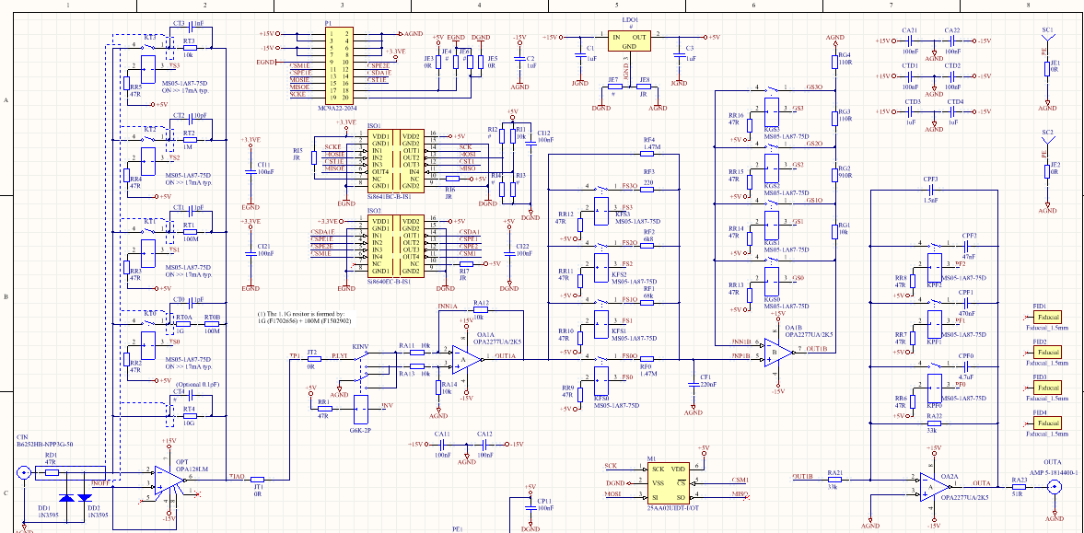
Bandwidth reduction

