Slide 1
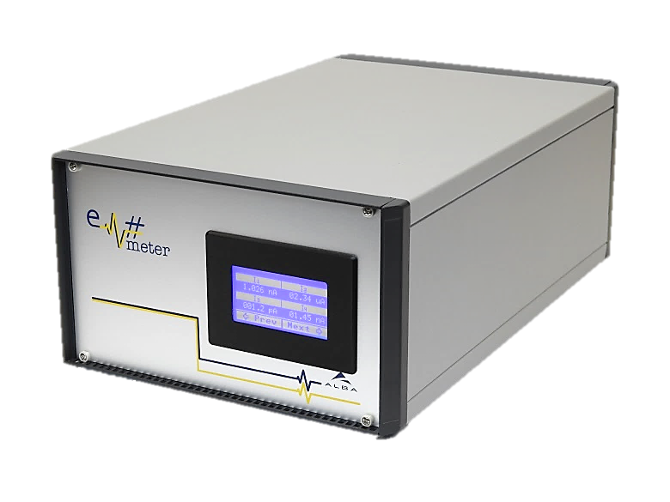
Em# Collaboration Meeting
23rd July, ALBA

Slide 2
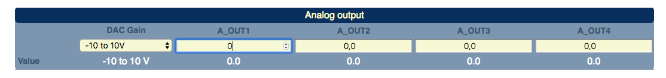
Em# problems & incidents at MAX IV
Bug report 2019 03 19
(PS) With a HW reset, it happens that the amplifiers are saturated when the Em# is started.
(FrontEnd) Analog output after firmware update (and maybe after following power cycle) goes high. Problematic as it is steering a HV supply. Could happen also when resetting to factory settings. It is the voltages settings that gets to the value of 10.
(FrontEnd) When output voltage range is changed, the voltage is also changed, to mimic the same place in the range as previously. The power supply that is steered gets wrong value.

Slide 3
Cont. 1
(Finest and Nanomax) In autorange, the first datapoint (only) is incorrect. The datapoint is falling down if the range is going up and vice versa. Could it be that either sardana or em is not waiting for the transition or calculate with wrong values. In fixed range the spikes are not visible.

Slide 4
Cont. 2
Issues using two electrometers in the same measurement group. The measurement group was not applied, impossible to close the window. Tango/sardana layer issue. FW from 2019.
In scan mode and autotrigger mode the wait time becomes equal even though something else is set, like 0.
The state in webserver is changing between Accuiring and Running during a measurement. Is there a reason for it and what is the implication as this is a status flag in sardana?

