Slide 1
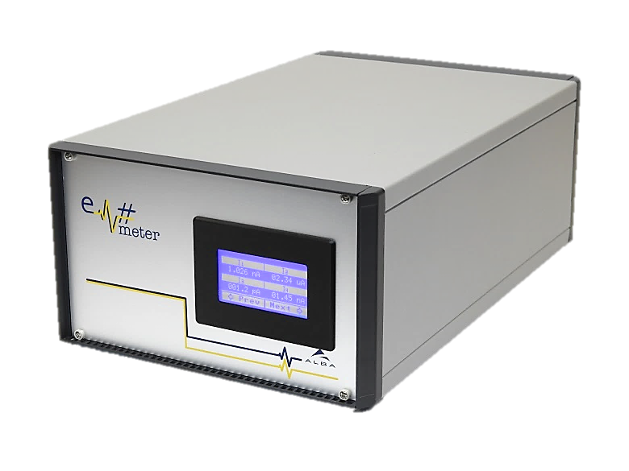
Em#
Collaboration meeting
Calibration
23 July, 2019

Slide 2
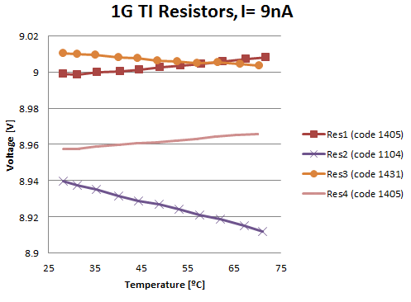
Objectives of the calibration
With calibration we want to compensate the tolerances and temperature dependencies to increase the accuracy
Main Error sources are resistor’s tolerances
The calibration should be done in-situ
The calibration should be easy/automatic
Calibrator should also allow to check whole Em#
Calibration must be saved on CA

Slide 3

Em# firmware
On FW version 1.0.04 (described in Doc “Em# Calibration Procedure”)
  It corrects offset current applying a offset voltage with DAC
  It corrects Gain offset

Slide 4
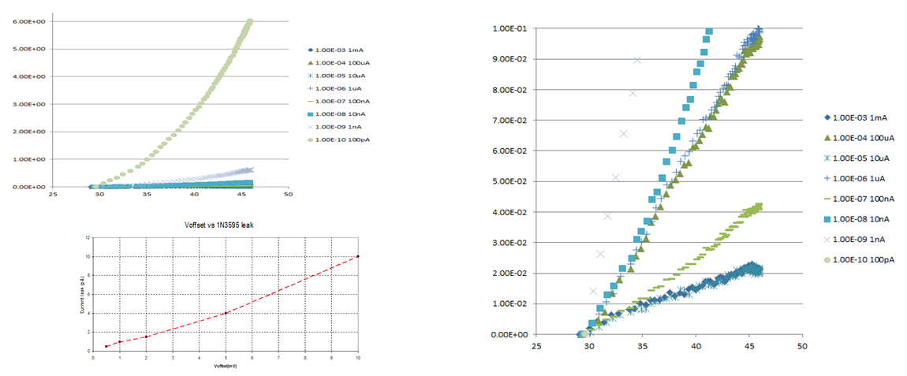
Em# firmware
We discovered that offset Voltage depends on temperature, so correction is needed. This is included in version 1.3.03
Also in Version 1.3.03 are included SCPI commands to save user calibration

Slide 5
Calibration routine
To calculate the parameters of the formula it is needed the calibrator. Calibration is described in “Em# Calibration Procedure” document uploaded in Alfresco
The calibration starts when Em# is cold
Compensate the offset with no input current and save the DAC voltage applied and temperature
Calibrator generates a known current at 70% of range and the current read is saved to calculate the parameters with the temperature
This is repeated for all channels( from 4 to 1) and for all Ti gains(from 10GΩ to 10kΩ) and voltage gains(10 and 100)
It is wait 4h till Em# temperature is stabilized
Points 2 to 4 are repeated
A calibration file is saved and a parameters are calculated and saved in the CA EEPROMs

Slide 6
Calibration
Calibration can be done by command line with command calib
User calibration using SCPI (users can calculate its own parameters and save in CA)

Slide 7
Calibrator Targets
It must be a high accuracy current reference
It must cover all the ranges from 100pA to 1mA
It must be portable and stand-alone
It should check the filters
It should check as much Hardware as possible

Slide 8
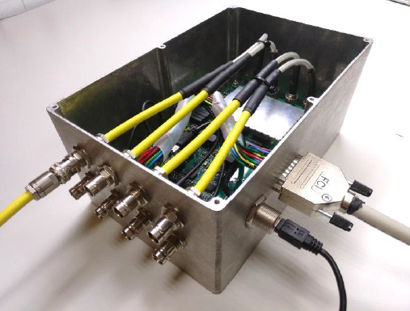
Calibrator

Slide 9
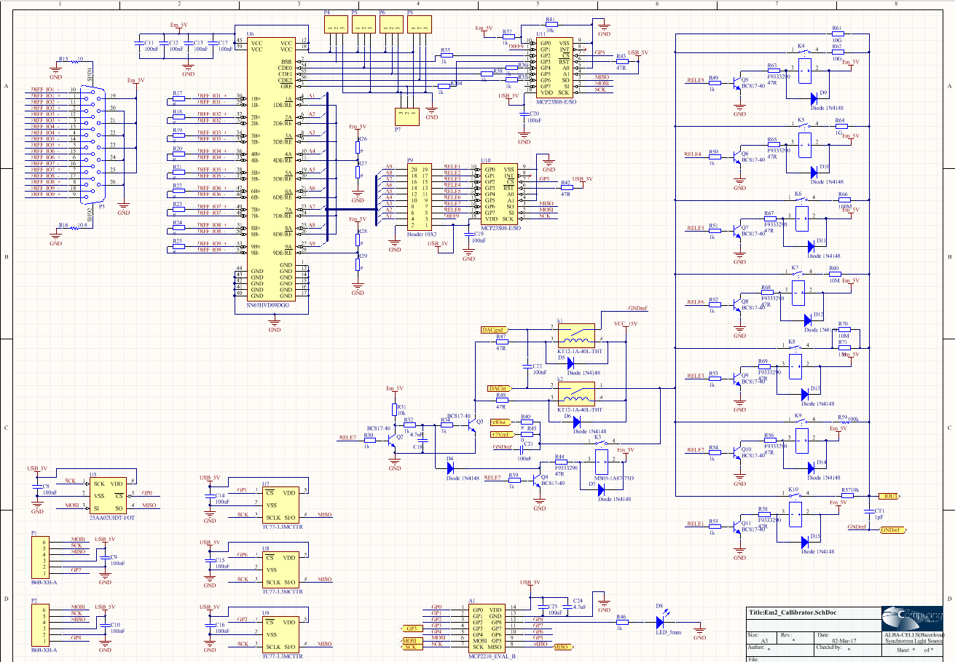
Calibrator
DB26
USB

Slide 10
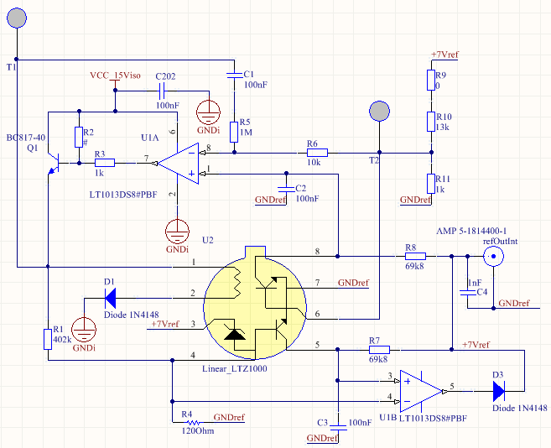
Calibrator
For calibration it is needed a reference
LTZ1000: 0.05ppm/ºC, 1.2μVp-p of noise, but output voltage tolerance from 7.0V to 7.5V

Slide 11
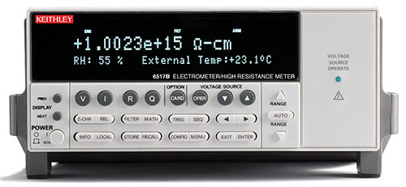
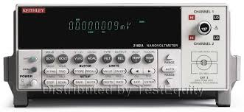
Calibrator needs to be calibrated
Reference devices to calibrate Calibrator
Electrometer and Resistance meter Keithley 6517B
NanoVoltmeter Keithley 2182A
Able to measure 1TΩ resistors
6 ½ digit resolution
Resolution of 1μV in 10V range

Slide 12
Memory Maps Header

Slide 13
Memory map Of Calibrator

Slide 14
Memory map of CA

Slide 15
Problems
Ground loop: Despite a relay disconnect the channels. Ground of the channels is not disconnected and generates noise for low ranges
Previous error, makes calibration semi-manual
Calibration is long. And Calibrator can not be disconected

