Slide 1
7. Integration in the CS at Alba
23/7/2019
1

Slide 2
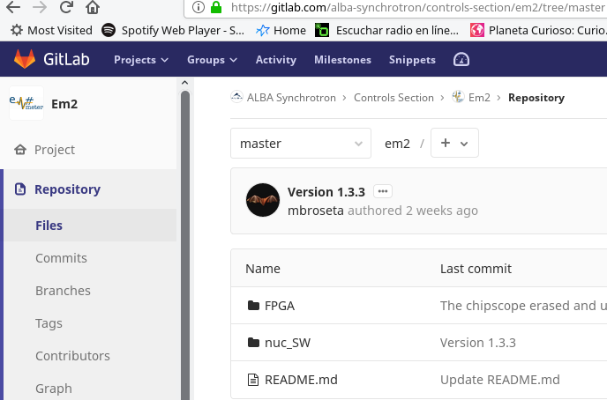
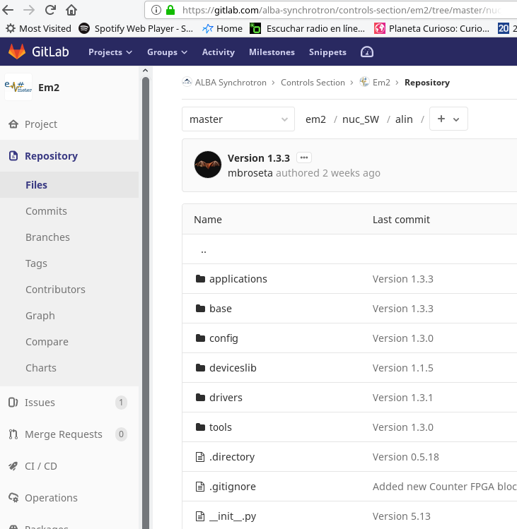
Main SW & GateWare
git@gitlab.com:alba-synchrotron/controls-section/em2.git
FPGA: VHDL project
alin ➔ main software project files
doc ➔ source files to autogenerate web help
resources ➔ FPGA bin file & Web files
scripts ➔ scripts to launch alin & tools
nuc_SW: Main SW project
Alin folder:
Em# Main App
ALIN tools
Harmony Ctrl
(R/W fns(Fast/Slow Bus))
Web
SCPI
Diags
Display
Applications
ADC
CORE
FIFO
ID Gen
AVG
MEM
SPI
Tornado
lib
SCPI
Ads
7828
Mcp
23008
Edip128
Drivers
Linux (Yocto)
Alindev
wb files
Alin
Spec.ko
tcp/ip
i2c_dev.ko
Linux
Drivers
Fmc.ko
PCIe
I2C
I2C
SPEC (FPGA)
Network
PSB
Display
23/7/2019
2

Slide 3
Em# Main App
ALIN tools
Harmony Ctrl
(R/W fns(Fast/Slow Bus))
Web
SCPI
Diags
Display
Applications
ADC
CORE
FIFO
ID Gen
AVG
MEM
SPI
Tornado
lib
SCPI
Ads
7828
Mcp
23008
Edip128
Drivers
Linux (Yocto)
Alindev
wb files
Alin
SPEC linux drivers (original repo):
git://ohwr.org/fmc-projects/spec/spec-getting-started/meta-spec.git
Local repo (clone):
https://git.cells.es/controls/meta-spec-controls.git
Spec.ko
tcp/ip
i2c_dev.ko
Linux
Drivers
Fmc.ko
PCIe
I2C
I2C
SPEC (FPGA)
Network
PSB
Display
Other python drivers required:
SCPI protocol ➔ git://github.com/srgblnch/python-scpilib.git
Tornado webserver ➔ https://files.pythonhosted.org/packages/source/t/tornado/tornado-4.0.2.tar.gz
I2C/SMBus ➔ http://dl.lm-sensors.org/i2c-tools/releases/i2c-tools-3.1.1.tar.bz2
Hidapi ➔ https://pypi.python.org/packages/source/h/hidapi/hidapi-0.7.99.post20.tar.gz
MCP2210 ➔ https://pypi.python.org/packages/source/m/mcp2210/mcp2210-0.1.4.tar.gz
23/7/2019
3

Slide 4
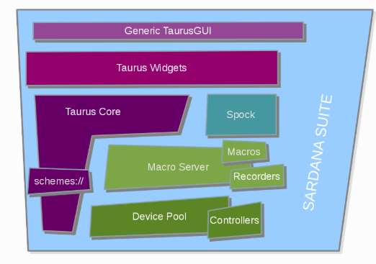
Python code outside the Insturment
Pool Controller: https://sourceforge.net/p/sardana/controllers.git/ci/master/tree/python/countertimer/Albaem2CoTiCtrl.py
To be moved to a new repo at GitHub: sardana-albaem2
Macroserver Macros: https://sourceforge.net/p/sardana/macros.git/ci/master/tree/ALBA_GENERAL/albaEmUtils.py
To be moved in GitHub sardana-albaem2 repo
Taurus GUI: https://git.cells.es/controls/AlbaEmGui
Web GUI
TANGO DS Skippy: https://git.cells.es/controls/SkippyDS.git
23/7/2019
4

Slide 5
Installed at:
BL04-MSPD
  Used routinely with the Sardana Controller reading 4 channels + timer
  All measurement groups (23) include Em# channels
  Step and continuous scans with software and hardware triggers
  Both GUIs (Web and Qt) are used
BL11-NCD
  Used in a specific experiment to read some diodes, they are planning to use it routinely
  External trigger from NI, configured with specific macros and the Sardana Controller
  No GUIs used, while testing several access via Web, Qt, Jive used
BL24-CIRCE
  Not used routinely, it is in the process of commissioning
  In the near future to be used with step and continuous scans with external hardware triggers
  Both GUIs (Web and Qt) are used
There are some plans to evaluated the Em# at:
BL22-CLAESS
23/7/2019
5

Slide 6
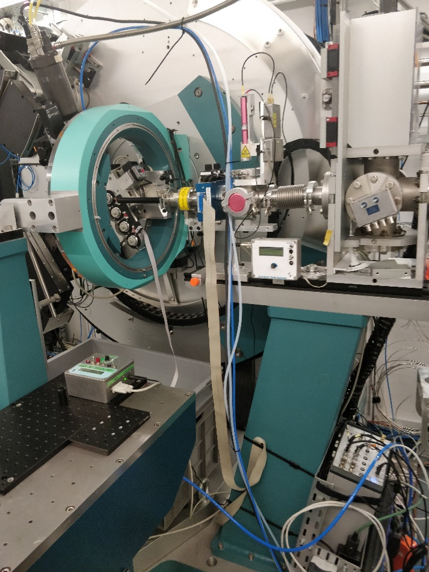
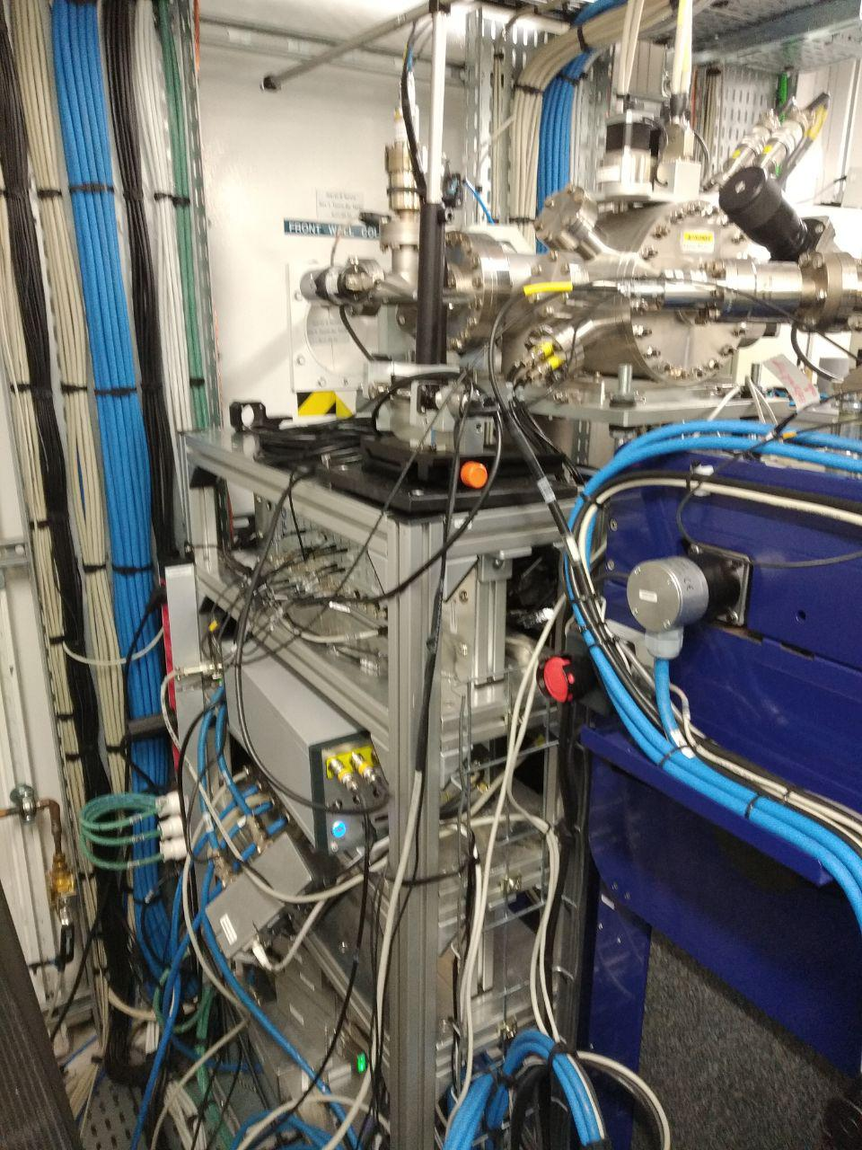
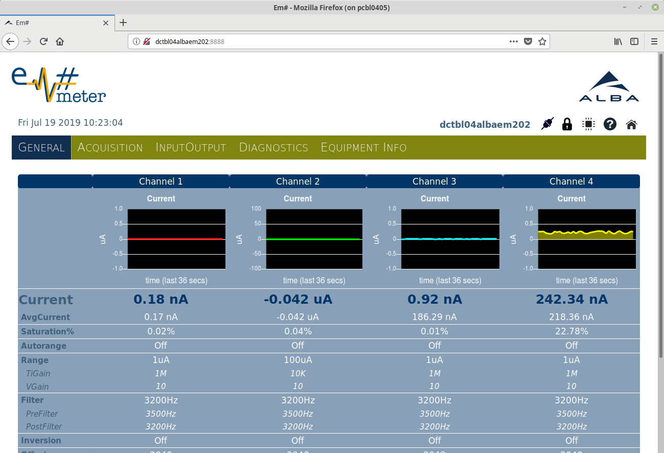
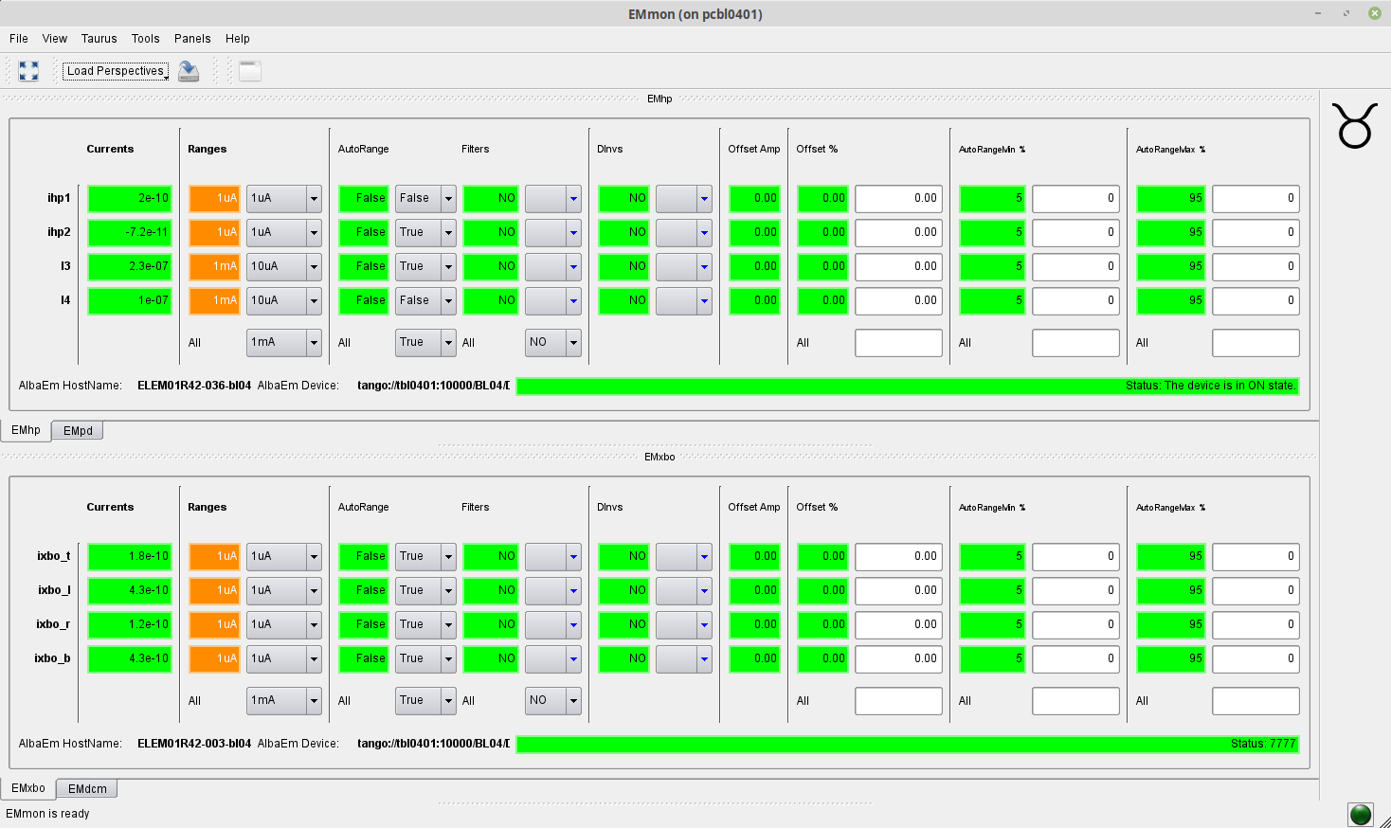
Installations at:
BL04-MSPD
BL11-NCD
23/7/2019
6

