Slide 1
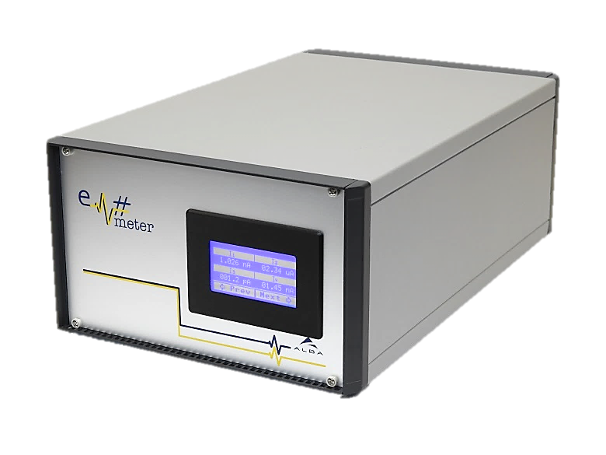
Em# Collaboration Meeting
23rd July, ALBA

Slide 2
Integration in Control System Status
Use cases
  Isolated environment:
    Configuration, acquisition and monitoring through web interface
    E.g. XBPM
  Monitoring only:
    Skippy DS used only to monitor.
    Sardana ctrl extended to monitor instant current.
  Data acquisition using Sardana:
    Step scans
    Continuous scans

Slide 3
Integration in Control System Status
New attributes in the Sardana Ctrl
  Ctrl attributes needed for Continuous Scans:
    Delay: in ms
    Mode: HW, SW
    Polarity: rising, falling
    Triggers: number of triggers
    IntegrationTime
    TriggerDetected: number of triggers detected
    Filter
    Range
  Axis attributes required by users:
    InstantCurrent
    Filter
  Code not pushed yet to the Sardana 3rd party repository.

Slide 4
Integration in Control System Status
EM# firmware installation and update done with Ansible:
  Possibility to update all the EM# with one command …
  Or update them filtering by subsystem

Slide 5
Integration in Control System Status
FPGA development done at MAXIV:
  Not integrated in the control system.
  Extension of SW is required:
    Alin, Web, Skippy, Sardana Ctrl.

Slide 6
Integration in Control System Status
Extra – ideas for future development/improvements.
  Ntp (chrony) service included in the NUC distribution.
  Move to Python 3
  Zeromq and gRPC as alternative to SCPI
    Pros: (among others) event subscription, stream of data.
    Cons: extra dev
  Adopt upcoming SEP16 for the Sardana Ctrl

