Slide 1
5. Documentation
23/7/2019
1

Slide 2
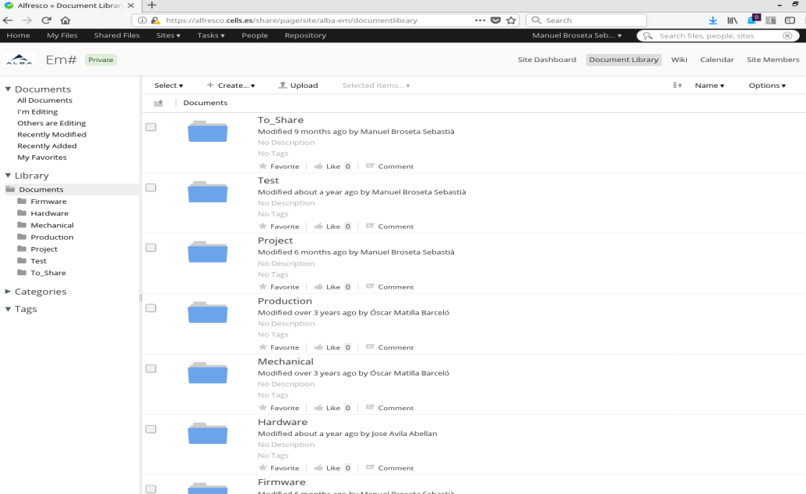
Documentation
Technical documentation:
  All technical documentation available at alfresco site:
  https://alfresco.cells.es/share/page/site/alba-em/dashboard
  Software projects and new issues/problem tracking list at:
    https://gitlab.com/alba-synchrotron/controls-section/em2.git
23/7/2019
2

Slide 3
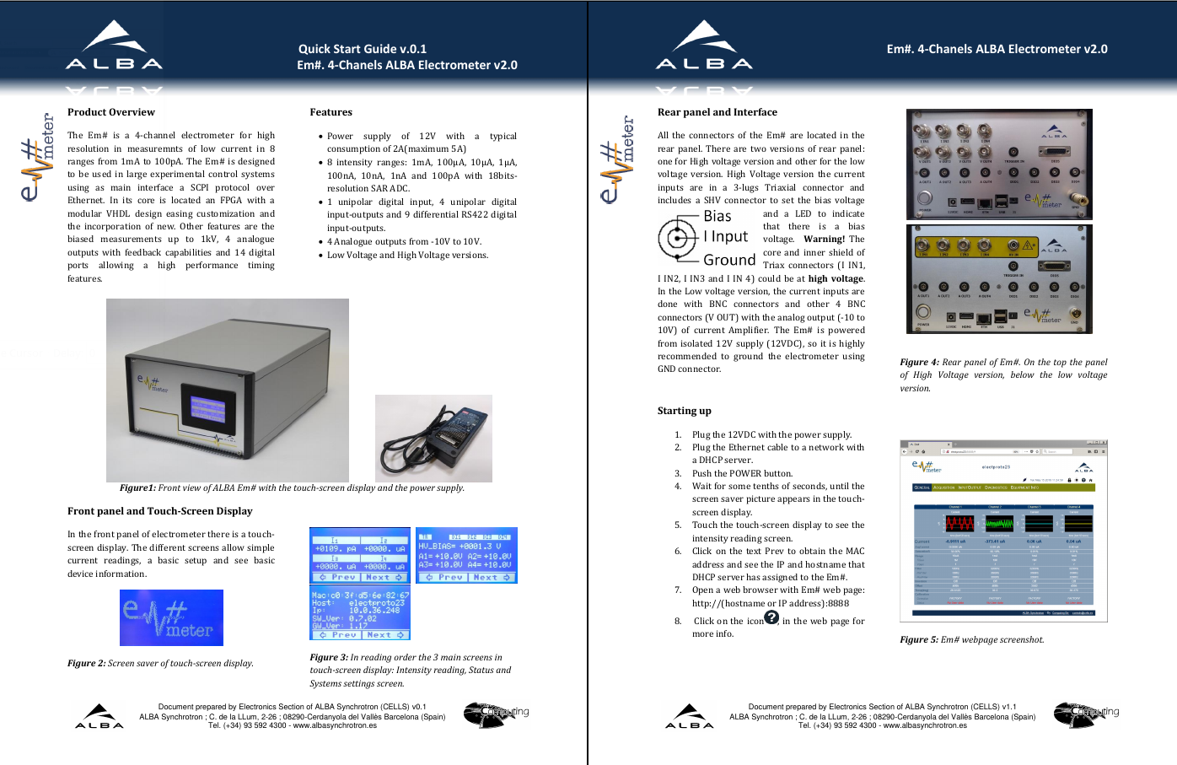
Documentation
User documentation: Quick Start Guide.pdf
  Brochure provided with every new electrometer.
    Description of equipment and how to connect it for the first time to get hostname
23/7/2019
3

Slide 4
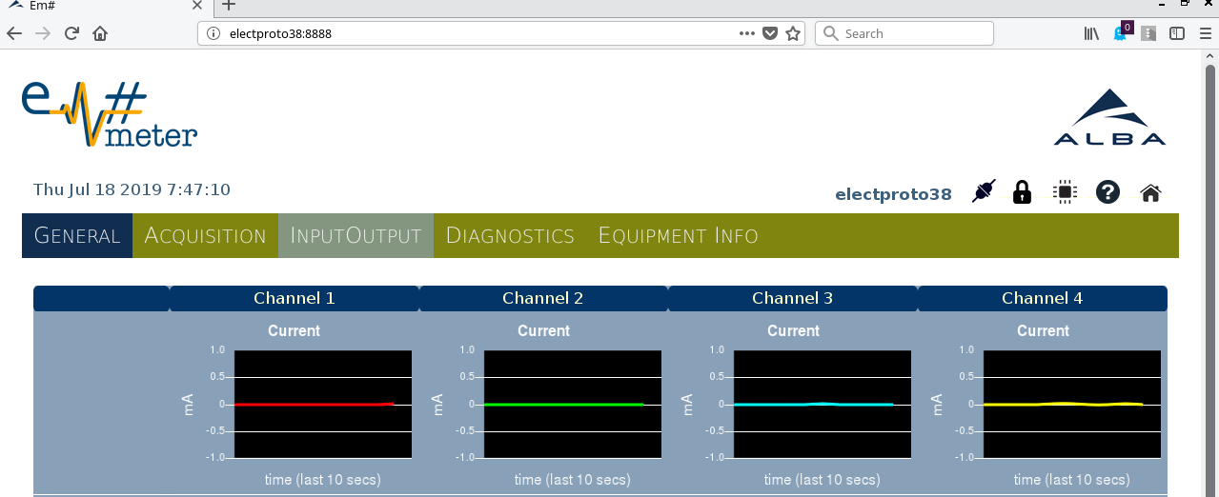
Documentation
User documentation: User manual
  Detailed user manual available in the Em# web application
    To access the Alba EM# web page, just connect to the instrument ip or hostname, with port 8888, from any internet browser (http://Hostname_or_ipaddress:8888)
User manual link
23/7/2019
4

Slide 5
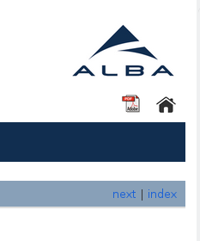
Documentation
User documentation: User manual
  PDF document can be downloaded from the web.
  Use browser to read documentation
    All parameters available in the web are linked to its explanation in the user manual web.
    Index:
    Local operation Explain how to use the Em# using the touch screen display.
    Remote operation Use of the web server or the SCPI commands for remote control.
    Quick Start Guide Link to the QuickStartGuide.pdf brochure.
    Web Reference Brief explanation about how to use web application.
    Commands Summary Table summary with the list of SCPI commands.
    Command Reference Detail description for each SCPI command.
    Tango Device Server For facilities using TANGO, how to use the tango DS available.
    Sardana controller For facilities using Sardana, brief explanation and link to controller and documentation.
    Advanced tools Description of the available tools to be used from shell.
    Em# Design Brief explanation about the equipment design.
23/7/2019
5

Slide 6
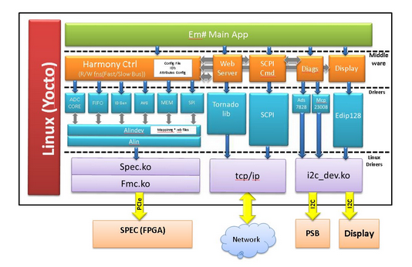
Documentation
User documentation: Advanced User Documentation
  As Em# is multipurpose equipment, advanced users can develop its own applications
  Thanks to python, any module in the SW Architecture can be easily imported from a python program.
Alindev module lets user access to any FPGA core attribute.
  Detailed documentation regarding FPGA cores, available from web:
FPGA
link
23/7/2019
6

Slide 7
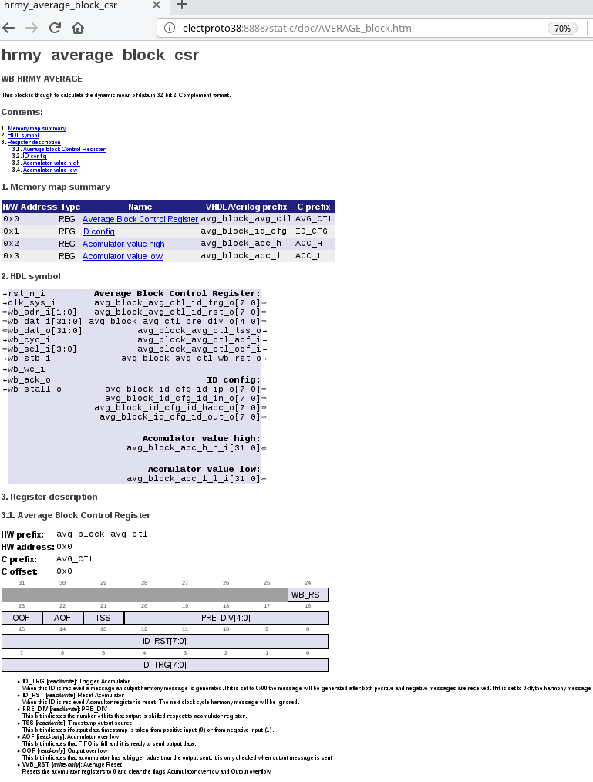
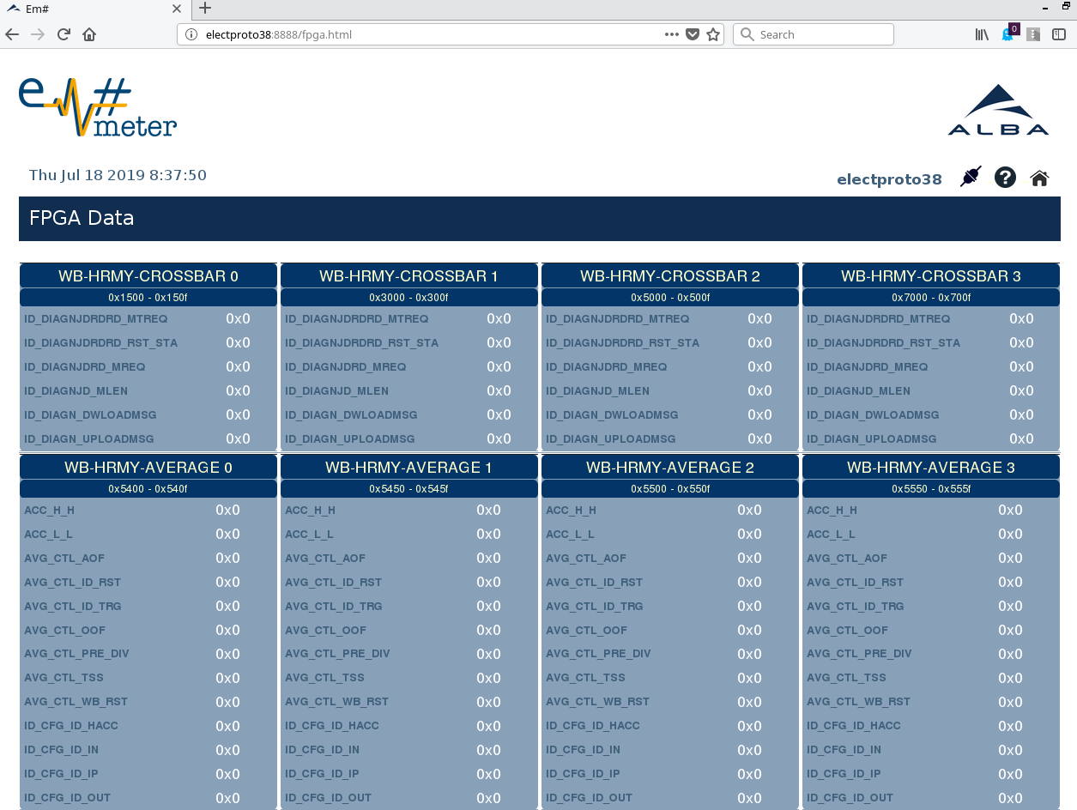
Documentation
User documentation: Advanced User Documentation
  In FPGA web page, all available cores and its attributes are list in tables
  Values are refreshed every 1s.
  Detailed documentation for each core is available clicking on each core name
23/7/2019
7

