Slide 1
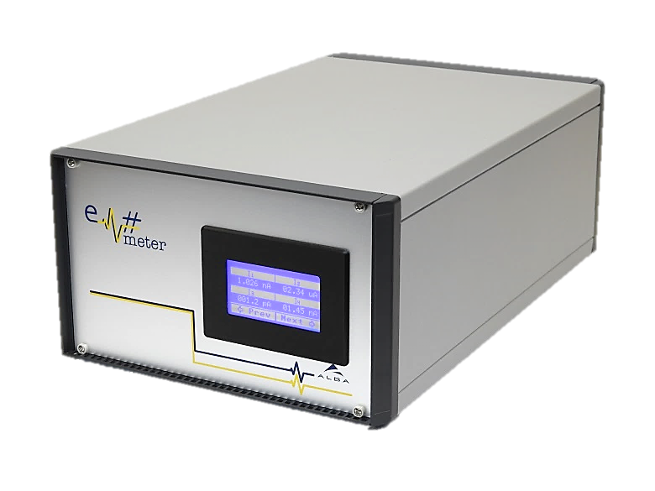
Em#
Collaboration meeting
Gateware status
23 July, 2019

Slide 2
Gateware
Electrometer gateware was written to be modular
Modules are independent only connected to SDB for configuration and if it is needed to Harmony bus for data transmission
It is possible ad-hoc connection between Cores (digital-io and timestamp), but this remove flexibility on Cores
Cores are designed to be flexible, small, and give maximum flexibility to firmware engineer, but this requires a deep knowledge of how cores works
Right now harmony bus is underused, more than 90% of time there is no communication on it. So lots of things can be done

Slide 3
Some Gateware blocks
Em#
CERN
GN4124
SDB
ALBA
ADC
Digital IO
Average
SPI
Harmony
IDGEN
DAC
PID
DDR
oneWire

Slide 4
Core Components in Gateware version 1.20
Em#
CERN
GN4124
SDB
ALBA
ADC
Digital IO
Average
SPI
Harmony
IDGEN
DAC
PID
DDR
oneWire

Slide 5
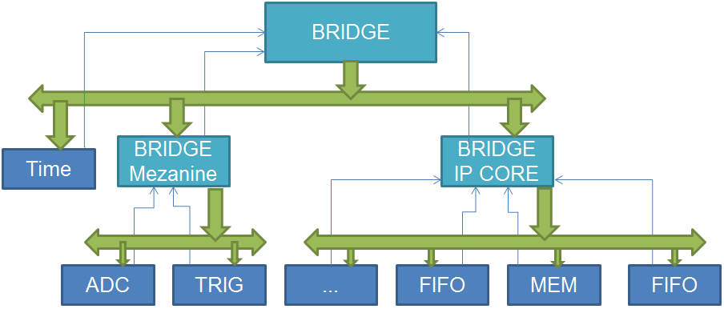
Harmony Bus
2x 64 bits (+ 3 Control lines)
  Upstream
  Downstream
  32 bits DATA
  24 bits TimeStamp(in ns)
  8 bits Identification (ID)

Slide 6
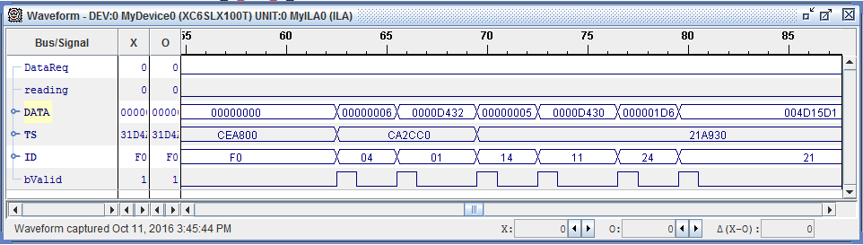
Harmony bus in Chipscope
Harmony is thought for medium speed applications (~100kHz)
For speeds over MHz Harmony is not the suitable protocol

Slide 7
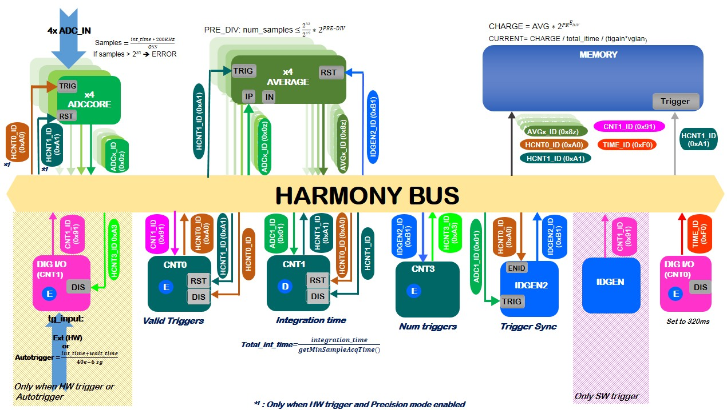
Diagram of how Core Components are used in version 1.20
6
5
1
6
3
4
1
6
6
7
4
4
7
2
4
6
2

Slide 8
Timestamp
All Harmony messages has a timestamp of 24bits with 40ns resolution, this timestamp is generated from internal 125MHz clock
  24bits 40ns → ~670ms
To solve the overflow of timestamp and to allow a external clock synchronization a ID = 0x00 Harmony message is sent
  It is generated by WB-Hrmy-TimeStamp IP Core
  The message can be generated:
    internally at TS overflow
    Hardware. When Digital-IO core counter 0 generates a trigger
  It has a 24bits internal timestamp and in data field a counter of the messages sent.
  The counter can be reset by hardware
The SBC has to recover the timestamp of each harmony message using the timestamp field of the message and the ID 0 message
So the general formula to calculate timestamp is:
  TimeStamp = 40ns*(ID0_data + (TS – ID0_TS))

Slide 9
Timestamp
Example: Calculating the TIMESTAMP
A Message with TS=600 previous ID0 message with TS=500 and D0=10
  Real time stamp = 40ns*(D0*2^24 +(TS – TS0))
  Real time stamp = 40ns*(10*2^24 + (600 – 500)) = 6710890400
But the order of messages can be different
A Message with TS=400 previous ID0 message with TS=500 and D0=10
  Real time stamp = 40ns*(D0*2^24 +(TS-TS0)) = 6710882400
The software has to keep in mind that there is a overflow of timestamp at 2^24
The software must be aware that some IP Cores delays the message. For example the TS of ADC is when S&H is switched, not when message is send

Slide 10
Changes from the first official release
FW: 1.0.00 GW: 1.18
Average
  Now Average IP allows to sent the 64bits of acomulator in to Harmony ID
  Added Reset ID. To reset accumulator by Harmony. Needed for Gate mode
IDGEN
  Modified to solve a desynchronization of ADCs. Enable ID allows synchronization of ADCs avoiding triggers between ADC harmony messages.
Counters (hrmy-cnt and digital-io):
  Include the Enable and reset by harmony ID

