Slide 1
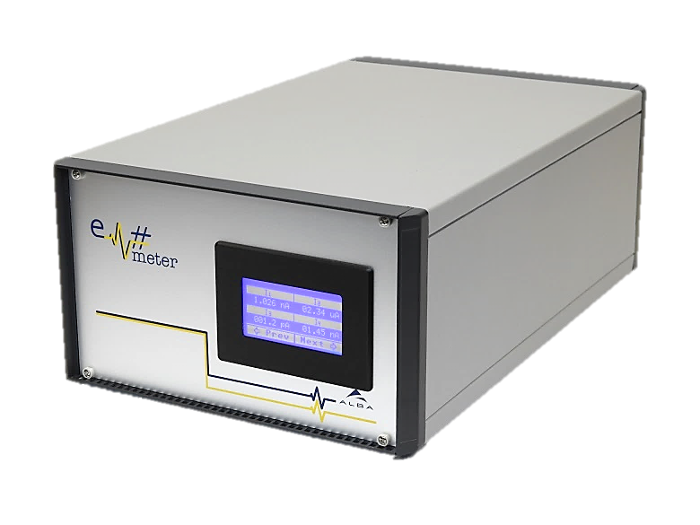
Project Introduction and Meeting Objectives
23 July, 2019

Slide 2
Historical Background
2010 Febr – ALBA starts first designs of Current Amplifiers. After first positive results a design of a 4ch electrometer is approved.
2011 March – First prototype unit of ALBA Em 4ch is produced and installed in a beamline.
  Results presented at ICALEPCS 2011: http://accelconf.web.cern.ch/AccelConf/icalepcs2011/papers/wepms025.pdf
2011 Dec – 2012 Jan – Production of 40 units of ALBA Em is finished. Installation in the beamlines as diagnostic units.
2012-2013 – The results of the current amplifiers induced a design of an improved version of the ALBA Em… Already called the Em# project.
  Ideas about the architecture and first prototypes presented at ICALEPCS 2013: http://accelconf.web.cern.ch/AccelConf/ICALEPCS2013/papers/tuppc094.pdf
After a lot of ideas received and discussed with colleagues at ICALEPCS 2013 a complete different concept of the project is chosen which involve a complete redesign of the hardware.
2013-2015 A first prototype of the unit is designed.
  Results were presented at ICALEPCS 2015: http://accelconf.web.cern.ch/AccelConf/ICALEPCS2015/papers/wepgf081.pdf

Slide 3
Historical Background
2015 March – MAXIV informs ALBA that they would like to acquire different units of ALBA Em for their beamlines and also are interested to collaborate in future developments of the unit:
  On 1st September 2015 a collaboration agreement of 5 years duration is signed. (*more details later). In it it was guaranteed the possibility of producing ALBA Em but also of producing newer units of Em#.
  Different meetings have been held between MAXIV/ALBA (theoretically annual)
    2nd June 2015 @ MAX IV – General Project Introduction
    11th March 2016 @ ALBA – Annual Project Meeting
    2017 - ?
    2018 - ?
    Febr 2019 – Visit of MAXIV Eng to coordinate FPGA firmware access and new developments.
    23rd July 2019 @ ALBA – Annual Project Meeting
2017 - First complete functional unit of Em# is produced.
  Results are shown at ICALEPCS 2017: http://accelconf.web.cern.ch/AccelConf/icalepcs2017/papers/tuapl04.pdf http://accelconf.web.cern.ch/AccelConf/icalepcs2017/papers/weapl01.pdf

Slide 4
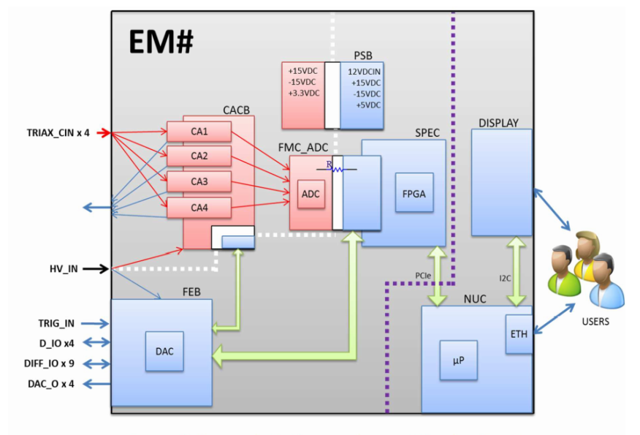
Collaboration
Em# is divided in three types of components:
  ALBA Em Current Amplifier
  Em# Core components
    ALBA/CELLS is responsible of their maintenance:
      Bugs solving
      Obsolescence
  Em# Compatible components
    Developed by any members of the collaboration (who will own its IP)
CORE components:
ALBA Em CA (Current amplifier)
Single Board Computer (NUC) firmware
Internal PCB boards:
  Power Supply Block (PSB)
  ADC board (FMC_ADC)
  Current Amplifier Carrier Board (CACB)
  Front End Board (FEB)
Master FPGA Board firmware responsible of acquisition engine tool (SPEC board).
Mechanical design and assembly instructions of Em# unit.

Slide 5
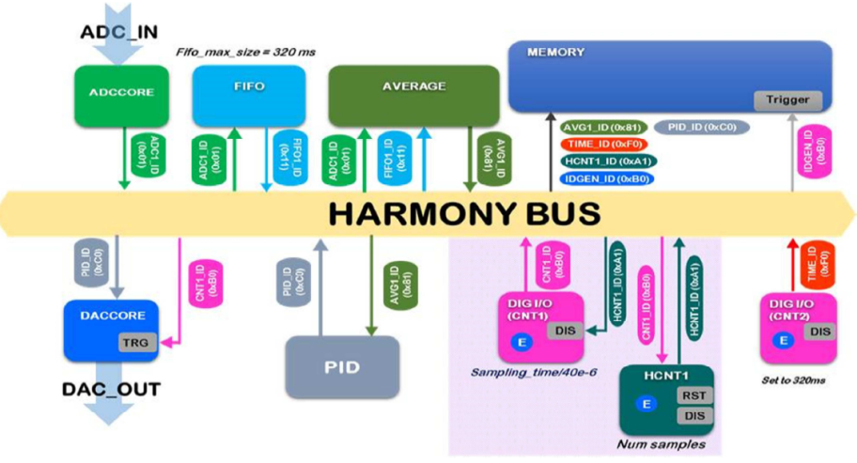
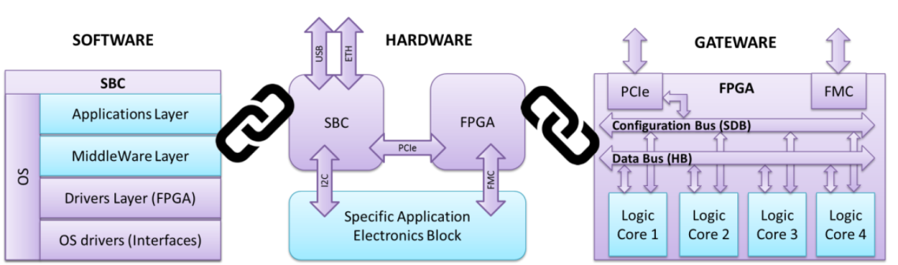
Collaboration
COMPATIBLE components:
Extra internal PCB boards that could be designed to add extra functionalities (extra internal power supply sources are available for being used in these cases).
External hardware components that could be used using the available input & output interfaces.
Extra functional IP cores to increase specific user functionalities. They would be added to Master FPGA board firmware using a firmware framework based in Wishbone protocol provided as part of the Core Components.
Extra High-level programming tools that could add extra functionalities to the Em# or ease its configuration.

Slide 6
Collaboration
Steering Committee responsibility (our objectives of this meeting)
  Monitor and assess the progress of the Collaboration,
  Authorize access of new Parties to the Collaboration.
  Build a common view of development plans, examine, discuss and, as appropriate, approve proposals for new developments
  Decide on the classification of new developments (Core Component, Compatible Component, etc.), and ensure the compatibility of Core Components,
  Ensure that IP issues are formally clarified before any new development is undertaken.

