Slide 1
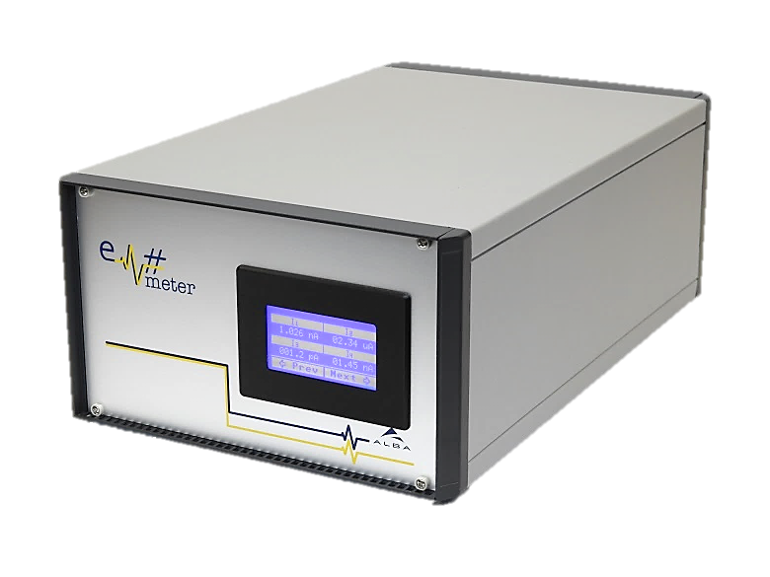
Em#
Collaboration meeting
WELCOME
23 July, 2019

Slide 2
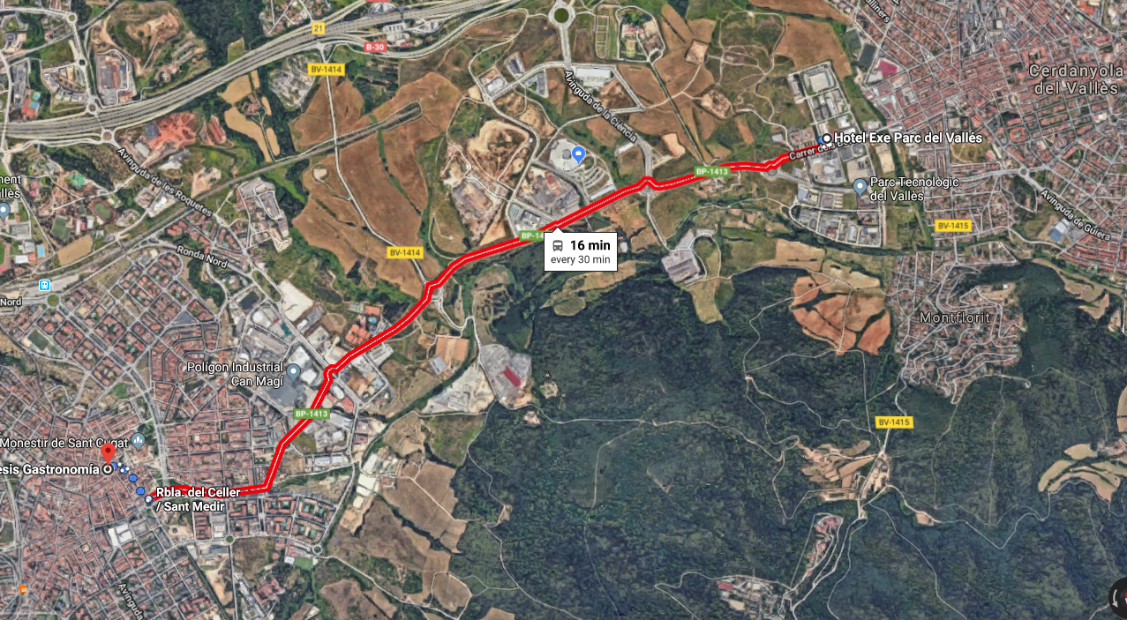
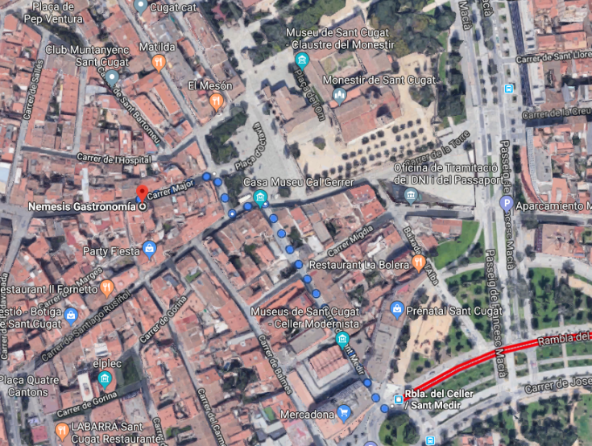
Long time ago
Collaboration Meeting was on march 2016
Dinner
Tapas dinner will be in “némesis” restaurant in Sant Cugat at 20h
Carrer Major 22
08172 Sant Cugat del Vallès

Slide 3
Agenda
Tuesday 23rd July 2019
9:00 – Welcome
9:10 – Project introduction and meeting objectives (Oscar)
9:30 – Gateware status (Xevi)
9:50 – Firmware and OS status (Manolo)
10:10 – Break
10:40 – Documentation (Manolo)
11:00 – Integration in Control system status (Antonio Milan)
11:10 – Integration in Control system status (Guifre)
11:20 – Calibration (Xevi)
11:45 – Need of evaluation and Validation Plan (Manolo)
12:05 – Em# problems & incidents at MAX IV (Peter)
12:25 – Em# problems & incidents at ALBA(Manolo)
12:45 – Round table about incidents(Open discussion)
13:00 – Lunch

Slide 4
Agenda
Tuesday 23rd July 2019
14:00 – FPGA Gateware developments at MAX IV (MAX IV)
14:20 – Related projects at MAX IV: Multiplexer, ... (MAX IV)
14:40 – Wish list and future needs (MAX IV)
15:00 – Wish list and future needs (ALBA)
15:20 – Feedback and perspectives of Rhythm. (Oscar/Guifre)
15:40 – Round table (wish list and future needs)
16:00 – End of the session
20:00 – Dinner at Sant Cugat

Slide 5
Agenda
Wednesday 24th July 2019
9:30 – Production and installation at ALBA and feedback from other facilities (Jose Avila)
9:45 – Production and installation at MAX IV(MAX IV)
10:00 – Components obsolescence (Xevi)
10:15 – Break
10:45 – Roadmap approval, tasks assignation (open discussion)
12:00 – Final wrap-up (open discussion)
13:00 – Lunch

Slide 6
Notes

Slide 7
Notes

Slide 8
Notes

