Slide 1
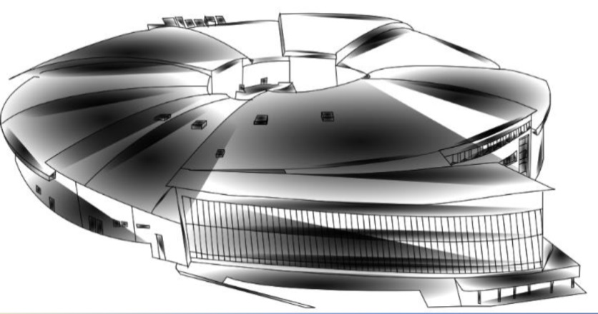
Conventional IDs
for unconventional
requirements
Dr. Josep Campmany

Slide 2
Outline
LOREA
  Special unconventional requests
  Conventional solution
  Colateral damages
XAIRA
  Special unconventional requests
  Conventional solution
FAXTOR
  Special requests
  Conventional solution

Slide 3

LOREA
LOREA (Low-Energy Ultra-High-Resolution Angular Photoemission for Complex Materials) is a new beam line that will operate in the range of 10 – 1500 eV and will use polarized light.
Special unconventional request:
  Wide spectral range: 10 eV to 1500 eV
  Circular / elliptical polarized light
  Same range in H and V polarizations
ID conventional solution:
  Apple-II type undulator, out vacuum, reaching 10 eV
    This leads to a huge period (125 mm)
    With this period, only 500 eV maximum is reached
To reach the 1500 eV as maximum, a solution is proposed:
    At low energies (10 – 500 eV), ID works as undulator
    At high energies (500 – 1500 eV), ID fix the gap at 35 mm and it works as a wiggler (smooth spectrum). In this mode, a polarization rate of 90% is achievable

Slide 4
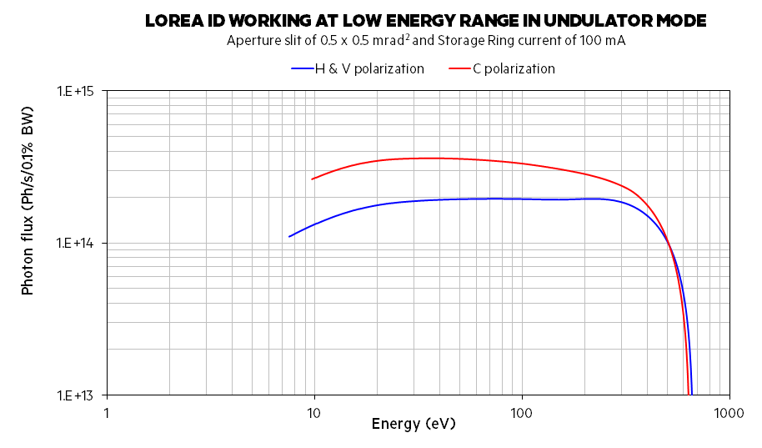
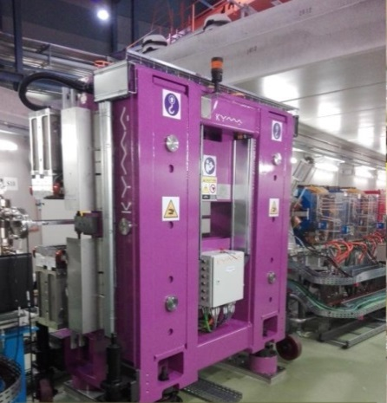
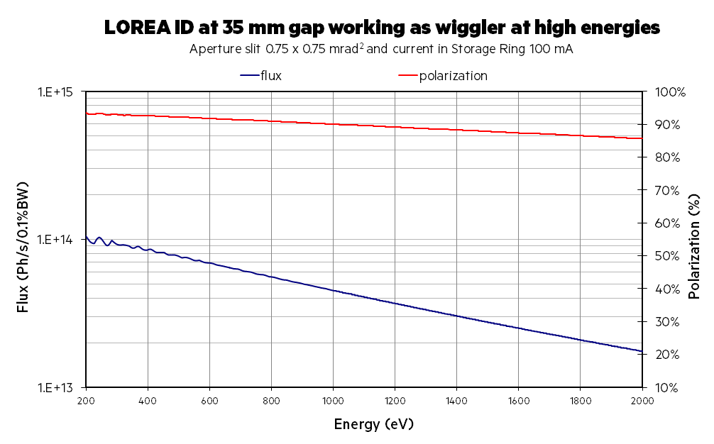
LOREA
ID built by Kyma

Slide 5
LOREA
Colateral damages:
  Huge power emission -> 6 kW
  High emission fans –> specially in vertical mode
  High field and long undulator -> big impact on Machine working point with a reduction of Dynamic Aperture
Adopted solutions:
  High emission fans –> New vacuum chamber and absorber for downstream bending magnet
  Huge power emission -> Special design of Front End using CuCrZr for the manufacturing of the Movable Masks. Thermomechanical behaviour not as good as Glidcop®, but better than that of OFHC copper and enough to tackle with power.

Slide 6
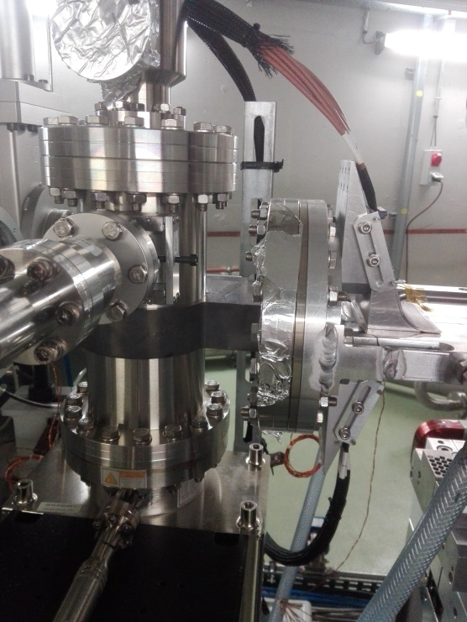
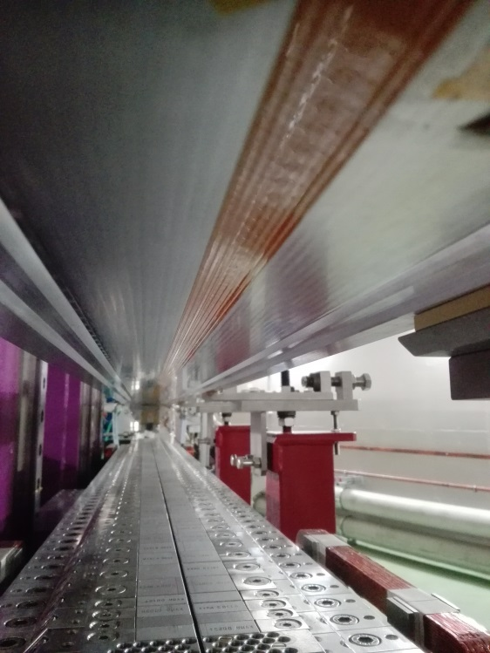
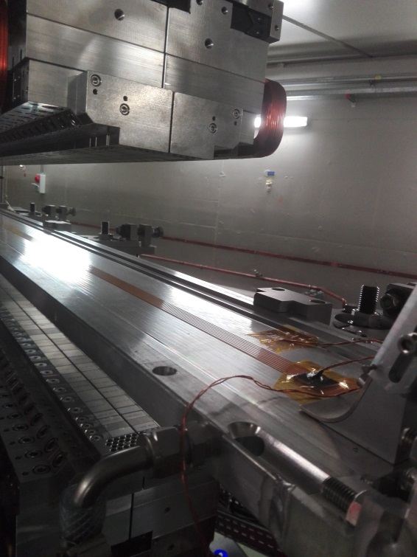
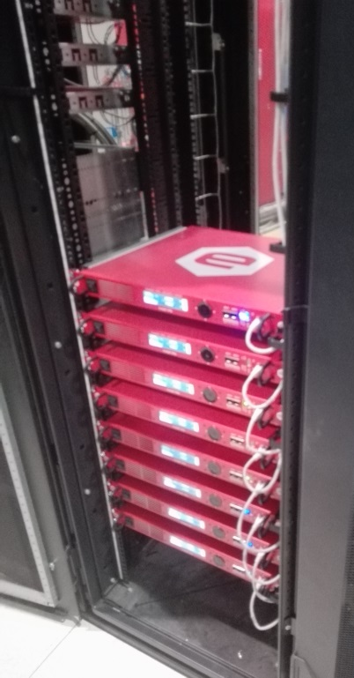
Adopted solutions:
  Machine working point and reduction of Dynamic Aperture –> Local correction scheme using long wire belts placed on top and bottom of vacuum chamber powered by 8 independent power supplies.
Wire belts heat the chamber (currents are in the range 1-14 A),
so additional cooling for vacuum chamber has been installed

Slide 7
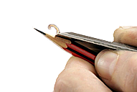
XAIRA
XAIRA (Experimental microfocus beamline for macromolecular crystallography) is a microfocus beamline for macromolecular crystallography, specifically designed to deliver high flux X-rays with a beam size down to the micrometer size, fully tunable around all essential K and L edgesto tackle MX projects for which only tiny (<10 µm) or imperfect crystals are obtained.
Special unconventional request:
  Exploit the anomalous signal of the metals naturally occurring in proteins (native phasing), which is enhanced in the case of small crystals and long wavelengths.
  Deliver high flux and high brilliance optimized in two ranges:
    Energies between 4 to 6 keV on the 3rd harmonic
    Energy ~ 12.6 keV on the 9th harmonic, corresponding to the Se K edge
  Provide an easily tunable photon energy with a range of 4.0 to 20 keV
  Photon beam size 3×1 µm² FWHM (h×v) at ~12.6 keV on the 9th harmonic
  Photon flux > 3×10¹² Ph/s in central cone (250 mA in SR) at 1 Å wavelength (12.4 keV)

Slide 8
XAIRA
Conventional solution:
  In-vacuum hybrid type undulator (4.8 mm minimum physical gap)
    Short period (19 mm) -> reaching 4 keV
    Long device (2.3 m) -> high flux
    B₀ = 1.2275 T
Challenge: phase error < 2º in such a long hybrid undulator
Low energy
High energy

Slide 9
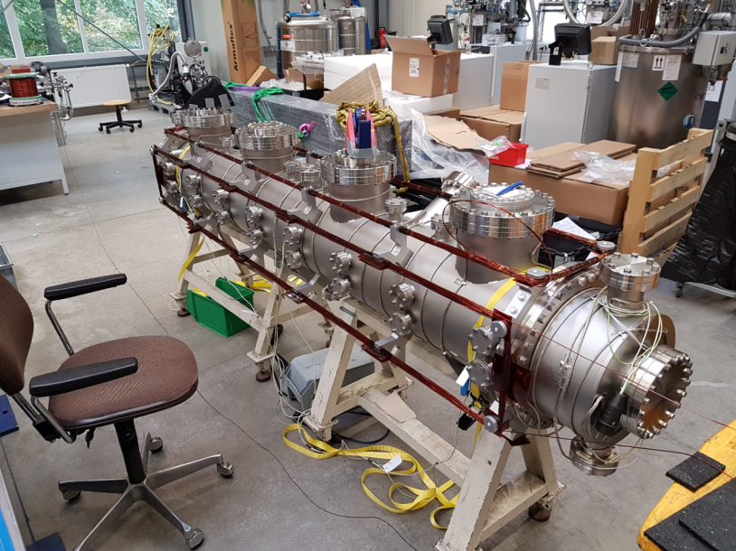
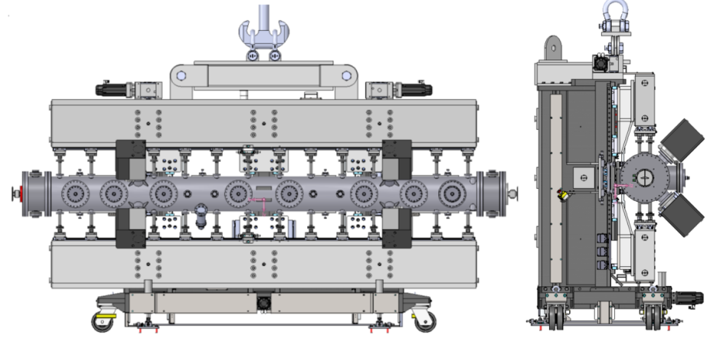
XAIRA
Huge device: length and weigth
Undulator being built by Kyma+Research Instruments
Difficult shimming to achieve phase error < 2º

Slide 10

FAXTOR
FAXTOR (Fast X-ray Tomography & Radioscopy Beamline for ALBA) is an X-Ray tomography beamline, specifically designed to deliver high flux X-rays with a small beam size, fully tunable in the range 5 – 50 keV.
Special requests:
  Photon source size < 310 H x 30 V µm²
  Wide photon fan > 1 mrad
  Energy range 10 – 50 keV
Conventional solution:
  In-vacuum hybrid type wiggler (5 mm minimum magnetic gap)
    Short device (250 mm) -> to obtain small source size
    Regular period size (50 m) -> to have high B₀ and therefore flux enough in the range 5 – 50 keV

Slide 11
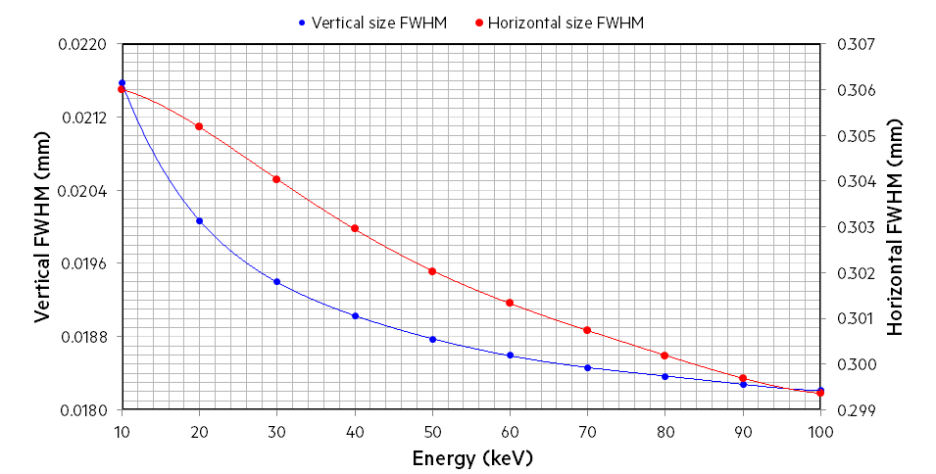
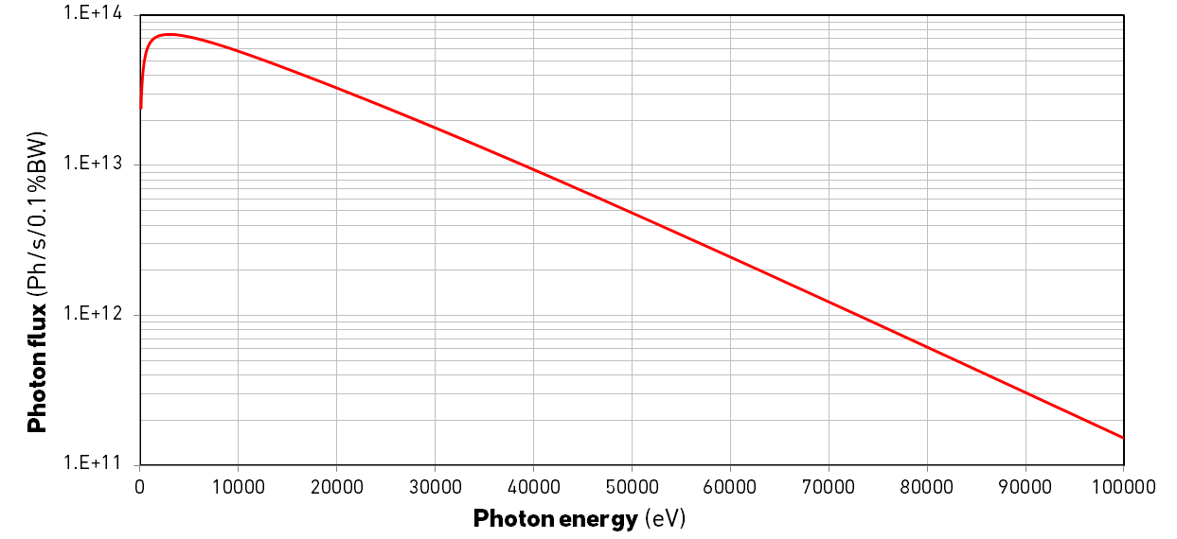
FAXTOR
In vacuum wiggler
Hybrid-type with side magnets
5 periods
50 mm period length
FWHM < 306 H x 22 V µm²
Flux at 250 mA in SR > 5·10¹² Ph/s/0.1%BW
H aperture: 2 mrad
Aperture slit: 1 mrad H x 1 mrad V
CURRENT STATUS:
Ready for tendering
5-50 keV

Slide 12
CONCLUSIONS
Standard solutions can be applied to face challenging scientific requirements
The same ID can be used in different ways (wiggler / undulator in the LOREA case)
IDs affectation on beam dynamics can be corrected using local corrections
Hybrid in-vacuum undulators can be used to cover a long range of energies
IDs can be used as Tomography photon source in the X-ray range

Slide 13

?

