Slide 1
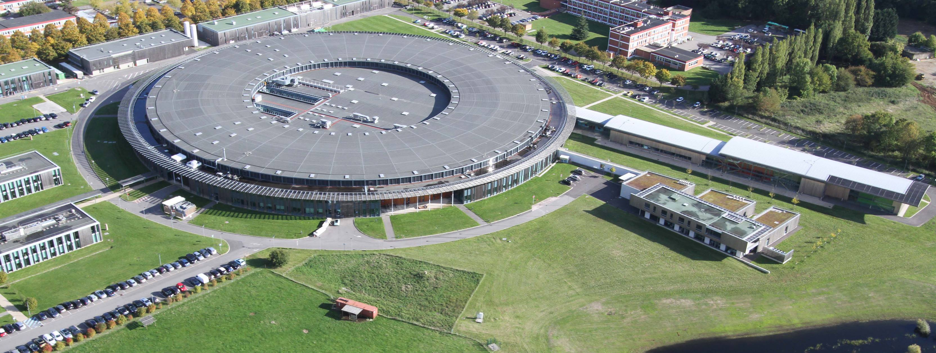
Status and Operation of SOLEIL
The Upgrade Project
C. Herbeaux, L. Nadolski, A. Nadji

Slide 2
Outline
Operation
  Key Performance Indicators (KPI’s)
  Operational metrics
  Major Incidents
Major R&D Projects
  Multipole Injection Kicker
  Superbend Project
Conceptual Design for a Major Upgrade
  Overview
  Salient features
  R&D

Slide 3
Operation

Slide 4
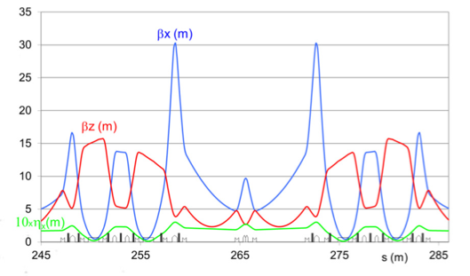
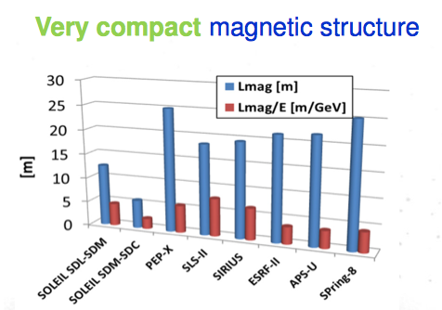
Lattice
ε_{x0} = 3.9 nm•rad @ 2.75 GeV
Location: France
Circumference: 354 m
DBA + distributed dispersion
24 straight sections
  SDL: 4 x 12 m
SDM: 12 x 7 m
SDC: 8 x 3.6 m
(variable length)
SDL-SDM
SDC-SDM-SDC
One long straight section (SDL13, accommodating 2 canted long beamlines) has been modified
4

Slide 5
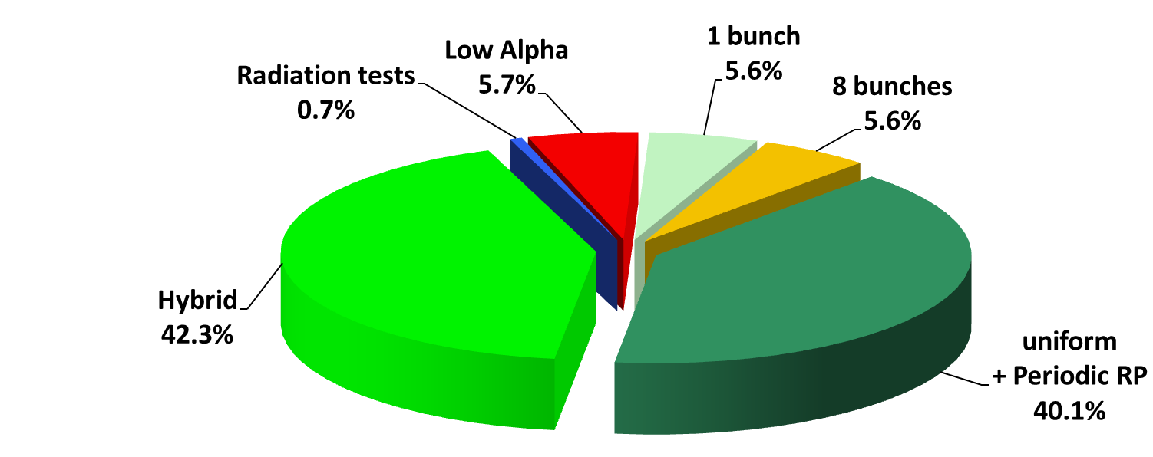
Beam Time Schedule in 2019

Slide 6
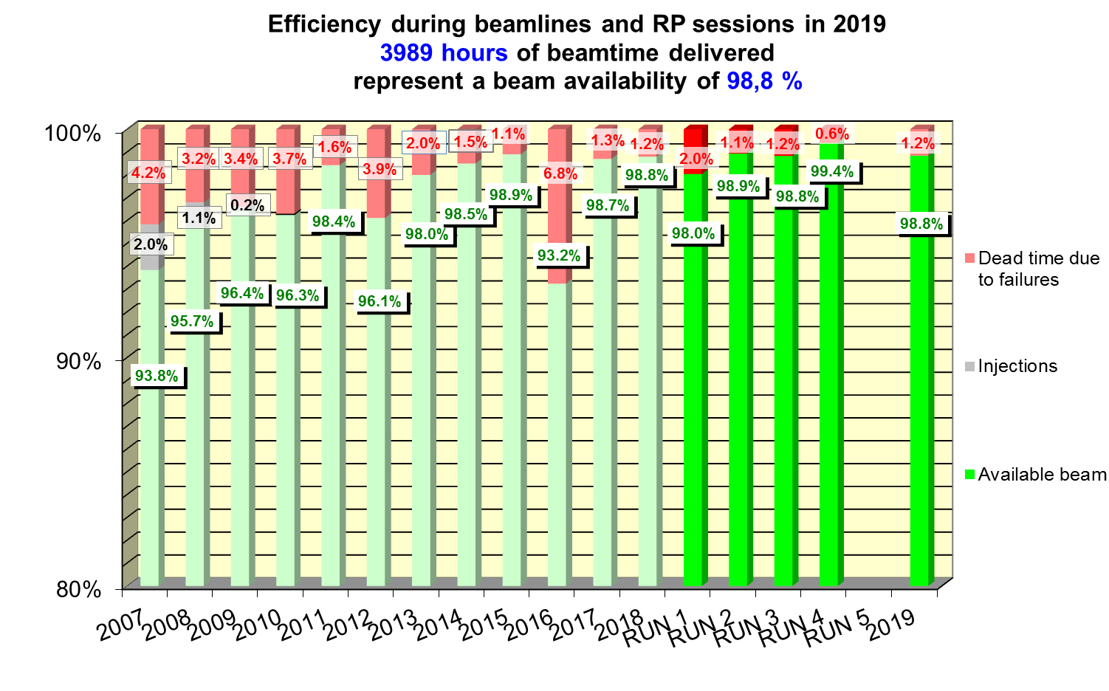

Slide 7
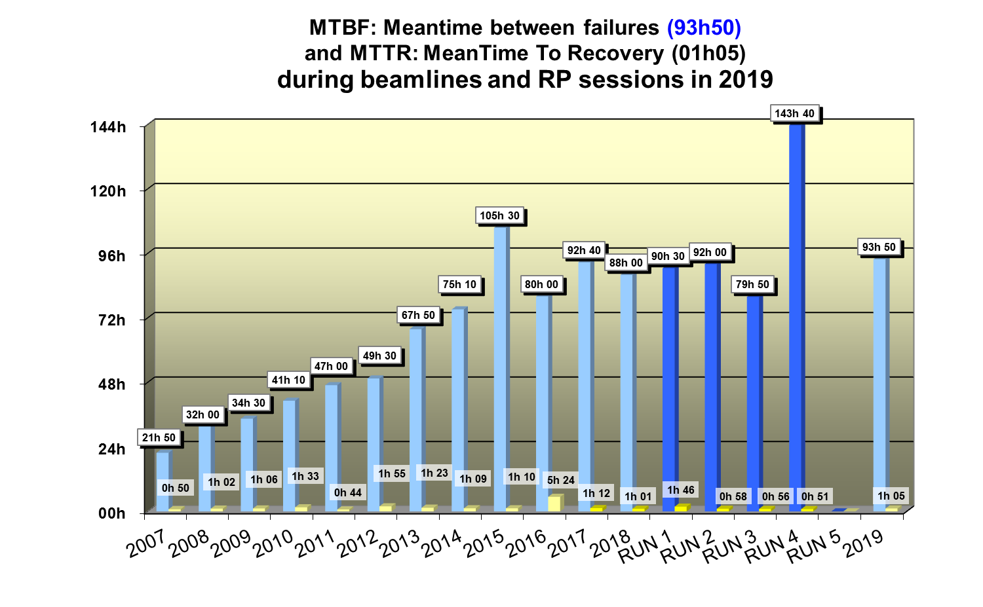

Slide 8
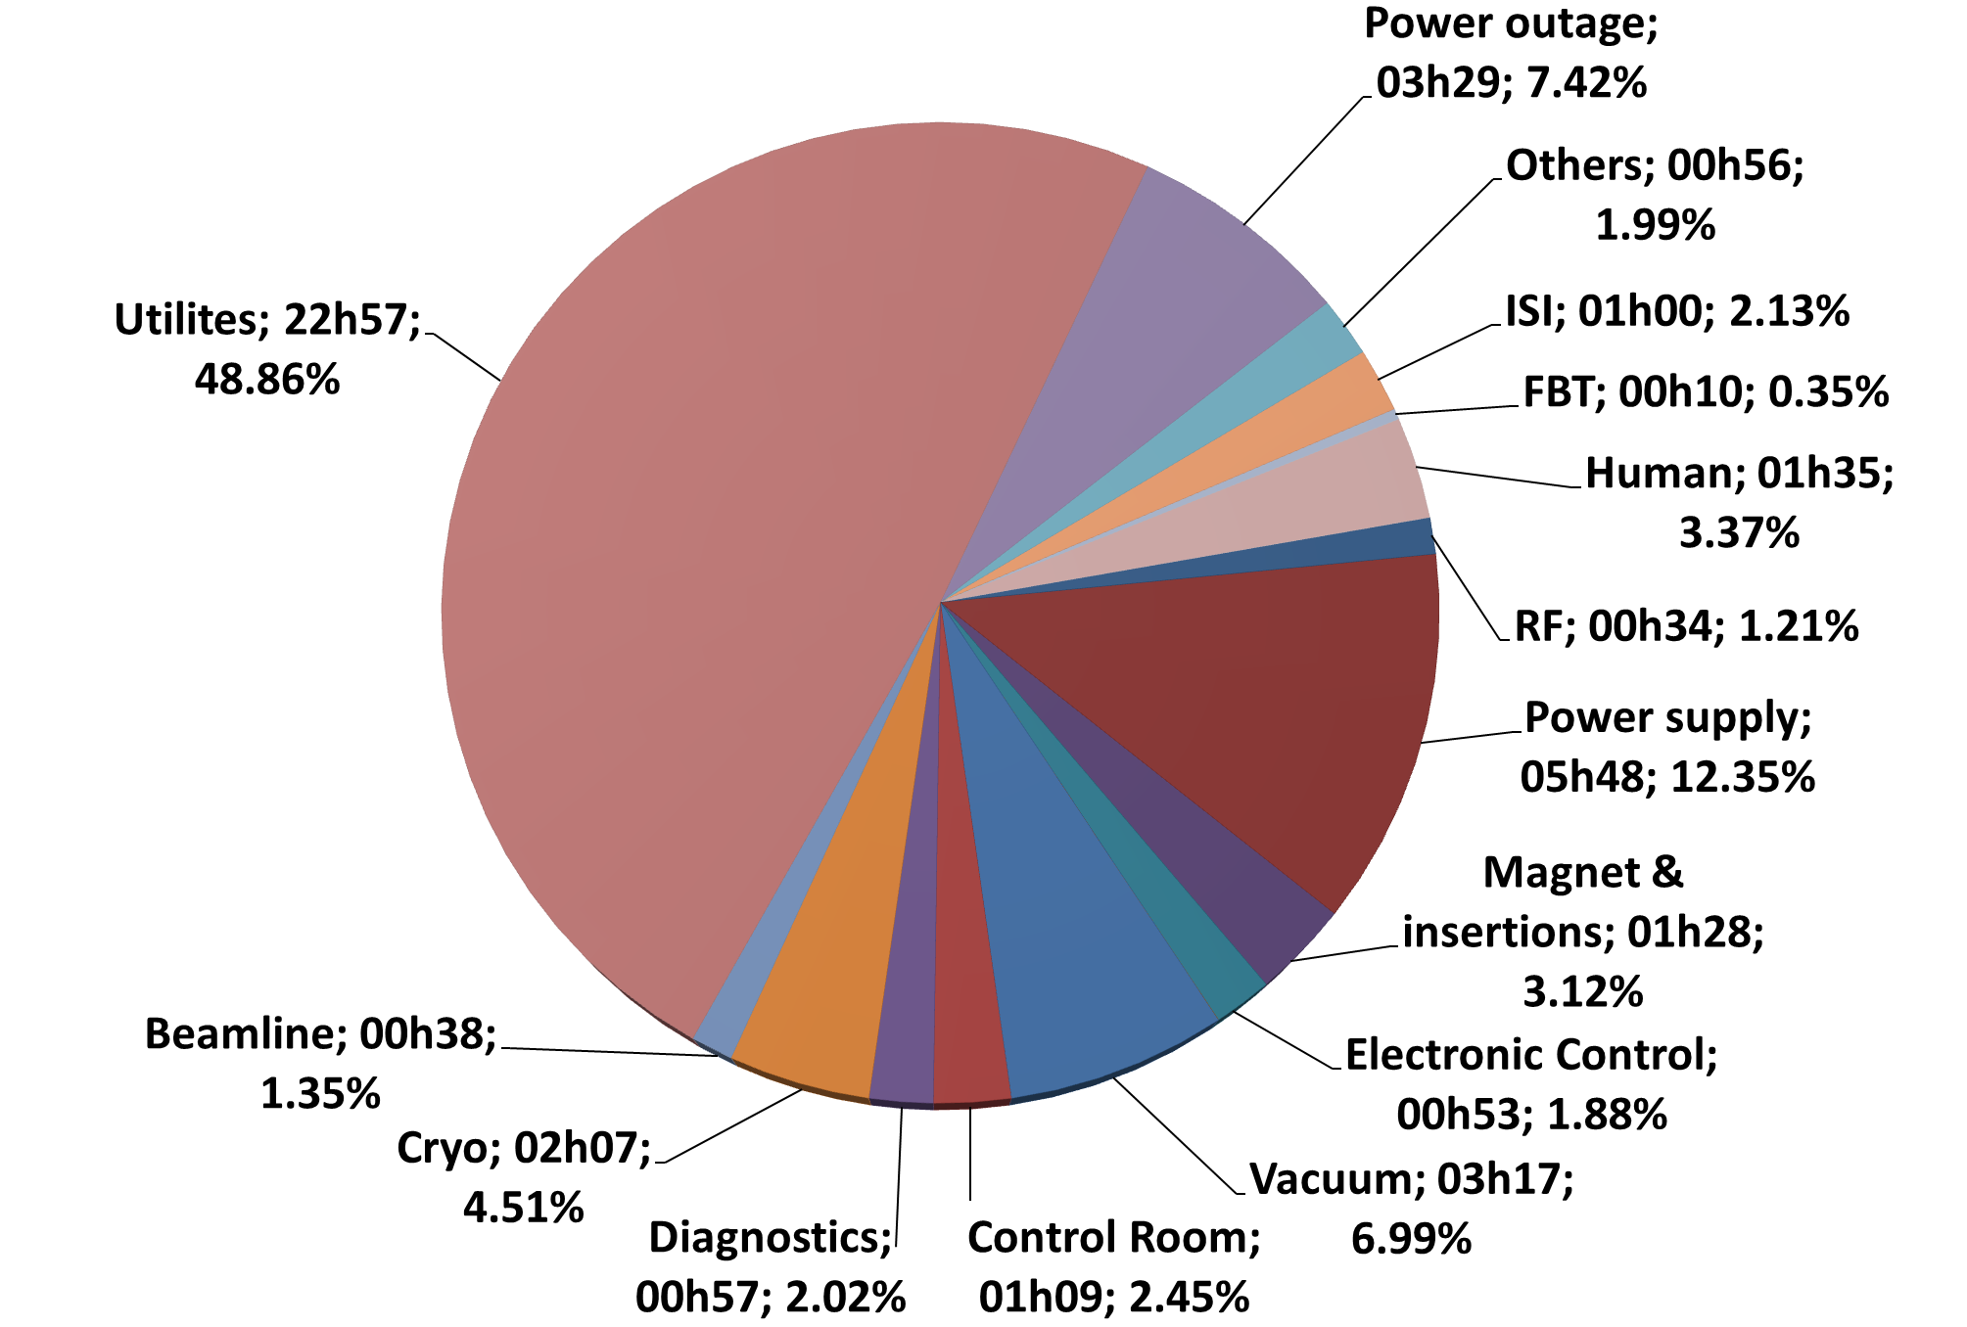
Origin of the 47 hours of Downtime
in 2019 (RUN1 to RUN4)

Slide 9
Duration of every beam trip (Run 1 to 4)
“Status of SOLEIL”, XXV ESLS, Delta, 2017
Notes:
RUN1
Il y a eu 2 remontées de température sur le circuit 30°C ayant nécessité d’interrompre le faisceau :
Le 27/01/19, montée jusqu’à 42°C (3h46 sans faisceau). Il y avait 2 problèmes :
Un défaut de fin de course (présence humidité dans boitier de contrôle) sur une vanne pneumatique d’une tour (OK en basculant sur une autre tour). En étude la possibilité de basculer automatiquement sur une autre tour dans ce type d’incident.
Une vanne 3 voies qui n’a pas fait son office, suite à l’incident précédent. Problème d’inversion de consigne 0% <-> 100% ? A voir avec HoneyWell.
Le 14/02/19, montée jusqu’à 35°C (3h21 sans faisceau). Il y avait 2 problèmes.
Une fuite d’eau sur l’échangeur -> perte de pression. La fuite a été réparée.
Pb de régulation de la vanne 3 voies (idem 27/01 ?). La vanne doit être révisée
RUN2
Problème de régulation du circuit 21°C (30°C au RUN1) : problème sur un fin de course d’une vanne pneumatique de la TAR5 (les boitiers de toutes les vannes vont être vérifiés), problème de régulation de la vanne 3 voies (en discussion avec Honeywell) ; fuite sur un doigt de gant de l’échangeur 3 (réparée), une des deux résistances de chauffage d’un GF HS (réparée).

Slide 10
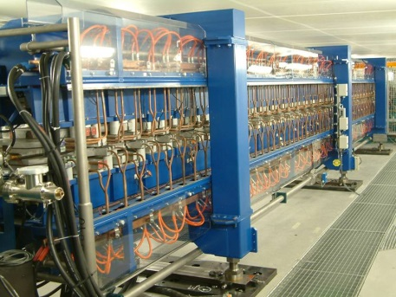
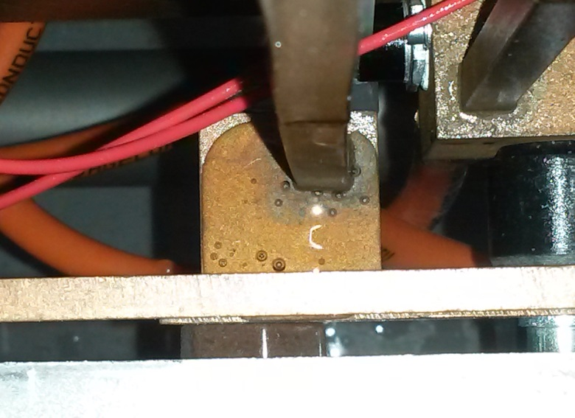
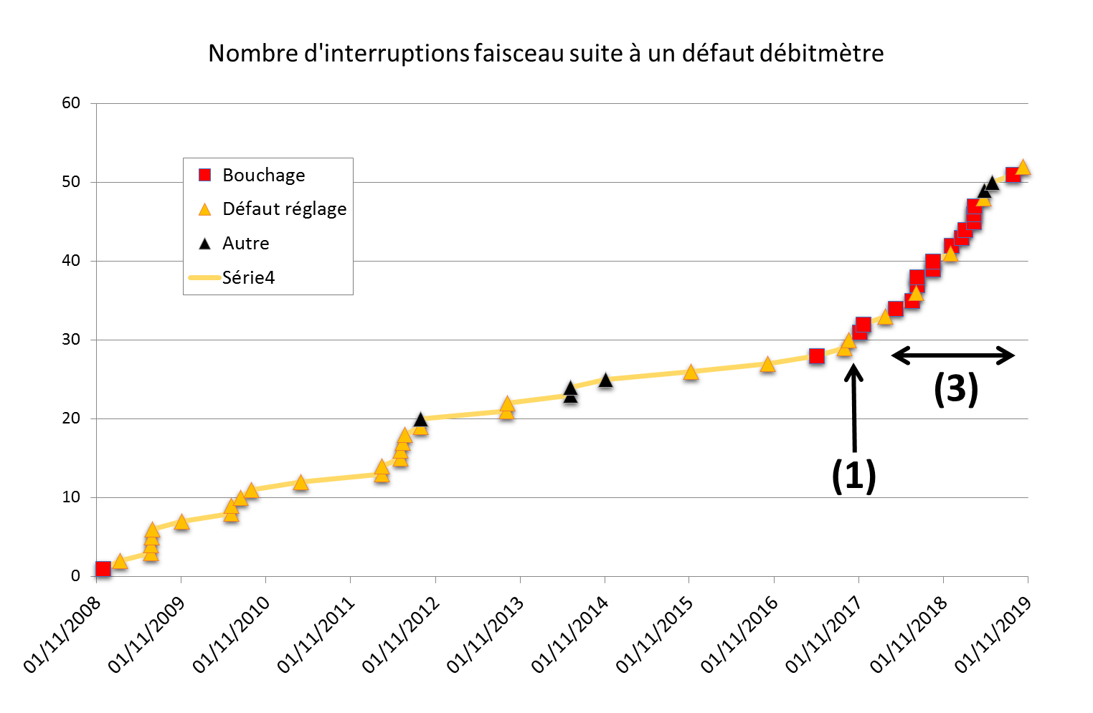
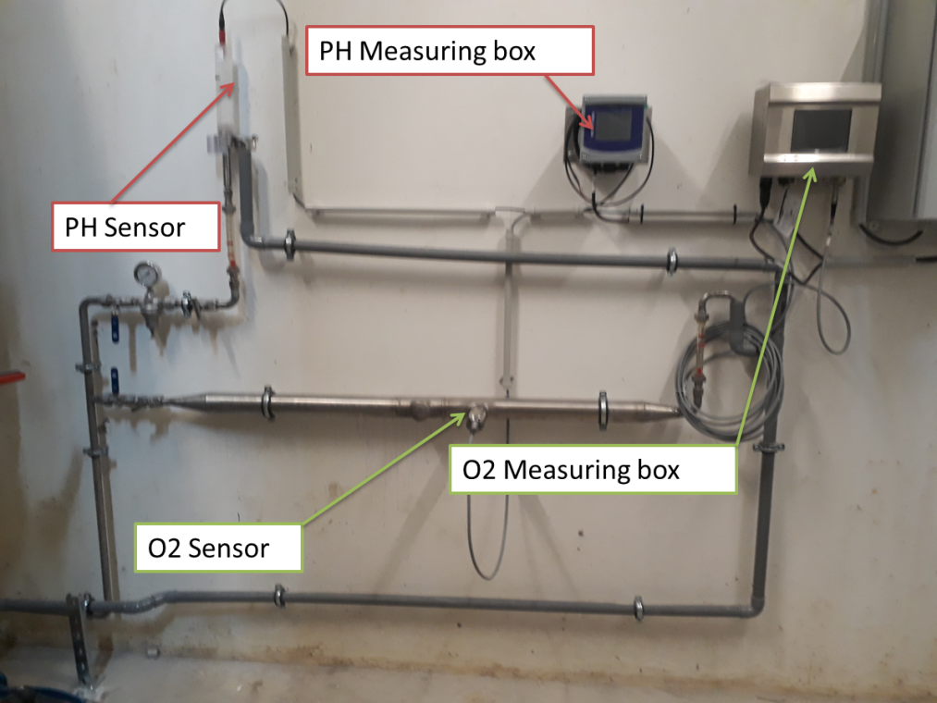
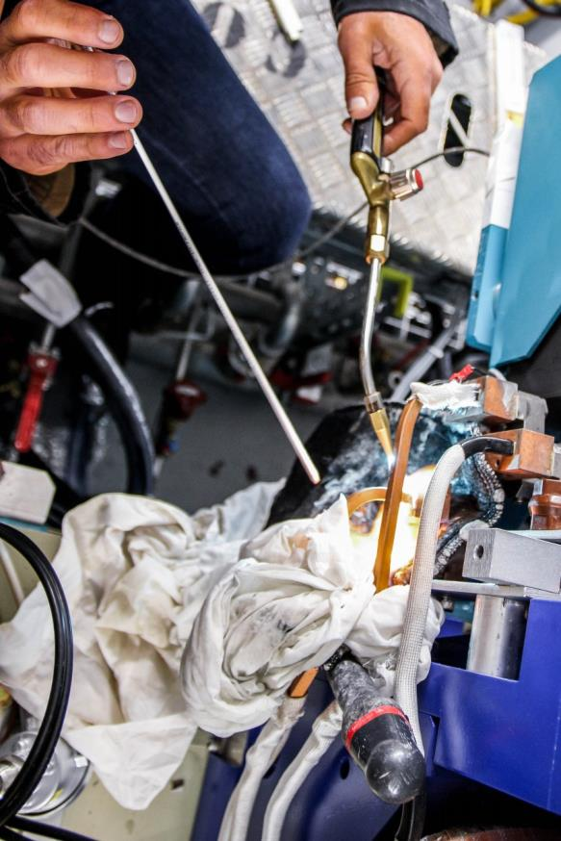
21°C Cooling Circuit Leaks on
Brazing Joints and Clogging
Since April 2017, 5 leaks on brazing joints
  2 on HU640 10 m long ID
  2 on SR sextupole and 1 SR quadrupole
Significant increase of clogging events
  @filters, @pressure reductor at BPM locations, etc.
  Cu oxide residues, whitish precipitations
January 2019, 12 anomalies corrected:
  3 brazing joints secured, 8 threaded connections disassembled, clean-up.
Concern about aging of the 21°C cooling circuit
  Regime of high DO regime (4000 ppb, pH~6.5-7.5)
  Survey/experience of other facilities on similar issues
  Improve on-site brazing expertise and training (4 people)
  Revisiting erosion/corrosion process and water chemistry
  Online measurement capability (pHmeter, dissolved oxygen)
  Identification of sensitive Waterflow meters. Fine adjustments of trigger thresholds (how: reducing the water pumps regime);
  Campaign to clean-up the water flow reducer and filters (over 6 shutdown periods > 1 year);
  Expertise with CEA (service de la corrosion et du comportement des matériaux dans leurs environ-nements)
HU640
brazing joint
Clogging @ Filter
In Situ brazing/ welding/soldering:
A 4 Hour Operation
Notes:
The series of actions adopted have being given very positive results. No water leak since 18 months (No sign of aging); decrease of the downtime due to flowmeters faults, better procedures, panel of welding expert trained.
Lessons learned will be applied for the forthcoming upgrade of the accelerator complex of SOLEIL: installation of a single main water filter outside the tunnel, avoiding the use of Al vacuum chambers (or having two separated circuits), having a better on-line monitoring of the chemistry of the LCW water (pH, DO, etc.), strict limitation of the water flow (below 2m/s).

Slide 11
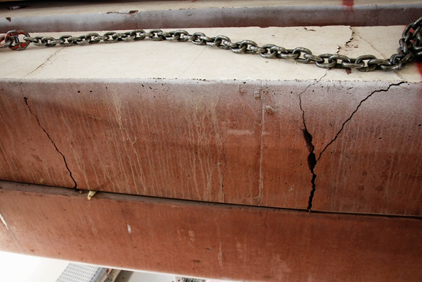
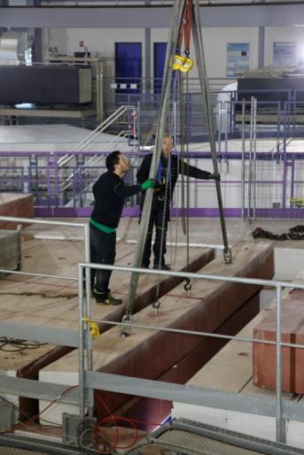
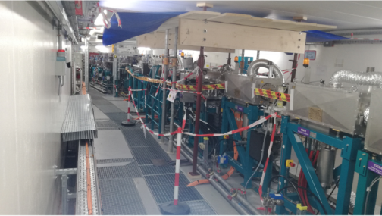
An incident with the handling of a Bean Roof
When handling one slab of the storage ring roof, the system malfunctioned and the slab hit the wall and broke.
After analysis, technical expertise, added 4 additional anchor points.
Repositioning the slabs, without any problem.
Set up protections on machine equipment located just below. Left until the change of the slabs.
ZERO impact on the beam time.
Restarting of the beam as scheduled.
Replacement August 2019 & Spring 2020

Slide 12
Major R&D Projects

Slide 13
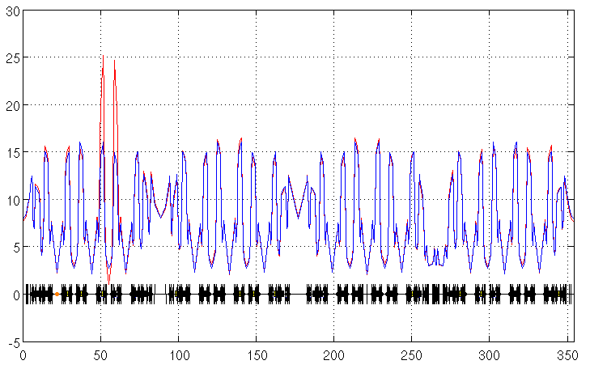
Increase of the photon flux for the PSICHÉ beamline
Reducing the WSV50 wiggler gap from 5.5 mm to 4.5 mm
Measurement on air diffusion with a Ge solid detector (2015, June, 29th)
Intensity gain (as referred to 5.5 mm gap case) versus photon energy and comparison to calculations made by T. Moreno
Vertical optical function (m) along the storage ring
5.5 mm gap
4.5 mm gap
The smaller gap leads to a local reduction of the physical aperture
A new optics was optimized to locally increase the vertical focusing and is in operation since February 2019.
SDC03
S (m)

Slide 14
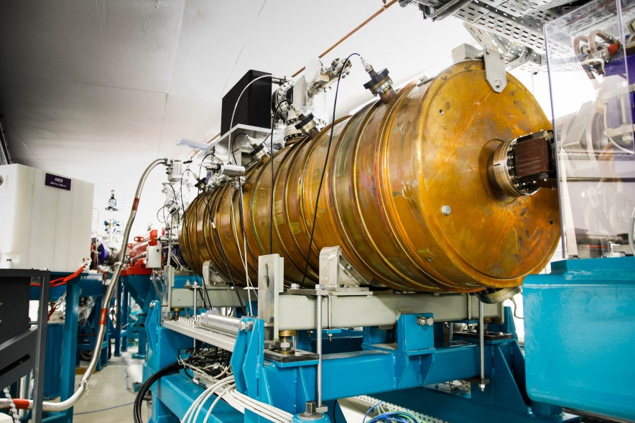
Main RF activities in 2019
Installation of a 2nd Booster RF Cavity :
In operation since beginning of 2018
→ Injection efficiency enhancement from 19
up to 35% in low-a mode
redundancy in all the other modes of operation.
Validation of the new Transverse Feedback (FBT)
processor (SPring8/TED/SOLEIL )
Ongoing upgrades of the Storage Ring RF system
- Solid state power amplifiers (SSPA) → New transistors + improvement of the power combiners
→ Full completion scheduled for the 1st quarter of 2020.
- New cavity input power couplers (P : 200 → 300 kW)
- Modification of the wave guide network with the insertion of « Magic Switches »
At this stage, it is possible to store 450 mA with 1 of the 4 RF stations out of use.
After completing of the SSPA refurbishment (1st quarter 2020) → 500 mA with 1 of the 4
RF stations out of use or 450 mA using a single cryomodule and combing 2 SSPA on each cavity.

Slide 15
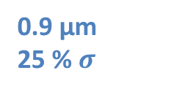
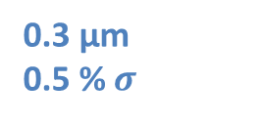
SOLEIL MIK @ MAXIV: Residual Stored Beam Perturbations
Transverse beam profile measured at diagnostic beamline while pulsing the MIK.
Values scaled to the centre of the long straight
Horizontal transparency ≾
0.3 µm
0.5 % $σ$
Vertical transparency ≾
0.9 µm
25 % $σ$
Courtesy Pedro Tavares (MAX IV)

Slide 16
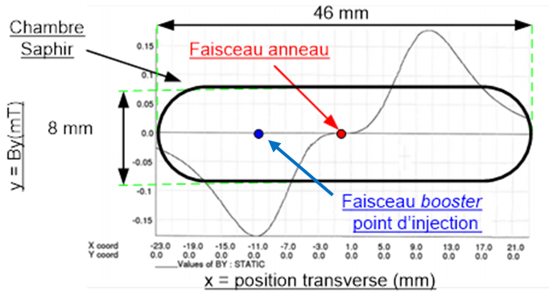
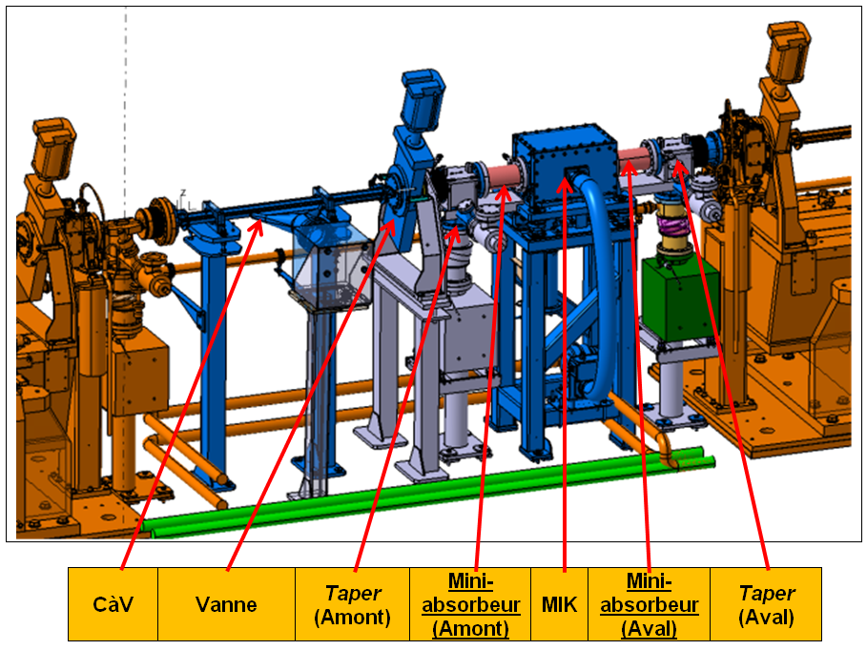
Installation of the MIK @ SOLEIL
Installation of the MIK in an available Short Straight Section.
Feedback from MAX IV
Good Efficieincy
Sustainable heating vs Ti coating thickness
Objective :
Test the MIK concept on SOLEIL : efficiency, orbit perturbation.
Test of injection schemes in the framework of the upgrade studies
On axis Injection with Transverse kick combined with longitudinal kick with the RF
Same geometry as the on installed at MAX IV
Courtesy of Rachid Ben El-Kefih

Slide 17
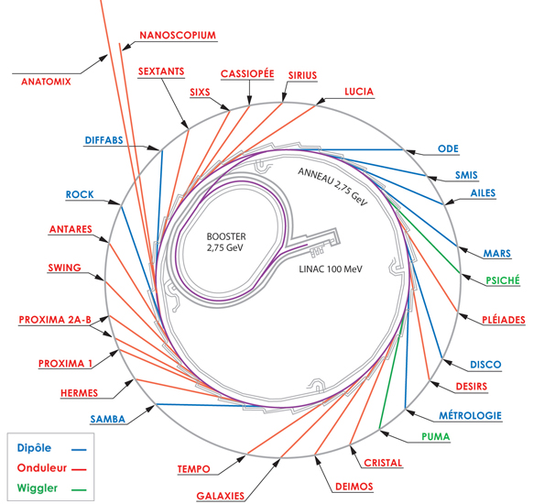

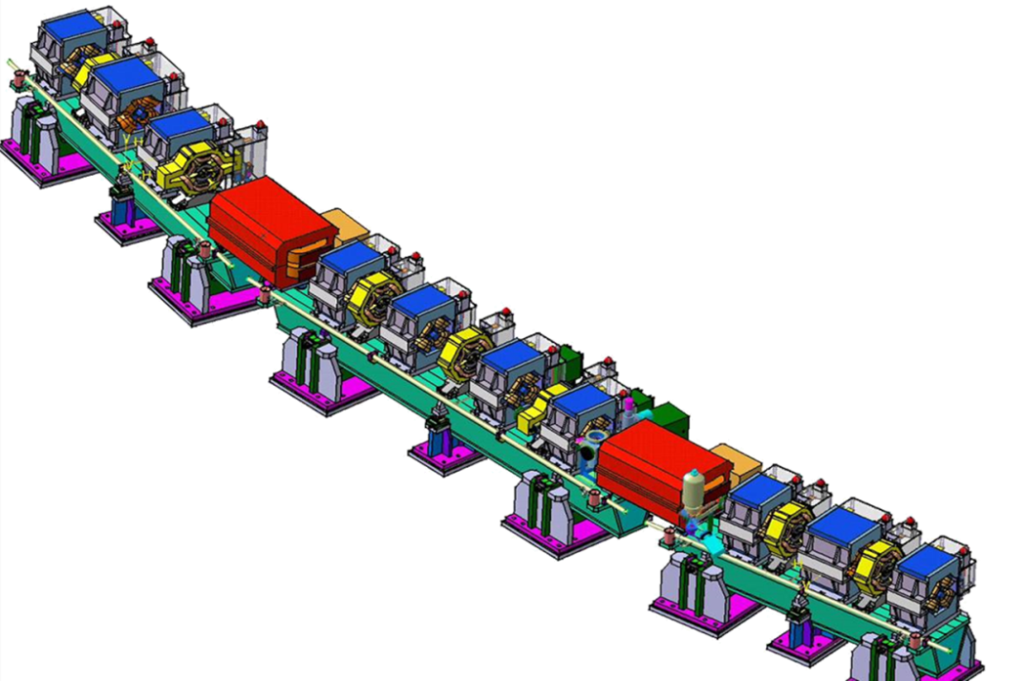
New photon source for the ROCK beamline
Present source : Bending magnet 1.7 T
Horizontal aperture 1.5 mrad
e-

Slide 18
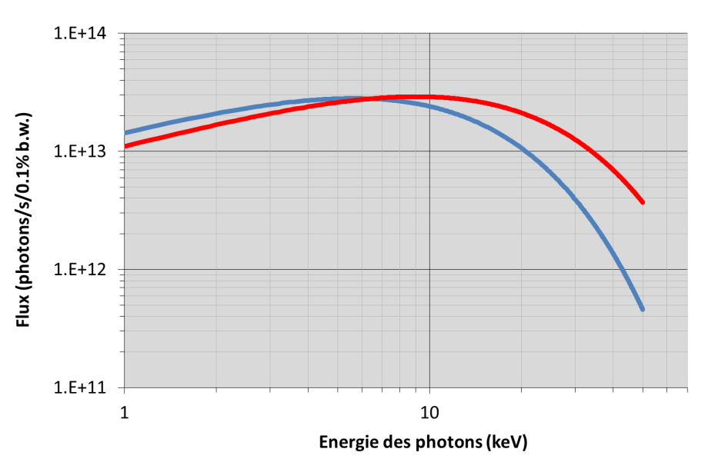
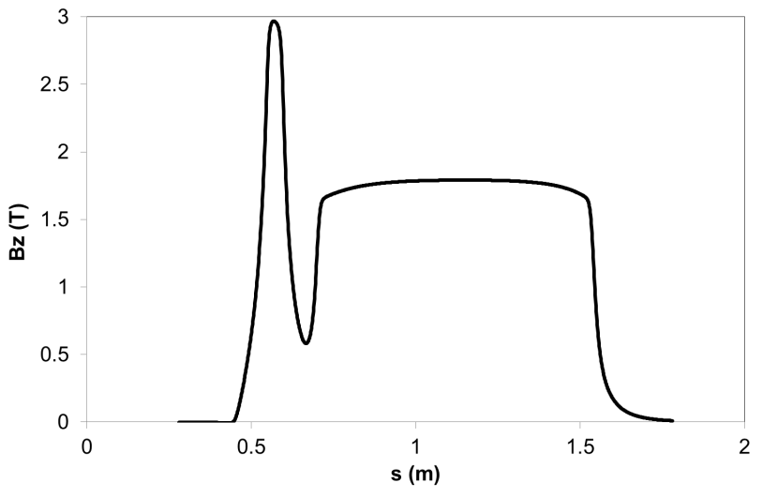
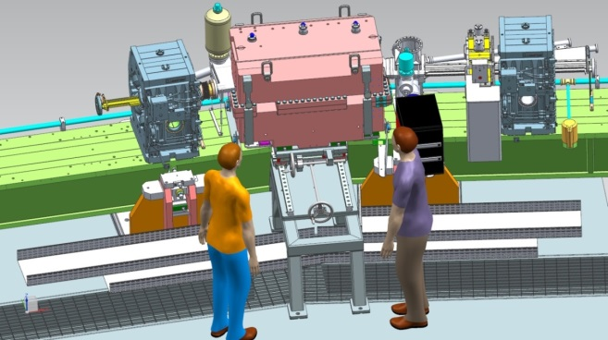
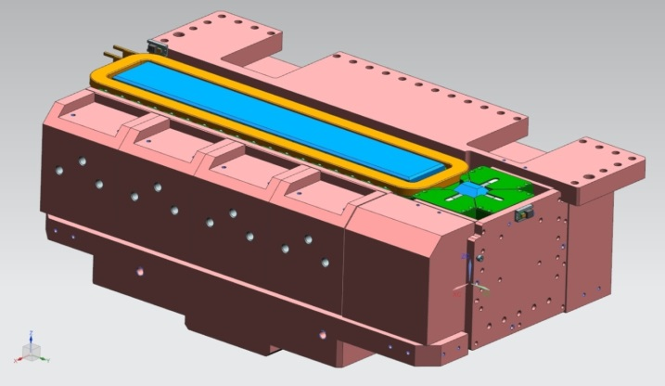
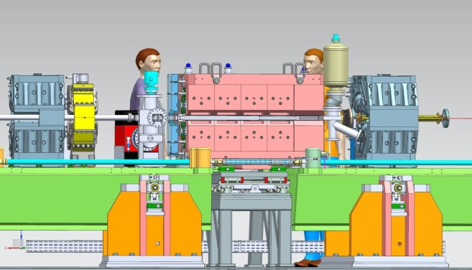
3T Superbend Project
Permanent magnet dipole(NdFeB)
Length 1.260 m
Superbend : 3 T
Prenent bending magnet: 1.71 T
Calcul au niveau de la fente à 8700 mm du point source pour une ouverture de 13 x 2.4 mm²
A C shape yoke which allow the removal of the magnet for bake out
Gap 16.1 mm
B = 2.84 T
Gap 23 mm
B = 1.81 T
Outside the storage ring
Inside storage ring
Magnet remove devide for bake out
Courtesy of Pascale Brunelle

Slide 19
Conceptual Design for A Major Upgrade

Slide 20
Boundary Conditions and Constraints
Reduce by more than a factor 30 or 40 the horizontal electron beam emittance (in the order of 100 pm.rad).
Reuse of the existing tunnel and its radiation shielding wall.
Maintain the existing insertion device source points as much as possible.
Keep a storage ring energy that covers a very broad photon energy range.
Preserve a current of 500 mA in multibunch operation.
Preserve time structure and time resolved operations.
Reuse as much as possible of the injector complex: linac and booster.
Reuse much of the technical infrastructure.
Provide alternative radiation sources for the existing bending magnet based beamlines.
Innovative insertion devices to cover low to high energy spectrum (IVU: ≤ 4mm full gap)
Preserve Infra-Red (IR) beamlines
Preserve the location of the MARS radioactive beamline
Preserve the location of long canted beamlines (150/200 m long BL)
Limit downtime to a maximum of two years.
Minimize operation costs, in particular the wall-plug-power.
Notes:
The brilliance increase reaches two orders of magnitude in the region of interest:
Between 1 to 3 keV, exceeding a value of 10²² photons/s/mm2/mrad2/0.1%b.w
It can exceed 10²⁰ photons/s/mm2/mrad2/0.1%b.w at 40 keV,
Beam transverse coherence
The photon beam should be fully coherent up to almost 200 eV, exceeding 40 % at 1 KeV
And reaching 14 % at 3 keV

Slide 21
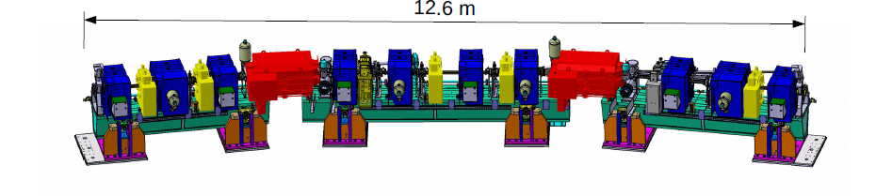
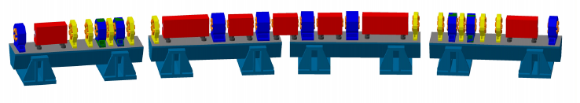
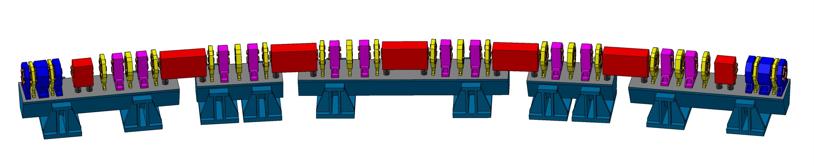
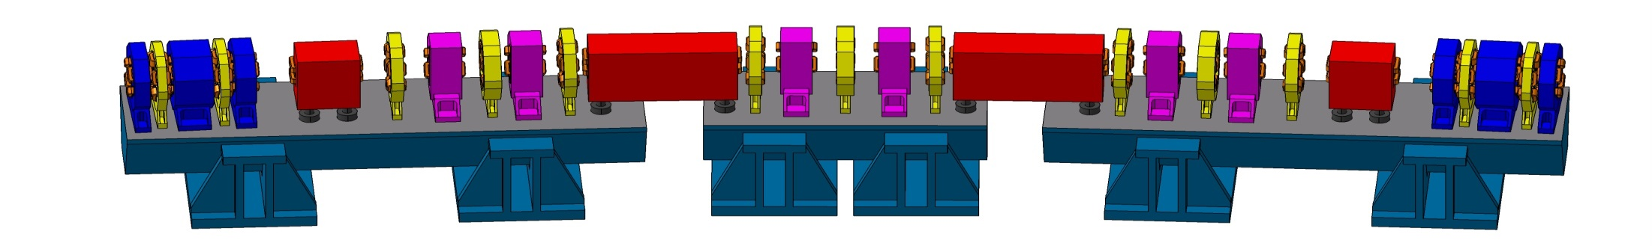
One cell of the present lattice : a total of 312 magnets ( 16 cells)
HYBRID lattice
One cell of the 7BA Hybrid : a total of ~620 magnets (20 cells)
HOA lattice
7BA cell type (12 cells)
4BA cell type (8 cells)
A total of ~ 1200 magnets
Notes:
Hybrid / HOA
Besoin alterner 7BA-4B→ épouser la dynamique

Slide 22
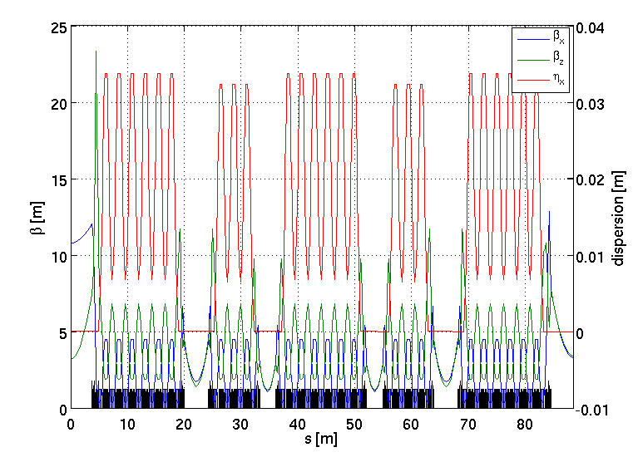
Lattice: Combinaison of 4BA and 7 BA
1/4 of the ring
Strong Geometry Constraints
  No modification of the shielding walls.
  All hutches are preserved.
  Zero radial offset for the three beamlines from the long straight sections (canted insertions).
  Radial shift for the other beamlines on insertion devices: (still on progress)
    -114 mm (4 beamlines )
    +/- 37 mm or 42 mm (10 beamlines)
7BA
4BA
Symmetry 2, 20 straight sections
  8 x 2.8 m
  8 x 4.2 m
  2 x 7.7 m and 2 x 7.3 m

Slide 23
R&D to Alleviate Any Technological Showstopper
Magnet (PM, 100 T/m quadrupole, 7OOO T/m² sextupole)
Vacuum System (10 mm tube, desorption / NEG)
Low-energy Undulator (5 eV-40eV)
RF system (fundamental and harmonic)

Slide 24
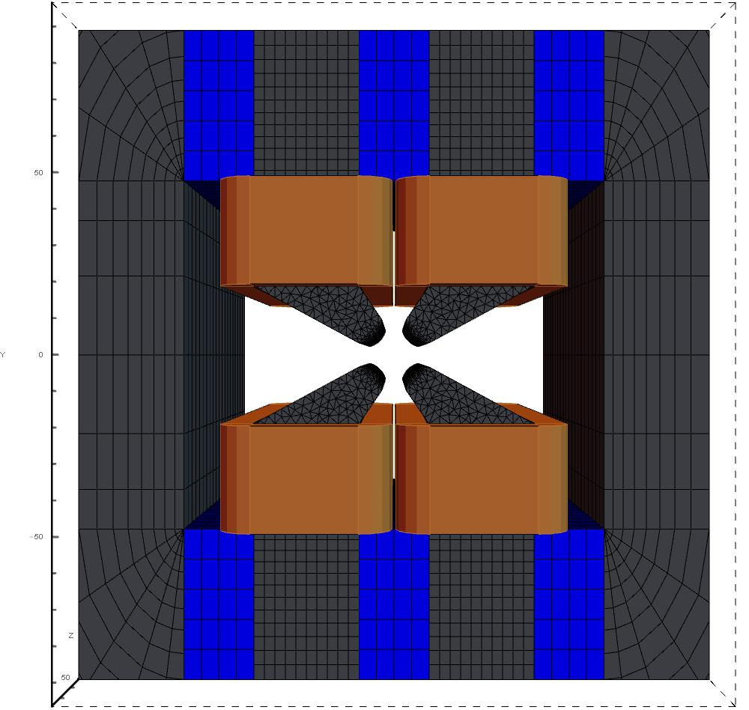
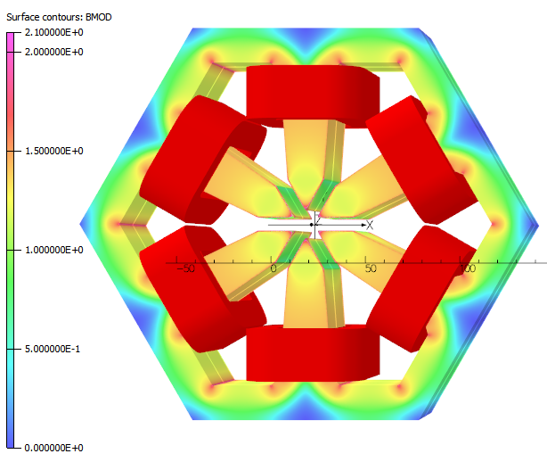
Magnet Strategy
Modular Approach
Inspired by N’Gotta PhD Dissertation
[ Permanent Magnet with coil allowing gradient variation of ± 5% ]
Use of permanent magnets beyond dipole: dipole, quadrupole, reverse bend
Reduce Power on plug.
180 mm
QP# 1 Prototype in 2020
[ Sextupole: Electromagnetic ]
260 mm
185 mm
240 mm
Diameter aperture = 16 mm
Magnet | QP #1 | QP # 2 | QP #3 | QP #4 | QP #5 | QP #6
L meca (mm) | 54.9 | 73.2 | 91.5 | 134.2 | 189.1 | 195.2
G int (T) | 6.18 | 8.55 | 10.93 | 16.48 | 23.62 | 24.41
G (T/m) | 96.5 | 104.2 | 109.3 | 116.1 | 120.6 | 120.9
Diff. with spec. (%) | -0.68 | 0.29 | 0.11 | 0.51 | -0.76 | -0.27
÷ 6.1mm
7200 T/m²
Prototype in 2021
Permanent magnet size: 20 mm x 49 mm x 6.1 mm
Notes:
PM Dipole, quad, RB

Slide 25
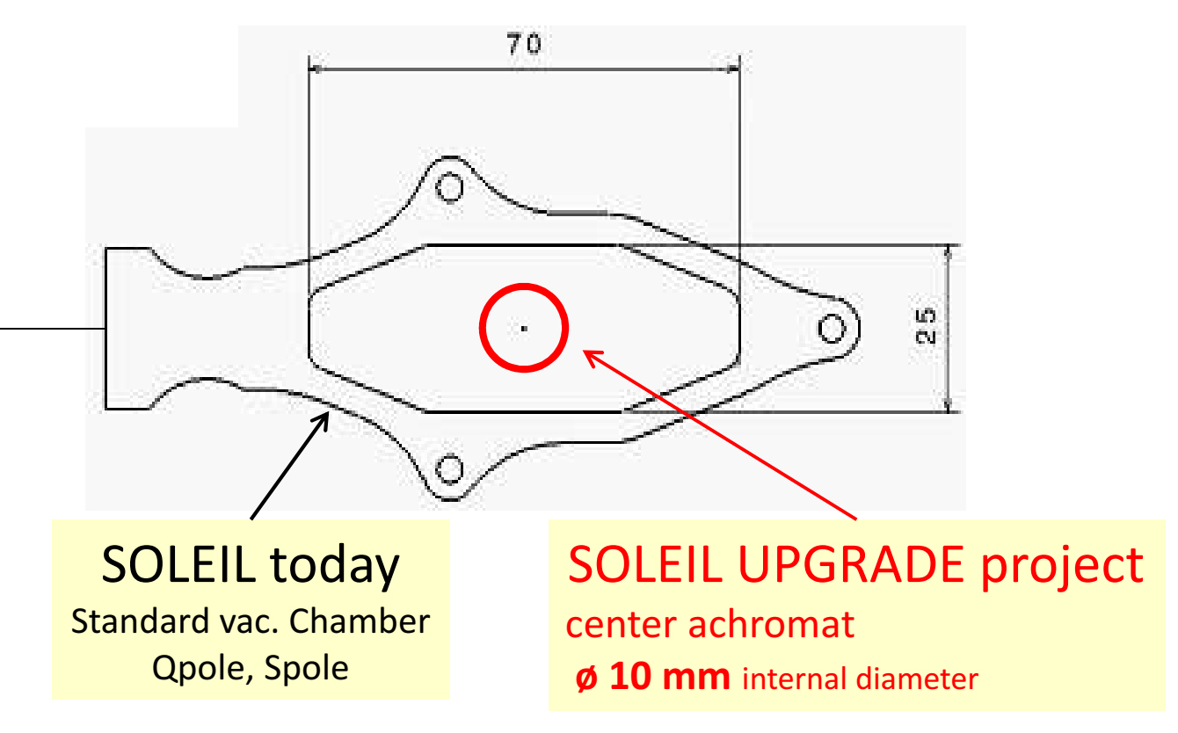
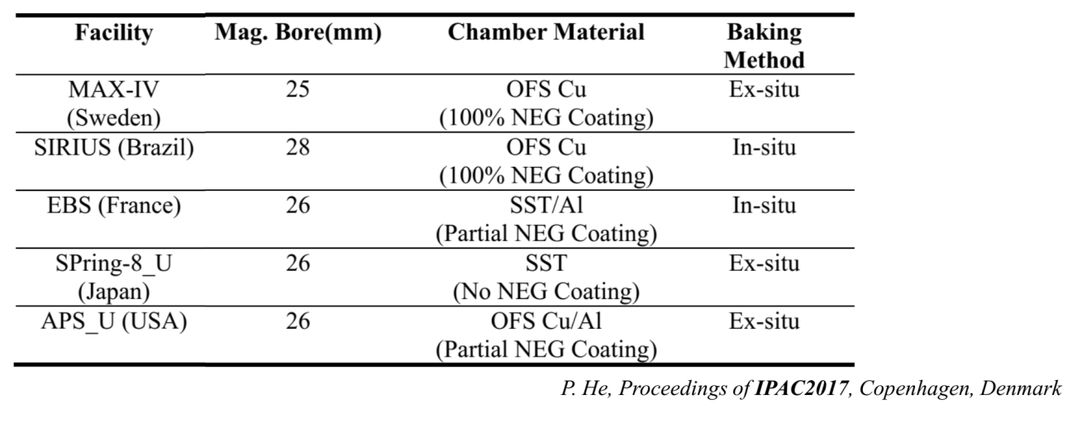
Vacuum System
Drastic reduction of the size of the vacuum chambers
Traditional linear distributed pumping not possible.
Less « standard » pumping space available
(only few ionic pumps along the ring!).
More than 95 % of the ring chambers must be NEG coated.
10 mm inner diameter chambers foreseen
along the lattice (not only on straight section).
Comparison with new Synchrotron Light Sources worldwide
SOLEIL UPGRADE project and challenges:
Magnetic bore of 16 mm needed for high gradient magnets required for targeted emittance

Slide 26
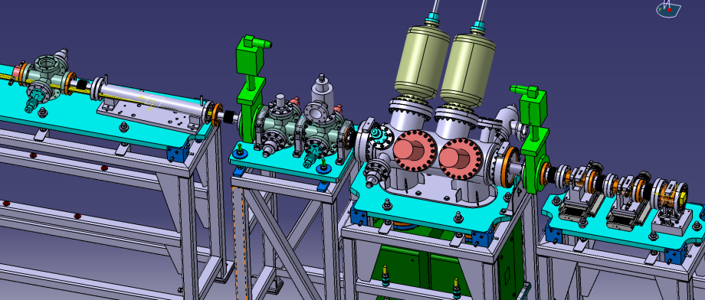
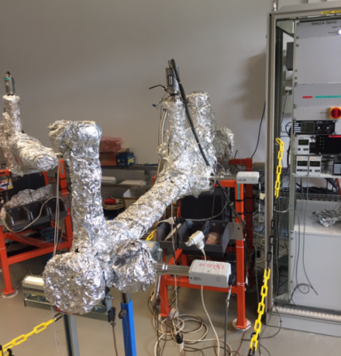



Balance between Photon Stimulated Desorption yield η
& the NEG Pumping speed / saturation-capacity
→ For 10 mm diameter chamber ←
What would be the dynamic pressure and
its evolution with the photon DOSE
2 TEST BENCH launched @SOLEIL
In the LAB
Intrinsic pumping speed of the NEG S^{NEG}
Capacity/saturation
with Injection gaz pur/µleak
H2, CO, CO2, CH4…..
On the ring
PSD η / Dose of photons
Activation NEG with SR ?
Pumping CH4?
(First measurements in June 2020)
« Measuring » $P_{T}$ [mbar]
NEG test chamber
$C \text{[}\text{l}\text{.}\text{s}\text{−1}\text{]}$
S.R.
PSD flux
$Q=C×P_{T}$
for $C$ << S
« Pumping »
S [l.s⁻¹]

Slide 27
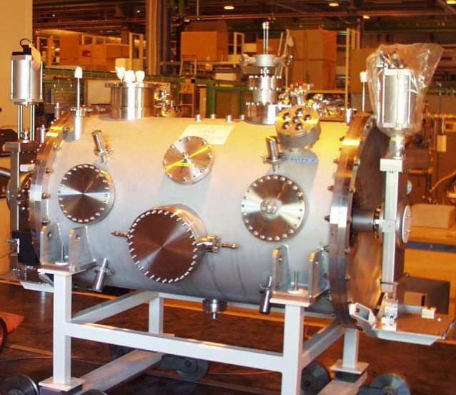
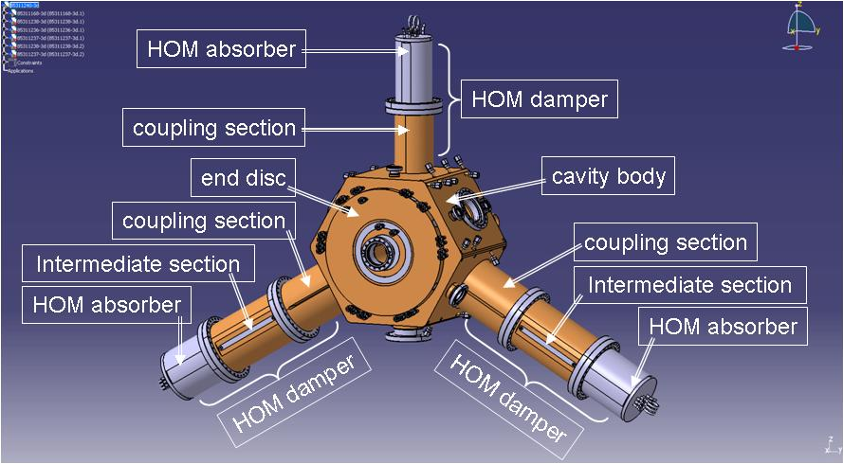
RF System
Main RF cavity: use 4 Normal Cavities (ESRF-EBS type is a good candidate) in a 4.2 m straight → P_{RF} = 4 x 75 kW
Redundancy : one can easily meet the requirements with only 3 of the 4 cavities in use.
Harmonic RF system: h = 3, 4 or 5. The favored
one is presently a passive SC system, based on the
Super3HC CM.
V [MV]
V1h + V3h
V1h = 1.7 MV
V3h = 0.53 MV
Super3HC CM.
Long bunch
Long
bunch

Slide 28
A Tentative Schedule for An Upgrade
Date | Phase
Dec. 2016 | Council meeting, presentation of the first proposal for an upgrade.
2017 - 2019 | Discussions regarding the definition of the project (beamlines and storage ring); definition of objectives. Baseline Lattice defined.
2018 - 2019 | Continuation of discussions and prototyping to assess feasibility of key options.
2019 | Decision to launch a Conceptual Design Report (CDR).
2019-2020 | CDR based on preliminary studies and prototyping. New Baseline Lattice.
2021 | Decision to launch a Technical Design Report (TDR).
2021-2022 | Technical Design Report.
2023 | Decision to start the project.
2023-2026 | Reconstruction of storage ring and beamlines.
2027 | Restart of user operation.

Slide 29
CONCLUSION
The main metrics of the machine operation: availability of the beam
for the users (98.8%), mean time between failures (95h) and mean time to recover (1h) are all at a very good level and among the best light sources.
Ambitious and innovative R&D projects are conducted either to
enhance the performances of the present Machine (second RF cavity
in the Booster), to improve the flux at high photon energy (Rock and Psiche beamlines) or to validate new schemes for the upgrade ( injection scheme).
The upgrade of Soleil is in its CDR phase. The definition of the baseline lattice, the first engineering studies and prototyping are under progress.

Slide 30
Thank you for your attention
Questions?

Slide 31
Annexes

Slide 32

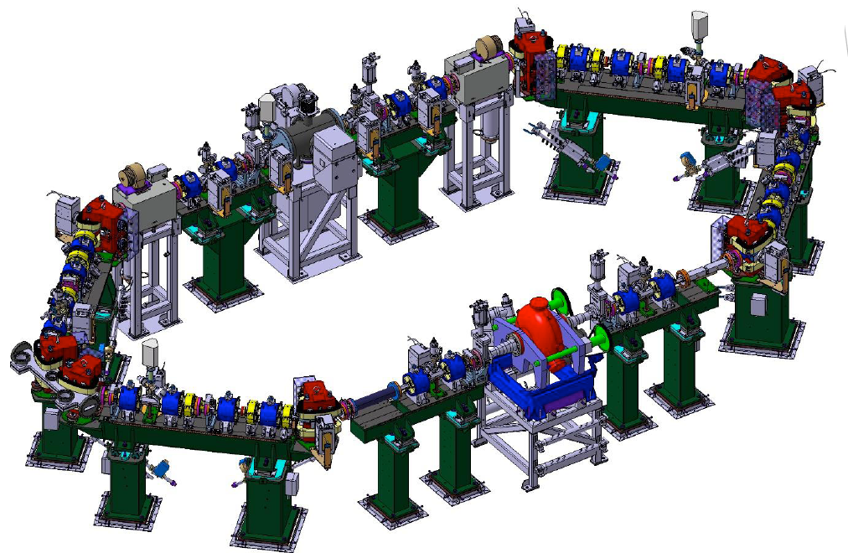
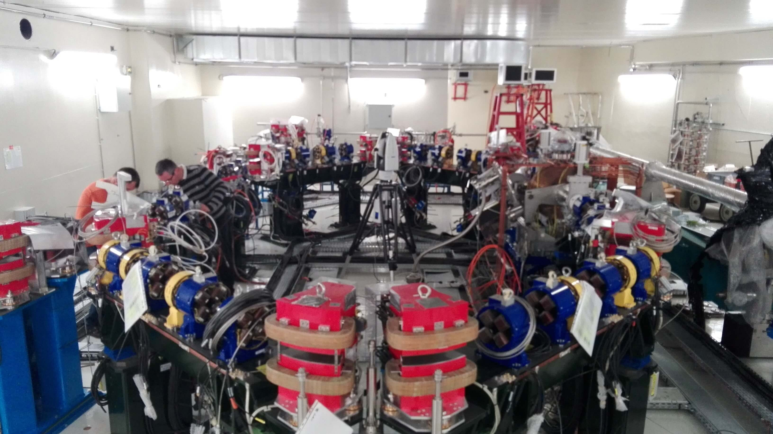
Courtesy of A. Loulergue
Compton Back Scattering X-ray Source
Electron: 1 bunch, 1 nC, 20 to 70 MeV max
Rep = 20 MHz in a ring
Laser: 1 pulse, 10 – 30 mJ max
Rep = 40 MHz in FP cavity
X-Flux: up to 90 keV
up to 10¹³ Photon/s
18 m
Status
All installation should end by March-2020
Commissioning: (Show-stopper ASN)
Linac March – 2020
Fabry-Perot cavity April – 2020
Ring Spring – 2020
First photon by end of 2020
Installation almost completed
Missing pulsed magnets and few connecting pipes
C. Herbeaux, 27th ESLS Workshop, ALBA, 2019
Notes:
32

