Slide 1
SLS and SLS 2.0 Status
Volker Schlott :: SLS 2.0 Accelerator Systems :: Paul Scherrer Institut
27th European Synchrotron Light Sources Workshop, Barcelona, November 28th – 29th 2019

Slide 2
Overview
courtesy of
Andreas Lüdeke and
Thomas Schietinger
SLS Operation 2019: Statistics and Developments
SLS 2.0 Design Criteria and Lattice Solution
Examples of SLS 2.0 Technical Systems:
Vacuum System
Room Temperature Magnets
Superconducting Super-Bend
Conclusions and Outlook
courtesy of
Andreas Streun
many thanks to
Adriano Zandonella
Marco Negrazus
Philippe Lerch and
Ciro Calzolaio

Slide 3
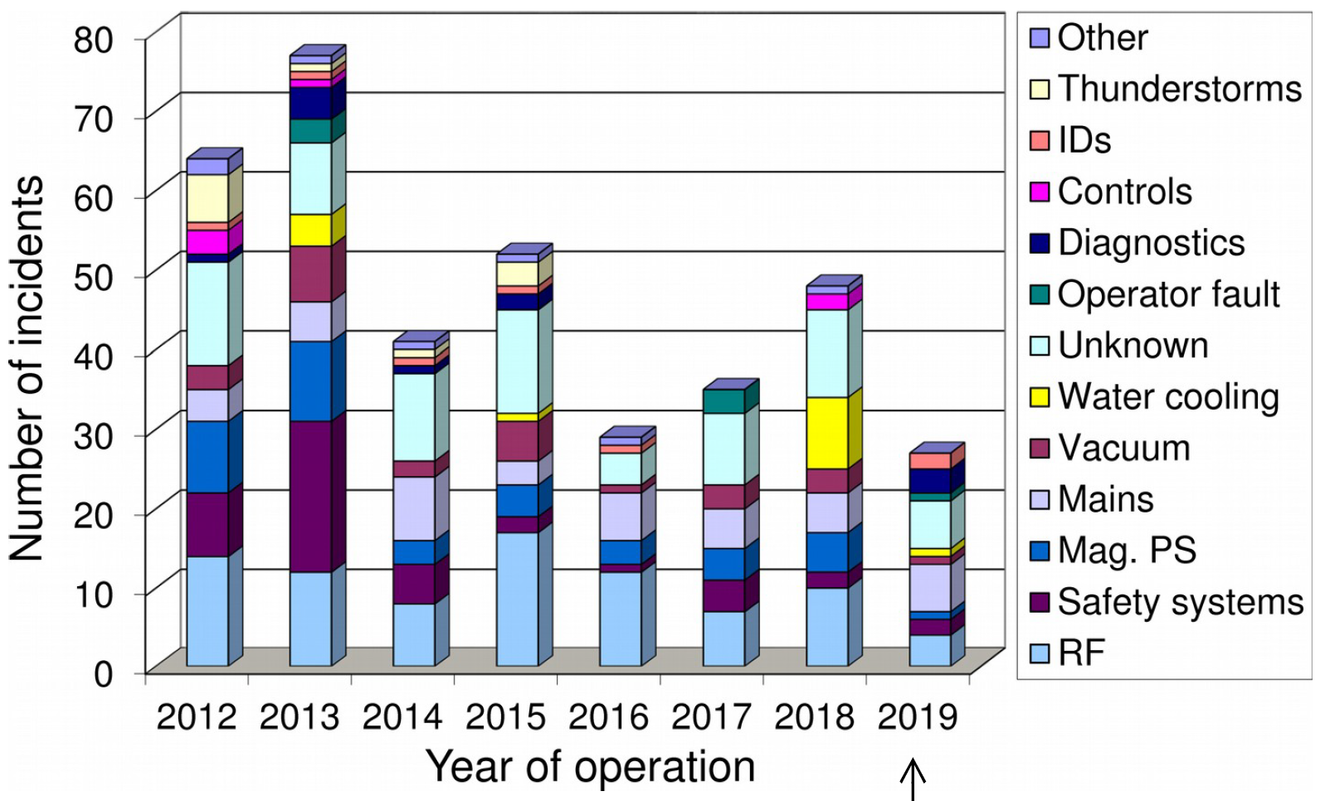
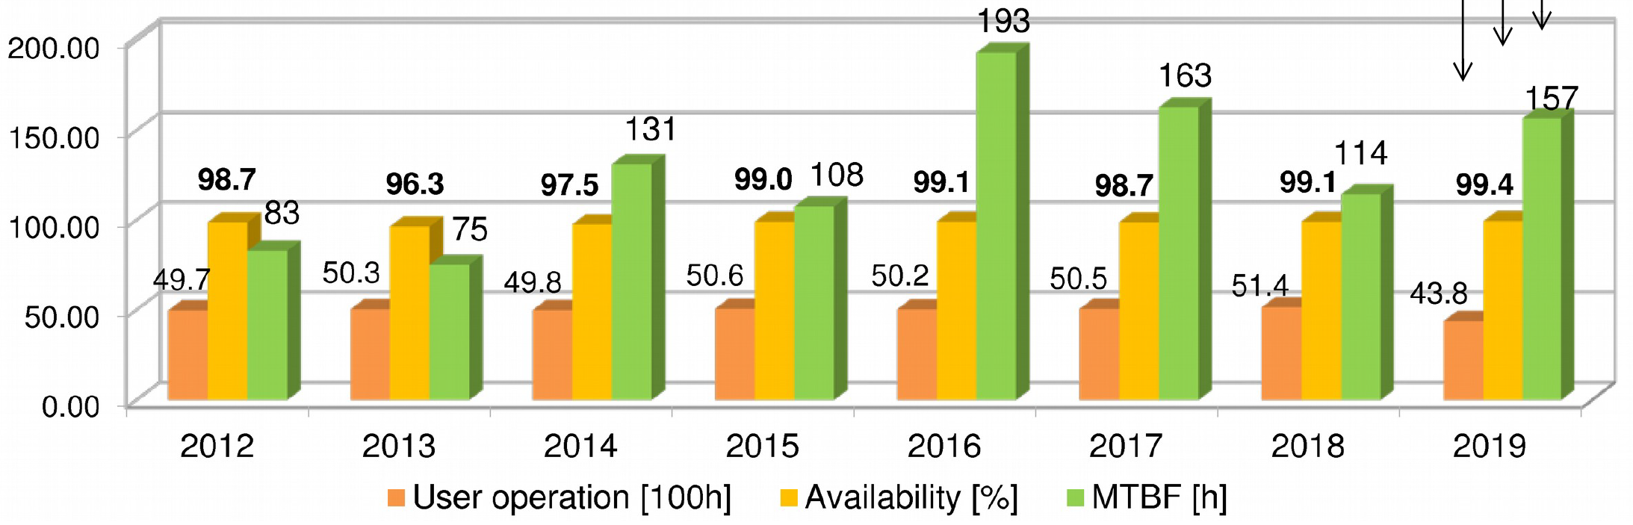
SLS Operations Statistics - 2019
Excellent year 2019 (so far):
Highest beam availability ever: 99.4%
6 ½ days mean time between failures (MTBF)
Mean time between distortions (MTBD) was relatively low: 30 h (59 h in 2018)
a noticeable number of BPM glitches
due to ageing HW (DBPM from 1999)
data until 12-11-2019

Slide 4
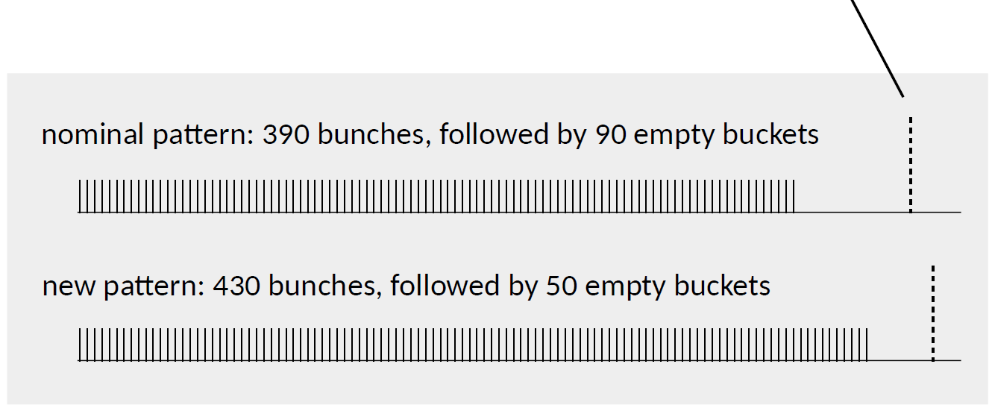
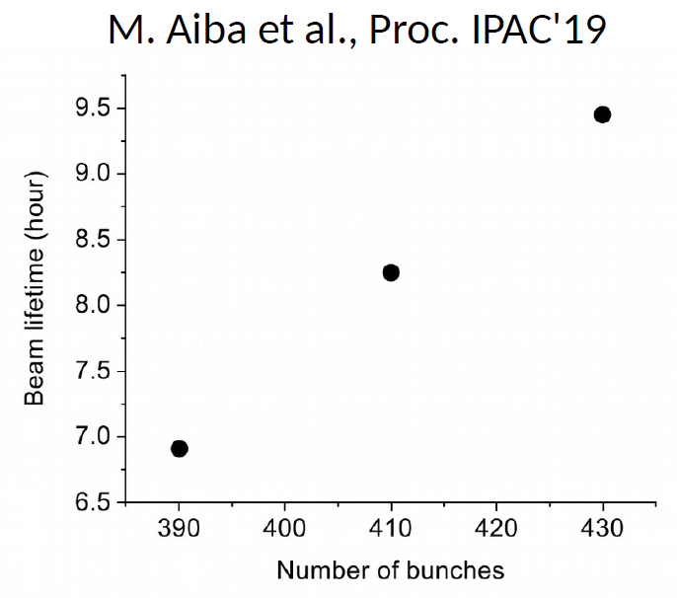
SLS: New Filling Pattern with Longer Lifetime
Background
uniform filling pattern of bunch train gives longest lifetime
however ion clearing gap is necessary to avoid ion instabilities
shorter ion clearing gap appears to be possible (improved vacuum conditions?)
optional camshaft-bunch
new filling pattern
is available on
user request
Test of New Filling Patterns
shorter ion clearing gaps have resulted in improved lifetime (up t 30%)
additional effect from reduction of beam-loading in 3HC
drawbacks: optimal placement of camshaft-bunch used by some
beamlines is more difficult with shorter ion clearing gap
camshaft-bunch is slightly longer for shorter clearing gap

Slide 5
SLS 2.0 Upgrade Project: Some Milestones
September 2017: CDR and CDR Review
January 2018: Submission Document to Funding Agencies (SBFI)
January 2018 – December 2020: Pre-Project Phase
  → pre-financing from SBFI and PSI for project preparation
  → lattice design and beamline layout (TDR in April 2020)
  → component specifications, designs and prototyping
January 2021 – December 2024: Project Phase
  → main funding period for project execution
  → series production, component deliveries, quality control…
  → full cell mock-up
  → pre-assembly of storage ring components on girders
  → “dark period” (April 2023 – September 2024)
  → machine and beamline commissioning (until end of 2024)

Slide 6
SLS 2.0 Design Charge
user requirements
  → 30× higher brightness (@ 12 keV)
  → wide spectrum of beam lines: from VUV to hard X-ray
beam dynamics challenge: comparatively small circumference
  → brightness ∝ (circumference)³
beam physics feasibility
  → lifetime and injection efficiency: dynamic aperture
  → 400 mA beam current: impedances & instabilities
technical challenges
  → magnets, vacuum system and (on-axis) injection
civil engineering (and dark period logistics)
  → limited modifications of building and infrastructure

Slide 7
SLS 2.0 Lattice Solution
Increased number of bending magnets
→ 12 × 7-Bend-Achromat [SLS: 12 × 3-BA]
Reduced beam pipe aperture
→ 18 mm diameter [SLS: 65 mm × 32 mm]
Novel low emittance unit cell
→ combination of reverse bends and longitudinal gradient bends
results in optimum suppression of quantum excitation
→ Emittance 123 pm [SLS: 5580 pm] ⇨ factor 45 smaller
Maintain total straight length of ≈ 80 m (28 %)
→ 3 × long (11.4 m) + 9 × standard (5.4 m)
→ [SLS: 3 × long (11.5 m) + 3 × medium (7 m) + 6 × short (4 m)]
→ all straights to be split at variable ratio
Avoid tunnel modification
→ symmetry-3 footprint but symmetry-12 dynamics by tuning
(7/3)³ ≈ factor 13
+15…20% emittance increase
by intra-beam scattering (IBS)

Slide 8
Issues Causing SLS 2.0 Lattice Revisions
Space conflicts
→ feasibility of mounting due minimum distances between elements
→ feasibility of magnets (short, wide, high fields)
→ free pathways for photon beams (especially at long wavelengths)
Insufficient brightness
→ bad matching of electron phase space to diffraction
as brightness depends on the area of the electron phase space
(emittance ε_{x} = σ_{x}⋅ σ_{x′} ) and its aspect ratio (beta function β_{x} = σ_{x} /σ_{x′} )
  solution: split standard straights with mini-beta optics (“completion phase”)
Insufficient dynamic aperture (optimizations still to be done!)
→ constraints on (dynamic) symmetry and working point
→ development of alternative injection schemes
Risk of beam instabilities
→ switch from negative to positive momentum compaction (side effect: reduced power consumption)
x′
x
GREEN MACHINE

Slide 9
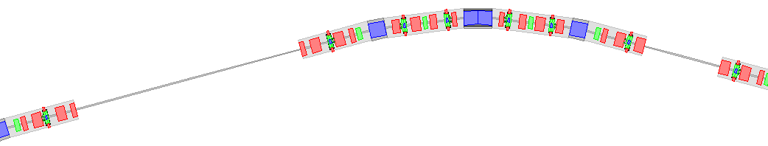
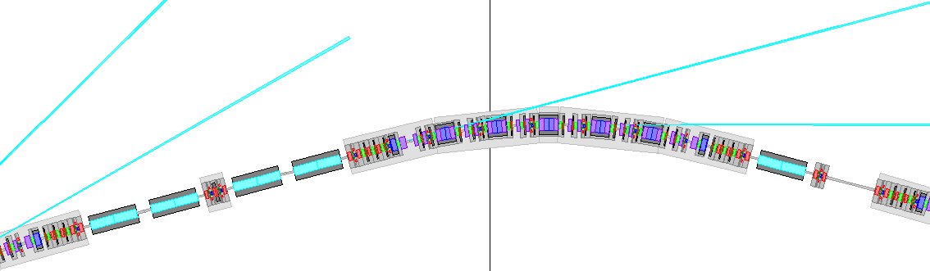
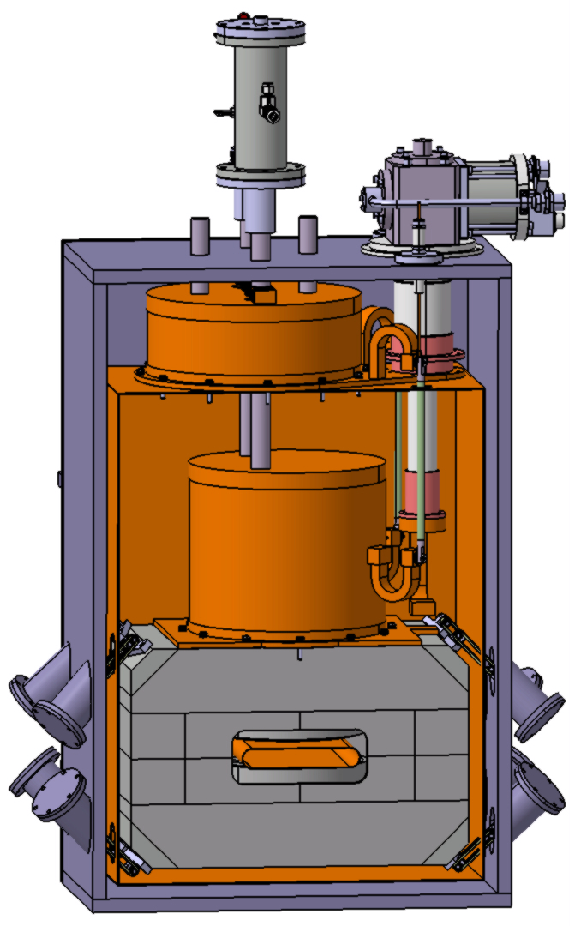
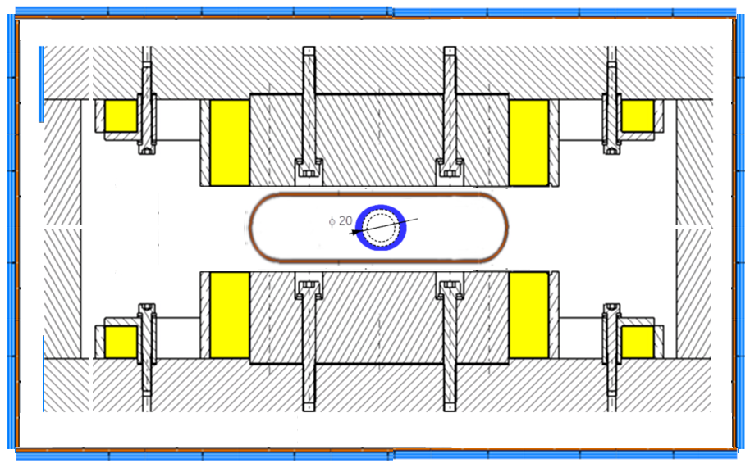
Comparison: SLS and SLS 2.0 Sector Layouts
3 BA
SLS sector
SLS 2.0 sector
7 BA
standard straight
long straight
optional superconducting super-bends (5T) in arc centers
→ 3 sc super-bends planned in centers of arcs 02, 06 and 10
long straights 05L and 09L split from beginning
→ quadrupole doublets for variable splitting of standard straights
to be used in completion phase

Slide 10
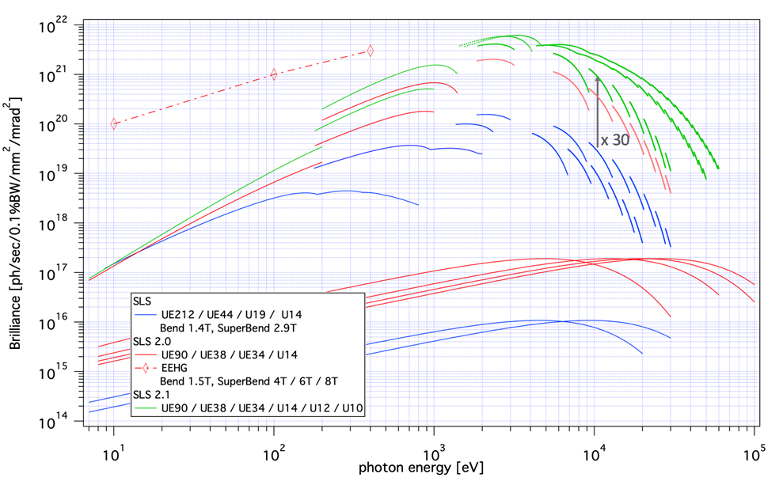
SLS 2.0 Performance: Brightness
SLS now
SLS 2.0 commissioning phase
SLS 2.0 completion phase

Slide 11
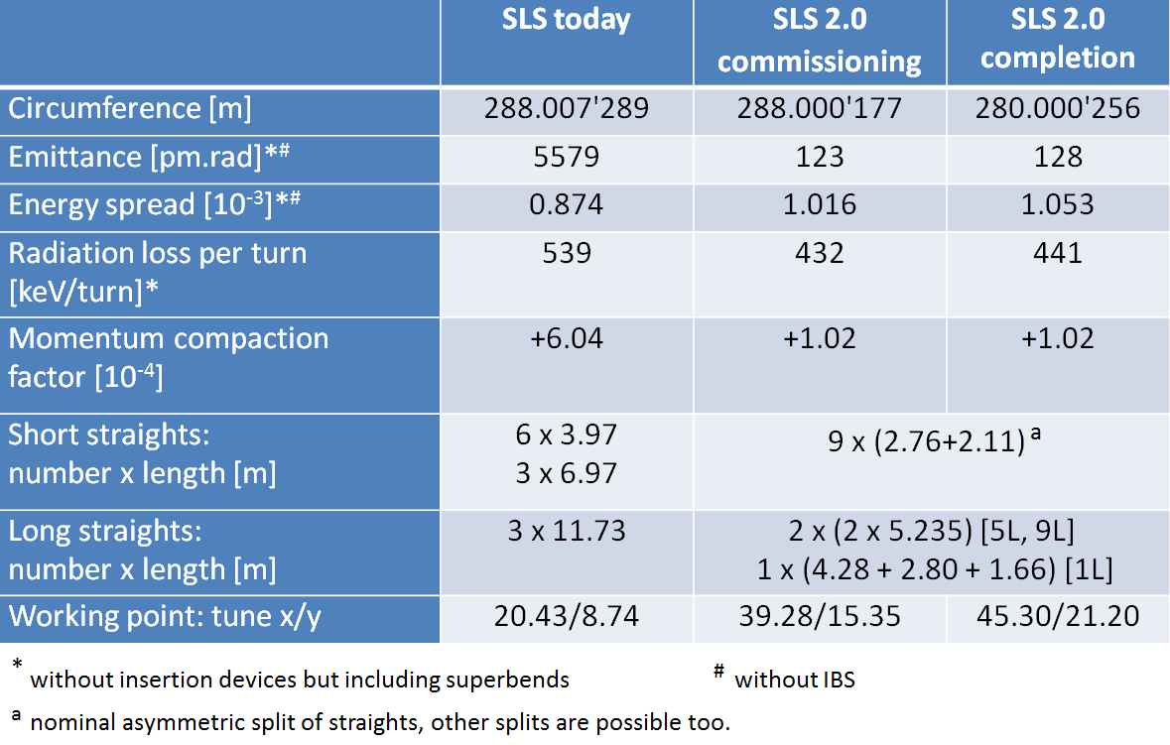
SLS 2.0 Lattice Parameters

Slide 12
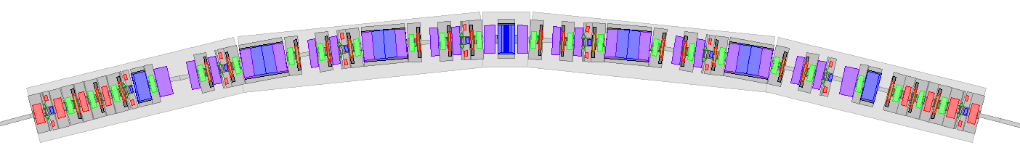
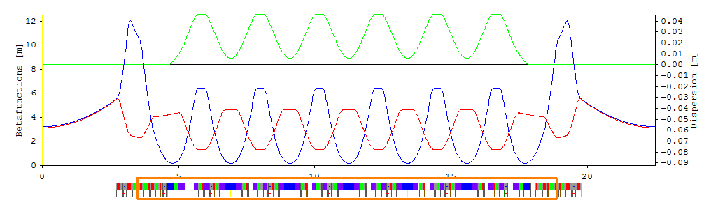

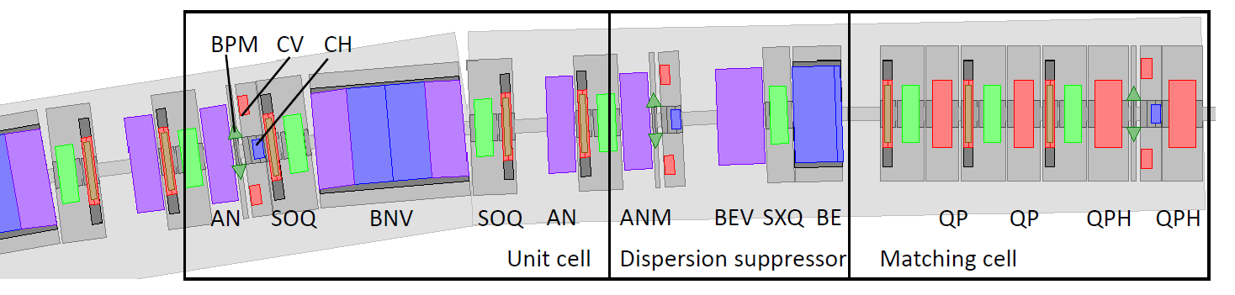
SLS 2.0: Layout and Optics of an Arc

Slide 13
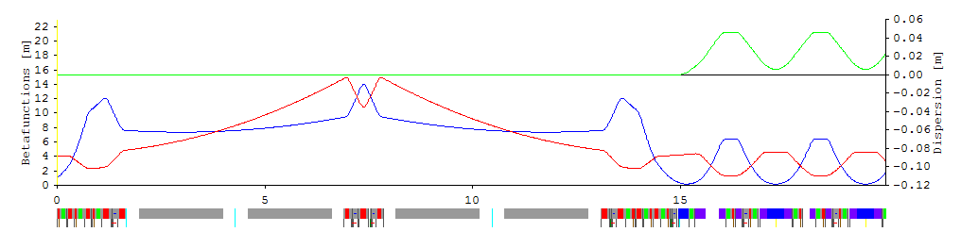
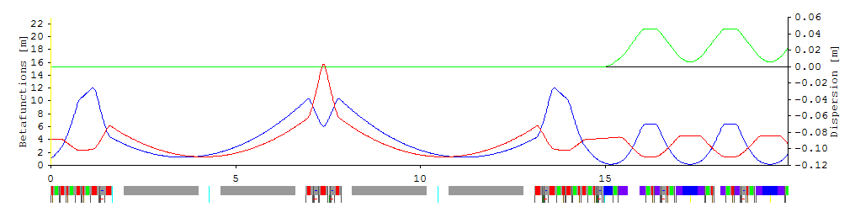
SLS 2.0: Long Straights 05L and 09L
Layout and optics in commissioning phase
Layout and optics in completion phase

Slide 14
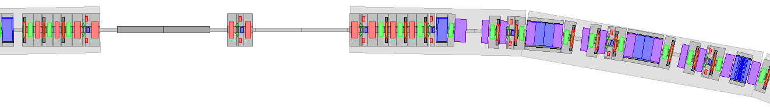
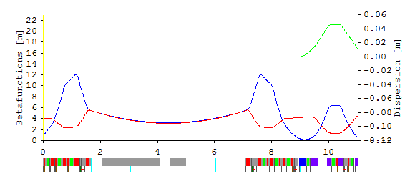
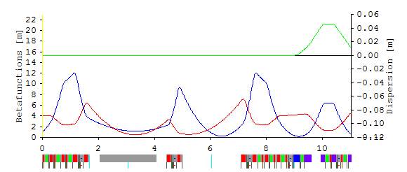
SLS 2.0: Standard Straights
Layout and optics in commissioning phase
Split Options:
nominal: 2.76 + 2.11 m
straights: 06, 10, 12
inverse nominal: 2.11 + 2.76 m
straights: 02, 04
almost symmetric: 2.50 + 2.37 m
straights: 03, 07, 11
very asymmetric: 2.90 + 1.97 m
straight: 08
Layout and optics in completion phase

Slide 15
Technical Advances and Innovations for SLS 2.0
SLS 2.0 requires technical innovations…
vacuum system small diameter copper chambers and ultra-thin NEG-coatings
magnets high gradient electro-magnets and permanent magnet technology
on-axis injection thin septum and ultra-fast, high-field pulsers and kickers
SC super-bends integrated vacuum chamber design with Nb-Ti conductor provides B ≈ 5 T
…and state-of-the-art technologies
solid state RF amplifiers high efficiency, increased reliability and low noise performance
digital electronics power supplies, BPMs & Feedbacks, LLRF, NPP, motor controllers...
photon monitors reliable and feedback-ready photon beam (position) measurements
pixel detectors for next generation imaging applications
science IT extremely large data volumes and data reduction at the source

Slide 16






Renewals and Make-Ups for the SLS Facility…
…for SLS 2.0 we need mature systems with the timeless agility of youngsters ☺
Cher
The Rolling Stones
ZZ Top
1960’s
1974
2019
2019
1970’s
2019

Slide 17
Renewals and Make-Ups for the SLS Facility…
injector → 20 more years of reliable top-up operation for LINAC and booster synchrotron
→ renewal of power supplies, vacuum control and interlock systems
electronics and controls system → avoid various generations of HW, FW and SW
→ renewal of BPM and LLRF systems, FOFB and MBFB
→ renewal of electronics (NPP) and motion control
infrastructure systems → new SR cabling and renewal of electrical installations
→ renewal of water cooling, cryogenics and air conditioning
→ renewal of safety systems (MPS, PSYS, EPS, LAC etc…)
WSLA building → renovations of roof and floor
→ refurbishment of existing crane
→ installation of 2nd crane and 2nd entrance (later used as BL-extension)

Slide 18
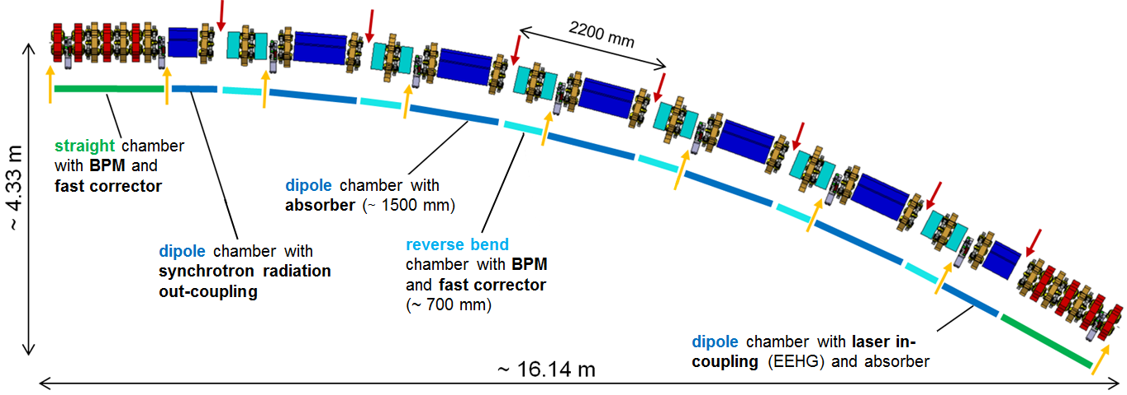
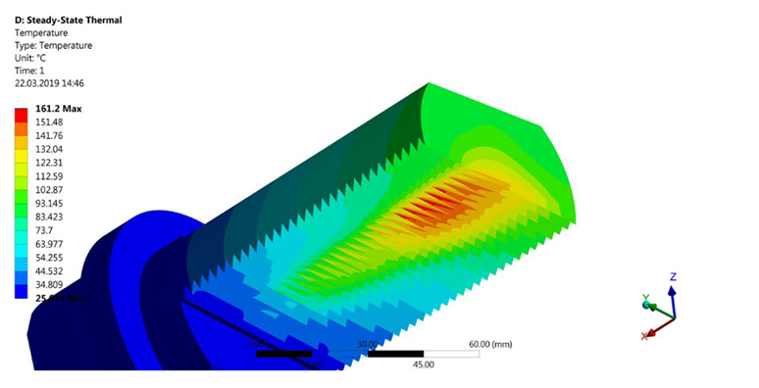
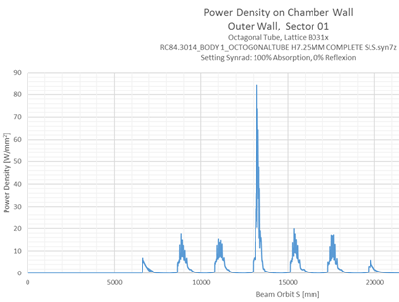
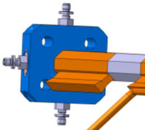
Vacuum System for SLS 2.0 Storage Ring Sector
sc super-bend
normal bends
small diameter vacuum chamber in copper without bellows provides low resistive wakes
18 mm diameter with 1 mm wall thickness over ~ 20 m arc length with 0.5 mm space in magnet bores
high heat load from SR requires ante-chambers with water-cooled crotch absorbers
~ 20 W/mm² from normal bends (CuCrZr) and ~ 85 W/mm² from 5T SC super-bends (Glidcop)

Slide 19
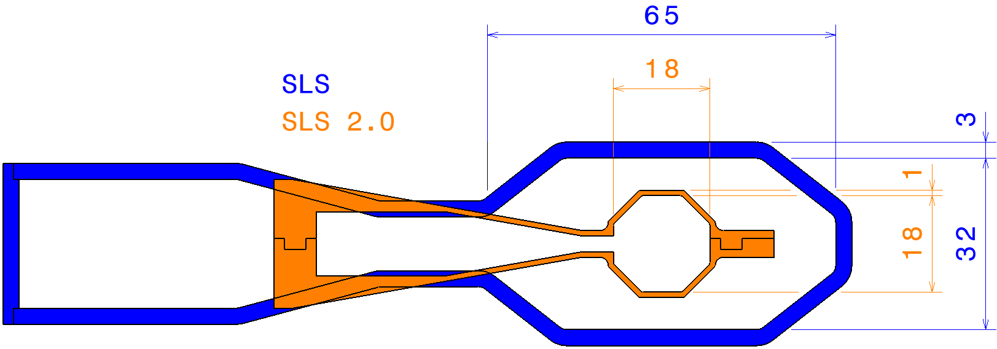
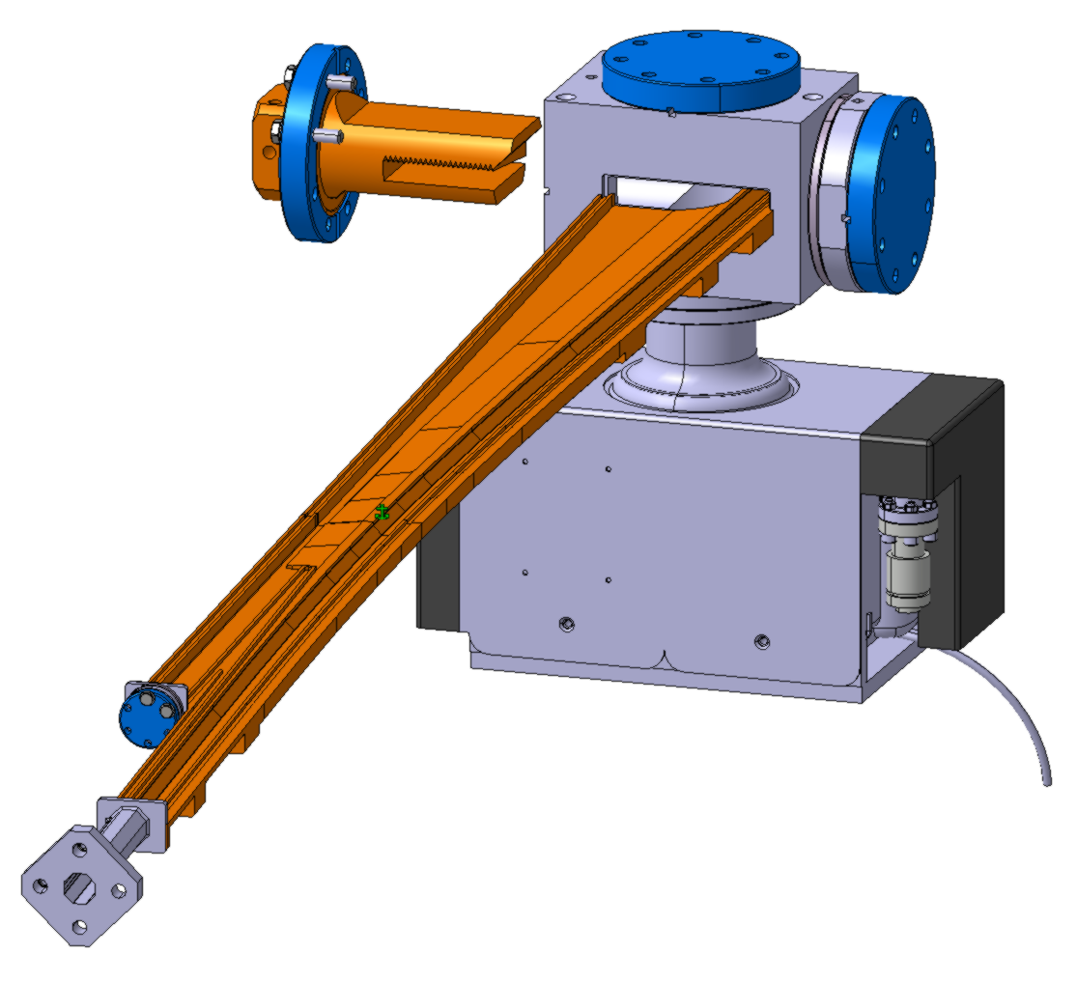
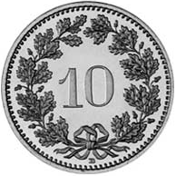
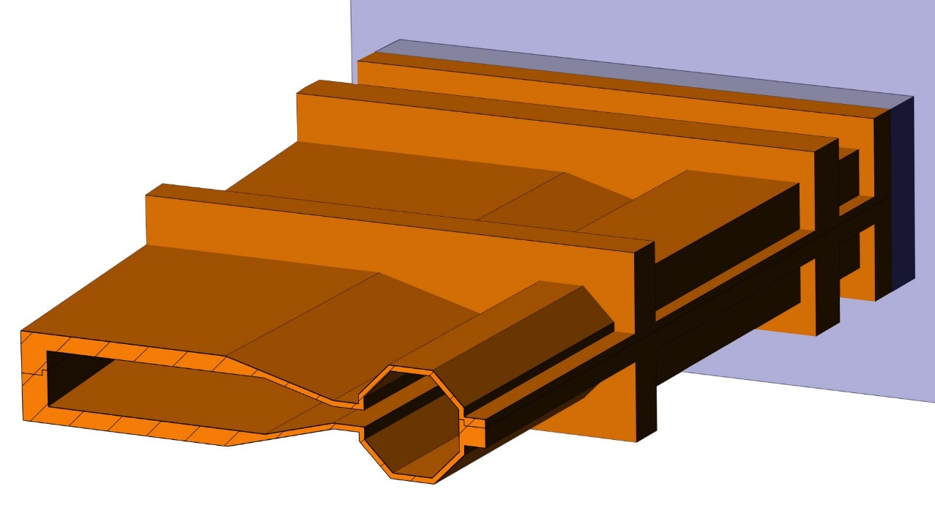
Examples of SLS 2.0 Vacuum Chambers
Four Main Vacuum Chamber Types per Arc:
dipole chamber with crotch absorber (#60)
dipole chamber with BPM / Corr (#72)
light in / out coupling dipole chamber (#12)
straight chamber with BPM / Corr (#24)
water-cooled straight chamber with BPM pickup & fast corrector
dipole chamber
crotch absorber
port for NEG coating of antechamber
antechamber
e-beam
channel
stainless steel
for fast correctors

Slide 20
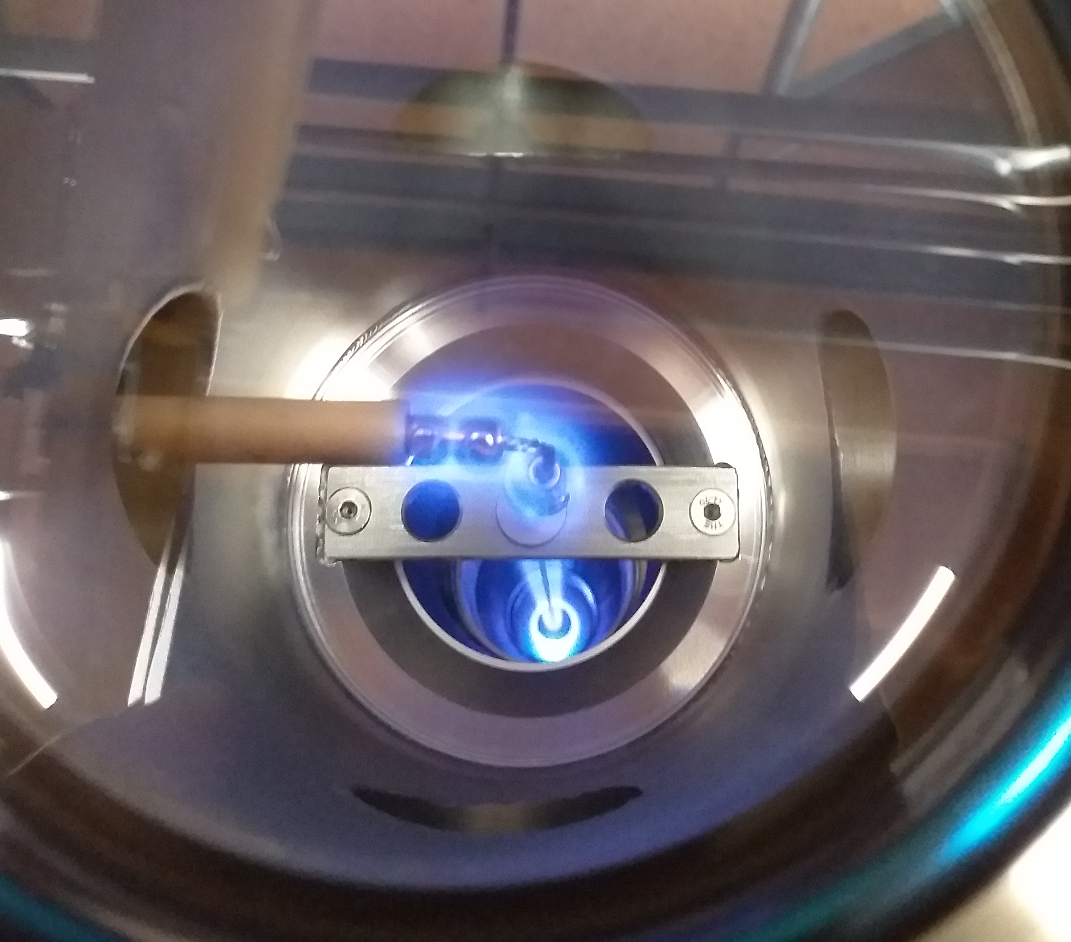
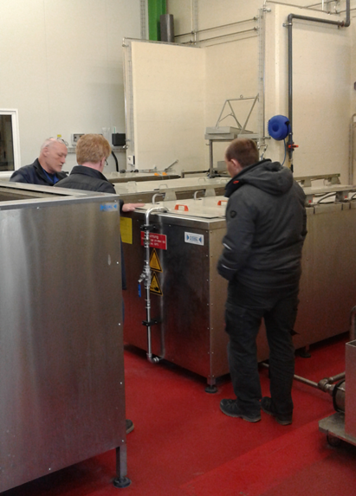
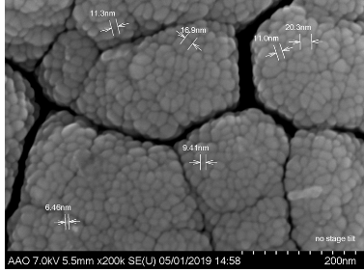
NEG-Coating for SLS 2.0 Vacuum Chambers
NEG-coating (non-evaporable getter) reduces synchrotron radiation induced desorption
NEG-coating thickness of 200 nm ± 30% for low beam impedance and “safe” 400 mA operation
Surface cleaning at AIK
NEG-Coating Set-Up at SLS
Measurements at LMX-PSD and Hot-Labor
1
2
3
etching and passivation
of Cu-tubes
NEG magnetron sputtering
(20W/m)
FIB + SEM: thickness
EDX: Composition (e.g. 55% V; 30 % Ti; 15% Zr)
Recipe:
surface cleaning → very important for adhesion
plasma magnetron sputtering: definition of pressure*distance; T_{substrate}; current; B field
analysis: pumping speed after activation; SEM for thickness and EDX for composition

Slide 21
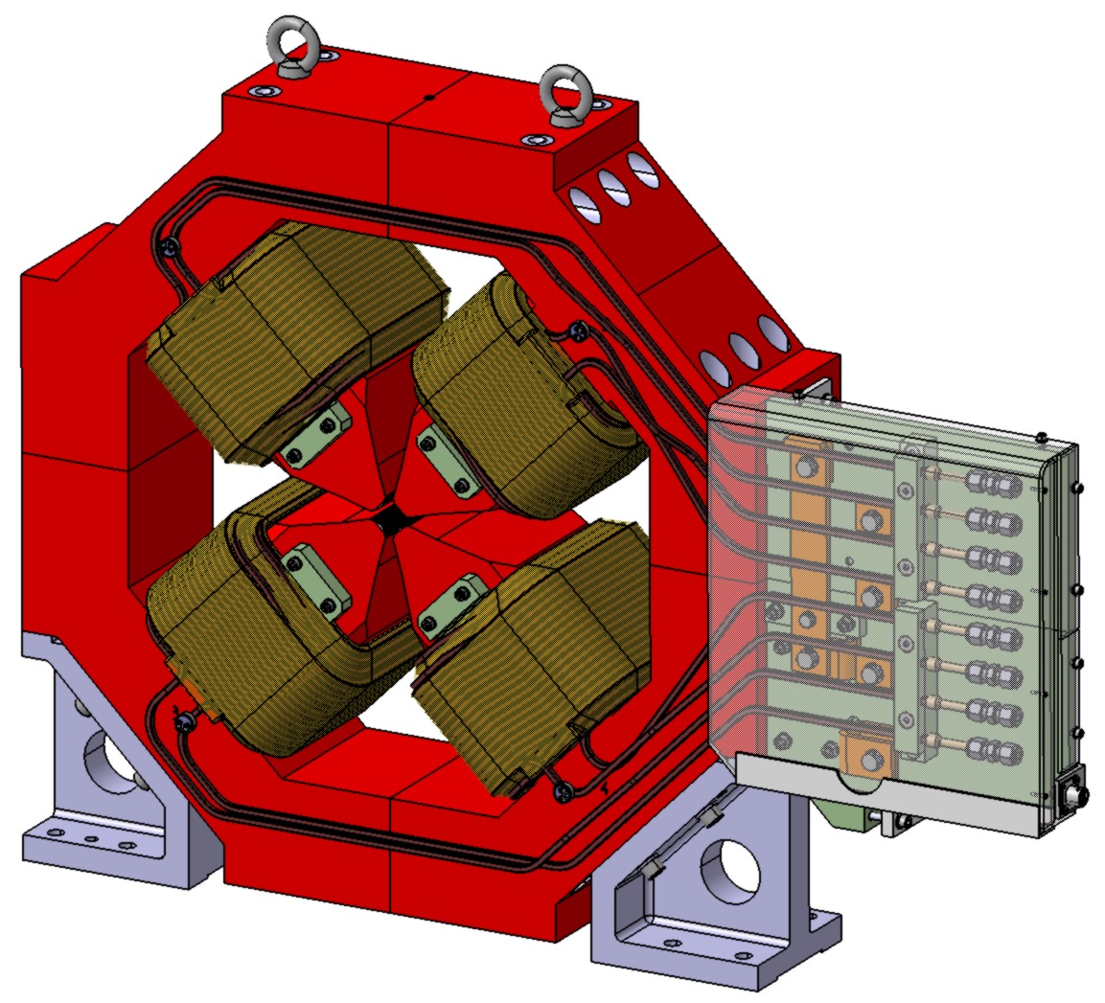
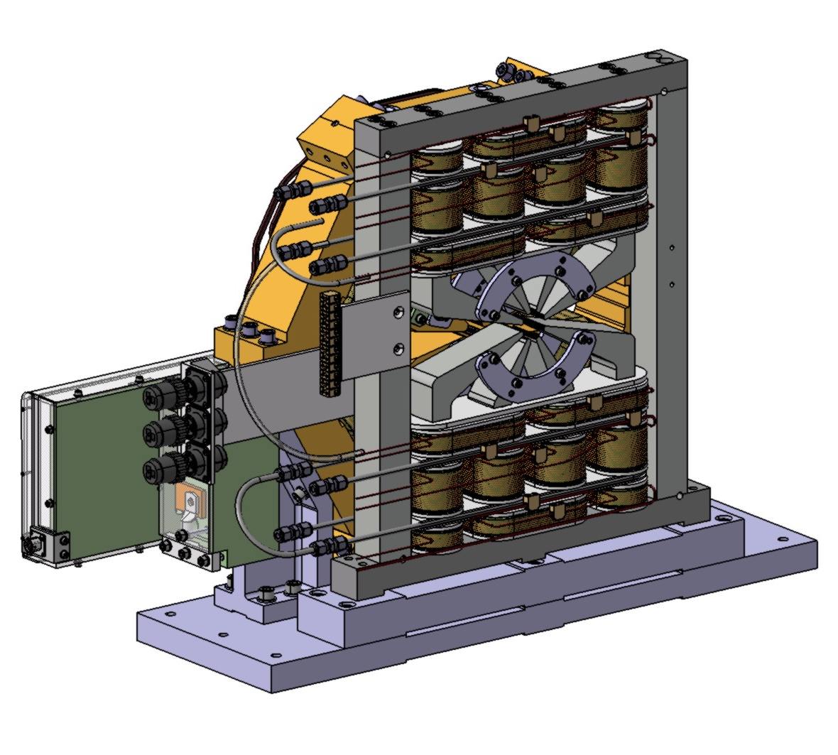
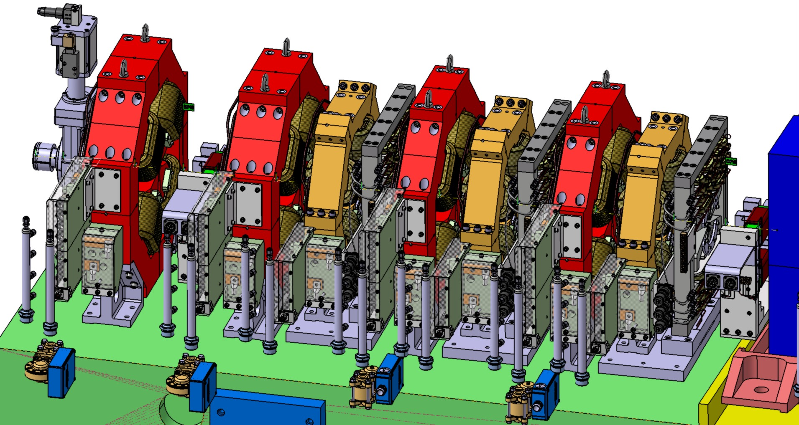
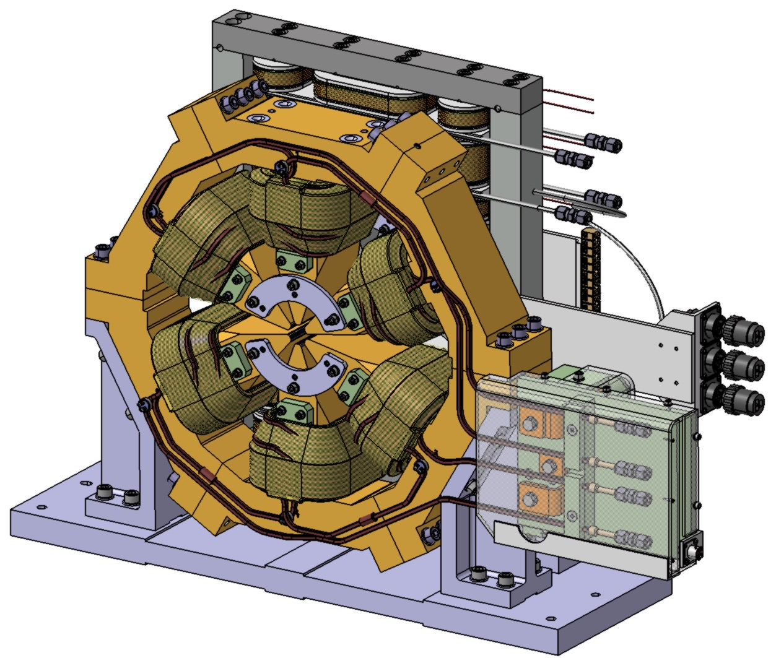
SLS 2.0 Magnets: Electro-Magnets
extremely dense SLS 2.0 lattice requires very compact and complicated magnet designs
only a few millimeters space between magnets in the matching sections
strong focusing (for low β-functions in the straights) requires extremely high gradients
e.g. quadrupole gradients of up to 100 T/m are close to saturation
CAD-Drawing of SLS 2.0 Matching Section
CAD-Drawings of QP / QPH and Sextupole-Octupole Sandwich

Slide 22
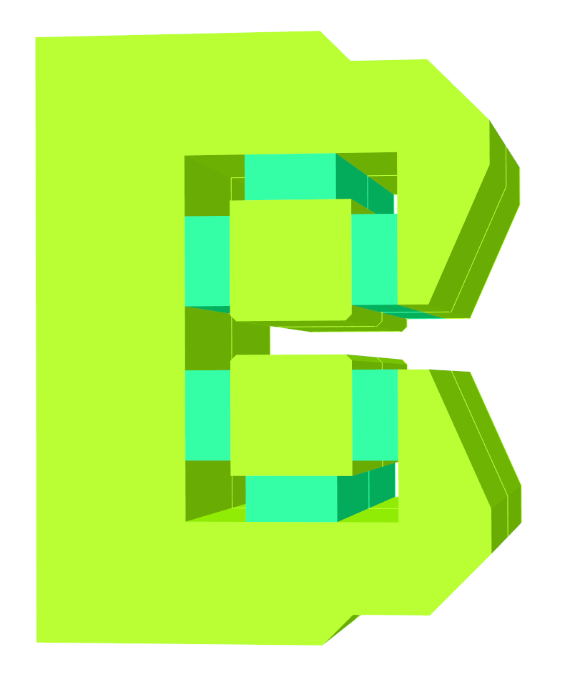
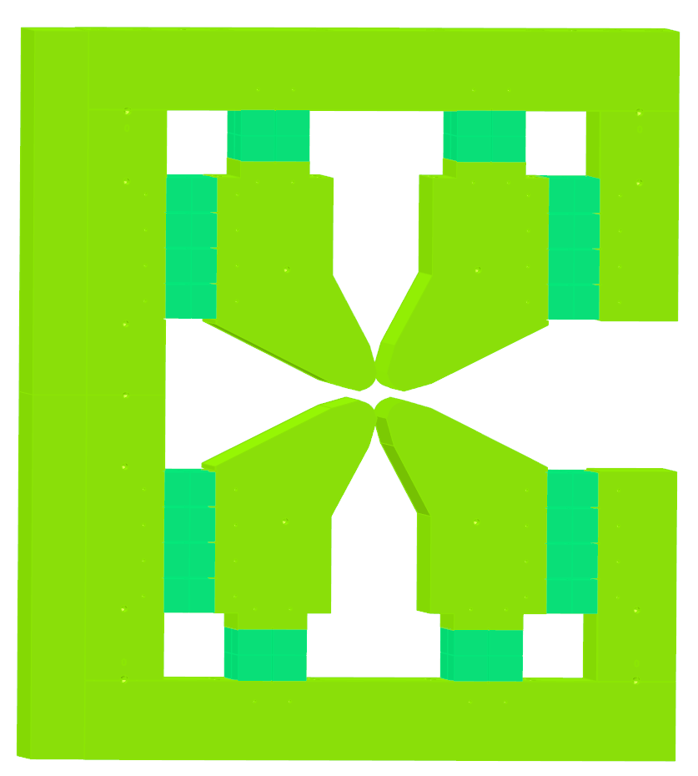

SLS 2.0 Magnets: Permanent-Magnet Design
compact SLS 2.0 lattice design requires three types of permanent magnet bends
PM-bends represent new technology for accelerator magnets at PSI
SLS 2.0 dipole BN is about twice as strong as ESRF dipoles
Dipole BN
Quadrupole with Dipole AN
Dipole with Quadrupole VB
dipole field: 1.201 T
# of magnets: 60
dipole field: - 0.24 T
quad. gradient: 69.05 T/m
# of magnets: 120
dipole field: 0.755 T
quad. gradient: - 36.0 T/m
# of magnets: 120
iron yoke
iron yoke
iron yoke
600 mm
800 mm
600 mm
PM
blocks
PM
blocks
PM
blocks

Slide 23

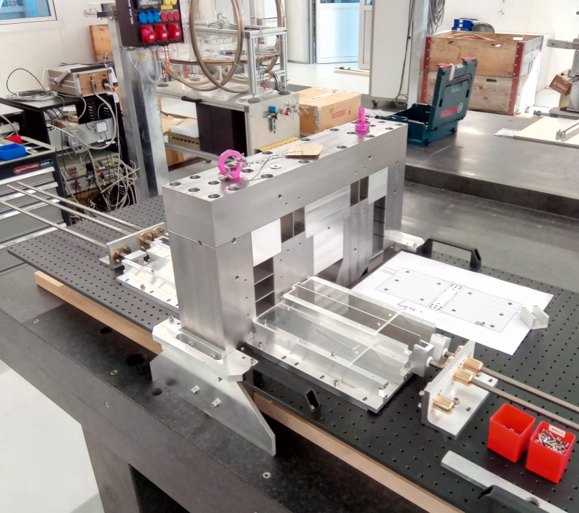
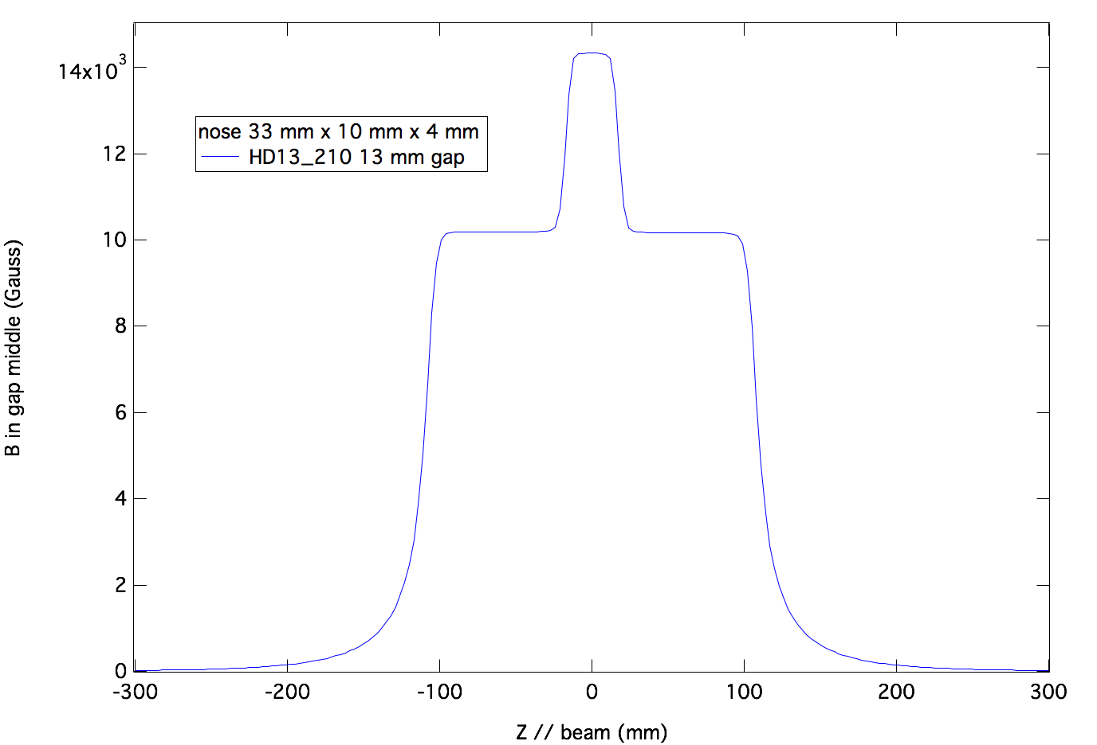
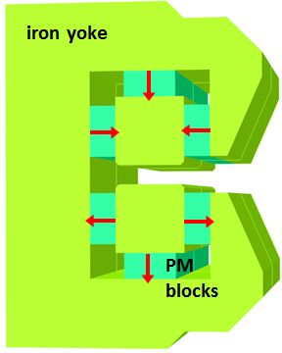
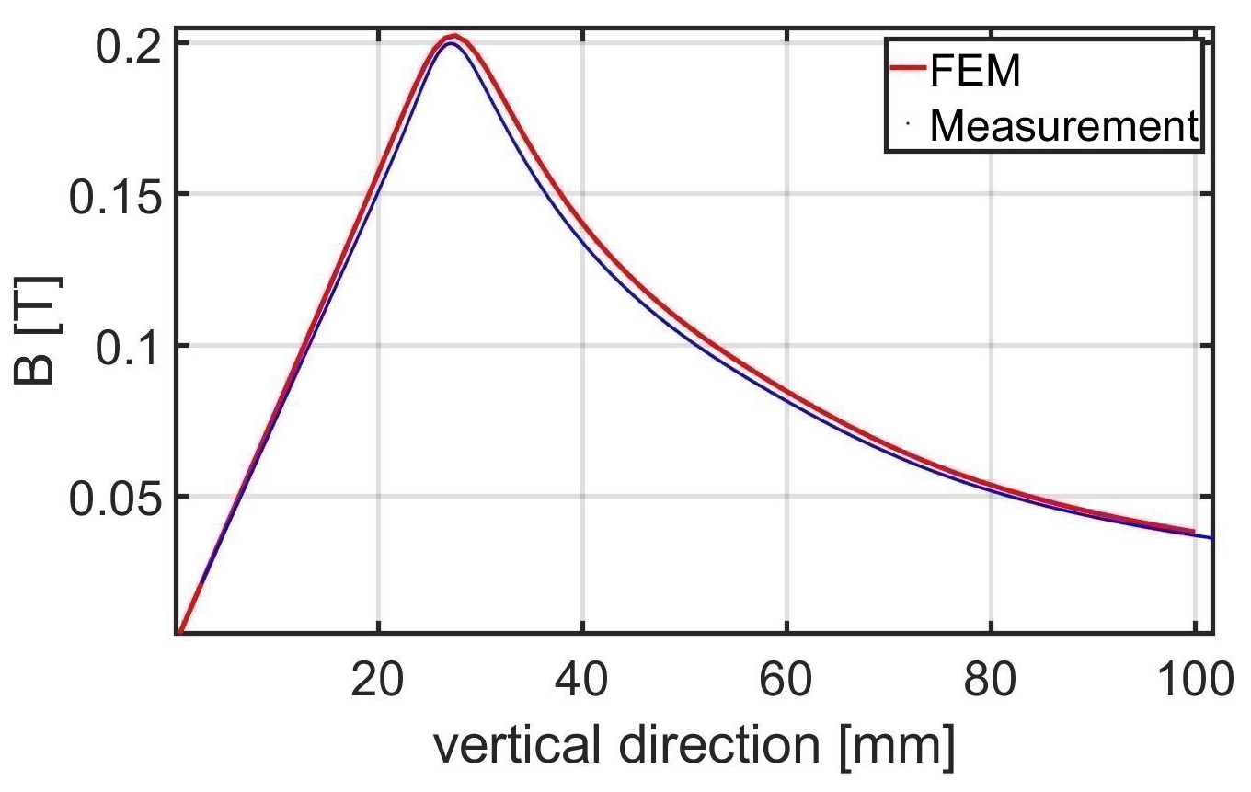
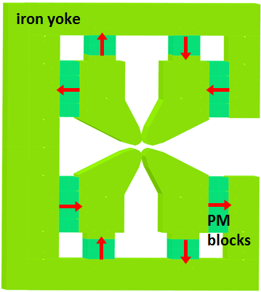
SLS 2.0 Magnets: PM-Magnets Prototyping
strong forces of PM-blocks require special tools and procedures for assembly and handling
prototyping of PM-magnets and handling tools is ongoing
safety procedures to be developed for in-house or external series production
PM magnet measurements and iterative field optimization by shimming is planned be done at PSI
PM Assembly Procedure
Assembly Bench with Prototype Half-Dipole BN
Magnetic Measurements of Prototypes
PM-block sizes:
20 mm x 40 mm x 70 mm
½-Dipole BN
210 mm
block to block
magnetic pull ≈ 200 kg
counter force
½-Quadrupole AN
PM-block
to be inserted
feeding
force
variable forces
between
iron and PM blocks

Slide 24
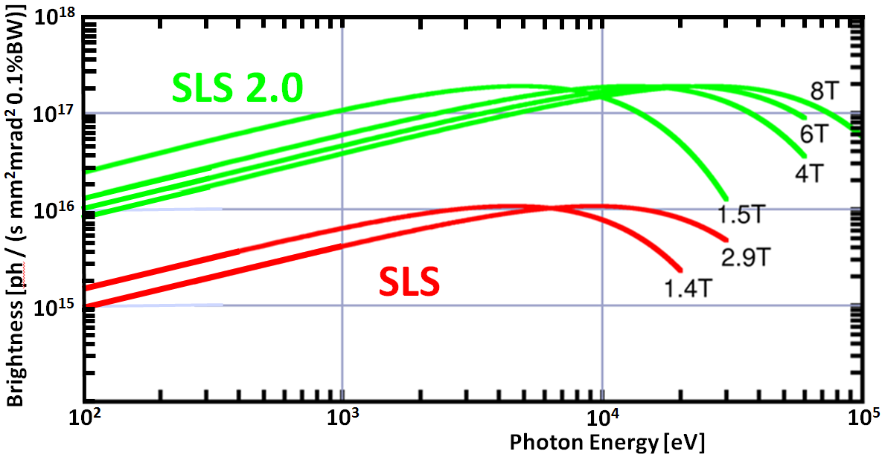
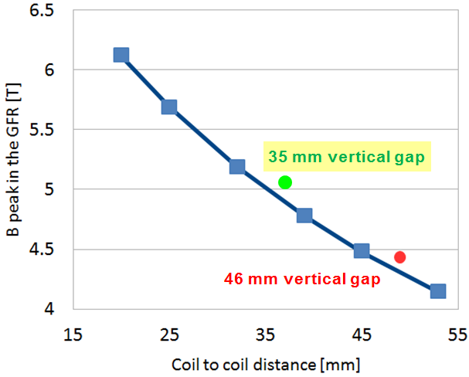
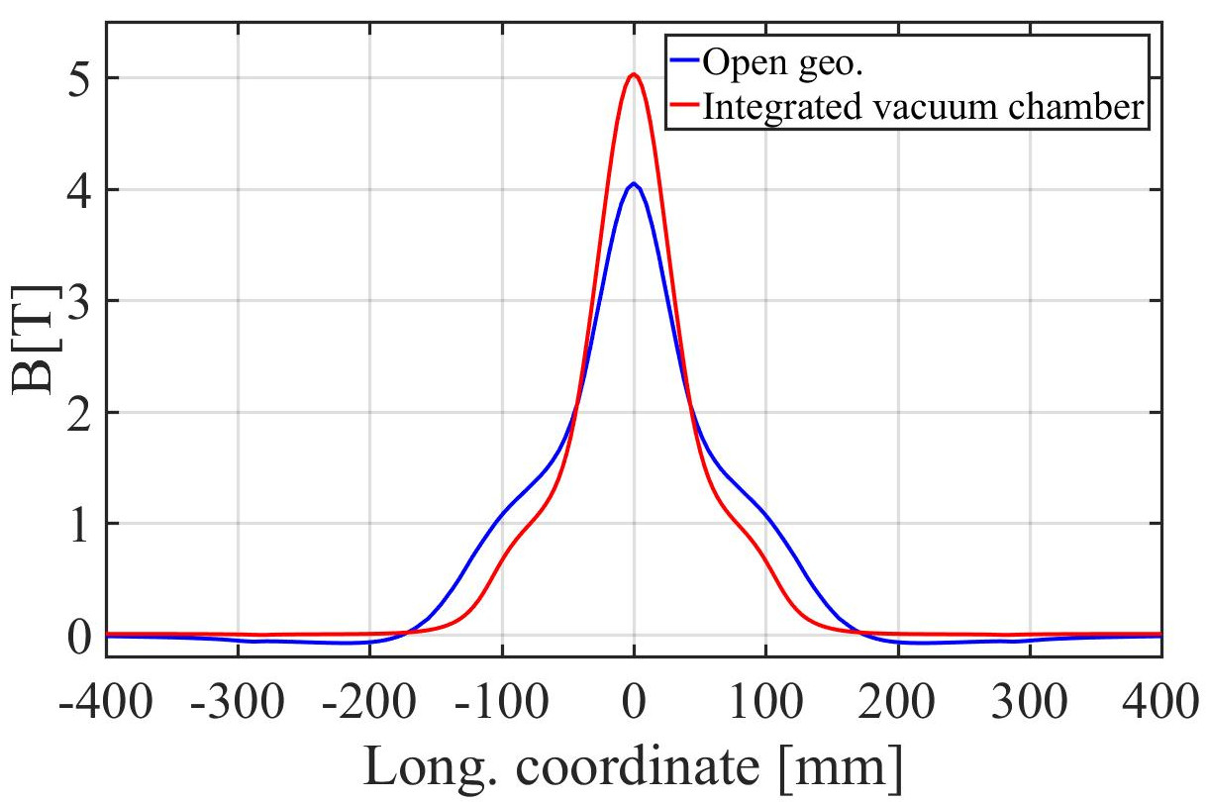
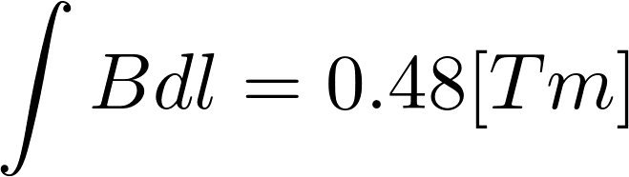
SLS 2.0 Magnets: Superconducting Super-Bend
SC super-bend extends the SLS 2.0 spectral range towards 100 keV
→ apply proven technology initially: Nb-Ti conductor (B ≤ 5T)
→ R&D on improved technology: HTS or Nb₃Sn conductor (B ≥ 5T)
→ design with integrated vacuum chamber to reduce vertical aperture
→ variable field (2.8 – 5 T) and very limited mounting space (405 mm)
CAD-Drawings of the Super-Conducting Super-Bend for SLS 2.0 with Integrated Vacuum Chamber Geometry
1: Kryostat;
2: Wärmeschild;
3: Flüssigstickstofftank;
4: Flüssigheliumtank;
5: Kryokühler
RDK-415D GM;
6: Füllrohre;
7: Eisenjoch;
8: Strahlvakuumkammer;
9: Vakuumkammer-
Anschlussflansch;
10: Kaltmasse-
Aufhängungsgurtversteller;
11: Stromleitungen;
12: flexible Wärmeanschlüsse;
13: Spulenträgerstruktur;
14: innere Spule;
15: äußere Spule
gap dependency
field profile

Slide 25
SLS & SLS 2.0 Upgrade: Conclusions and Outlook
SLS: excellent operational statistics in 2019 with 99.4% availability and 6 ½ days MTBF
new filling pattern with longer lifetime available on demand for the users
SLS 2.0: → lattice provides 123 pm (≈ 140 pm with IBS) emittance
→ brightness increase of 30 (@ 12 keV) can be achieved with splitting of straights
→ superconducting super-bends (5T) extend photon spectrum up to 100 keV
→ work is still required to obtain sufficient dynamic aperture
SLS 2.0: advanced technical solutions are (need to be) introduced and developed at PSI:
→ NEG-coating for the compact vacuum system (18 mm beam pipe diameter)
→ strong and compact electro-magnets and permanent magnet dipoles
→ superconducting super-bends
→ ultra-fast (1.5 ns) pulsers (few kV) and (stripline) kickers for on-axis injection

Slide 26
Wir schaffen Wissen – heute für morgen
My thanks go to…
GFA, LOG and PSD Groups
SLS 2.0 Project Group
…and especially to the
operations, beam dynamics, vacuum and magnet sections for providing information material
…and of course the audience for their interest and patience ☺☺☺

Slide 27
Additional / Back-Up Slides

Slide 28
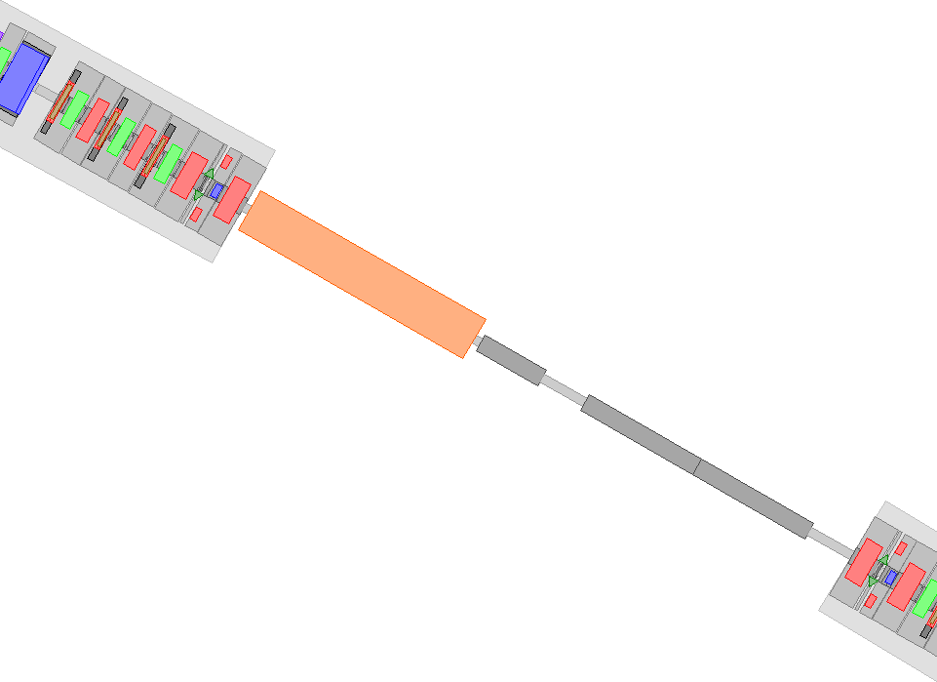
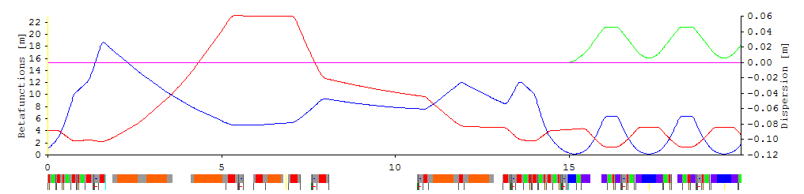
Injection straight 1L (slide by Andreas Streun)
Injection for commissioning phase
Layout  and optics  of injection straight 1L
Vertical injection elements:
4 bump kickers (re-use SLS)
Thick septum and thin (1mm) septum
Fast kicker for pseudo-on-axis injection in 2S 
4 large aperture quadrupoles (re-use SLS)

Slide 29
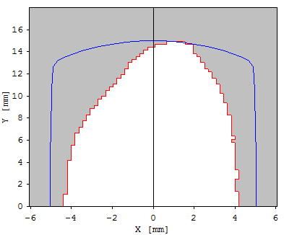
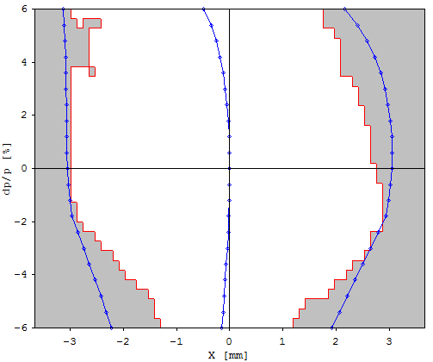
Dynamic aperture – commissioning (slide by Andreas Streun)
Dynamic aperture (x,y)
physical aperture from (“fake”)
10 mm × 15 mm beam pipe
approx. physical aperture from real
beam pipes including mini-gap undulators
5-sigma beam size of injected beam
from booster
1 mm thin septum
β_{x} = 5 m β_{y} = 26 m
Momentum dependent. D.A. (x, Δp/p) Range ±6%
× max. initial amplitudes of Touschek scattered particles
= (H_{max} β_{x})^{½} Δp/p , H_{max} ≈ 0.45 mm
eff. momentum acceptance
⇨ Touschek- Lifetime ∝ (mom. acc.) ³
> ± 4%
⇨ 11 hrs

Slide 30
Magnet and power supply inventory (A. Streun)
SLS 2.0 288 m circumference = 80 m straights + 208 m arcs
60 long./trans. grad. compound bends, BNV=[VB|BN|VB] 0 (PM)
24 end magnets BE 0 (PM)
144 reverse bends AN 0 (PM)
106 quadrupoles QP 96
288 sextupoles + 264 octupoles [ incl. quad+skewquad] 2×48 (?) +2×264
114 twin correctors CHV [CH+CV] 2×114
upgrade: +4 super-bends BS [+8 VBS] (-4 BNV), +18 high gradient quads QX,
+9 twin correctors CHVX: +39/-4, +39
➔ 739 magnets (228 PM, 4 SC), ≥ ≈ 987 power supplies
SLS 288 m circumference = 80 m straights + 208 m arcs
36 bending magnets BX, BE 2
174 quadrupoles QA/B/C[W] 174
120 sextupoles SR[W] {sext.+{CH+CV}(72),skewquad(36),aux.sext.(12)} 9+2×72+36+12
upgrade: 3 superbends BXS: +3/-3 bends, +6 PS
upgrade: Femto insertion: +3 bends, +4 quads, +1 corr.H/V, +9
➔ 338 magnets, 392 power supplies

Slide 31
Commissioning strategy (slide by Andreas Streun)
Commissioning (end 2024 / early 2025)
small aperture chambers in place (∅ 8 mm)
  small aperture BPMs already installed
reduced gap chambers for super-bend (10 mm)
  but PM-bends in place of super-bends
undulators in place but open or off
Risk: beam threading with small apertures
First year of operation (2025/26)
installation of 5 T super-bends
beam line commissioning and user operation
machine development: optics correction, beam based alignment
installation of high gradient quads to split standard straights
completion: low beta optics and injection

