Slide 1
Status of Metrology Light Source
Jörg Feikes, Ji Li on behalf of MLS team
Helmholtz-Zentrum Berlin, Germany

Slide 2
Outline
The Metrology Light Source(MLS)
Problems in operation
Status of Robinson Wiggler Project
Single-particle effects limiting the bunch length in low alpha mode

Slide 3
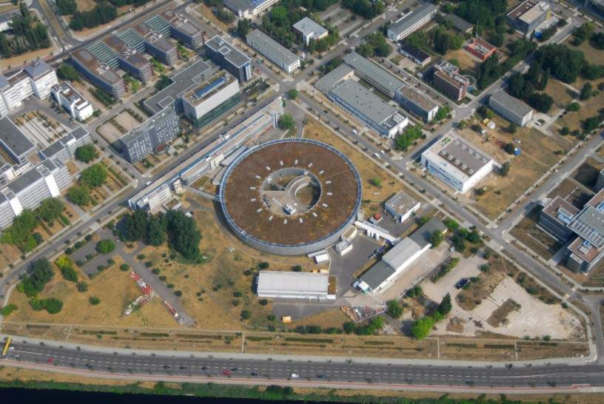
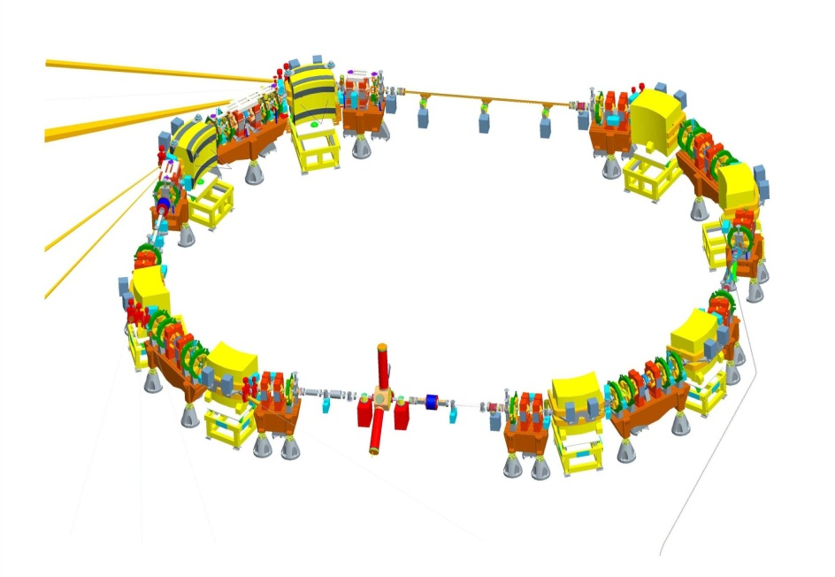
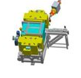
The Metrology light source
U125 undulator
BESSY II
Metrology Light Source (MLS)
RF cavity, HOM damped
500 kV@ 500 MHz, h=80
Circumference Revolution time | 48 m, 160 ns = 1/6.25MHz
Injection Energy | 105 MeV
Operational Energy beam current | 50 MeV to 630 MeV 1pA (1e-) – 200mA
Momentum Comp. Factor | -0.05 < α < 0.05
Emittances at 630 MeV | 25 nmrad (low emittance) 120 nmrad (standard user) 250 nmrad(low alpha)
Typical lifetimes in different operation modes | standard 6h @150mA, 100h@1pA low emit. 2h @150mA low Alpha 10h @150mA
Owned by PTB
Run by HZB

Slide 4
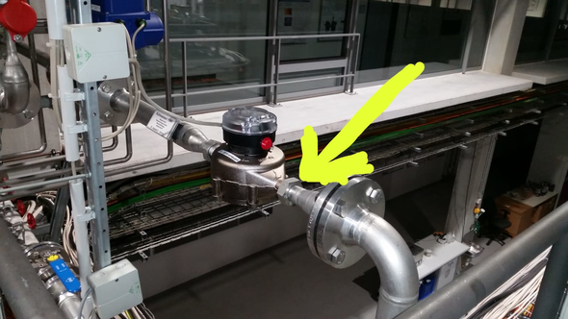
Problems
  Occasional water leaks
    Power supply room, 01.2019
      caused by corroded water-cooled sextupole power supplies
      5 out of 7 PS corroded (21 same PS at BESSY II run well for 20 years, same cooling water quality)
      we decided to replace all of them with air-cooled PS
      air-cooled PS running well since Sep.2019
    On MLS bunker roof, 09.2019
      caused by improperly designed water flow controller
      All of them have been replaced
  An IOT failed due to vacuum leak, 08.2019 (after 12000 h)
    replaced by a formerly installed IOT
    a new IOT ordered

Slide 5
Problems
  Power cut caused by disfunction UPS
    Electric network fluctuation in 07.2019
    Misoperation when repairing the UPS in 08.2019
  Venting of the MLS storage ring in 10.2019

Slide 6
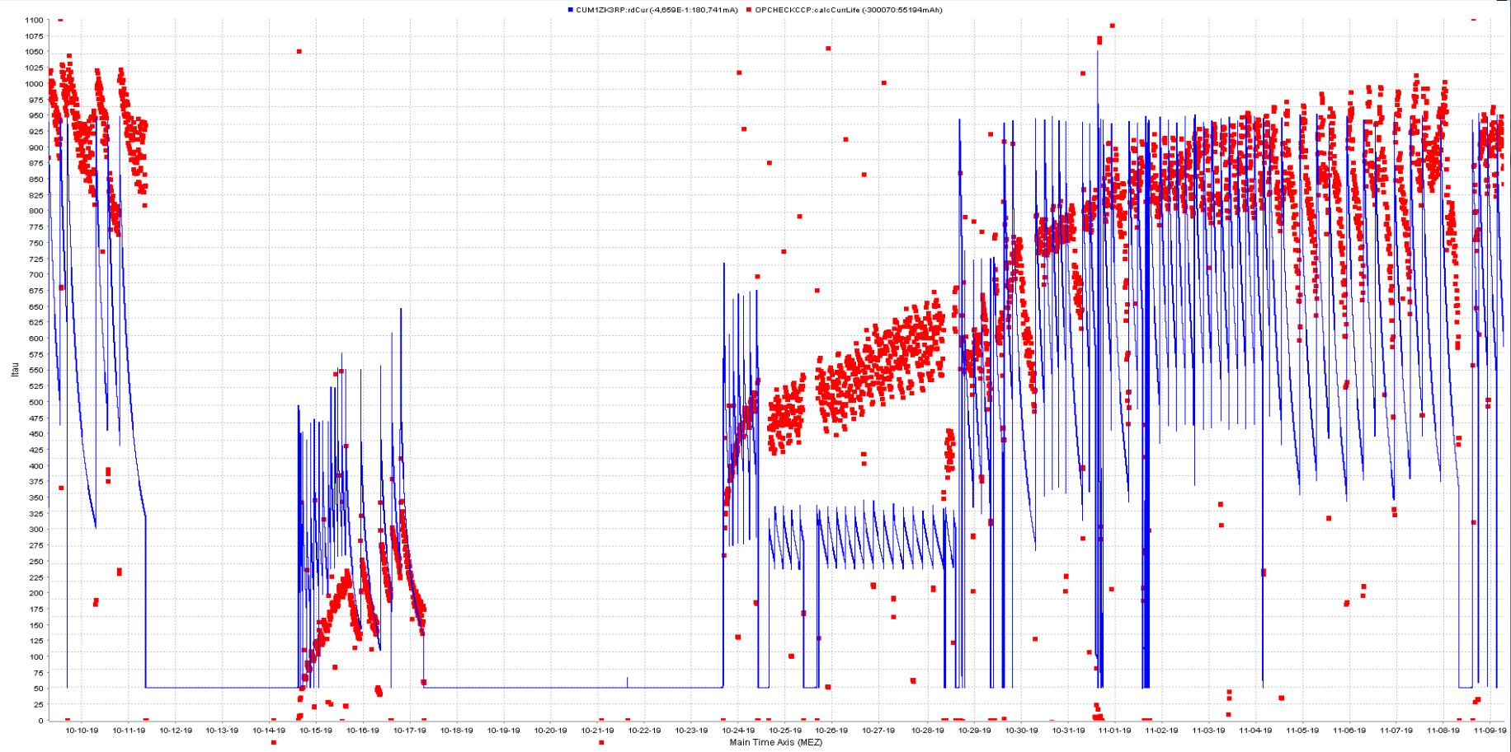
Problems
1100
200
current*Lifetime/mA*h
7
8
6
beam current/mA
1
2
5
3
4
50
0
09/10/2019
1 week
09/11/2019
1. MLS storage ring completely vented by operational error
2. pumping
3. beam scrubbing
4. user operation for last urgent measurement before baking
5. access to bunker – activation of all NEG-coated chambers located in the straight sections
6. beam scrubbing
7. user operation with reduced performance
8. user operation at nearly full performance

Slide 7
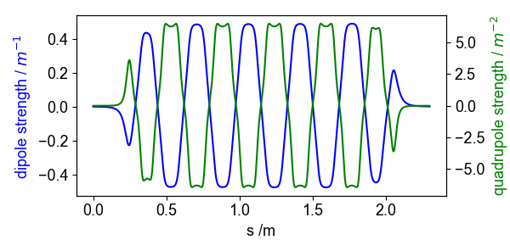
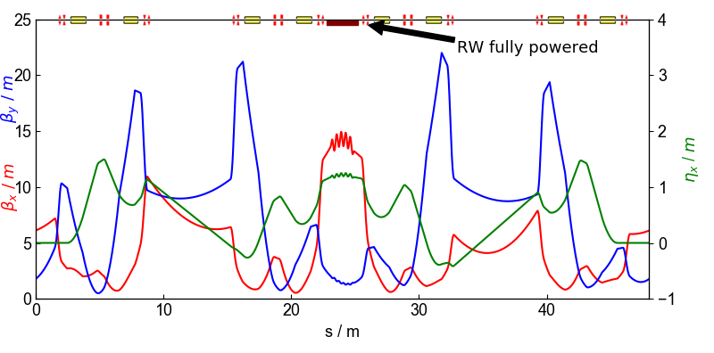
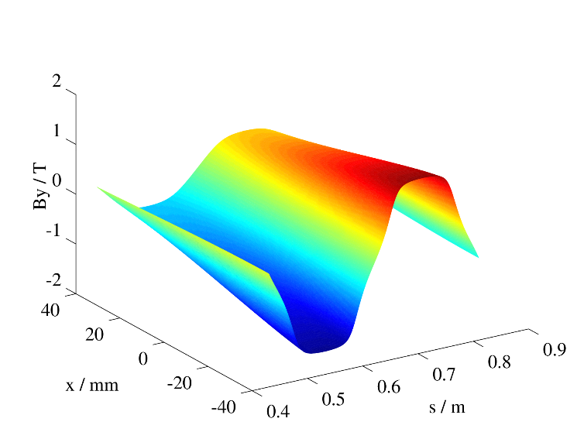
Robinson Wiggler
manipulating damping partition D
  smaller emittance and larger energy spread
  smaller transverse beam size
  longer bunch length
together with maintained transverse beam size by excitation
  large bunch volume
  increasing Touschek lifetime (~ 200%)
Field on the mid plane of one period of the Robinson Wiggler

Slide 8
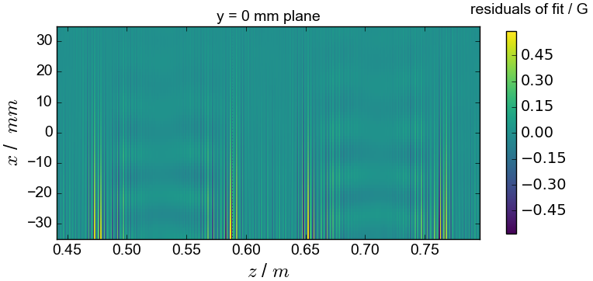
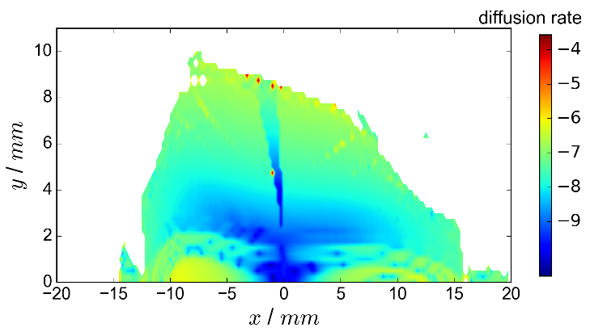
Symplectic tracking for Robinson Wiggler
Modified Halbach expression
Complex asymmetric field in RW:
Analytic expression of 3D field
Vector potential(Ax, Ay, Az)
Hamiltonian
Symplectic integrator for solving Hamiltonian Equations:
Symplectic Runge-Kutta intergrator
Generating function method
Tracking Result:
- Dynamic Aperture is OK
- operating the RW in the MLS SR is possible

Slide 9
Robinson Wiggler Project: officially cancelled for now
internal report: „Potential and risks of installing a Robinson Wiggler at the MLS”
  based on the discussion in PTB steering committee meeting.
  Potential:
    to gain a factor of 2 in Touschek lifetime after a long installation and commissioning period
    more options for lattice development
  Price:
    a 10 weeks shut down for installation + long commissioning time
    partly venting of the storage ring → months to recover
  Risks:
    small dynamic aperture due to manufacture errors
    influence on injection caused by residual magnetic field of the RW
  Conclusion: It is not desired to invest now.
  What to do now?
    summarizing the work done for publication and final report
    options for a future machine with a Robinson Wiggler (MLS II)
What have we gained in this project?
  a complete Ph.D. Thesis (Tobias Tydecks)
  knowledge in magnet design, power supply, magnetic material….
  modeling the insertion devices for linear optics and nonlinear dynamics study
    analytic expression for complex field
    symplectic integrator

Slide 10
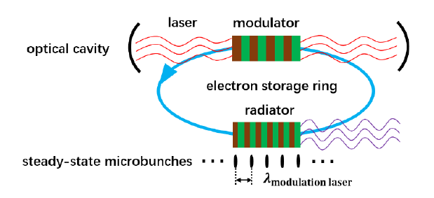
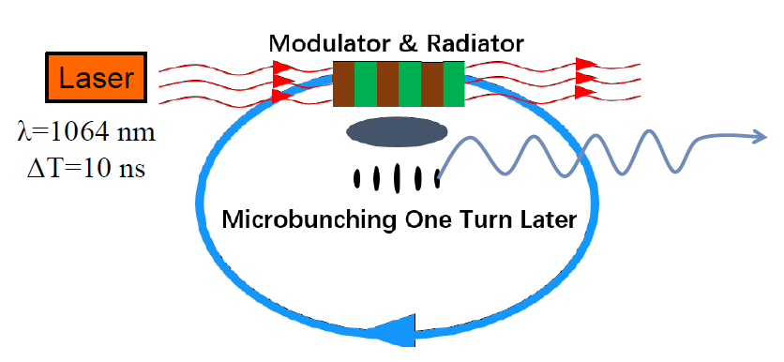
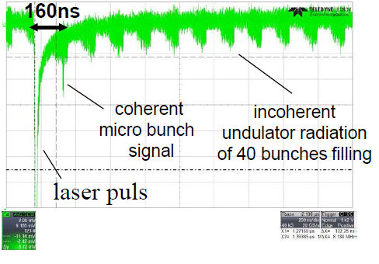
Successful SSMB PoP experiment at the MLS
principle of Steady-State MicroBunching(SSMB)
PoP at the MLS Phase I: One-pass experiment
laser modulator to form optical buckets like RF buckets
Microbunching for high power + steady state for high repetition rate
Proposed by A. Chao and D. Ratner
On-going investigation in Tsinghua University, Beijing, China
Why MLS?
Low alpha approach for SSMB
MLS: optimized for low alpha operation in design stage
Sufficient commissioning time available.
‘The First Experiment towards Steady-State MicroBunching’
Xiujie Deng(Tsinghua University, Beijing, China) tomorrow
laser pulse

Slide 11
Single-particle effects limiting the bunch length in low alpha mode
Verification of single-particle effects driven by PoP experiment of SSMB:
longitudinal quantum radiation excitation (partial alpha effect)
second order transverse-longitudinal coupling
in collaboration with Xiujie Deng, Alex Chao et. al (Tsinghua University, Bejing)
and Roman Klein, Arne Hoehl (PTB, Berlin)

Slide 12
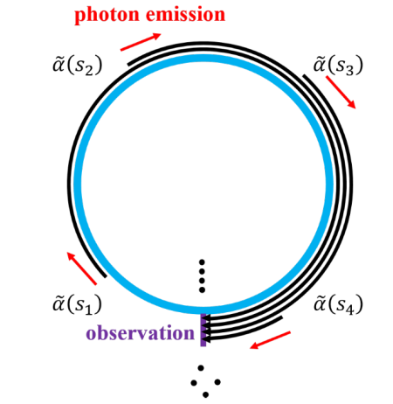
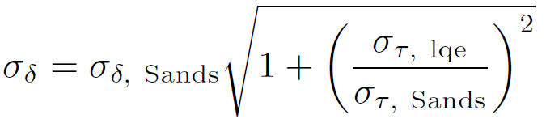

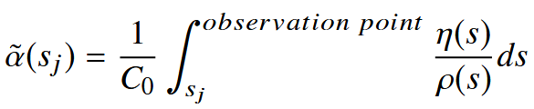
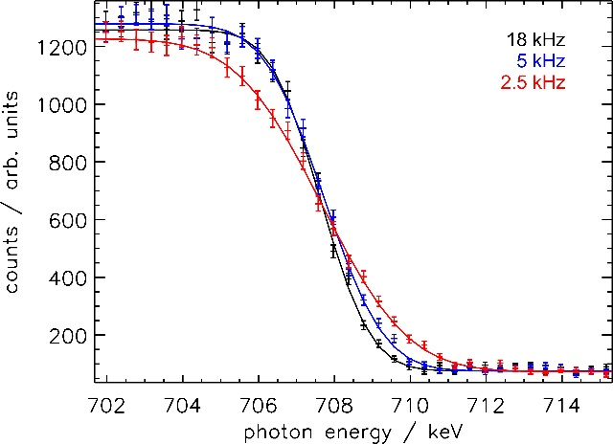
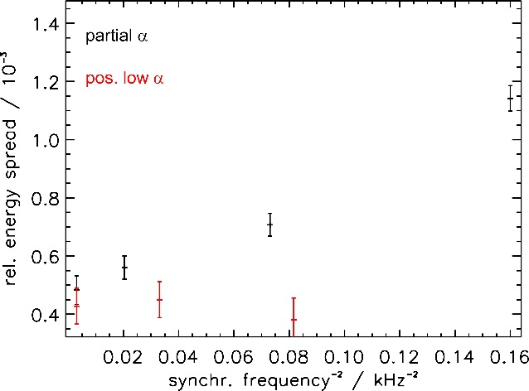
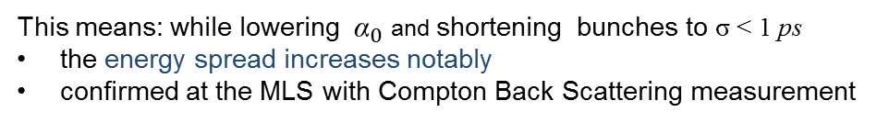

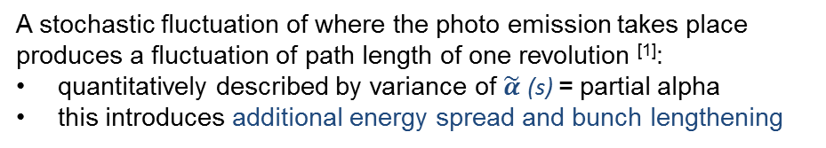
Bunch Length Limit 1: fluctuations of partial alpha
A stochastic fluctuation of where the photo emission takes place produces a fluctuation of path length of one revolution ^{[1]}:
quantitatively described by variance of $\tilde{α}$ (s) = partial alpha
this introduces additional energy spread and bunch lengthening
[2]
∝ Variance of {$\tilde{α }$(s)} ≈ ${(\text{\sim } 120 fs)}^{2}$ in standard low alpha mode @MLS
${ (\text{\sim } 280 fs)}^{2}$ in a special low alpha lattice
This means: while lowering ${\text{α}}_{0}$ and shortening bunches to σ < 1 ps
the energy spread increases notably
confirmed at the MLS with Compton Back Scattering measurement
CBS photo spectra measurement with Synchrotron frequency of 18 kHz, 5 kHz and 2.5 kHz ^{[2]}
Energy spread widening with decreasing alpha value ^{[2]}
[1] Shoji, Yoshihiko, et al. "Longitudinal radiation excitation in an electron storage ring.“ Physical Review E54.5 (1996):R4556
[2] Deng, et al, .“Experimental Verification of the Longitudinal Quantum Radiation”, to be submitted to soon

Slide 13
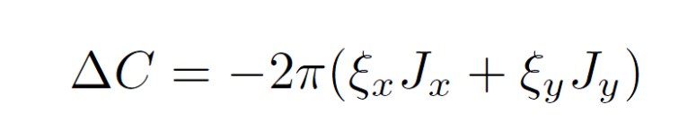
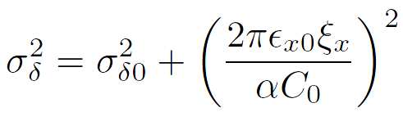
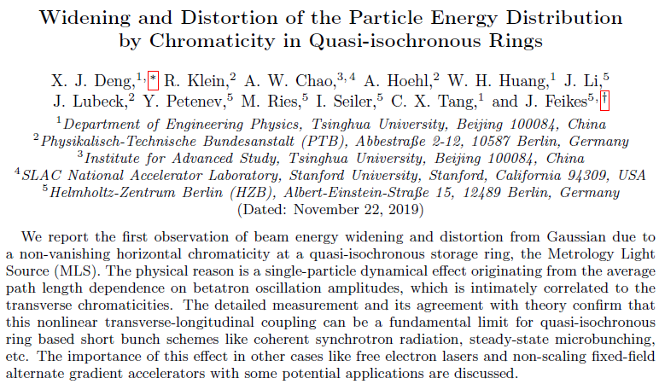
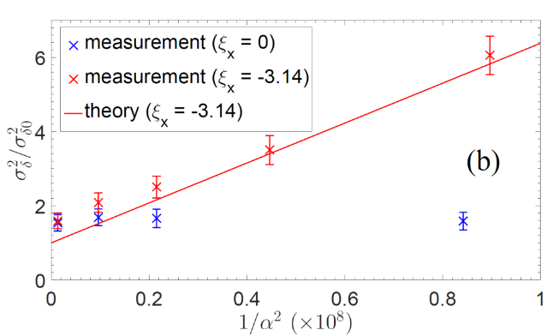
Bunch Length Limit 2: second order transverse-longitudinal coupling
a non-zero amplitude betatron oscillation lengthens the beam path length in the second order
also confirmed at MLS with Compton Back Scattering measurement
one of several papers submitted

Slide 14
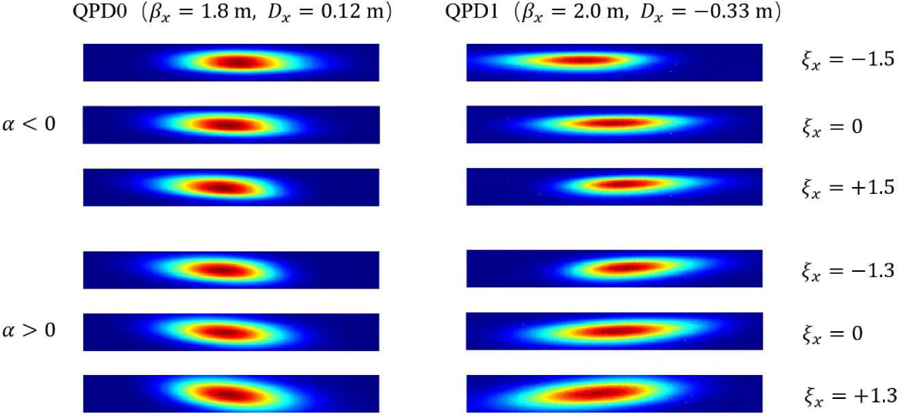
Bunch Length Limit 2: second order transverse-longitudinal coupling
Bunch distribution distorted from Gaussian :

Slide 15
Thanks for your attention!
Thanks to all the contributions from HZB and PTB colleagues !

Slide 16


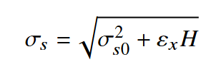
Backup slides 1:
First order transverse-longitudinal coupling
Particles with different Betatron amplitudes and phases pass bending magnets on different trajectories, resulting in longitudinal displacement differences and a bunch length limit: ^{[1][2]}
[1] C. Tang, et al, .“AN OVERVIEW OF THE PROGRESS ON SSMB”, proceedings of FLS2018, Shanghai, China
[2] Shoji, Yoshihiko. "Bunch lengthening by a betatron motion in quasi-isochronous storage rings.“ Physical Review Special Topics-Accelerators and Beams7.9 (2004): 090703

Slide 17
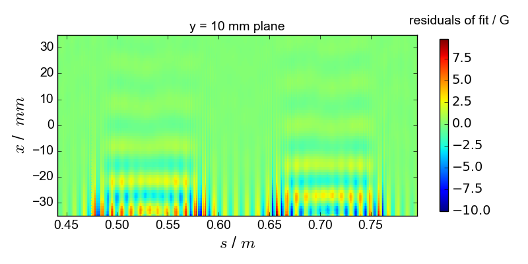
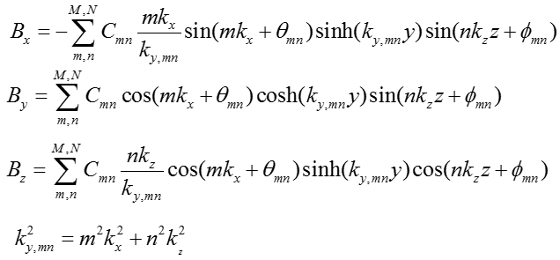
Backup slides 2:
Modified HalBach formula *
* J. Li, et al, .“SYMPLECTIC TRACKING FOR THE ROBINSON WIGGLER”, proceedings of IPAC19, Melbourne, Australia

Slide 18
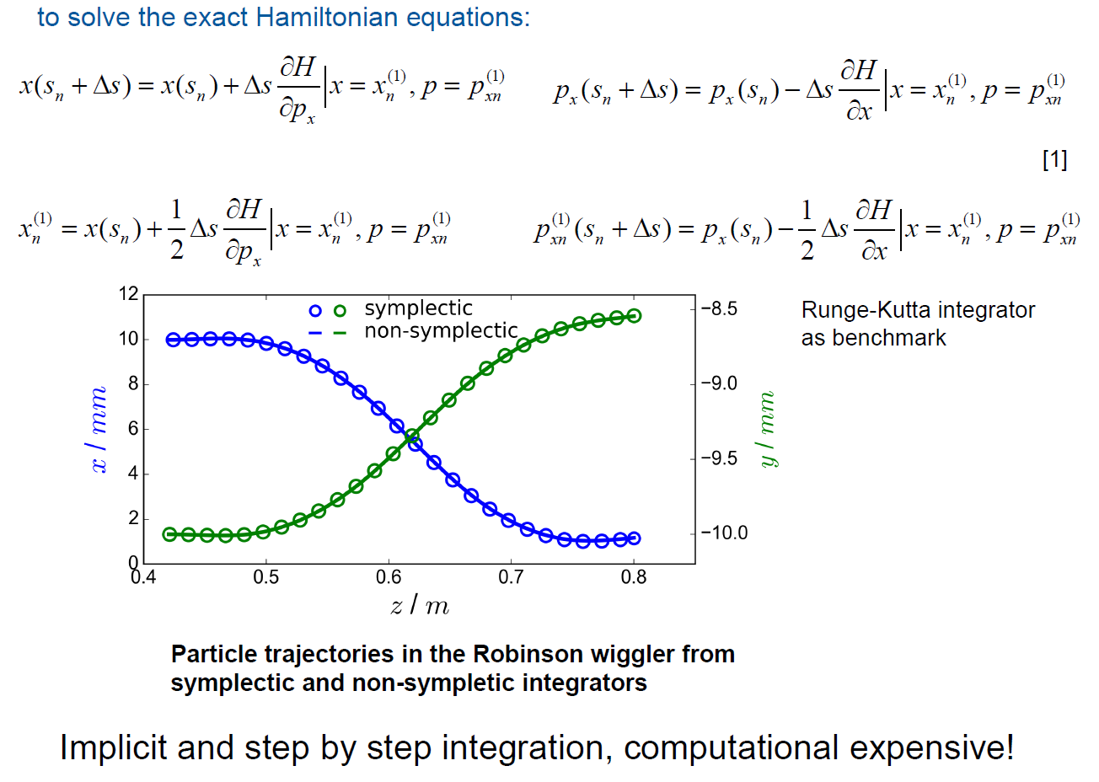
Backup slides 3:
SymPLeCtic RUNge-Kutta integrtator
[1] A. Wolski, Beam dynamics in high energy particle accelerators. London, UK: Imperial Colleague Press, 2014.

Slide 19
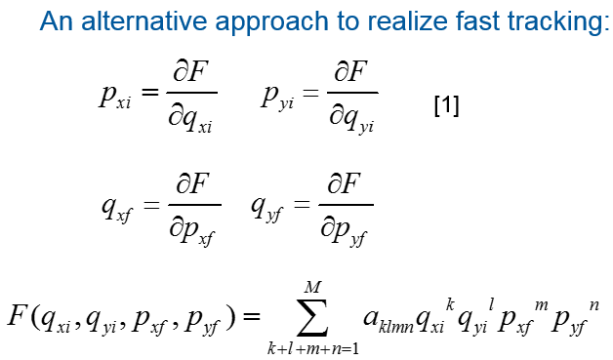
Backup slides 4:
Numerical generating function method
[1] M. Scheer, “Beschleunigerphysik und radiometrische Eigenschaften supraleitender Wellenlänenschieber”,Ph.D. thesis, Mathematics and Nature Sciences Dept., Humboldt-Universität zu Berlin, Berlin,Germany,2008

