Slide 1
Status of the
ASTRID2 facility
Jørgen S. Nielsen
Center for Storage Ring Facilities (ISA)
Aarhus University
Denmark

Slide 2
ASTRID2
ASTRID2 is the new synchrotron light source in Aarhus, Denmark, since 2013
ASTRID2 main parameters
  Electron energy: 580 MeV
  Emittance: 12 nm
  Beam Current: 200 mA (presently 180 mA)
  Circumference: 45.7 m
  6-fold symmetry
    lattice: DBA with 12 combined function dipole magnets
      Integrated quadrupole gradient
  4 straight sections for insertion devices
  Using ASTRID as booster (full energy injection)
      Allows top-up operation

Slide 3
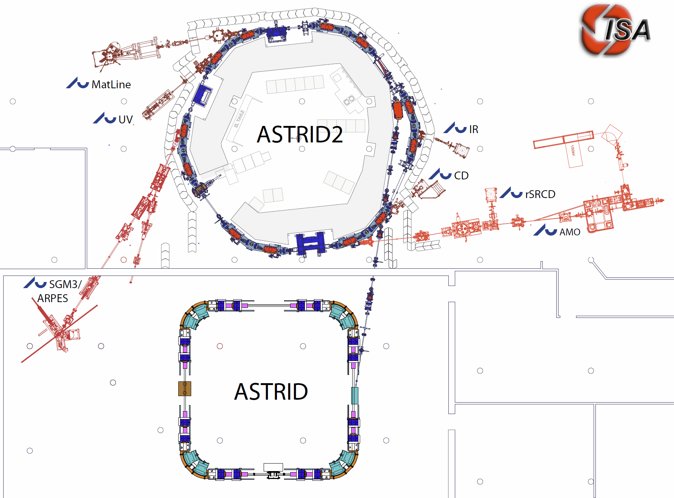
The ASTRID 2 facility
ASTRID2 main parameters
Circumference 45.71m
Energy 580MeV
Current 200mA
Characteristic energy 257eV
RF frequency 105MHz
Harmonic 16
Horiz. emittance 12nmrad
#Straight sections 6
Length of straight sections 2.82m
#ID’s 3
10m
Microtron (100MeV)
Notes:
Microtron, Booster, Inj. Bl., A2 ring, 6 beamlines, 7 experiments

Slide 4
User hours and reliability
Downtime if current goes below 90% of topup set current
Estimated
until 31/10
MTBF=101 h
MTTR=5.1 h
Notes:
MTBF 2018 was 52 h

Slide 5
Failures
2019 has been better than last year
    MTBF: 2018: ~50 h, 2019: ~100 h (until now)
Jul.-Sep.: ASTRID septum supply
  Undetected transistor failures
  ~6 days lost because of two weekends and one night
Sep.: Astrid2 RF system
  Failure of new circulator dump
  0.5 day lost because of evening and night
Oct.: Microtron
  A spark turned everything off
  0.5 day lost because of evening and night
Plus various smaller issues

Slide 6
“Large” circulator
Installed a 8 kW circulator at ASTRID2 RF system
  Only allow 2 kW reflected power in steady state
    LLRF insures reflected power <2 kW continuously
Added more monitoring and interlock of reflected power
Allows us to run at somewhat higher cavity amplitudes, but beam lifetime turned out not to improve
  Previously had various errors running with high power out of the amplifier (temperature interlocks, …)
Circulator load failed due to poor assembly
  Repaired by manufacturer

Slide 7
Microtron klystron HV problems
We have had some problems with the Microtron klystron HV, which suddenly decreases and then slowly over several hours return to normal
  At the same time the klystron RF gain INCREASES
  Believe it is caused by impedance changes of klystron
The problem seems to go away if we run the klystron at a lower filament current
By measuring klystron “heating curves” (klystron HV current Vs. klystron filament current) we have determined that we were running the klystron at too high a filament current
  Filament current needs to be lowered as klystron is aging!
Klystron has been running about 140000 hours
  So we are considering replacement (have an old spare)
Thanks to all who helped us with ideas and suggestions

Slide 8
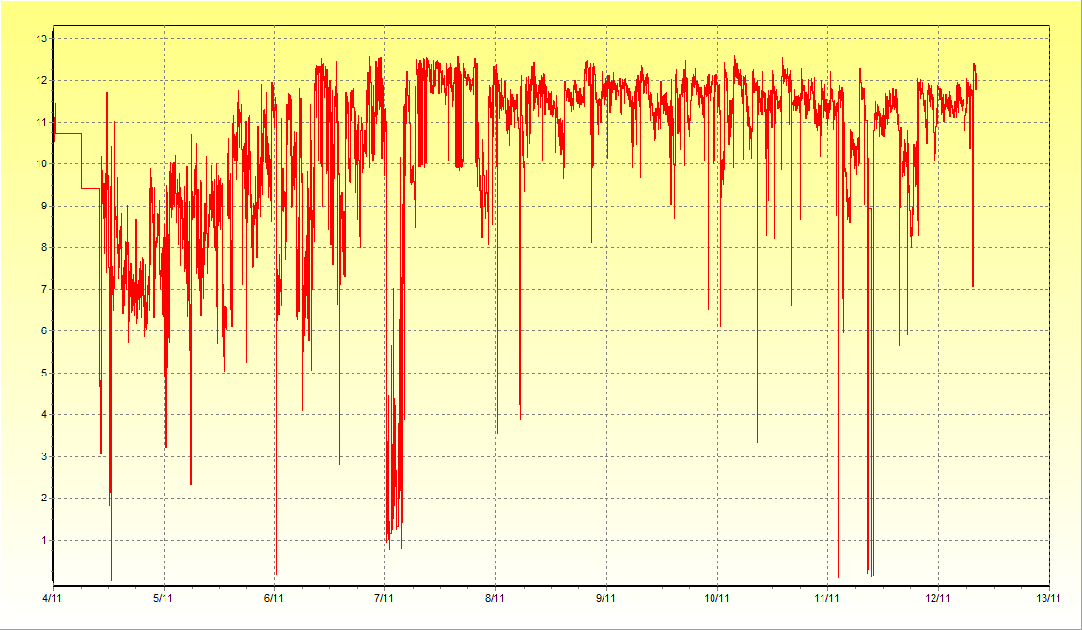
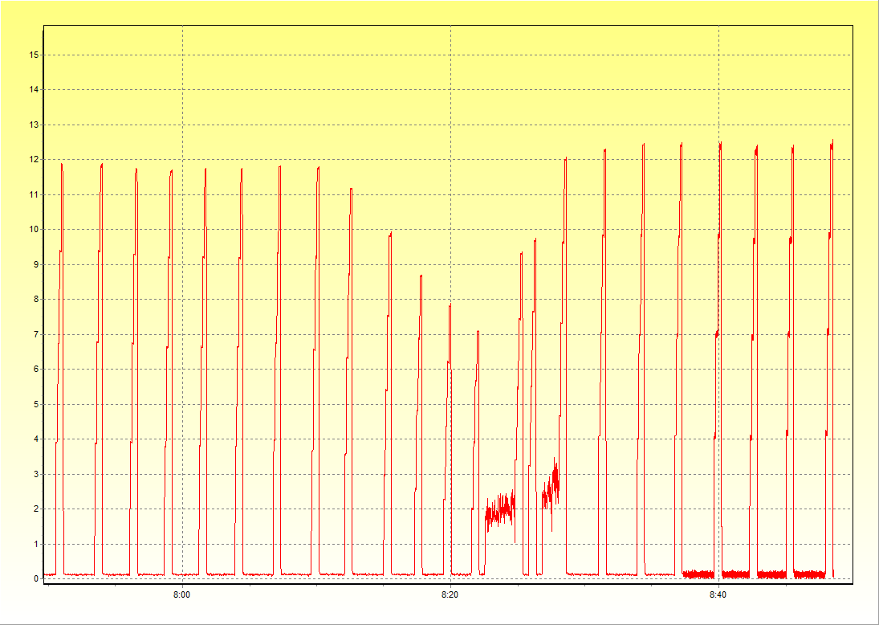
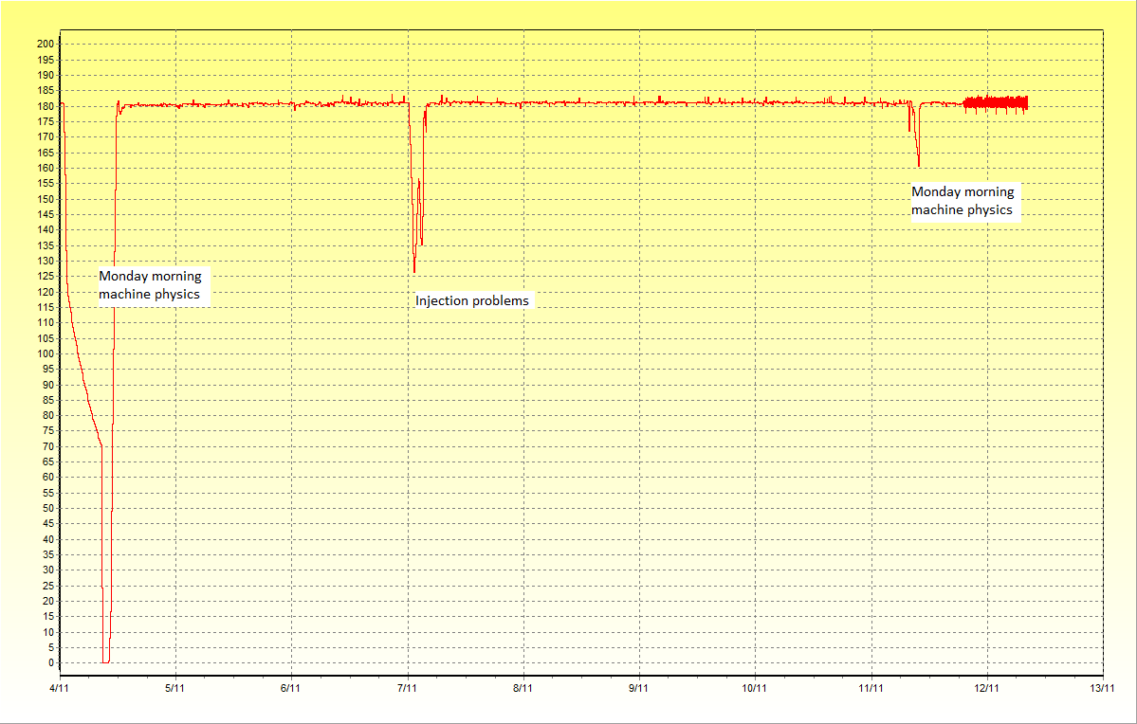
Microtron AutoAlign program
To circumvent drifts we have developed a small program which regularly does an alignment of some of the microtron parameters
  Quite simple: Just simple adjustments a little up and down to determine optimum value and then just simple iteration between the parameters
  But very effective
ASTRID beam current (over 1 week)
ASTRID beam current (over 1h)
ASTRID2 beam current
Monday morning machine physics
Injection problems
at midnight

Slide 9
Network problems
New Cisco C9300 switches gave quite some trouble
  Some devices incorrectly made broadcast ARP responses (instead of unicast ARP response). These wrong network packages are being blocked by the new switches (and not the old Cisco C2960S)
    Basler cameras (ACE acA640-100gm)
      Presently using an old switch as “gateway”
      Basler has acknowledged the problem, but will not do anything because the acA640-100gm is an old model
      Have bought a few new cameras (ACE acA640-121gm), which does not have the problem
    Gamma Vacuum SPCe vacuum pump controller
      New firmware has solved the issue

Slide 10
Thank you for your attention

Slide 11
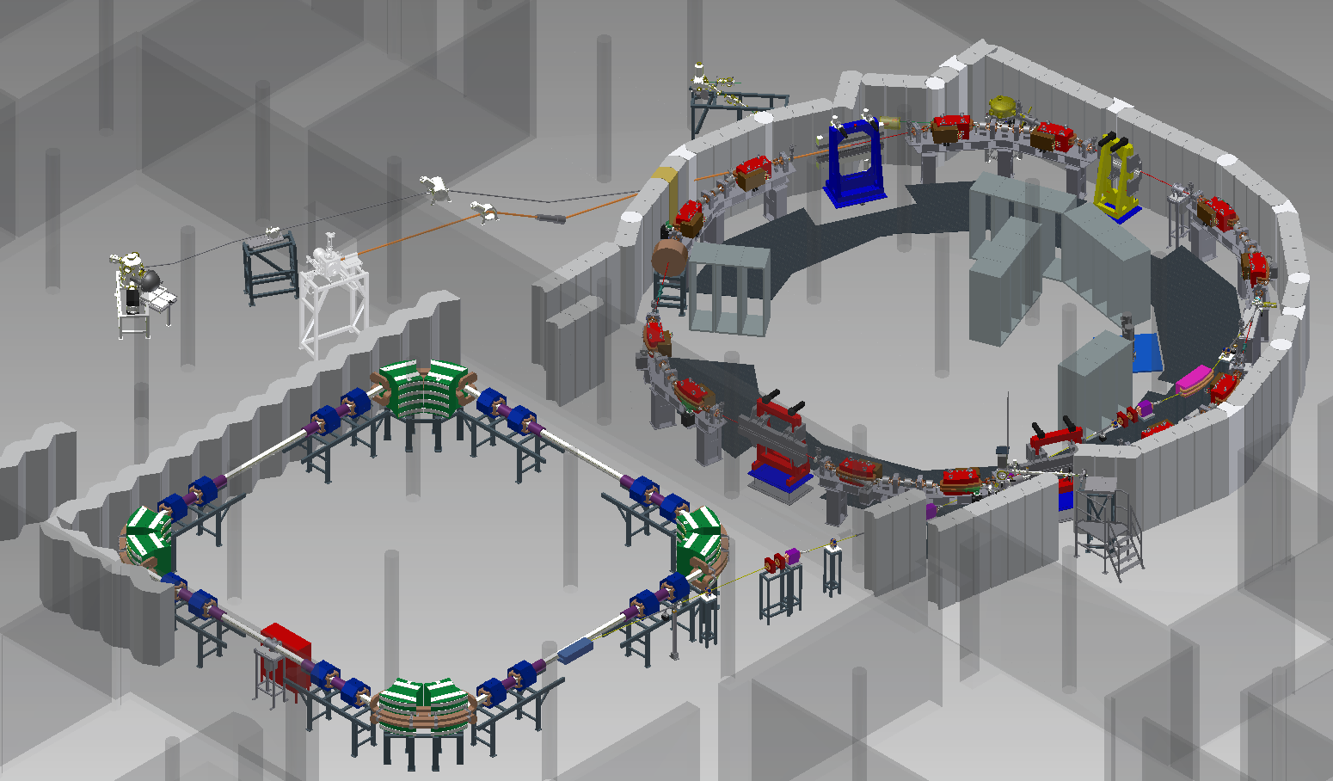
ASTRID2 Layout

