Slide 1

27th ESLS Workshop
Welcome !

Slide 2
Practical informations
Wifi: albaguest
pwd: guest2010
Workshop INDICO: https://indico.cells.es/event/224/
Upload the presentations or give them to me during the coffee break
Group picture at the entrance at 12:45
Visit to ALBA tomorrow afternoon at 13:40
Coffee breaks at the entrace of the Auditorium
Lunches at the tents in the back of the Auditorium

Slide 3
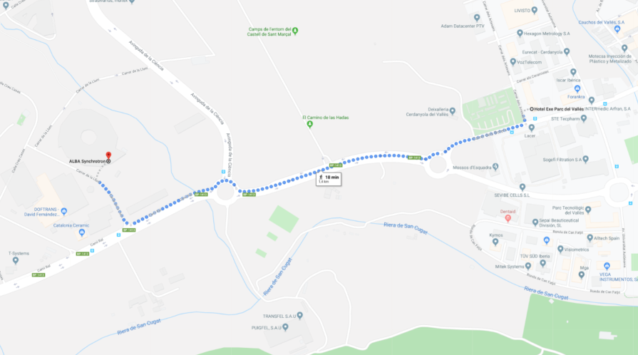
Practical informations
SHUTTLE BUS between ALBA and Hotel during the Workshop
Th 28/11, bus at 08:15
Fr 29/11, bus at 08:30
Th 28/11, bus at 18:00
Tonight dinner in Barcelona
Restaurant XIROI ca la Nuri, Passeig Marítim de la Nova Icària, 38
BUS at 20:00 from the hotel
Return around 22:45 from the restaurant
We can order taxis for you for Friday. Talk to Daimí at the registration desk
HOTEL
ALBA
18min walk

