Slide 1
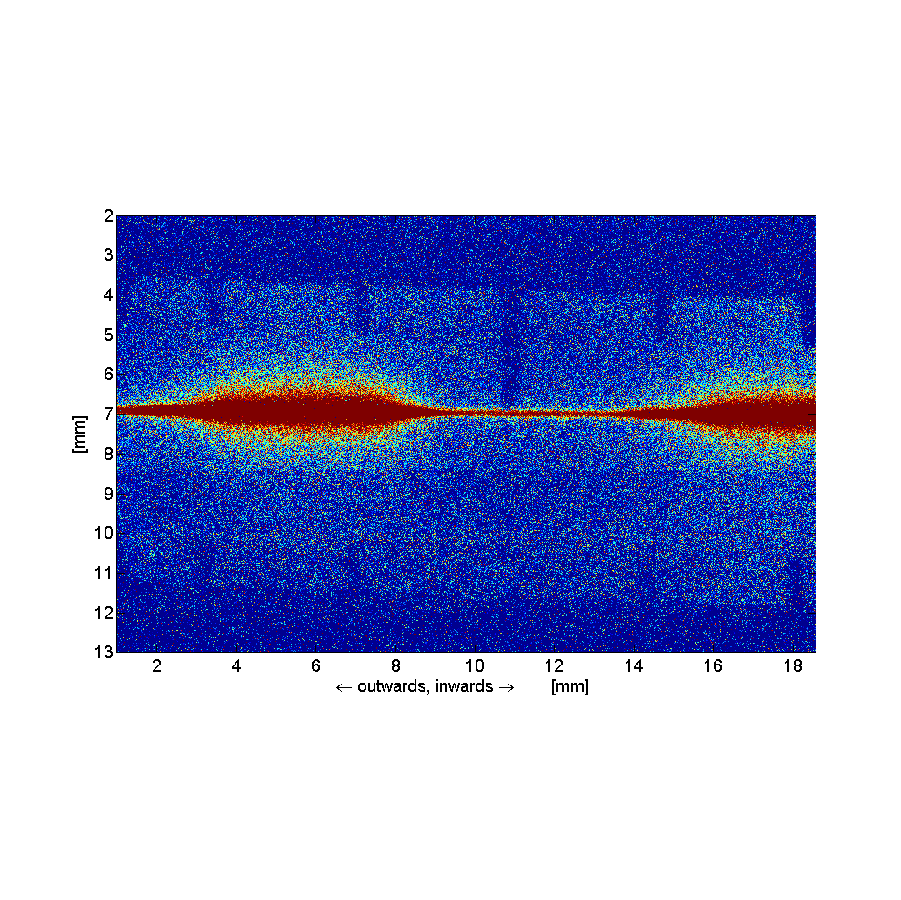

[Mysterious] vertical beam size measurements using iXD at ALBA
Andriy Nosych
Ubaldo Iriso
DEELS Workshop 2015

Slide 2
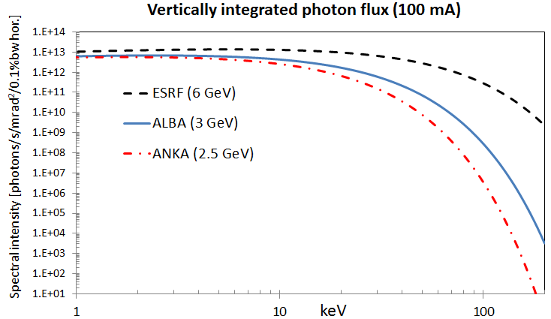
The ALBA machine provides:

Slide 3
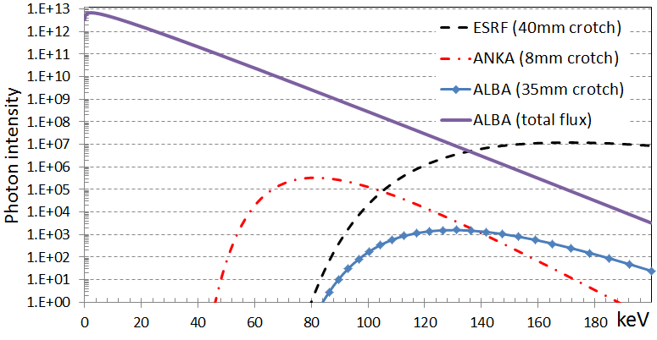
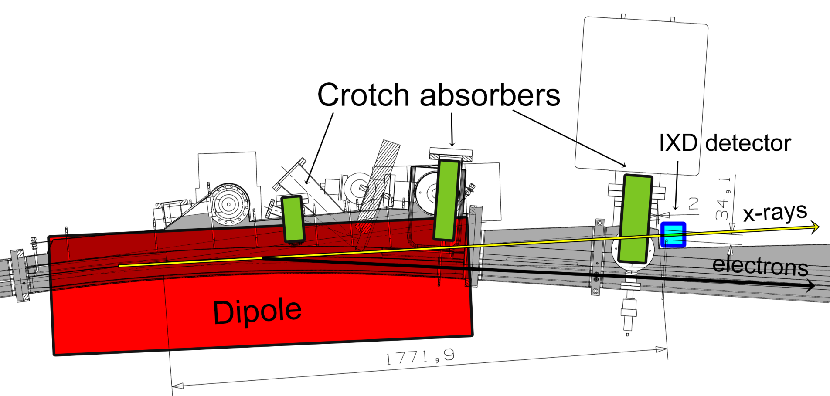
The idea behind IXD:
To provide an alternative-to-pinhole vertical beam size measurement,
possibly in real time
1E4 flux reduction
1.4 T

Slide 4
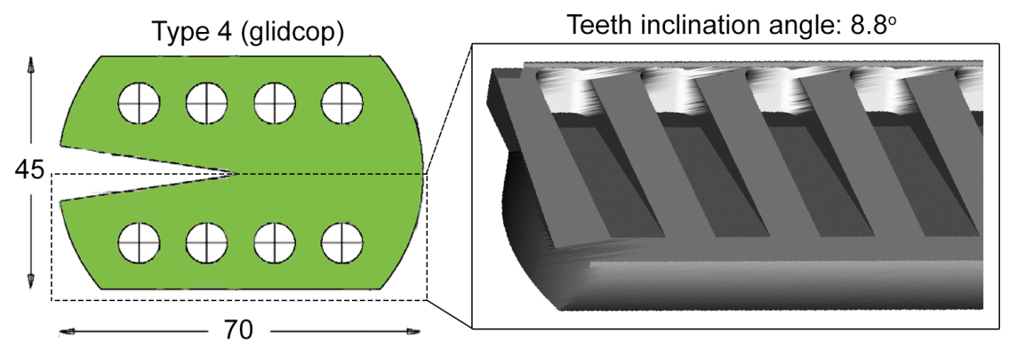
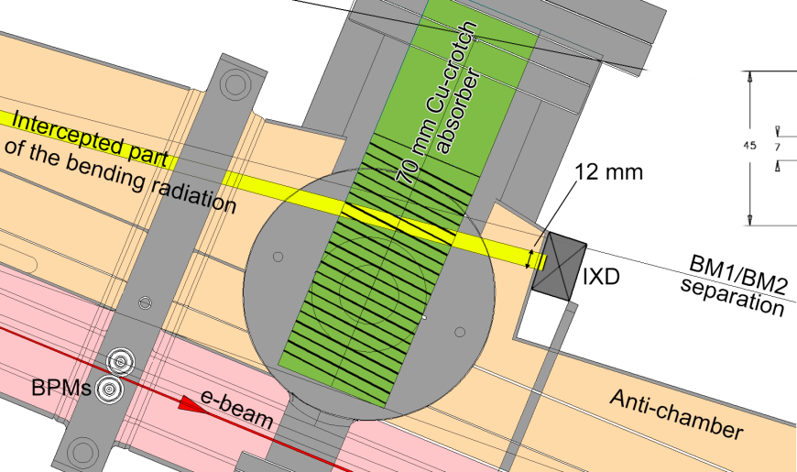
Crotch absorbers
Cross-section
bottom jaw
Tooth width: 6 mm
Teeth inclination angle: 8.8º
1700 mm
to source
35 mm of Cu
2 mm of steel
Ray tracing shows that radiation from previous dipole does NOT pass by the IXD, so we are looking at a single photon source

Slide 5
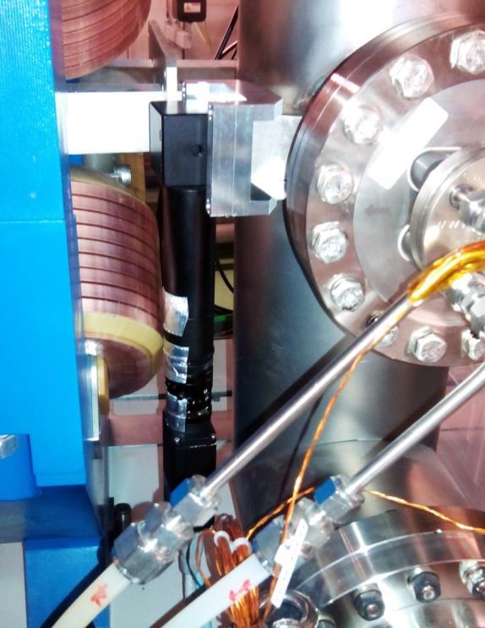
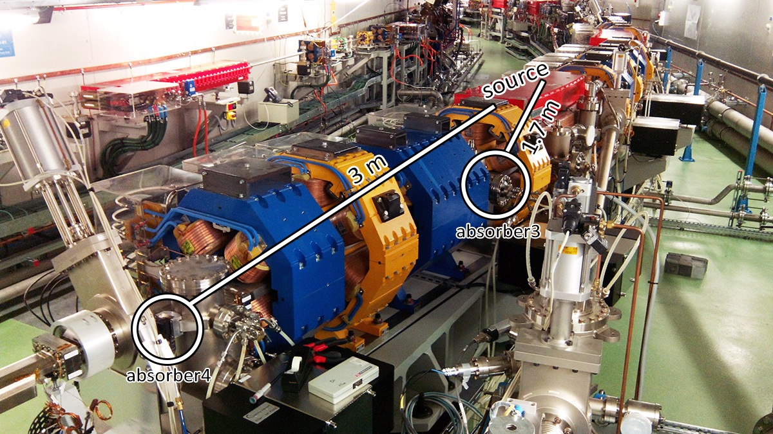
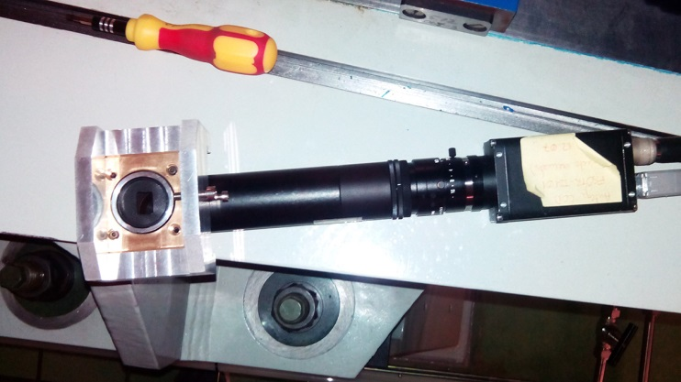
How it looks like
Storage ring sectors: 16
Dipoles per sector: 2
Absorbers per dipole: 4
Given the space constraints, there are 2 possible IXD locations at the end of each sector. We choose the one closer to the source (second dipole).

Slide 6
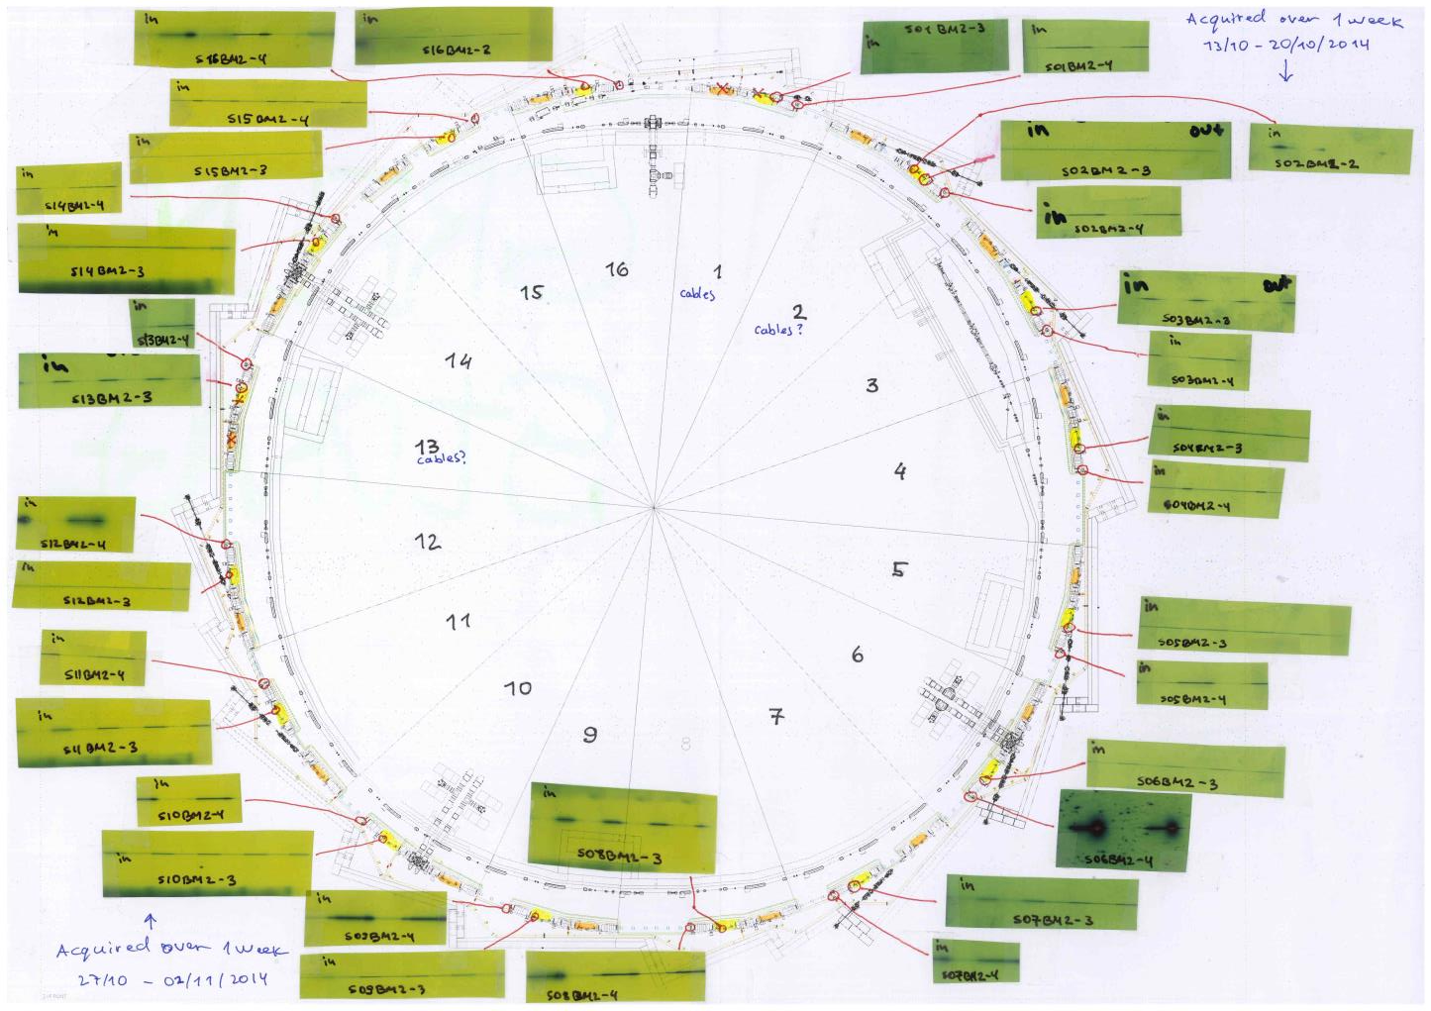
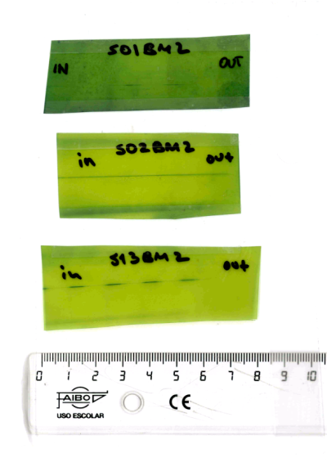
Green-paper study

Slide 7

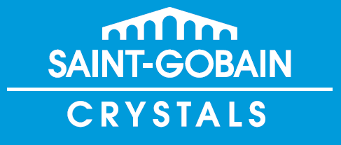

Scintillators
Chemical composition: Lu_{1.8}Y0_{.2}SiO₅:Ce
Light yield: 32 photons/keV
Decay time: 41 ns
Scintillation emission wavelength: 420 nm
Available size: 1” x 0.8 mm, 1 mm, 2 mm
CRY19 a silicate single crystal for X-ray detectors.
Chemical composition: unknown
Light yield: 28 @300K [10³Ph/MeV]
Decay time: 41 ns
Scintillation emission wavelength: 420 nm
Available size: 1” x 1 mm

Slide 8
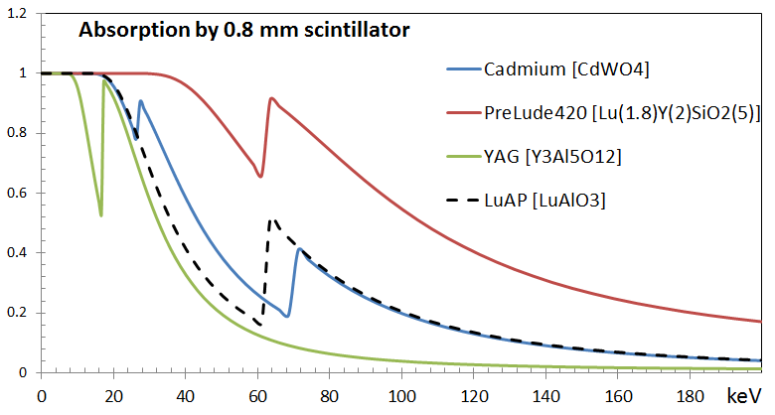

Scintillators
Photon absorption by common scintillators (0.8 mm thick)
Simulation by XOP

Slide 9
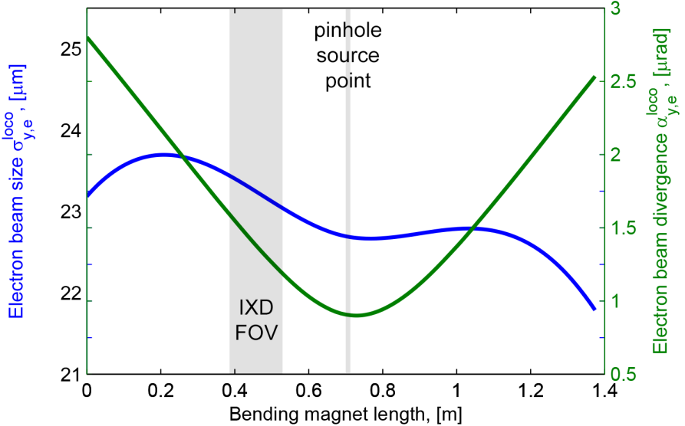
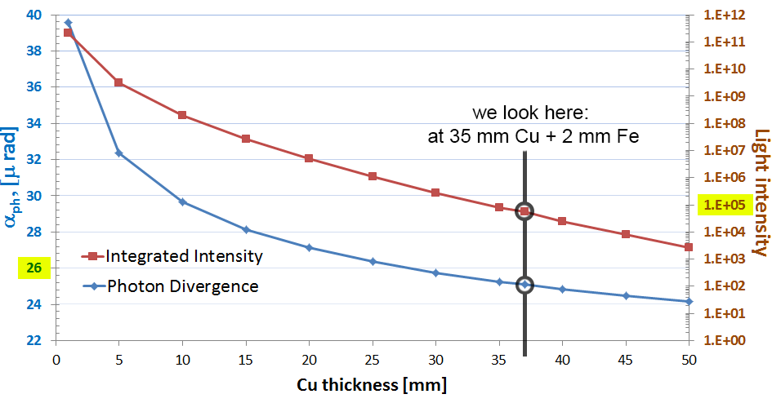
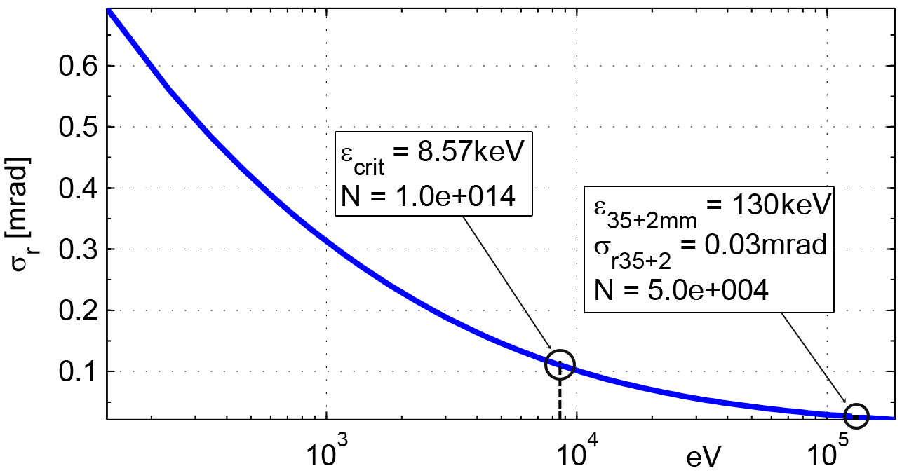
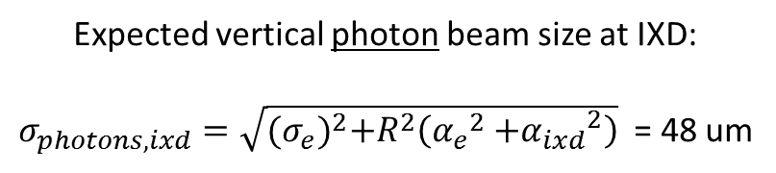
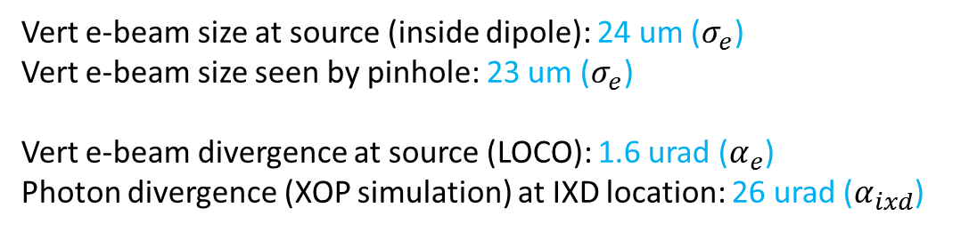
Theory & expectation
Vert e-beam size at source (inside dipole): 24 um ($σ_{e}$)
Vert e-beam size seen by pinhole: 23 um ($σ_{e}$)
Vert e-beam divergence at source (LOCO): 1.6 urad ($α_{e}$)
Photon divergence (XOP simulation) at IXD location: 26 urad ($α_{ixd}$)
Expected vertical photon beam size at IXD:
$σ_{photons, ixd}=\sqrt{{(σ_{e})}^{2}+R^{2}\left({α_{e}}^{2}{+α_{ixd}}^{2}\right)}$ = 48 um

Slide 10
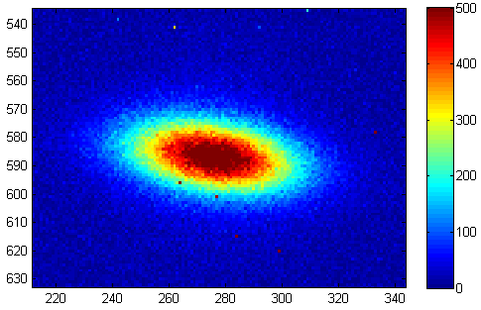
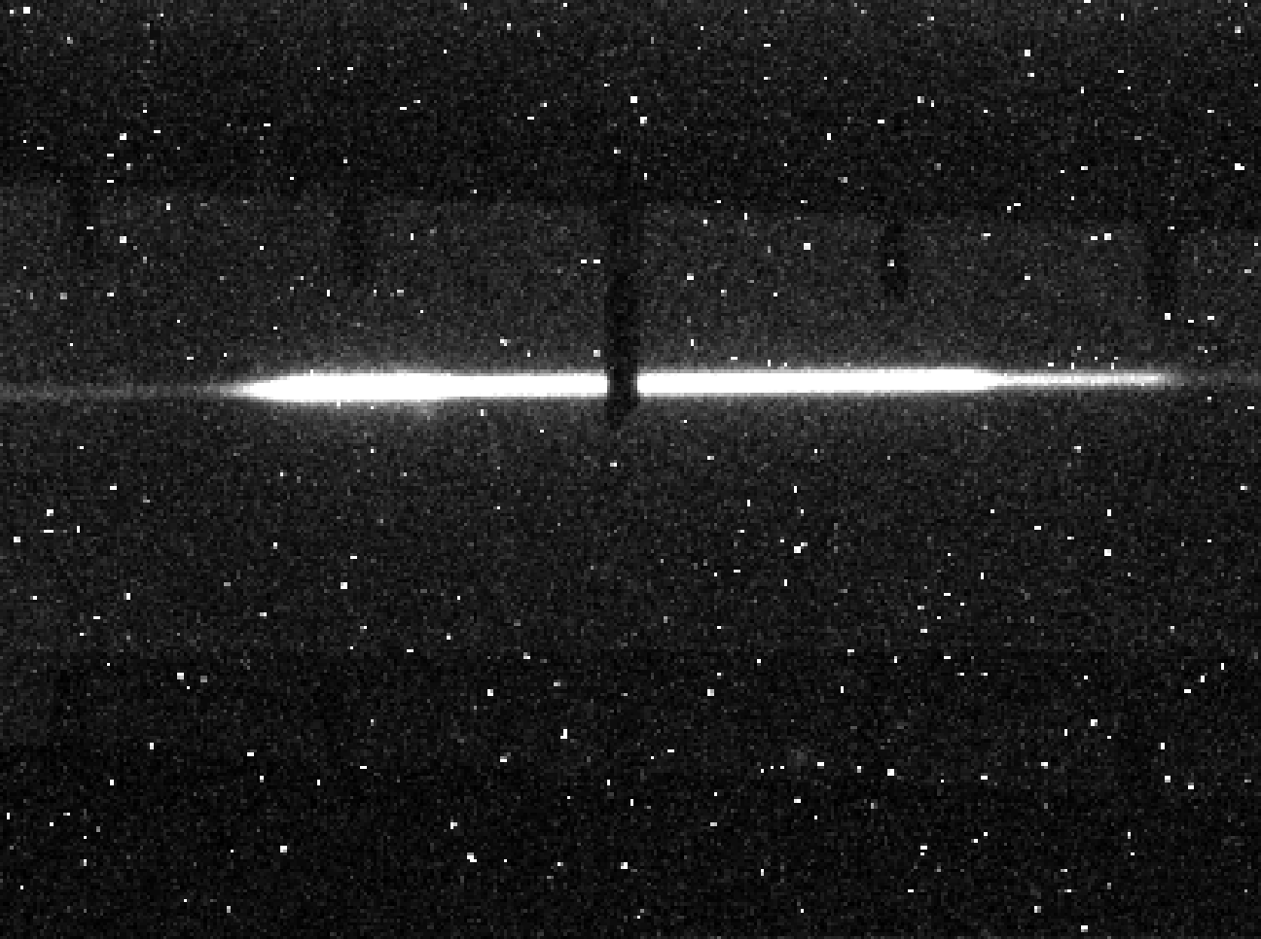
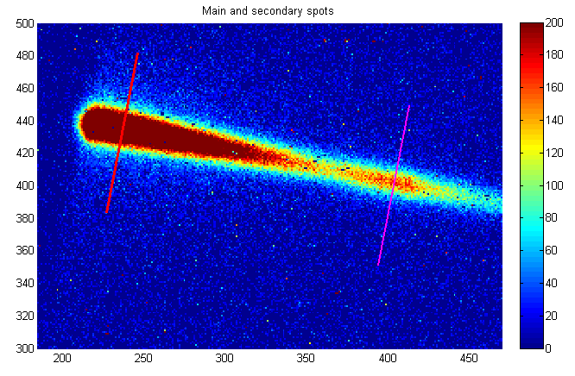
Best IXD shots (@10s)
σy =
25 um
σx = 60 um
Typical pinhole image
IXD images
What causes the segmented pattern??

Slide 11

The teeth imprint
40 um
6 mm
39 um

Slide 12
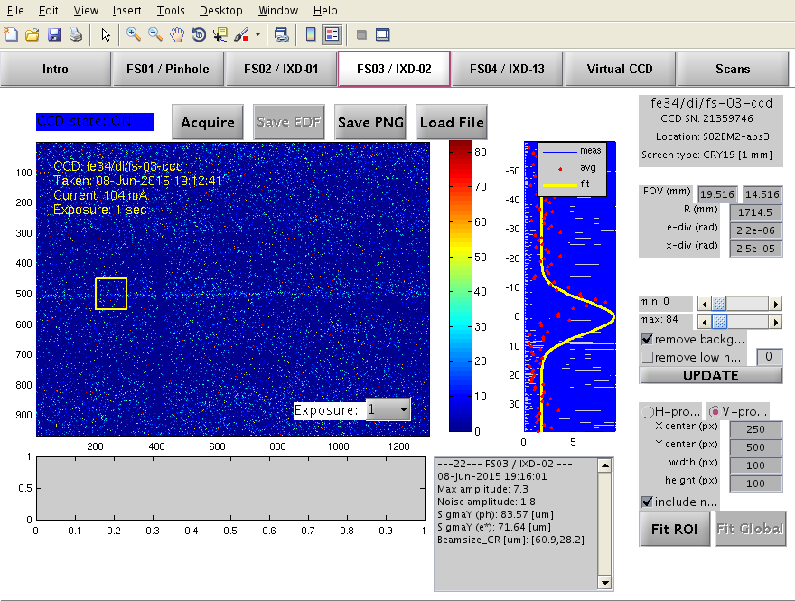
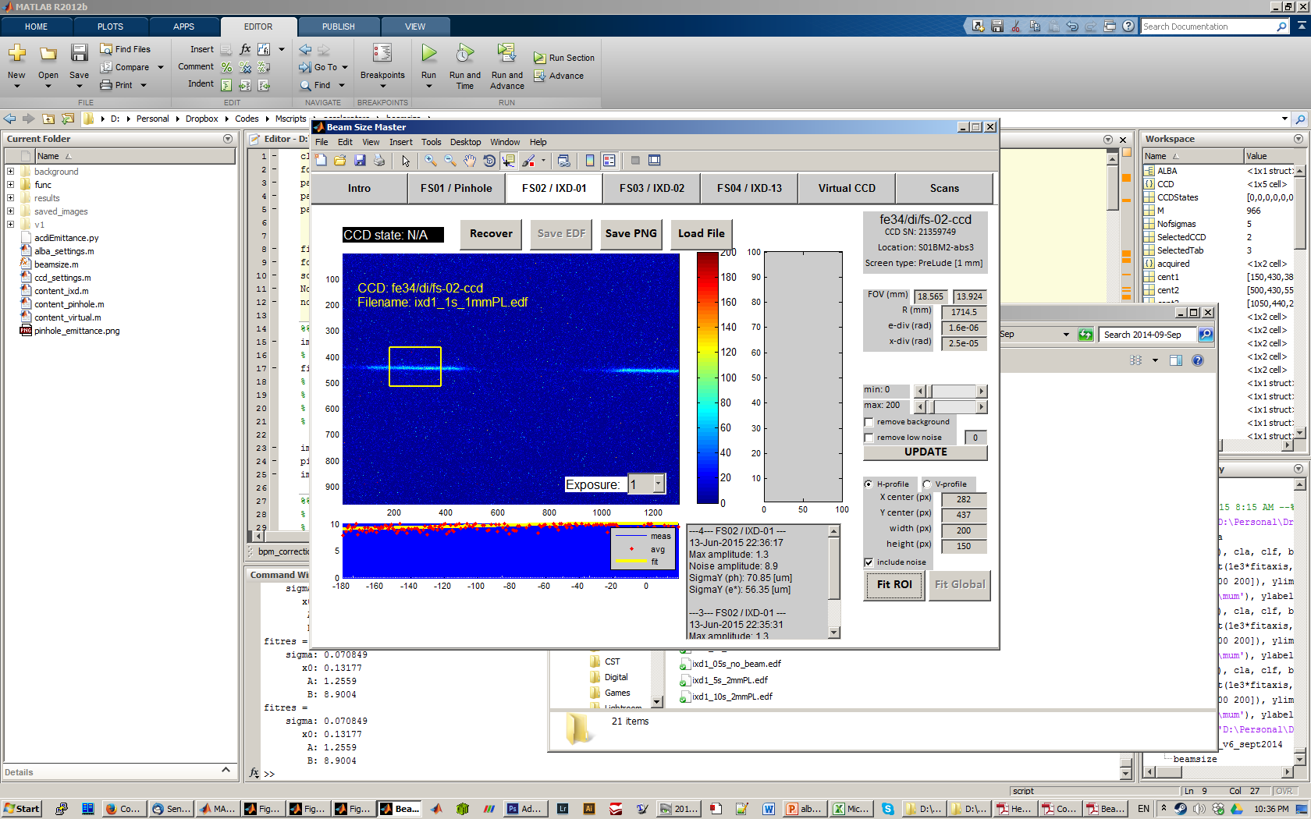
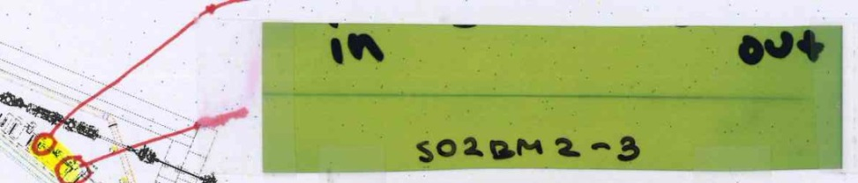
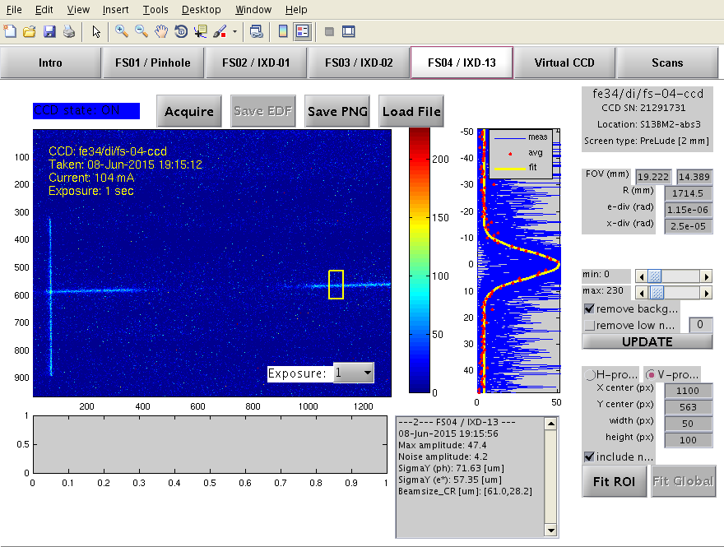
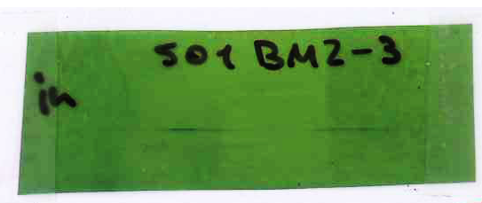
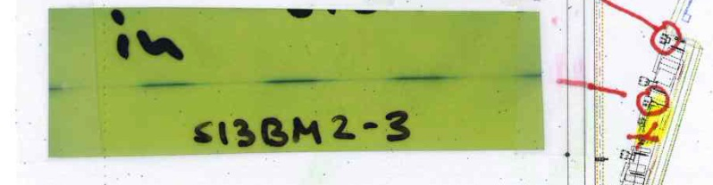
Current status
(@1s)
Cry19
1 mm
σy = 71 um
σy = 56 um
PreLude 1 mm
PreLude 2 mm
σy = 57 um
FOV: around 18 x 13 mm

Slide 13
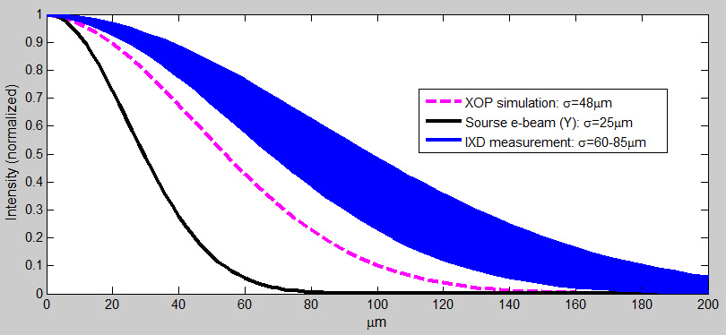
Current status
photon beamsize
Measured photon beam size is quite far off the expected value.
Photon divergence corresponding to the measured values is: 32-47 urad
Copper thickness corresponding to this divergence: <5 mm !!!

Slide 14
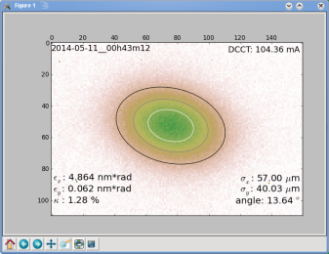
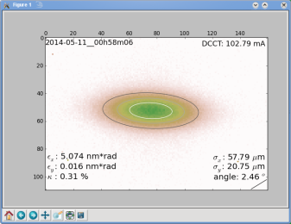
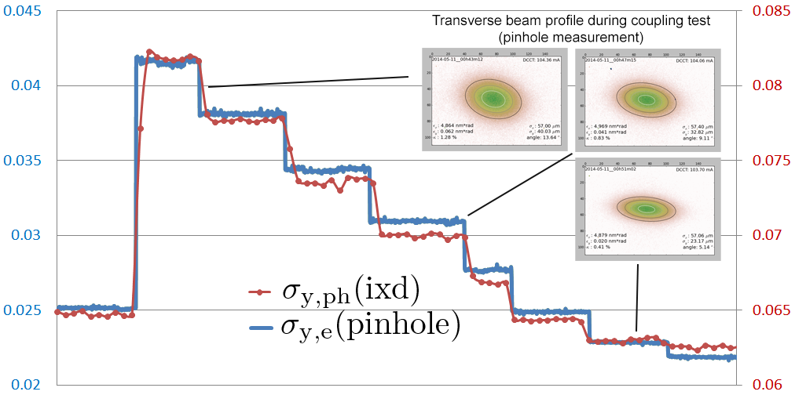
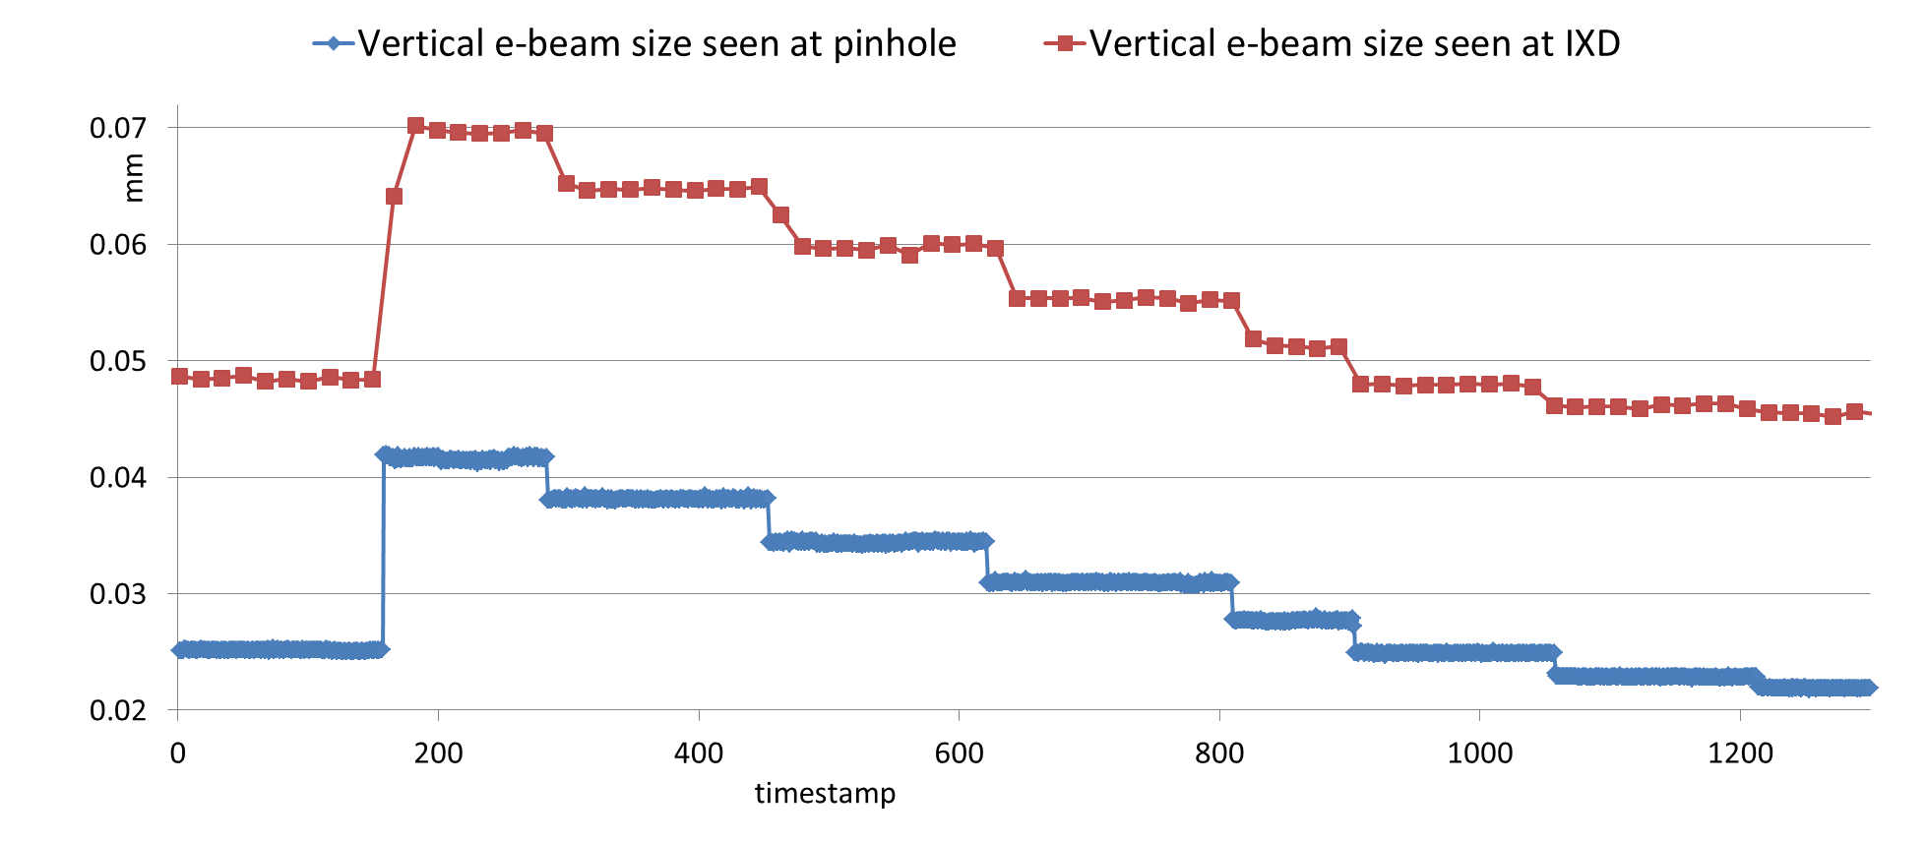
Coupling scans
1.3%
coupling
0.3%
coupling
IXD1 (Sector1) PL 0.8 mm

Slide 15
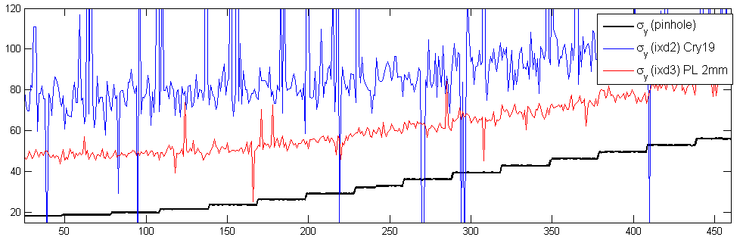
Coupling scans
0.3%
coupling
2.4%
coupling

Slide 16
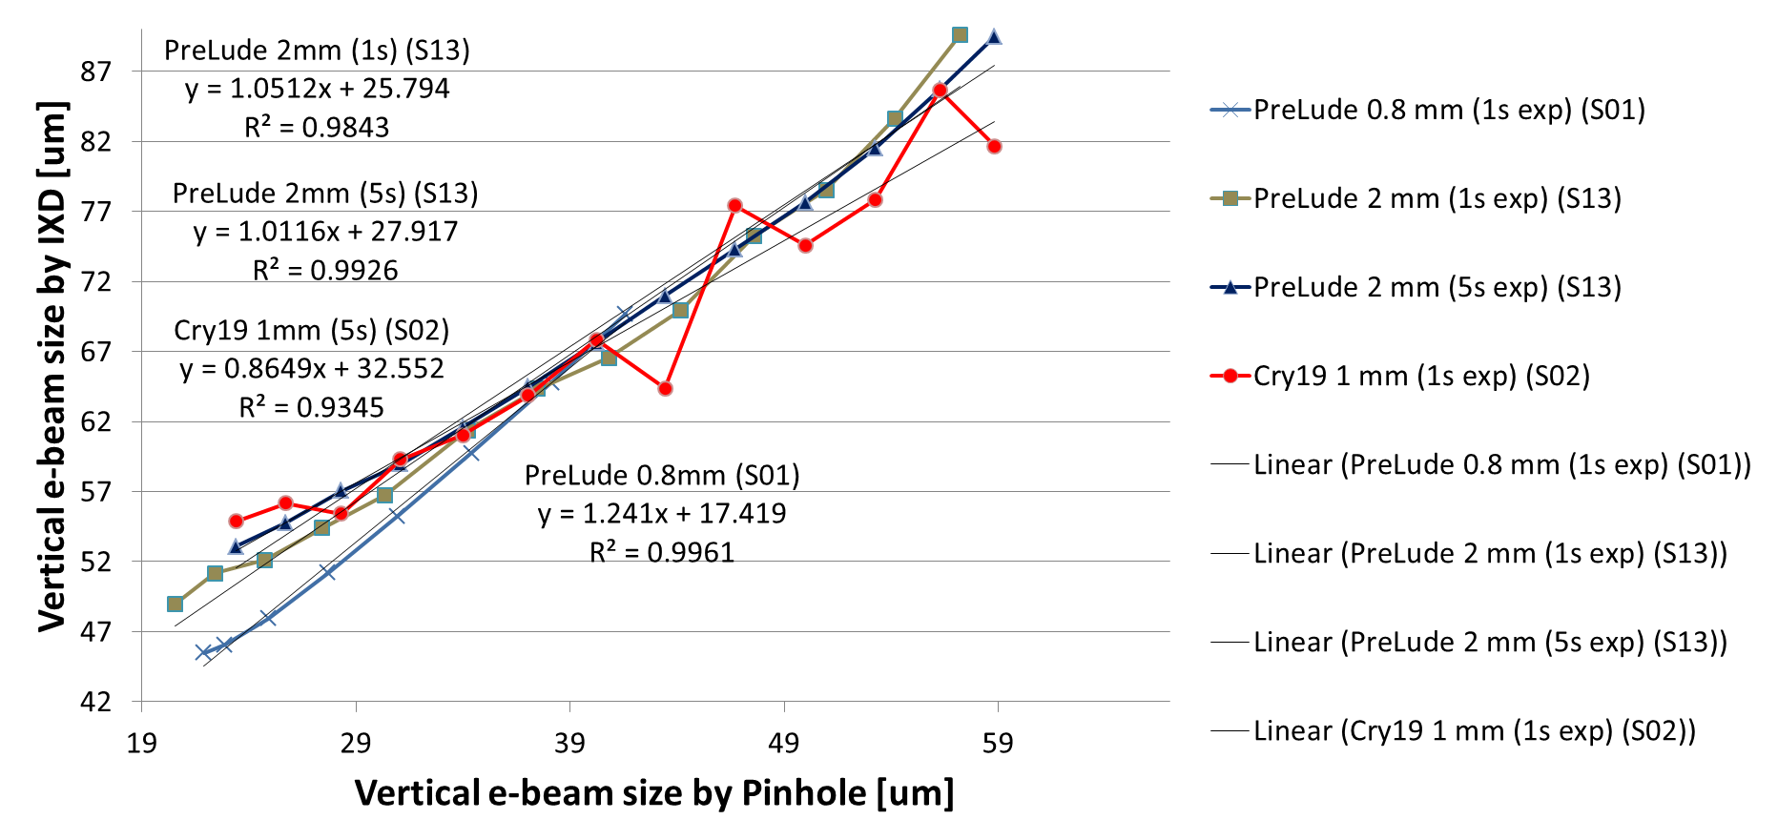
Screen materials test
 | Lin | PSF* | R²
PL 2mm (1s) | 1 | 25 | .984
PL 2mm (5s) | 1 | 27 | .992
CR 1mm (1s) | 0.8 | 32 | .934
PL .8mm (1s) | 1.2 | 17 | .996
brightest
measurements
PreLude (2 mm)
CRY19 (1mm)
PreLude (1 mm)
PreLude (0.8 mm)
cleanest measurements
What is enlarging our beam?

Slide 17
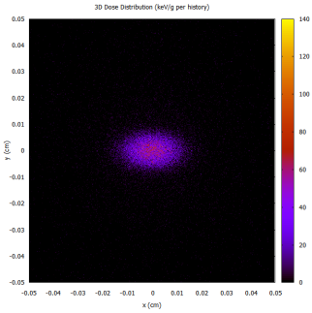
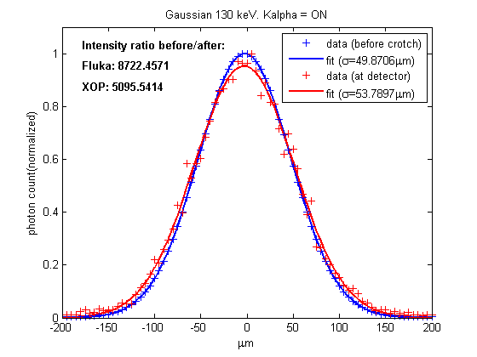
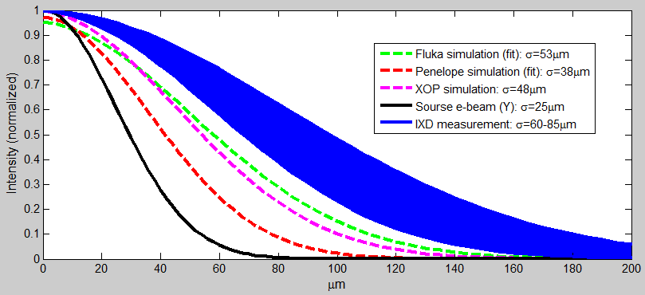
Penelope & Fluka simulations
to evaluate the PSF enlargement by secondary emission
Penelope:
Secondary electrons tracking ON
produced 0.1% more beamsize w.r.t to tracking OFF
Fluka:
Secondary Cu photons (K_alpha) tracking ON produced 0.2% more beamsize w.r.t. to tracking OFF
Neither are able to predict the PSF enlargement of IXD

Slide 18
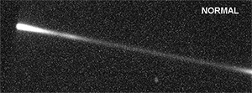
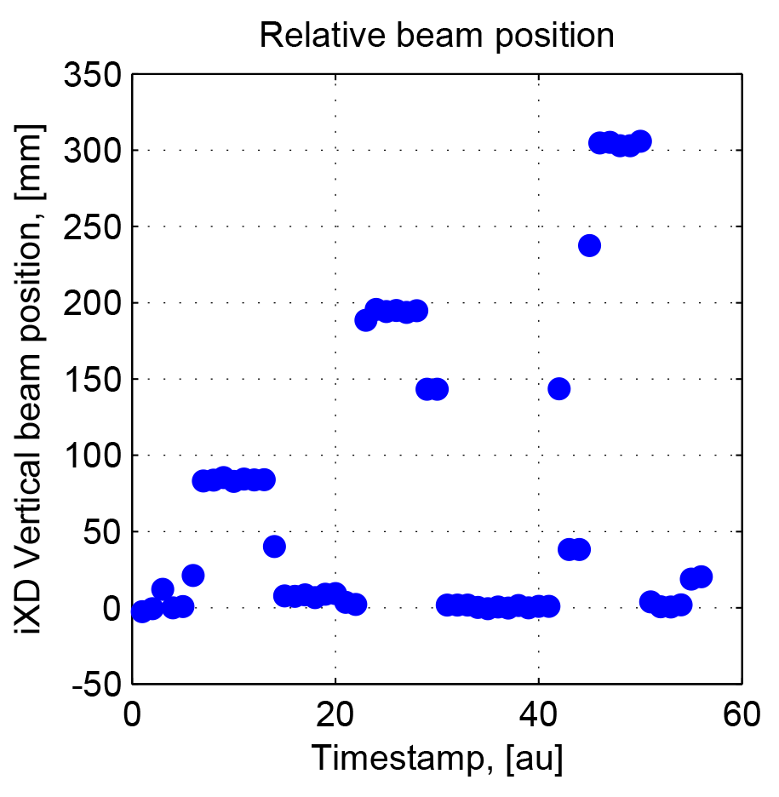
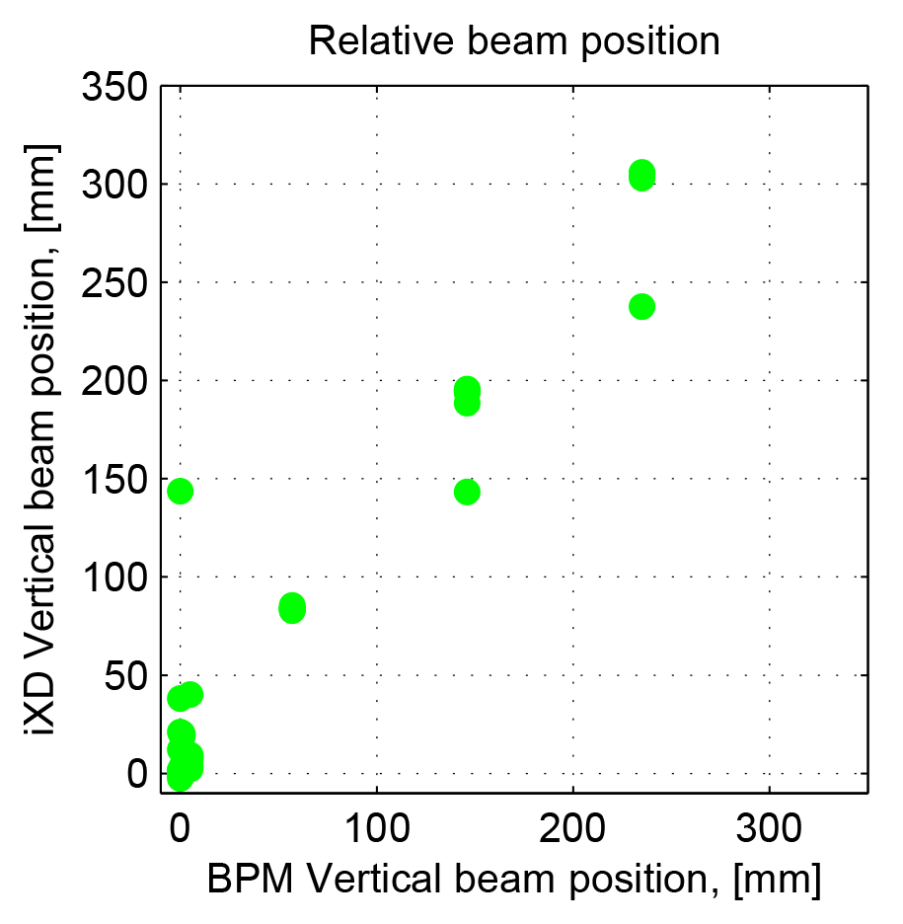
Vertical bumps
Bumps of 50-100-200-300 um are detected well by the IXD
(calculating the difference in Gaussian centroids)

Slide 19
Conclusions
We see a linear correlation between beam size measured by IXD and Pinhole
There is a linear offset which is not understood:
- Optics effect? (DOF checked, pixel size calibrated)
- Secondary emission? (checked by tracking simulations: Fluka, Penelope, which
explain the negligible enlargement by secondary photons and electrons)
- Other?
IXD measurements with different screen materials: results are similar but measure different beam sizes, intensities, and have different sensitivity to high energy x-rays.
IXD measurements in different but geometrically-identical machine sectors show difference in photon intensity and IXD image shape.
Difficult to get to sub-second measurement due to overall low residual flux (absorbers are doing a good job).
Difference in attenuation by identical absorber is not fully understood as well

Slide 20
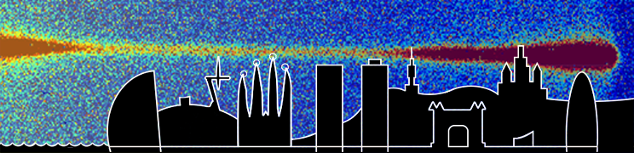
Thank you!

Slide 21
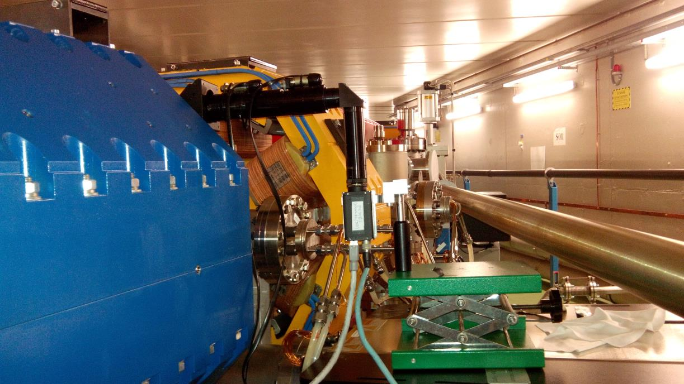
Motorized setup (fail)

Slide 22
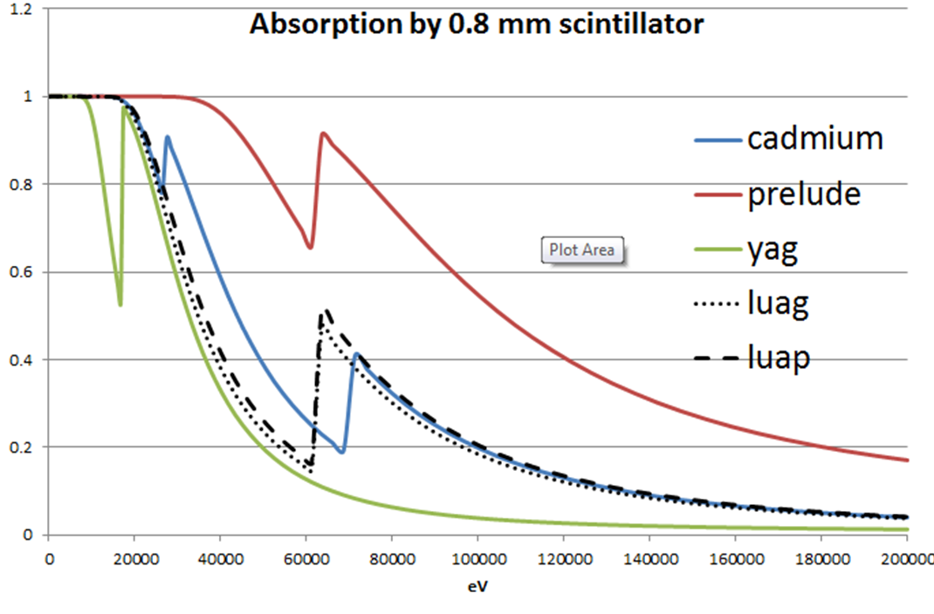
More absorption

Slide 23
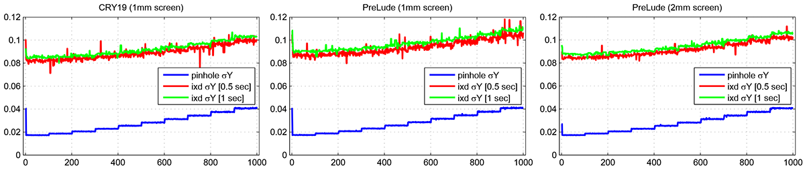
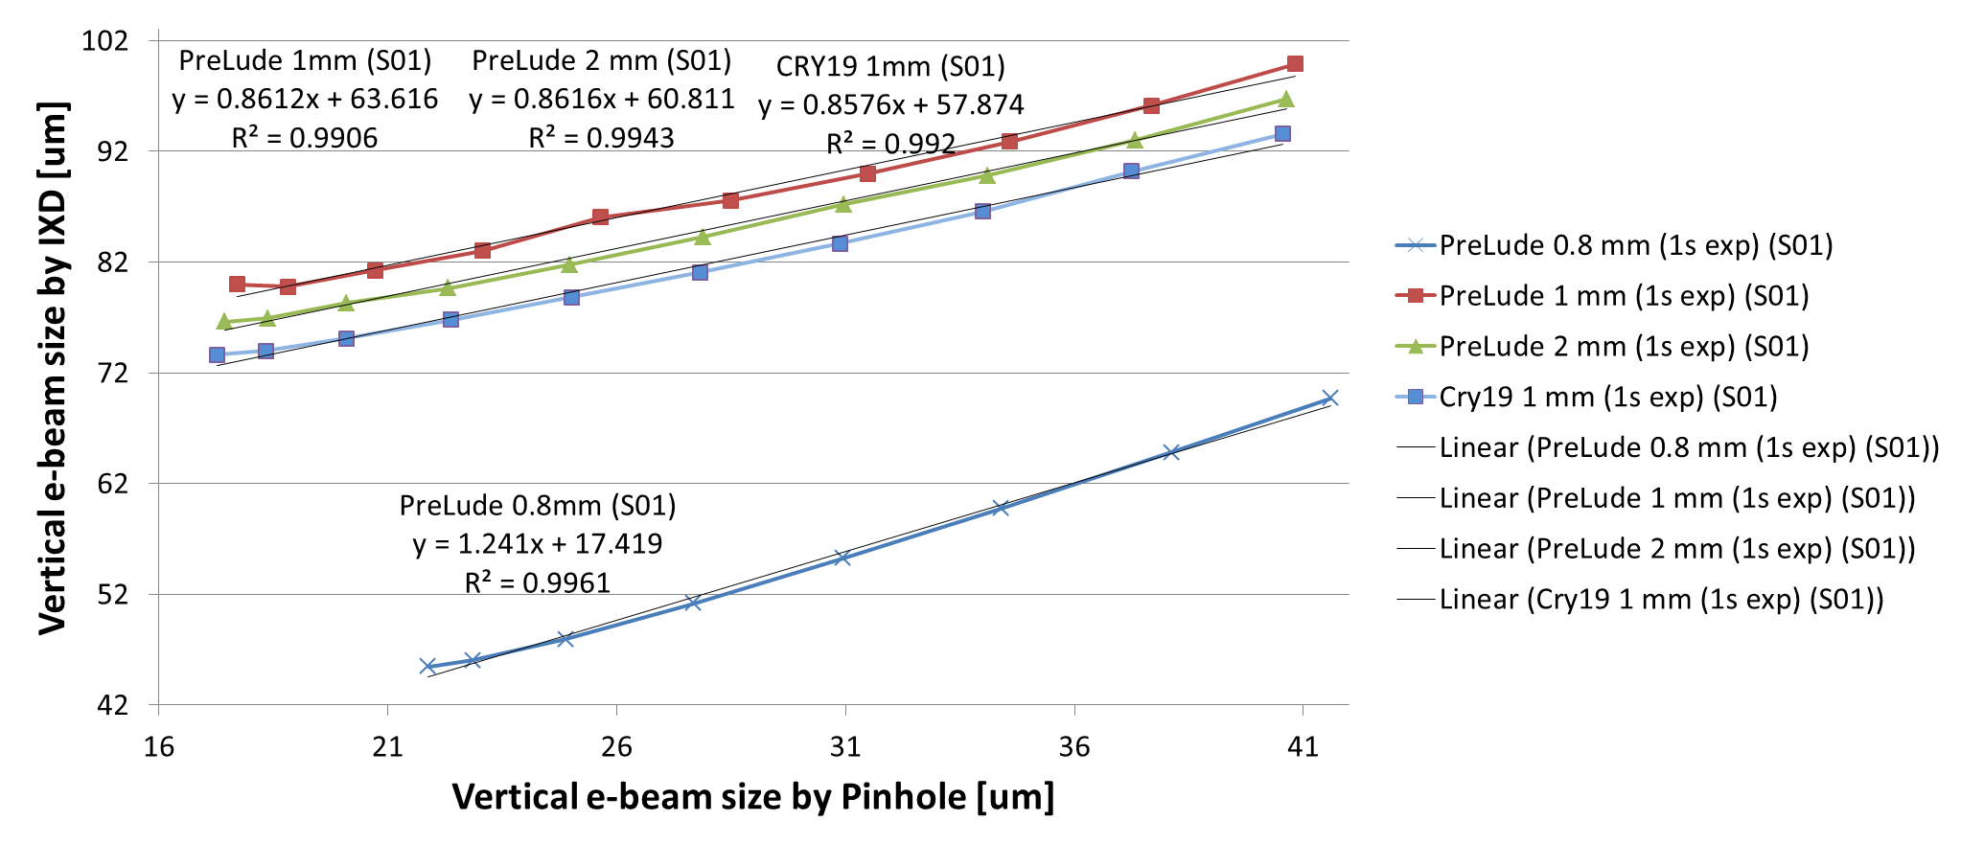
Coupling scans

Slide 24
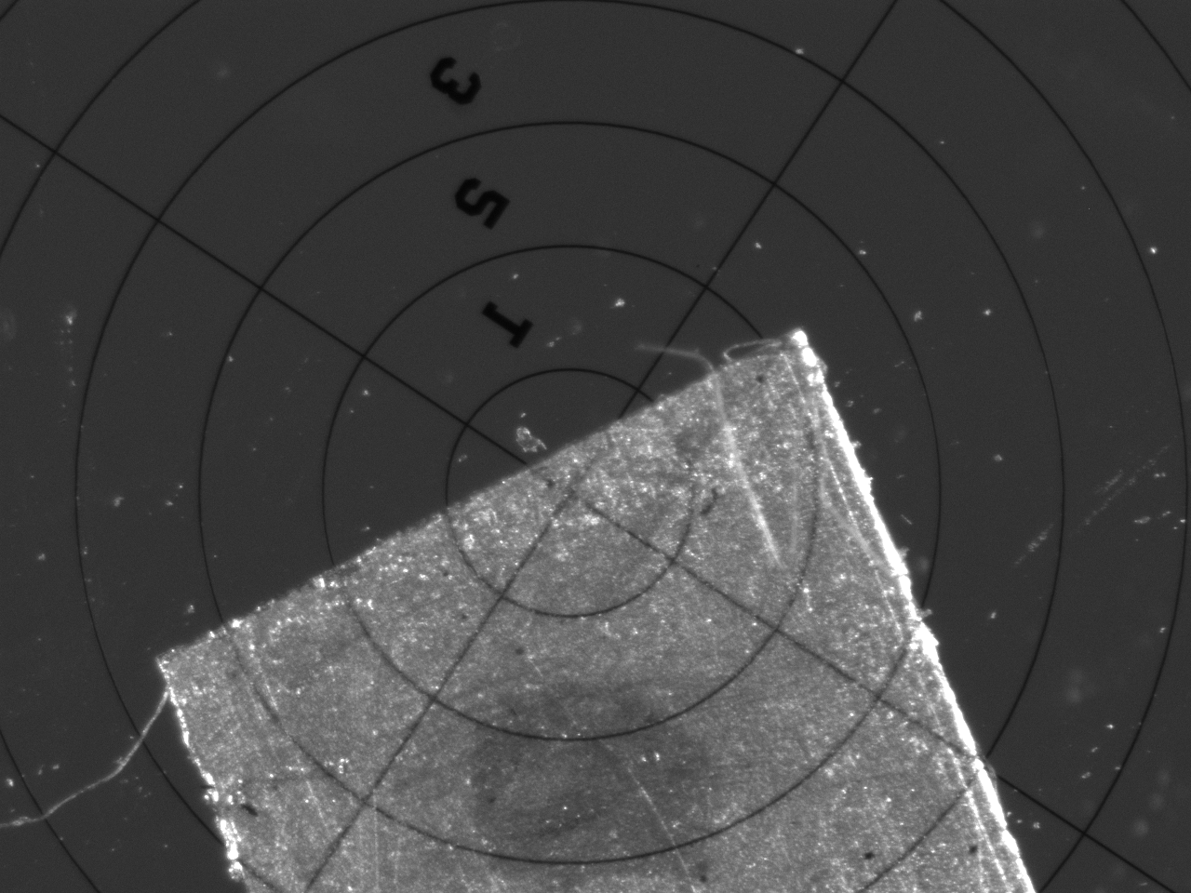
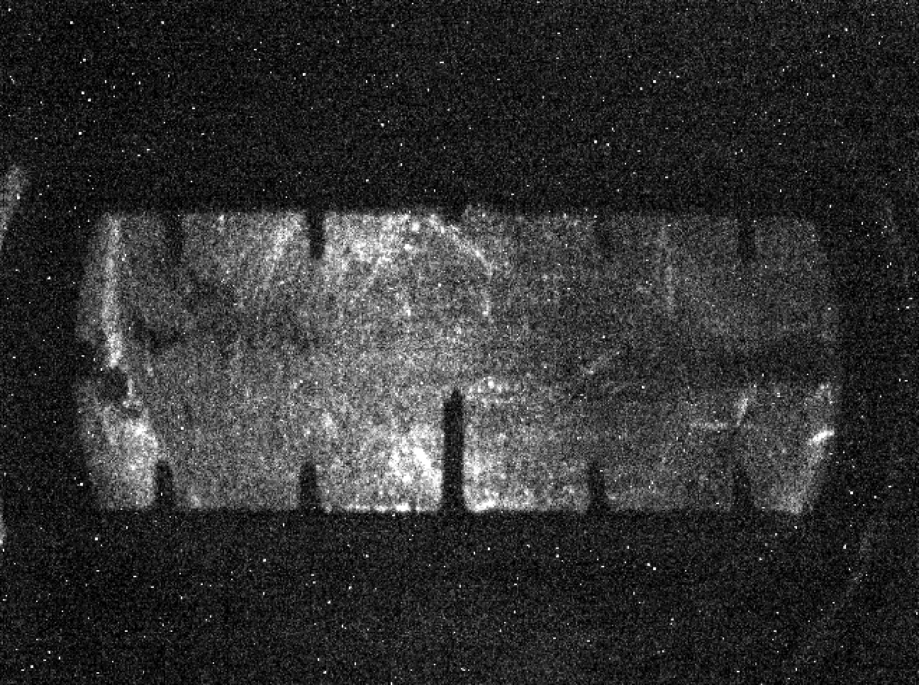
Backup: IXD calibration
FOV measurement
Pixel size calibration
DOF test (typically 1 mm) so focusing on either side of the screen is OK
Calibration can be cross-checked online by looking at the shadow of marks (if visible, especially at high CCD exposures)
Alignment in-situ

Slide 25
Abstract
An in-air x-ray detector (IXD) is used for vertical beam size measurements at ALBA. The IXD intercepts the residual x-rays (above 120 keV) which are left of the main flux after passing through copper absorbers. These x-rays generate a visible footprint on a sensitive scintillator and are observed by a CCD camera equipped with simple optics with the exposures in the order of 1-10 seconds. This measurement allows evaluation of the original electron beam size; however, at the moment, several unexpected systematic effects are not understood and forbid the reliable application of IXD for ALBA diagnostics. Among these effects are a) enlarged x-ray fan size w.r.t. theoretical value, b) varying (very low) intensity of the residual x-rays if sampled at different but geometrically identical locations of the machine, c) attenuation effect of the absorber "teeth" on the x-ray fan.

Slide 26
+Idea + tunnel location + Green paper study
+IXD setup photos
+Scintillators
+Theory, flux, transmission
+Calibration+focusing+line thickness test
+Beam imprints – best picks
+Current status
+ We see different imprints in 3 locations (wtf?)
+ Coupling scans + mismatch with pinhole
+ Coupling scans with changing screens
+ Fluka+XOP+penelope study
+ Bumps
not understood:
enlarged x-ray fan size w.r.t. theoretical value,
varying (very low) intensity at different locations of the SR
attenuation effect of the absorber "teeth" on the x-ray fan.

