Slide 1
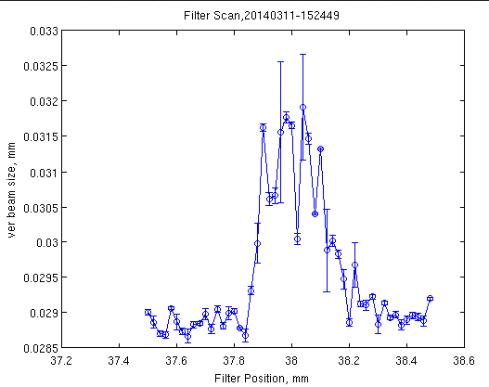
ALBA Pinhole Contimination
Slight beam size increase detected, until at certain point, it was not compatible with the lifetime
Then scan the filter position, and found this extrange behaviour:
Usual working position

Slide 2
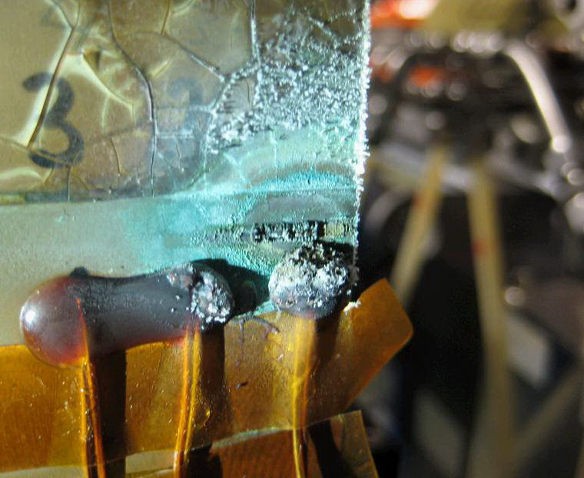
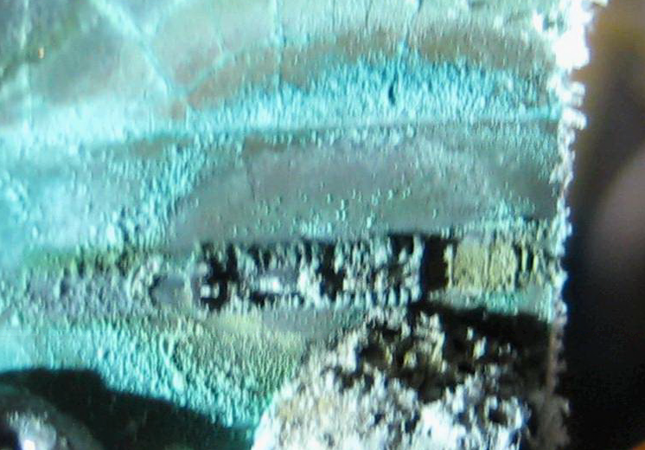
ALBA Pinhole Contimination
Picture of Cu-filter:
Zoom of Cu-filter:
Malachite, a copper carbonate hydroxide mineral Cu2C03(OH)2
This is a well-known problem in Cu things in churchs and such.
The process is that x-rays ionize the air, and ions of oxygen and CO are created.
If the enviroment pH is slightly acid (as apparently is our tunnel), then you have the conditions to create this mineral.

Slide 3
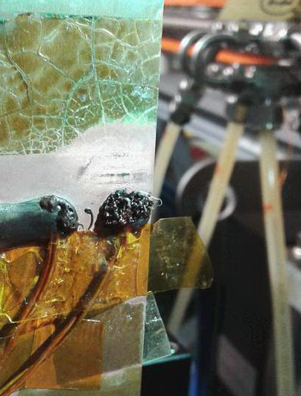
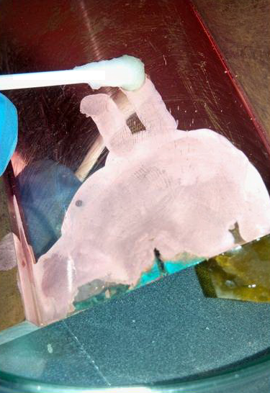
ALBA Pinhole Contamination
Cleaned with diluted (1/10) Hydrochloric acid (37%) on both sides

Slide 4
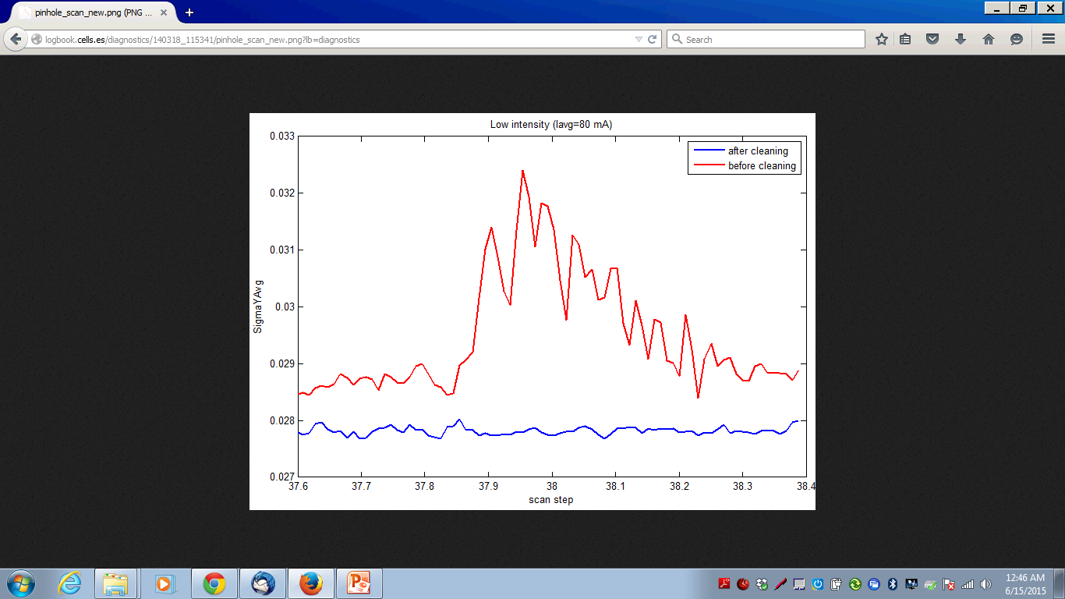
ALBA Pinhole Contamination
Scan Before / After Cleaning

