Slide 1

SOLEIL diagnostics transverse projects and collaborations
DEELS
15-16 June 2015
ALBA, Barcelona
Femto-slicing @ SOLEIL
Thom-X Project
COXINEL
Nicolas HUBERT#
on behalf of the SOLEIL Diagnostics group
# nicolas.hubert@synchrotron-soleil.fr

Slide 2
femto-slicing principle
Production of femtosecond X-ray pulses at SOLEIL:
Schematic of a femto-slicing [1] experiment:
From R. W. Schoenlein et al., Science 287, 2237(2000).
[1] A.A. Zholents, Proc. of the PAC’07 Conference, Albuquerque, New Mexico, USA, 69-73 (2007).

Slide 3
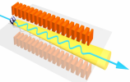
SOLEIL specificities
1) One single laser Ti:Sa 800 nm, 1 kHz, 30 fs-fwhm for the machine and for the CRISTAL beamline
Laser
Beam
SDM6
SDC6
SDM7
dipole
SDC7
SDM8
Courtesy M-A. TORDEUX,
SOLEIL accelerator physics group

Slide 4
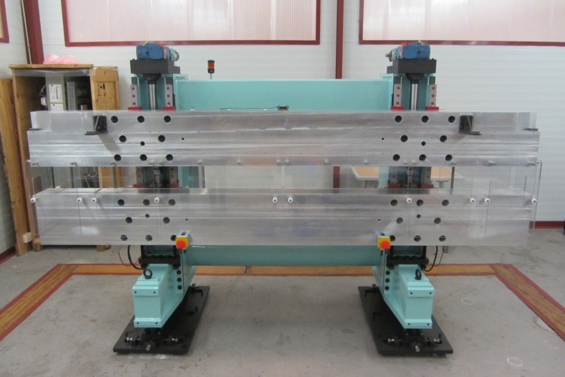
SOLEIL specificities
2) Modulator = a wiggler used for femto-slicing and as a source for PUMA beamline
Laser
Beam
Wiggler Type | Hybrid out-vacuum
Magnetic period | 164.4 mm
Period number | 20
Magnetic gap | 14.5 mm – 240 mm
Magnetic components | Poles: VACOFLUX50 (Saturat. field: 2.35 T) Magnets: VACODYM 764 TP (magn.: 1.37 T)
Max. magnetic field | 1.81 T
Modulator
Wiggler
PUMA BL
SDM6
SDC6
SDM7
SDC7
SDM8
Courtesy M-A. TORDEUX,
SOLEIL accelerator physics group

Slide 5
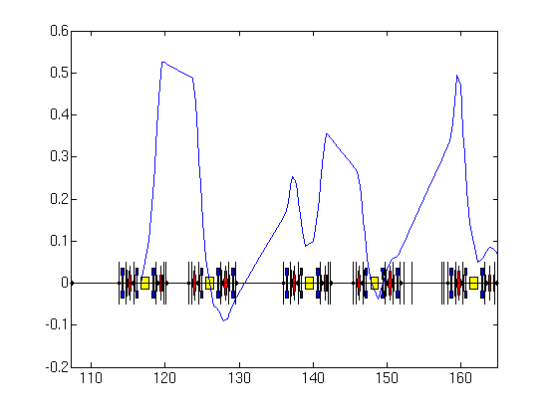
SOLEIL specificities
3) Slice separation using
the machine’s horizontal dispersion function
Effective Dispersion
D_{eff} (m)
3 mm
Shifted diaphragm in BL frontend
Laser
Beam
Modulator
Wiggler
S (m)
SDM6
SDC6
SDM7
SDC7
Slice
SDM8
Additional chicane to reduce the photon emission angle
Core
Courtesy M-A. TORDEUX,
SOLEIL accelerator physics group

Slide 6
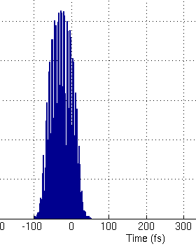
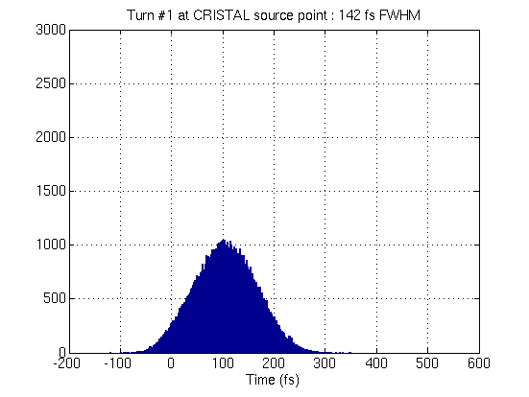
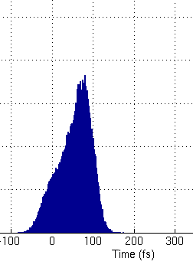
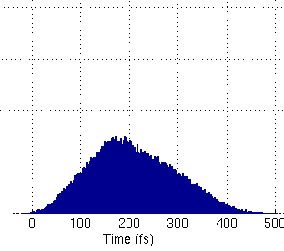
SOLEIL specificities
4) Delivery to several beamlines:
2 « Phase 1 » beamlines (CRISTAL, TEMPO)
2 beamlines under study (DEIMOS, GALAXIES)
1 extra possible beamline ? (SEXTANTS)
75 fs
Laser
Beam
140 fs
Modulator
Wiggler
80 fs
CRISTAL
(U20)
DEIMOS
(HU52 + HU65)
210 fs
GALAXIES
(U20)
TEMPO
(HU44 + HU80)
Courtesy M-A. TORDEUX,
SOLEIL accelerator physics group

Slide 7
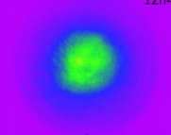
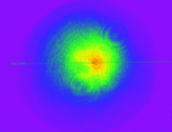
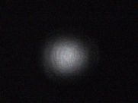
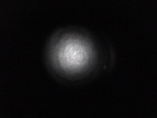
Setup
DIAG_103
Laser: 80 m transport line from CRISTAL Laser hutch to interaction point under primary vacuum
ENC103
5 mirrors under x-y remote control
ENC102
5 centering diagnostics
1 pointing diagnostic
Foreseen position feedback
ENC104
LENS 9 m
55 m
MgF₂
ENC101
MgF₂
STORAGE RING ROOF
Wiggler
DIAG_101
0 : Wiggler
DIAG_001
ENC105
STORAGE RING TUNNEL
LASER ROOM
LASER
Output
DIAG_02
DIAG_IR
CRISTAL BL
DIAG_00
DIAG_01
DIAG_20
PUMA BL
EXPERIMENTAL HALL

Slide 8
IR diagnostics
Infra-Red Diagnostics: measure the overlaps between Laser and SR radiations
→ inside the Storage Ring tunnel,
under the PUMA beamline frontend.
Extraction of the IR radiation:
Extraction mirror
In Vacuum Cu Mirror
Saphhire Window
Filters
2.5 m Lens
R_{max} Mirror
Wiggler
laser + wiggler
towards PUMA beamline
laser
Conception : M. Labat
e-

Slide 9
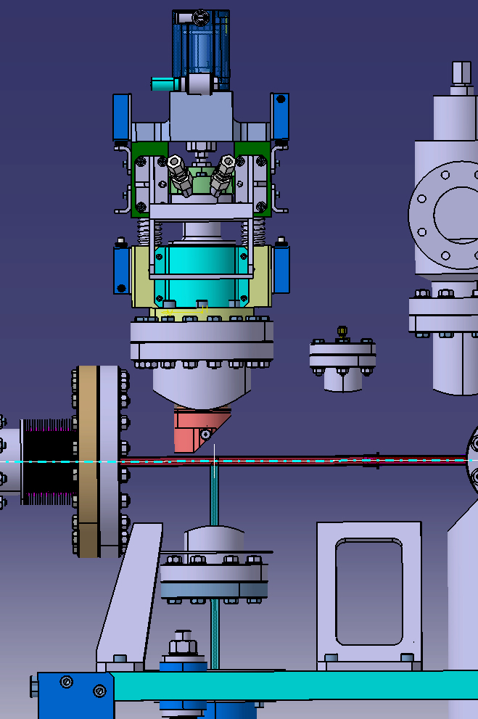
IR diagnostics
Extraction of the IR radiation:
Conception : M. Labat, D. Zerbib, J-L. Marlats
Extraction mirror
Wiggler
laser + wiggler
towards PUMA beamline
laser
e-
Main constraint on the extraction mirror:
→ P_{wigg}= 250 W @ 10 mA

Slide 10
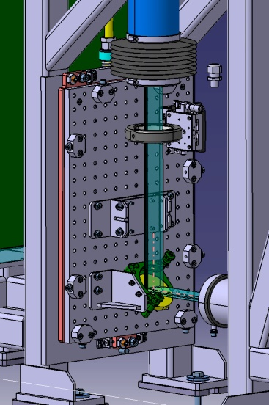
IR diagnostics
Transport of the IR radiation:
Extraction mirror
Wiggler
laser + wiggler
towards PUMA beamline
laser
IR diagnostics
e-
Mirror
Conception : M. Labat, D. Zerbib, J-L. Marlats

Slide 11
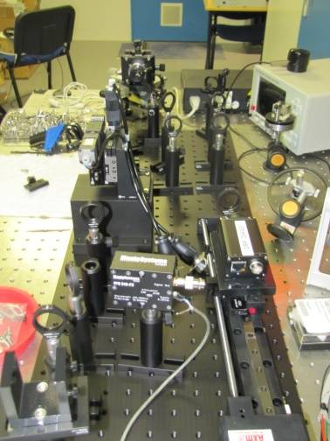
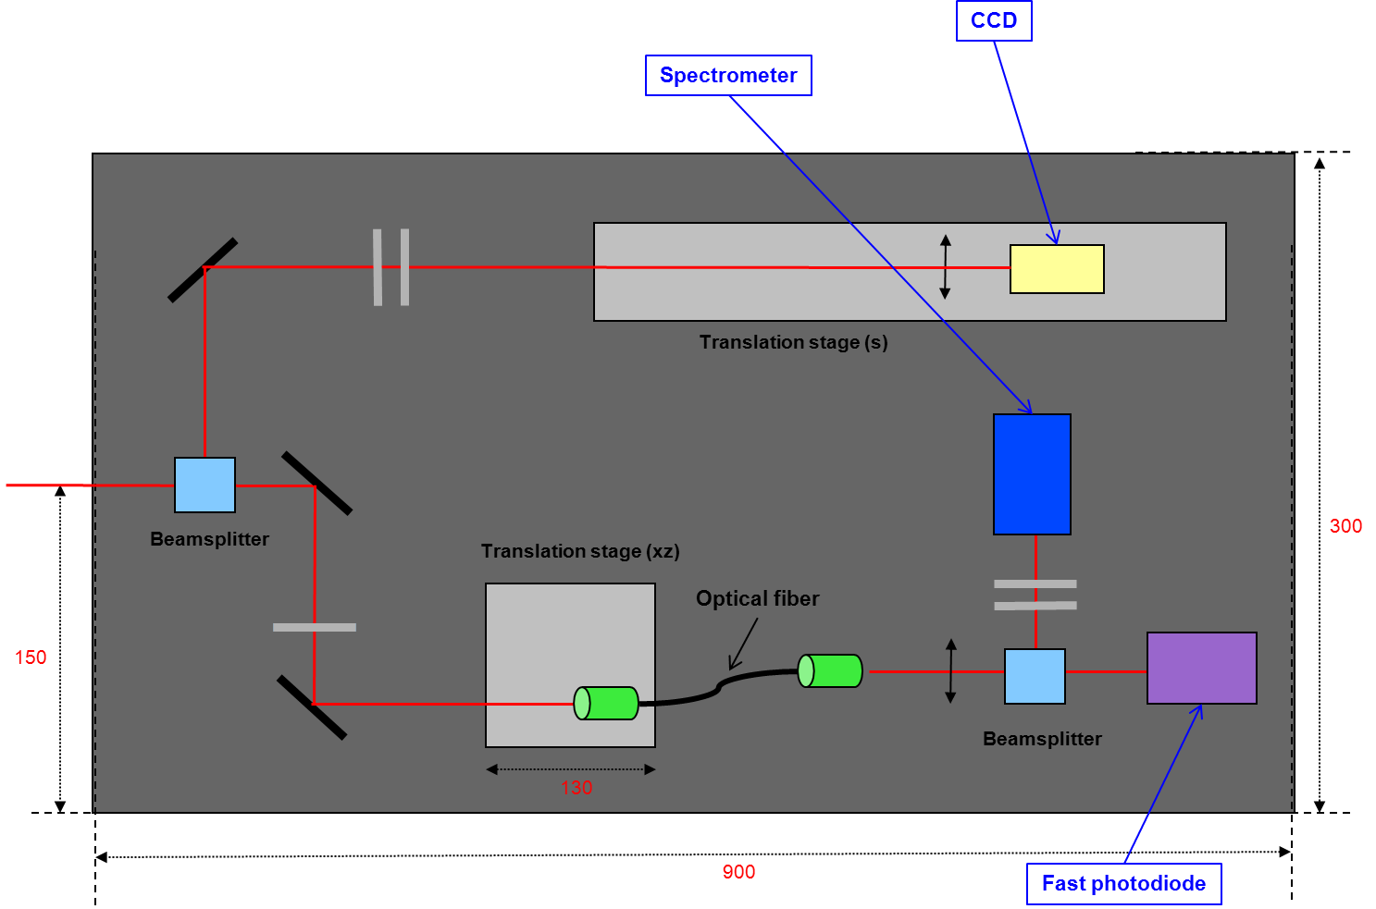
IR diagnostics
IR detectors :
    For temporal overlap:
    → Fast photodiode (FPD 310-FV from Menlo)
    For spatial overlap:
    → Optics + CCD (Basler) for imaging in the wiggler
    For spectral overlap:
    → Spectrometer (Ocean Optics USB2000)
Conception : M. Labat

Slide 12
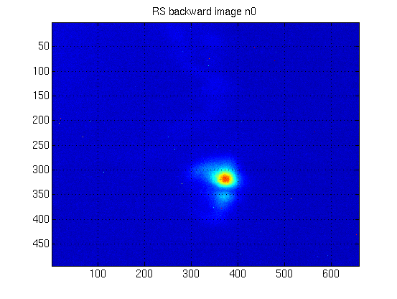
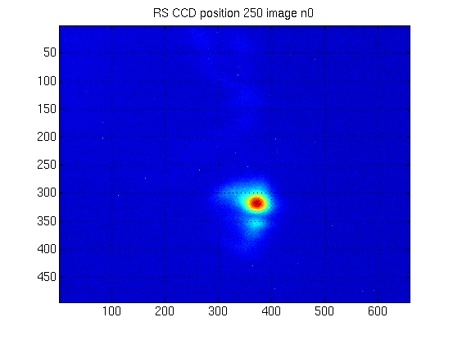
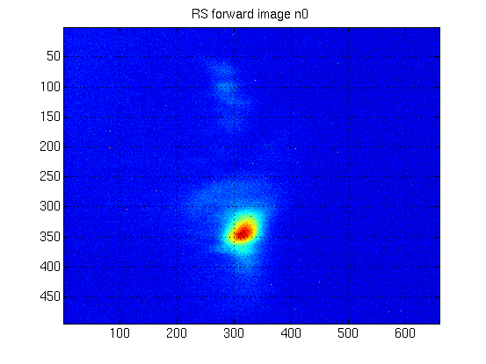
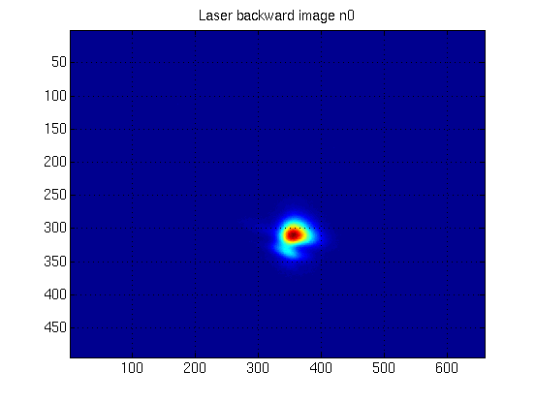
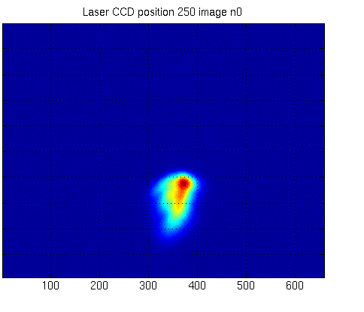
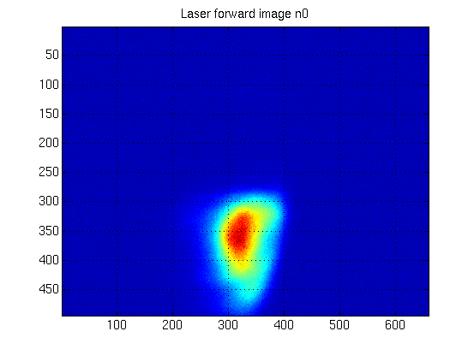
Alignment in the Wiggler of SR and laser
(in focused mode and low power)
SR
Wiggler entry
Wiggler middle
Wiggler exit
Laser
1 pixel on the CCD ≡ 20 µm in the transverse plane of the wiggler

Slide 13
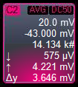

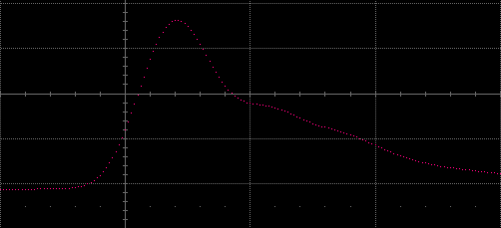
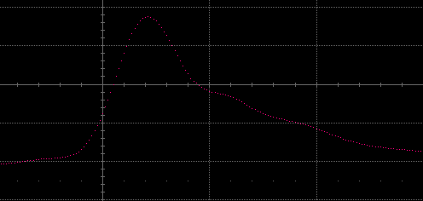
Synchronisation
  Measure arrival time of the SR on the photodiode, without laser.
  Add filters, open the laser shutter, adapt the optical fiber to equal SR and laser intensity level.
  Measure arrival time of the laser, adjust the laser delay to equal the SR’s.
  Final resolution: 10 ps
SR
Laser
1 ns

Slide 14
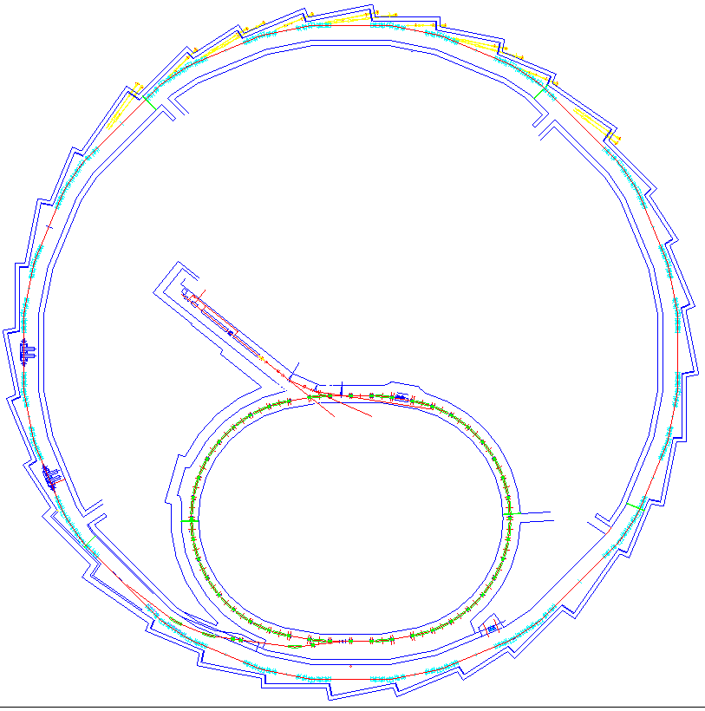

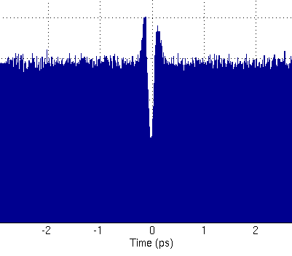
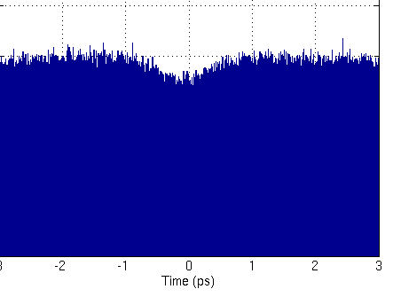
THz Diagnostics
PUMA BeamLine
fs pulses → CRISTAL BeamLine
Laser
Evaluates the dip in the core beam using the THz beamline AILES
Wiggler
fs pulses →
TEMPO BeamLine
1
0
    High sensitivity measurements:
    Bolometer
    QMC 1 ms, SAI card
    IR Labs 1.7 µs, oscillo Lecroy 1GHz
Fast measurements (turn by turn):
    THz diode
    Virginia Diode Virginia 1 nsdiodes)
-1 0 1
Time (ps)
10 m
1
0
THz pulses extracted @ AILES beamline
-1 0 1
Time (ps)

Slide 15
THz diagnostics
Bolometers:
  1st bolometer :
    Used during the first 2 tests of interaction
    Bolometre from QMC
    Time response = 1 ms
    ->> Integration of the signal : 1 coherent shot + 1000 incoherent shots
    (Laser @ 1 kHz, SR @ 846 kHz)
    Acquisition with SAI Card (@500 kHz max)
  2nd bolometer :
    Used during the third succesfull test of interaction
    Bolometre from IR Labs
    Time response = 1.33 µs
    ->> Integration of the signal : 1 coherent shot + 1 incoherent shot
    ->> Much more suitable for first (not optimized) THz detection
    “Acquisition” with Oscilloscope LeCroy (1 GHz)

Slide 16
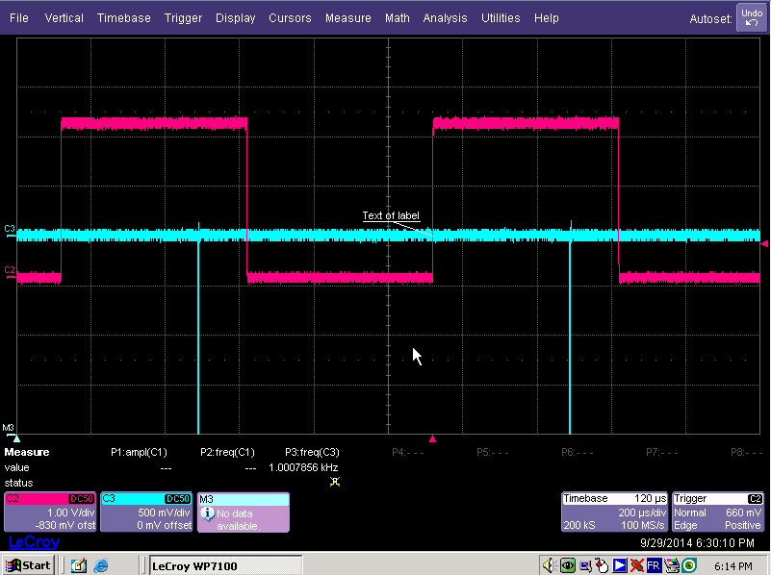
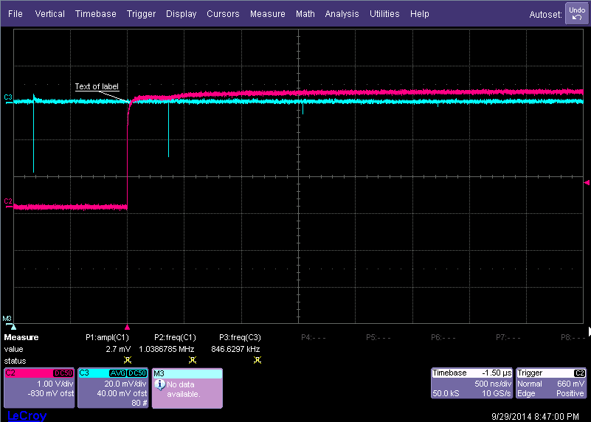
First results : THz intensity measurement
  Bolometer signal
  Fast diode signal
1 kHz trigger
Bolometer signal = Interaction !!
1st turn
2nd turn
3rd turn
4th turn
  With the bolometer (0.1 – 3 THz BW), we saw a few V signal at laser repetition rate.
  After a rough optimisation, we saw some signal up to 4 turns with the fast diode (0.3 – 0.5 THz BW).

Slide 17
Femto-slicing summary
  Slicing interaction is done (since 29/09/2014)
Setup is very reproducible (2 hours to set up the slicing operation)
Bolometer operation is painful, to be replaced by photodiode soon
  First photons seen on CRISTAL Beamline the 09/02/2015
Toward user operation
  First experiments on CRISTAL planned in the 2nd part of 2015
  Preparation for next beamlines: TEMPO (2015), DEIMOS, GALAXIES, SEXTANTS

Slide 18
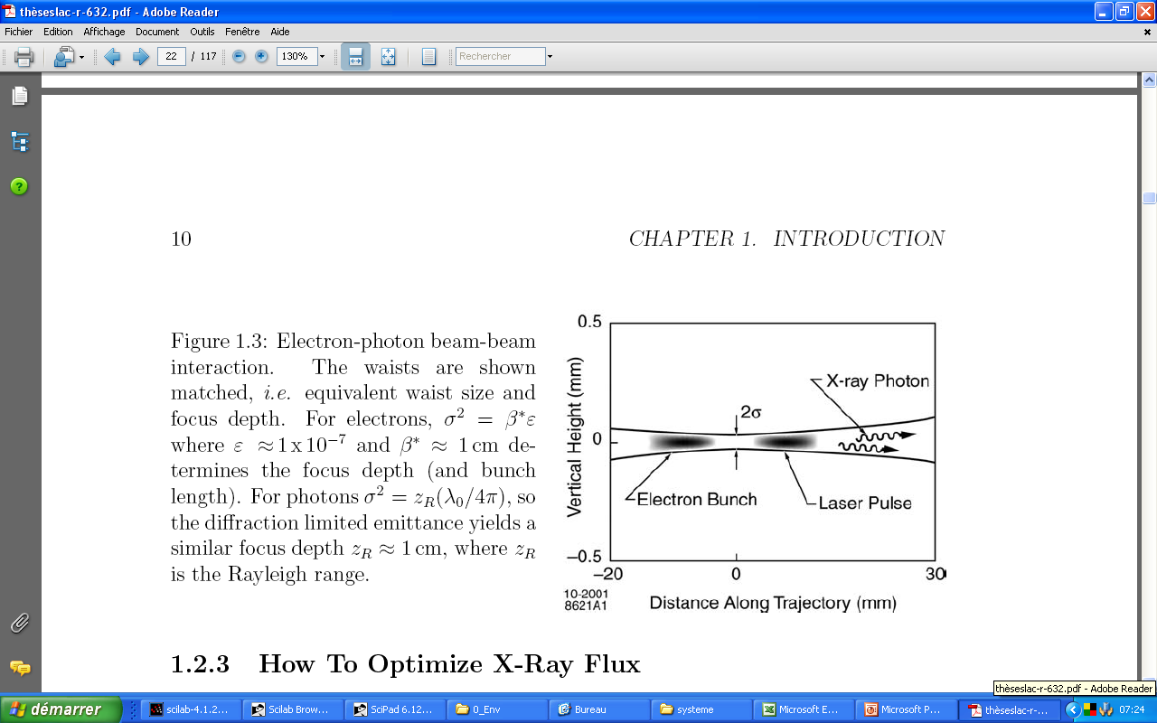
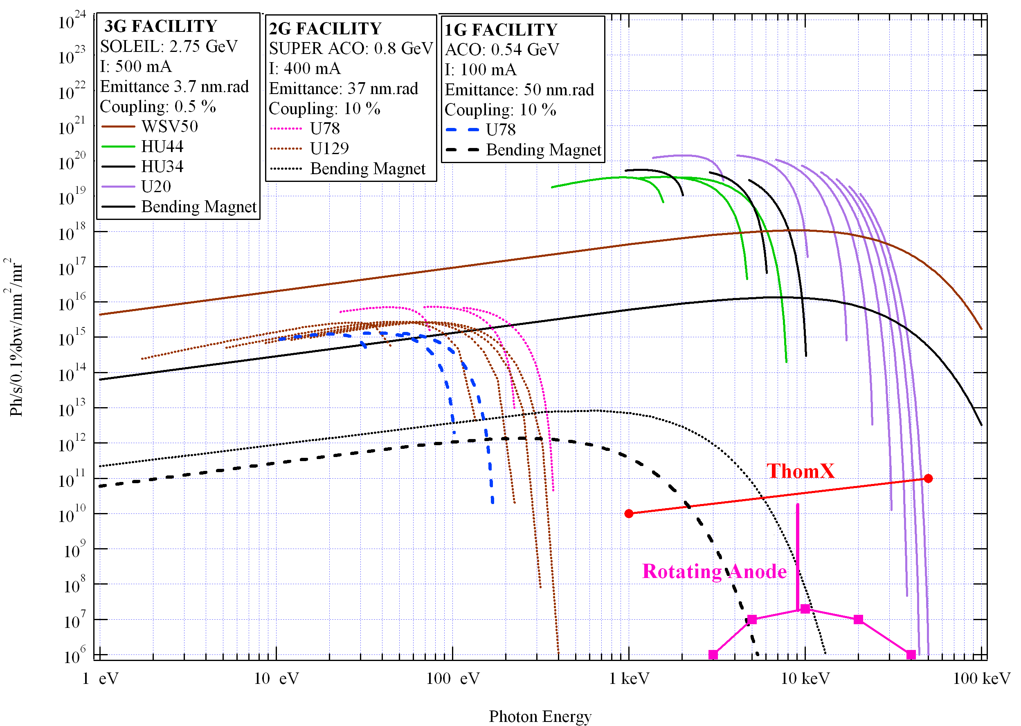
The ThomX Project
What is ThomX?
  Light source based on Compton Back Scattering effect (CBS)
    Most efficient energy amplifier
    Production of hard X-rays with relatively low energy machine
    Example : 50 MeV electrons and 1.23 eV laser give up to 50 keV back scattered X-rays
  High average flux
    Storage ring to have a high repetition rate
    high average power laser amplified in a Fabry Perot resonator
Target : Store one electron bunch of 1 nC over 20 ms in the ring
Store one laser pulse of 25 mJ in the FP cavity
==> Thom-X is a demonstrator
=> 10¹³ Ph/s

Slide 19
The ThomX Project
What is ThomX?
  Collaboration!
  Supported by
    the EQUIPEX program – French Research Ministry,
    Ile-de-France region,
    CNRS-IN2P3
    Université Paris Sud XI
SOLEIL has in charge the design of the accelerator and will be part of the installation tests and commissioning

Slide 20
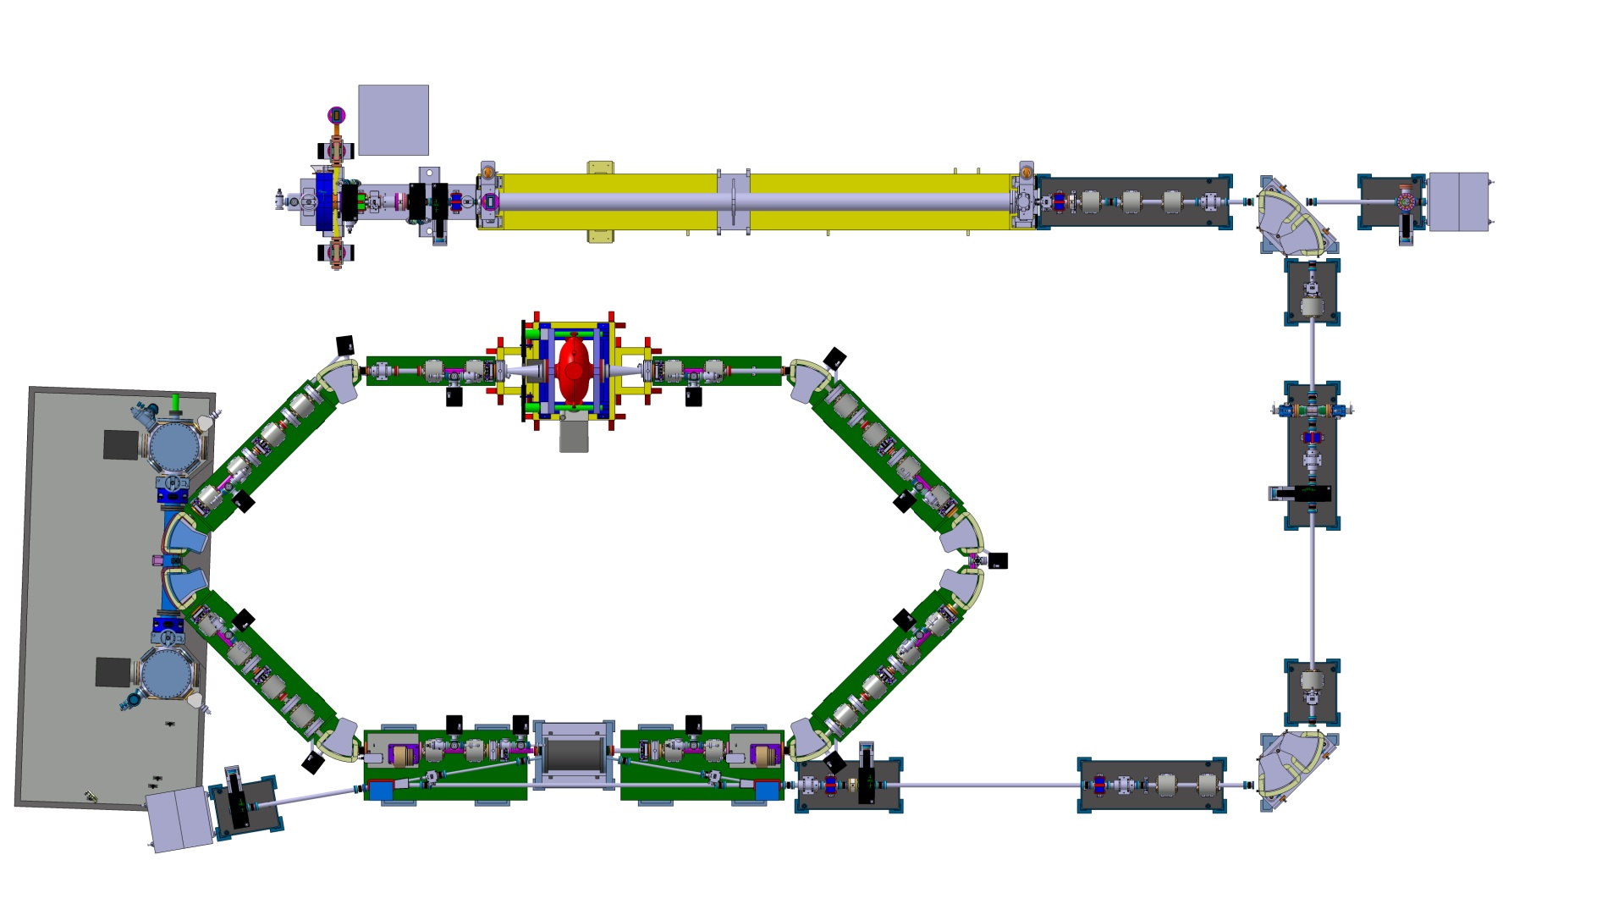
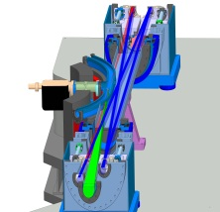
ThomX Machine
X-rays
Cycle Frep = 20 msec
RF pulse length 3 μs
Energy 50 - 70 MeV
Easy integration
2 Interaction Points in the arcs
Frees the straight sections
RF gun 3 GHz
Linac 3 GHz 50-70 MeV
Linac dump
& diag
Laser
and FP cavity
Feedback system & RF 500 MHz
E-diag
7 m.
Interaction point
Matching section
Inj & Ext section
Ring dump
10 m.

Slide 21

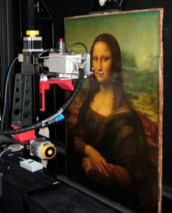

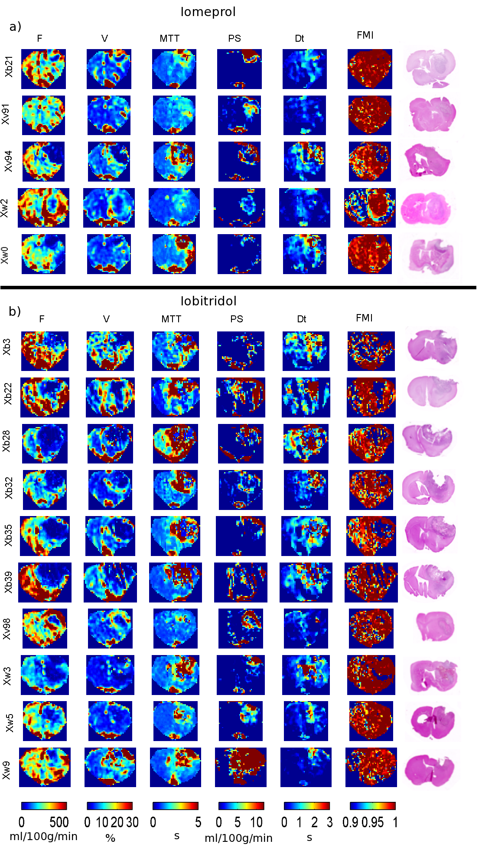
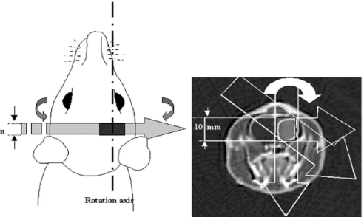
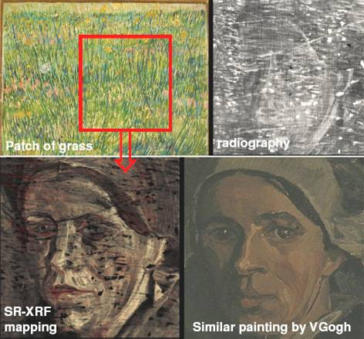
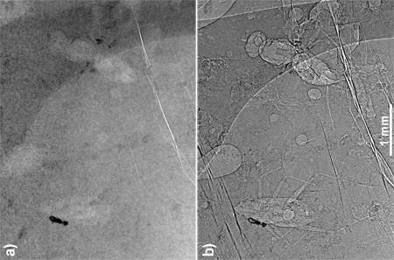
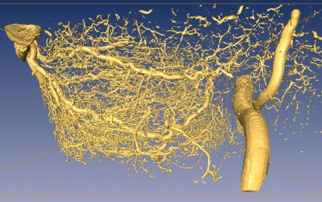
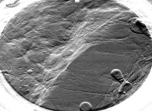
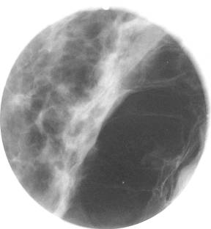
ThomX: what for?
Transfer of the SR techniques to these new machines. Many fields can be interested…
At present two contributors: Medical field (ESRF, INSERM Grenoble) Cultural Heritage (C2RMF CNRS – Louvre Museum)
Painting analysis
Physiopathology and Contrast agents,
Dynamic Contrast Enhancement SRCT
Convection Enhanced Delivery =>Stereotactic Synchrotron RT
Paleontology
Non-destructive analysis
Imaging,
Mammography
Microtomography
Biston et al, Cancer Res 2004, 64, 2317-23
K-edge imaging (Pb➔white, Hg➔ vermilion…) of a Van-Gogh’s painting
J. Dik et al., Analytical Chemistry, 2008, 80, 6436
  J Cereb Blood Flow and Metab, 2007. 27 (2):292-303.
Journal of Radiology 53, 226-237 (2005)
Thanks to G.Le Duc, P.Walter

Slide 22
Expected beams characteristics
Injector
Charge | 1 nC in 1 bunch
Laser wavelength and pulse power | 266 nm, 100 μJ
Gun Q and Rs | 14400, 49 MW/m
Gun accelerating gradient | 100 MV/m @ 9.4 MW
Normalized r.m.s emittance | 8 π mm mrad
Energy spread | 0.36%
Bunch length | 3.7 ps
Ring
Energy | 50 MeV (70 MeV possible)
Circumference | 18 m
Crossing-Angle (full) | 2 degrees
B_{x,y} @ IP | 0.2 m
Emittance x,y (without IBS and Compton) | 3 10⁻⁸ m
Bunch length (@ 20 ms) | 30 ps
Beam current | 17.84 mA
RF frequency | 500 MHz
Transverse / longitudinal damping time | 1 s /0.5 s
RF Voltage | 300 kV
Revolution frequency | 16,7 MHz
Harmonic Number | 30
σ_{x} @ IP (injection) | 78 mm
Tune x / y | 3.4 / 1.74
Momentum compaction factor α_{c} | 0.013
Final Energy spread | 0.6 %
Laser and FP cavity
Laser wavelength | 1030 nm
Laser and FP cavity Frep | 36 MHz
Laser Power | 50 – 100 W
FP cavity finesse / gain | 30000 / 10000
FP waist | 70 μm
Source
Photon energy cut off | 46 keV (@50 MeV), 90 keV (@ 70 MeV)
Total Flux | 10¹¹-10¹³ ph/sec
Bandwidth | 1 % - 10%
Divergence | 1/γ ~ 10 mrad without diaphragm @ 50 MeV

Slide 23
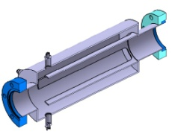
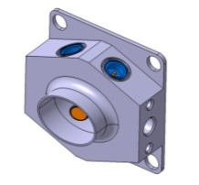
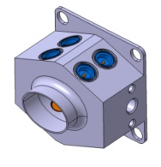
ThomX Diagnostics
Position
  Mechanics:
    Linac: 1 stripline
    Transfer Line: 4 striplines
    Ring: 12 buttons BPMs
  Electronics:
    Libera Brilliance +
      First unit delivered in January
      Series to be delivered end of September

Slide 24
ThomX Diagnostics
Feedthroughs
  All provided by PMB-ALCEN (France)
  90 Buttons, identical to ESRF ones (Φ=10,8 mm)
    Ordered in may 2015
  25 Feedthroughs for striplines are on the same basis, button replaced by a long central pin.
    Ordered in January 2014
    Delay + Major difficulties to be in tolerances
    Loss of concentricity during transportation?

Slide 25
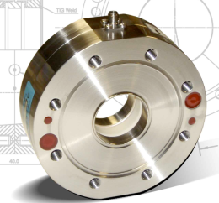
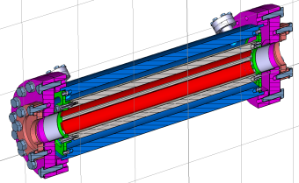
ThomX Diagnostics
Charge
  Linac and transfer line:
    3 Bergoz in-flange ICTs
  Ring:
    BPM Sum Signal
Transverse Feedback
  Design of the stripline
Ion Cleaning (mandatory!)
  Use of 20 additional BPM buttons for polarization
Loss (LAL in charge):
  Optic fibers (Cherenkok radiation)
Bergoz in-flange ICT
FBT Stripline

Slide 26
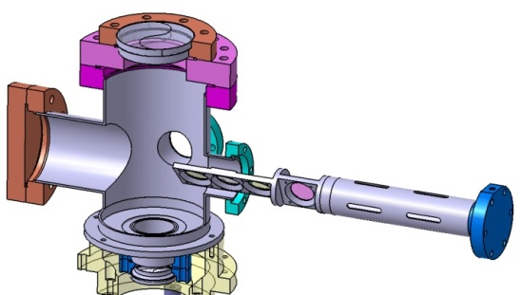
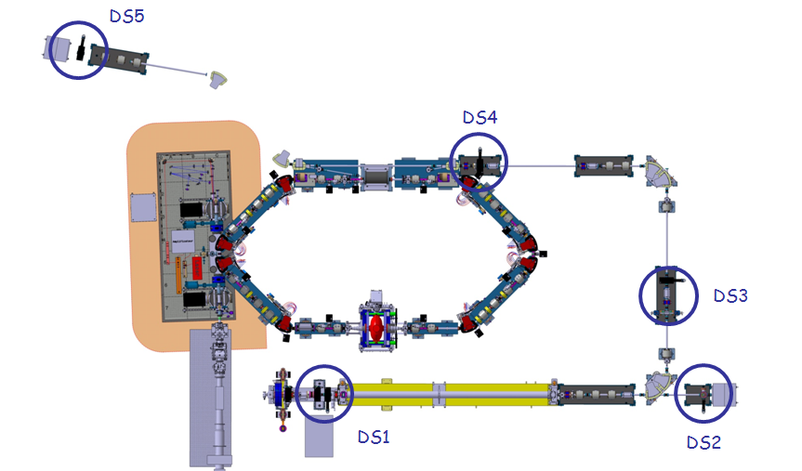
ThomX Diagnostics
Diagnostic stations (LAL in charge)
  4 screens on a translation stage
    1 YAG(Ce) screen in all stations
    1 optical transition radiation (OTR) screen in all stations
    1 target to allow an online calibration of the camera in all stations
    one Cerenkov screen for bunch length measurements in station DS2 (described in more detail below).
  Measurements:
    Transverse size (YAG + OTR)
    Emittance (Q-scan + screen)
    Energy (Dipole + screen)
    Length (Cerenkov + Streak Camera)
Diagnostic station x5

Slide 27
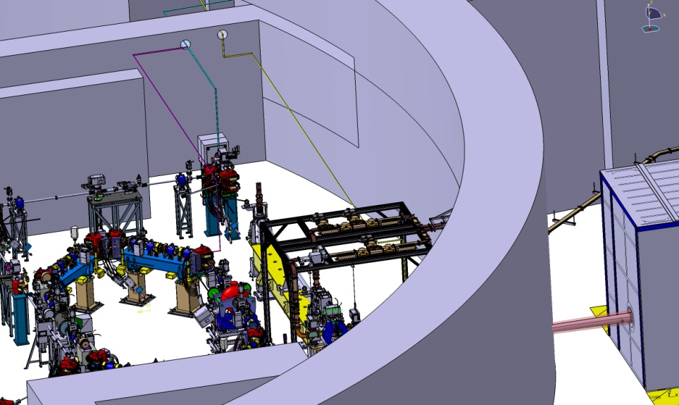
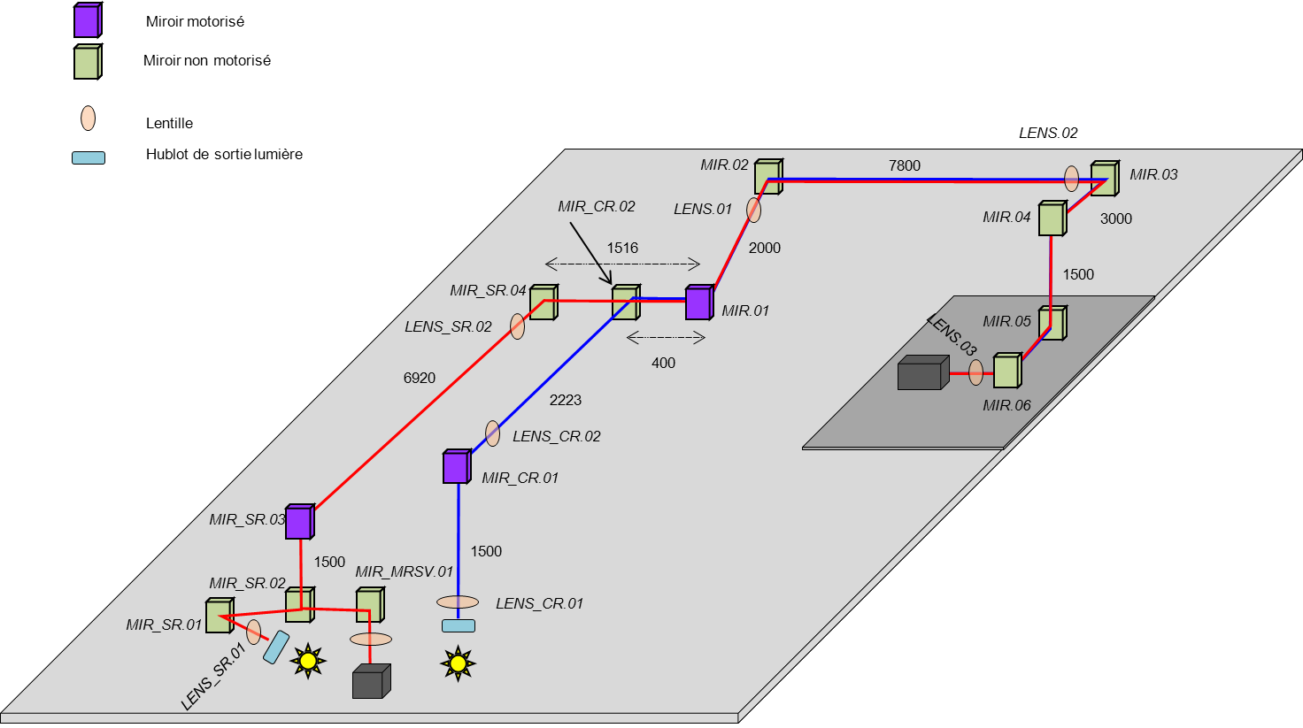
ThomX Diagnostics
Bunch length measurement
  Sources
    End of Linac: Cerenkov radiation
    Storage ring: Synchrotron radiation
  Complex transport path for the photon beam
    13 mirors (3 motorized)
    7 lenses
  Detector: Streak Camera
    Hamamatsu
    Already delivered and tested

Slide 28
ThomX schedule
Machine will be installed in an already existing building
Infrastructure works (utilities, shielding) should start in september 2015
Installation is foreseen at the end of 2016
Commissioning planned for begining 2017
~2 years delay on initial planning

Slide 29





















The LUNEX5 project
www.lunex5.com
LUNEX5 project layout
Advanced FEL line
400 MeV Superconducting Linear Accelerator
HHG
40-20 nm
266 nm
Pilot user experiments
400 MeV Laser WakeField Accelerator
Superconducting linear accelerator
LWFA
Improve the performances and reduce the size/price of the FEL sources:
- FEL seen as an application qualifying the LWFA
- compact / Lab. scale
- «high risk», «challenging»
- low repetition rate (1 Hz)
- fiability of the operation?
- solid basis for the study of advanced FEL lines
- evolution towards high repetition rate
- evolution towards a multi-user FEL facility

Slide 30



ERC Advanced Grant COXINEL
www.lunex5.com
COherent X-ray source INferred from Electrons accelerated by lasers
COXINEL ( Advanced) aims at demonstrating Free Electron Laser amplification with present LWFA performances with a existing TW laser.
Objectives :
• demonstrate an appropriate transport to the undulator
• demonstrate FEL amplification at 200 nm and at shorter wavelength (40 nm)
• investigate and control (theory/experiments) FEL performance (seeding, polarisation...)
Acknowledgments to ERC Advanced Grant COXINEL (340015) M. E. Couprie

Slide 31


COXINEL general integration
www.lunex5.com
String PM Quad
Undulator
Spectrometer
Steerer
Chicane
Quadrupoles
Stripline
Dump
Mechanical conception : D. Zerbib, K. Tavakoli, J. L. Marlats
~10 m

Slide 32

Charge monitors
www.lunex5.com
Measuring the beam charge: up to 10 pC!
Use of 2 Bergoz in-flange Turbo-ICT
Beam axis
ICT location

Slide 33

Position monitors
www.lunex5.com
Measuring the beam position with (very) good resolution (few µm) at low charge (10 pC)
Use of 16 mm cavity BPMs from Swiss FEL
Mounted on translation stage
B. Keil, “Design of the SwissFEL BPM System”, IBIC13
Beam axis
CBPM location
Study of a resonant stripline in parallel

Slide 34


Tests on SOLEIL TL1
www.lunex5.com
Charge and position monitors have been installed on SOLEIL TL1 for testing in January 2015:

Slide 35

Tests on SOLEIL TL1: charge
www.lunex5.com
Turbo-ICT: sub pC resolution
10 pC
ICT1
ICT2
T-ICT
DCCT (Booster)
Beam charge measurement comparison on SOLEIL first transfer line and booster

Slide 36



Tests on SOLEIL TL1: cavity BPM
www.lunex5.com
Pickup:
Analog signals from CBPM
Centering CBPM
Electronics:
  Web server running on the electronics
    Permits preliminary tests
  Dedicated Tango server is under development
    Mandatory for machine correlated measurements

Slide 37
Transverse size monitors
www.lunex5.com
Aim:
  Image the beam along the experiment for alignment and beam size measurement
Principle:
  Screen on the beam path
  Imaging system of the screen with variable magnification
Beam axis
Screens location

Slide 38
Transverse size monitors
www.lunex5.com
Screen:
  3 different screens mounted on a translation stage
  YAG and LyCo : scintillator screens for high flux / low resolution measurements
  Metallic screen: OTR screen for higher resolution measurement. But COTR effects ?
Imaging system:
  5 lenses telescope
  2 lenses mounted on a stage to provide 2 magnifications (large field and high resolution)
e- beam
d5
d4
d3
d2
d1
d0
F2
F1
F0
F4
F3
F2
F1

Slide 39


Transverse size monitors
www.lunex5.com
Preliminar design:
Screens on the motorized stage
for insertion on the beam path
Imaging system
(G=1.1 – 0.2 for 5 microns resolution and 20mm field of view)

Slide 40
Conclusion
SOLEIL diagnostic group is involved in 3 very interesting but time and resources demanding projects:
  Femto-slicing
  ThomX
  Coxinel
Without forgetting the SOLEIL operation!
  29 Beamlines taking beam
  450 mA Hybrid
  490 mA full ring (500 mA expected this summer)
  Simultaneous operation of IDs on canted straight section (see MEA talk)
Thank you for your attention!

