Slide 1
FEEDBACK SYSTEMS AT ALBA
DEELS’15
A. Olmos, U. Iriso (CELLS)
G. Rehm, M. Abbot (Diamond)

Slide 2
Content
Fast Orbit Feedback
At a glance
In operation
Fast Archiver
Bunch-by-Bunch Feedback
At a glance
Diamond TMBF Commissioning
TMBF Features

Slide 3
Content
Fast Orbit Feedback
At a glance
In operation
Fast Archiver
Bunch-by-Bunch Feedback
At a glance
Diamond TMBF Commissioning
TMBF Features

Slide 4
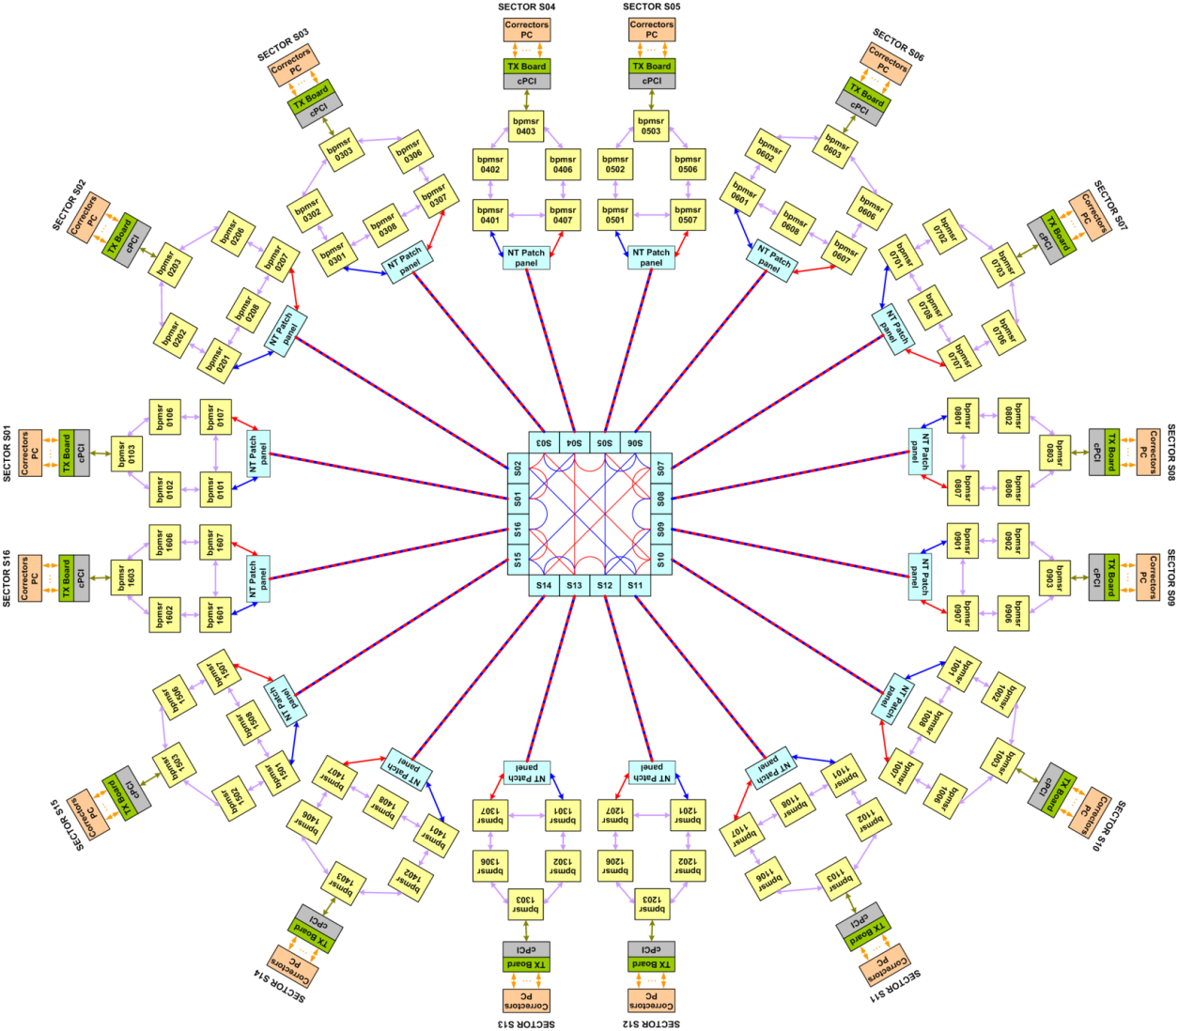
FOFB – At a glance
88 BPMs and 88 H/V correctors distributed in 16 cells
One XBPM (Libera Photon) integrated in the FOFB
Diamond Communication Controller protocol for data transfer
Ring type topology without redundancy links
Distributed correction calculation on 16 non-real time CPUs
MicroResearch timing boards recycled as position reading nodes (sniffers)

Slide 5
FOFB – At a glance
One sector out of 16
Next
sector
cPCI crate
Previous
sector
Libera
Libera
PMC board
(sniffer)
Libera
Libera
CPU
Libera
Libera
IP modules
Libera
Libera
Tx Board
Tx Board
Corrector PS
Corrector PS
…
Corrector PS
Corrector PS

Slide 6
Content
Fast Orbit Feedback
At a glance
In operation
Fast Archiver
Bunch-by-Bunch Feedback
At a glance
Diamond TMBF Commissioning
TMBF Features

Slide 7
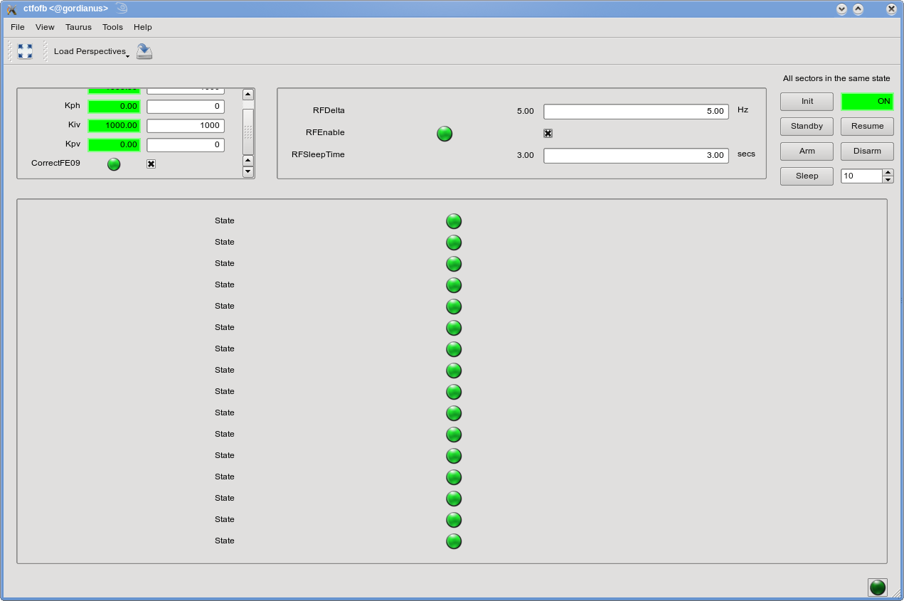
FOFB – In operation
RF frequency control by standalone process
No Slow Orbit Feedback
No Safe-stop, no BPMs check, no CC check
Lucky?
Is all this really needed?
FOFB nonstop running from the 13th of May until last Friday
* No beam lost due to FOFB
* No phone-call about FOFB problems

Slide 8
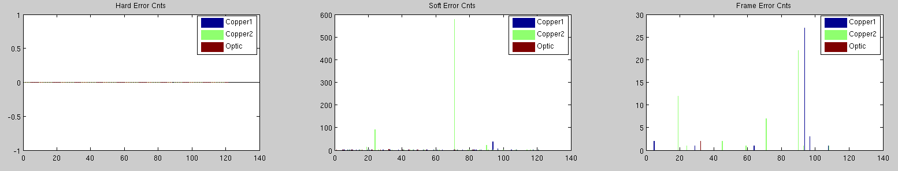
FOFB – In operation
No Safe-stop, only limits on correctors setpoints:
- Max correctors delta 5mA
- Max correctors absolute 8A
Correction problems will drive the PS to their Max –> beam lost
FOFB stays ON after a beam trip
No BPMs check:
- System always considers BPM data as “healthy data”
- No check on BPMs noise, FFT, glitches …
A failure in one Libera will run correctors to crazy values
No Communication Controller check
- No on-line check of FOFB links
What should we consider as a failing link?
How does a CC error look like?
Does this matter?
Status after 24h

Slide 9
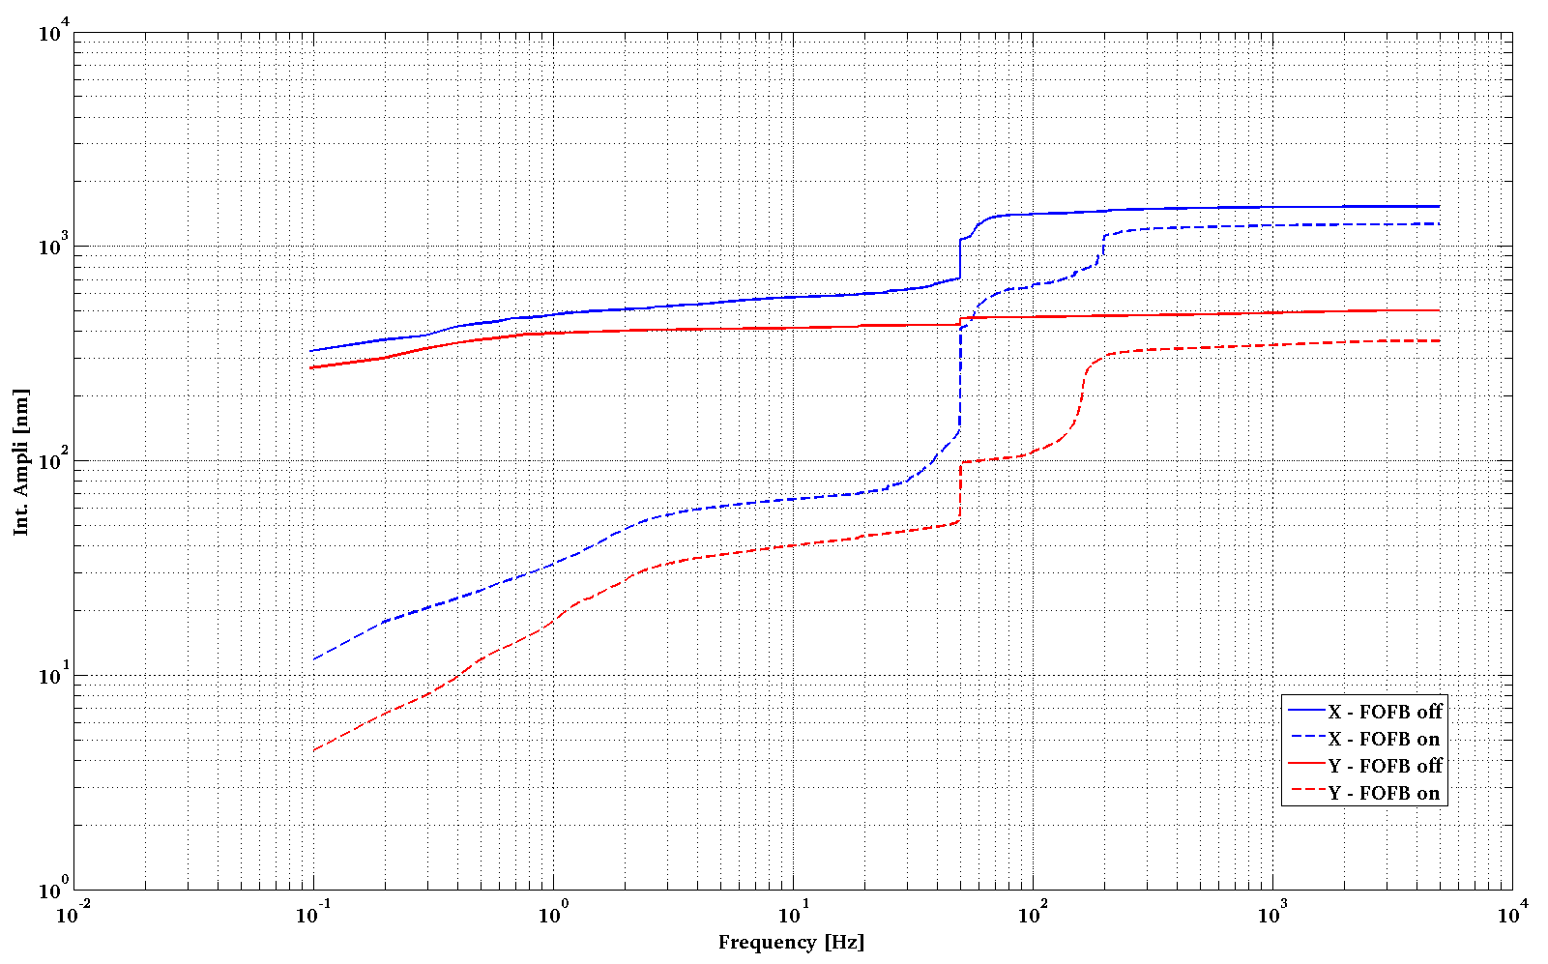
FOFB – In operation

Slide 10
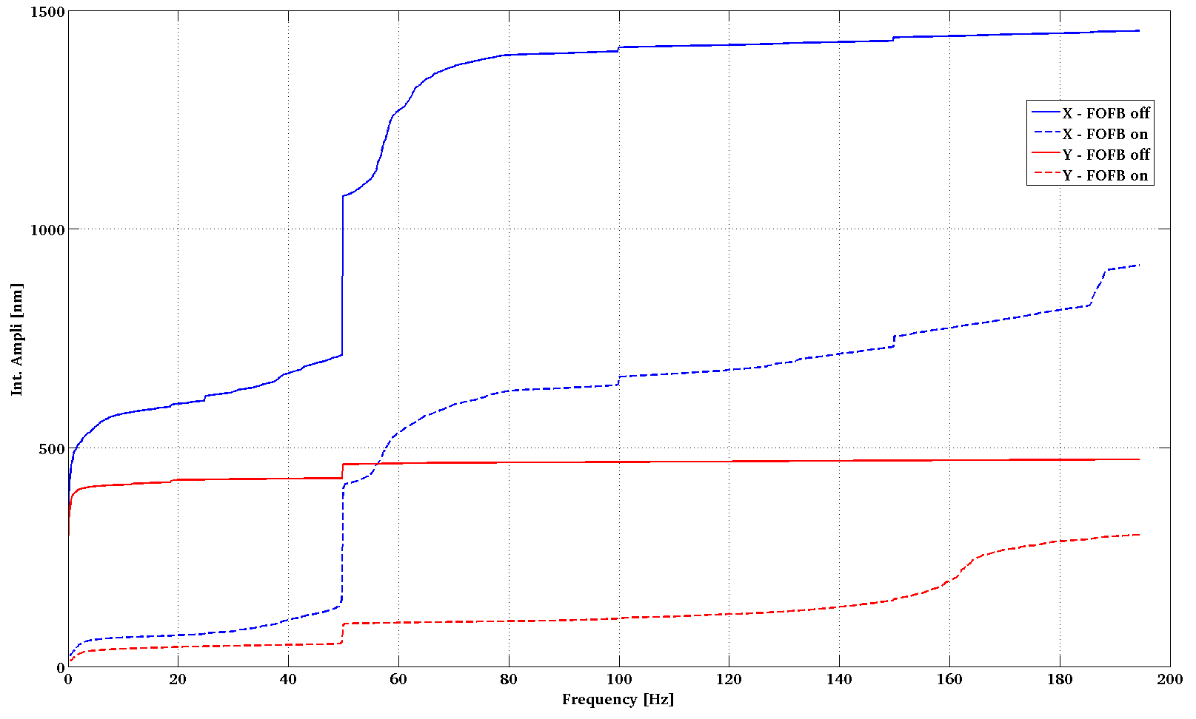
FOFB – In operation
Good but … to be improved

Slide 11
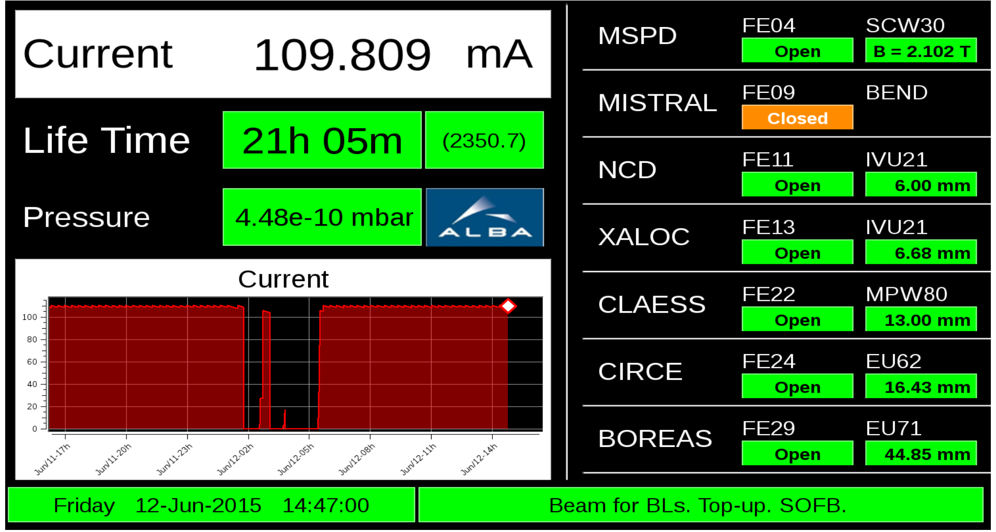
FOFB – In operation
But while doing this slides ...
Unknown problems with FOFB. Operation changed to only SOFB mode

Slide 12
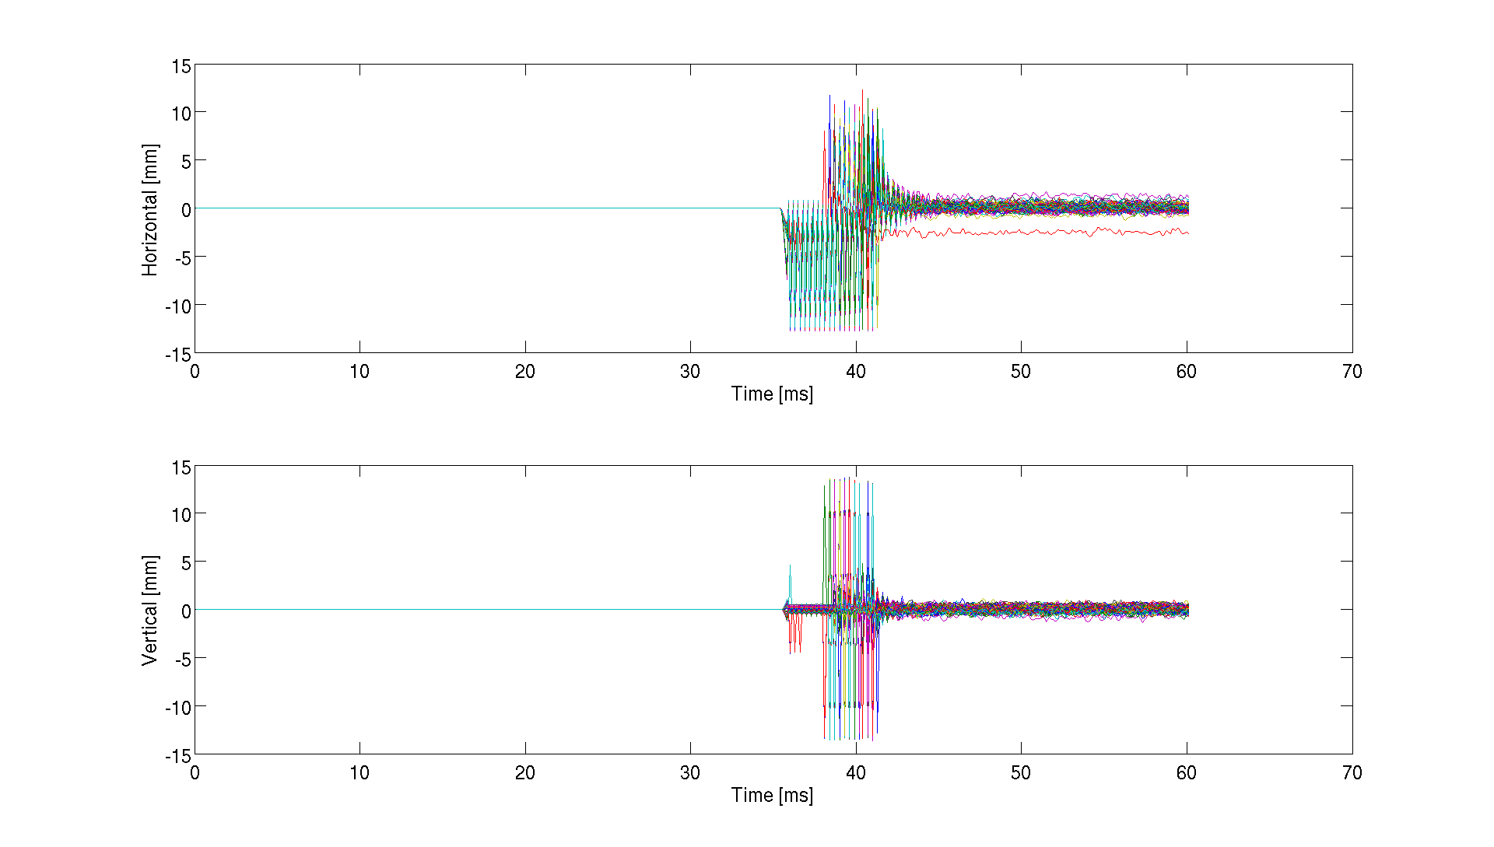
FOFB – In operation
FA data during the trip (10kHz)
5mm

Slide 13
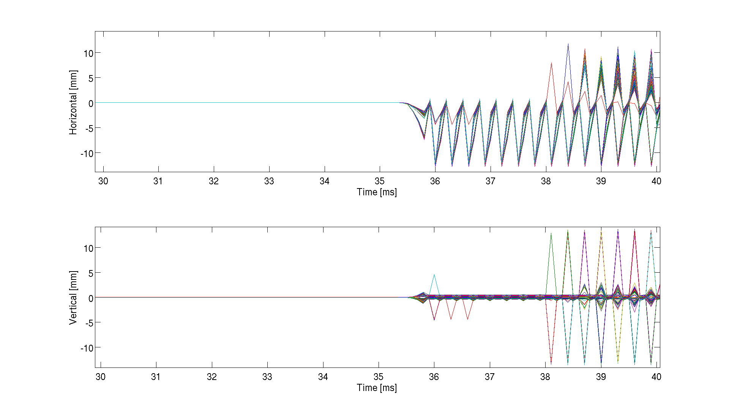
FOFB – In operation
FA data during the trip (10kHz)
?
5mm
1ms

Slide 14
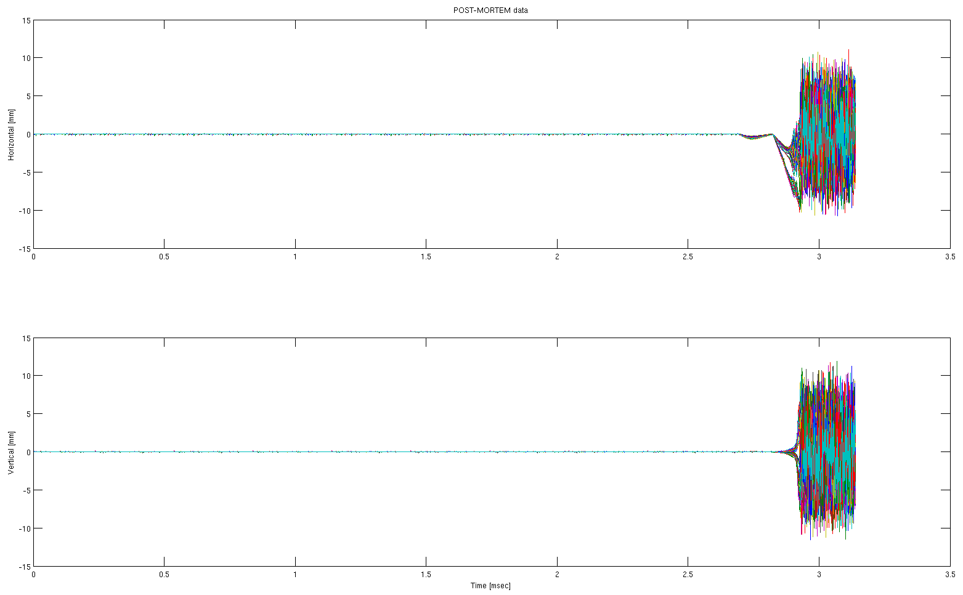
FOFB – In operation
Post-Mortem data during the trip (TbT – 1.1MHz)
Horizontal (mm)
5mm
1ms
Vertical (mm)
5mm
Time (ms)

Slide 15
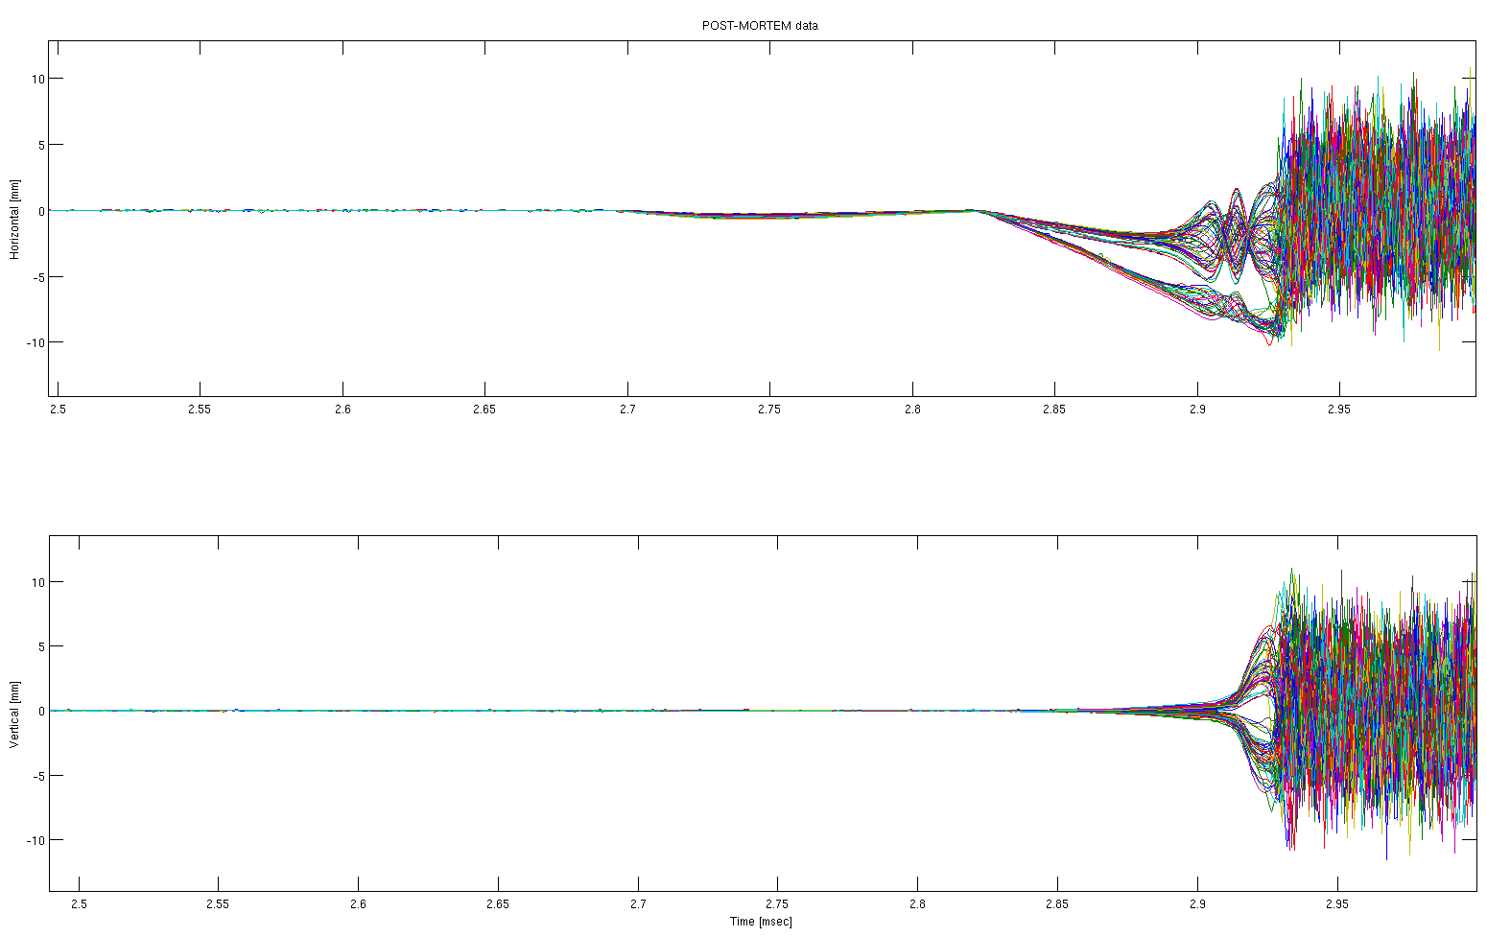
FOFB – In operation
Post-Mortem data during the trip (TbT – 1.1MHz)
Horizontal (mm)
5mm
50us
Post-Mortem data shows same pattern than when loosing beam because of RF trip (?)
Vertical (mm)
5mm
Time (ms)

Slide 16

FOFB – In operation
FA data during the trip (10kHz)
Could this be when beam was already lost?
(rem: FOFB does not stop)
We have no means right now to time-correlate this FA data with the Post-Mortem data

Slide 17
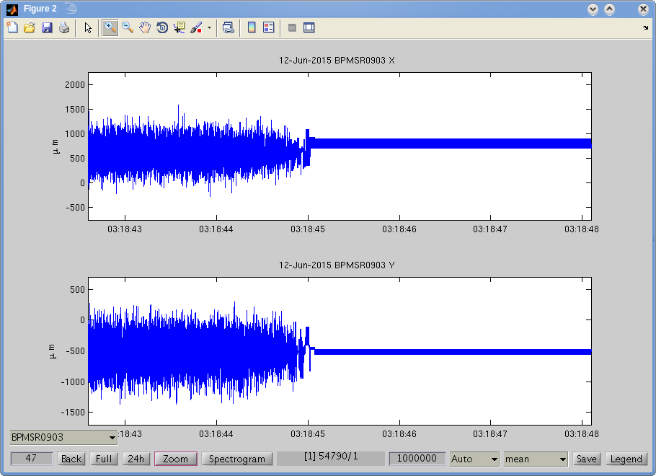

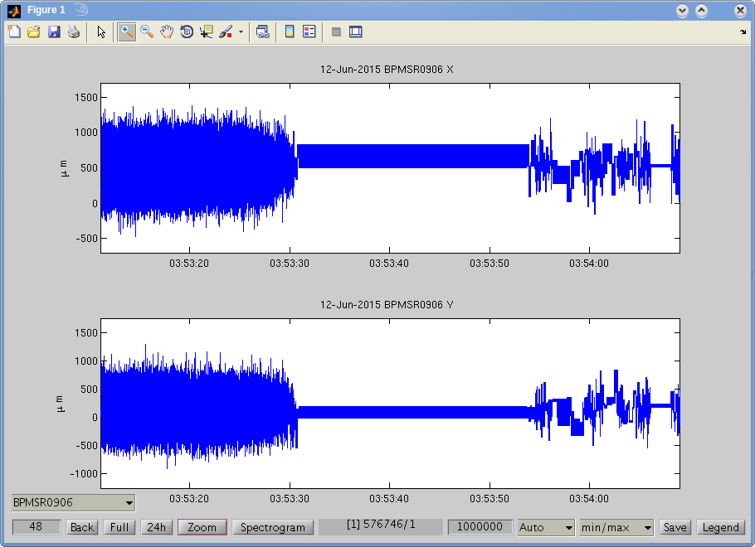
FOFB – In operation
More puzzling FA data
BPMSR0903 after 2nd trip
At some moment, w/o beam,
these BPMs had FA position jumping
between 2 fixed values (?)
BPMSR0906 after 3rd trip
And few seconds later they start
to recover “normal” data

Slide 18
Content
Fast Orbit Feedback
At a glance
In operation
Fast Archiver
Bunch-by-Bunch Feedback
At a glance
Diamond TMBF Commissioning
TMBF Features

Slide 19
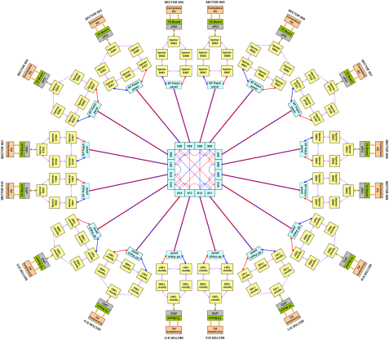
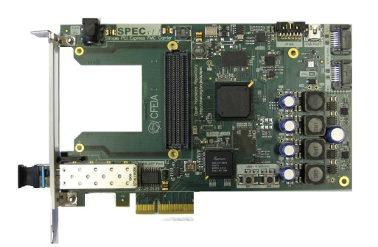



FOFB – Fast Archiver
System developed by Diamond and used at other facilities since 2011
Server with few HDs allowing many Tbytes of archived BPM data @ 10kHz rate
Our current Fast Archiver consists of:
- a PCIe SPEC card as sniffer to the FOFB network (CC integration by Diamond)
- 1Tbyte HD in a desktop PC
- Capability to store 37h of 88 BPMs position data @ 10kHz
- Data can be retrieved from Matlab, Python Qt GUI or command line tools
1Tb
We’ll soon upgrade to a 12Tbytes system in an IndustrialPC, allowing more than 2 weeks of data

Slide 20
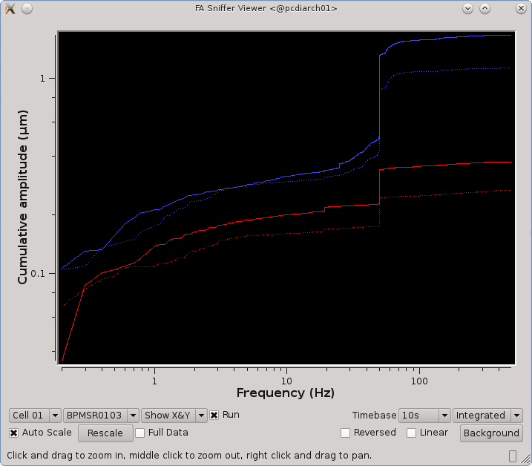
FOFB – Fast Archiver
Very useful diagnostics tools for FOFB commissioning and continuous fast BPM data monitoring
Retrieve 10kHz data from archiver
Live 10kHz BPM data analysis

Slide 21
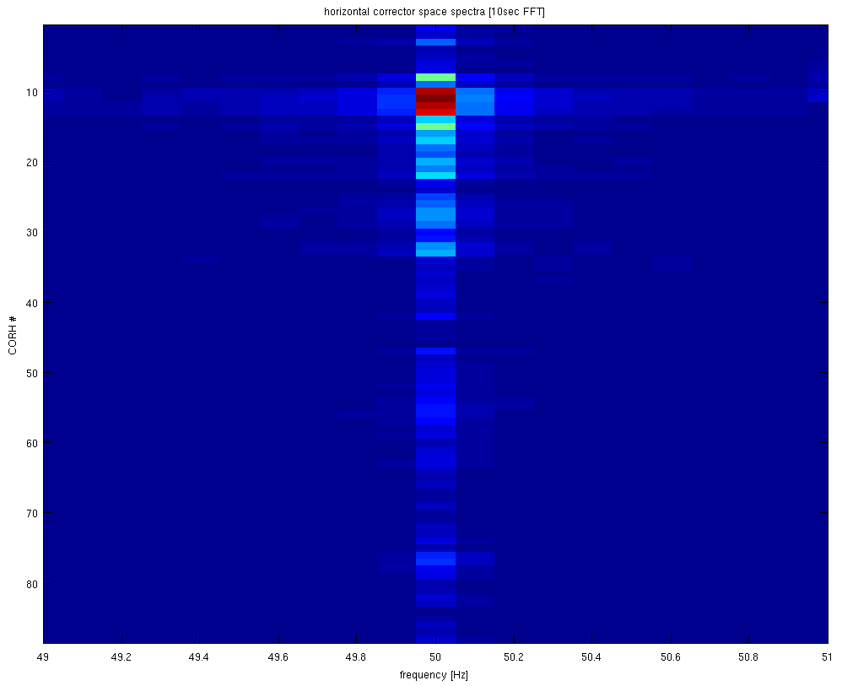
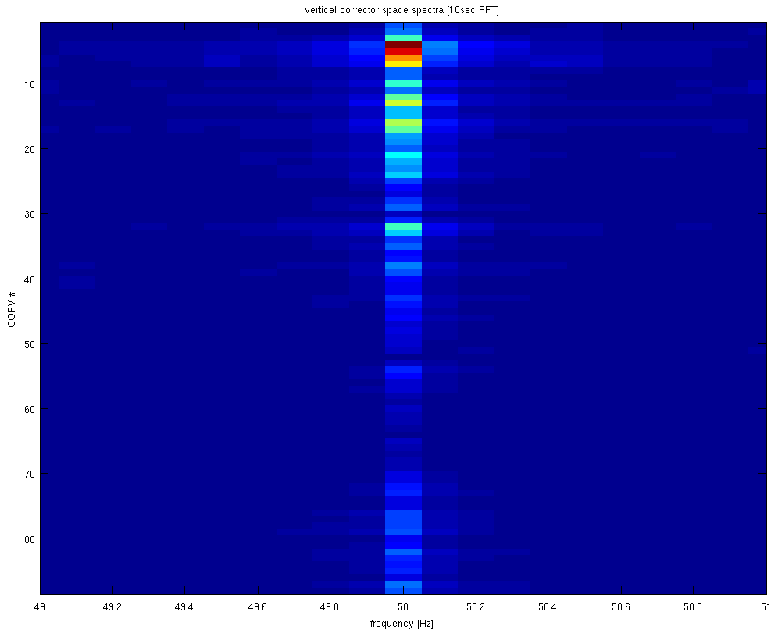
FOFB – Fast Archiver
FFT analysis allows localization of possible noise sources
BPMs data
Response Matrix
Correctors space
Horizontal
50Hz
Vertical
50Hz

Slide 22
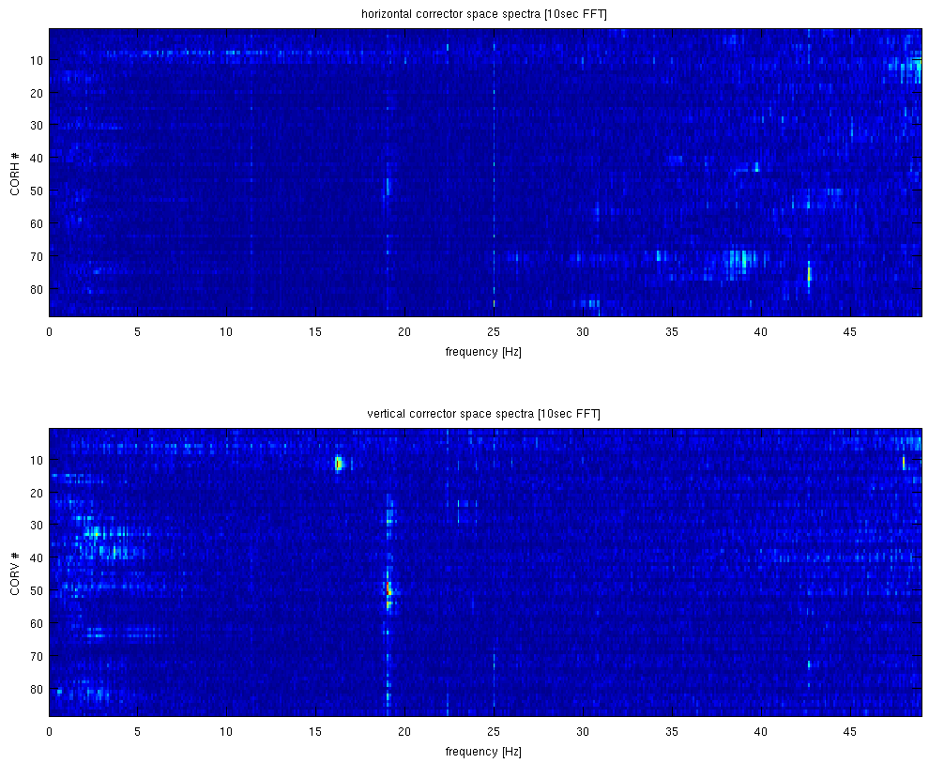
FOFB – Fast Archiver
Frequencies
below 50Hz
It’s time to hunt the guilty

Slide 23
Content
Fast Orbit Feedback
At a glance
In operation
Fast Archiver
Bunch-by-Bunch Feedback
At a glance
Diamond TMBF Commissioning
TMBF Features

Slide 24
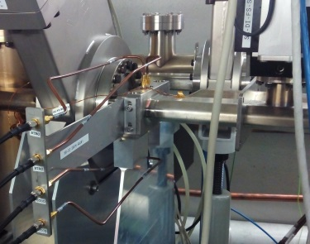
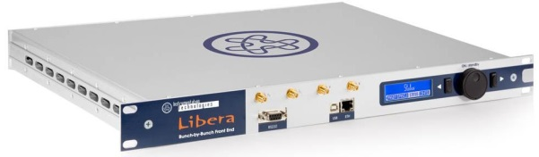
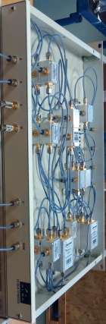
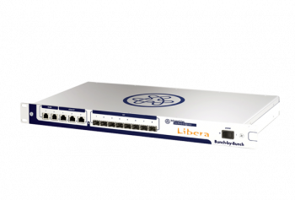
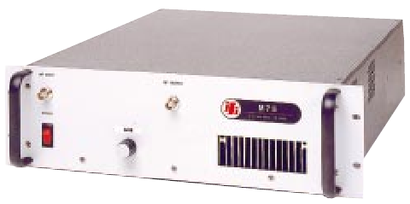
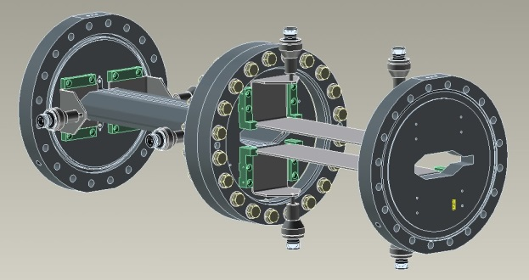
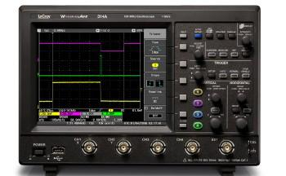
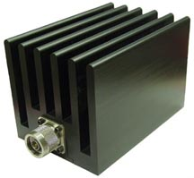
BbB – At a glance
Hybrids
Button BPM
Libera FrontEnd
IFI 100W ampli
Libera BbB
Stripline Kickers
Scope
100W atten

Slide 25
BbB – At a glance
Timing
EVR
ALBA Master Clock
Clk1 - 500MHz
BbB - X
500MHz
Xout
A
RF FE
Hybrids
B
BPM
C
Yout
D
BbB - Y
Clk2 - 500MHz
100W
FFK - Y
100W
Load
Scope
100W Att
Load
Scope
100W Att
100W
Load
Scope
100W Att
Load
Scope
100W Att
100W
FFK - X

Slide 26
Content
Fast Orbit Feedback
At a glance
In operation
Fast Archiver
Bunch-by-Bunch Feedback
At a glance
Diamond TMBF Commissioning
TMBF Features

Slide 27
BbB – Diamond TMBF Commissioning
We did a not very successful try with I-Tech Matlab interface
Diamond colleagues offered a collaboration to port Diamond TMBF to ALBA system
Main tasks carried out (mainly by Diamond or under their advise):
* Migrate the full FPGA code from SystemVerilog to VHDL language
* Adapt it to ALBA machine (harmonic number, revolution frequency, tunes, …)
* Modify graphical interfaces (EDM) and side utilities (scripts) to make them work in
ALBA environment
* Install an “EPICS worm” (EPICS Base) inside our Tango control room
* Build libca library to transfer data to Matlab
* Permanently install Diamond TMBF code in our Liberas BbB (factory code washed)
* HW checks/modifications on Amplifiers, Hybrids and phase matching of cables
TMBF Commissioning with beam in presence of G. Rehm and M. Abbot (May 11-12)

Slide 28
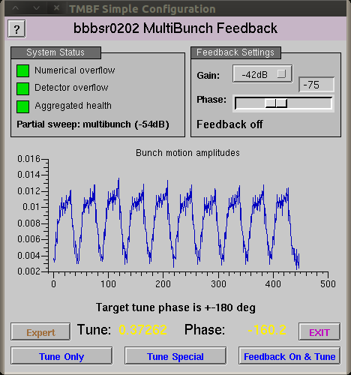
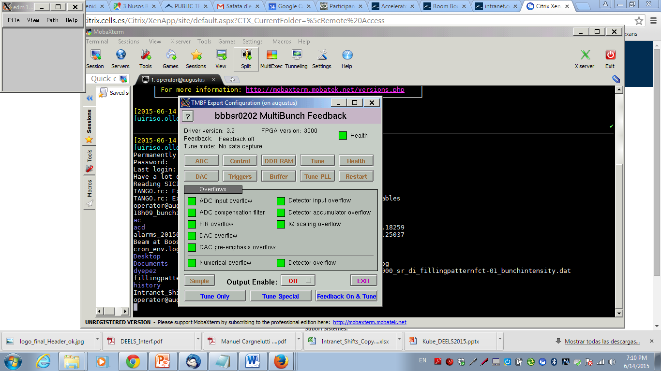
BbB – Diamond TMBF Commissioning
Simple View GUI
Expert View GUI

Slide 29
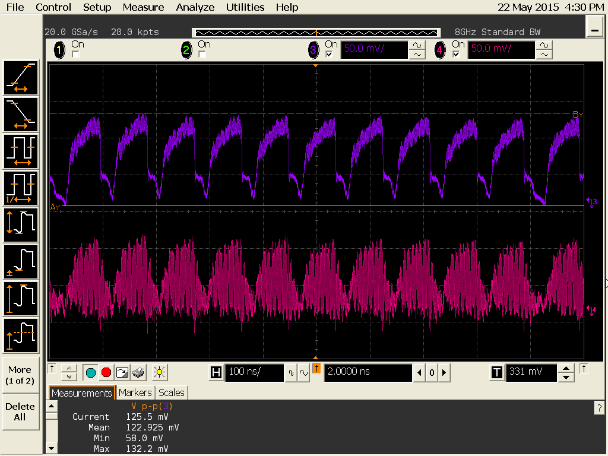
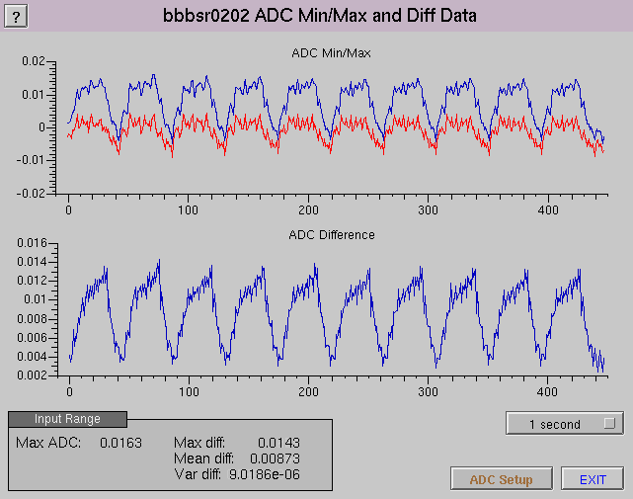
BbB – Diamond TMBF Commissioning
Phase Offset Optimization (Mixer)
RF FrontEnd X/Y outputs
Phase Clock Optimization (Sampler)
Hor
Ver
PhaseX=20deg @BBB-FE
PhaseY=-20deg @BBB-FE
PhaseX Clock: +20deg
PhaseY Clock: +60deg

Slide 30
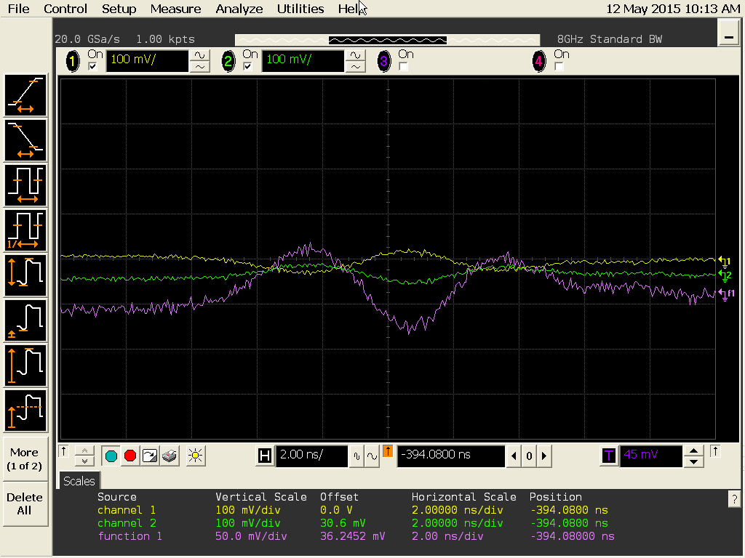
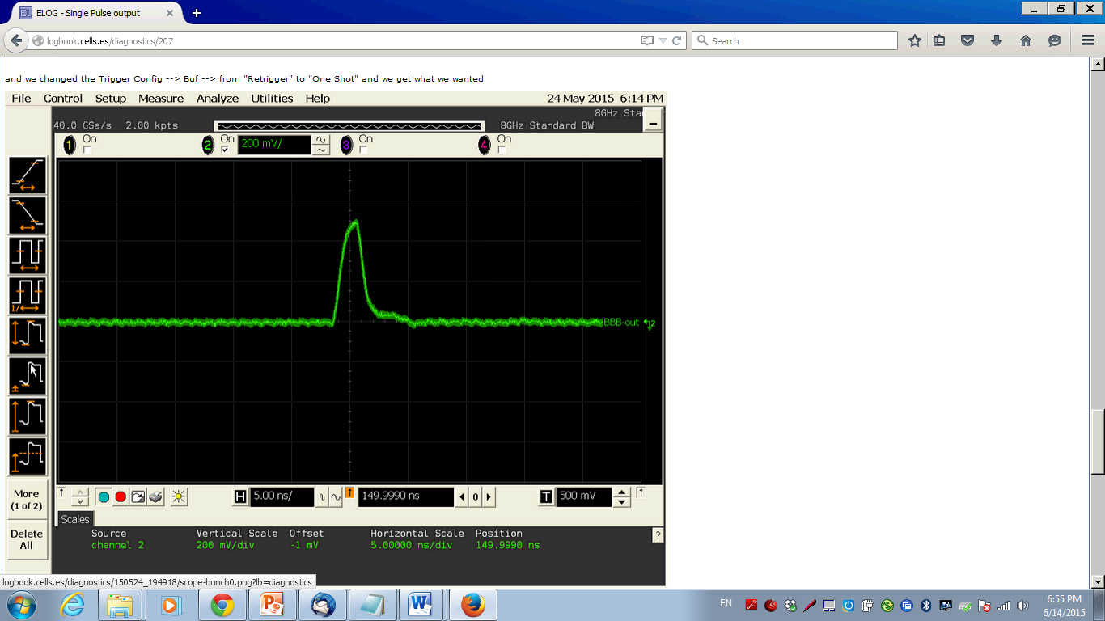
BbB – Diamond TMBF Commissioning
Single Pulse from Libera BBB + Ampli + Kickers + Attenuators
Single Pulse (2ns) from Libera BBB
The amplis distort the signal, produces a ripple of ~6ns
We will kick adjacent bunches!

Slide 31
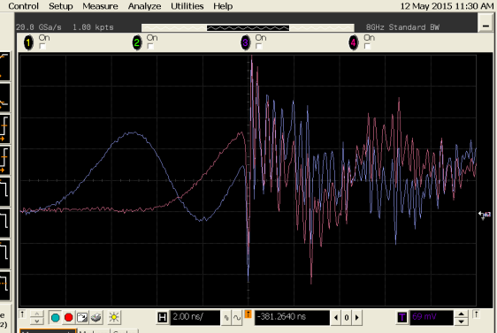
BbB – Diamond TMBF Commissioning
Synchronize BBB pulse with bunch passage (single bunch):
Add 1ns cable for exact matching
BBB Pulse
BBB Pulse
+ delay +
1ns cable
Bunch Passage

Slide 32
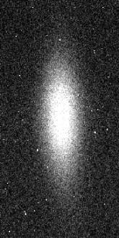
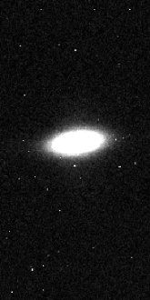
BbB – Diamond TMBF Commissioning
Inject 100mA, uniform filling, chroms (1.6, 3.4)
Loop closed just by setting the vertical phase
We also reduce further the ChromV ~ 0, beam was kept stable

Slide 33
Content
Fast Orbit Feedback
At a glance
In operation
Fast Archiver
Bunch-by-Bunch Feedback
At a glance
Diamond TMBF Commissioning
TMBF Features

Slide 34
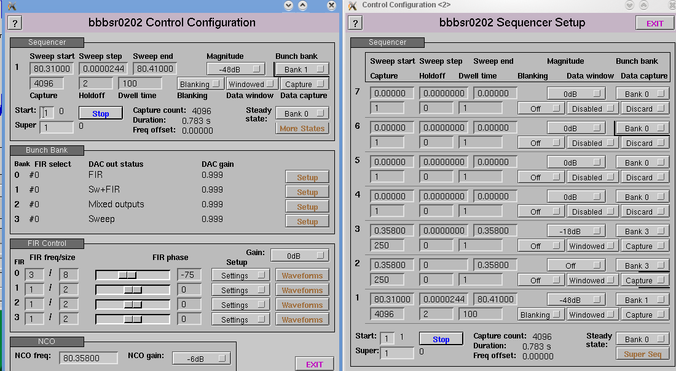
BbB – Diamond TMBF Features
Diamond TMBF allows to:
Setup different “Banks”: ways to act on the beam (damping, excitation, sweep…)
Combine them with the “Sequencer”
This can produce interesting features (see next, and also Guenther’s ppt at DEELS14 )

Slide 35
BbB – Diamond TMBF Features
Unstable modes identification
Prepare the following sequence:
Get a stable beam using TMBF
Excite mode m
Measure the growth time
Switch TMBF back on for that mode
Measure damping time
Damp again mode m, and repeat for m+1

Slide 36
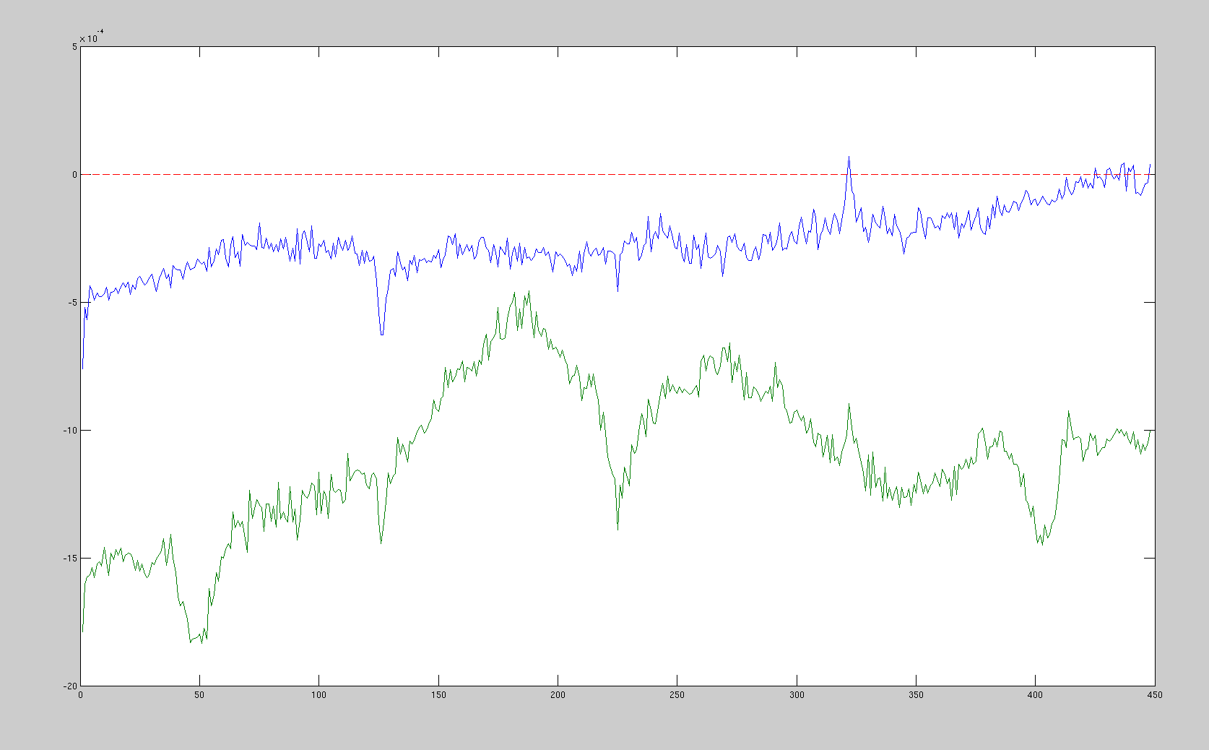
BbB – Diamond TMBF Features
Unstable modes identification
?
RW
No Damping
Growth rate, 1/turns
Damping
Excitation Mode m

Slide 37
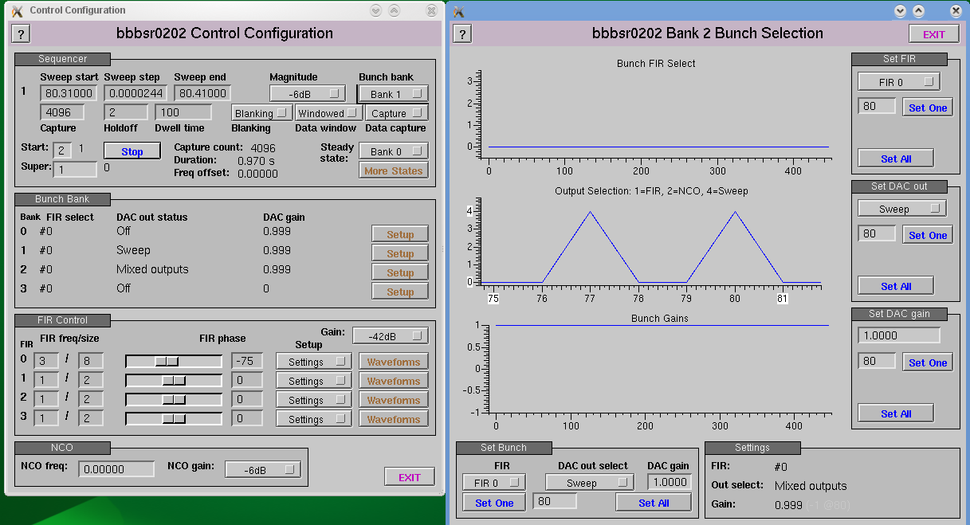
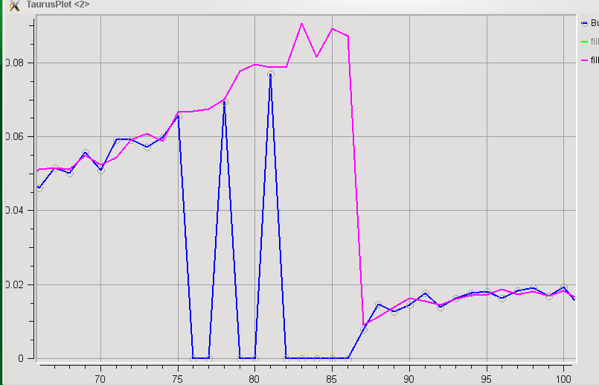
BbB – Diamond TMBF Features
Bunch Cleaning:
Define a backwards sweep around Qv
Activate DAC only in buckets B77 & B80
Killed B79, B80
Killed B76, B77
Before BC
After BC
Killed in previous tests

Slide 38
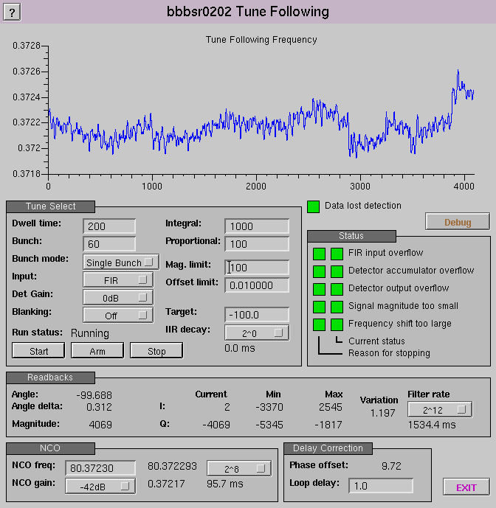
BbB – Diamond TMBF Features
Tune Measurement using PLL:
Measure beam phase response to an input (needs to be very close to Qv)
Keep track of frequency (tune) change to match phase
Input signal needs to be very small, compatible with normal operation
In this case, one measurement/200 turns
Applied only to bucket 60
ΔQ ~ 1e-5!

Slide 39
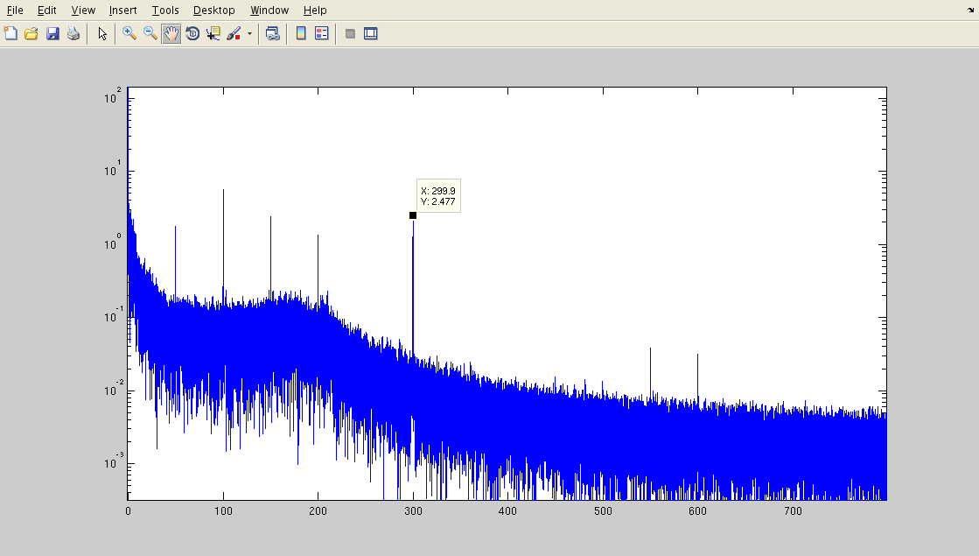
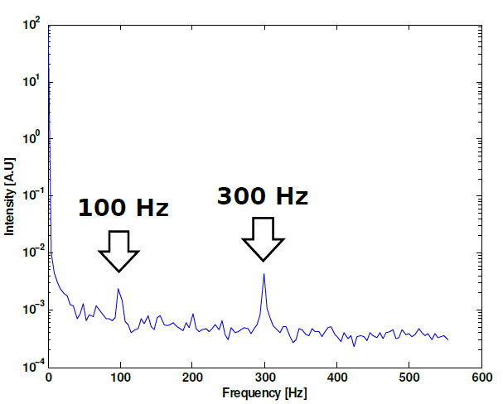
BbB – Diamond TMBF Features
Tune Measurement using PLL:
Compatible with tune jitter measurements with other means:
Main tune jitter peaks at 100 and 300Hz
FFT Amplitude
Frequency, Hz
Measurement taken with ChromV~0
FFT of a BPM buffer of 2.5e5 turns

Slide 40
BbB – Conclusions
Diamond TMBF has been commissioned at ALBA
Quite easy and straight-forward (thanks to Guenther and Michael!)
An “EPICS worm” has been installed in our Tango-based Control Room
Diamond TMBF allows several interesting features and already tested at ALBA:
  Sequences to identify unstable modes
  PLL tune tracking with 1e-5 precision
So far, only commissioned in the vertical plane due to hardware (ampli) failure.
Many thanks for your attention !!

Slide 41
BBB – Extra slides

Slide 42
Commissioning procedure
* Finding proper RF FE settings (phase offset, clock phase, …)
* Problem in Hybrids X signal
* BbB “brain washing” failed → processor board already reflashed at Diamond
* Ugly single pulse out of the amplifier. That will affect adjacent bunches
* 2ns jump of the single pulse out of one BbB unit. Diamond has reproduced the problem in their lab (DAC initialisation)
* Change ALBA timing to TMBF needs
* Aligning system to the bunches @ machine SBM
* Inject 100mA uniform filling beam
* Vertical loop closed just by setting the feedback phase
* Chrom reduced to ‘0’ and beam kept stable
* Bunch cleaning test:
- no bunch kicking until scrapper closed
- 2 bunches kicked out because of ampli
* Unstable modes identification (m=-8)
*
*

Slide 43
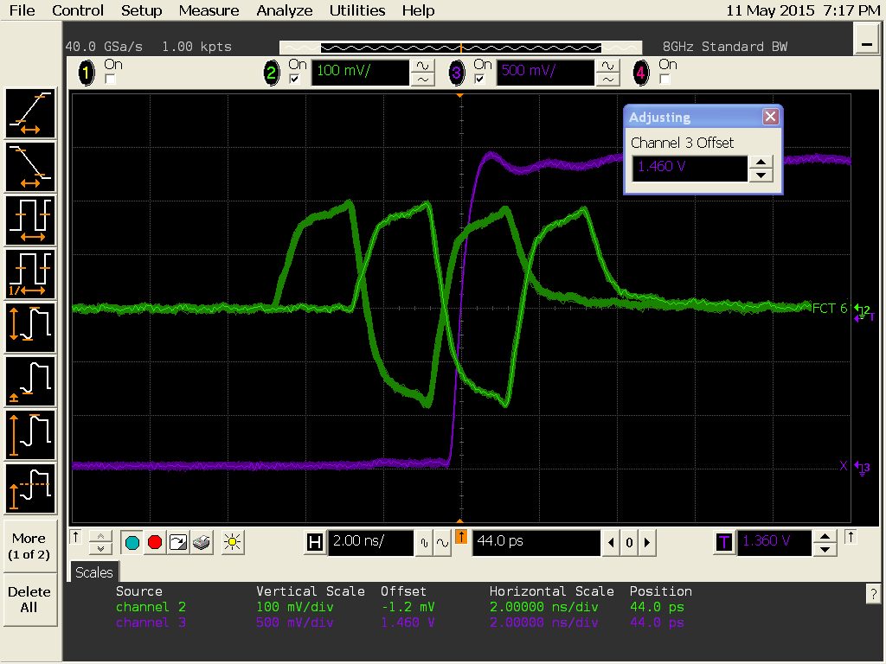
Extra slides: 2ns jumps
Scope in persistence mode, to show the 2ns jump (green). The violet trace is the trigger.

Slide 44
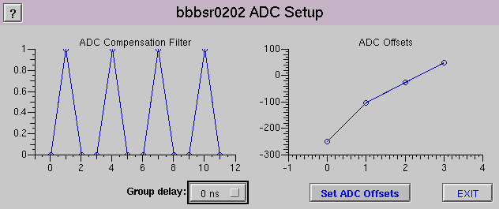
Extra Slides: ADC offsets
Fixed w.o. beam, just using the GUI capabilities

