Slide 1




Status of Beam Loss Detector Tests and Developments at PETRA III & ESRF
Gero Kube
DESY (Hamburg)
Introduction: PETRA III Extension Project
Beam Loss Monitor Tests @ ESRF

Slide 2


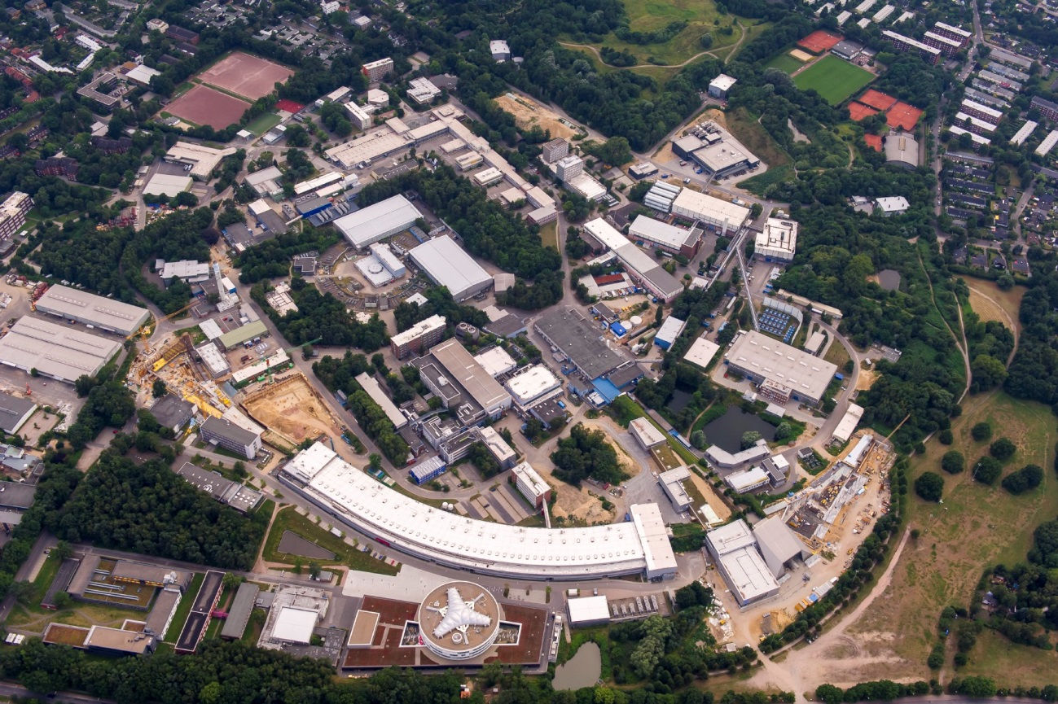
DESY Accelerator Complex
PETRA III
E-XFEL
DESY II
PIA
LINAC II
P3X-E
P3X-N
FLASH I
FLASH II
Gero Kube, DESY / MDI
DEELS 2015 Workshop @ ALBA, 15.06.2015

Slide 3
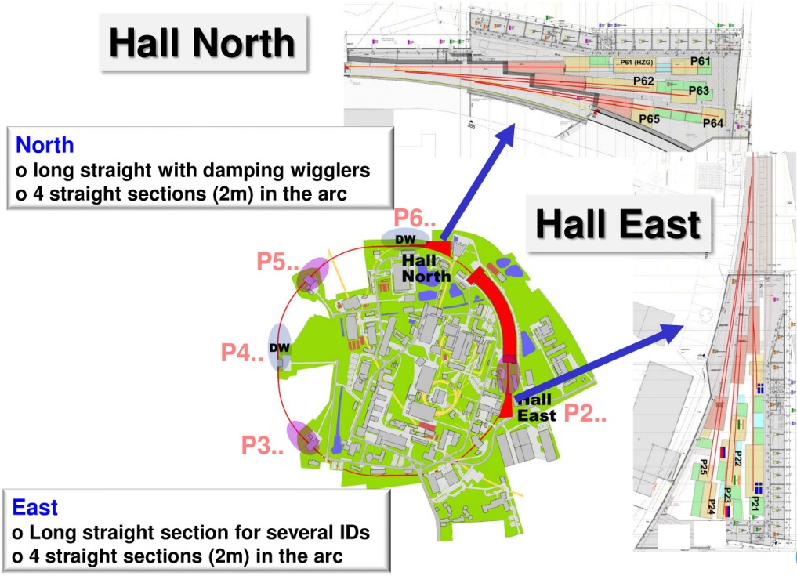
PETRA III Extension Project
Storage Ring PETRA III
PETRA III parameters
circumference: 2304 m
energy: 6 GeV
emittance: 1 nm.rad
current: 100 mA
# bunches: 40 / 960
straight sections: 9
user beamlines: 14
→ 1.2 nm.rad
→ 24
Gero Kube, DESY / MDI
DEELS 2015 Workshop @ ALBA, 15.06.2015

Slide 4
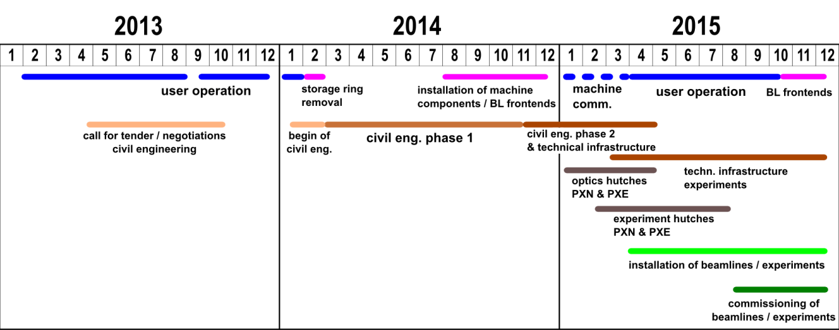
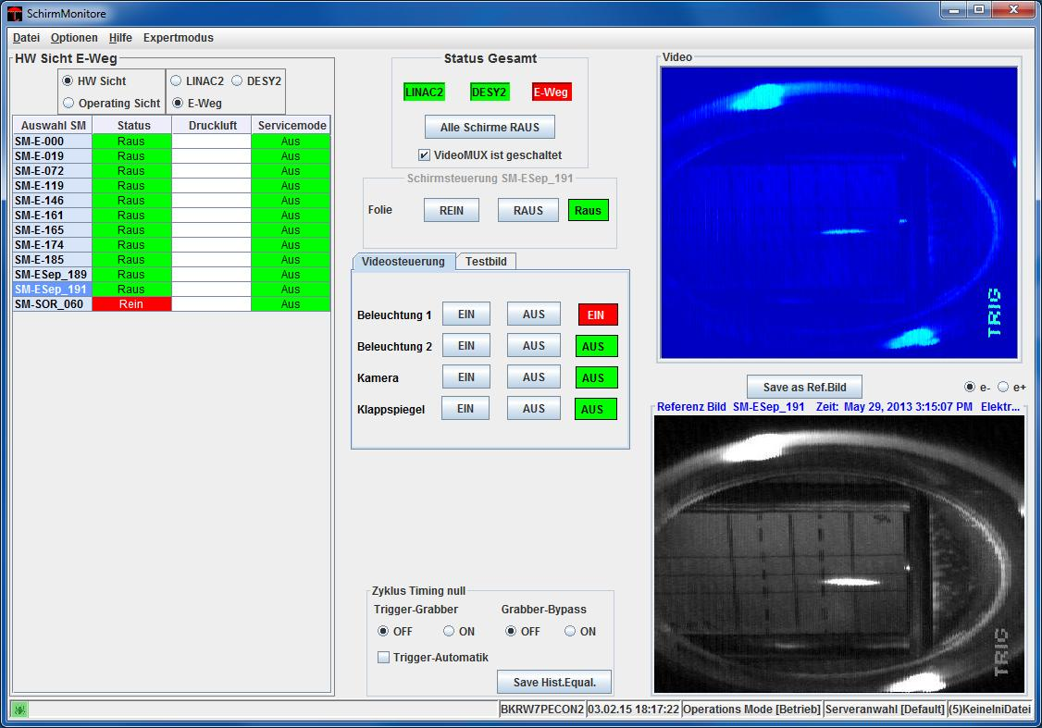
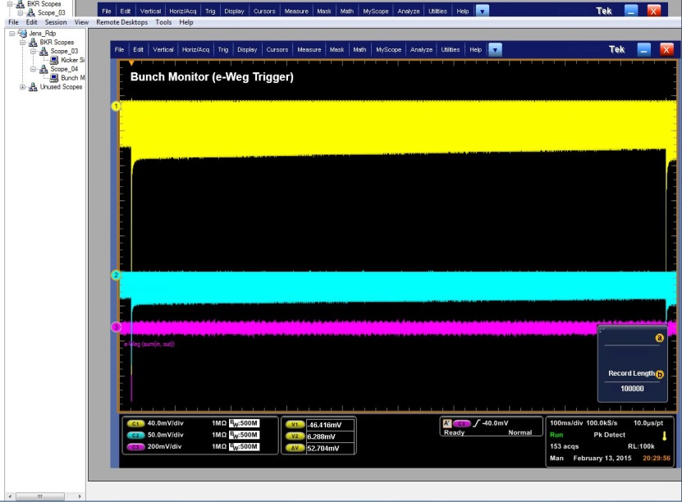
P3X Commissioning
project schedule
3.2.2015: first beam back in PETRA
13.2.2015: first stored beam
end of March 2015: back in user operation
external users: end of April 2015
Gero Kube, DESY / MDI
DEELS 2015 Workshop @ ALBA, 15.06.2015

Slide 5
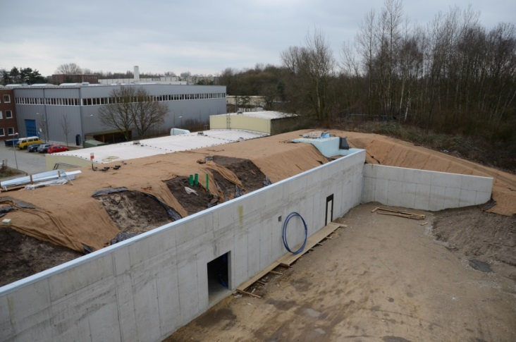
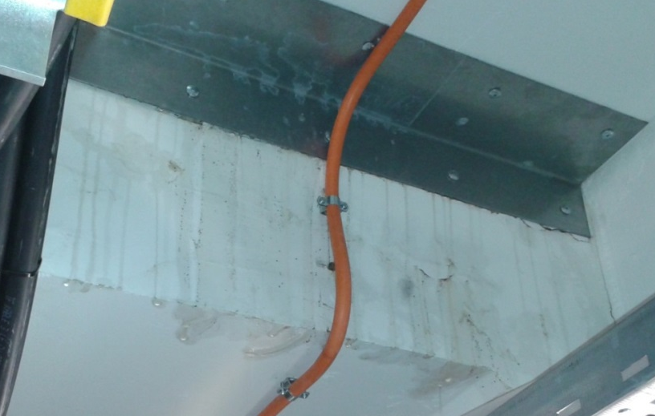
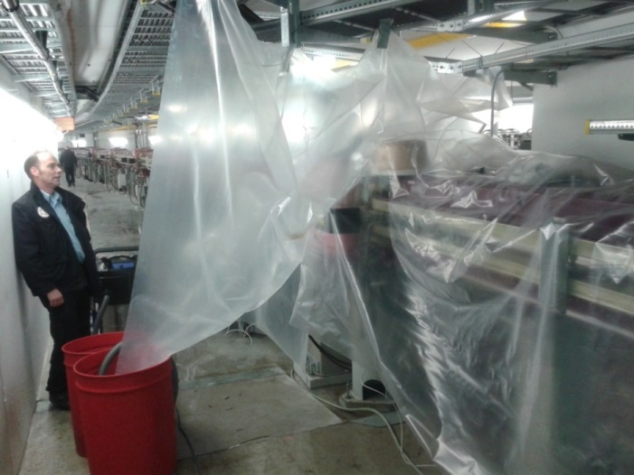
P3X: Diagnostics Tasks
expectation…
Ubaldo: „I'm sure you guys at Desy have interesting studies to show at the DEELS15!”
…and reality
how to operate sensitive electronics (Liberas) if only
the shell of the buiding is complete…
how to seal the roof of your diagnostics cabinet
if you have normal rain in Hamburg…
how to dry and clean the components
if it was not successful…
and so on…
Gero Kube, DESY / MDI
DEELS 2015 Workshop @ ALBA, 15.06.2015

Slide 6


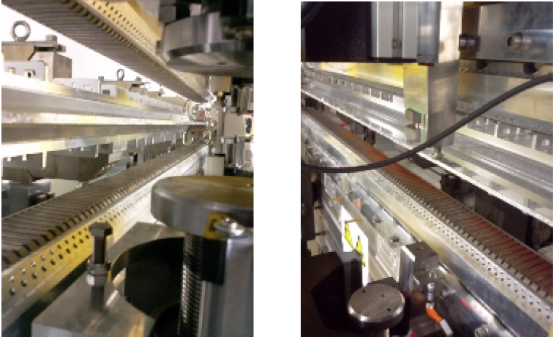
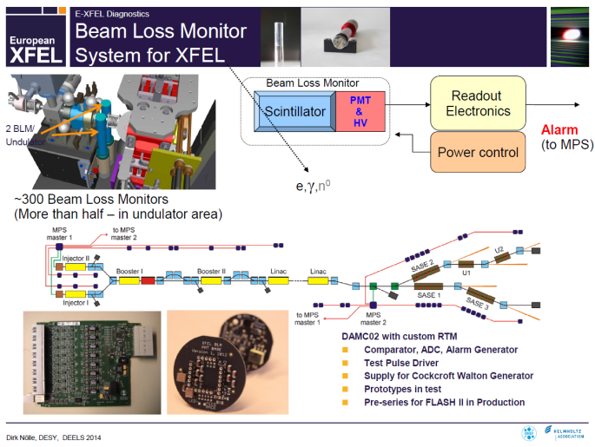
PETRA III: Touschek Factory…
operation in time resolved (40 bunch) mode
Touschek limited lifetime
→ τ ≈ 1.4 h
top-up operation
observation of radiation damage
→ rust at undulator magnets
→ undulator performance degradation
→ damaged cables
magnet structure of two undulators had to be replaced during P3X shutdown
DEELS 2014 @ ESRF
PETRA III: need for new BLM system
talk Dirk Nölle (DESY): E-XFEL standard beam diagnostics
→ XFEL-BLM system based on PMT and radiator
XFEL-BLMs for PETRA III ???
Gero Kube, DESY / MDI
DEELS 2015 Workshop @ ALBA, 15.06.2015

Slide 7
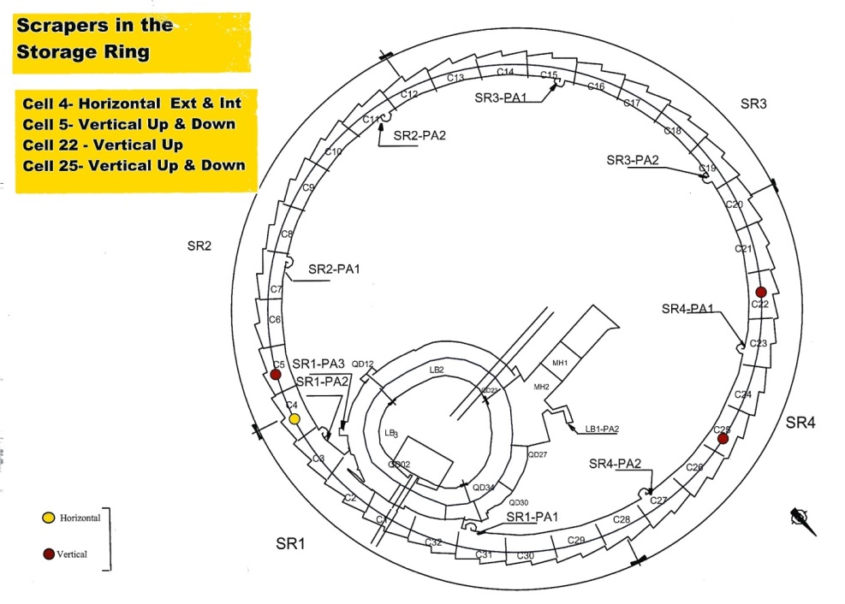
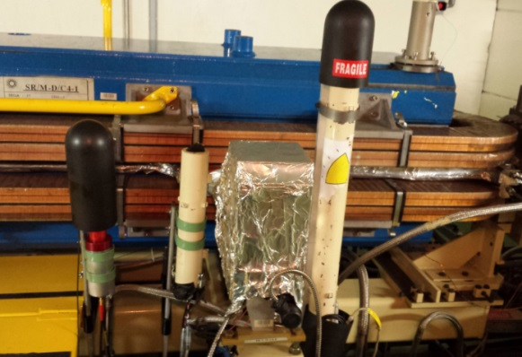
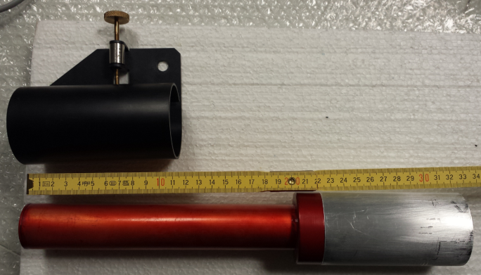
BLM Tests
P3X shutdown: no tests possible @ DESY
→ proposal: ESRF (Kees Scheidt)
BLM installation @ ESRF in cell 4 behind scraper
BLM setup
Hamamatsu R5900 PMT
synthetic fused silica (SQ1) radiator
A. Kaukher et al.,
Proc. DIPAC 2011, TUPD21
Proc. BIW 2012, MOPG007
→ Cherenkov radiation
→ no lead shield necessary (?)
Libera BLD (Spark) → DC-to-8 MHz BW @ 50Ω input (DC-to-10kHz BW @ 10kΩ input)
Gero Kube, DESY / MDI
DEELS 2015 Workshop @ ALBA, 15.06.2015

Slide 8
BLM Test @ ESRF
single bunch injection into the main ring
scraper SCRATCH4/INT inserted
→ all beam dumped into the scraper
→ one signal expected from BLM
scraper SCRATCH4/INT out, …/EXT inserted
→ signals from:
injection, crashing, passing beam
→ three signals expected from BLM
origin of measured loss signals well understood
Gero Kube, DESY / MDI
DEELS 2015 Workshop @ ALBA, 15.06.2015

Slide 9
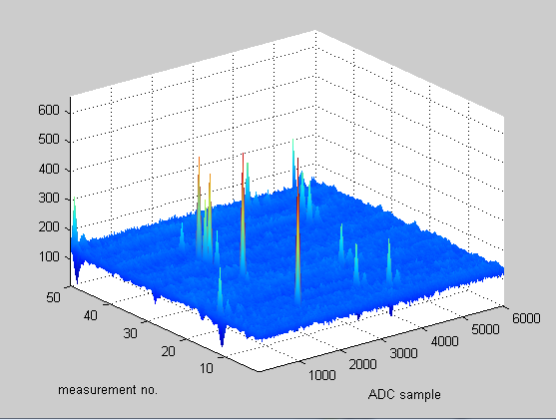
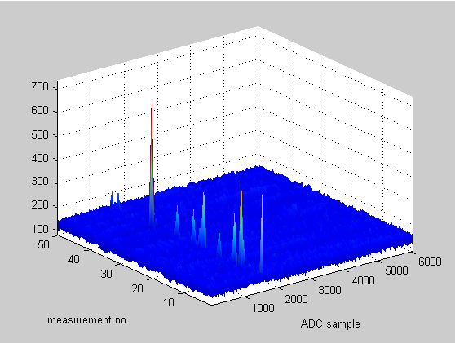
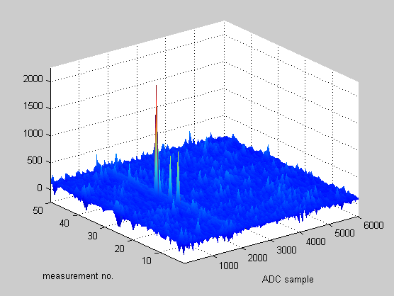
BLM Test @ ESRF
dark current injection into the main ring
e-gun off
injector chain as for usual operation
screen behind septum inserted
→ generate losses from single electrons
all BLMs are sensitive for single electron losses
good S/N level from DESY-type BLM
→ not the same losses observed
Gero Kube, DESY / MDI
DEELS 2015 Workshop @ ALBA, 15.06.2015

Slide 10
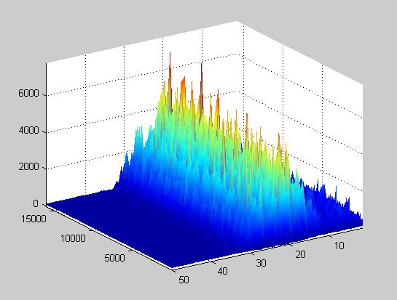
BLM Test @ ESRF
filling pattern: 16 bunches, equally distributed
scraper pos. 20
h = 992, f_{RF} = 352.202 MHz
→ T_{rev} = 2.817 μsec, t_{bucket} = 2.84 nsec
internal horizontal scraper moved in
BLM signal
1 turn: 2.817 μsec
16 bunches
176.03 nsec
ADC samples
scraper position [a.u.]
filling pattern nicely reproduced
losses from individual bunches resolved
Gero Kube, DESY / MDI
DEELS 2015 Workshop @ ALBA, 15.06.2015

Slide 11
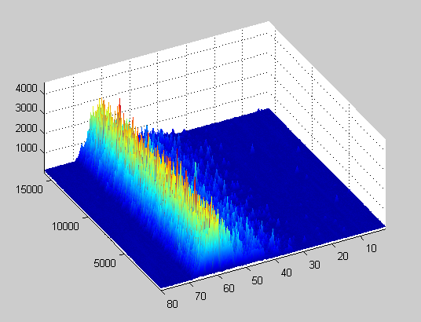
BLM Test @ ESRF
filling pattern: 1/3rd fill
scraper pos. 62
h = 992, f_{RF} = 352.202 MHz
→ T_{rev} = 2.817 μsec, t_{bucket} = 2.84 nsec
internal horizontal scraper moved in
BLM signal
331 bunches
ADC samples
scraper position [a.u.]
0.954 nsec
filling pattern nicely reproduced
system bandwidth → no single bunch resolution
2.817 μsec
Gero Kube, DESY / MDI
DEELS 2015 Workshop @ ALBA, 15.06.2015

Slide 12


Summary and Outlook
PETRA III back in operation after 1 year shut-down
test of XFEL-BLMs at ESRF
beam parameters reached
good S/N level
→ internal/external power supply
no lead shielding required (high radiator purity)
→ at least at location of test setup
discrepancy between loss rate from BLMs and lifetime
→ measured loss rate (scraper inserted) much smaller than expected from lifetime
- small signals not detected @ 50Ω impedance, i.e. high input impedance advantageous
- influence of loss geometry (?)
BLM tests will continue at PETRA
BLMs will be a critical system for diffraction limited storage rings
Gero Kube, DESY / MDI
DEELS 2015 Workshop @ ALBA, 15.06.2015

Slide 13
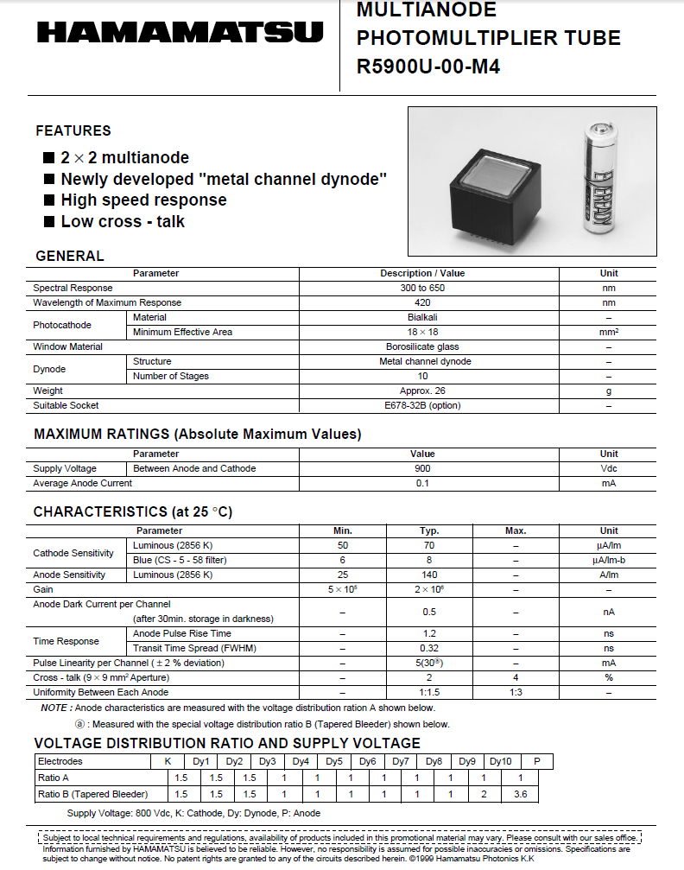
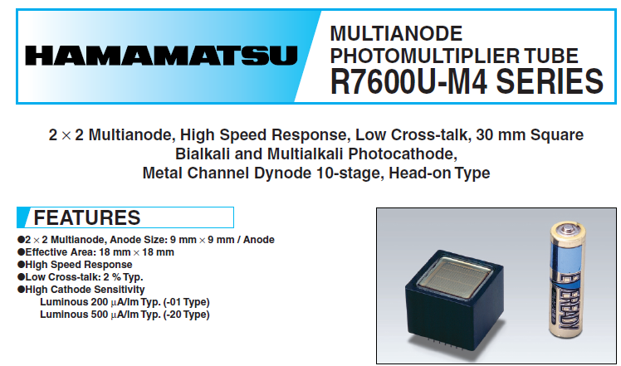
Specs
PMT specs
→ 1140,- EUR / piece
R7600U Series:
→ 933,- EUR / piece
radiator
synthetic fused silica (SQ1)
slab: 30 x 220mm
j-plasma GmbH
Jena (Germany)
→ 490,- EUR / piece
Gero Kube, DESY / MDI
DEELS 2015 Workshop @ ALBA, 15.06.2015

