Slide 1
Insertion Device Antennae
Guenther Rehm
(with help from the DLS ID group)
DEELS15, Barcelona

Slide 2
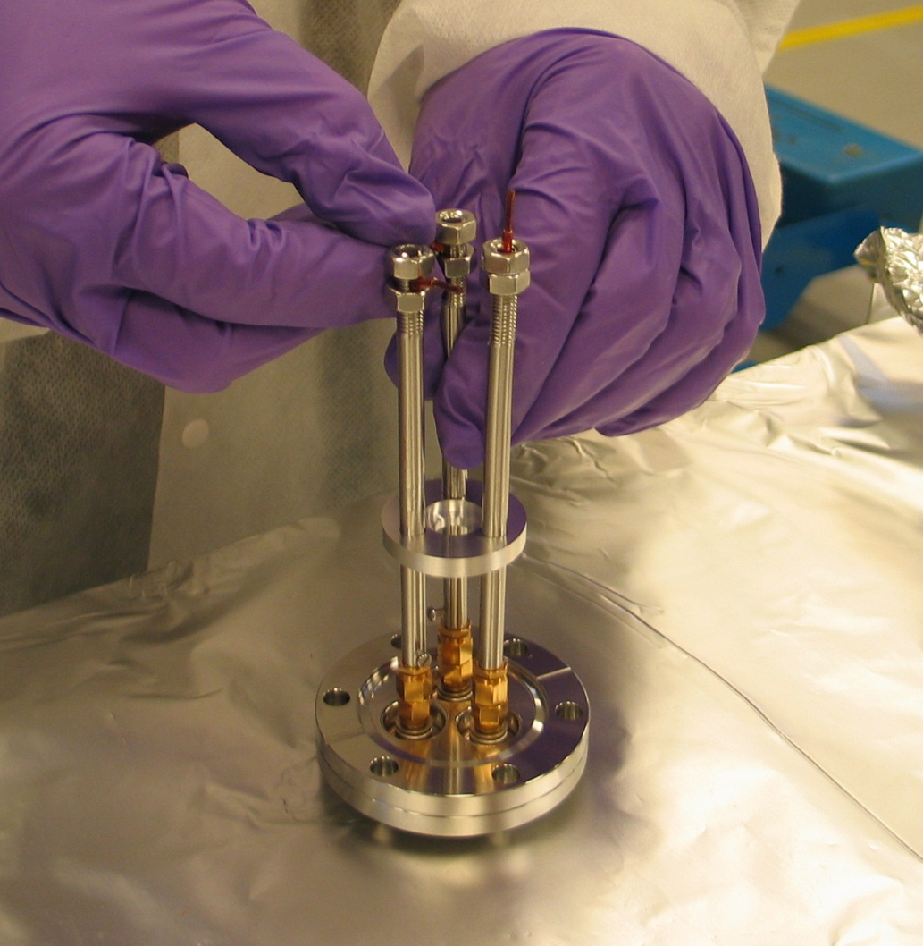
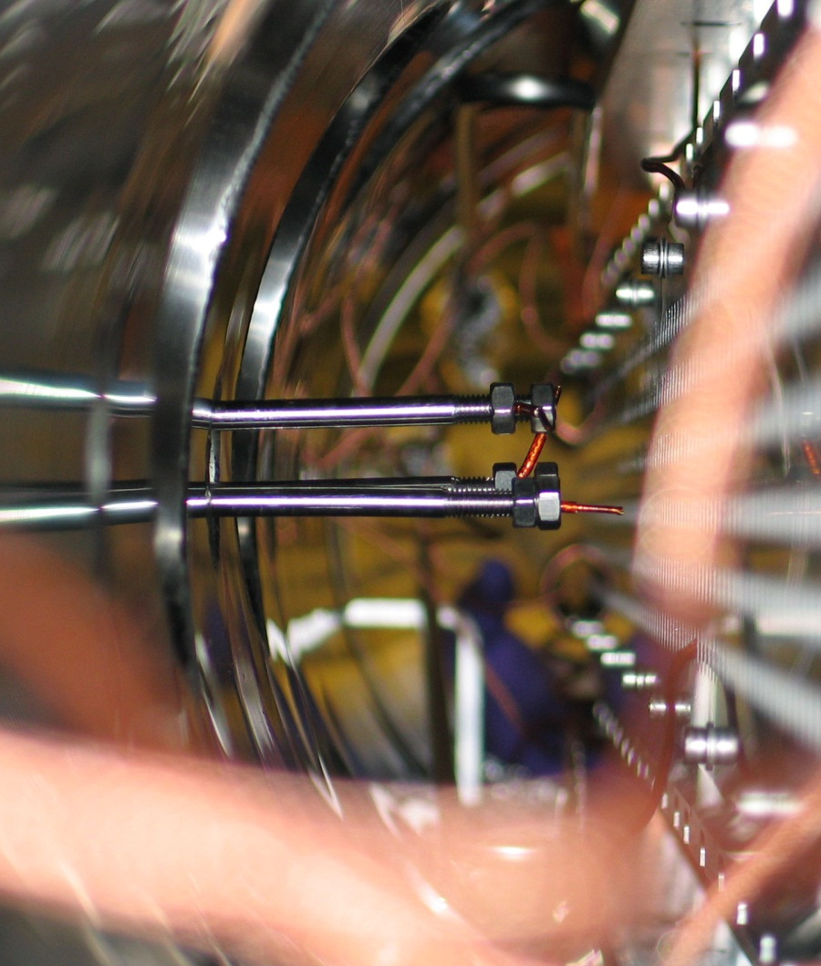
UHV compatible antennae
V
S
H

Slide 3
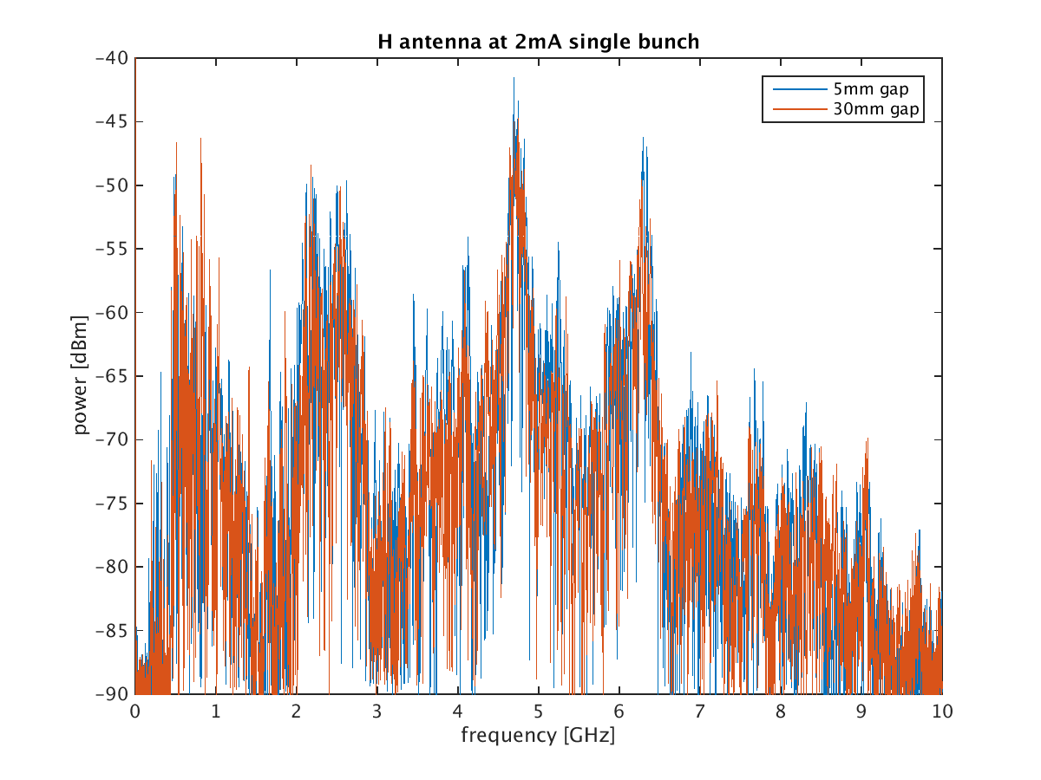
H Antenna spectrum single bunch

Slide 4
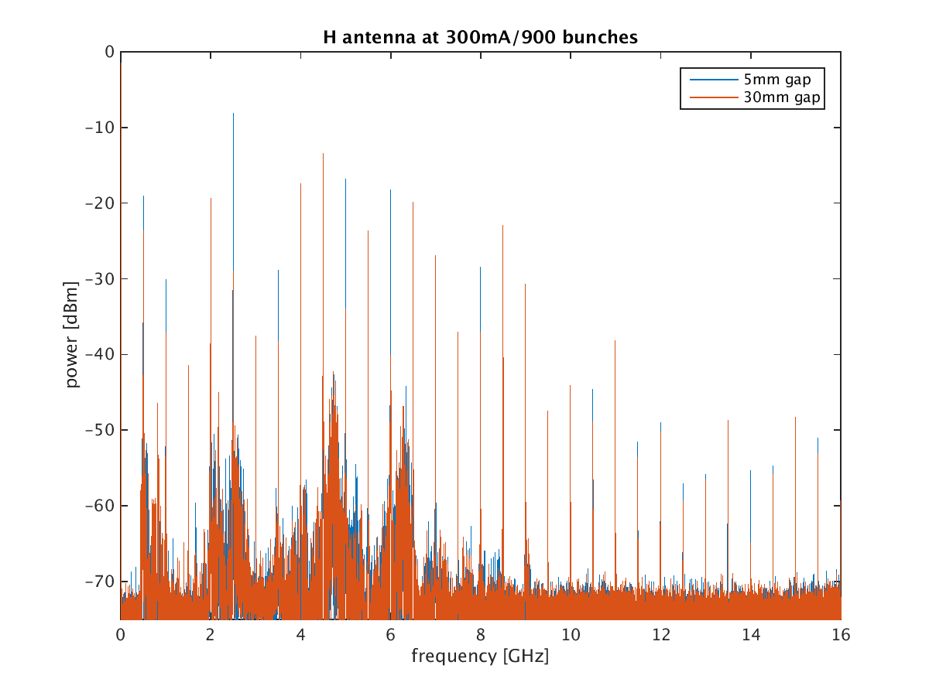
H Antenna spectrum multibunch

Slide 5
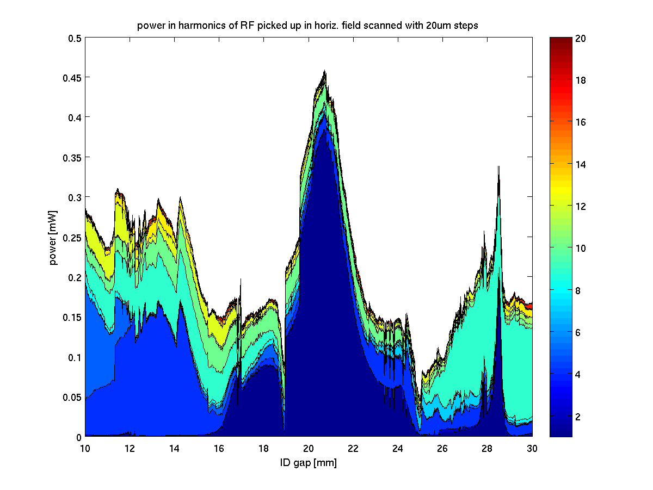
H, 10-30mm gap, 20um step

Slide 6
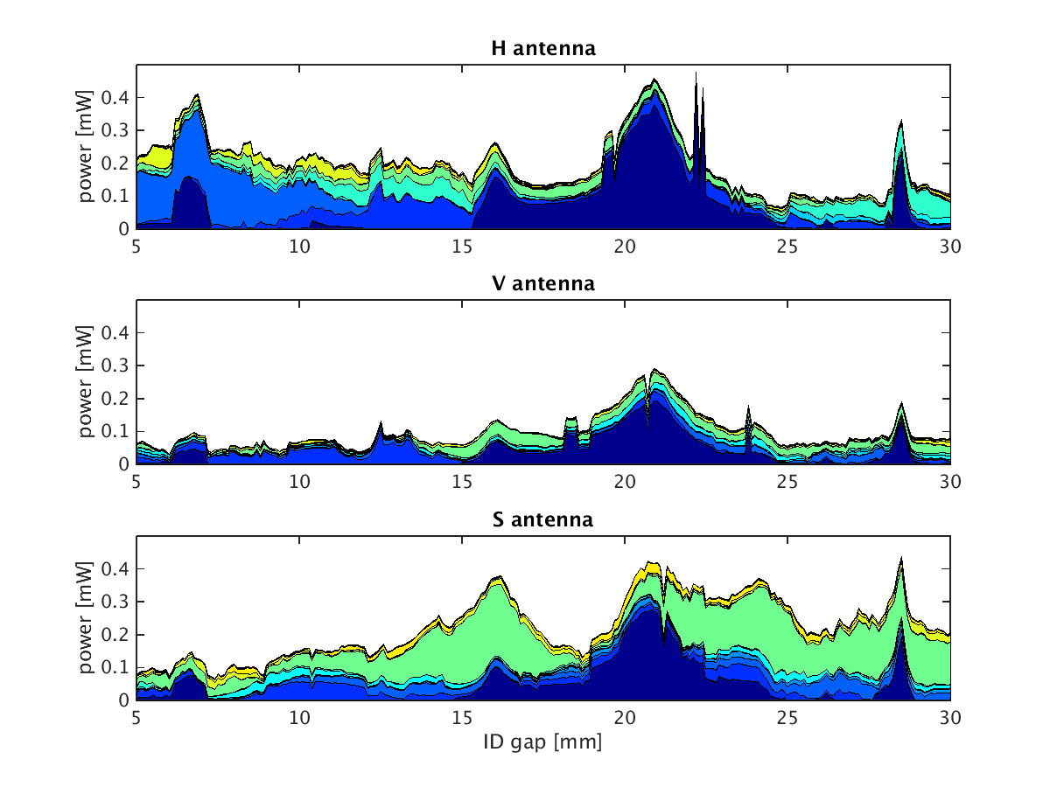
All Antennae, 5-30mm gap, 100um step

Slide 7
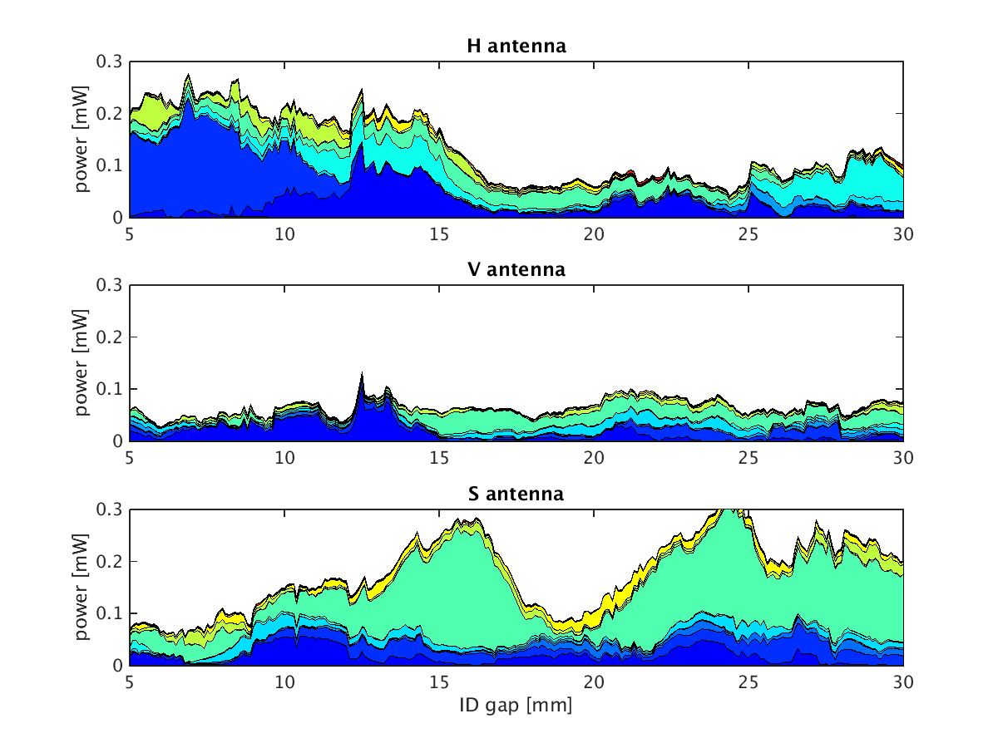
All Antennae, 5-30mm gap, 100um step
500MHz component not plotted

Slide 8
Conclusion
Huge amount of data still to be analysed (30001 frequencies at 400 gaps)
Lots of resonances found, some of the quite sharp
Jumping of spectrum around certain gap settings might indicate some stiction on sliding contacts?

Slide 9
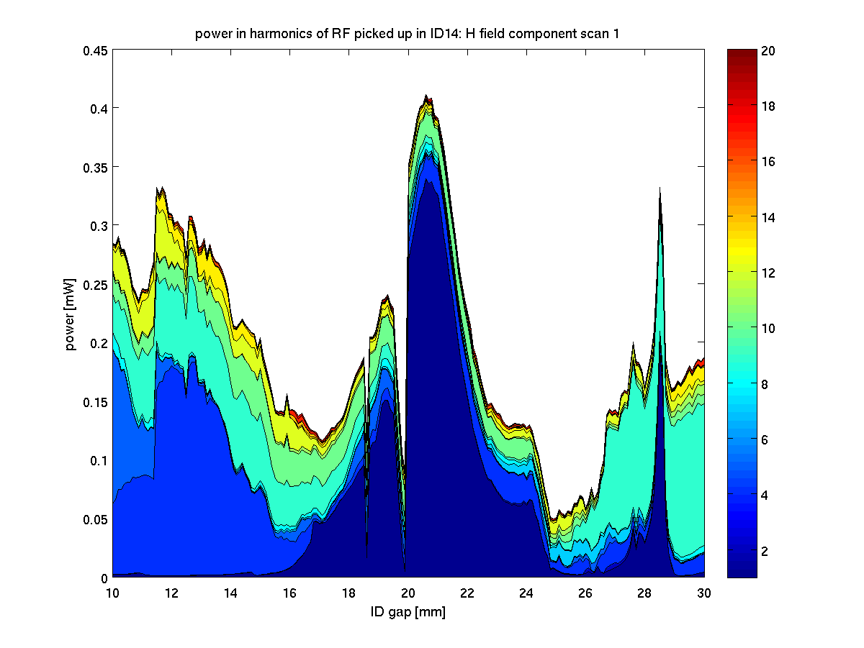
H, 10-30mm gap, 100um step

Slide 10
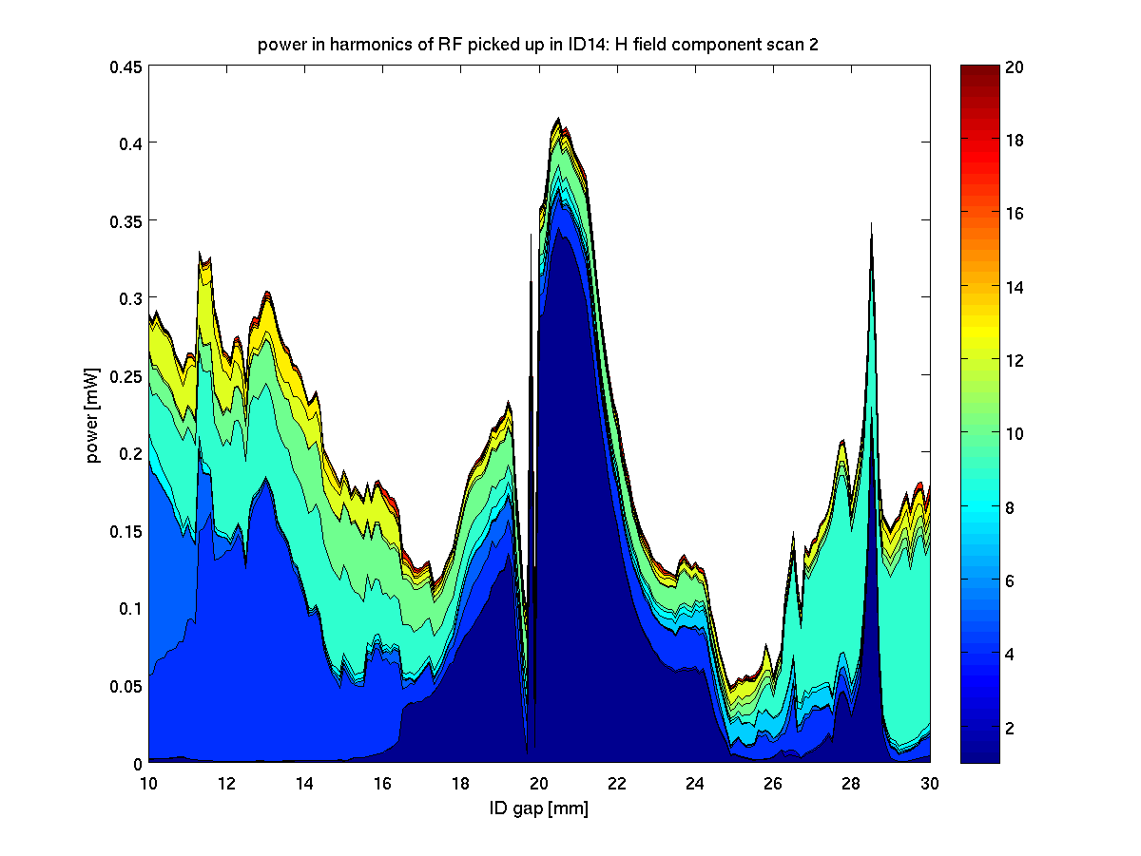
H, 10-30mm gap, 100um step

Slide 11
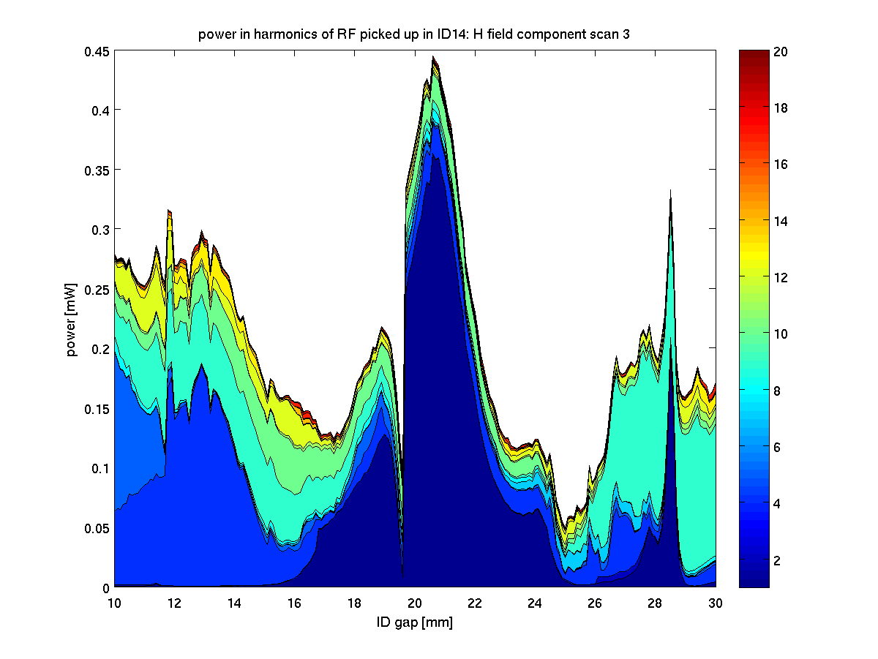
H, 10-30mm gap, 100um step

Slide 12
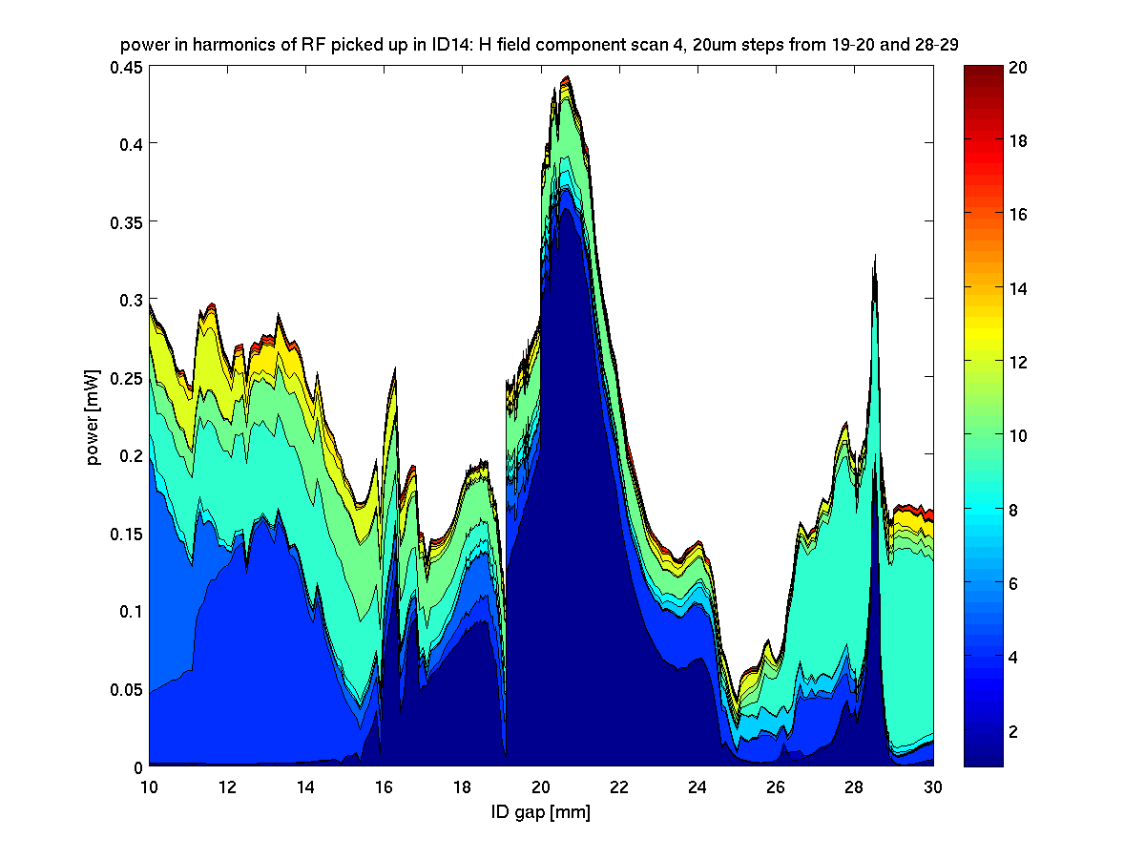
H, 10-30mm gap, 100um step

