Slide 1
Streak camera optimisation at Diamond
L. M. Bobb and G. Rehm

Slide 2
Overview
PROBLEM | SOLUTION
Low alpha beam mode: Single bunch investigations Low beam current (~µA) Low flux at streak camera High resolution required to measure short bunch lengths (1ps) | Reflective input optics → Boost flux Pinhole → Obtain small, round PSF Calibration of dual sweep time bases → High resolution measurements
Streak Camera (SC):
Optronis Optoscope SE, FSSU1-H2, STSU2
PSF = Point Spread Function
= Spot size with dual sweeps disabled

Slide 3
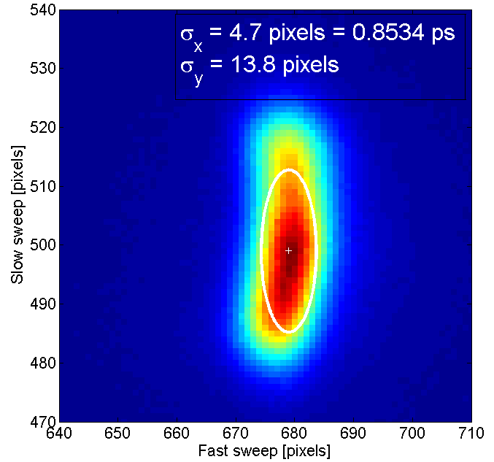
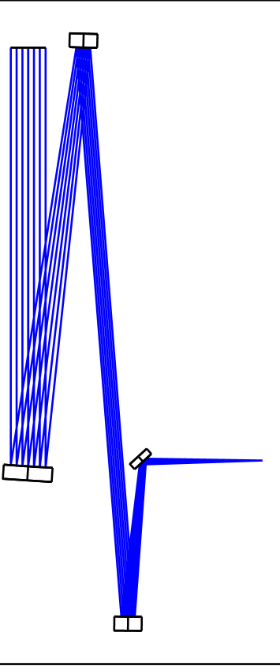
Input Optics Progression (1)
2
Concave parabolic
Convex spherical
Concave spherical
Flat fold mirror
4
SC
1
Breadboard optics:
System of focussing mirrors
= High Flux
Astigmatism
→ Poor slow axis resolution
3

Slide 4
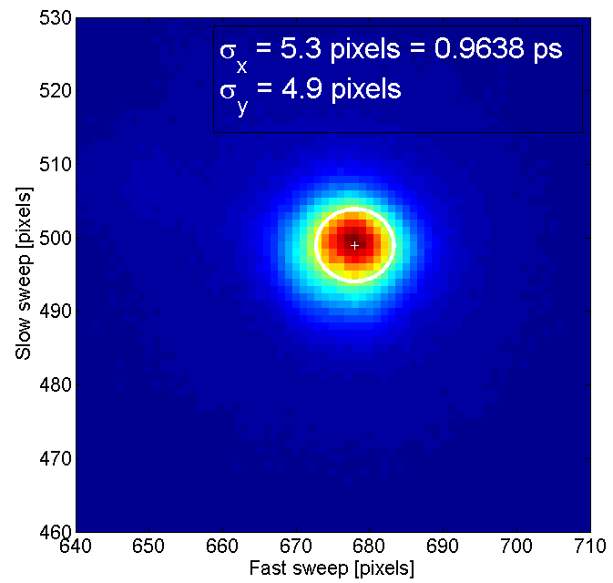
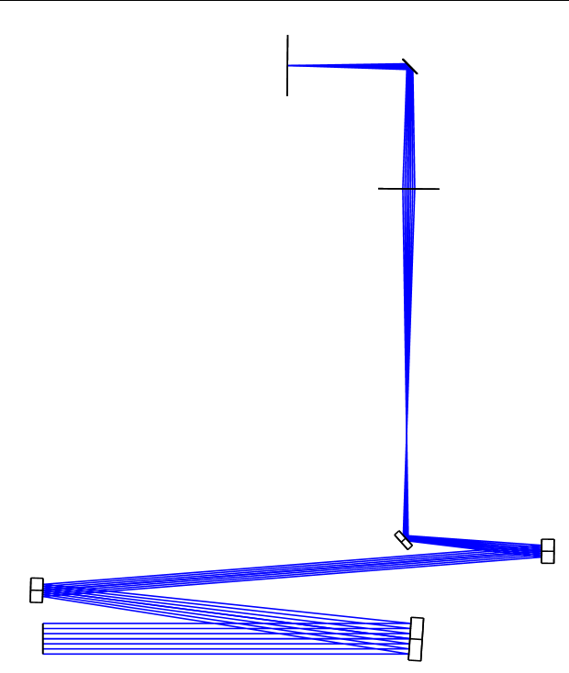
Input Optics Progression (2)
SC
Fold mirror
Lens
Bandpass filter
Pinhole
Breadboard optics + filter
= Limited Flux
Imaging pinhole
= Small round PSF

Slide 5
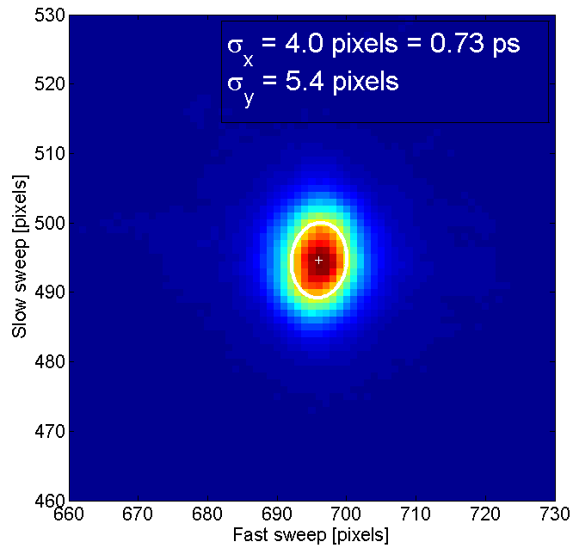
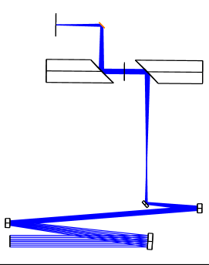
Input Optics Progression (3)
SC
Fold mirror
OAP
Pinhole
Breadboard optics + 2x 90° OAP
= High Flux
Imaging pinhole
= Small round PSF

Slide 6
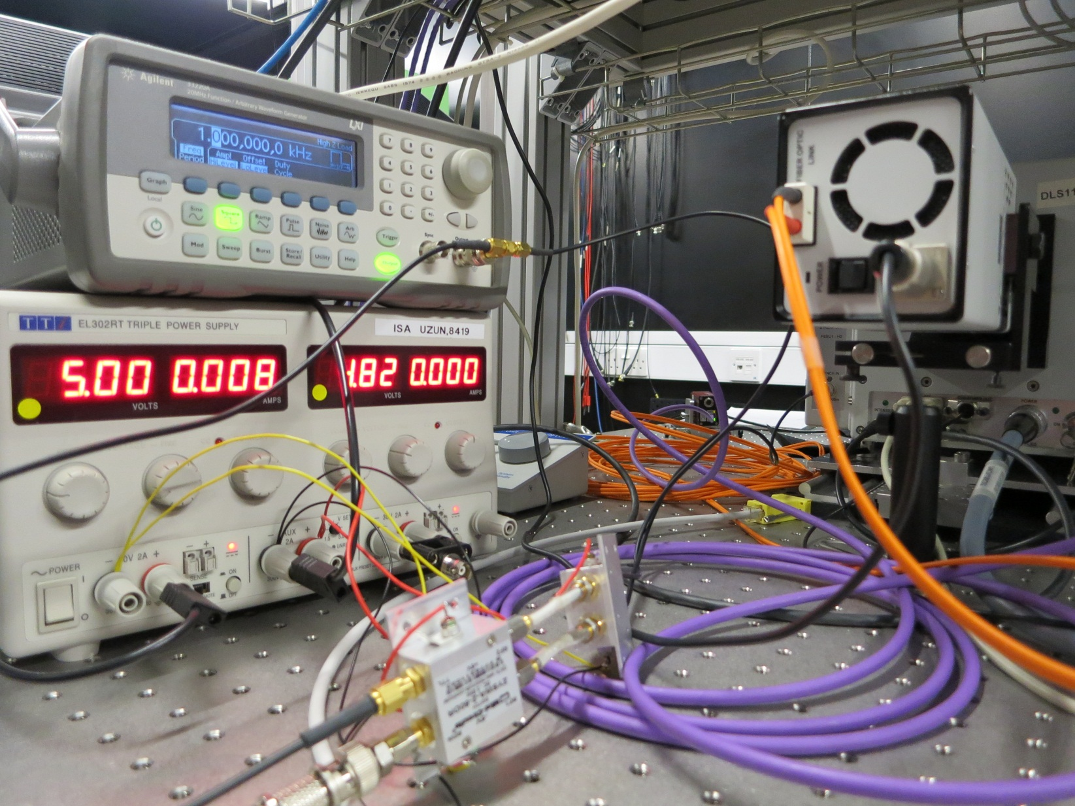
Electrical Delay Calibration Setup
For slow sweep calibration
For fast sweep calibration:
Difference in time between the 2 cables = 15.7 ps
Mini-circuits switches

Slide 7
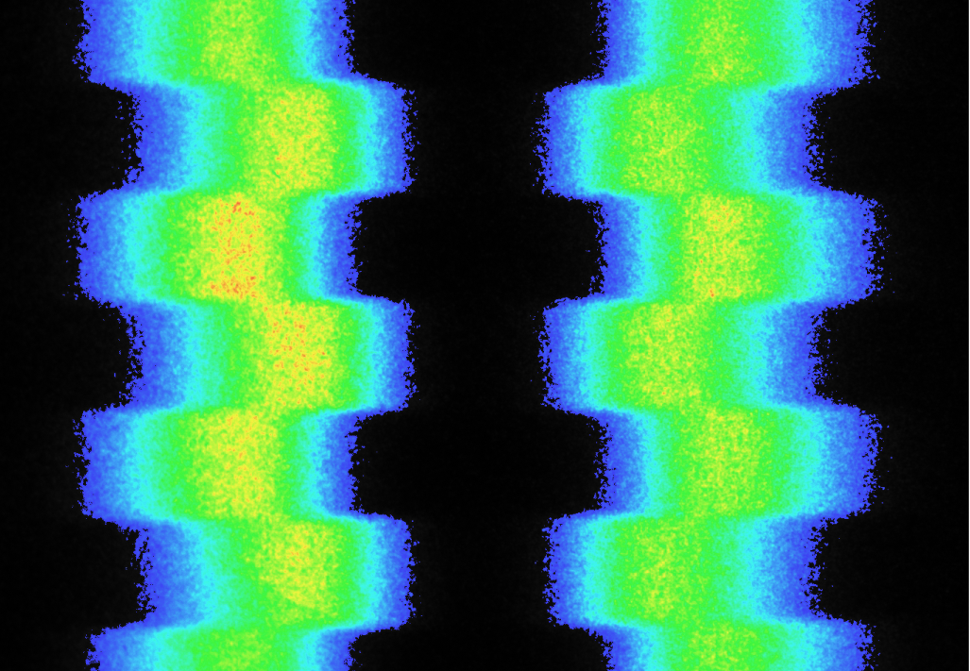
Calibration Results
Calibration
Difference between centroid positions in number of pixels
= 15.7 ps
Resolution setting [ps/mm] | Measured resolution [ps/pixel] | Which corresponds to… [ps/mm]
15 | 0.1816 (Feb 2015) 0.1998 (May 2015) | 12.97 14.27
25 | 0.3195 | 22.82
50 | 0.6466 | 46.19

Slide 8
Performance
RECONSTRUCTION OF ELECTRON BUNCH MOTION DURING CSR BURSTS USING SYNCHRONISED DIAGNOSTICS
I.P.S. Martin et al.
Example of CSR bursting
3.4 MV
alpha = +4.6×10⁻⁶
fs = 460 Hz
3.4 MV, alpha = -9.9×10⁻⁶, fs = 675 Hz, I_{bunch} = 95.9 μA

Slide 9
Thank you for your attention!

Slide 10
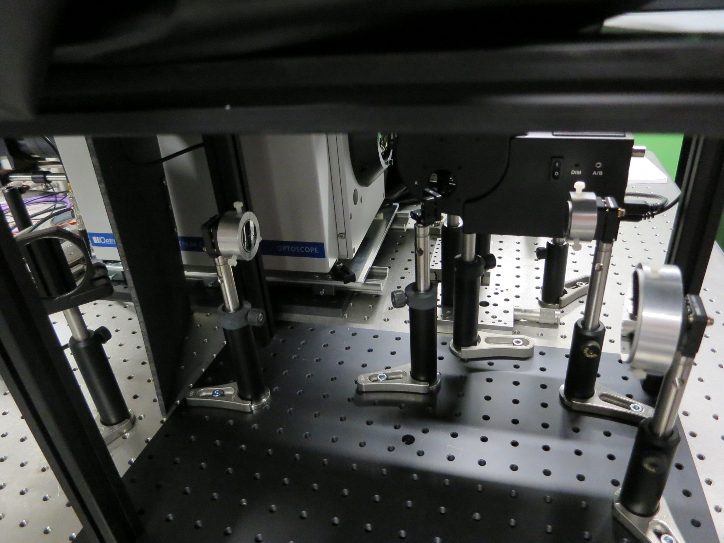
Input Optics (1)

Slide 11
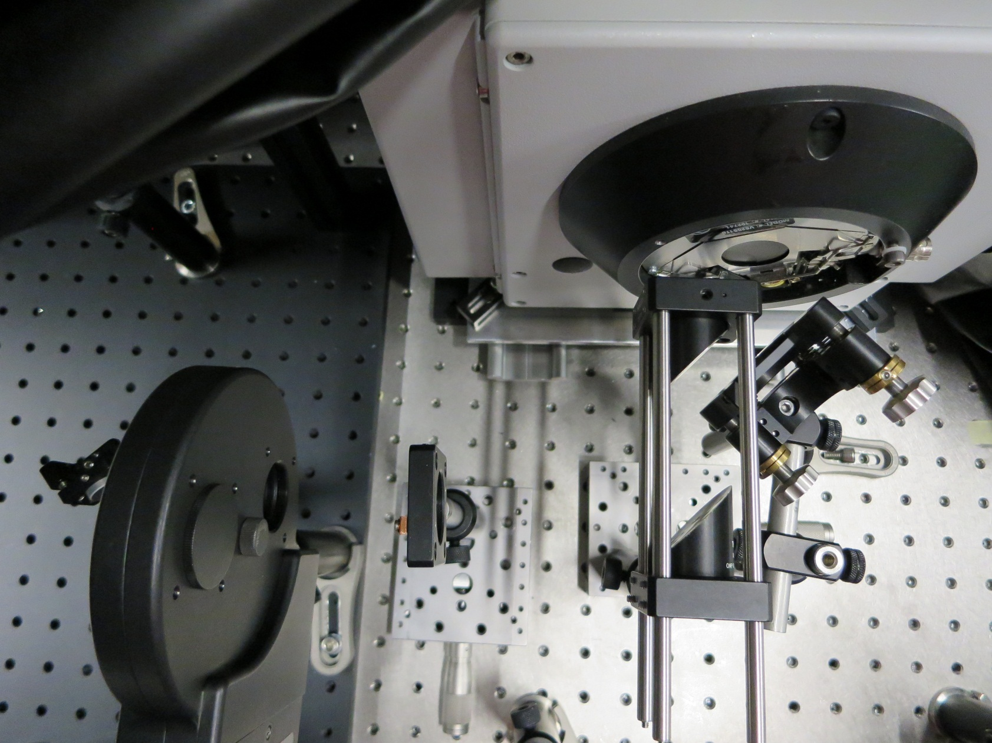
Input Optics (2)

Slide 12
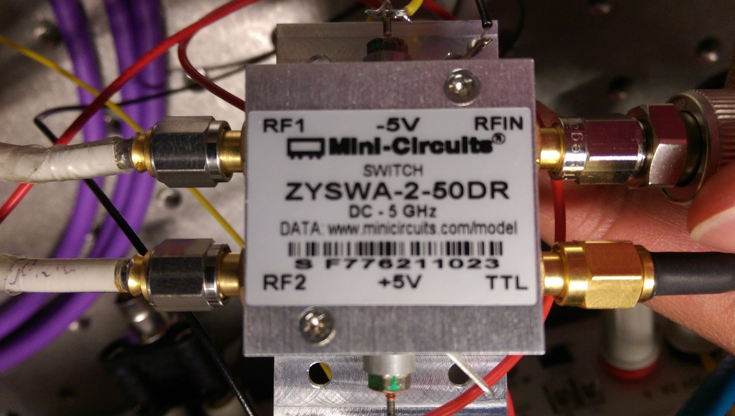
Mini-Circuit Switches

