Slide 1
Picking up the 100th RF harmonic
Guenther Rehm
DEELS15, Barcelona

Slide 2
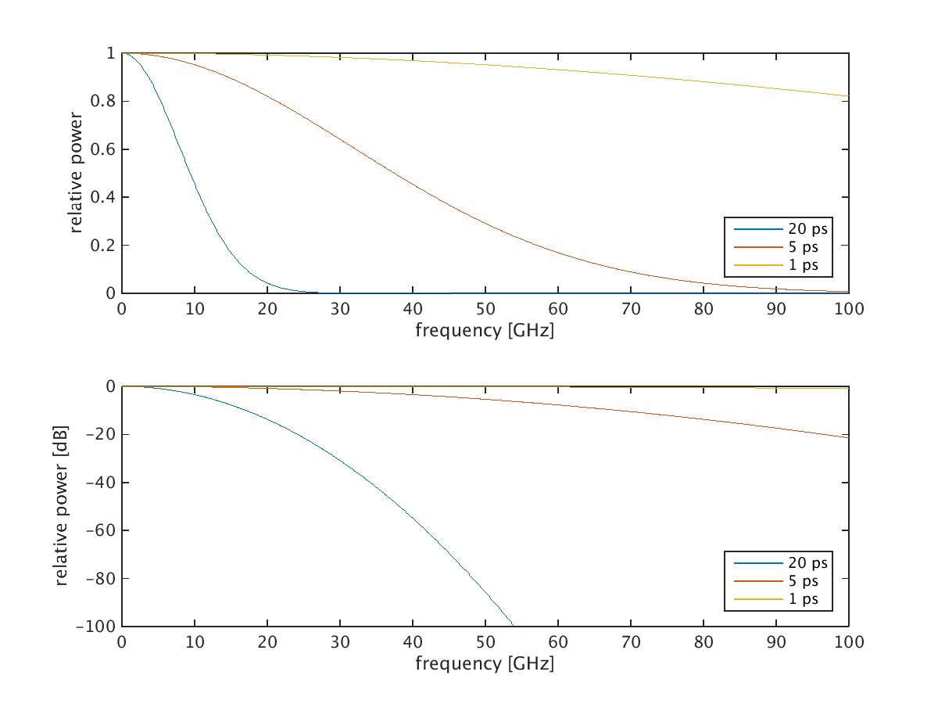
Bunch Length and Spectrum

Slide 3
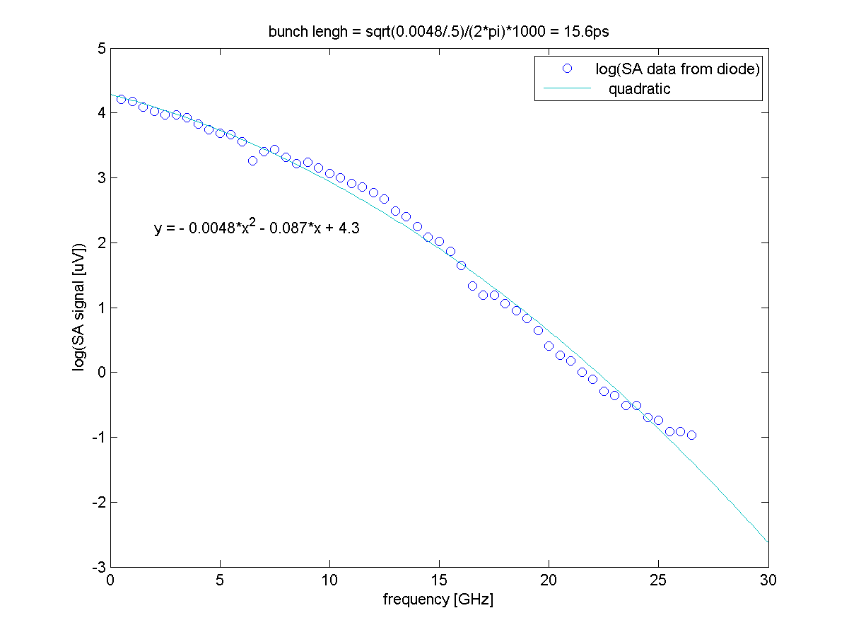
Visible light spectrum

Slide 4
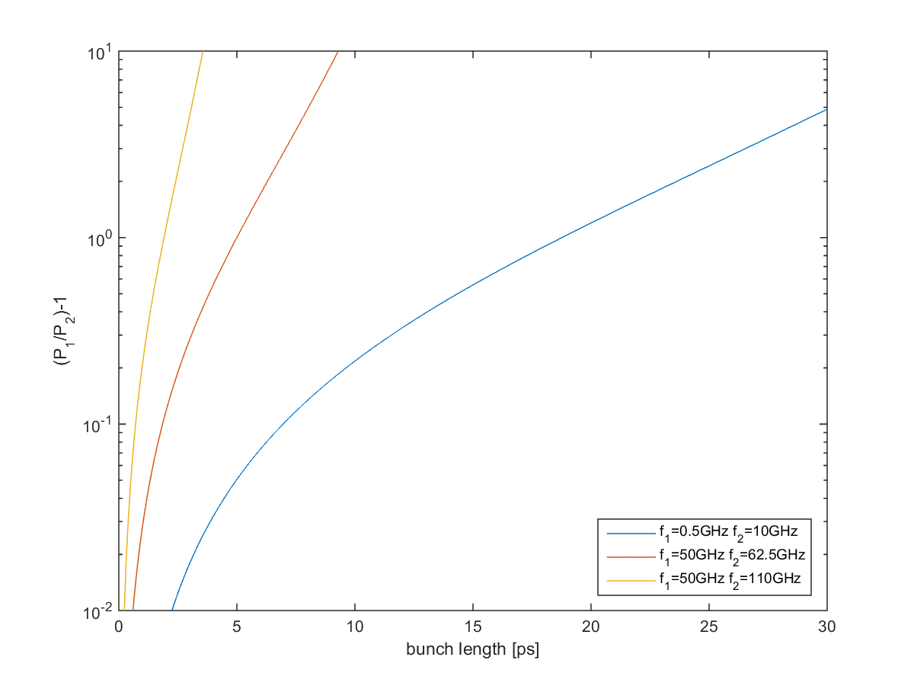
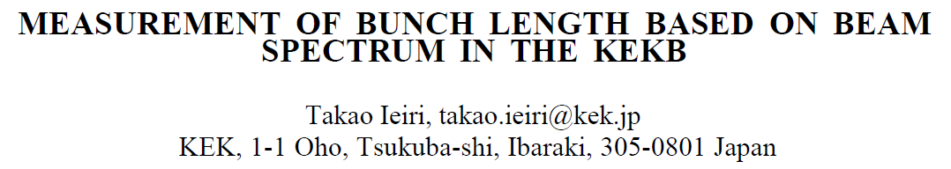
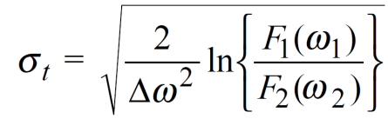
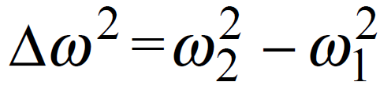
Bunch Length from Two Frequencies

Slide 5
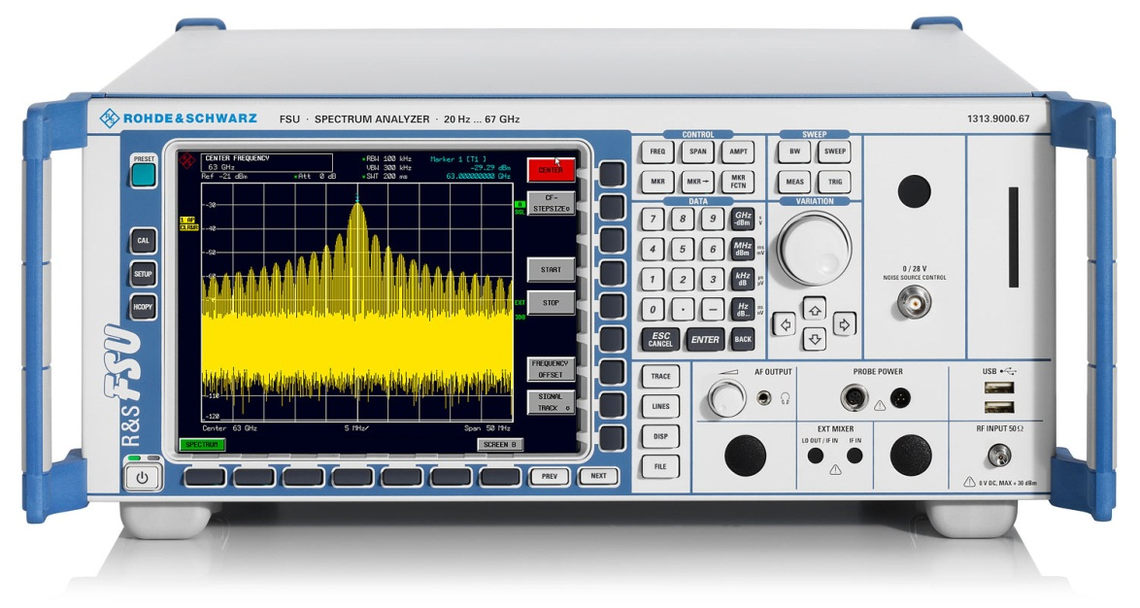
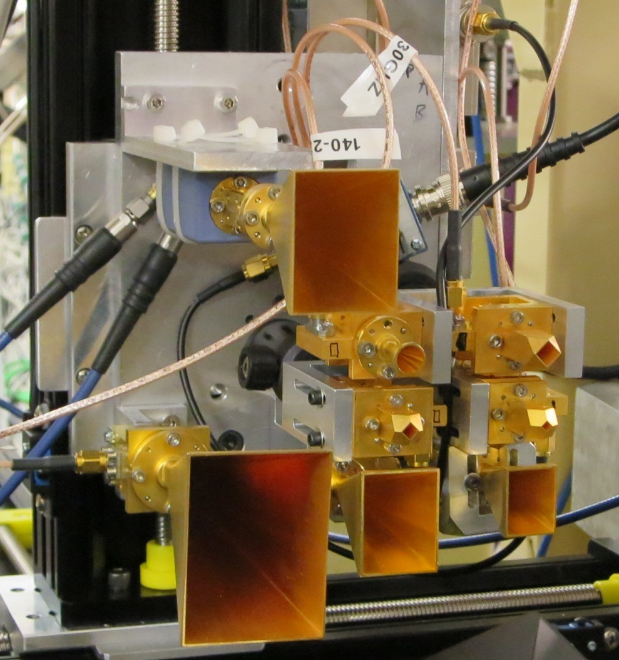
Harmonic Mixer 50-75GHz
Worked fine OK but:
FSU does not allow FFT only sweep with external mixer
A very costly instrument that needed to be in the tunnel to supply the LO at 6.25GHz.

Slide 6
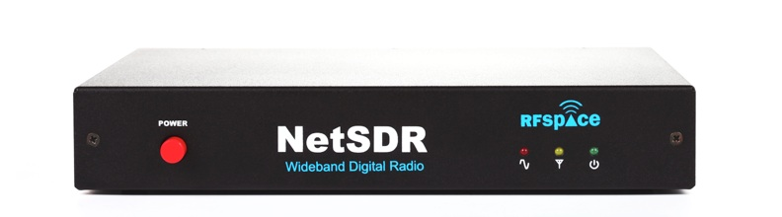
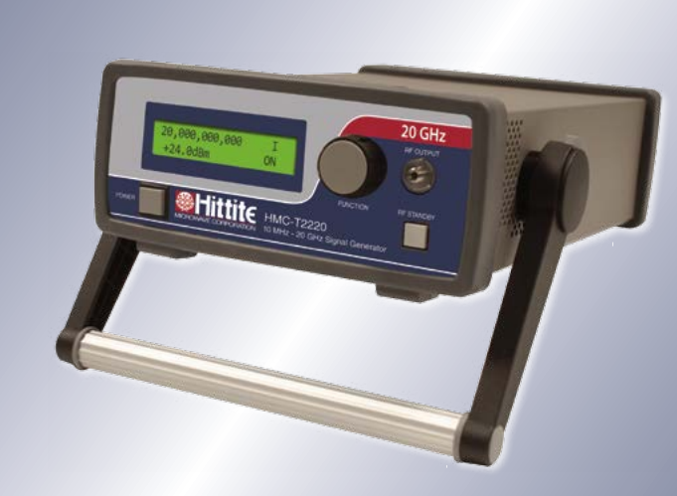
Harmonic Mixer 50-75GHz
80MS/s 0-40MHz internal DDC
Streaming via Ethernet
Works fine, once you have supplied 10MHz reference to lock with the machine RF

Slide 7
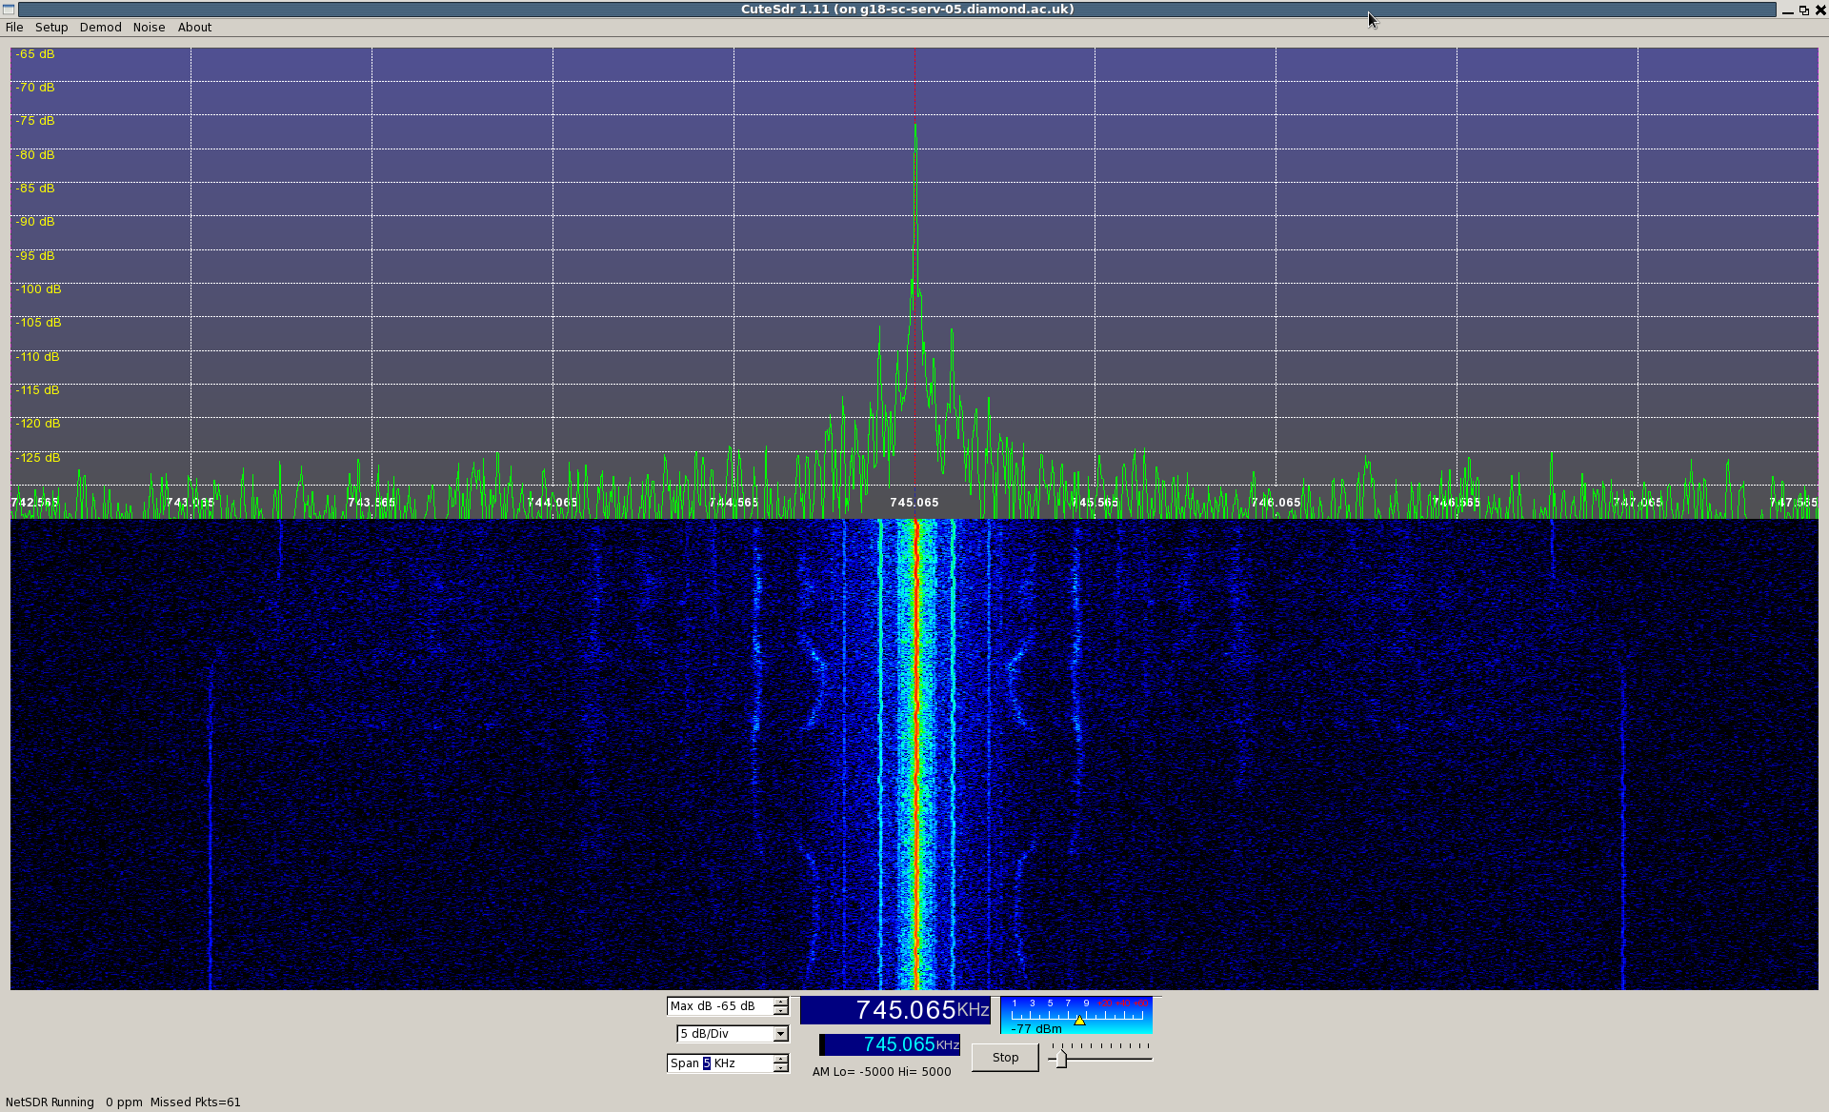
50GHz mixed down to 745kHz
Mains sidebands
300mA
250mA

Slide 8
Next steps
Need chose LO so that both 8th and 10th harmonic are within a few 100KHz
Need to get data from NETSDR into something with processing capabilities (MATLAB or GNUradio)
Lock-in in on the two lines, measure there power, calculate bunch length
Possibly use two harmonic mixers to get larger frequency separation

