Slide 1
Machine Operation and Studies at SSRF
Wenzhi ZHANG
Dec. 16, 2013 Spain

Slide 2
Outline
Brief Introduction
Operation status of SSRF Accelerators
Machine Studies
Summary

Slide 3
Introduction -- History
Dec. 25, 2004 -- Groundbreaking;
Oct. 2007 --- Commissioning
May, 2009 ---- Open to users
Dec. 6 2012 ---- Top up operation
Beam lines in Operation
  7 Beamlines -- in the first phase
  6 Beamlines commissioning had been finished, will be in use next year

Slide 4
Outline
Introduction
Operation status of SSRF Accelerator
Machine studies
Summary

Slide 5
Beam Parameters (Operation mode)
Parameter / unit | Design value | Operation
Beam energy / GeV | 3.50 | 3.50±0.02
Beam current / mA | 200~300 | 210 (operation current) 300 (achievable)
Tune (H, V) | 22.22, 11.29 | 22.220, 11.290 (±0.002)
Natural emittance / nm.rad | 3.89 | 3.8±0.2
Coupling | 1% | 0.6% (0.1%)
Natural chromaticity (H, V) | -55.7, -17.9 | -55.8, -17.9 (LOCO model) -50, -15 (direct measurement)
Corrected chromaticity (H, V) | --------- | 1.5, 0.5
RMS energy spread | 9.845×10⁻⁴ | 0.001
Energy loss per turn / MeV | 1.435 | ~1.45 (without ID, from RF power)
Momentum compaction factor | 4.27×10⁻⁴ | (4.2±0.2)×10⁻⁴
RF voltage / MV | 4.0 | 1.51, 1.55, 1.54 (Three cavities)
RF frequency / MHz | 499.654 | 499.654 (depend on machine conditions)
Synchrotron frequency | 0.0072 (V_{RF}=4.0MV) | 0.0075±0.0002
Natural bunch length / ps | 13 | 14±2
Injection efficiency | --------- | >95% (from BS DCCT to SR DCCT)
Beam lifetime / hrs | >10 | ~17 (0.6% coupling, 210 mA)

Slide 6
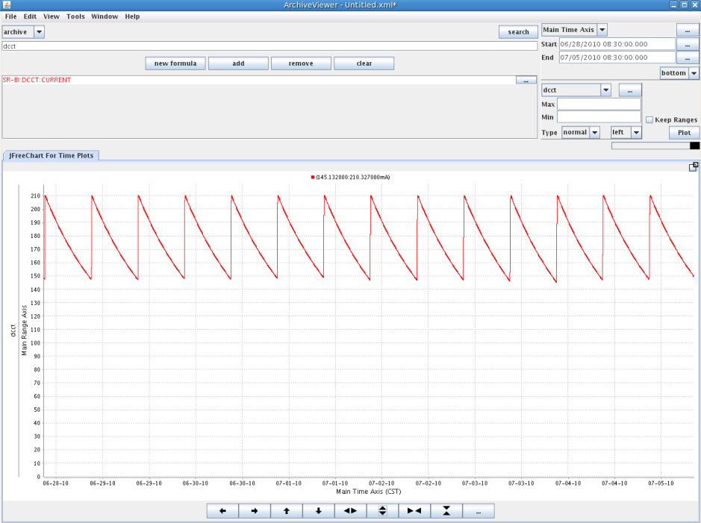
User’s operation from May 6, 2009 to Dec. 6 2012
Delivery time = 12 hours

Slide 7
Operation time Schedule
year | total | user | beamline | AP | maintenance
2010 | 7319 | 4003 | 1702 | 1330 | 284
2011 | 7356 | 4476 | 1130 | 1280 | 470
2012 | 6696 | 4610 | 856 | 960 | 270
2013 | 7272 | 4608 | 1488 | 912 | 264
total | 28643 | 17697 | 5176 | 4482 | 1288

Slide 8
Availability & MTBF during scheduled experiment time

Slide 9
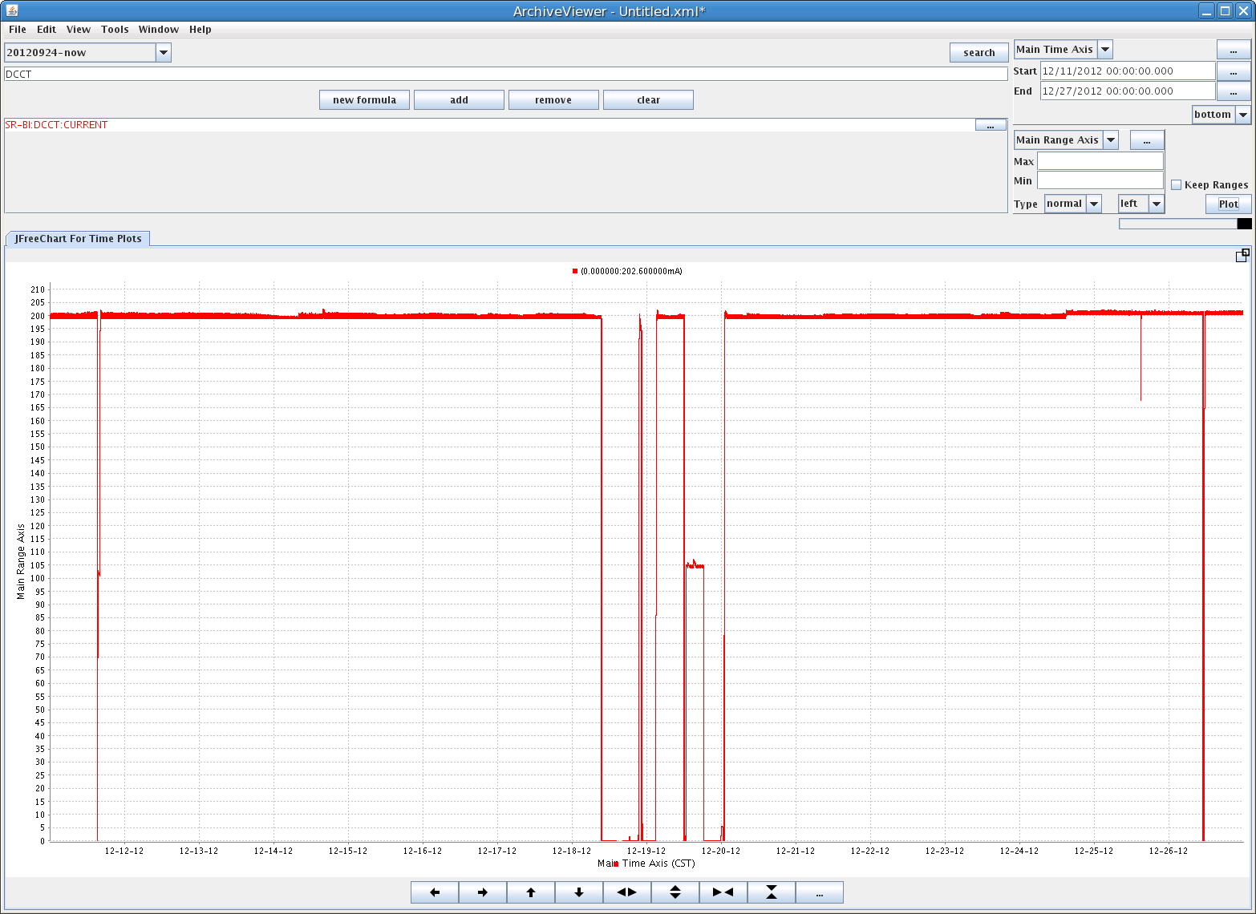
The longest running without hardware faults– 307 hours

Slide 10
Hardware faults distribution

Slide 11
Outline
Introduction
Operation status of SSRF Accelerator
Machine Studies
Summary

Slide 12
1. Top up Operation
To provide more stable beam for users
  Electron orbit stability, which we have already taken a lot of methods to keep the beam stabilized within 2~5 microns
  Heating stabililty of beamline monochromator, which must be solved by keeping beam current as stable as possible, i.e. top-up injection
Beam current will oscillate within less than ±0.5% level during top-up operation, that means the injection process will running frequently, mostly once per several minutes, and the users can still do experiment during this period.
Safety is the most important in any case

Slide 13
Goal of top up
Current stability
  Single bunch <1%
  Multibunch <0.1% (in the next year)
Orbit disturbance
  Stored beam oscillation <0.1mm
Beam lifetime
  Sufficient beam lifetime > 5 hours

Slide 14
Safety simulation
ID beamline simulation

Slide 15
Safety simulation
Dipole magnets beamline simulation

Slide 16
Magnets interlock threshold according to simulation
 | ID beamline |  | Bend beamline
 | Max. | Min. | Max. | Min.
Energy | 15% | - | 15% | -8%
Dipole | - | -40% | - | -40%
Q1 | - | -100% | 100% | -20%
Q2 | 20% | -40% | 5% | -20%
Q3 | - | -100% | - | -100%
Q4 | - | - | - | -30%
Q5 | - | - | 8% | -
S5 | - | -100% | 45% | -
S6 | 100% | - | - | -100%
SD | - | - | 30% | -
SF | - | - | - | -20%
HVC | 3mrad | - | 3mrad | -3mrad

Slide 17
Top up interlock threthold
Beam current interlock: > 100mA
Beam life time > 5 hours
Injection efficiency >50%
Beam energy interlock
  BTS Dipole ~ +/-5%
  SR dipole ~ +/-3%
SR magnets
  Quads Q2 ~ +/-3%, others ~ +/-5%
  Sext. ~ +/- 20%
Dose interlock
  Intergrated dose (beam dump)
  Instantaneous dose (to Decay)
Injector hardware failure (transfer to decay)

Slide 18
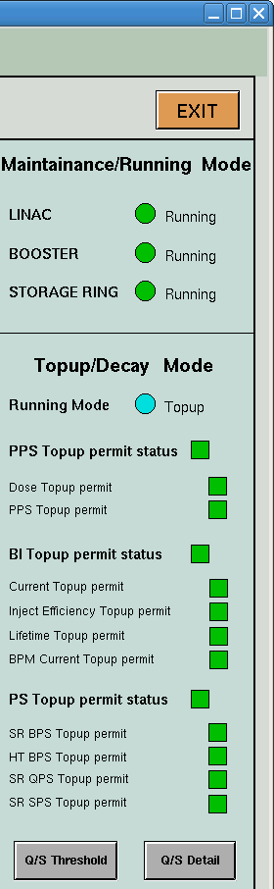
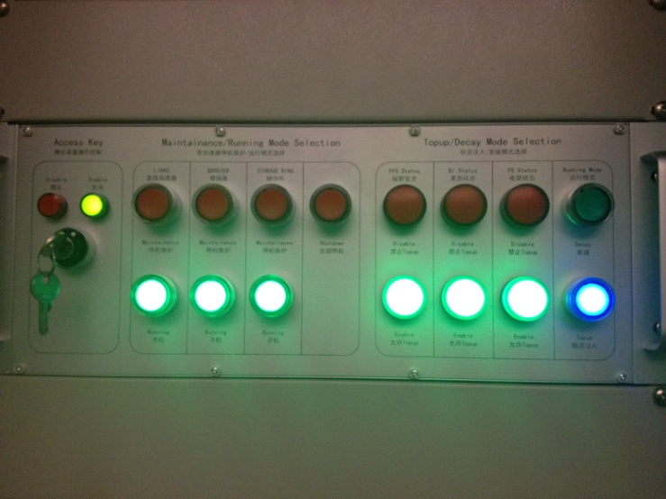
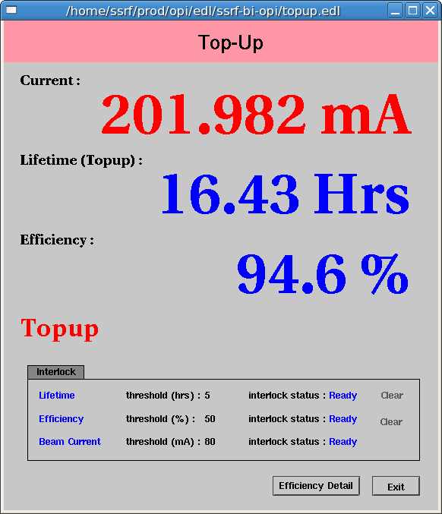
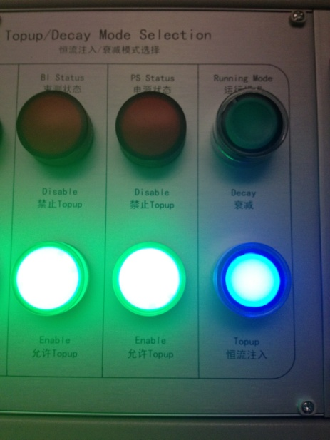
Interlock interface

Slide 19
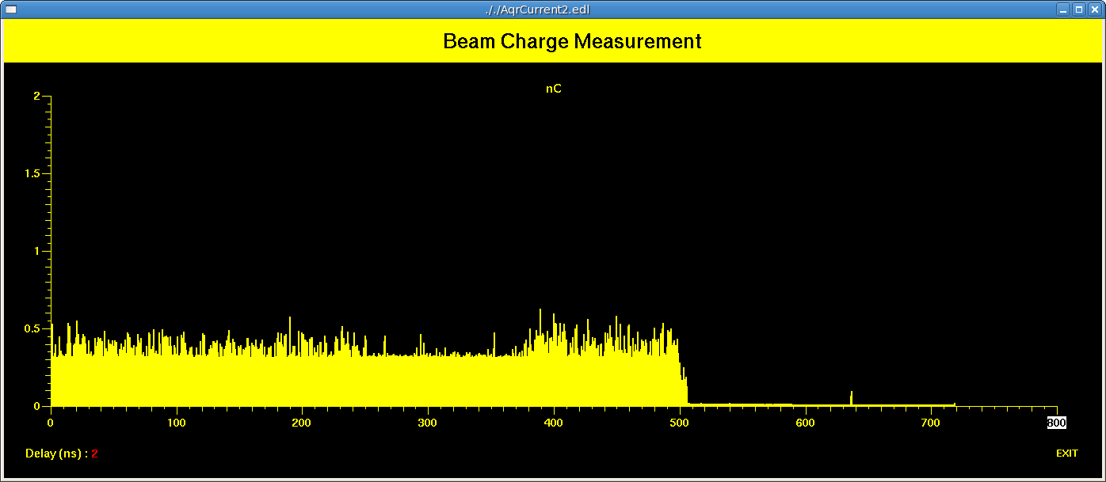
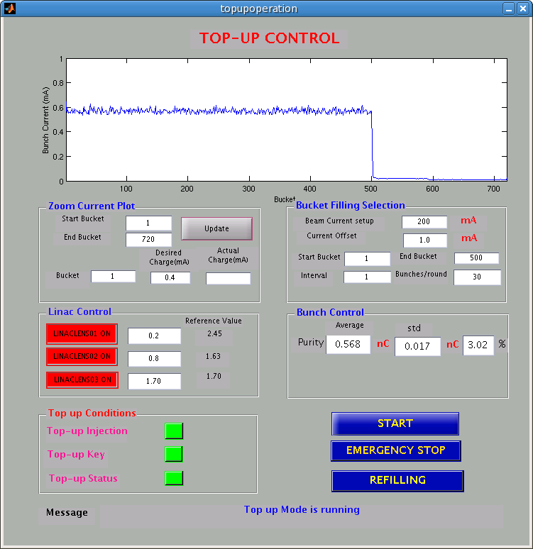
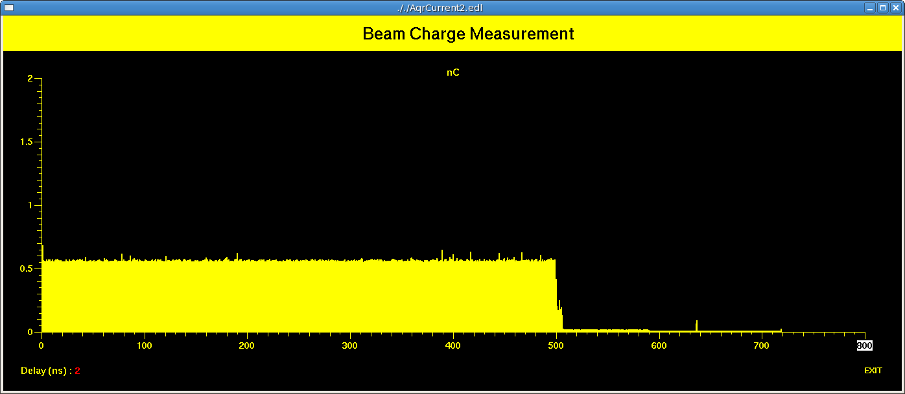
Bunch charge control
Filling pattern control (up: initial, below: 3hours top-up operation
Control software panel

Slide 20
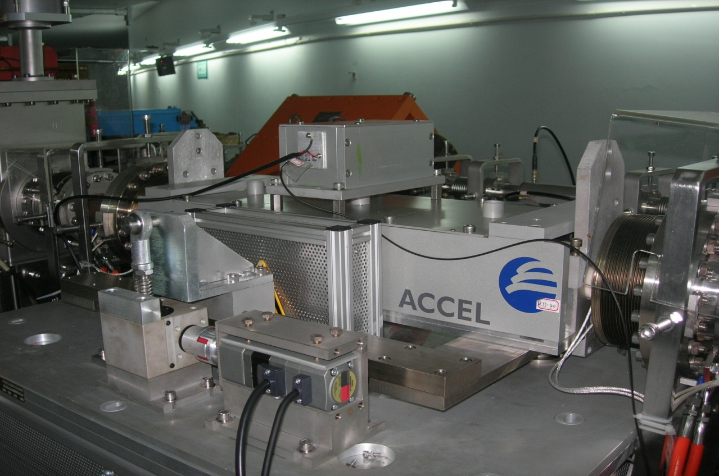
Topup injection
  range：-5∼5 mrad±2mm）
  step： < 10μrad；
  speed：= 18μrad/sec；
  resolution：10μrad；

Slide 21
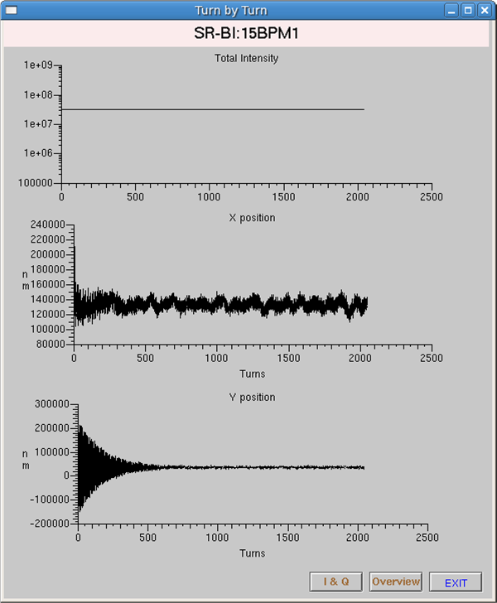
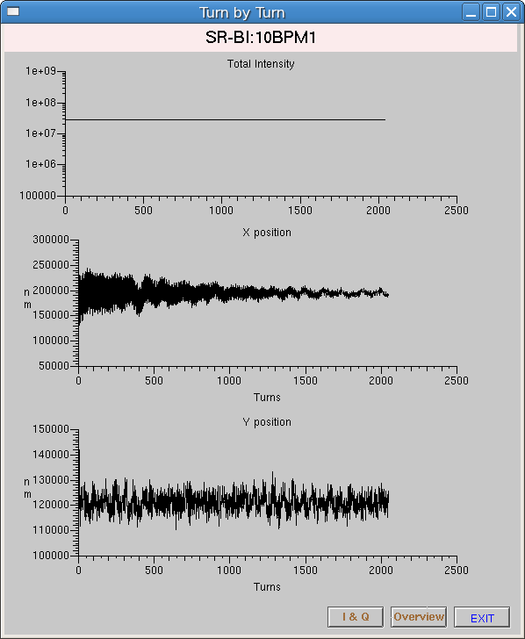
Top up commissioning
BPM 15-1 turn-by-turn data after injection
Before optimize after optimize
During machine shutdown, 4 stepper motors are added to the 4 injection kickers to adjust tilt. After online optimizing, the injection perturbation in vertical plane reduced from 150micron to ±10 micron , and ±40 micron in horizontal

Slide 22
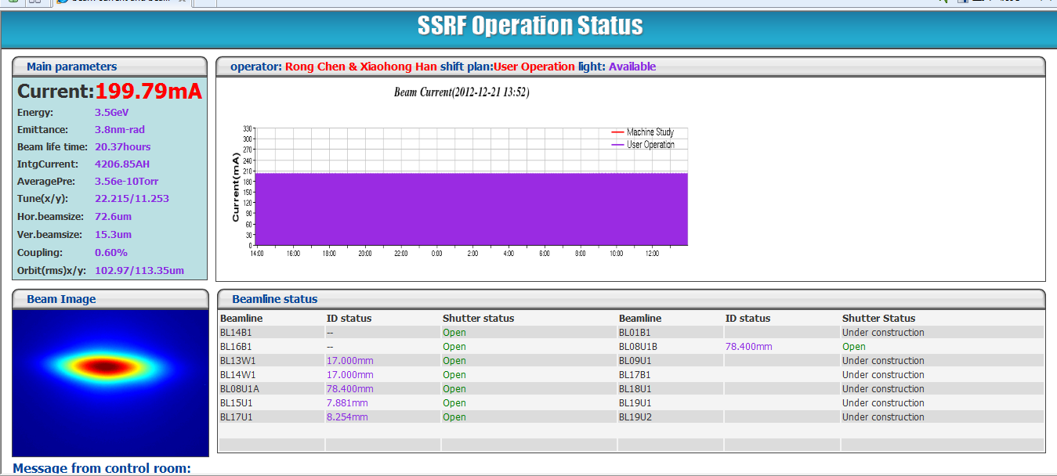
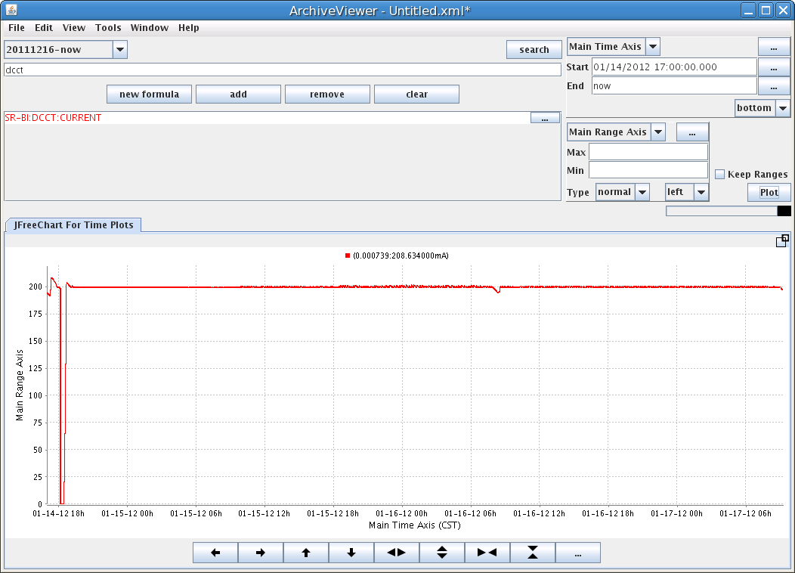
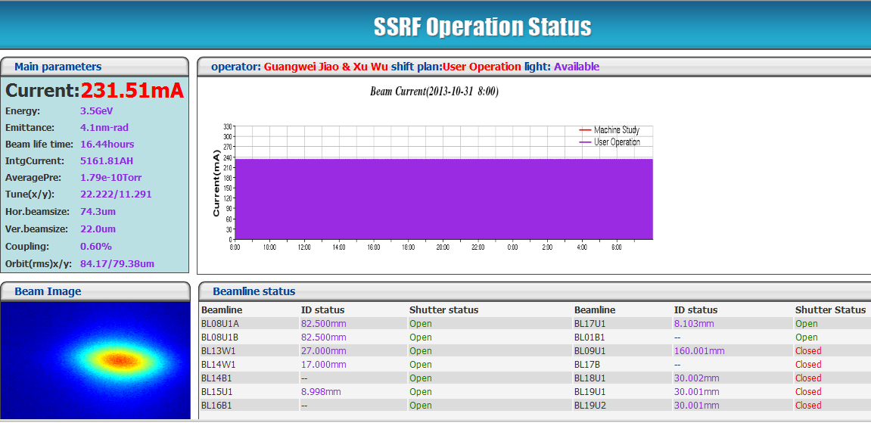
top up operation for users
Dec. 6, 2012
Nov. 11, 2013

Slide 23
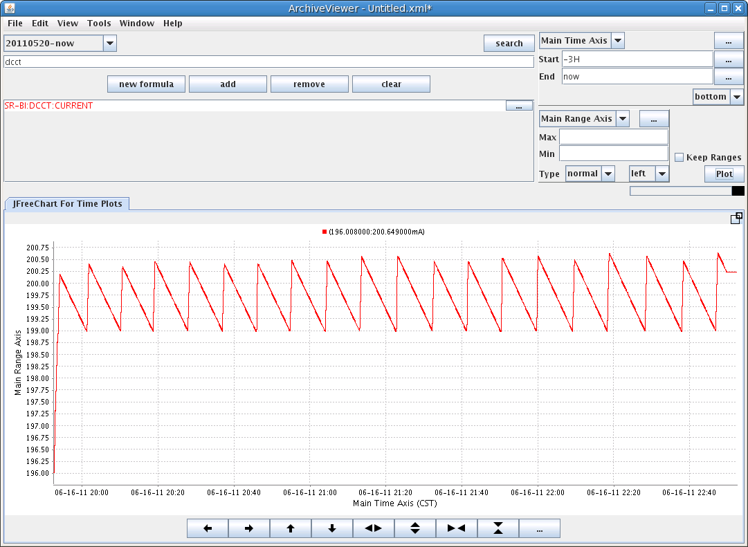
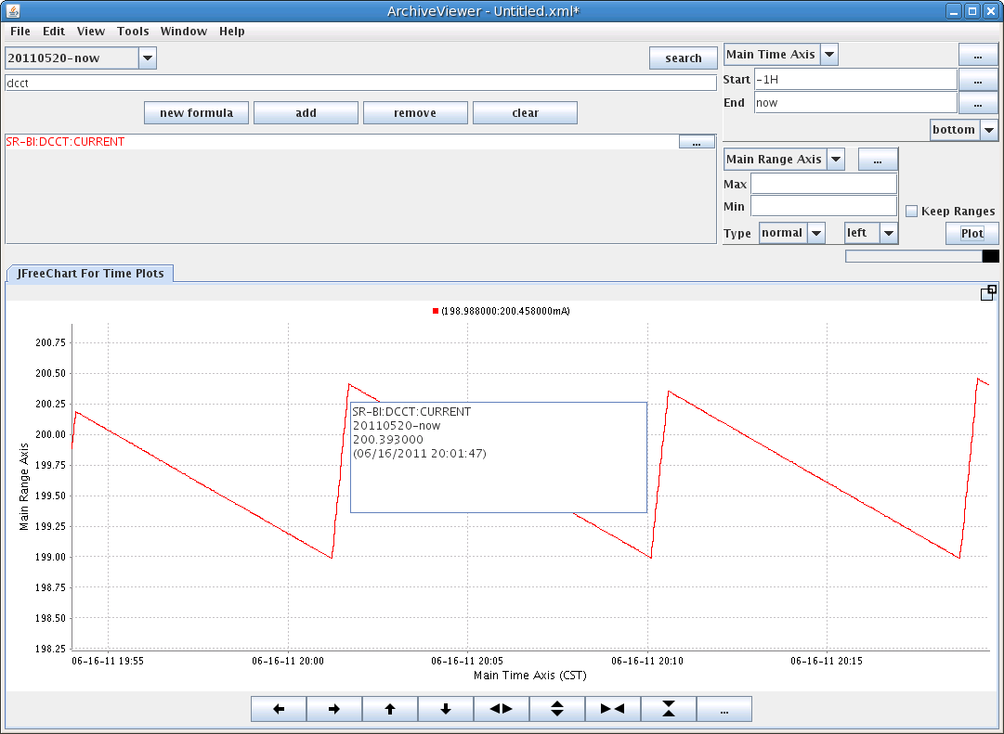
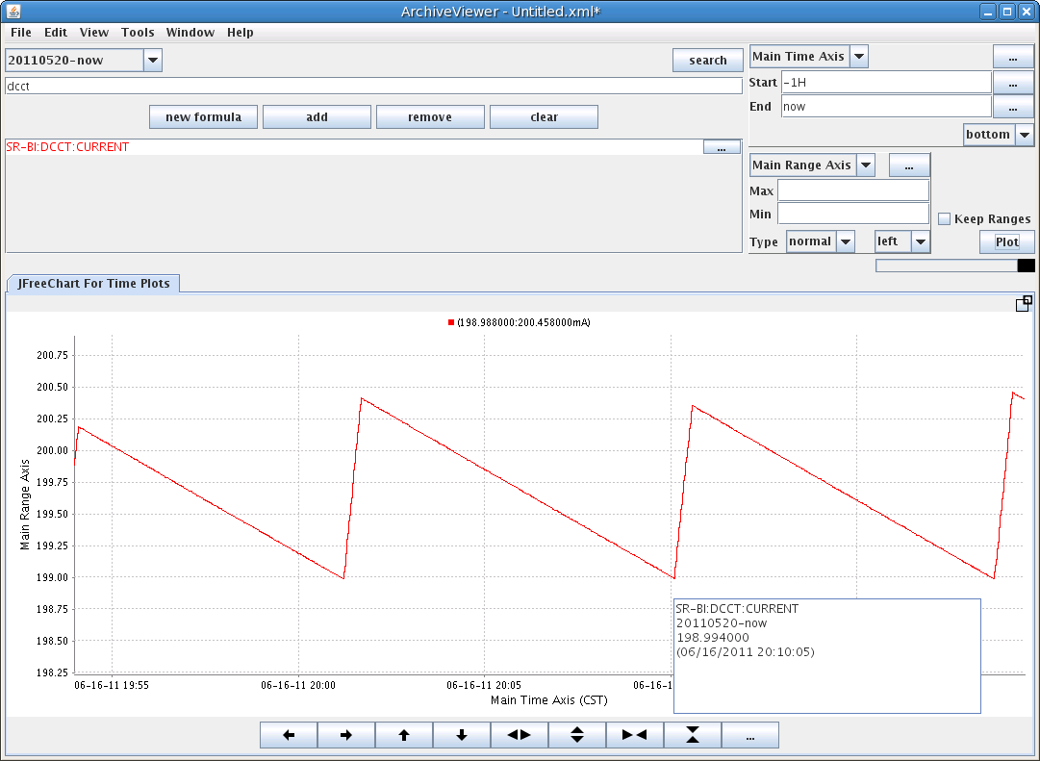
Refill
Injection period 10min with single bunch
Injection time 10s (20 bunches)

Slide 24
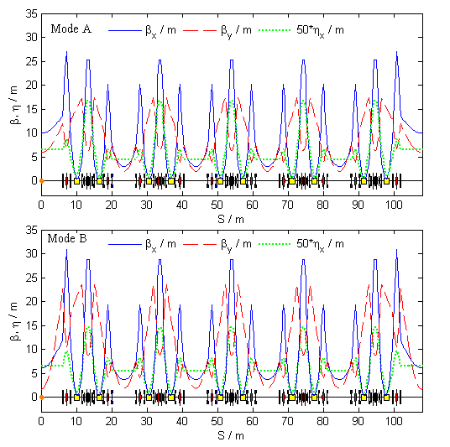
2. Lower Emittance Lattice mode
Parameter / unit | Ope. Mode | Mode A | Mode B
Tune (H, V) | 22.22, 11.29 | 23.31, 11.23 | 23.31, 11.23
Natural emittance / nm.rad | 3.89 | 3.51 | 2.88
Eff. Emitt. in LSS / nm.rad | 4.86 | 4.25 | 4.00
Eff. Emitt. in SSS / nm.rad | 5.17 | 4.58 | 4.15
Natural chromaticity (H, V) | -55.7, -17.9 | -69.9, -20.5 | -74.5, -26.7
Momentum compaction factor | 4.27×10⁻⁴ | 4.03×10⁻⁴ | 4.13×10⁻⁴
β_{x}, β_{y}, η_{x} at the center of LSS /m | 10.00, 6.00, 0.15 | 10.00, 6.00, 0.13 | 6.15, 1.71, 0.13
β_{x}, β_{y}, η_{x} at the center of SSS /m | 3.60, 2.50, 0.11 | 3.00, 2.00, 0.087 | 3.71, 1.90, 0.11

Slide 25
Lower emittance mode user’s operation
LOCO calibration，beta beating~0.40%/0.45%
Injection efficiency ~70%
Coupling~0.3%，Beam life time 17 hours@210mA
July 8 – 13, 2012, for users operation
Beam lines | Brightness | Other merit
BL08U | +20%
BL13W | - | Beam size decreased
BL14W | +50% | Ionization chamber I0 decreased
BL14B | +8% | Much stable
BL16B | +7% | Scattering background -10%
BL15U | +30% | Energy resolution
BL17U | -

Slide 26
3. Vertical Beam Size Control
Two important parameters
the spectral photon flux
spectral brightness
Vertical Beam size is important for the brightness
Recently, SLS, ASP and APS reported their veridical beam size
6.5um/2pmrad/8um

Slide 27
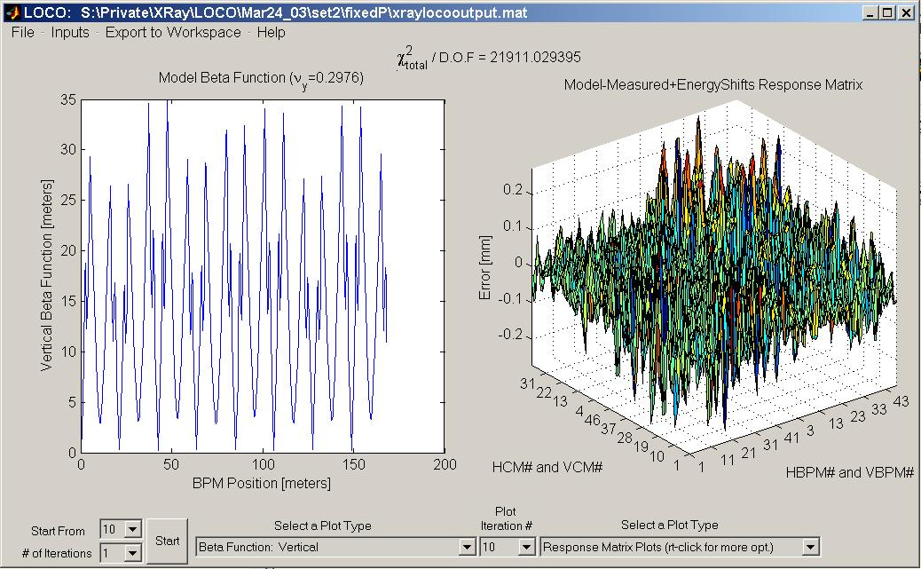
Fit By LOCO
LOCO Fitting Results
A crude estimate: shunting a horizontal corrector and watching the resulting vertical orbit ---off-Diagonal response matrix
RMS Tilt = 1.512420 [degrees]
RMS Vertical Dispersion = 0.003455 [m]
Mean Horizontal Emittance = 3.886847 [nm rad]
Mean Vertical Emittance = 0.017166 [nm rad]
Emittance Ratio = 0.441654%
The coupling of the lattice is measured by using a model which includes a number of non-existent (or ghost) skew quadrupoles.
equilibrium beam envelope in a
circular accelerator using Ohmi's beam envelope formalism

Slide 28
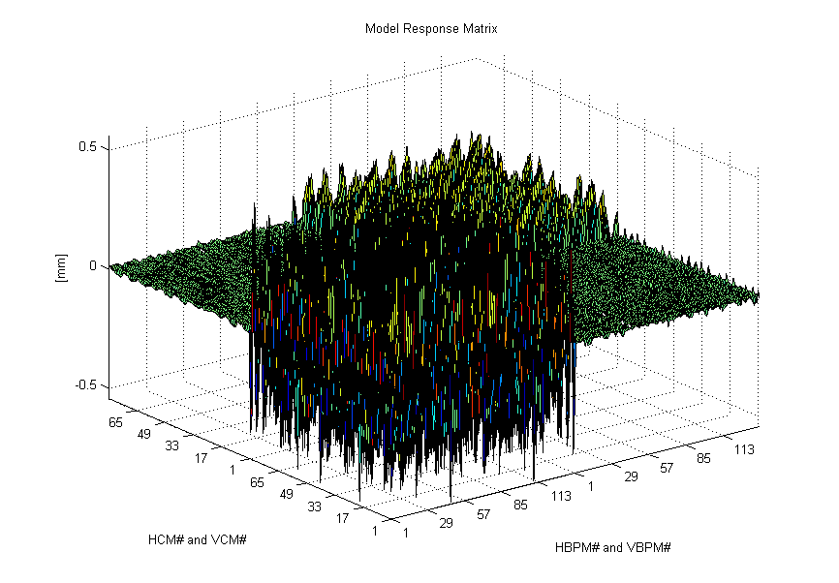
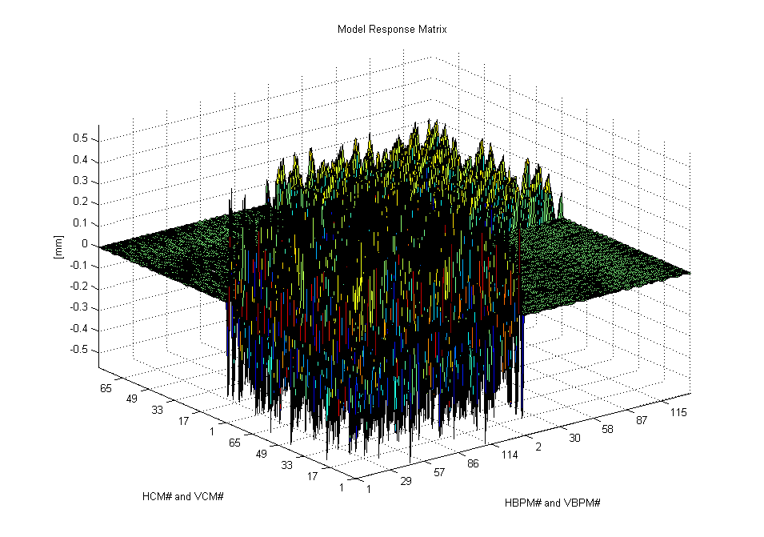
Decouple

Slide 29
Skew quadrupole strengths
In measurements
Used

Slide 30
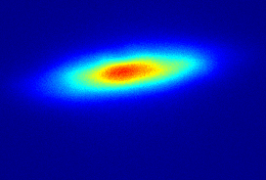
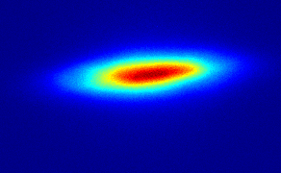
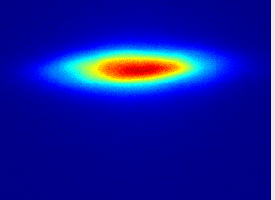
Correction results
Vertical Dispersion
Chi^2 = 1417
Life time (Hrs) | 32 | 24 | 22.5
Betatron Coupling | 0.29% | 0.106% | 0.013%
Coupling | 0.44% | 0.26% | 0.17%

Slide 31
Simulation
Initial Coupling 1.1%, rms vertical dispersion 37.7
Final Coupling 0.86%, rms vertical dispersion 12.3
by 19 skew quadrupoles
Final Coupling 0.09%, rms vertical dispersion 2.3
by 140 skew quadrupoles
More Skew quadrupole wings are needed!

Slide 32
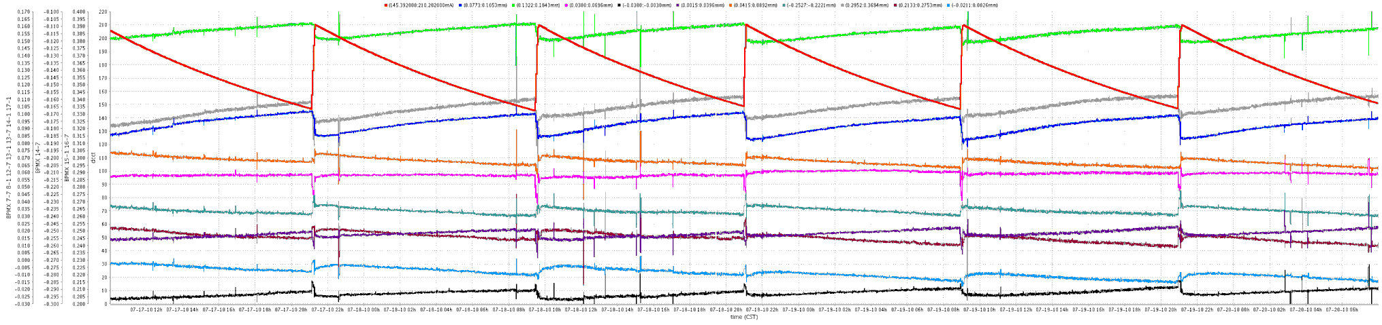
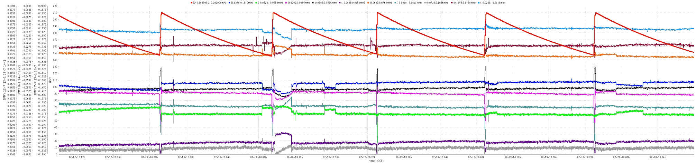
4. Orbit stability
Orbit stability During User Operation (Decay)
( BPM besides 5 IDs, 72Hours )
Horizontal : ~5 microns
Vertical : 1~2 microns

Slide 33
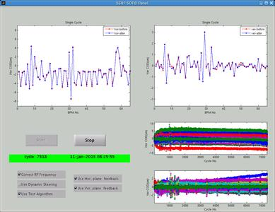
Orbit stability for top up operation by using SOFB only
  Horizontal/vertical plane ~0.56μm/0.25μm(12days)

Slide 34
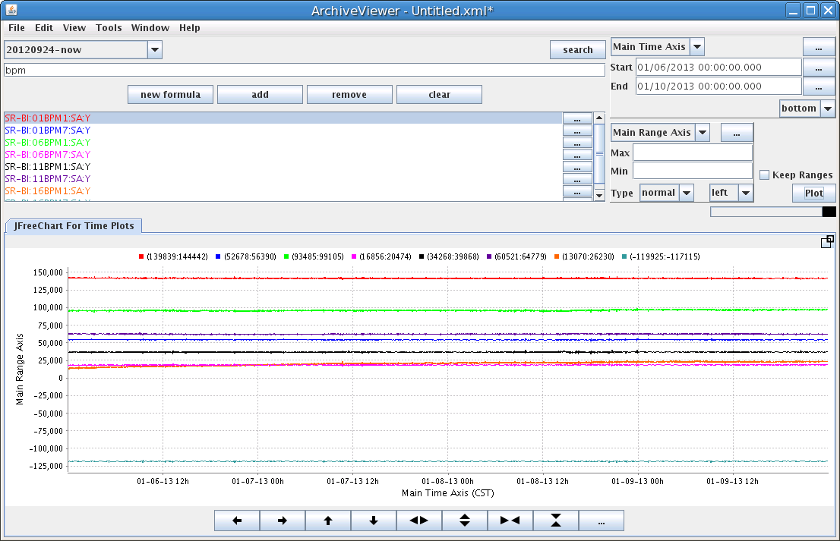
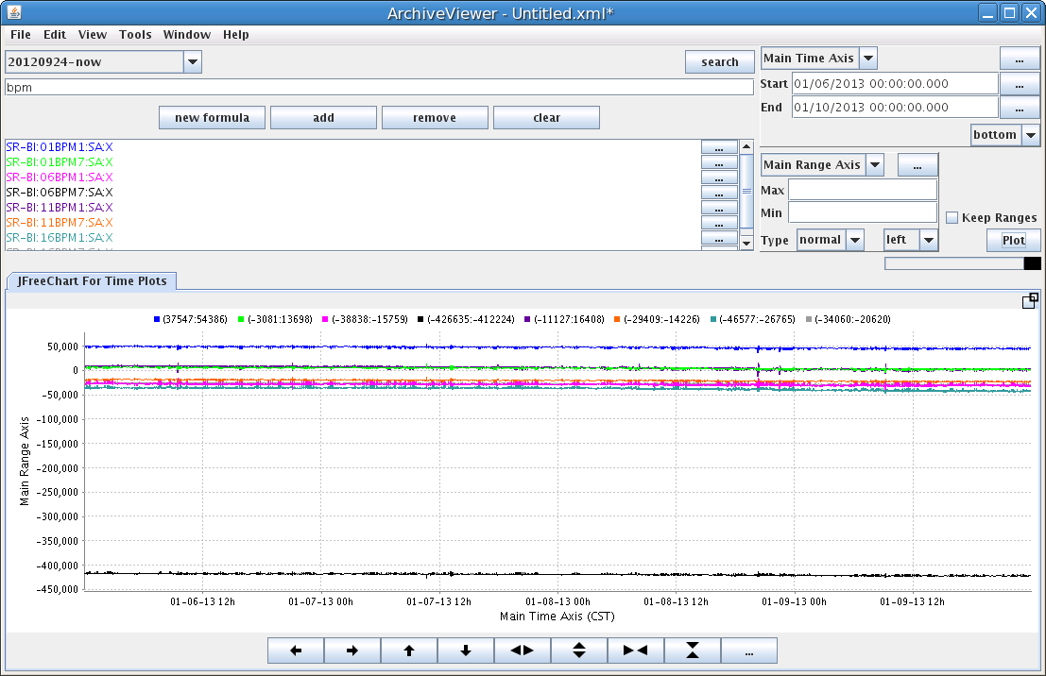
Horizontal ~ 0.56 um (RMS)
Vertical ~ 0.25 um (RMS)

Slide 35
Fast orbit feedback
System test
Orbit distortion less than 1um under 100Hz；
Orbit distortion less than 0.1um under 10Hz；
。

Slide 36
SOFB+FOFB+FB
Data exchange between FOFB and SOFB can suppress the orbit distortion less than 1um at decay mode
for top up mode, orbit stabilities are better than 0.3 microns in both horizontal and vertical.

Slide 37
5. ID commissioning
For most of the IDs, (5 existed IDs, newly installed 3 IVUs ) the influences are only on orbit distortion. The feed-forward method can solve their influence.
For a newly installed DEPU, it not only influence on orbit, but also on working point, coupling, dynamics aperture (injection efficiency)

Slide 38
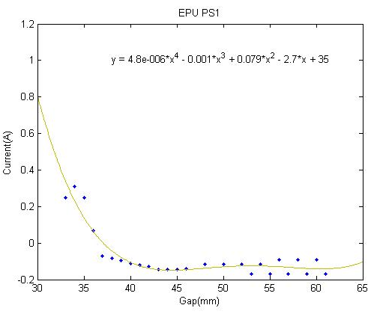
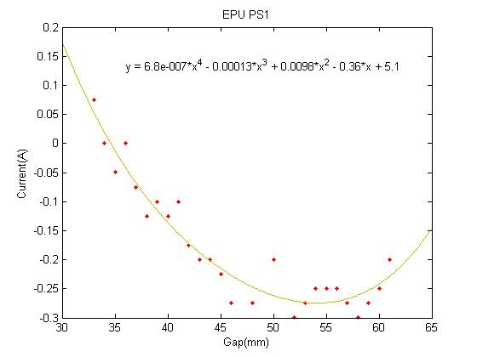
ID gap is controlled by user with feedforward
PS2
PS3
e⁻
PS4
PS1

Slide 39
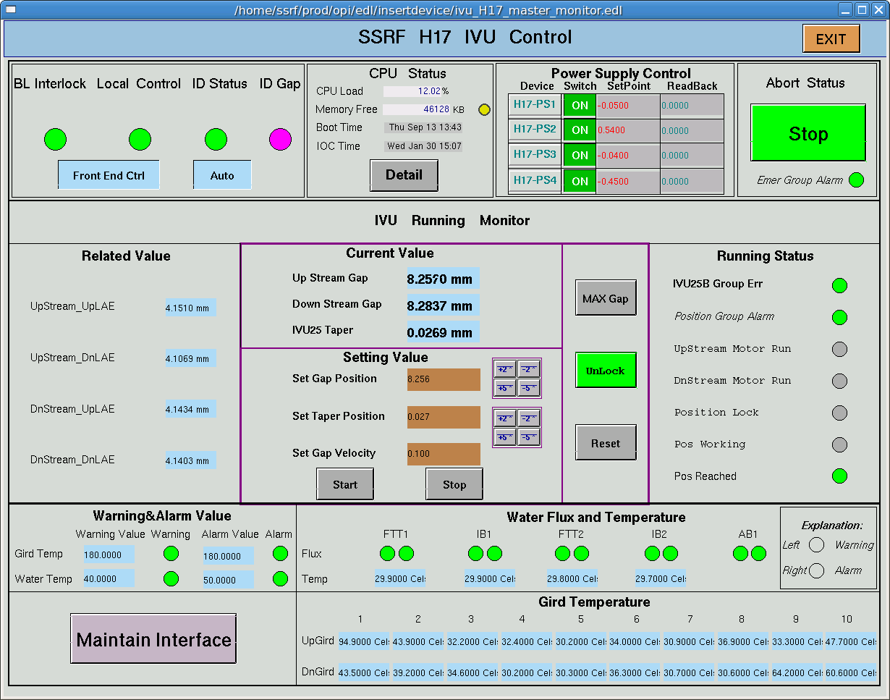
ID control interface

Slide 40
DEPU commissioning

Slide 41
For DEPU
cod : dipole error
Working point shift: quadrupole error
Coupling(vertical emittance): skew quadrupole field
Dynamics aperture: beam life (time/Injection efficiency)

Slide 42
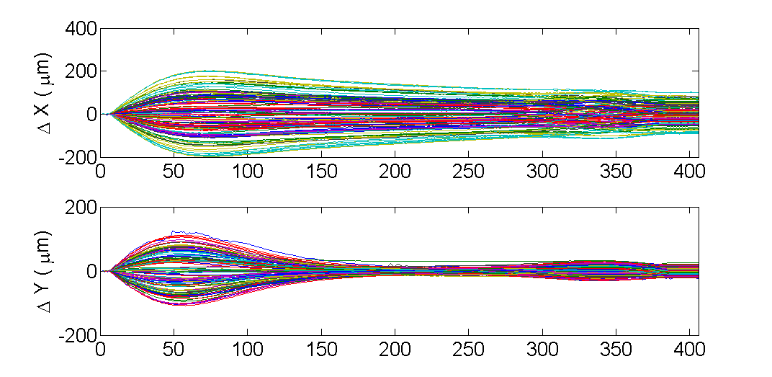
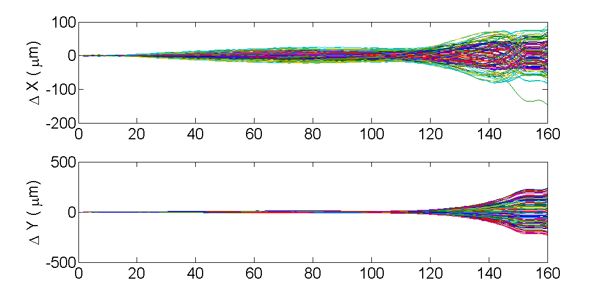
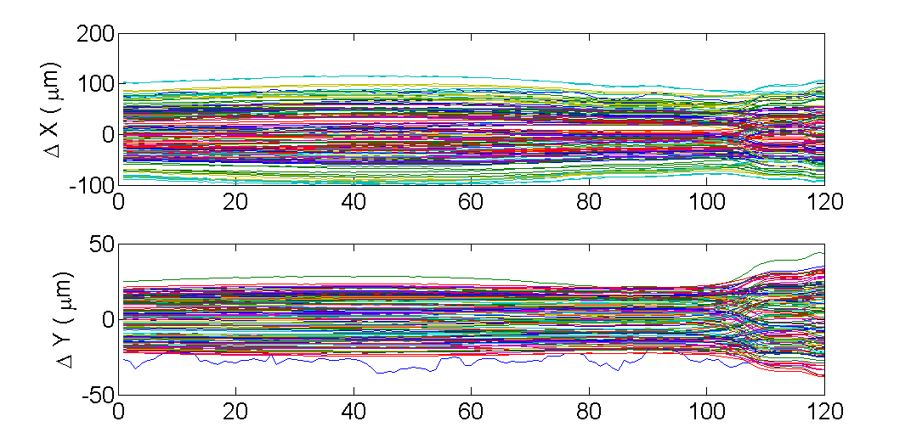
Cod caused by Gap and shift
Frame 467 67
U58 160 18
U148 118 22

Slide 43
cod
RMS：U148 gap
118 22
RMS：U148 shift
-60 60

Slide 44
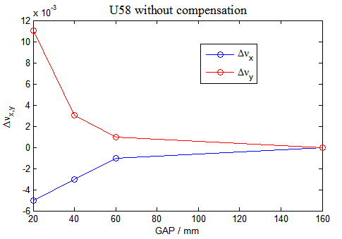
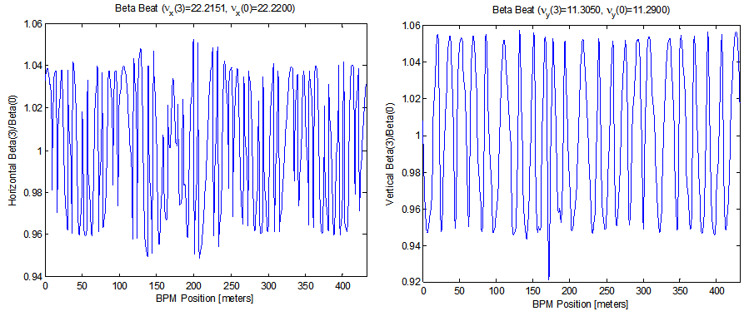

measured for (U58)
U58 GAP has big influence，shift’s can be neglectable
Minimum GAP，beta-beating>5%，tune shift～0.005
Linear optics compensation is needed

Slide 45
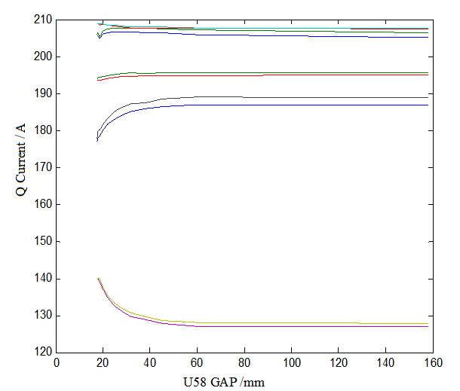
Measured tune shift
EPU 58
Gap | 160 | 60 | 40 | 20
Working point | .221/.293 | .220/.294 | .218/.296 | .216/.304
10 quads are employed for local compensation, beta-beating decrease to～0.7%（0.5%）at minimum gap，working point～0.001，but 6 quads are prefered.

Slide 46
Injection efficiency
EPU 58
Gap | 160 | 60 | 40 | 20
Injection efficiency | 93% | 86% | 77% | 62%
Shift influence can be neglectable
EPU 148
Shift | Injection rate
60 | 85%
50 | 88%
40 | 84%
30 | 86%
20 | 85%
10 | 86%
-10 | 88%
-20 | 87%
-30 | 89%
-40 | 84%
-50 | 90%
-60 | 86%
Gap | Injection rate
118 | 88%
90 | 89%
70 | 87%
50 | 86%
40 | 87%
30 | 90%
22 | 88%

Slide 47
coupling
EPU 58 Gap
Cell8 and cell9 6skew quads，at all gap, coupling can be corrected less than 0.5%
EPU 58 shift

Slide 48
Compensation of DEPU
Shimming
COD compensation
Working point compensation
Coupling compensation
Aperture compensation

Slide 49
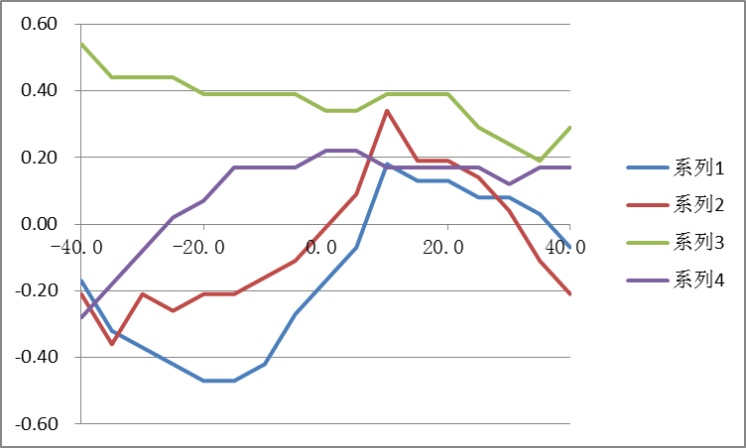
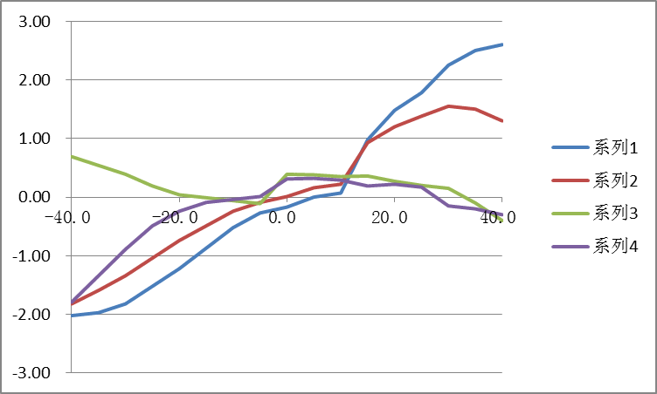
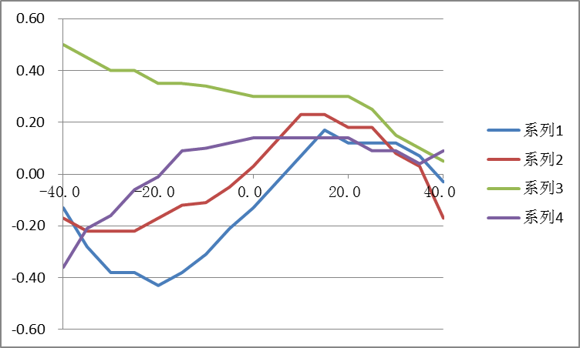
COD COMPENSATION
2H+2V correctors
08EPU
Gap = 56.06211
Gap = 52.62576
Gap = 59.74527

Slide 50
Working point compensation table
Q2
Q1
Q5
Q4
Q3
EPU58 gap 18- 160

Slide 51
dynamics aperture compensation
Harmonic Sextupole
Online multi-objective genetic algorithm
Aim：Injection efficiency
process：stochastic seeds-better one as the father generation – stochastic seeds
Injection efficiency：28% - 43% - 60% -70%-75%
Tian SQ A design strategy of achievable linear optics for a complex storage ring lattice

Slide 52
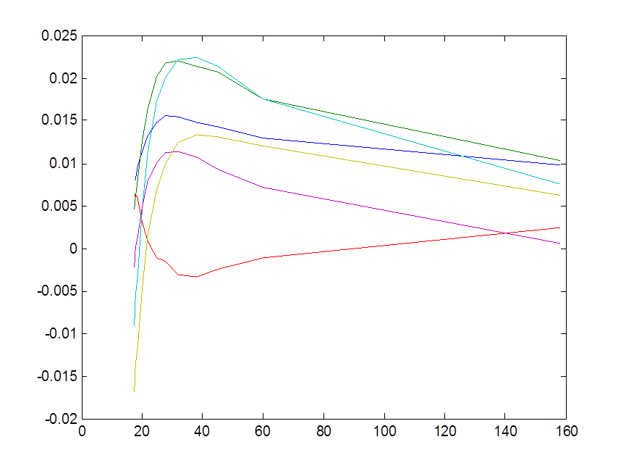
Coupling compensation – skew quadrupole
By employing cell8 and cell9 6 skew quadrupoles-- LOCO

Slide 53
Summary
1. SSRF had a very stable user’s operation during last more than four years.
Beam parameters and machine performance had been improved gradually.
Orbit stability and brightness had been improved dramatically after top up operation.
There are still a lot of works to do in order to get our goal: Availability > 98%, MTBF ~ 100 hours.
Challenges are waiting for us when more and more beamlines will be built.

Slide 54

Thank you

