Slide 1
CIRCE beamline at ALBA
variable polarization soft x-rays
for advanced photoelectron spectroscopy & microscopy

Slide 2
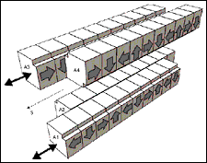
CIRCE layout
APPLE II
undulator
plane
grating monochromator
branching
refocusing
M4b
M3b
XSb
NAPP
PEEM
Side view
GR
M1
KB
4J
M3a
XSa
M2
NAPP
GR
M3a
M4b
Top view
XSb
M1
M2
4J
PEEM
M3b
XSa
KB

Slide 3
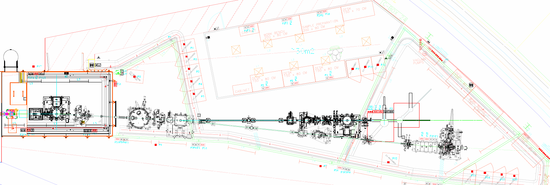
CIRCE layout

Slide 4
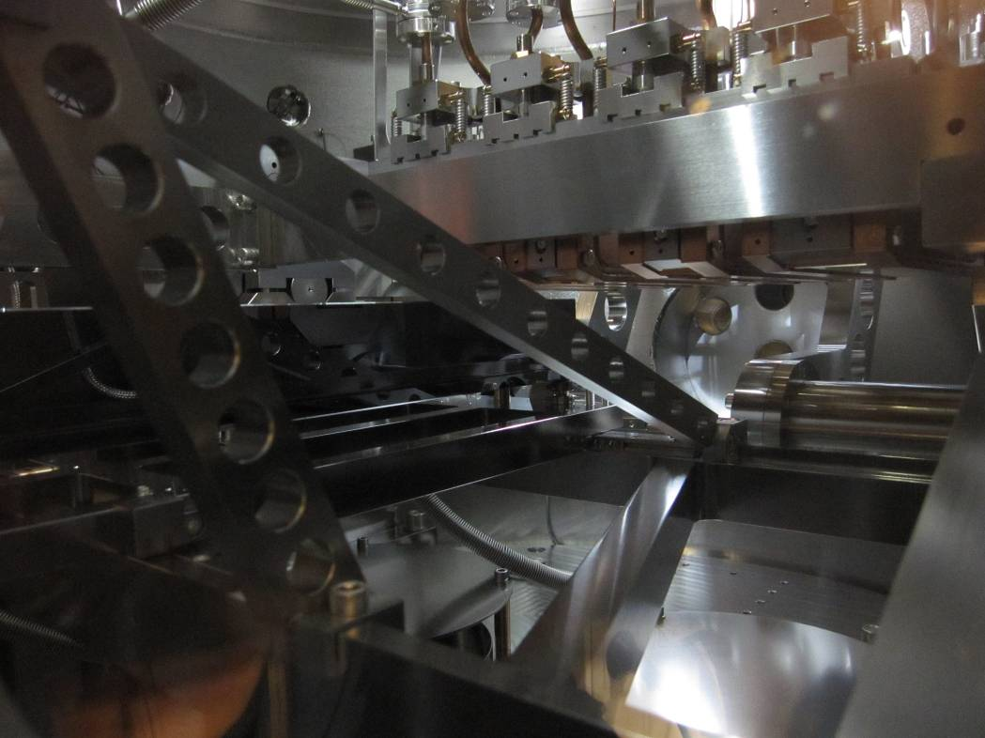
plane grating monochromator
90 - 2000 eV (3 exchangeable plane gratings)
R_{M2}
GR
θ
GR
R_{GR}
precision
“exit” slit
θ
M2
M2

Slide 5
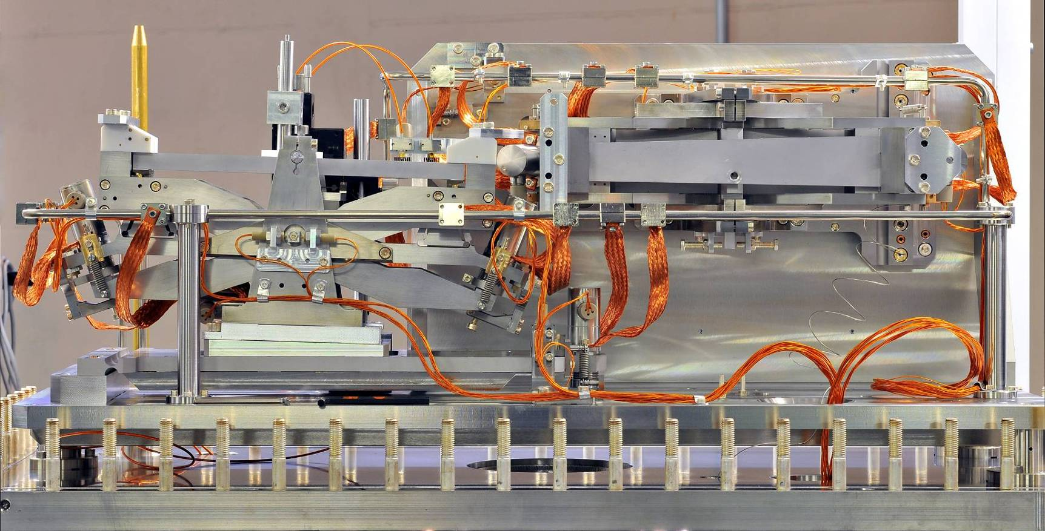
KB refocusing mirrors
demagnification ~ 4:1 H x 6:1 V
variable curvature (down to 44m mirror radius): variable spot size

Slide 6
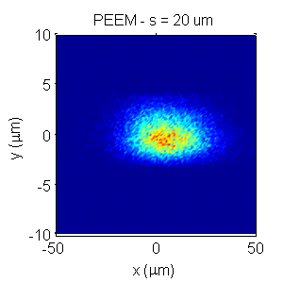
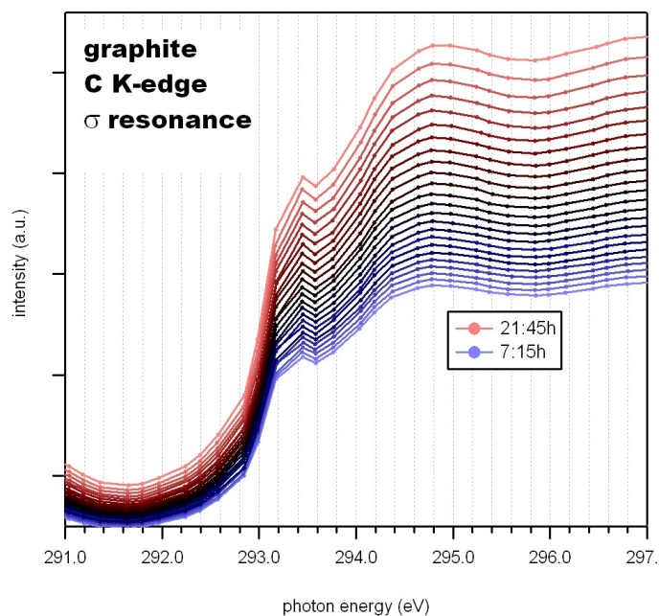
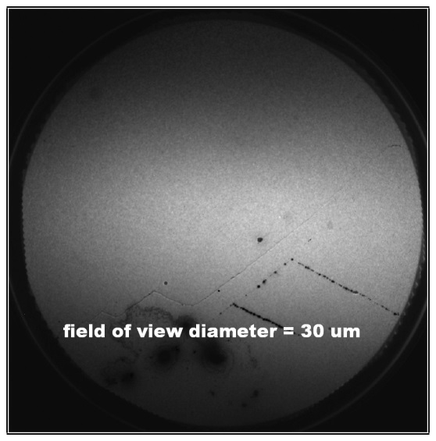
CIRCE performance
PEEM branch
flux (ph/s)
E/ΔE (20um) = 7000
resolution
FWHM = 3.2 x 36 μm² (V x H)
energy stability < 0.1 eV

Slide 7
Photoelectron spectroscopy
known photons
energy, polarization, incidence angle
+
analysis photo-electrons
energy, angle, (spin)
+
conservation rules
energy, momentum
”
sample properties
composition
chemical state
depth profile
electronic structure
magnetic properties
e⁻
e⁻
E_{kin}= hν – E_{binding}- Φ
e⁻
hν
monochromatic
surface sensitive

Slide 8
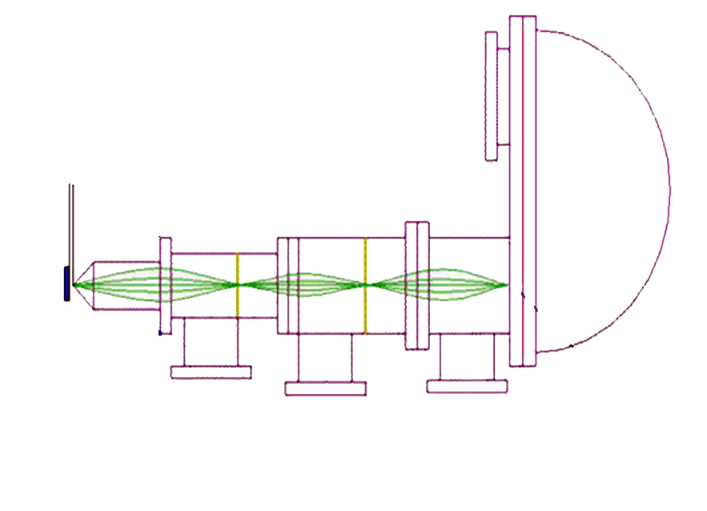
NAPP principle
Gap ≤ 1 mm
Aperture 2
Aperture 1
Sample
1
2
3
Entrance slit
into hemisphere
Differential pumping sections

Slide 9
PEEM principle
screen
projective
lens
x-rays
backfocal
plane
electron optics
e⁻
sample
objective
lens
scan hν: XAS, NEXAFS CHEMICAL contrast
variable polarization: XCD, XLD ORIENTATION contrast (e.g. magnetic)
+ electron energy analyzer: XPS SURFACE sensitivity, VALENCE BANDS
 chromatic aberration
+ electron gun: LEEM real time TOPOGRAPHY
diffraction: PED, LEED surface structure

Slide 10
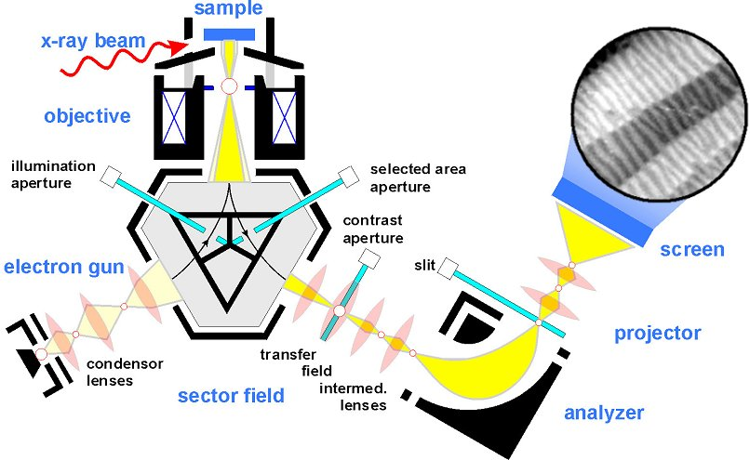
PEEM scheme
LEEM < 10nm
PEEM < 10nm
XPEEM < 30nm
ΔE < 0.2 eV
100 K < T < 2100 K
Th. Schmidt et al, Surf. Rev. and Lett. 5, 1287 (1998)

Slide 11
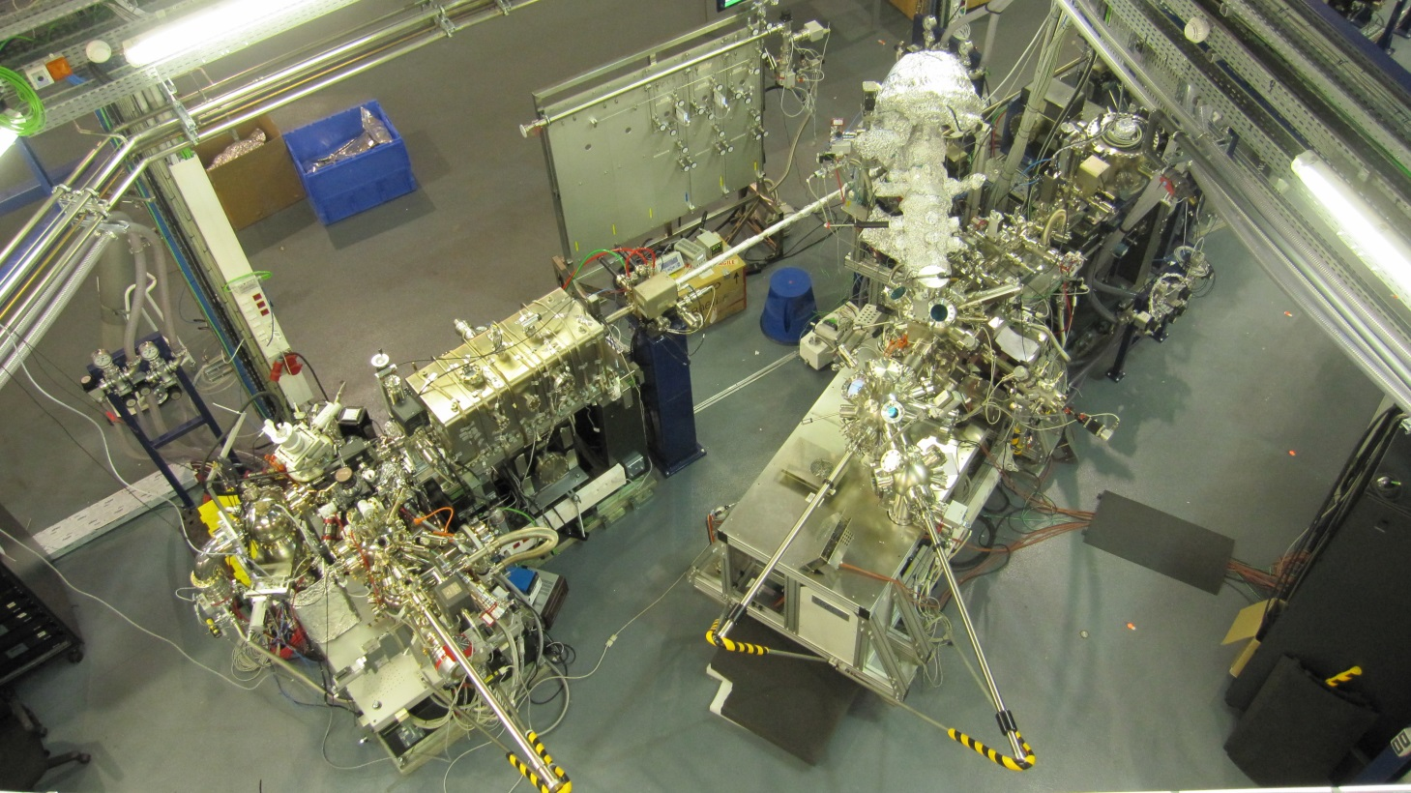

Slide 12
applications NAPP
in-situ heterogeneous catalysis
oxidation and corrosion processes
liquids in equilibrium with vapor pressure
liquid-liquid and liquid-solid interfaces
electrolytes, fuel cells
aerosols: radiation sensitive materials

Slide 13
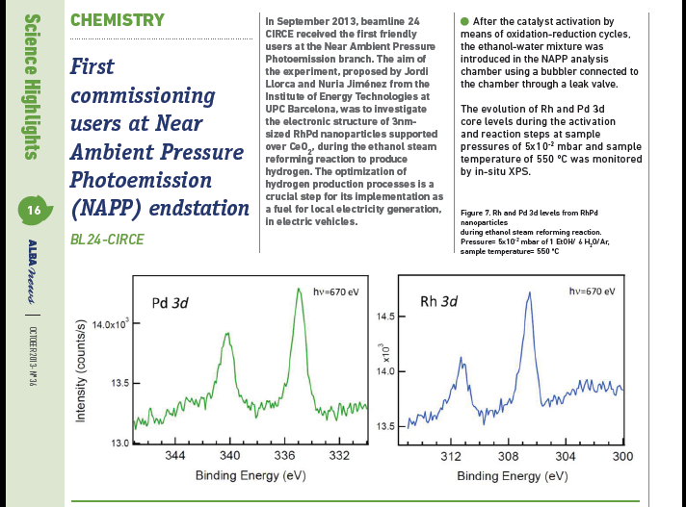
first NAPP results

Slide 14
applications XPEEM
chemistry of heterogeneous systems/processes
surfaces and thin films: film growth, phase transitions, structural domains, strain
nanostructures, materials science
magnetism: domain structure, multilayers, magnetic structure of low dimensional systems
limitations: UHV, samples relatively flat & conductive

Slide 15
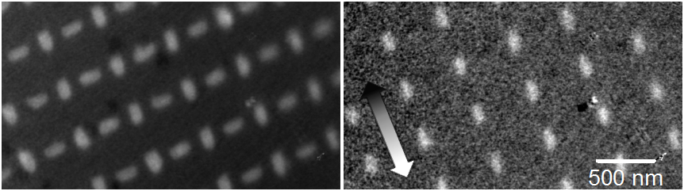
some PEEM results
Magnetic (XMCD) imaging with 20 nm lateral resolution
NiFe nanostructures with magnetization along their long axes
Fe L3
Fe L3
Si background
chemical contrast
magnetic contrast
XMCD image highlights structures with magnetization along the beam direction (white) and
the structures with magnetization ┴ to the beam disappear into the background (gray)
Sample courtesy of P. López-Barberá & J. Nogués (ICN Barcelona) and J. Perron & L. Heydermann (PSI Switzerland).

Slide 16
some PEEM results
Magnetic spectromicroscopy on submicrometer islands
Fe-L edge
M. A. Niño, IMDEA Nanociencia
XMCD-PEEM scans: a spectrum can be obtained
from each pixel

Slide 17
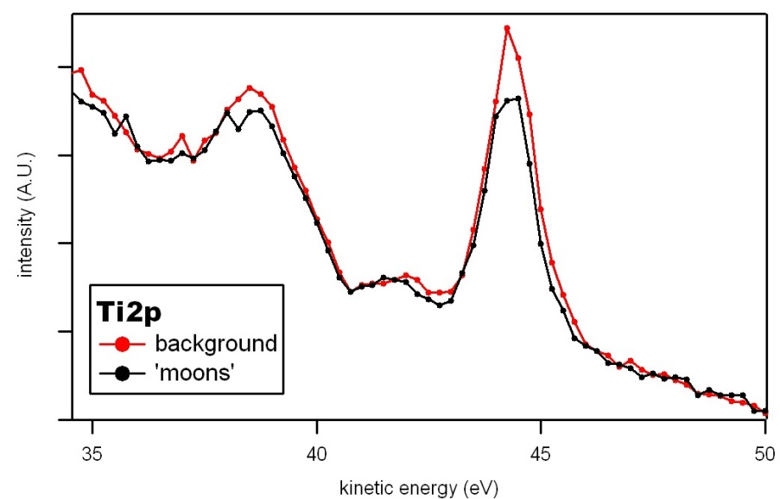
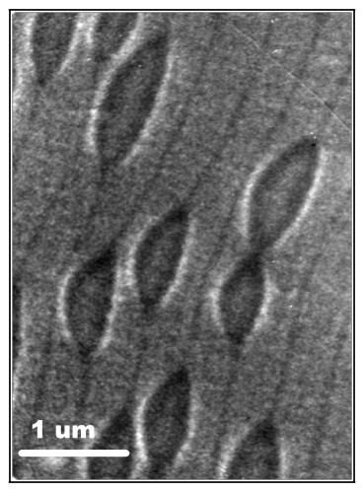
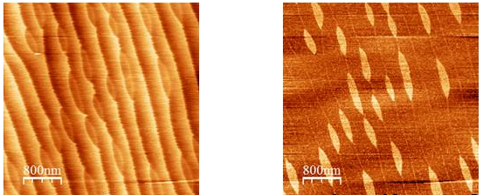
some PEEM results
Self assembled distinct termination
areas on SrTiO₃(100):
MEM image:
- SrO/TiO₂ areas
- steps
XPEEM spectromicroscopy at min electron escape depth confirms surface SrO vs TiO₂
AFM: topography (left) & lateral force (right)
Work function difference from MEM-LEEM transition shift < 70 meV
J. Fontcuberta, C. Ocal, E. Barrena, S. Matencio (ICMAB), Oct 2012

Slide 18
thanks
Carlos Escudero, BL Postdoc
Michael Foerster, BL Scientist
Virginia Pérez-Dieste, BL Scientist
Fulvio Becheri, BL Controls
Nahikari González, BL Engineer
José Prieto, BL Technician
and…
Josep Nicolás, Transversal Support Section Head
Eric Pellegrin, Physics Section Head
Juan Reyes, Visiting Student
WITH CRUCIAL SUPPORT FROM ALL THE DIVISIONS

