Slide 1
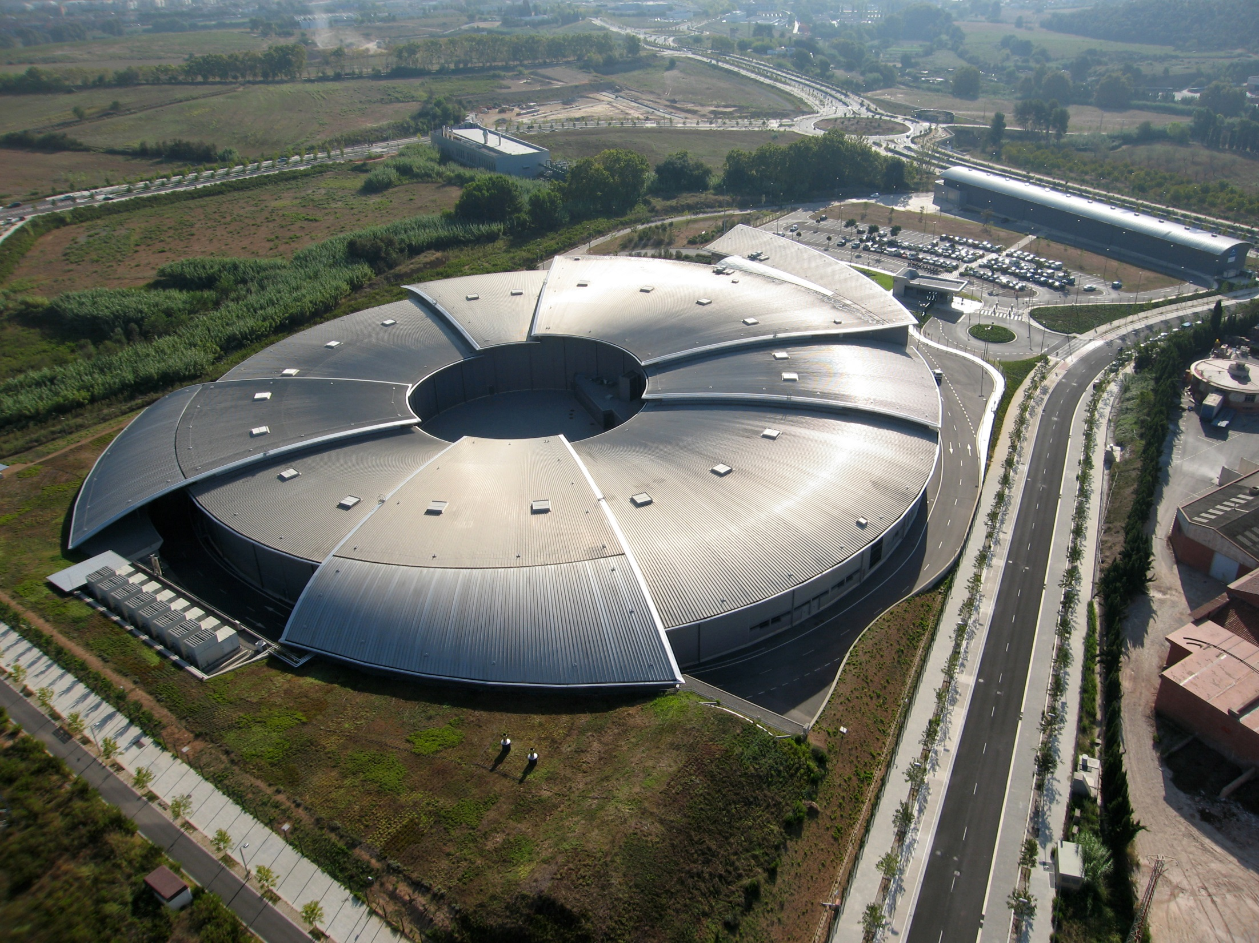


Possibilities for investment
in new beamlines at ALBA
Gastón García
1st ALBA-SSRF workshop
Barcelona, December 2013
1
Notes:
R. Pascual
1

Slide 2
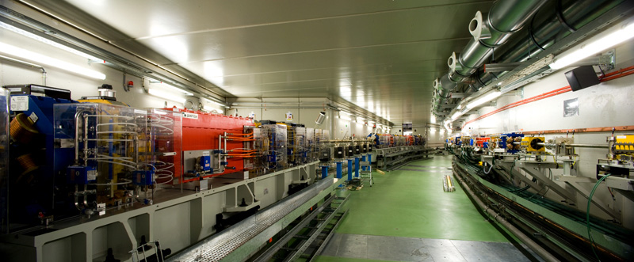
ALBA key parameters:
Energy: 3 GeV
Current: 250 mA
Emmitance: 4.4 nm rad
Operation mode: top-up
2

Slide 3
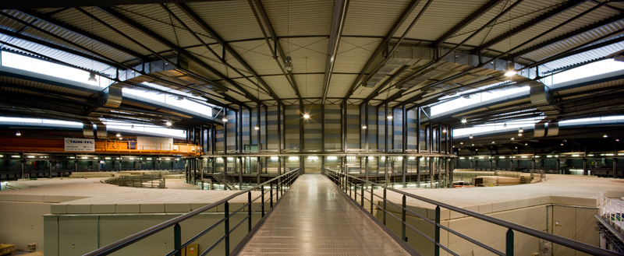
ALBA output ports:
3 long (8 m) straights
12 medium (4 m) straights
2 short (2.6 m) straights
17 dipoles
3

Slide 4
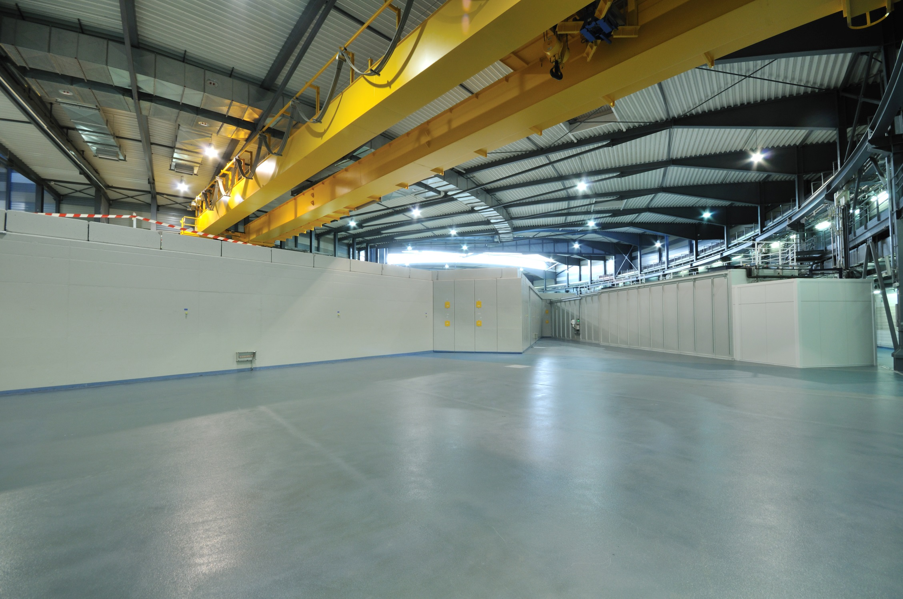
ALBA ports available:
3 long (8 m) straights
6 medium (4 m) straights
2 short (2.6 m) straights
15 dipoles
4

Slide 5
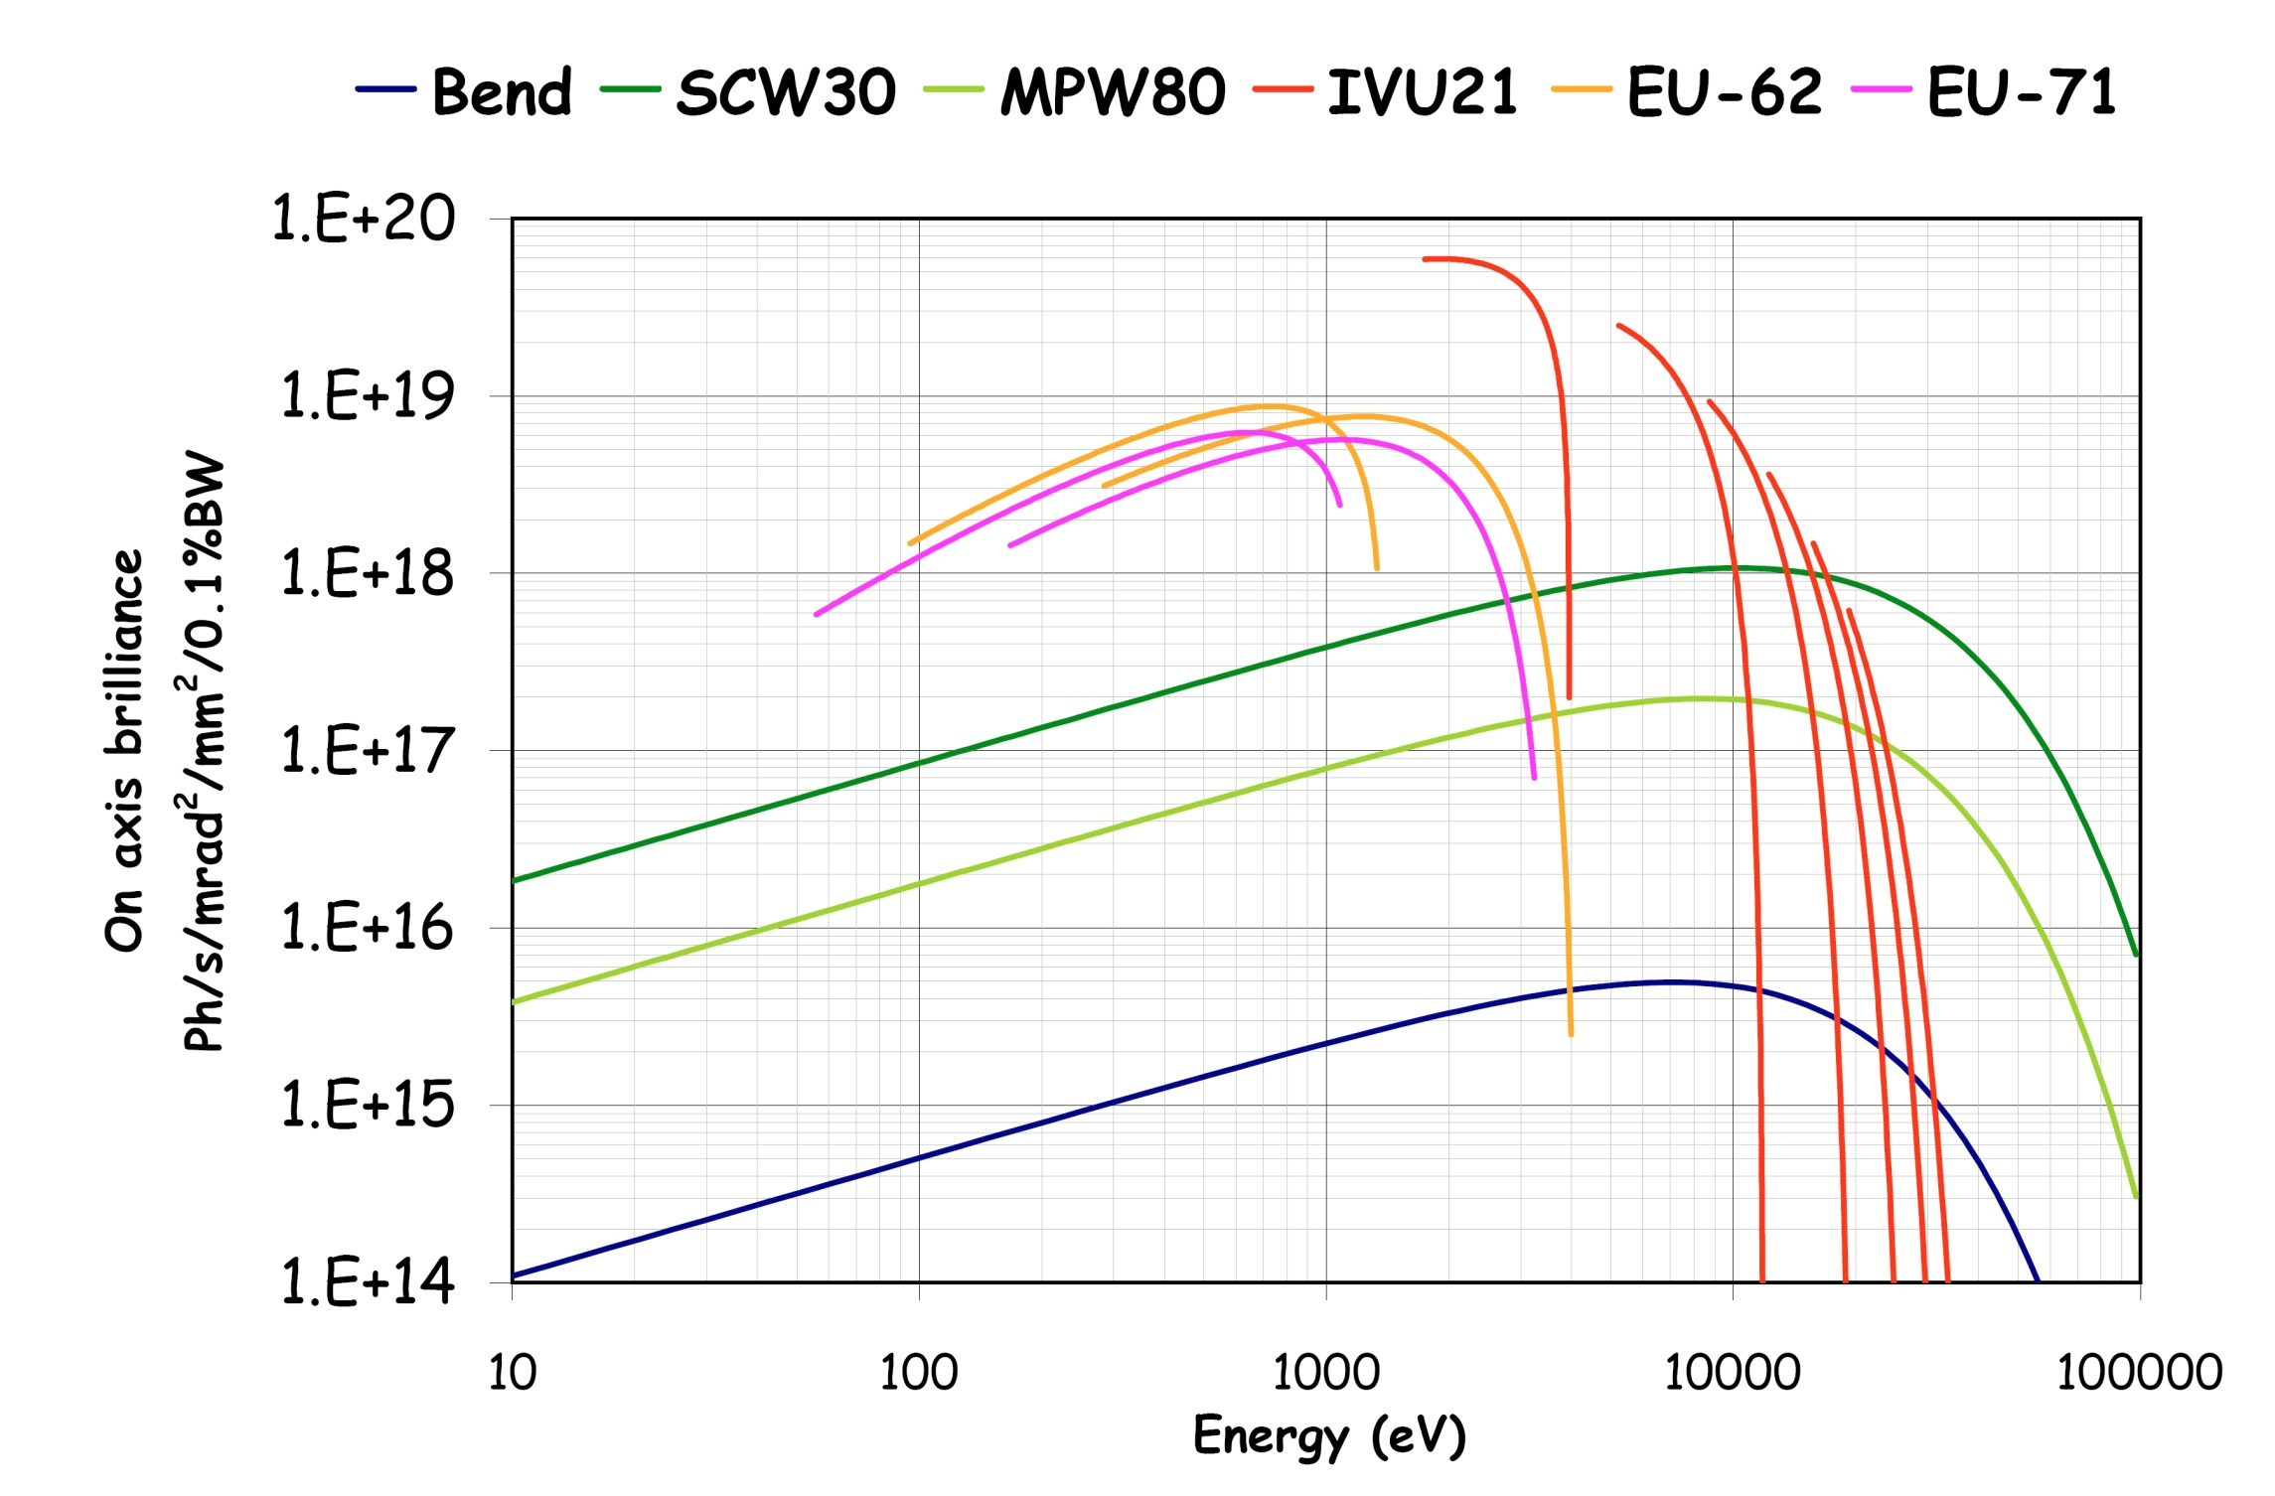
Brilliance at 250 mA
5

Slide 6
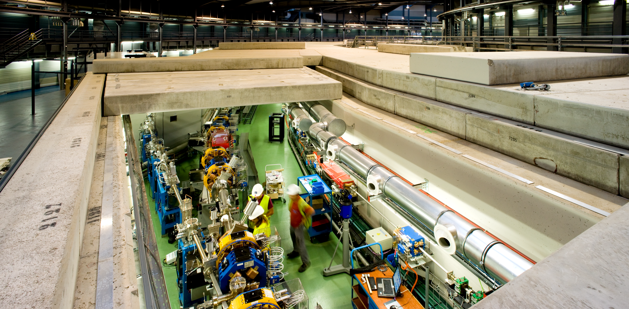
6

Slide 7
16 secciones rectas
8m, 4.4m and 2.6 m
Booster: 3 GeV, 250 m
4 fold symmetry
Storage ring: 268 m
double bend achromat lattice
16 cells with 4 fold symmetry
Linac: 100 MeV
At 3 GHz
Repetition rate of 3Hz
7

Slide 8
Port | Beam-line | Experimental techniques | Scientific applications
4 | MSPD (SCW-30) | - High resolution powder diffraction. - High pressure diffraction | Structure of Materials, Time resolved diffraction
9 | MISTRAL (BM) | Soft X-ray full field transmission X-ray microscope. Optimized on the water window | Cryogenic tomography of biological objects. Spatially resolved spectroscopy
11 | NCD (IVU-21) | High Resolution Small and High Angle X-ray Scattering/Diffraction | Structure and phase transformations of biological fibers, polymers, solu-tions. Time resolved X-ray studies
13 | XALOC (IVU-21) | X-ray diffraction from crystals of biological macromolecules | Protein crystallography, with particular emphasis on large unit cell crystals
22 | XAS (MPW-80) | - EXAFS, XANES, Quick-EXAFS - In situ catalytic cell | Material Science, Chemistry, Time resolved studies
24 | CIRCE (EU-62) | - Photoemission microscopy (PEEM) - Near atmospheric pressure photoemission (NAPP) | Nano-science and magnetic domain imaging (PEEM). Surface chemistry (NAPP)
29 | XMCD (EU-71) | - Circular Magnetic Dichroism - Resonant Magnetic Diffraction | Magnetism, surface magnetism and magnetic structure
8

Slide 9
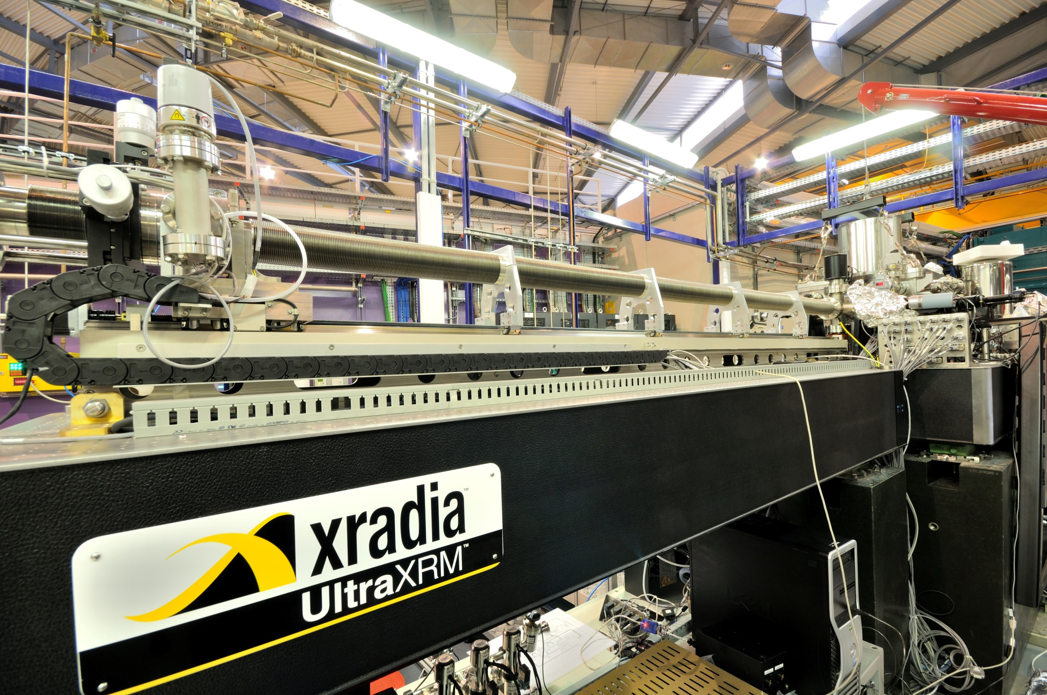
9

Slide 10
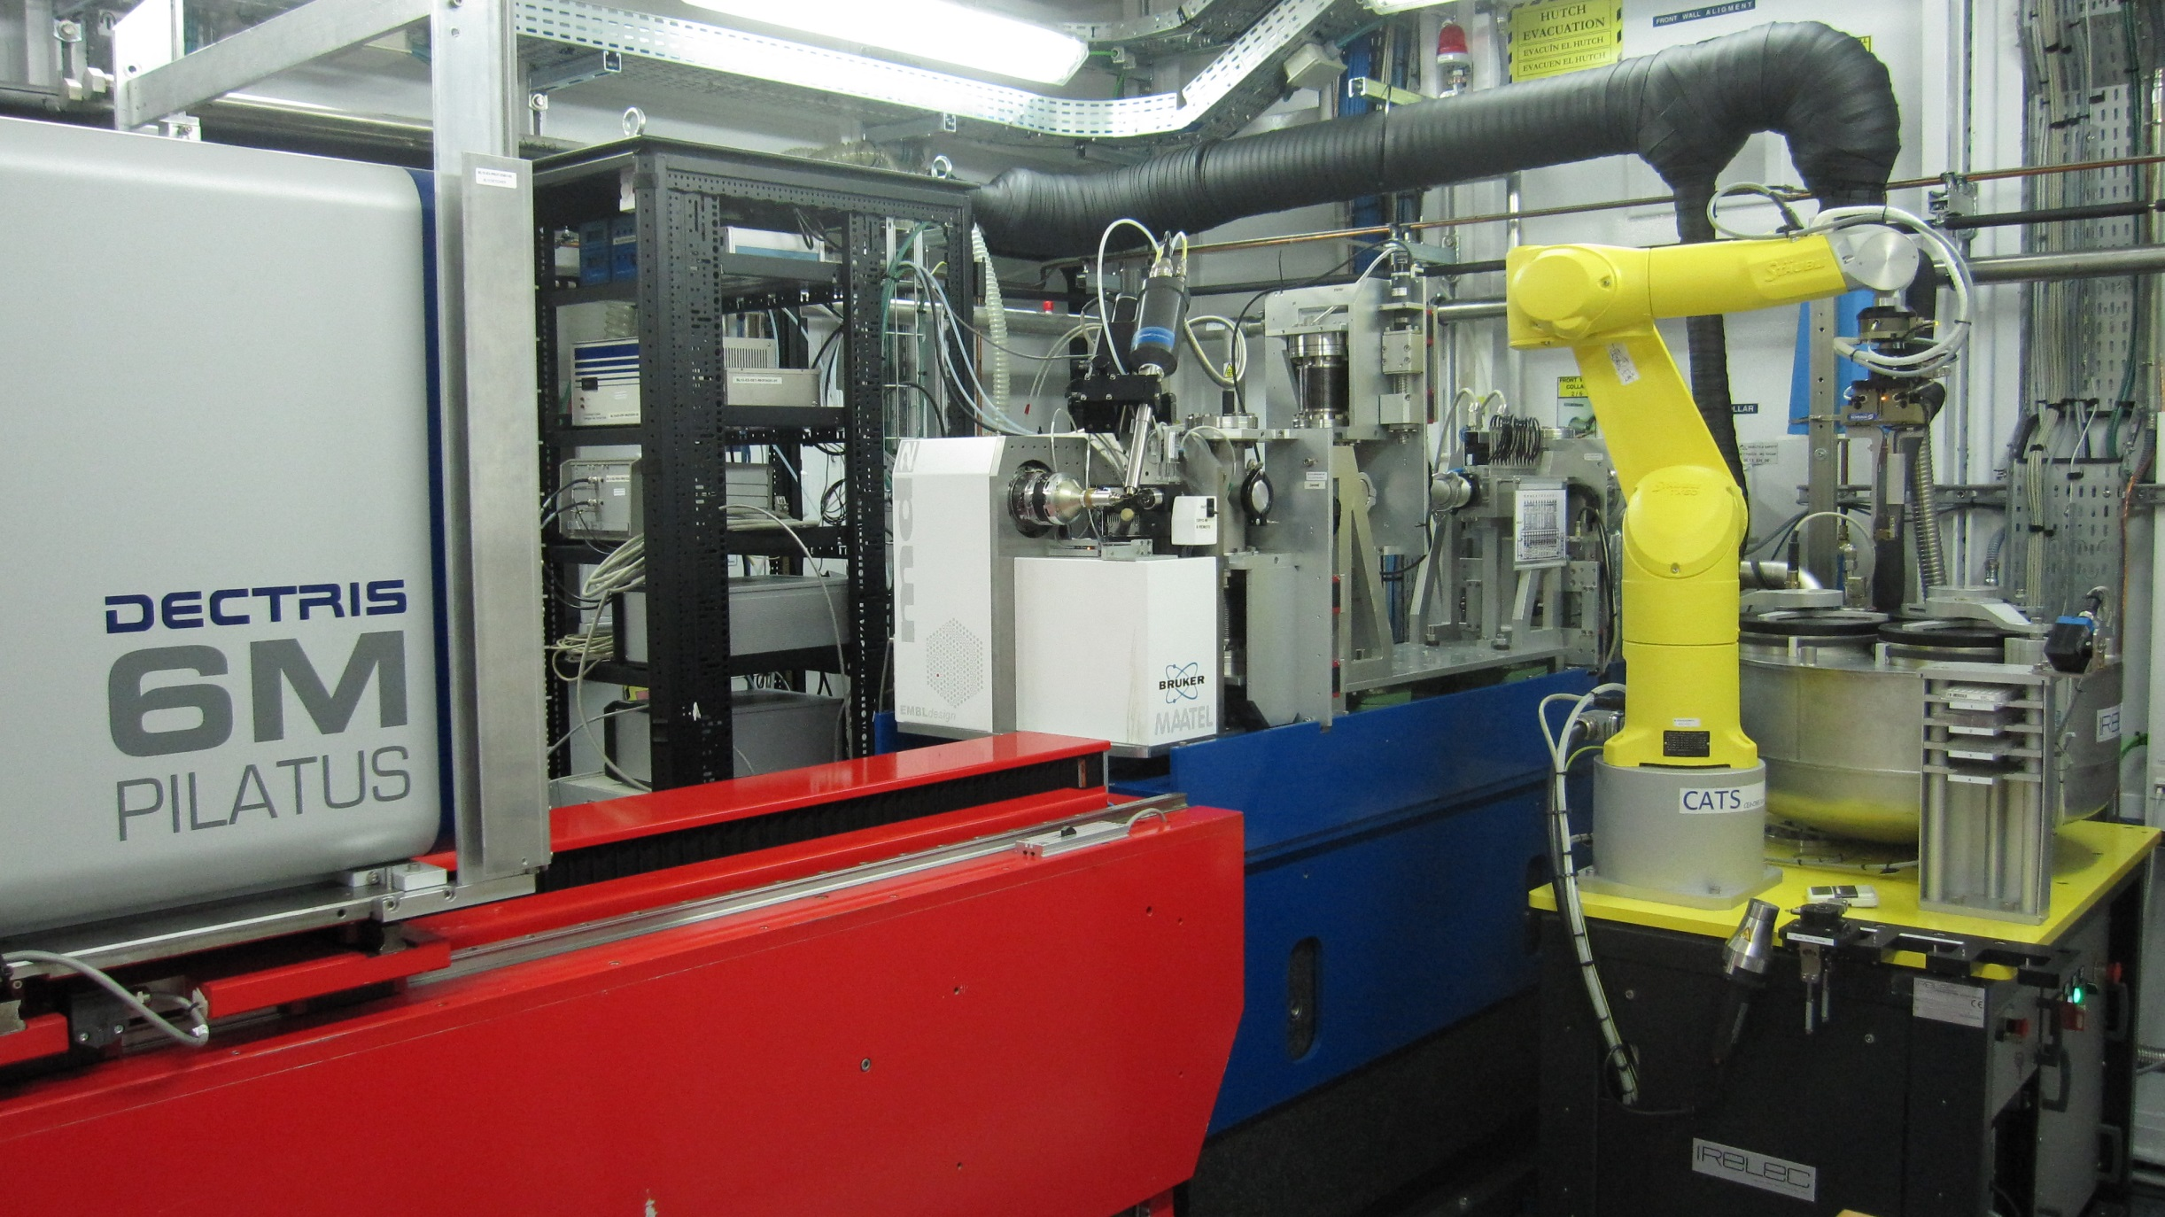
10

Slide 11
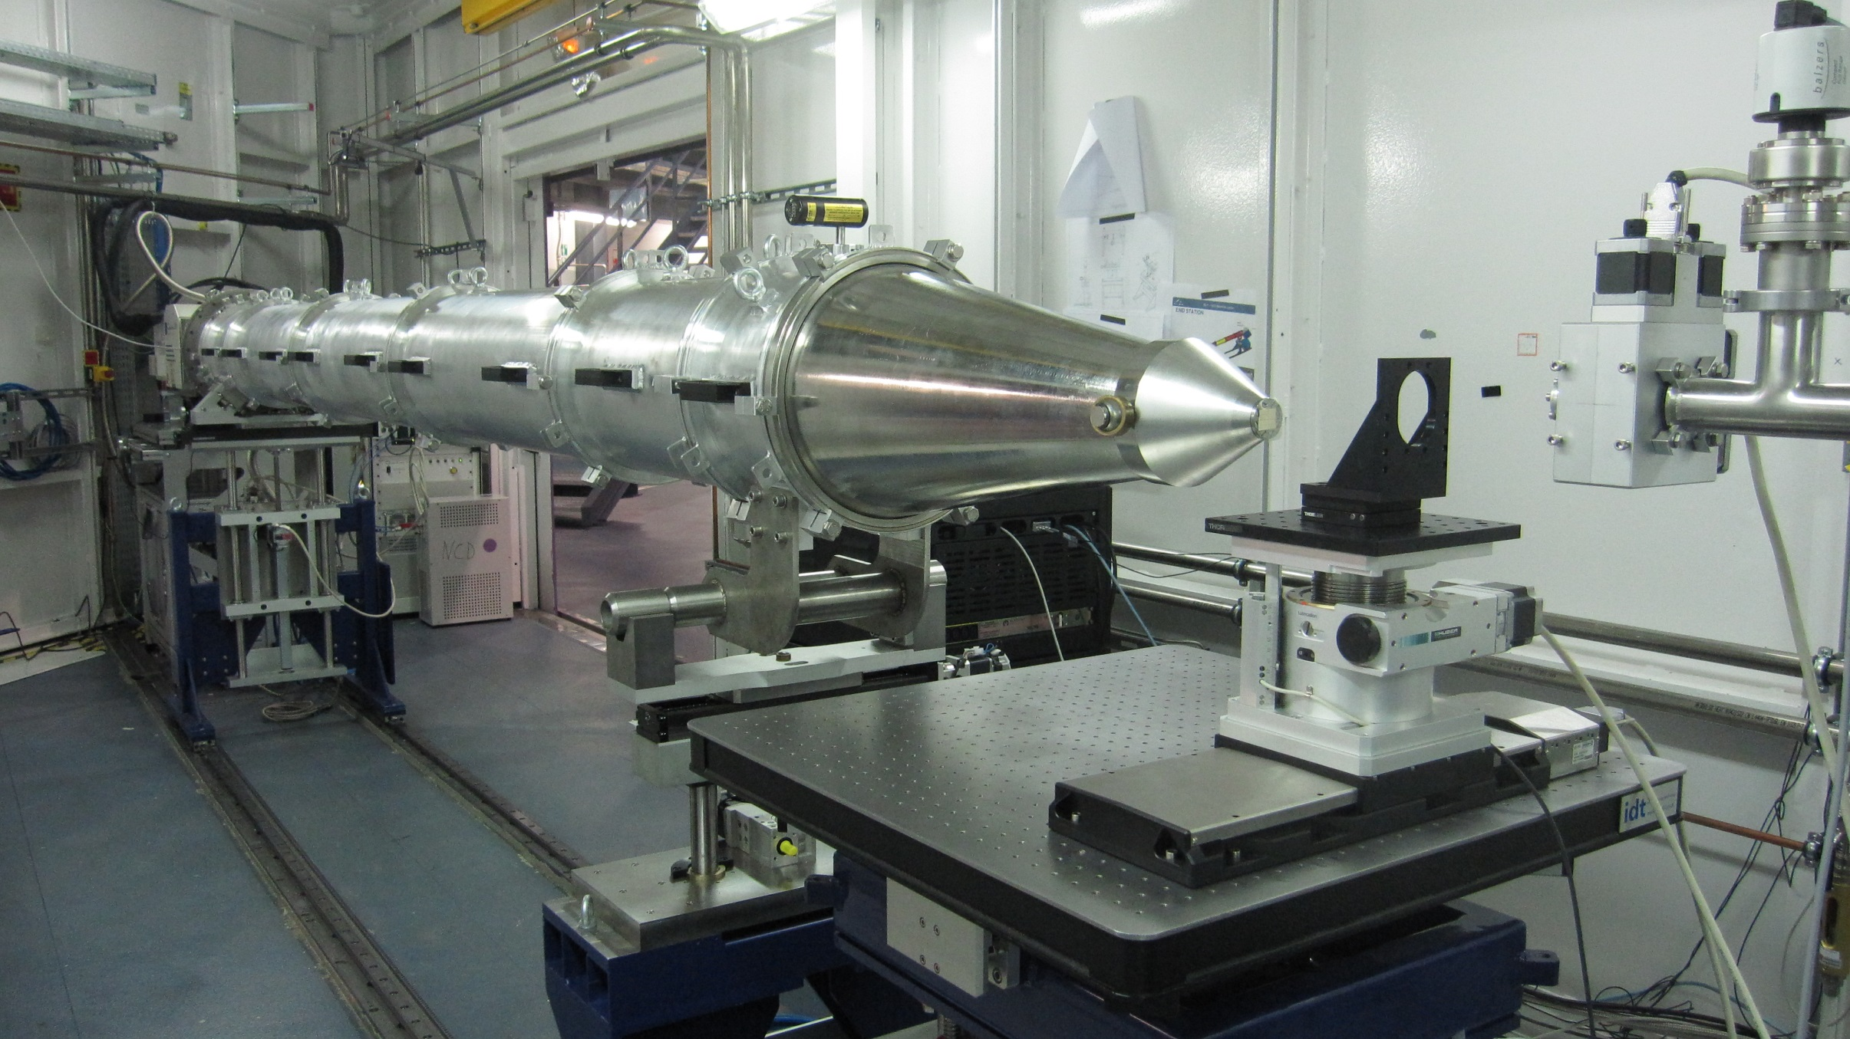
11

Slide 12
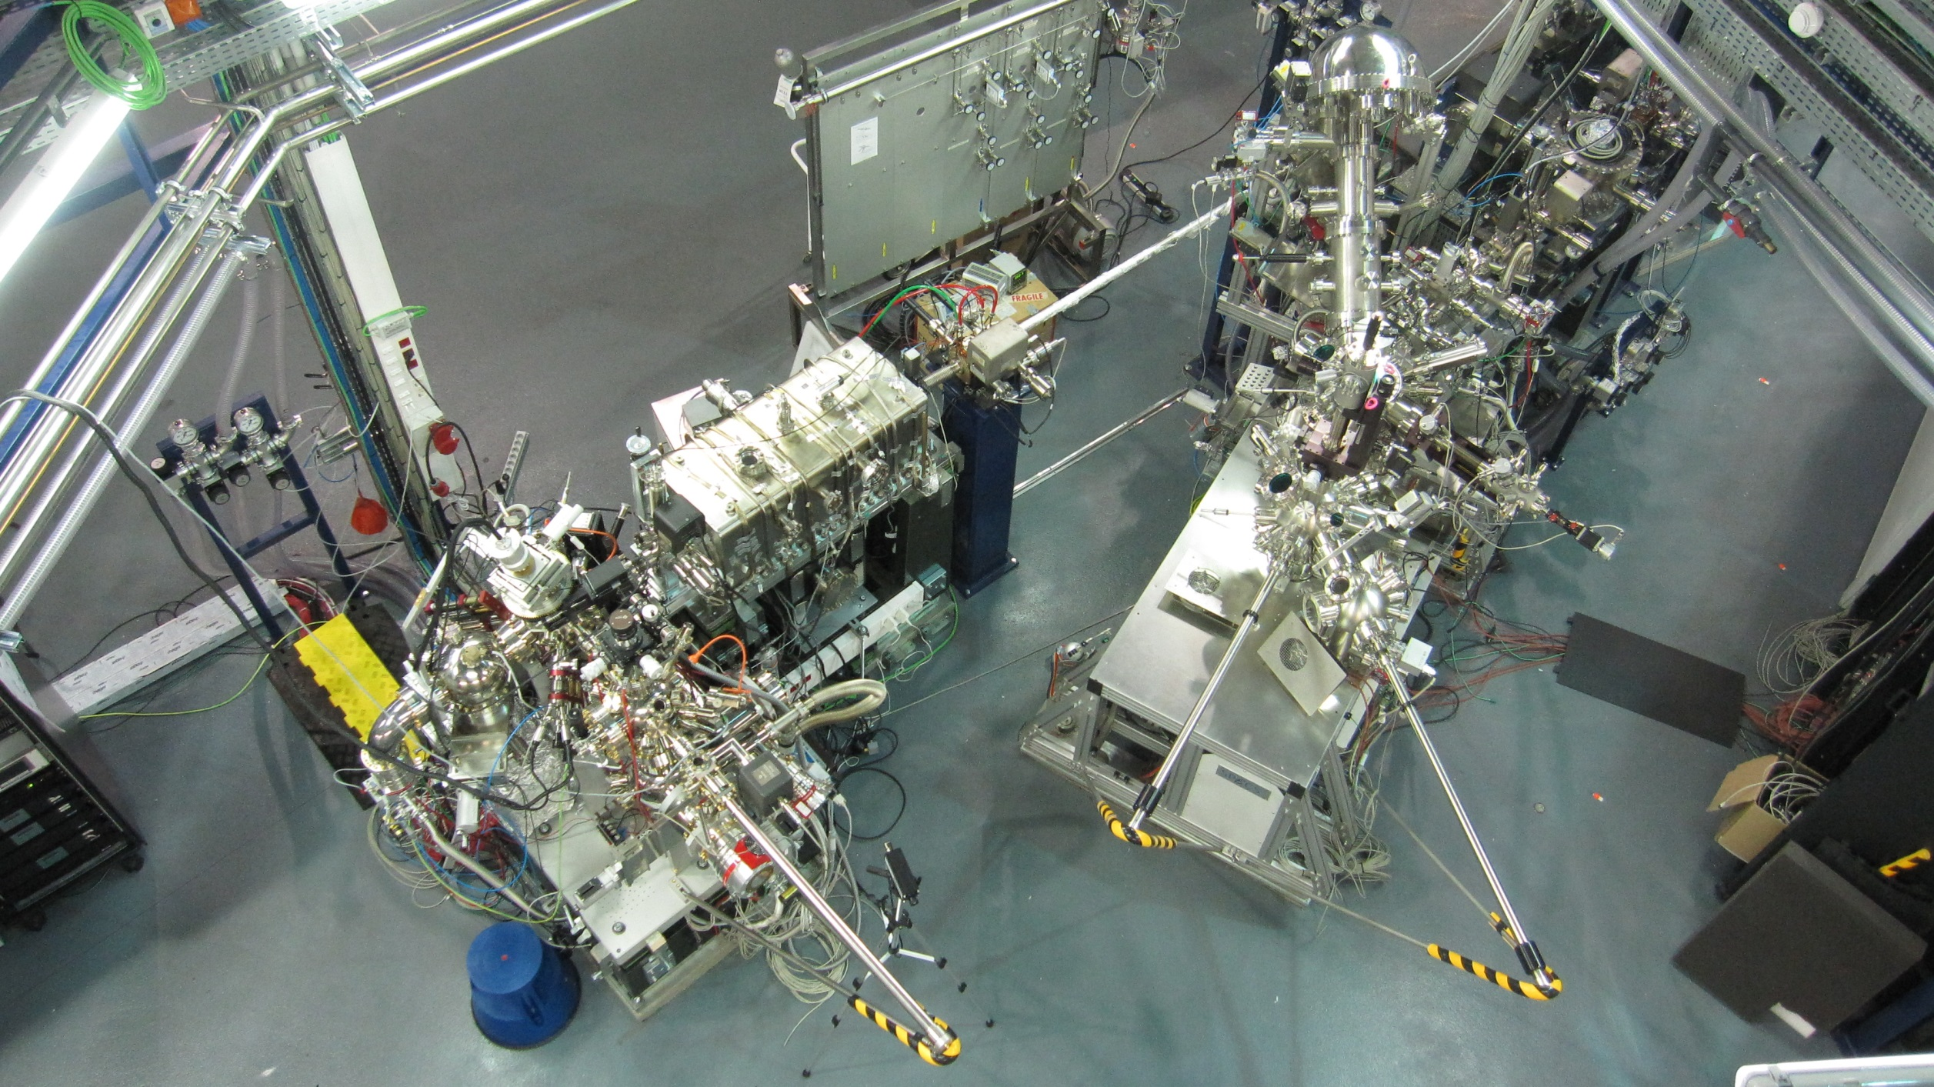
12

Slide 13
Distribución de usuarios en ALBA
13

Slide 14
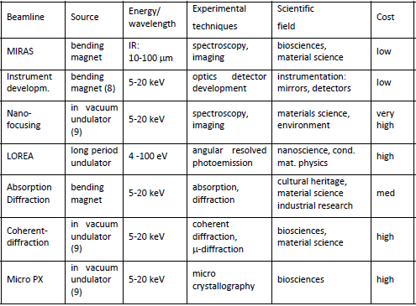
Plans for new ALBA BLs (2013-20)
14

Slide 15
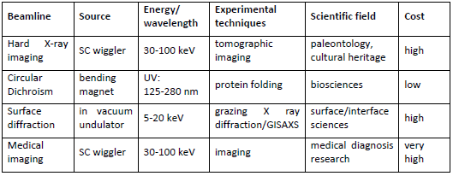
Plans for new ALBA BLs (2013-20)
15

Slide 16

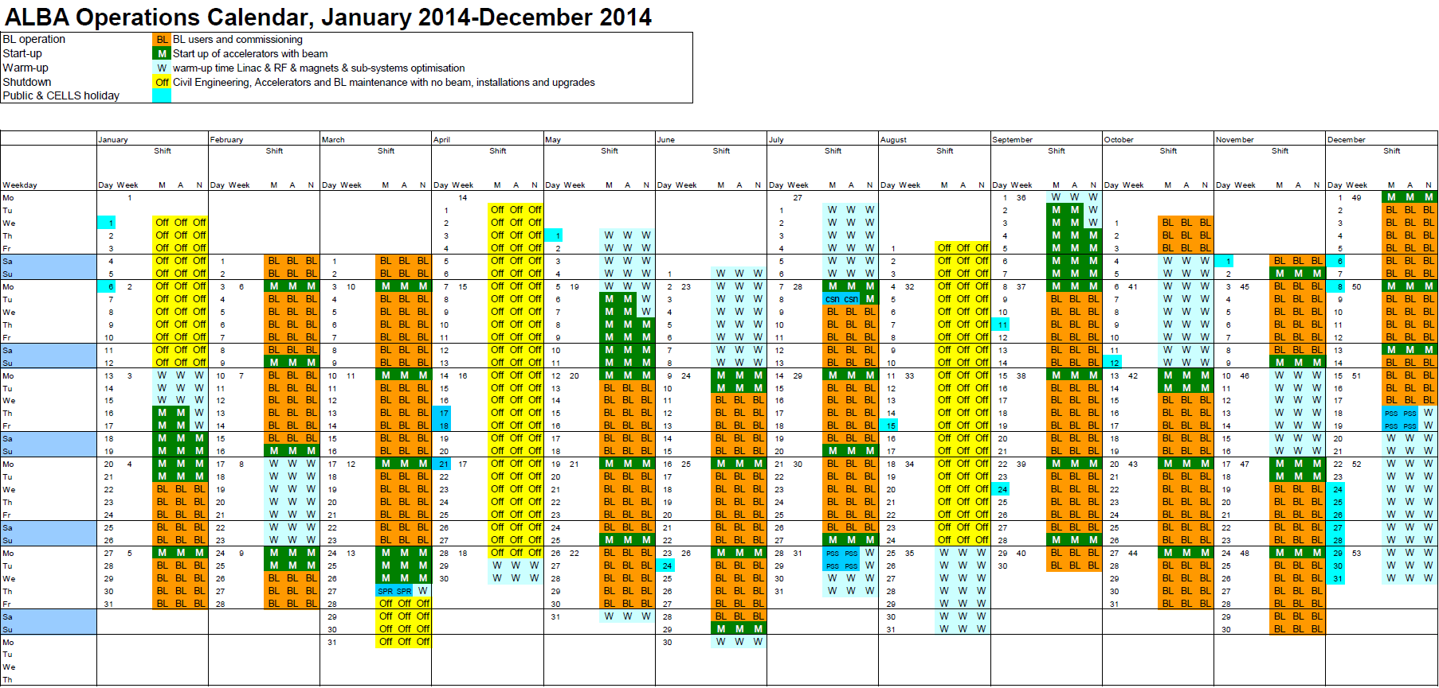
2014 Operations Calendar
Run periods : January - March
May - July
September - December
5272 operation hours (3888 h for BLs)
17 January 2013

Slide 17
External BLs at ALBA
Formal regulation recently approved (PBL, Partner
BeamLine)
Specific agreement shall be signed for each PBL
Two possibilities:
  EPBL: investment + running cost external, BL
  managed by external institution (incl. staff), beam time shared
  (60% external, 40% ALBA incl. commissioning)
  IPBL: investment + running cost external or shared
  (30-100%), managed by ALBA (incl. staff), beam time shared
  (up to 50% external, down to 50% ALBA incl. commissioning)
Minimum agreement duration: 10 years
Possibility of external beam time at other ALBA BLs
17

Slide 18
Possible practical scenarios
External institution interested on funding part of a
new BL of strong interest for ALBA
External institution interested on full funding of a
new BL
Straight section ports may be considered
18

Slide 19
Possible roadmap
Identify Chinese institutions potentially interested
ALBA presents PBL options directly to interested
institutions with SSRF support (perhaps in a future
visit to SSRF?)
Start negotiation if an interested institution arises
External institution may visit ALBA
19

Slide 20
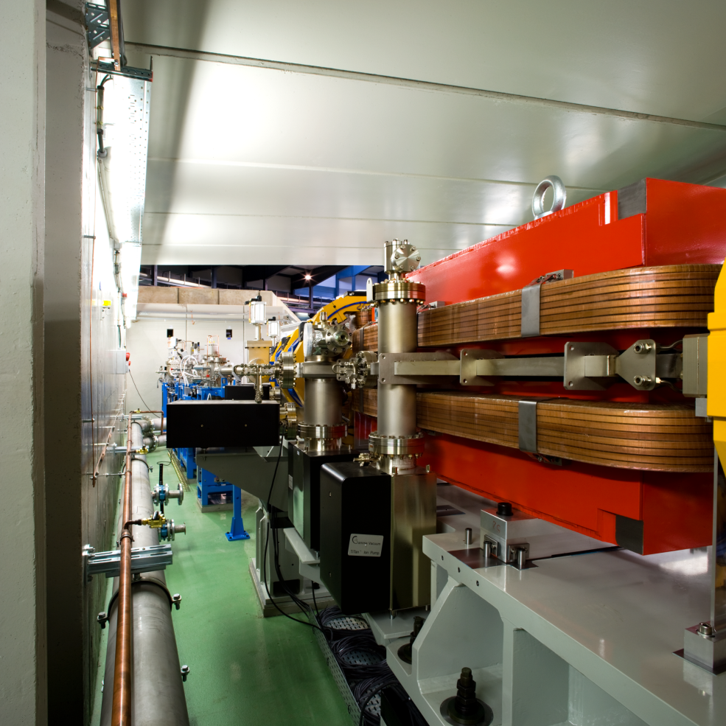
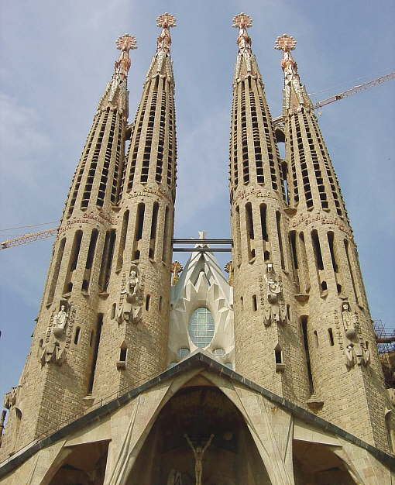
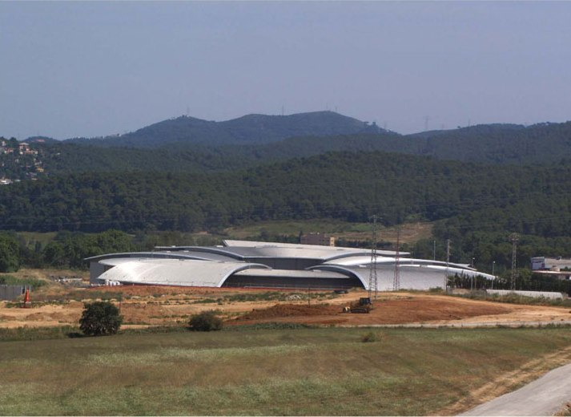

¡ Gracias !
20

