Slide 1
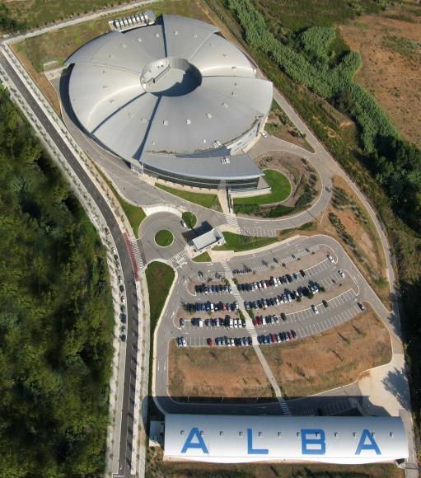
ALBA labs
Magnetic lab
RF lab
Vacuum lab
Francis Perez

Slide 2
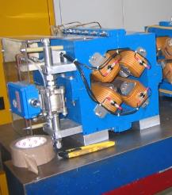
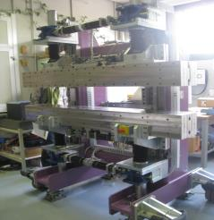
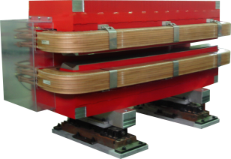
Magnetic Measurements Laboratory
Belongs to ALBA accelerators division
Specialized in accurate measurements of big magnetic structures

Slide 3
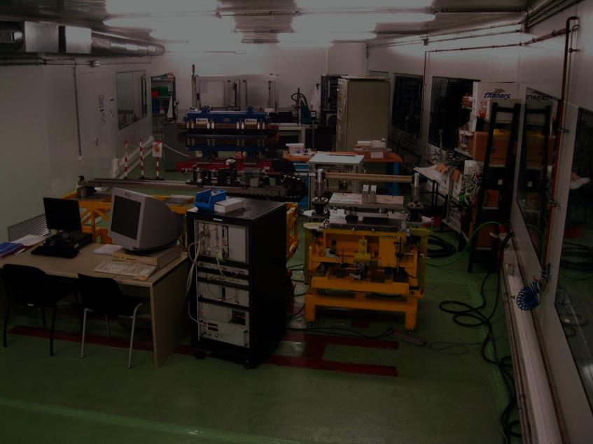
Magnetic Measurements Laboratory

Slide 4
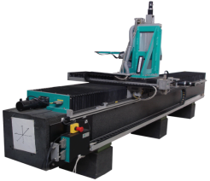
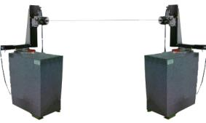
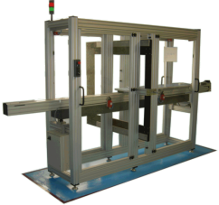
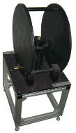
Magnetic Measurements Laboratory
Measurement benches
  Hall probe bench
    Partially build in-house
  Rotating coil bench
    Purchased from CERN
  Flipping coil bench
    Purchased from ESRF
  Fixed stretched wire
    Designed and built in-house
  Helmholtz coils
    Purchased from Elettra

Slide 5
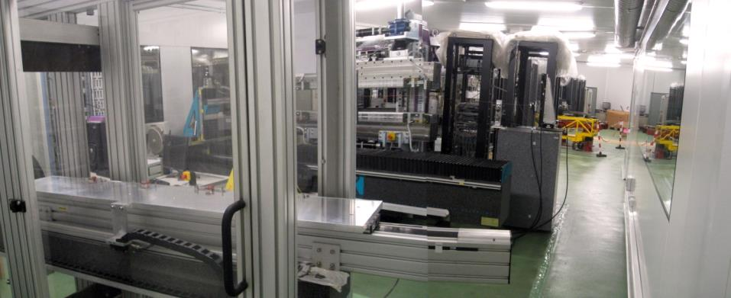
Magnetic Measurements Laboratory
  Fixed stretched wire bench
  Rotating coil bench
  Flipping coil bench
  Helmholtz coils
  Hall probe bench

Slide 6
Magnetic Measurements Laboratory
In order to build the accelerators, ALBA did set up a complete magnetic measurements laboratory specialized in characterization of big magnetic structures used in accelerators physics and technology
Magnetic measurement capabilities
    Bx, By, Bz bench (Hall)
    Iz bench (Rotating coil)
    Mx, My, Mz (Helmholtz)
    Ix, Iz (Stretched wire / flipping coil)

Slide 7
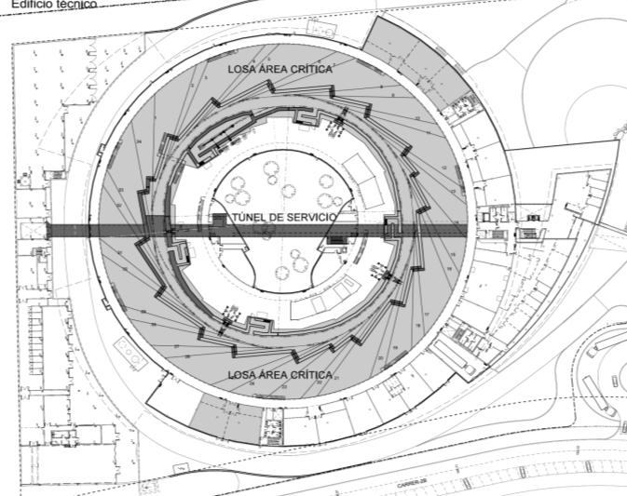
Magnetic Measurements Laboratory

Slide 8



Magnetic Measurements Laboratory
Mission of the laboratory:
Measurement of Storage Ring Magnets
  Measurement of magnetic field maps
    Hall probe bench
  Measurement of multipoles
    Rotating coil bench
Construction and measurement of IDs
  Permanent magnet blocks characterisation
    Helmholtz coils & Fixed Stretched wire
  Measurenent of magnetic field maps
    Hall probe bench
  Measurement of field integrals
    Flipping coil bench

Slide 9
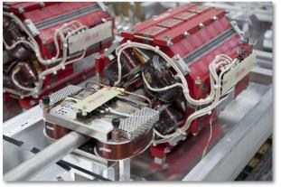
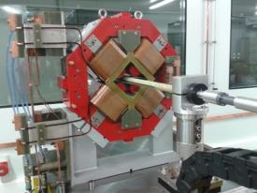
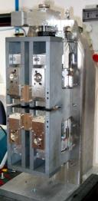
Magnetic Measurements Laboratory
Collaboration with other research centers
Magnets for ESRF upgrade
CIEMAT magnets for IFMIF
CIEMAT phase shifter for E-XFEL
SESAME dipoles (2014)

Slide 10
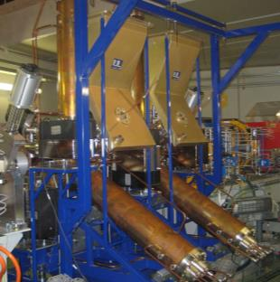
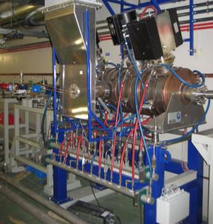
High Power RF Laboratory
Belongs to ALBA accelerators division
Specialized in low and high RF power measurements and cavity conditioning

Slide 11
High Power RF Laboratory
In order to build the accelerators, ALBA did set up a complete high power RF laboratory for prototype testing and cavity conditioning.
Bunker 4.1 x 3.4 m²
High Voltage Power Supply 38 kV – 4 A
IOT amplifier 80 kW – 500 MHz
Waveguide system WR1800
LLRF Digital IQ
Controls Tango

Slide 12
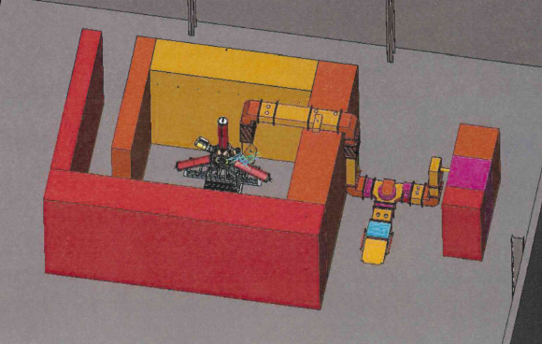
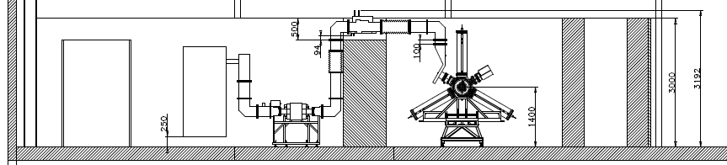
High Power RF Laboratory

Slide 13
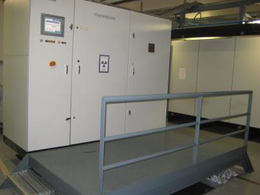
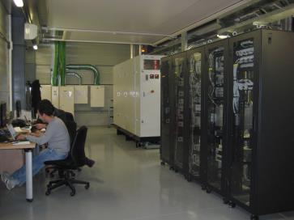
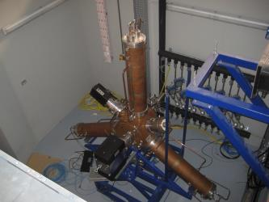
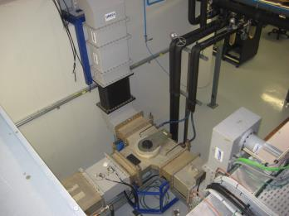
High Power RF Laboratory
  HVPS
  IOT cabinet
  RF transmitter
  LLRF and Controls racks
  Cavity inside the Bunker
  Waveguide System

Slide 14
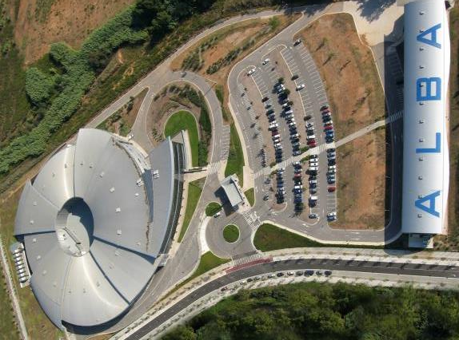
High Power RF Laboratory
RF lab

Slide 15
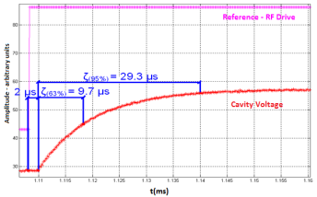
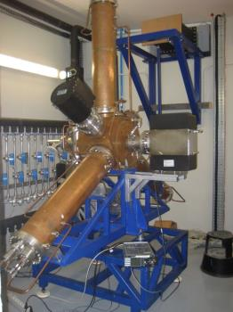
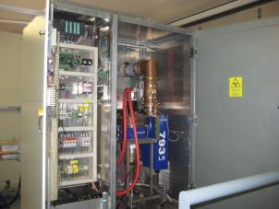
High Power RF Laboratory
Mission of the laboratory:
LLRF tests
Amplifier IOTs test
High power RF conditioning of:
  Cavities
  Input power couplers

Slide 16
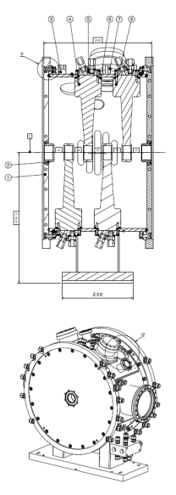
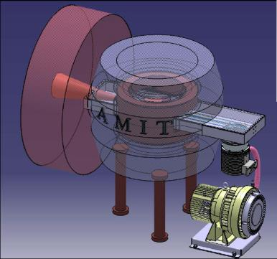
High Power RF Laboratory
CIEMAT
IFMIF
Buncher cavity
(2014)
CIEMAT - Cyclotron Cavity (2014)
Collaboration with other research centers

Slide 17
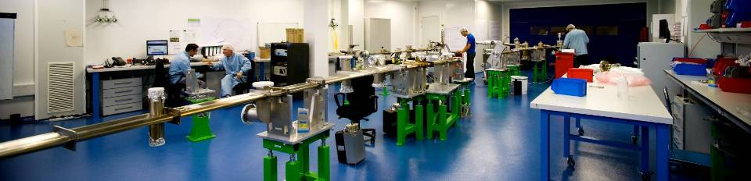
Vacuum Laboratory
Belongs to ALBA Engineering division
Specialized in Ultra High Vacuum: design, construction and tests.
Staff:
2 vacuum engineers
2 Vacuum technicians

Slide 18
Vacuum Laboratory

Slide 19

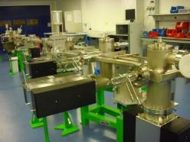
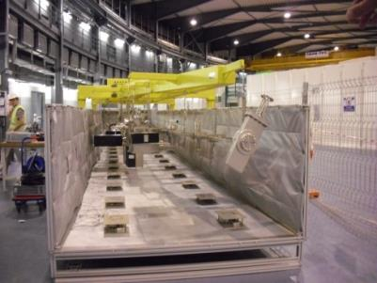
Vacuum Laboratory
Installation and Material :
Clean room class 100000 (ISO 8)
Bake out oven (length 14m,height 1m,width 2m)
12 roughing station
7 leak detectors
Material for bake out (controllers, heaters …)
Ion pumps
Residual gas analyser
Vacuum measurement gauges
Traveling crane (1T)
Design and Calculation
Nx (Siemens) Cad system
Ansys for calculation
Molflow for vacuum calculation

Slide 20
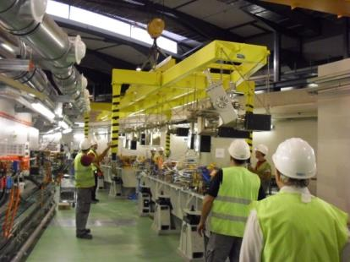
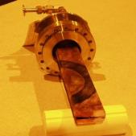
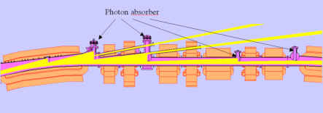
Vacuum Laboratory
ALBA VACUUM SYSTEM
Based on lumped Absorber
16 Cells:
8 Unit Cells ~12,5m
8 Matching Cells ~10,3m
4 Long straight sections 8m
12 Medium straight sections 4m
8 Short straight sections 2m
Complete Cell baked out in a special oven
no bake out in situ except straight sections
3 Aluminium Neg coated chambers (medium straight)
2 In vacuum ondulators (medium straight)

Slide 21
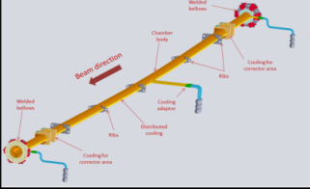
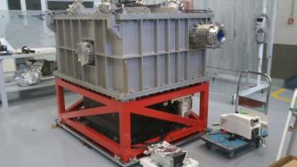
Vacuum Laboratory
Collaboration with other research centers
MAXLAB (Sweden):
Design of vacuum chambers for the 3Gev and 1,5Gev MaxIV Storage Rings
Thermal, mechanical and vacuum calculation
Technical specifications & CFT process
Design review meeting with vacuum experts (CERN,BNL,GSI,SOLEIL)
Meeting with CERN for coating collaboration
Salamanca University (Spain)
Design and calculation of a vacuum chamber for a 200TW laser compressor optical devices
Technical specifications & CFT process
Fabrication follow-up
Installation and vacuum tests

Slide 22
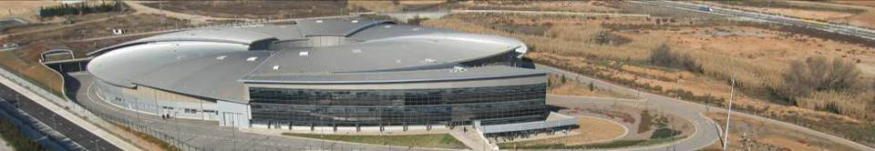
Conclusion
Three labs, developed for the construction of ALBA:
  Magnetic Lab
  RF lab
  Vacuum lab
are now ready and used for:
  ALBA upgrades
  Collaborations
Thank you

