Slide 1
Beamline Control and
Data Acquisition System at SSRF
Zhang Zhaohong, Zheng Lifang
Beamline Control Group
Shanghai Synchrotron Radiation Facility
about 25 pages

Slide 2
Outlines
Overview
Infrastructure
Control System
Data Acquisition System
Current Missions
Conclusion
Average 4 slides per section

Slide 3
Overview
1.1 Organization
1.2 Responsibilities
1.3 System Overview

Slide 4
1.1 Organization
Beamline Engineering Department
Experiment Departments
IT Department
Control Group
13 Beamlines
~ 4 related people
1 group leader
7 engineers
Each scientific village has 1 to 3 control engineers
Electronic & Detector
Group
1 group leader
5 engineers
1 technician

Slide 5
1.2 Responsibilities
Control Group
E & D Group
Experiment Dep.
IT Dep.
Beamline Control
Personnel Safety
Endstation Control
Network
Equipment Protection
Endstation Control (participate )
Data Acquisition
Computing
& storage
Beam Monitoring
infrastructure
Control group cooperates with beamline staff to complete the whole control and data acquisition system

Slide 6
1.3 System overview
DAS: Data acquisition system
DAS
EPICS
CA interface
DAS
Labview
EPICS CA protocol
Based on TCP/IP
Communication Protocol
Computer
interface
PLC system
Equipment protection
EPICS
PLC system
Personnel safety
Platform
Control system
DAS
VC++
DAS
SPEC
DAS
Blu-Ice
EPICS: Experimental physical industrial control system

Slide 7
2. Infrastructure
2.1 Network
2.2 Personnel Safety Interlock System
2.3 Equipment Protection System

Slide 8




2.1 Network Structure
Each beamline has an independent subnet.
Computing Center
Cluster Switch
SSRF
Central Switch
2 $×10 Gbit/s$
In the future
MX & Image beamline Switches
Beamline
Central Switch
Other Beamline
Switches
Control Room
Switch

Slide 9
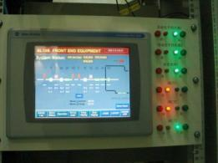
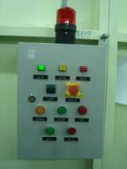
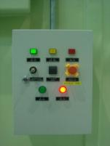
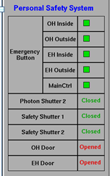
2.2 Personnel Safety Interlock System
A-B
Control-Logix 5561
Digital Values
Photon Shutter
Safety Shutter
Search Buttons
Door Switches
Emergency buttons
Interlock key
PLC Bus
Ethernet
PLC Modules
EPICS software
DI
Get digital values
Calculate logics
Set up interlocks
Give alarming signal
DO
Have the capacity to access each tag in PLC
Control Panel &
Display Screen
Search Buttons

Slide 10
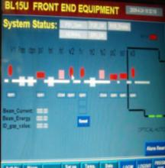
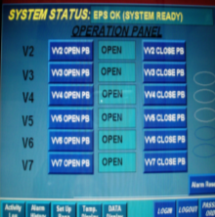
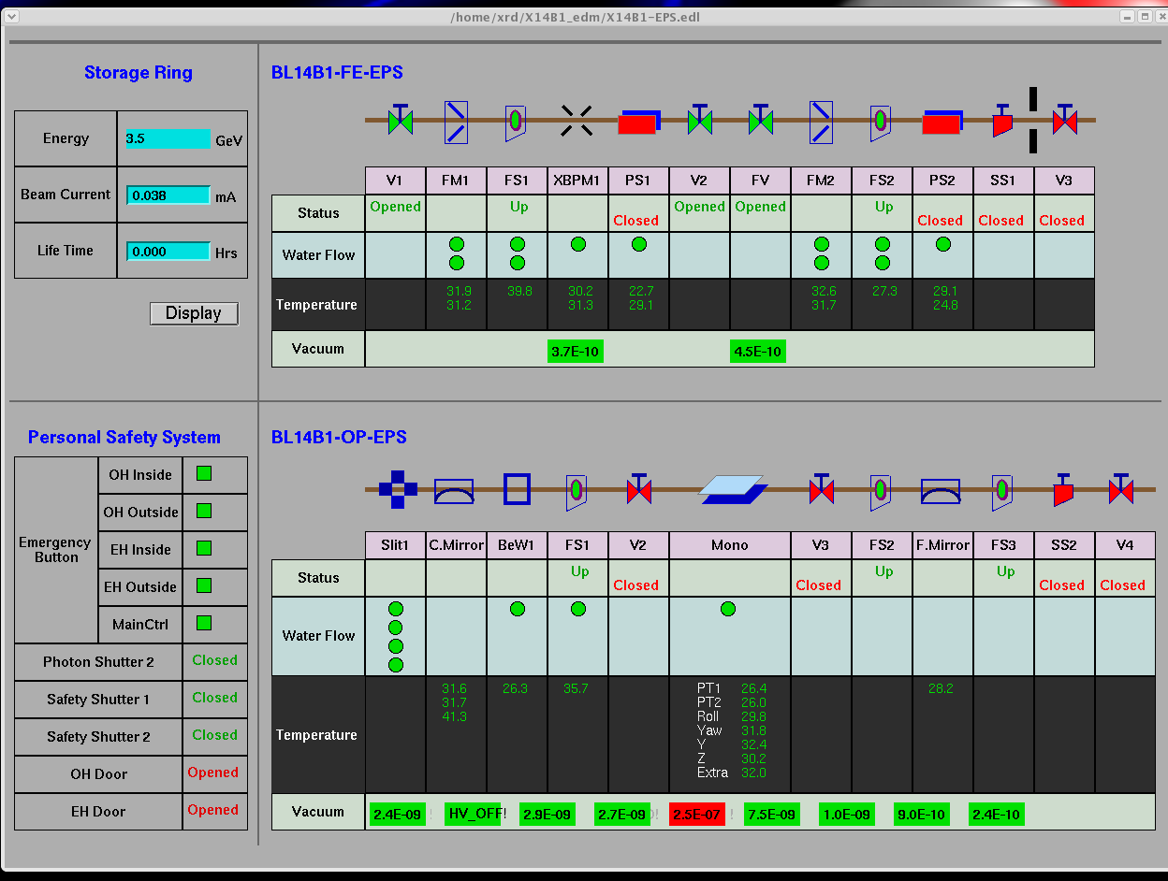
2.3 Equipment Protection System
Water Flow state
Temperature
Vacuum
etc.
PLC modules
PLC modules
Vacuum Gauge
Serial Server
PLC system
EPICS Software
OPI
Ethernet
PLC touch panels

Slide 11
3 Control System
3.1 EPICS Overview
3.2 Motion Control
3.3 Message Based Devices’ Control
3.4 Detector Control
3.5 Scan Mechanism
3.6 OPI Tools
3.7 Other Tools
Altogether 10 slides

Slide 12
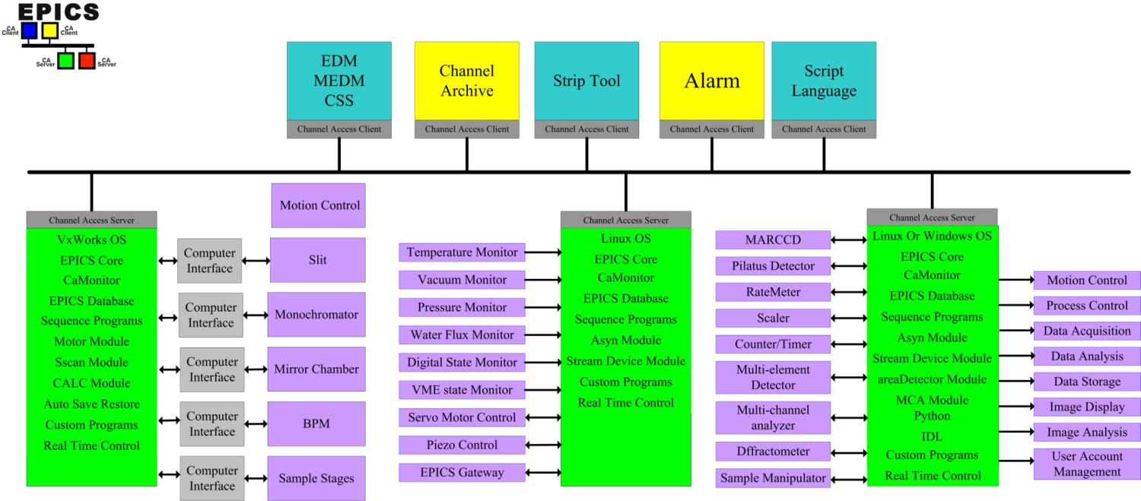
3.1 EPICS Overview
We benefit a lot from EPICS, developed so perfectly.
OPI Layer
LAN: CA Protocol
VME-IOC
PC-IOC
Detector
Control
PC-IOC
Data
Acquisition
status monitor
Motion Control
EPICS is competent for any control task in beamlines.

Slide 13
3 Control System
3.1 EPICS Overview
3.2 Motion Control
3.3 Message Based Devices’ Control
3.4 Detector Control
3.5 Scan Mechanism
3.6 OPI Tools
3.7 Other Tools
Altogether 10 slides

Slide 14
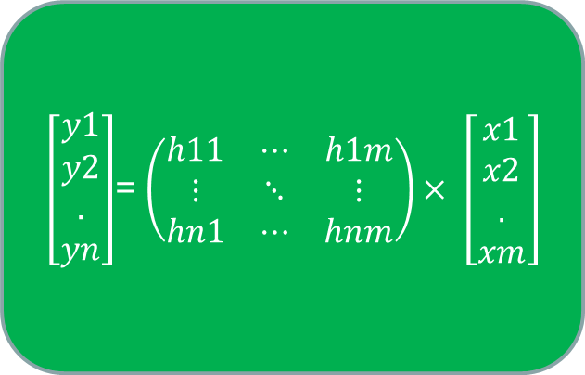
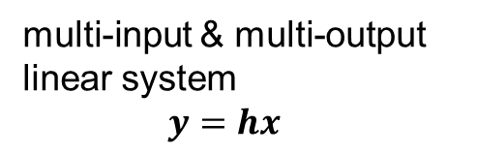
3.2.1 Mathematical Model
Beam line is all about motors
Control Objects
Slit
Mirror Chamber
Monochromator
Sample Stage
Filter
BPM
etc.
Control Variables
Size,offset
Height,pitch,roll
Energy, etc.
…
…
…
…
Execute Components
step motors (over 95%)
$\left[\begin{aligned}y1 \\ y2 \\ . \\ yn\end{aligned}\right]$= $\left(\begin{matrix}h11 & ⋯ & h1m \\ ⋮ & ⋱ & ⋮ \\ hn1 & ⋯ & hnm\end{matrix}\right)× \left[\begin{aligned}x1 \\ x2 \\ . \\ xm\end{aligned}\right]$
multi-input & multi-output
linear system
$$y=hx$$
Motion control is everywhere.
Position control !

Slide 15
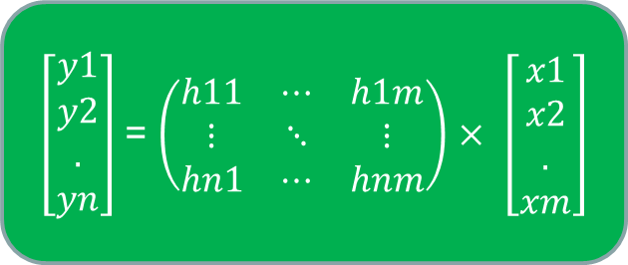
3.2.2 EPICS facilities
We formed a Standardized method to implement motion systems
using the elements in EPICS.
OPI
Output
Algorithm
Input
$\left[\begin{aligned}y1 \\ y2 \\ . \\ yn\end{aligned}\right]$= $\left(\begin{matrix}h11 & ⋯ & h1m \\ ⋮ & ⋱ & ⋮ \\ hn1 & ⋯ & hnm\end{matrix}\right)× \left[\begin{aligned}x1 \\ x2 \\ . \\ xm\end{aligned}\right]$
EPICS IOC
motor record
~100 fields
database
records
Transform record
A~P, float fields
CLC field(C language calculation)
PVS
record Links
INP OUT types
PP NPP CP modes
Low level drivers
softMotor record
~100 fields
In EPICS’s world, everything is PV. PVs = fields of EPICS record .

Slide 16
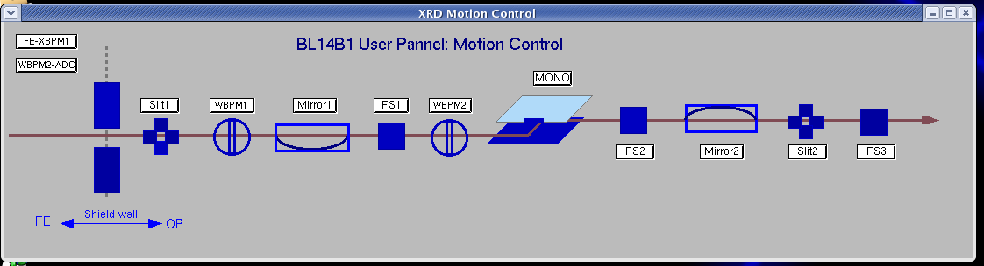
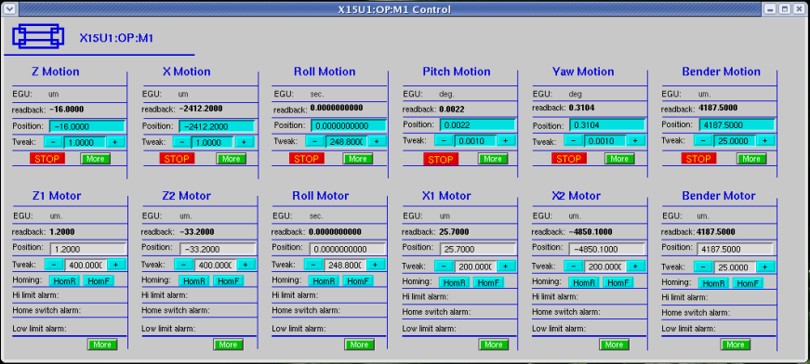
3.2.3 example
Var. | motors and formulas
y | y=(2*y1+y2+y3)/4
pitch | Pitch=atg (((y2+y3)-2y1)/2)
roll | Roll=atg ((y3-y2)/W)
x | x=(x1+x2)/2
yaw | yaw=atg ((x2-x1)/L)
Implement the formulas in IOC
transform records
softMotor records
Controlled variables
motor records
motors

Slide 17
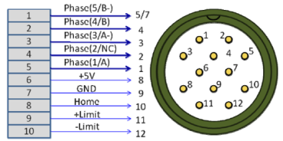
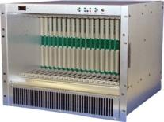
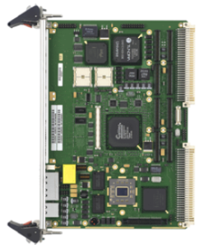
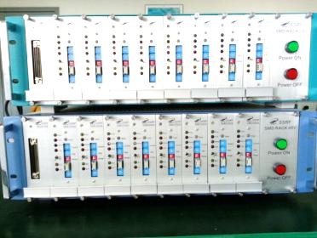
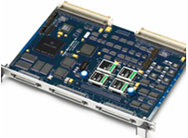
3.2.4 hardware for step motor control
Normalized connector and cabling discipline
MAXv-8000
motion controller
VME single board computer MVME 5500
Custom-build standard power
rack & modular motor drivers
CPU: 1GHz
On-board memory: 512M
Ethernet interface: gigabit
Bus speed: 66MHz
OS: VxWorks 5.5
Power supply: 24 VDC/48 VDC
2-phase, 5-phase
0.2~6A driver current
0~100% holding current
Phytron’s core motor power stage
8 axes
Open/closed loop
EPICS driver support
Standardized & normalized hardware
High efficiency & Good result

Slide 18
3 Control System
3.1 EPICS Overview
3.2 Motion Control
3.3 Message Based Devices’ Control
3.4 Detector Control
3.5 Scan Mechanism
3.6 OPI Tools
3.7 Other Tools
Altogether 10 slides

Slide 19
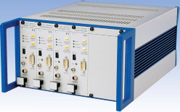
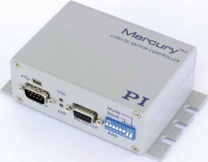
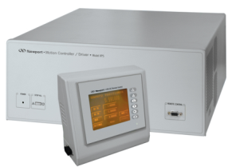
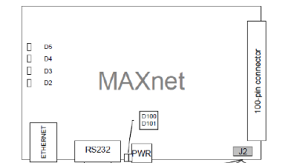
3.3 Message Based Devices
Epics communicates with devices through serial port or
ethernet port.
PI-E621
RS-232
RS-485
Ethernet
PI-C863
EPICS
Soft IOC
Serial
Server
LAN
streamDevice
devGPIB
Asyn
Newport-XPS
Configure a protocol file
Configure a C struct
Write some C codes
Simple
Complicated
Pro-dex MAXnet
Three independent methods, the more complicated, the more freedom

Slide 20
3 Control System
3.1 EPICS Overview
3.2 Motion Control
3.3 Message Based Devices’ Control
3.4 Detector Control
3.5 Scan Mechanism
3.6 OPI Tools
3.7 Other Tools
Altogether 10 slides

Slide 21
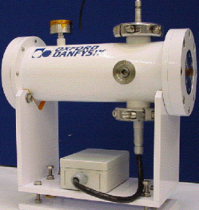
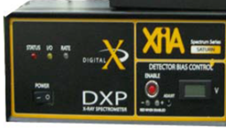
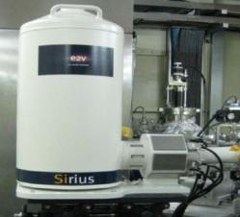
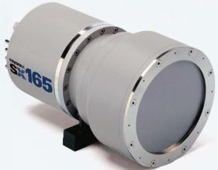
3.4 Detector Contol
Ionization Chambers
picoammeter + EPICS
Thank EPICS community!
There are so much hardware
used in the worldwide
synchrotron facilities with EPICS.
It’s a shortcut to choose
among these hardware.
VME ADC card + EPICS
V/F + VME scalar + EPICS
NI ADC + Labview
Solid Detectors
XIA electronic readout system
& EPICS
We share the benefit of
EPICS/synApps package, which has many support modules for specific devices.
CCDS
EPICS & image software

Slide 22
3 Control System
3.1 EPICS Overview
3.2 Motion Control
3.3 Message Based Devices’ Control
3.4 Detector Control
3.5 Scan Mechanism
3.6 OPI Tools
3.7 Other Tools
Altogether 10 slides

Slide 23
Scan Mechanism
Scan mechanism is the most important
Start scan
Set scan.EXCS = 1
SSCAN soft modules
  Scan record
  SaveData function
  Plotting function
Every numeric PV is scannable
  motor.VAL
Every numeric PV can act as a detector.
Data of positioners and detectors are collected in scan record’s array fields.
1-D、2-D and multi-D scan can be achieved flexibly.
Move to the next desired point
step by step scan
Wait DLY seconds for positioners to settle down
Continuous loops until the last point
Some predefined functions can be invoked during these periods.
Trigger the detector
Wait DDLY seconds for detectors to settle dpwn
Post data
Example:
Do averaging
Stop scan

Slide 24
3 Control System
3.1 EPICS Overview
3.2 Motion Control
3.3 Message Based Devices’ Control
3.4 Detector Control
3.5 Scan Mechanism
3.6 OPI Tools
3.7 Other Tools
Altogether 10 slides

Slide 25
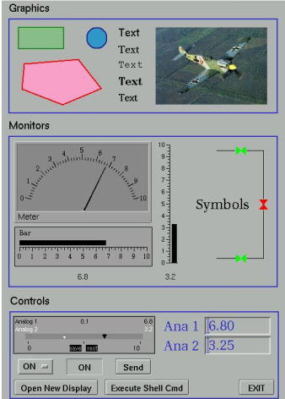
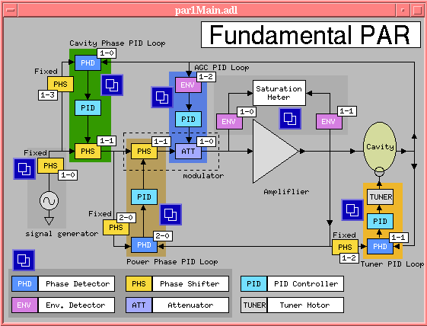
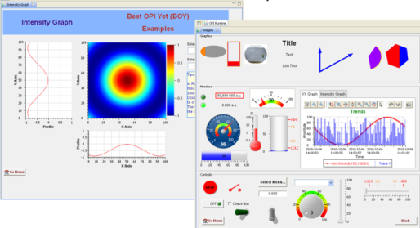
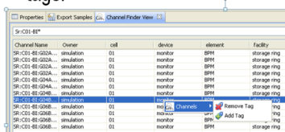
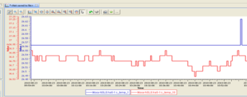
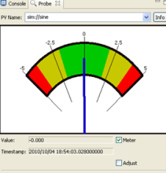
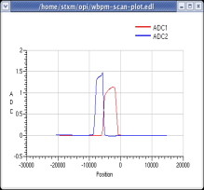
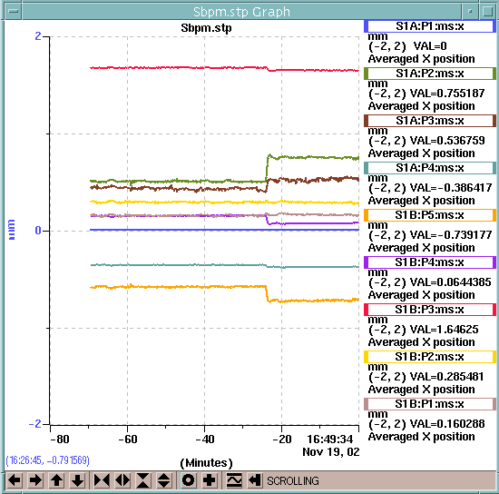
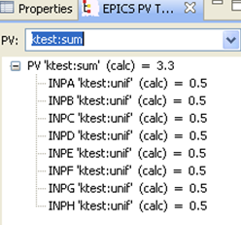
3.6 OPI Tools
EDM: Extemsible Display Manager
EDM @ Linux
medm @ Linux&windows
CSS@Linux&windows
Static graph
widgets
Monitoring
widgets
control
widgets
PV finder
dataBrowser
plot2D
stripTool
Probe
probe
PV tree
MEDM: Motif Editor and Display Manager
CSS: Control System Studio

Slide 26
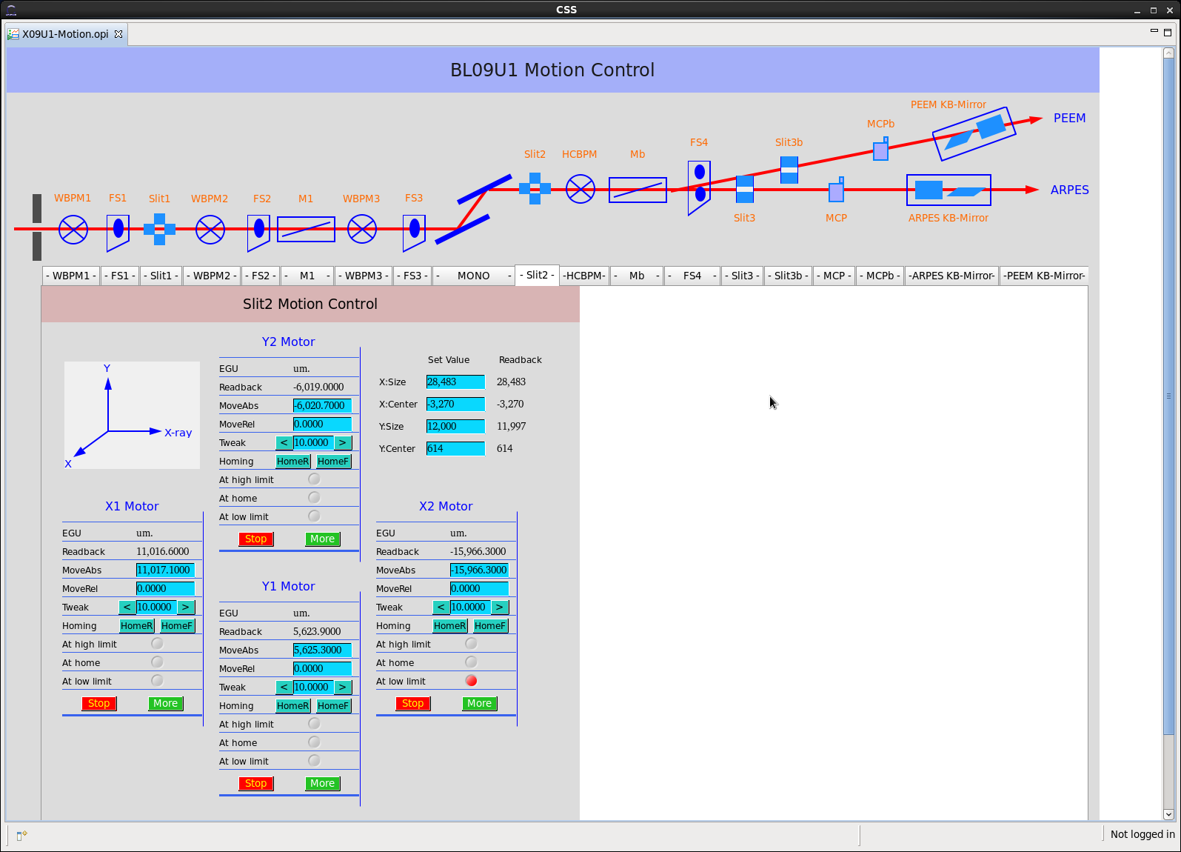

Slide 27
3. Control System
3.1 EPICS Overview
3.2 Motion Control
3.3 Message Based Devices’ Control
3.4 Detector Control
3.5 Scan Mechanism
3.6 OPI Tools
3.7 Other Tools
Altogether 10 slides

Slide 28
3.7 Other Tools
EPICS Sequencer
  one component of EPICS IOC
  access/compute /analyse
  C or SNL language
  example: FFT; event trigger generator
Pviewer
  motif tool to manage the .MDA data saved by the scan record
imageJ / fid2d / igor / origion
  tools to show and analyse image data or 2D ASC-II data
EPICS Archiver
  one EPICS tool
  archive PVS
  plot historic data
Python\Jython\Javascript \IDL
  with CA interface to EPICS
  flexibly do high level applications

Slide 29
4. Data Acquisition System
4.1 Overview
4.2 Example: Blu-Ice

Slide 30
4.1 DAQ Overview
Beamline Name | Beamline Control | Endstation Control | Data Acquisition
XAFS | EPICS | EPICS | LabView
STMX | EPICS | 3rd party software | VC++
XIM | EPICS | LabView | VC++
XRD | EPICS | 3rd party software | SPEC
SAXS | EPICS | EPICS | EPICS
XMF | EPICS | EPICS | EPICS
5 MX Beamlines | EPICS | EPICS 3rd party software | BlueIce
Dreamline | EPICS | 3rd party software | 3rd party software
Infrared Beamline | EPICS | 3rd party software | 3rd party software

Slide 31
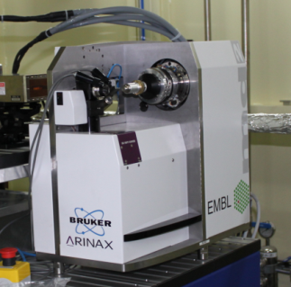
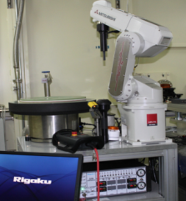
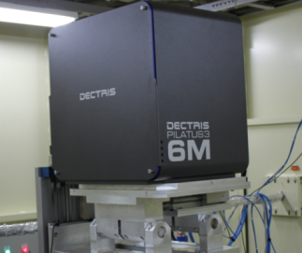
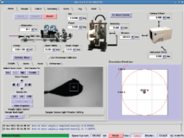
4.2 Example: Blu-Ice
DCSS: Distributed Control System Server
EPICS
Control System
TangoDeviceServer
CameraMan
CamServer
Call API
DHS
EPICS gateway
DHS
DHS
LAN
DCSS
GUI
servers
TK
DHS: Distributed Hardware Server
GUI: Graphic User Interface

Slide 32
5. Current Missions
5.1 Time Resolved Experiments
5.2 Sub-second QXAFS
5.3 Feedback System

Slide 33
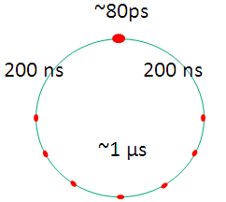
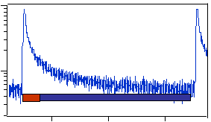
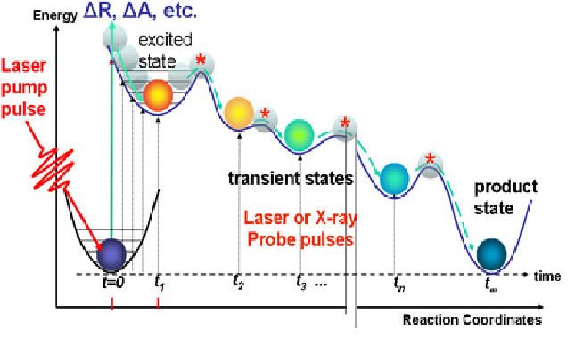
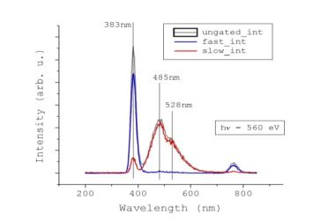
5.1 Time-resolved Experiments
XEOL: X-ray Excited Optical Luminescence
TR-XEOL
Pump: single X-ray pulse
Probe: Electronic devices
To get the luminescence decay curve
Resolution: 2ns
Laser Pump-probe system
Pump: Laser pulse
Probe: X-ray pulse
To study the intermediate state of the reversible reaction
Resolution: ~100 ps
Time structure of a special electron bunch pattern

Slide 34
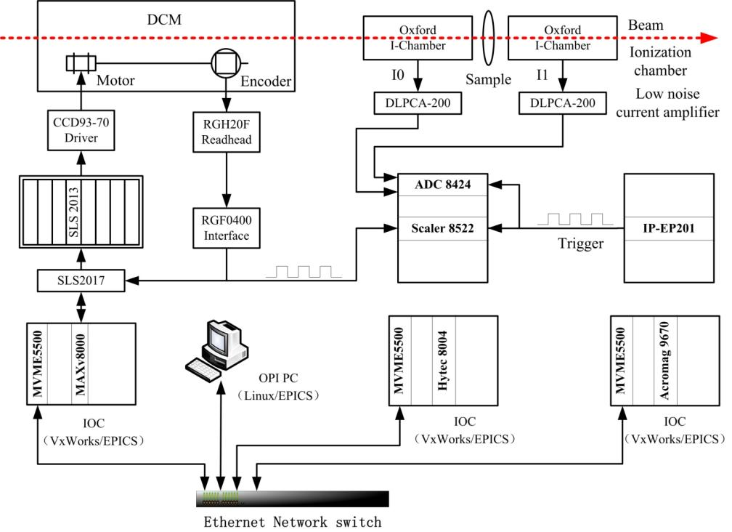
5.2 Sub-second QXAFS
Key techniques:
synchronous triggers
timing system

Slide 35
5.3 Feedback System
Many requirements in our coming beamlins
Beam
Position
Feedback
PSD
BBPM
CCD
photodiodes
Monochromator
To develop a universal high performance digital feedback controller based on FPGA
Beam
Intensity
Feedback
CCD or other devices
Mirrors
Laser interferometer
Nano-meter sample stage
Nano-meter focusing
Feedback

Slide 36
6. Conclusion

Slide 37
6. Conclusion
Standard control system has been developed
  Standard hardwares
  standard software based on EPICS
  EPICS does a lot for us, we should do more for EPICS next.
Data acquisiton systems are various
  Wish to develop a universal one
  With generic application framework, common feel&like GUIs, configurable and reusable components, capacity to trace behaviors, and “learn once, use everywhere” features.

Slide 38
6. Conclusion
Great challenges are waiting for us
  picosecond time-resolved experiments.
  nano-meter feedback controls
  sub-micrometer beam detect technologies
  information management system based on database
We hope to collaborate with experts
throughout the world.

Slide 39

Thank you for your attention

