Slide 1
JEMCA
9 October 2026
https://rediris.zoom.us/j/99118780380?pwd=zBwgPYBgrcVBFiazQbpemtEPfhyN7s.1
ALBA
IBMB CSIC
ICMAB CSIC
ICN2
CRG
IRB
UAB
PIC

Slide 2
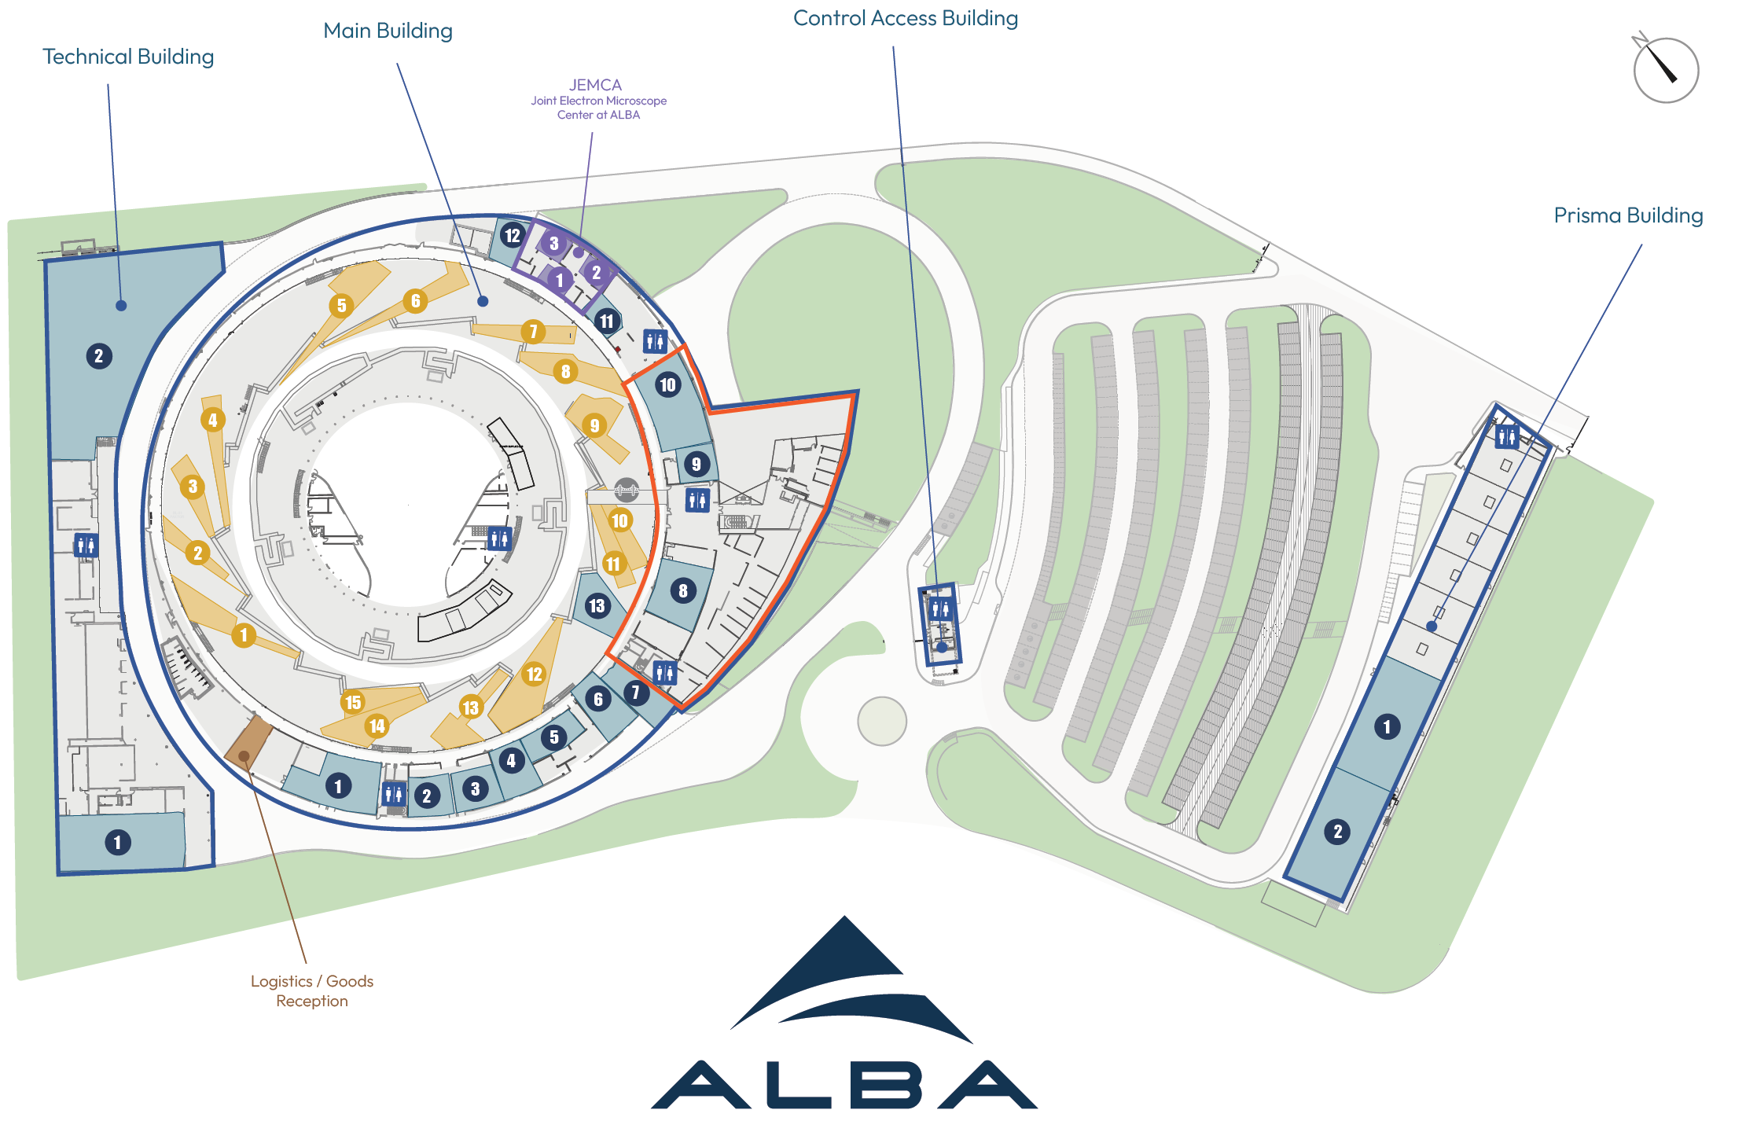
Map of JEMCA

Slide 3



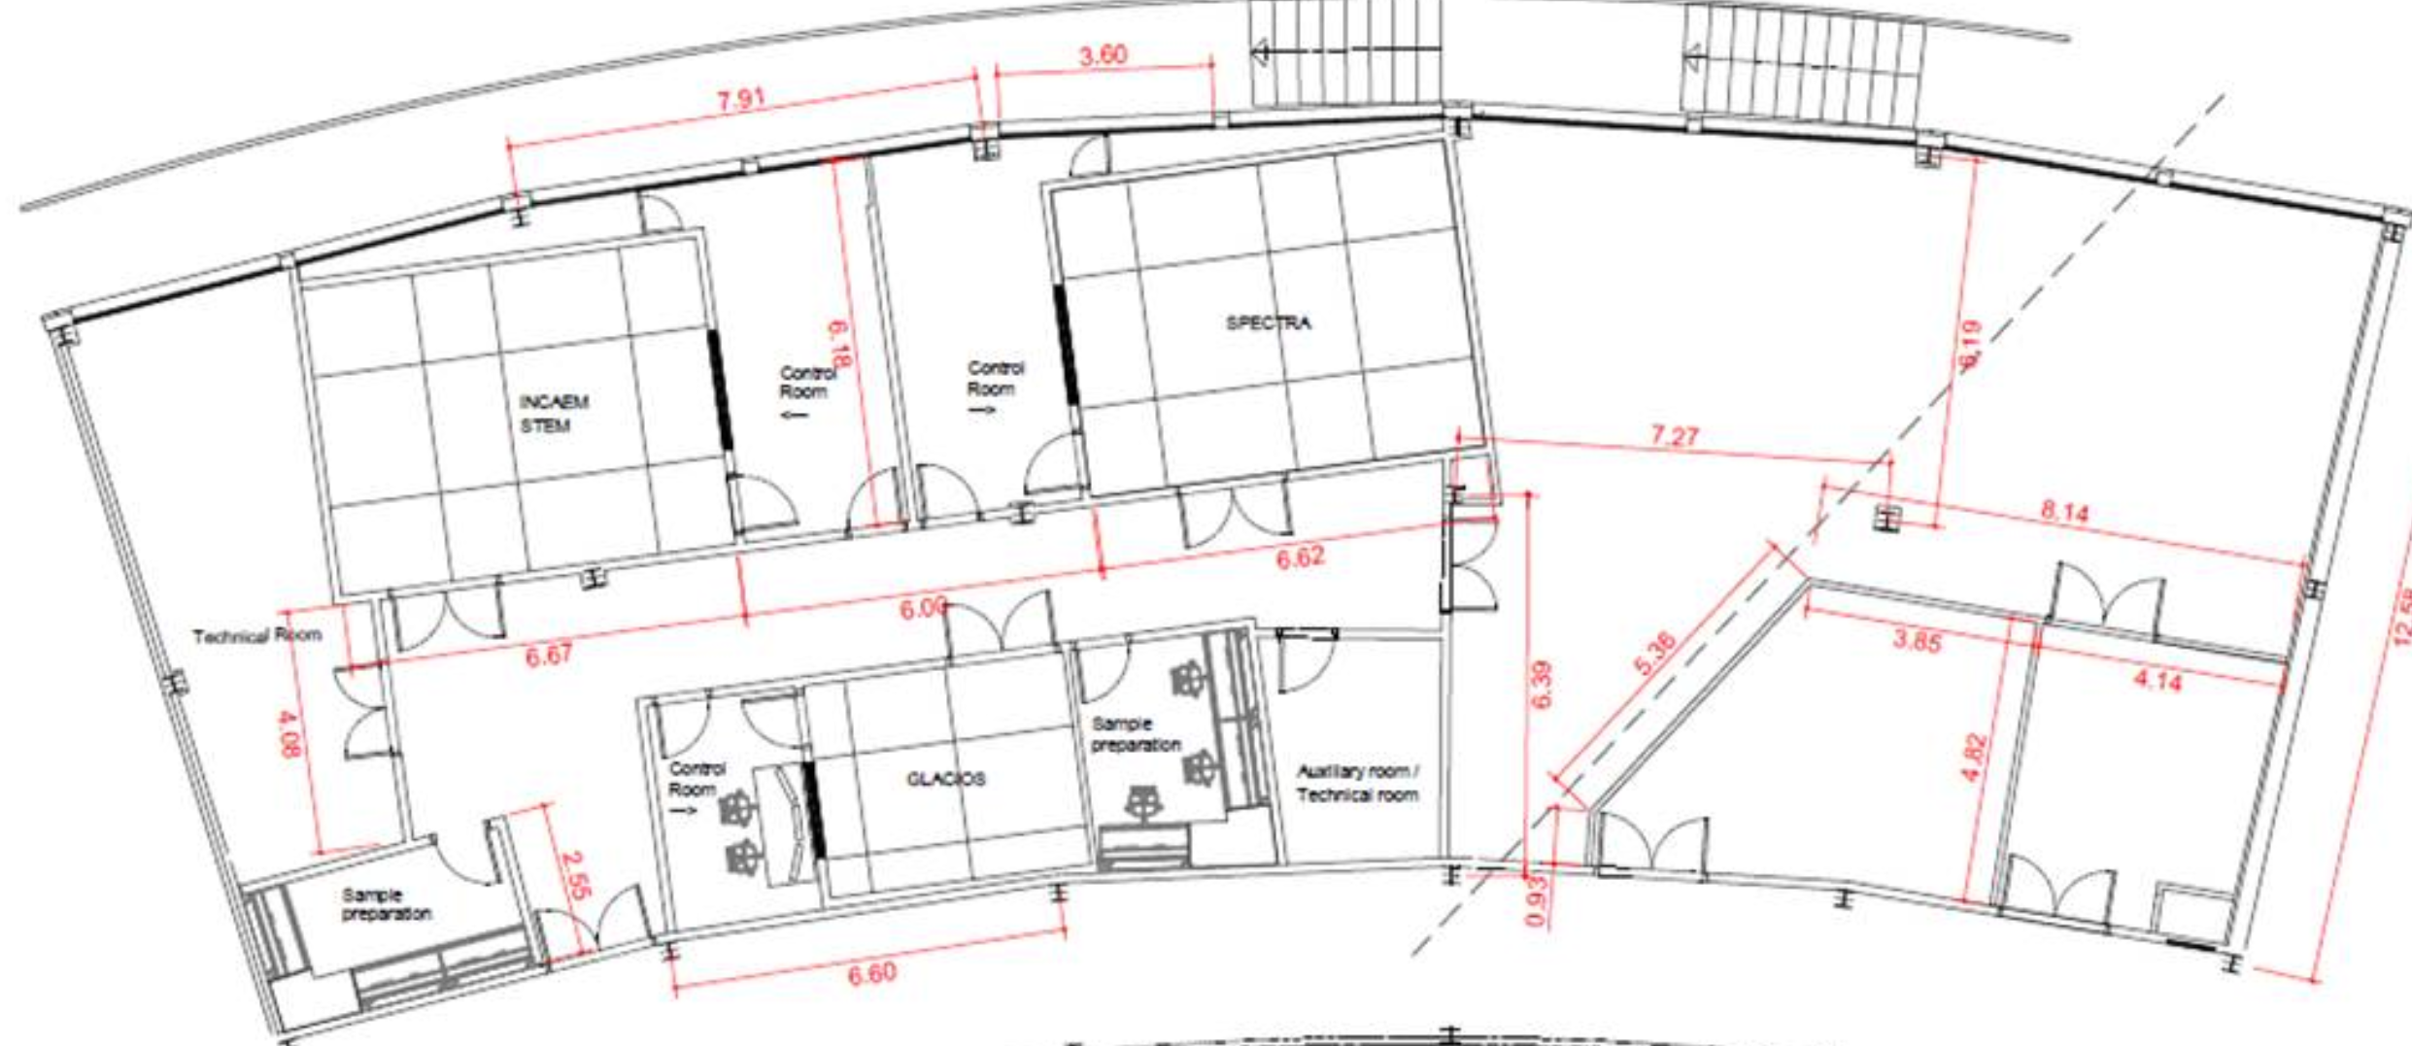


Map of JEMCA
EM01 | IBMB | 200 kV – Life science
EM02 | ICN2 | 300 kV – Material science
EM03 | ALBA | 300 kV – Material science – environmental/correlative
EM02
EM03
EM01

Slide 4
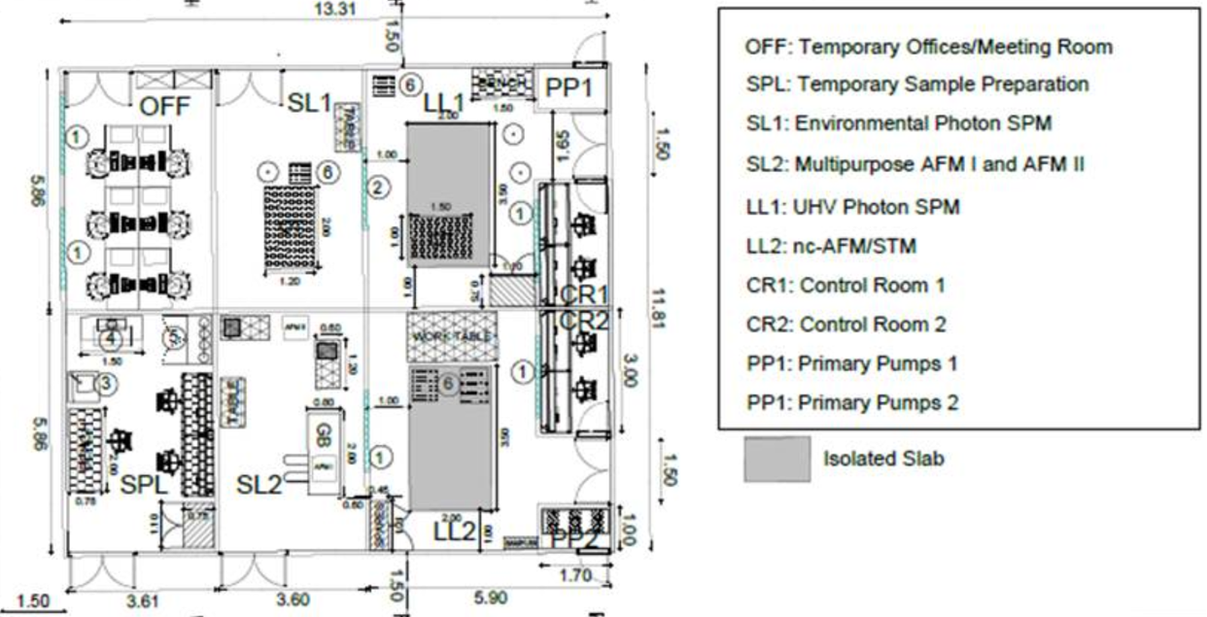
Map of JEMCA
SM01 | LL2 | (pre-existing) UHV Scanning Probe Microscope – ICMAB
SM02 | SL2 | Atomic Force Microscope 1 ICMAB
SM03 | SL2 | Atomic Force Microscope 2 ICMAB
SM04 | LL1 | UHV Photon SPM – ICN2
SM05 | SL1 | Environmental photon Atomic Force Microscope - ICN2

Slide 5


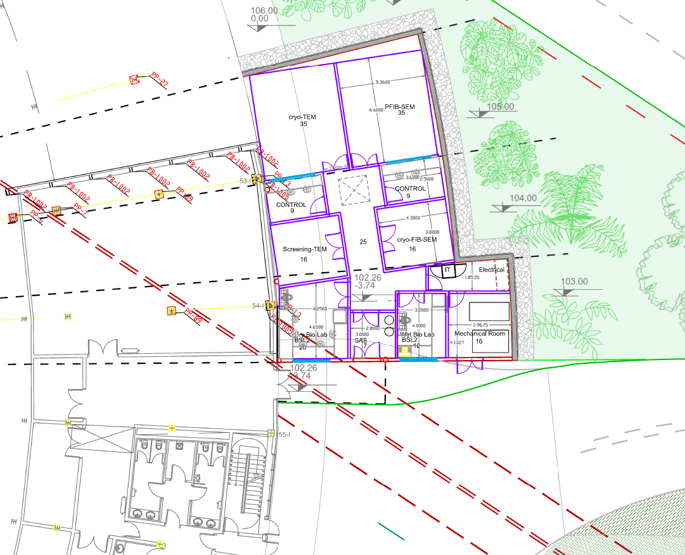
Map of JEMCA
EM04
EM04 | ALBA | 300 kV – Life science

Slide 6
JEMCA numbers
Numbers to be checked
Instrument | 1st users | Owner | Partners | Instrument* (ME) | Personnel | Operation (kE) | Maintenance (kE) | Investment funds
EM01 | Jul 2023 | IBMB-CSIC | CELLS (UAB, IRB, CRG) | 1.7 | 2 (CSIC) + 1 (CELLS) | 50 | 200 Mar 28 | FEDER Cooperatives
EM02 | Jan 2024 | ICN2 | CELLS, ICMAB, UAB | 3.45 + 0,85 (ICN2-CSIC) | 2 (ICN2) + 1 (CELLS) | 100 | 250 Jan 27 | FEDER Cooperatives (3.45) NEXT GENERATION CSIC QTEP (0,85)
EM03 | Jul 2027 | CELLS | ICN2, ICMAB, PIC | 4.9 | 2 (CELLS) + 2 (ICN2) + 1 (ICMAB) | 90 | 300 Jan 30 | Plans Complementaris
EM04 | 2030 | CELLS | IRB, CSIC | 7 (incl build) | 3 + 1 | 100 | 350 2032 | Projecte Singular FEDER
FIB | Jan 2024 | ICN2 | CELLS, ICMAB, UAB | Included in EM02 | 1 (ICN2) | 30 | 100 Apr 26 | FEDER Cooperatives
SM01 | 2028 | ICMAB | CELLS, ICN2, PIC |  | 2 (ICMAB) + 0.25 (CELLS) |  |  | Old instrument (2014)
SM02 & 03 | 2028 | ICMAB | CELLS, ICN2, PIC | 0.6 | 1 (ICMAB) + 0.25 (CELLS) | 80 |  | Plans Complementaris
SM04 & 05 | 2028 | ICN2 | CELLS, ICMAB, PIC | 1.6 | 3 (ICN2) + 0.5 (CELLS) | 130 |  | Plans Complementaris
Data |  | CELLS-PIC |  | 2 |  | 450 |  | Plans Complementaris
TOTAL (up to ‘35) |  |  |  |  | 1.3 -> 1.6 ME | 1 -> 1.3 | 0.3 -> 2.2 ME
* Cost of infrastructures not included

Slide 7
Host Institution: ALBA (coordinator)
Board: Instrument owners
and partners (one per institute)
Frame agreement
Chair: rotating among Board Members
Instrument committee:
Instrument responsible
Partners
Specific agreement (annex to frame)
JEMCA Network
Joint E Microscopy Center at ALBA
ALBA
IBMB CSIC
ICMAB CSIC
ICN2
CRG
IRB
UAB
PIC
Frame agreement
Board (1 participant per institution)
EM01
IBMB-CSIC
IRB
CRG
ALBA
UAB
EM02
ICN2
CSIC
ALBA
UAB
EM03
ALBA
ICN2
ICMAB
PIC
EM04
ALBA
CSIC
IRB
SM01
ICMAB
ALBA
ICN2
PIC
SM02/03
ICMAB
ALBA
ICN2
PIC
SM04
ICN2
ALBA
ICMAB
PIC
SM05
ICN2
ALBA
ICMAB
PIC
DATA Infrastructure ALBA - PIC - all members and associates

Slide 8
JEMCA Alliance/Platform/Center ?
General Protocols that express the intention of several institutions to act jointly, provided that they do not establish specific and legally enforceable commitments.
Operating rules: objectives, members, coordination committee, admission of new members, meetings, use of the name/logo, etc.
If there are specific obligations, it would be advisable to formalize them through an agreement between the institutions. Law 40/2015 expressly provides for agreements aimed at pursuing a common purpose and establishes their required content and obligations.
Member = an institution that jointly undertakes the commitment to invest in JEMCA at CAPEX and/or OPEX
JEMCA Board, with one representative from each Member
The Members Board provides guidance on strategy, development of capabilities, admission of new Members, general rules on access and general relationship between resource provided and access time. ALBA would retain those decisions that legally fall within its remit as the host entity.

Slide 9
Considerations for the governance (Frame Agreement)
Parties and Purpose — signatory institutions; definition of the “centre” as a coordinating brand/umbrella; explicit statement that no new legal entity is being established.
Board — composition, quorum, required majorities (simple majority for ordinary management matters; qualified majority/unanimity for the admission of new partners or changes to fees), meeting frequency, and rotating chairmanship.
Relationship between Board Level and Instrument Level — which decisions fall within the remit of the Board (common fee policy, branding, single application portal, code of good practice) and which remain reserved for each instrument committee (cost, fee, scheduling, maintenance, and scientific priorities relating to its allocated share).
Roles at facility level (operations manager?, maintenance technician?, outreach/industrial officer?). Accurate representation of roles and titles
Allocation of Common Costs — formula for shared expenses (website, coordination, user reception/support staff): shares, based on usage volume.
Liability Regime — each institution is liable only for matters falling within its own area of responsibility (its instrument and its personnel); clause excluding joint and several liability among partners participating in different instruments.
Default Intellectual Property and Data Rules — general rules applicable unless otherwise specified in the relevant instrument annex (typically, data belong to the user paying for the service or having granted competitive access time, while methodological improvements developed using common funds are jointly owned/shared).
Admission and Withdrawal of Partners — requirements for joining as a new partner of the centre or of a specific instrument; consequences of an institution’s withdrawal (withdrawal from an individual instrument versus withdrawal from the centre as a whole — the two should not automatically trigger one another).
Dispute Resolution — escalation procedure: instrument committee → Steering Committee → agreed mediation/arbitration.
Term, Review and Termination — duration, review arrangements, and grounds for discontinuing/dissolving the centre as a common brand.

Slide 10
Specific instrument annex (Collaboration Agreement)
(as for EM01, 02, InCAEM)
Identification of the Instrument — description of the instrument, its physical location, and the institution responsible for operating it.
Ownership — identification of the principal owner and any secondary partners, together with each party’s percentage contribution to the initial CAPEX for the acquisition of the instrument.
Funding of Instrument-Specific OPEX — maintenance, service contracts, consumables, and dedicated technical staff; cost-sharing formula between the owner and the partners (normally proportional to their percentage of reserved instrument time, rather than necessarily to their original ownership or CAPEX contribution).
Allocation of Instrument Time — distribution of available instrument time among the participating institutions.
Scientific/Technical Lead for the Instrument — appointment procedure (normally appointed by the principal owner) and definition of their responsibilities and functions. Instrument operators responsibilities and functions. Instrument technicians responsibilities and functions.
Data custodian (normally instrument owner)
Insurance and Risk — allocation of responsibility in the event of breakdown or damage, responsibility for insuring the equipment, and applicable limits of liability.
Access Conditions for Third Parties — conditions governing access by entities outside the centre (e.g. companies or other universities) and allocation of any revenue generated from such access.
Review of Time Allocation — mechanism for renegotiating a partner’s percentage of instrument time where that partner increases its contribution, for example by financing an upgrade to the equipment.
Withdrawal from the Instrument — consequences if a partner withdraws from the instrument or if the instrument is withdrawn/decommissioned from the centre, including the resulting arrangements regarding the equipment.

Slide 11
JEMCA in Spain and in Europe
Relationship with ELECMI (ICTS with UB, Un Cadiz, Un Madrid, Un Zaragoza)
Relationship with Instruct-ERIC
Relationship with Euro-Bioimaging
Relationship with NFFA - ESFRI
Relationship with Microscopy Europe (Jordi reporting)
ME is in ESFRI roadmap
Next week – 1st meeting of all countries – discussion on going

Slide 12
Next
Today
General unique vision - Today
Agreeing on using JEMCA as our name – Today
Agreeing on using a single general model for the operation of all instruments – Today
For next meeting
Work-out the model – One month
Each Instrument owner checking costs of operation
Each owner defines data infrastructure needs
Each member naming one person to form the task force for the document
Task force for the leaflet – proposal of members of task force
Date of next meeting:
https://docs.google.com/document/d/1mmBKOO90p8rXJ8d5ZzeLeqEjTgevqNCfKuTcc2kw4s0/edit?hl=es&tab=t.0

