Slide 1
JEMCA
29 September 2026
ALBA-IBMB-ICN2-ICMAB-PIC

Slide 2
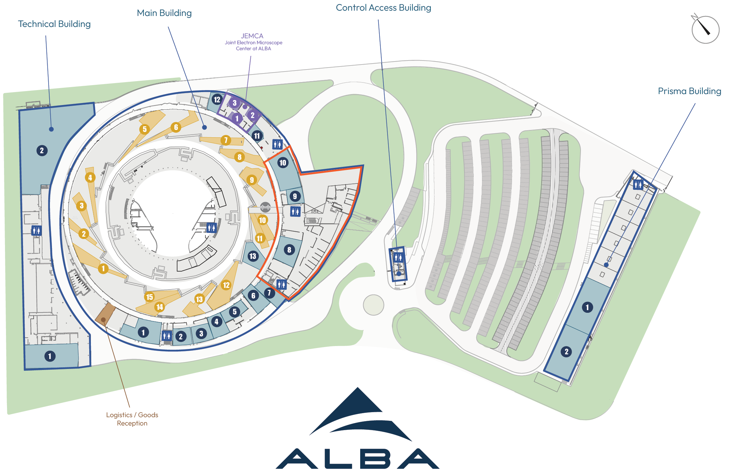
Map of JEMCA

Slide 3



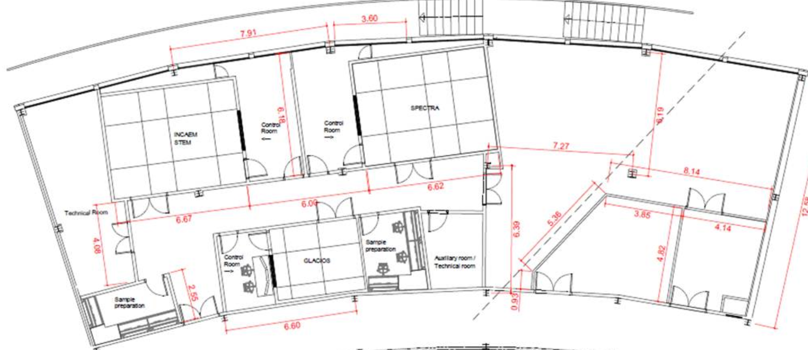


Map of JEMCA
EM01 | IBMB | 200 kV – Life science
EM02 | ICN2 | 300 kV – Material science
EM03 | ALBA | 300 kV – Material science – environmental/correlative
EM02
EM03
EM01

Slide 4
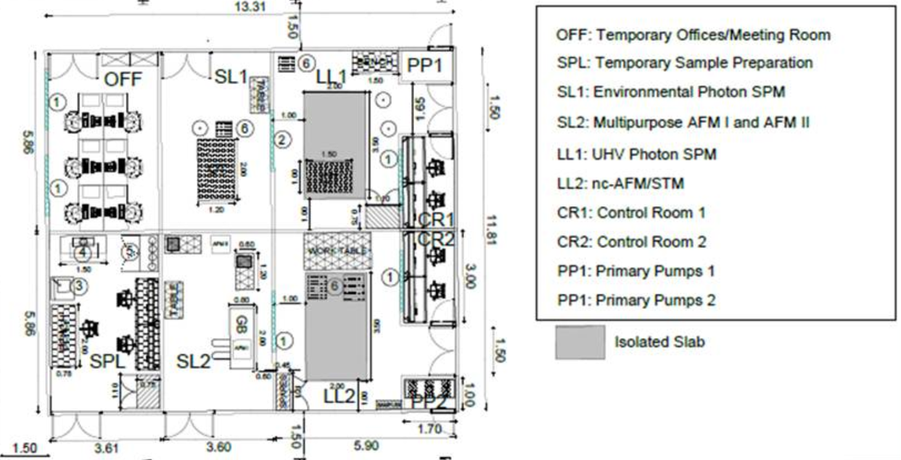
Map of JEMCA
SM01 | LL2 | (pre-existing) UHV Scanning Probe Microscope – ICMAB
SM02 | SL2 | Atomic Force Microscope 1 ICMAB
SM03 | SL2 | Atomic Force Microscope 2 ICMAB
SM04 | LL1 | UHV Photon SPM – ICN2
SM05 | SL1 | Environmental photon Atomic Force Microscope - ICN2

Slide 5


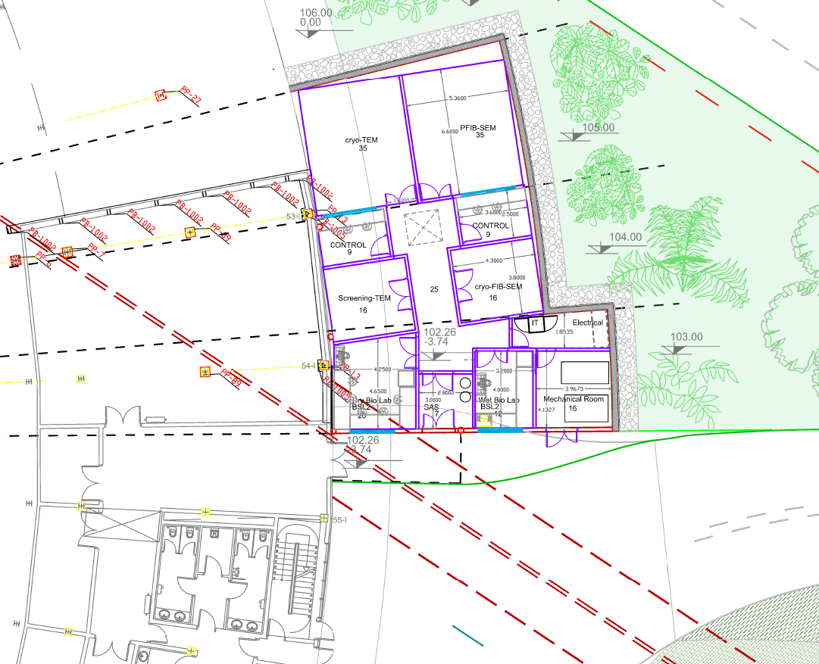
Map of JEMCA
EM04

Slide 6
JEMCA numbers
Instrument | 1st users | Owner | Partners | Instrument* (ME) | Personnel | Operation (kE) | Maintenance (kE) | Investment funds
EM01 | Jul 2023 | IBMB-CSIC | CELLS (UAB, IRB, CRG) | 1.7 | 2 (CSIC) + 1 (CELLS) | 50 | 200 Nov 26 | FEDER Cooperatives
EM02 | Jan 2024 | ICN2 | CELLS, ICMAB, UAB | 3.45 + 0,85 (ICN2-CSIC) | 2 (ICN2) + 1 (CELLS) | 100 | 250 Jan 27 | FEDER Cooperatives (3.45) NEXT GENERATION CSIC QTEP (0,85)
EM03 | Jul 2027 | CELLS | ICN2, ICMAB, PIC | 4.9 | 2 (CELLS) + 2 (ICN2) + 1 (ICMAB) | 90 | 300 Jan 30 | Plans Complementaris
EM04 | 2030 | CELLS | IRB, CSIC | 7 (incl build) | 3 + 1 | 100 | 350 2032 | Projecte Singular FEDER
FIB | Jan 2024 | ICN2 | CELLS, ICMAB, UAB | Included in EM02 | 1 (ICN2) | 30 | 100 Apr 26 | FEDER Cooperatives
SM01 | 2028 | ICMAB | CELLS, ICN2, PIC |  | 2 (ICMAB) + 0.25 (CELLS) |  |  | Old instrument (2014)
SM02 & 03 | 2028 | ICMAB | CELLS, ICN2, PIC | 0.6 | 1 (ICMAB) + 0.25 (CELLS) | 80 |  | Plans Complementaris
SM04 & 05 | 2028 | ICN2 | CELLS, ICMAB, PIC | 1.6 | 3 (ICN2) + 0.5 (CELLS) | 130 |  | Plans Complementaris
Data |  | CELLS-PIC |  | 2 |  | 450 |  | Plans Complementaris
TOTAL (up to ‘35) |  |  |  |  | 1.3 -> 1.6 ME | 1 -> 1.3 | 0.3 -> 2.2 ME
* Cost of infrastructures not included

Slide 7
Host Institution: ALBA (coordinator)
Board: Instrument owners
(one per institute)
Frame agreement
Chair: rotating among Board Members
Forum: includes Coordinator, Board and Associates
Specific agreements (annex to frame).
Instrument committee:
Instrument responsible
Partners
Associates
JEMCA Network
Joint E Microscopy Center at ALBA
CSIC
Owner EM01, SM01, SM02/03
ALBA
Owner EM03, EM04
IBMB-CSIC
Owner EM01
ICMAB-CSIC
Owner SM01, SM02/03
ICN2
Owner EM02, SM04, SM05
Frame agreement
Board (1 participant per member institutions)
EM01
IBMB-CSIC
IRB
CRG
ALBA
UAB
EM02
ICN2
CSIC
ALBA
UAB
EM03
ALBA
ICN2
ICMAB
PIC
EM04
ALBA
CSIC
IRB
SM01
ICMAB
ALBA
ICN2
PIC
SM02/03
ICMAB
ALBA
ICN2
PIC
SM04
ICN2
ALBA
ICMAB
PIC
SM05
ICN2
ALBA
ICMAB
PIC
DATA Infrastructure ALBA - PIC - all members and associates

Slide 8
JEMCA Alliance
General Protocols that express the intention of several institutions to act jointly, provided that they do not establish specific and legally enforceable commitments.
Operating rules: objectives, members, coordination committee, admission of new members, meetings, use of the name/logo, etc.
If there are specific obligations, it would be advisable to formalize them through an agreement between the institutions. Law 40/2015 expressly provides for agreements aimed at pursuing a common purpose and establishes their required content and obligations.
Member = an institution that jointly undertakes the commitment to invest in JEMCA and ensure its operational sustainability.
JEMCA Board, with one representative from each Member
Associate = an institution that contributes to JEMCA but does not undertake the full commitment of a Member. This allows an Associate to contribute only to CAPEX, only to OPEX, or to both, but on a limited or temporary basis.
JEMCA Forum, with one representative from each Member and Associate.
The Members Board provides guidance on strategy, development of capabilities, admission of new Members, general rules on access and general relationship between resource provided and access time. ALBA would retain those decisions that legally fall within its remit as the host entity.

Slide 9
Governance
Criterion | JEMCA Members | JEMCA Associates
Initial Investment | Yes, mandatory | Optional
Contribution to Operating Costs | Yes, mandatory | Optional
Commitment | Structural / long-term | Specific or limited
Participation in Governance | Full | Limited
Strategic Decisions | Yes | Normally not
Access / Benefits | According to contribution and common rules | According to the type of contribution
Admission / Withdrawal | More stringent requirements | More flexible

Slide 10
Considerations for the governance (Frame Agreement)
Parties and Purpose — signatory institutions; definition of the “centre” as a coordinating brand/umbrella; explicit statement that no new legal entity is being established.
Board — composition, quorum, required majorities (simple majority for ordinary management matters; qualified majority/unanimity for the admission of new partners or changes to fees), meeting frequency, and rotating chairmanship.
Relationship between Board Level and Instrument Level — which decisions fall within the remit of the Board (common fee policy, branding, single application portal, code of good practice) and which remain reserved for each instrument committee (cost, fee, scheduling, maintenance, and scientific priorities relating to its allocated share).
Roles at facility level (operations manager?, maintenance technician?, outreach/industrial officer?). Accurate representation of roles and titles
Allocation of Common Costs — formula for shared expenses (website, coordination, user reception/support staff): shares, based on usage volume.
Liability Regime — each institution is liable only for matters falling within its own area of responsibility (its instrument and its personnel); clause excluding joint and several liability among partners participating in different instruments.
Default Intellectual Property and Data Rules — general rules applicable unless otherwise specified in the relevant instrument annex (typically, data belong to the user paying for the service or having granted competitive access time, while methodological improvements developed using common funds are jointly owned/shared).
Admission and Withdrawal of Partners — requirements for joining as a new partner of the centre or of a specific instrument; consequences of an institution’s withdrawal (withdrawal from an individual instrument versus withdrawal from the centre as a whole — the two should not automatically trigger one another).
Dispute Resolution — escalation procedure: instrument committee → Steering Committee → agreed mediation/arbitration.
Term, Review and Termination — duration, review arrangements, and grounds for discontinuing/dissolving the centre as a common brand.

Slide 11
Specific instrument annex (Collaboration Agreement)
(as for EM01, 02, InCAEM)
Identification of the Instrument — description of the instrument, its physical location, and the institution responsible for operating it.
Ownership — identification of the principal owner and any secondary partners, together with each party’s percentage contribution to the initial CAPEX for the acquisition of the instrument.
Funding of Instrument-Specific OPEX — maintenance, service contracts, consumables, and dedicated technical staff; cost-sharing formula between the owner and the partners (normally proportional to their percentage of reserved instrument time, rather than necessarily to their original ownership or CAPEX contribution).
Allocation of Instrument Time — distribution of available instrument time among the participating institutions.
Scientific/Technical Lead for the Instrument — appointment procedure (normally appointed by the principal owner) and definition of their responsibilities and functions. Instrument operators responsibilities and functions. Instrument technicians responsibilities and functions.
Data custodian (normally instrument owner)
Insurance and Risk — allocation of responsibility in the event of breakdown or damage, responsibility for insuring the equipment, and applicable limits of liability.
Access Conditions for Third Parties — conditions governing access by entities outside the centre (e.g. companies or other universities) and allocation of any revenue generated from such access.
Review of Time Allocation — mechanism for renegotiating a partner’s percentage of instrument time where that partner increases its contribution, for example by financing an upgrade to the equipment.
Withdrawal from the Instrument — consequences if a partner withdraws from the instrument or if the instrument is withdrawn/decommissioned from the centre, including the resulting arrangements regarding the equipment.

Slide 12
Preparation of a leaflet for sharing with collaborators/industry/funders
Context:
Unique combination of Advanced instrumentation to provide solutions to complex problems in academy and innovation
Achieve international leadership of partnerships in strategically selected target areas.
Combining knowledge and instrumentation to tackle grand challenges in basic and applied sciences as well as engineering.
Integrating a facility(ies) with the research institution to form a part of the local innovation ecosystem.
Enhancing the regional capabilities to build a high-tech economy in Catalonia and Spain.
Act as an asset to the workforce development in Catalonia and Spain.
Contents:
JEMCA opportunities: Institutes and Universities plus one Research Infrastructure summing up capacities
X-ray, Electron Microscope, Data Infrastructure playing together
RI experience as user facility, research institution, data infrastructure and innovation hub
Institutes experience as research institutions and industry partners, TT, …
Universities as training and research centers and industry partners, TT,…
Catalunya, Spain, Europe
Two main areas: life and material science
Examples (using X-ray and JEMCA)
Users – resident users – industrial users…
Editorial Board:
One member per Instrument + ILO + communication, coordinated by one/two editors (one or one per section)
Document to be ready by the end of this year

Slide 13
Next
Meeting with all players – Members + IRB, CRG, UAB – propose dates within October/November
Each Instrument owner:
Defines responsible of the instrument
Summarizes resources assigned or to be assigned to each instrument
Summarizes maintenance costs with starting date
Defines data needs (storage, on-line analysis, off-line analysis, workflow developments)
Designates leaflet editorial board member

