Slide 1

Beam Size Measurements using Non-Redudant Aperture Interferometry
U. Iriso (ALBA), C. Carilli (NRAO), B. Nikolic (Univ. of Cambridge), N. Thyagarajan (CSIRO), and L. Torino (ALBA)
HEPS - ALBA Workshop
July 2026

Slide 2
Introduction: 2-apertures Interferometry
Fourier Domain: from 2-holes to N-holes Interferometry
Non-Redundant Aperture Interferometry
Examples and SRW Simulations
Other Applications: WaveFront Sensing
Conclusions

Slide 3
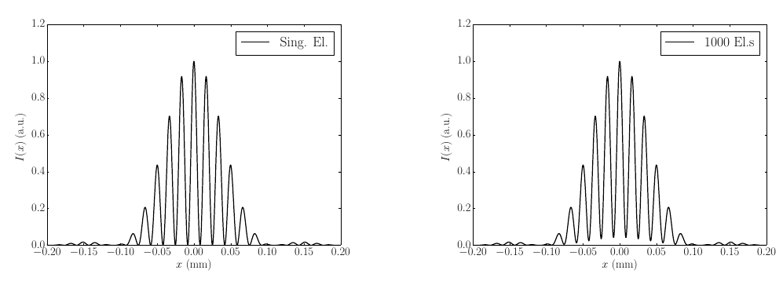
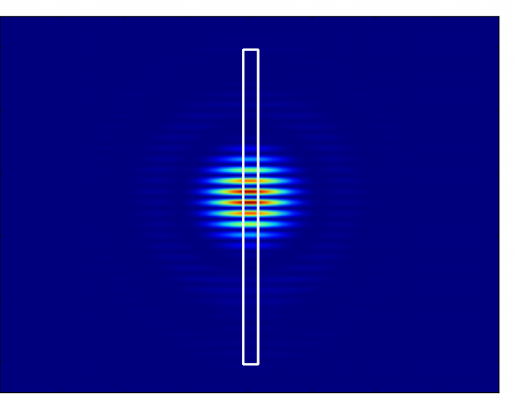
Double Aperture Interferometry
~1995
Pioneer implementation by T. Mitsuhashi based on Young’s Interferometer (~90s)
Use the synchrotron radiation and a double-aperture mask to produce an interferogram and measure the 1st order spatial coherence.
Typically used in the visible range.
SR
CCD
e-beam
Sync Rad from
Magnetic element
Polarizer
Lens
Monochromator
Double
Aperture
Interferogram @Image Plane
Interference profile from a point-like source
Interference profile from a finite source (σ > 0)
Notes:
Coherence already measured by Michaelson ~1900 by measuring the ratio peak/minimum of fringe

Slide 4
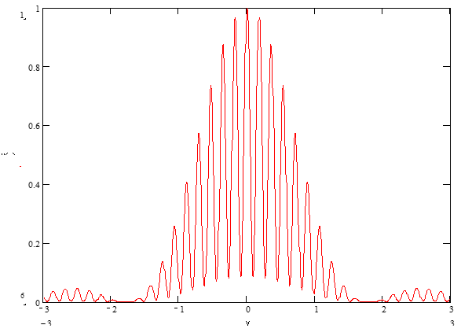
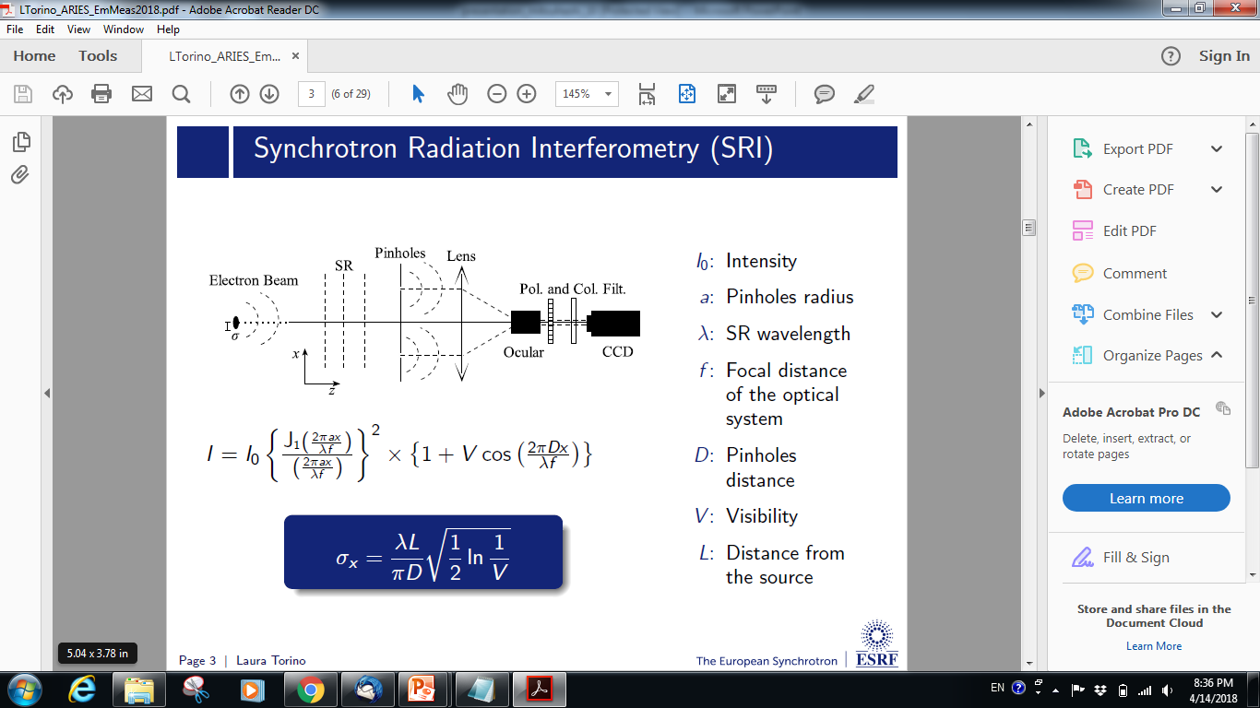
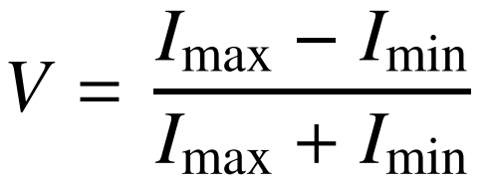
Double Aperture Interferometry
~1995
The interference pattern in the image plane follows an analytical expression:
Imax
I₀ : intensity
a: pinhole radius
D: distance between pinholes
λ = wavelength
f: focal length
L: distance to the source
Imin
All parameters are known, except the “Visibility” (V)
V obtained by fitting, or simply measuring max intensity and adjacent minima.
From V, the beam size (σ_{x}) is obtained using the Van Cittern-Zernique theorem

Slide 5
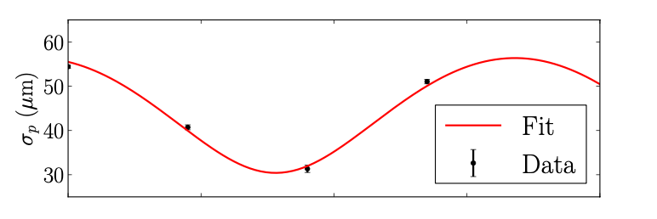
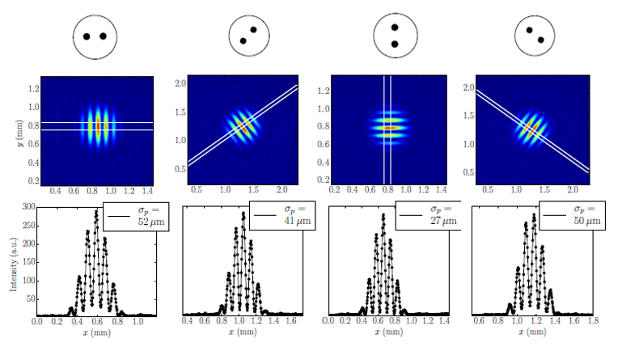
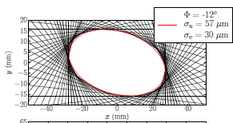
Double Aperture Interferometry: Rotating Mask
~2016
SRI limitation: provide only 1d measurement → the 2-aperture orientation defines direction analysis
Using a rotating mask, we can fully reconstruct beam profile by fitting σ for different rotation angles
Multiple interferograms (at least 4) need to be done → 2D reconstruction not in real time
*L.Torino and U.Iriso, PRST-AB 19, 122801 (2016)

Slide 6
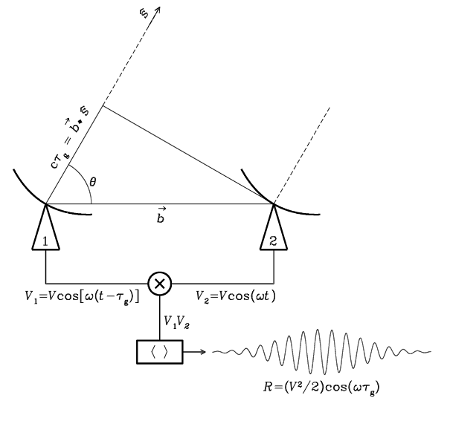
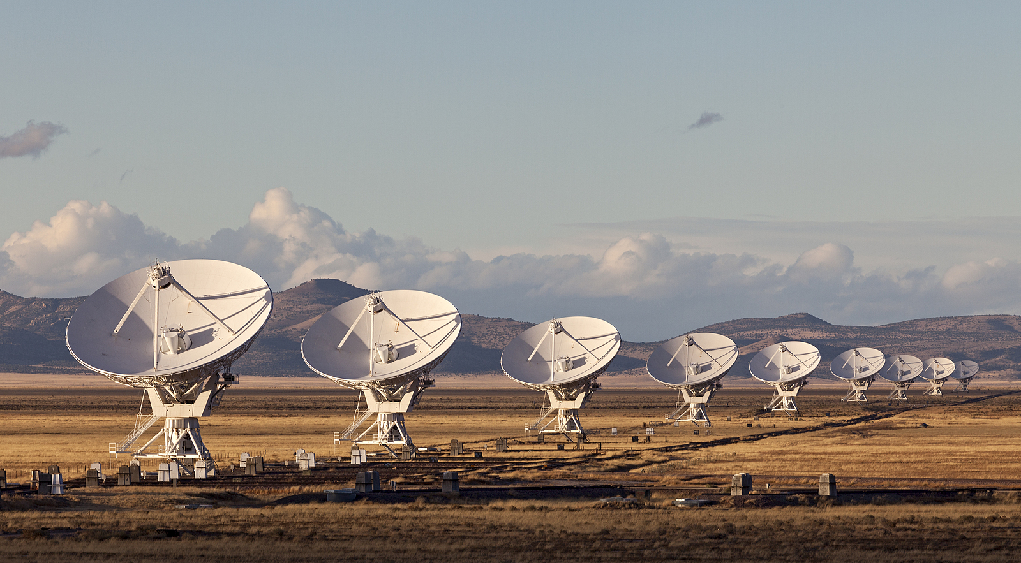

Influence from Radio-Astronomy
~2023
Radio-Astronomy Observatories | Synchrotron Radiation Interferometry
Antennas | Apertures
Radio (GHz) Measurements | Visibilities
Coherent amplification of voltages, E
Geometric delays set by electronics
Images made from Fourier Transform
V_{i,j} = E_{i} x E_{j}* = A_{i,j,} 𝝓_{i,j}
Notes:
Images made from Fourier Transform of Visibilities

Slide 7
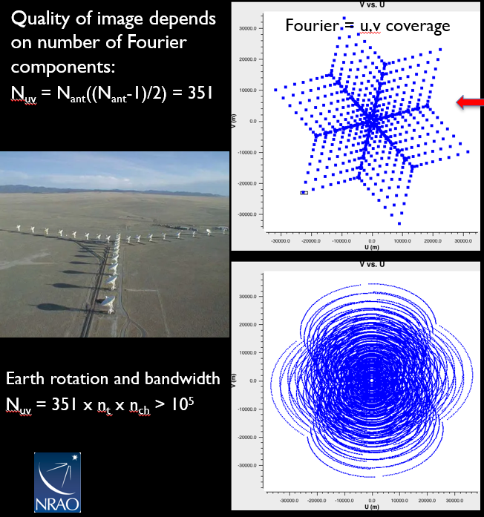
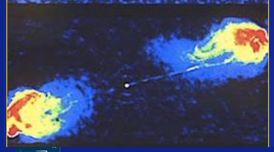
Influence from Radio-Astronomy
~2023
Nant = 27 antennas at the Very Large Array telescope
(NRAO – New Mexico, USA)
Antennas (telescopes) ⬅ ➔ Apertures
Nant = 27
Able to image stars with this shape, why not a Gaussian beam??
➔ For Synchrotron Radiation Interferometry, working in the Fourier Domain and working with more apertures will have advantages
Notes:
Q for Chris: This case corresponds to 27 antennas. Is this VLA?

Slide 8
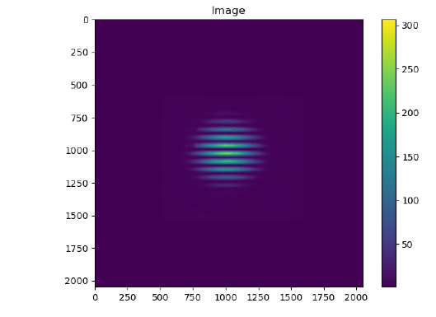
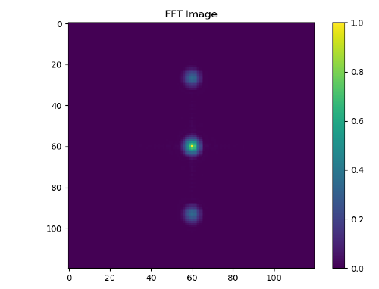



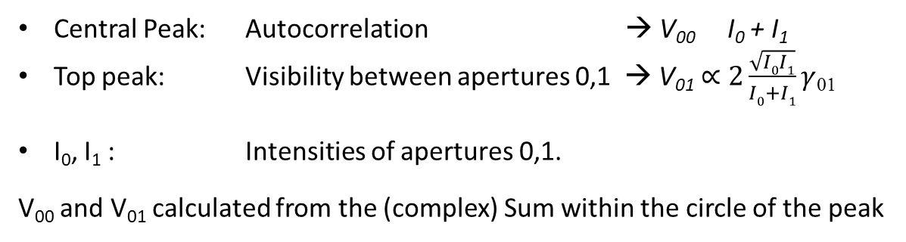
Fourier Domain: 2-apertures
Mask
Raw Image
2D FFT
0-1
Ap1
Auto
Ap0
1-0
Fourier Domaim (u,v) image:
We could fit the two points with a normalized Gaussian in the Fourier (u,v) plane and get the coherence length σ_{C}:
The beam size (σ) is inferred using VCZ theorem:
Central Peak: Autocorrelation → V₀₀ I₀ + I₁
Top peak: Visibility between apertures 0,1 → V₀₁ $∝2\frac{\sqrt{I0I1}}{I0+I1}γ$₀₁
I₀, I₁ : Intensities of apertures 0,1.
V₀₀ and V₀₁ calculated from the (complex) Sum within the circle of the peak
$∝$
$$I\left(v\right)=exp⁡(−v^{2}/2{σ_{C}^{2})}^{}$$
σ=λ·L/(π·σ_{C})

Slide 9
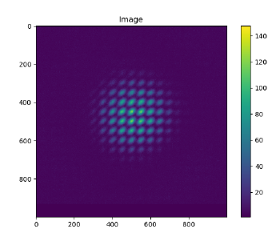
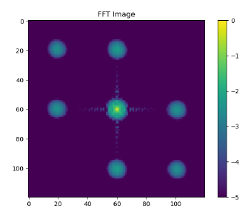
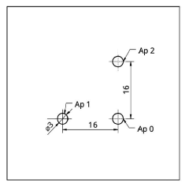

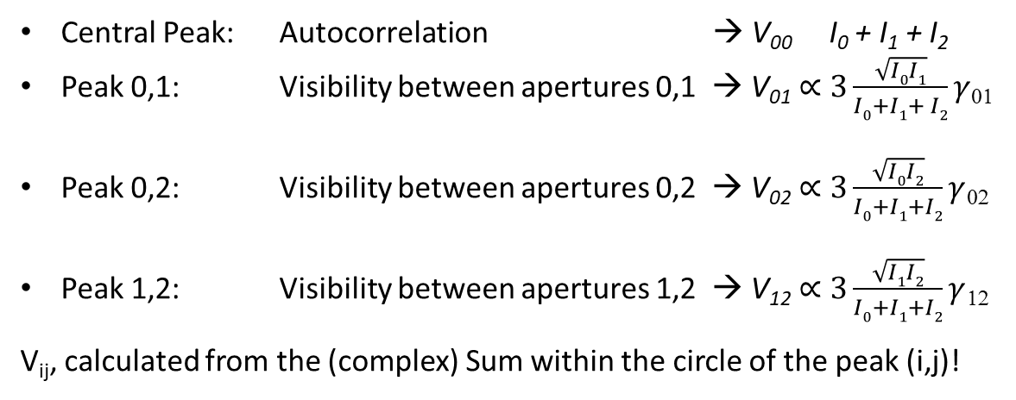
Fourier Domain: 3-apertures
Mask
Raw Image
2D FFT
Auto
0-1
0-2
1-2
Central Peak: Autocorrelation → V₀₀ I₀ + I₁ + I₂
Peak 0,1: Visibility between apertures 0,1 → V₀₁ $∝3\frac{\sqrt{I0I1}}{I0+I1+ I2}γ$₀₁
Peak 0,2: Visibility between apertures 0,2 → V₀₂ $∝3\frac{\sqrt{I0I2}}{I0+I1+I2}γ$₀₂
Peak 1,2: Visibility between apertures 1,2 → V₁₂ $∝3\frac{\sqrt{I1I2}}{I0+I1+I2}γ$₁₂
V_{ij}, calculated from the (complex) Sum within the circle of the peak (i,j)!
$$∝$$
→ In Fourier space, we can fit the three points with a normalized 2D-Gaussian and get (σ_{Cx} , σ_{Cy})
→ Beam size (σ_{x} , σ_{y}) using again the VCZ theorem
σ_{x}=λ·L/(π·σ_{Cx})
Notes:
Assuming a flat Gaussian beam, and knowing (I₀, I₁, I₂), or if I₀=I₁=I₂ .

Slide 10
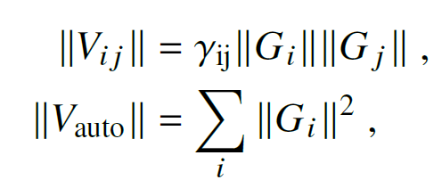

Fourier Domain: N-apertures
2D FFT
The process can be generalized as:
with
$$Gi=\sqrt{Ii}$$
Auto
0-1
0-2
1-2
For N-holes, the Known Parameters, P_{k}:
  Distinct peaks in the Fourier Domain (visibilities, V_{ij})
P_{k} = (𝑁(𝑁 − 1)/2) +1
System fully characterized if Pk > Pu
So, for 5 holes
For N-holes, the Unknown Parameters, P_{u}:
  2D tilted Gaussian: (σ_{u}, σ_{v}, φ) → 3 unknowns
  Hole Intensities: G_{i} , for i=1… N → N unknowns
P_{u}= N +3
Self-calibration Technique*:
  Joint fit to the measured Vij to obtain both the Gaussian source parameters and hole gains (intensities)
*B. Nikolic, C. Carilli, U. Iriso, N. Thyagarajan, and L. Torino, “Two-dimensional synchrotron beam characterization from a single interferogram“, PRAB, 27, 112802 – Published 25 November, 2024

Slide 11
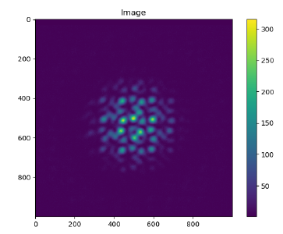
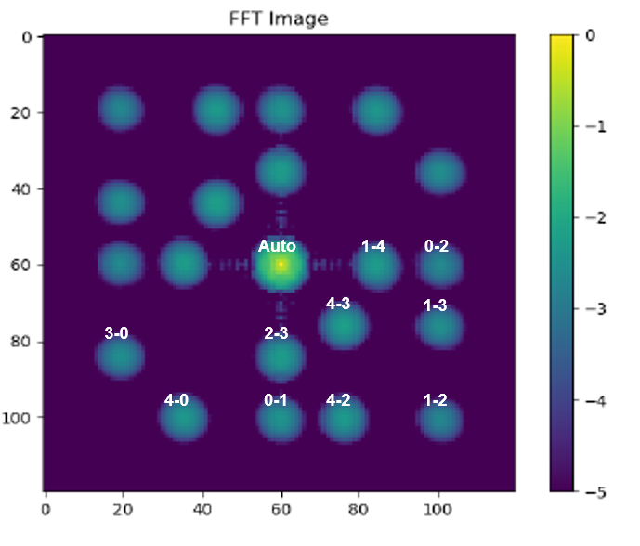
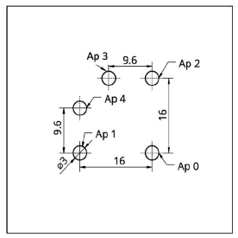
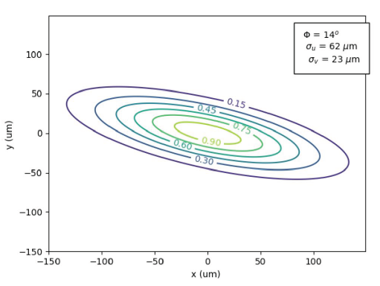
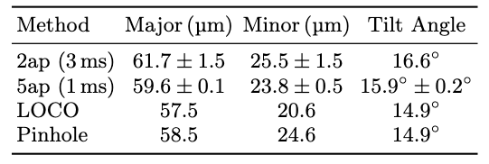
Results with 5-apertures
Mask
Raw Image
2D FFT
N=5 apertures
[N(N-1)·2 + 1] peaks
11 distinct peaks
Electron Beam Reconstruction from a single interferogram.
Results in agreement with other methods
*B. Nikolic, C. Carilli, U. Iriso, N. Thyagarajan, and L. Torino, “Two-dimensional synchrotron beam characterization from a single interferogram“, PRAB, 27, 112802 – Published 25 November, 2024

Slide 12
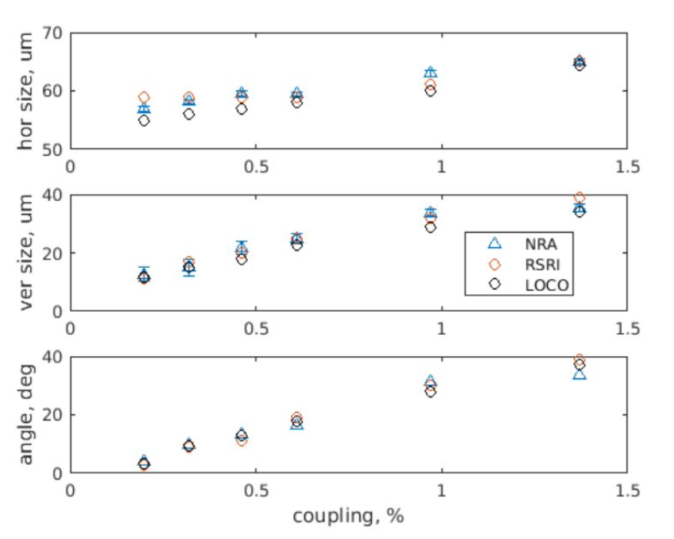
Example: Beam Coupling Scan
Vertical beam size scan changing the machine coupling with skew magnets.
Results using the NRA mask (7-hole) agrees with:
  Rotating (double aperture) SRI
  LOCO Analysis
The minimum beam size we can achieve at ALBA (11um) is well measured.
U. Iriso, L. Torino, C. Carilli, B. Nikolic, N. Thyagarajn, New interferometric aperture masking technique for full transverse beam characterization, Proc. of IBIC24, 2024

Slide 13
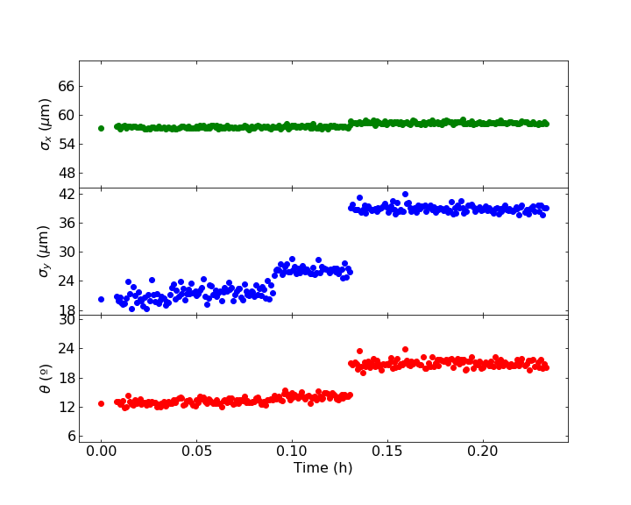
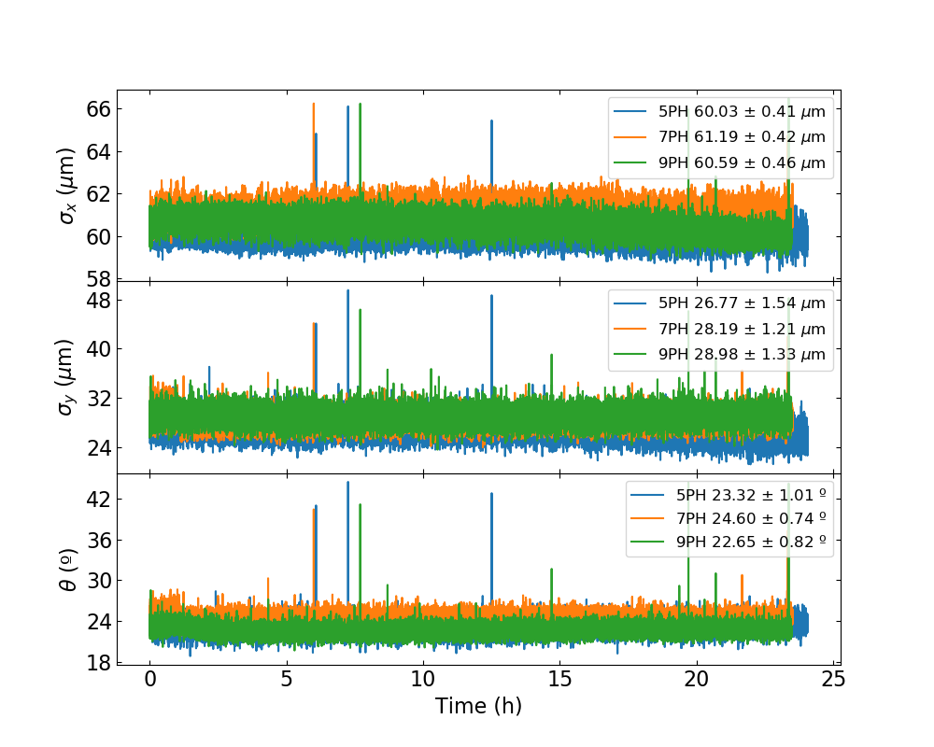
Example: Real-Time Measurements
Real Time Measurements while varying beam coupling
24h test with different masks (in different days)
*L. Torino, C. Carilli, U. Iriso, B. Nikolic, N. Thyagarajn, Capabilities and limitations of NRA inteferometry for beam size meas, Proc of IPAC26

Slide 14
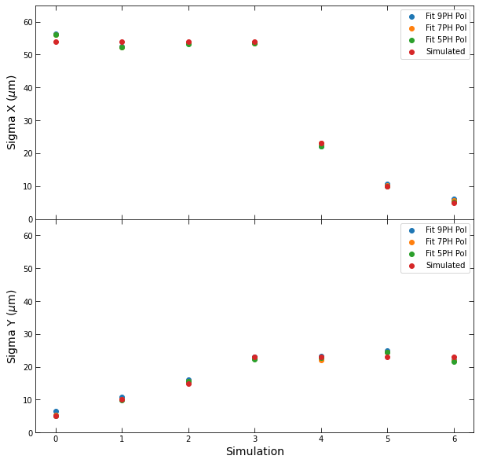
SRW Simulations
For ALBA-II, we plan to use a classical x-ray pinhole camera for normal operation (C=50% coupling)
Nevertheless, for C<10%, the vertical beamsize is dominated by diffraction and the PSF ~ σ_{y}
→ Synchrotron Radiation Workshop (SRW) simulations have been done, and we have reproduced beamsizes down to 5um*
Alba-II σ_{x}
Alba-II σ_{y} - depends on Coupling)
*L. Torino, C. Carilli, U. Iriso, B. Nikolic, N. Thyagarajn, Capabilities and limitations of NRA inteferometry for beam size meas, Proc of IPAC26

Slide 15
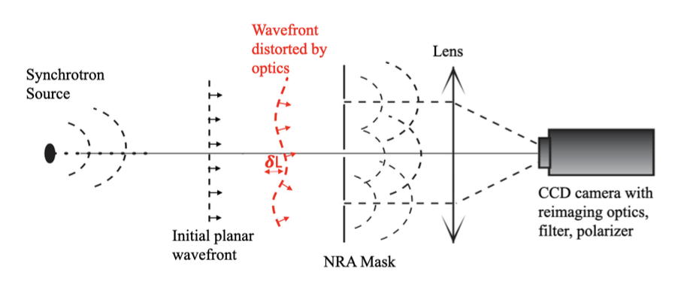
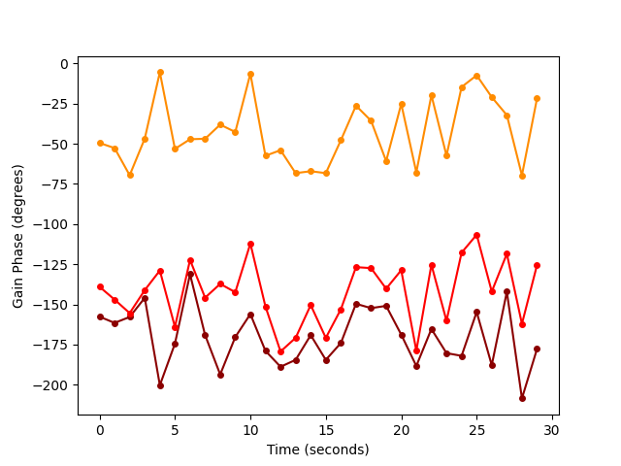
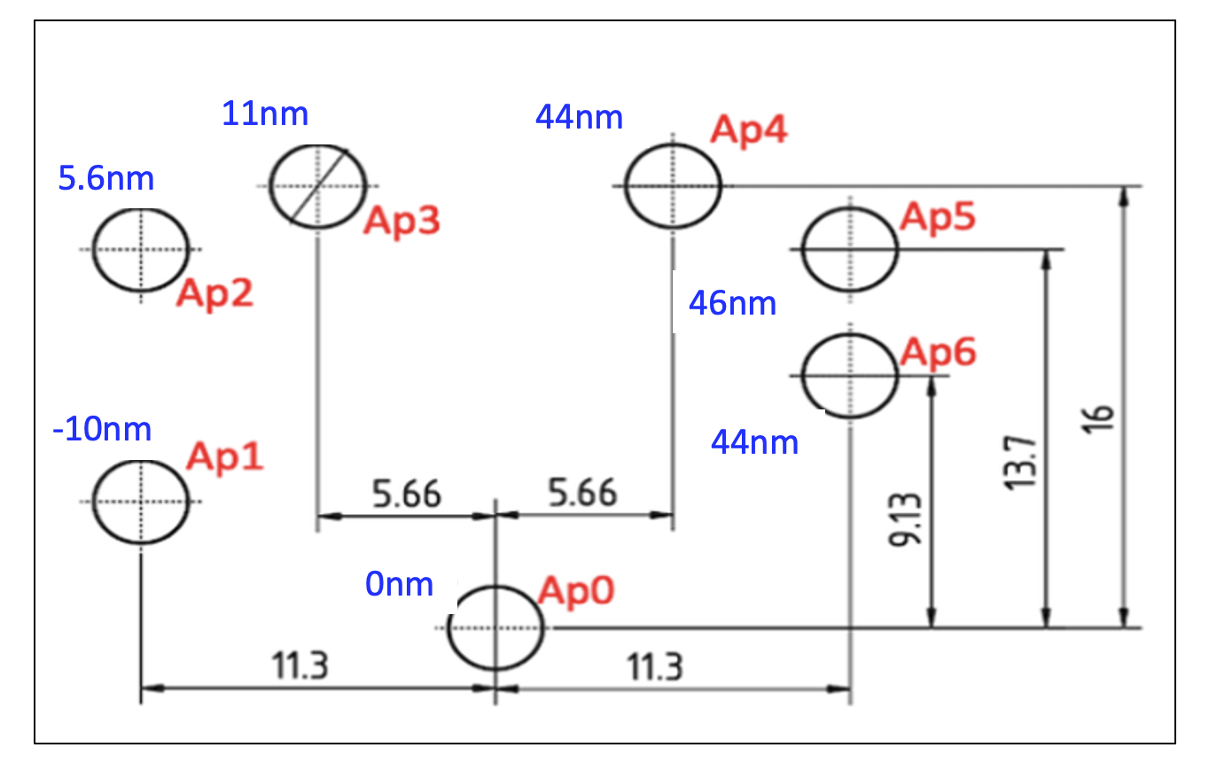
Other Applications: WaveFront Sensor
Gain Phase in Fourier Analysis encode path length diferences 𝛅L
➔ can be used as WaveFront Sensor
𝛅L = 𝛌 x 𝛉_{i}/360º
1,2,3
    Variations ~ 20º (6nm) are correlated between neighboring holes

Slide 16
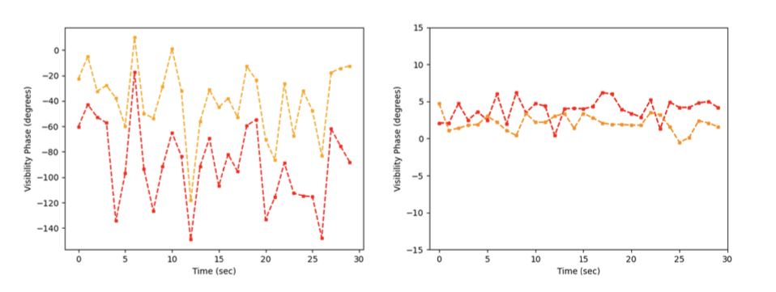
Other Applications: WaveFront Sensor
Before Self-cal
After Self-cal
1-6, 2-5
rms ~ 1.2º = 1.3nm
[𝛔_{N𝛄} ~ 0.1% ~ 0.4nm]
rms = 28º = 31nm
Mean = static pathlength differences (’metrology’)
Variations (millisec) = vibrations and turbulence
  𝛅𝚽 is correlated between pairs-of-holes => systematic 𝛅L, not noise
  rms after self-cal much lower => measuring frame 𝛅L to high significance
EXAMPLE APPLICATION:
  Control of possible mirror deformation due to heating, long-term contamination, etc

Slide 17
Conclusions
New Technique for Full 2D transverse beam characterization from a single interferogram, produced by a multi-hole Non-Redundant Aperture mask.
Advantages wrt “classical” double-aperture :
  Full 2D transverse beam reconstruction ➔ RealTime Measurements of (σ_{x}, σ_{y}, φ)!
  More holes → more light → better SNR, better resolution…
SRW simulations show that measurements down to 5um are possible → ready for ALBA-II
Other benefits:
  Wavefront distortions can be obtained using the Gain Phases: detected tilts ~urad scale
Multi-disciplinary collaboration between Astronomers and Accelerator Physicists pays off!

Slide 18
extra

Slide 19
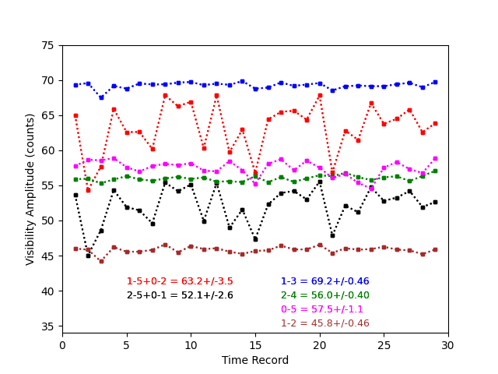
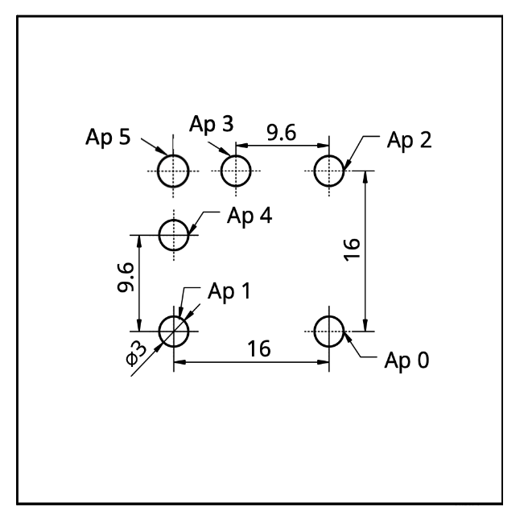
Why Non-Redundant Apertures?
To identify the peaks in the Fourier domain
Baselines with the same distance & direction produce blurring and decoherence in the Fourier space
2D FFT (NRA 5-holes)
Example using a 6-hole Redundant Aperture
Redundant combination:
(1,5 – 0,2), Red
(2,5 – 0,1), Black
rms for redundant samples ~6X larger

Slide 20
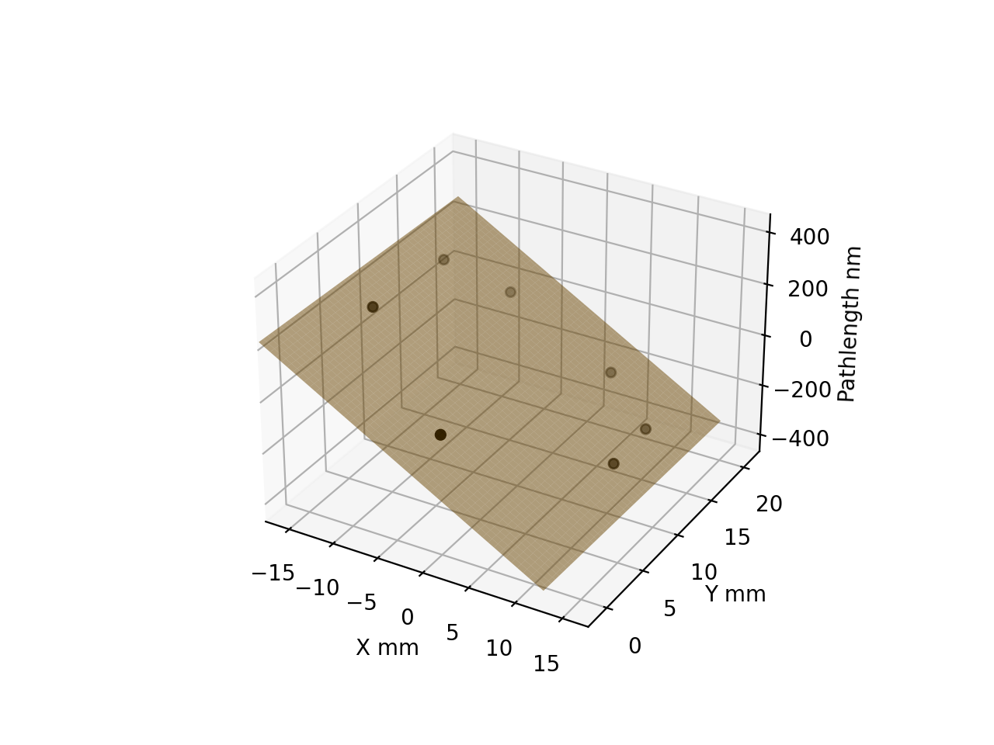
Other Applications: WaveFront Sensor
Mirror Rotation Tests
Wavefront Sensor “calibrated” using a mirror whose rotation can be controlled down to 0.1urad
Move the mirror by a known amount, and measure the wavefront distortion from the gain phases
Planar fit to the 2” tilt data: measured 2.15” with NRA fitting
Mean (static) residuals ~ +/-10nm
Non-plannar distortions are reproduced between experiments within +/-1nm
APPLICATION:
  Control of possible mirror deformation due to heating, long-term contamination, etc
2” input tilt
2.15” fit tilt
IBIC 2025, TUPMO09
https://meow.elettra.eu/90/pdf/TUPMO09.pdf

Slide 21
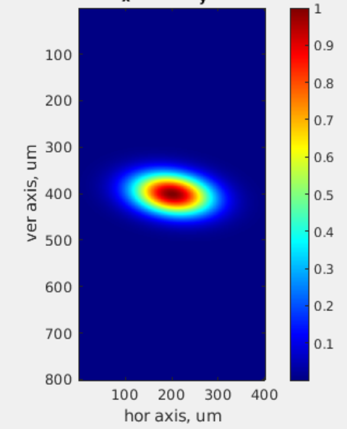
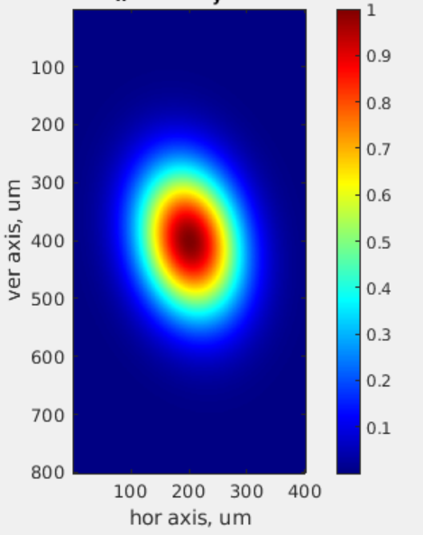
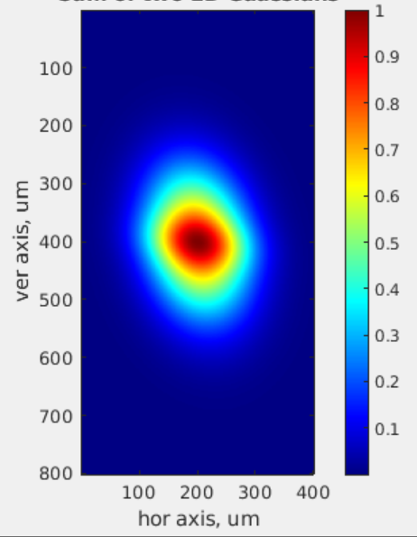
Imaging Double-Gaussian Beams
Artificially create beams with different shapes → re-construction using NRA?
Using the Bunch-by-bunch system, we mix different vertical beam sizes within the filling pattern
A. Beam stable (as in Operation):
(σ_{x}, σ_{y}) = (60, 30)um; φ = 8º
B. Coherent Excitation (Qv+Qs):
(σ_{x}, σ_{y}) = (60, 90)um; φ = 12º
(100 bchs of “A” + 340 bchs of “B”):
Beamshape characterization?
Pinhole Image
Pinhole Image
Pinhole Image

Slide 22
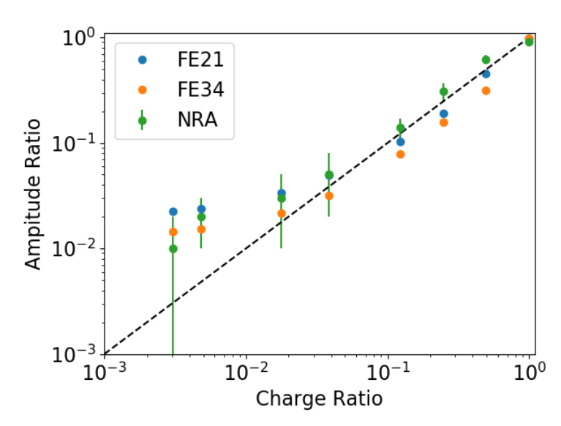
Imaging Double-Gaussian Beams
Fit a sum of two Gaussians, with the constraint that their sum of amplitudes is 1
Dual purpose experiment:
  Reproducing non-Gaussian beam shapes
  Possible Halo Measurements: reduction of excited bunches until < 1/440
Amplitude of the two Gaussians (Excited and Non-Excited beams) is compared with the charge ration measured using the Photon Counting.
The beam shape is well reproduced down to ~1% (similar precision obtained with pinhole cameras FE21 & FE34)
The complexity of the source that can be derived will depend on the completeness of the u,v sampling.
Mask design should be optimized to reproduce different beam shapes
IBIC 2025, TUPMO09
https://meow.elettra.eu/90/pdf/TUPMO09.pdf

Slide 23
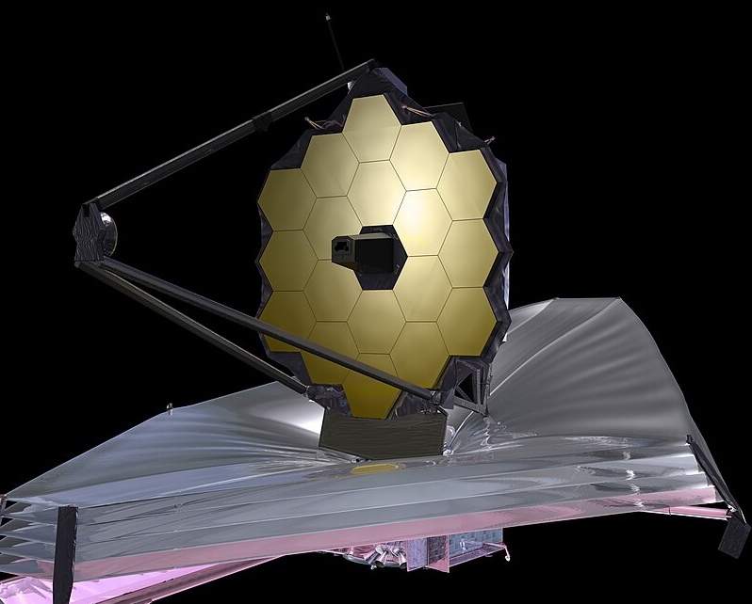
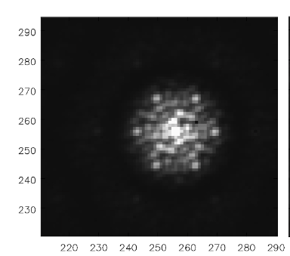
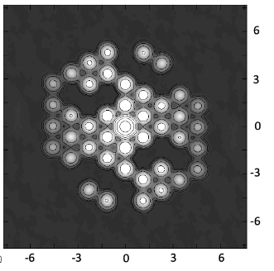
From ALBA to the James Webb Telescope
JWST can have up to 18 mirrors (apertures), but one can play with them to produce Aperture Mask Interferometry (AMI).
Self-calibration NRA remains a key capability for imaging at the diffraction limit of the JWST, in particular, for close star-planet systems.
This methodology was long used in radio astronomy, but not, to date, in optical interferometry*.
Interf. NRA with 7-mirrors
Fourier Transform.
*C. Carilli, “A New Method for Aperture Masking Interferometric Imaging: Demonstration with the JWST”, Optical Engineering SPIE, 2025

Slide 24
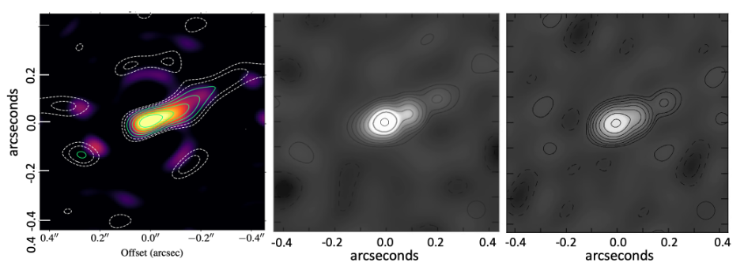
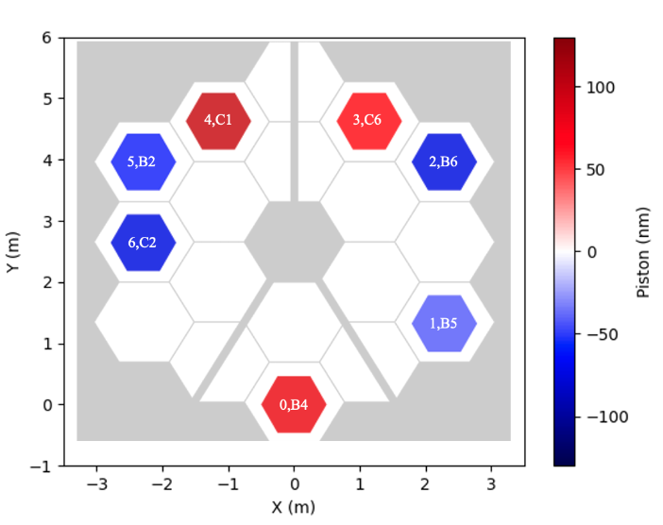
From ALBA to the James Webb Telescope
Reliable double-star system image reproduction using self-calibration techniques
Explore other aspects ofthe JWST system → ‘real-time’ wavefront sensor
Imaging of dusty binary star WR137
’Real-time’wavefront error sensor.
‘standard’ method
(R. Lau et al**)
NRA interf., λ=4.8um
(C. Carilli et al*)
NRA interf., λ=3.8um
(C. Carilli et al*)
*C. Carilli et al, “A New Method for Aperture Masking Interferometric Imaging: Demonstration with the JWST”
Optical Engineering SPIE, 2025
** R. Lau, et al., “A first look with JWST aperture masking interferometry: dust around the wolf–rayet binary WR 137 beyond the rayleigh limit,” The Astrophysical Journal 963, 127 (2024).

Slide 25
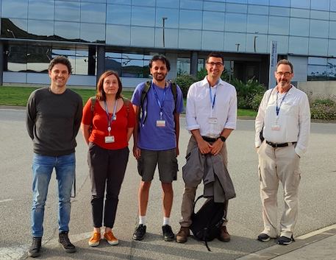
Publications
https://indico.synchrotron-soleil.fr/event/76/, New interferometric aperture masking technique for full transverse beam characterization using synchrotron radiation, DEELS24, June 2024
https://arxiv.org/abs/2406.02114 , Deriving the size and shape of the ALBA electron beam with optical synchrotron radiation interferometry using aperture masks: technical choices, June 2024
https://opg.optica.org/josaa/abstract.cfm?uri=josaa-41-8-1513 , Laboratory demonstration of image plane self-calibration in interferometry, , Journal of the Optical Society of America , Aug. 2024
https://accelconf.web.cern.ch/ibic2024/doi/jacow-ibic2024-tup56/ , New interferometric aperture masking technique for full transverse beam characterization, IBIC24, Sept. 2024
https://journals.aps.org/prab/abstract/10.1103/PhysRevAccelBeams.27.112802 , Two-dimensional synchrotron beam characterization from a single interferogram, Phys. Rev. Accelerator & Beams, Nov. 2024.
https://opg.optica.org/josaa/abstract.cfm?uri=josaa-42-9-1261, Two-dimensional light beam shape characterization using interferometric closure amplitudes, Journal of the Optical Society of America.
https://arxiv.org/abs/2503.10820 , Self-calibration in two dimensional aperture mask optical interferometry: a new method for wavefront sensing, March 2025
https://meow.elettra.eu/90/pdf/TUPMO09.pdf , Exploiting NRA Interferometry as a Diagnostics Tool for Synchrotron Light Characterization, IBIC25 (2025)
http://dx.doi.org/10.1117/12.3062598 , A new method for wavefront sensing using optical masking interferometry. Proc. SPIE Conference 13619, (18 September 2025);
https://arxiv.org/abs/2510.13502 , A New Method for Aperture Masking Interferometric Imaging: Demonstration with the JWST, submitted to Optical Engineering (SPIE). Oct. 2025
US patent 12,104,901
US patent app. No. 18/878,488
US patent app. No. 19/079,876

Slide 26
Extra

Slide 27
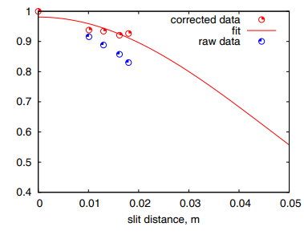
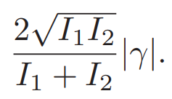
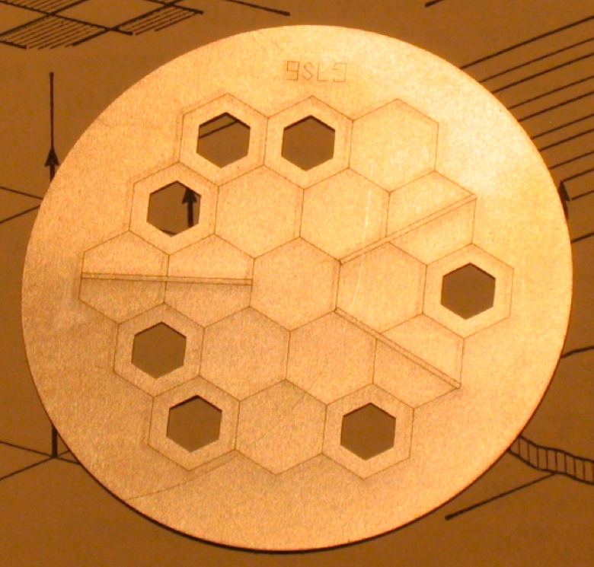
Double Aperture Interferometry: Intensity Imbalance
The Visibility V is related to the complex degree of coherence γ by a factor involving the intensities going through each hole I₁ and I₂ .
V =
James Webb Telescope Mask for 7-hole NRA

Slide 28
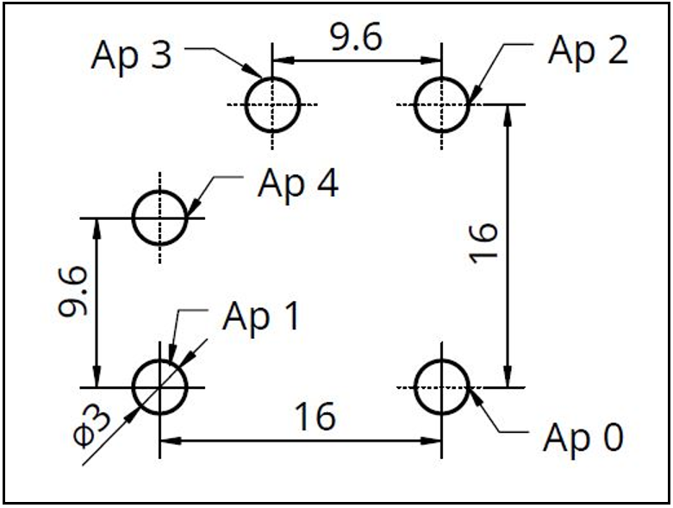




2-Hole SRI
3-Hole NRA SRI
5-Hole NRA SRI

Slide 29




Self-calibration Amplitudes = Illumination
Selfcal G_{amp} stable ~ 1%
Voltage gains differ by up to 30%
=> Power differs > 50%
1.24
1.19
1.23
1.19
1.31
1.11
Coherences > 60%
Stable < 1%
1.00

Slide 30




Alternative Techniques for σ<5um: NRA Interferometry
Non-Redundant Aperture Interferometry using the Visible Light from FE01
Direct measurement of the 2D coherence lenght of the photon beam with one single interferogram
Extract beam sizes (and tilt angle) of the e-beam
NRA Mask:
Direct Interf. Image
FFT Analysis
Electron Beam Image Re-construction
*New interferometric aperture masking technique for full transverse beam characterization, L. Torino et al, DEELS’24,
https://indico.synchrotron-soleil.fr/event/76/ – Accepted for publication at PRAB-2024

Slide 31





Alternative Techniques for σ<5um: X-ray HNFS
Beam size measurements at NCD down to σ = 4.5um

