Slide 1
ALBA II ALIGNMENT STRATEGY
Marta Llonch
On behalf of ALBA Survey and Alignment group:
Jon Ladrera
Marta Llonch
Jul 14th, 2026
mllonch@cells.es

Slide 2
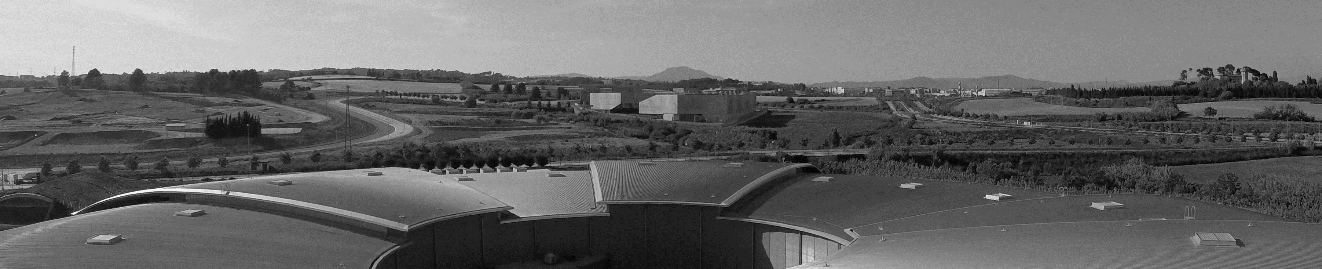
Outline
1. INTRODUCTION
2. ALBA II ALIGNMENT REQUIREMENTS AND UNCERTAINTY
3. ALBA II ALIGNMENT STRATEGY
4. ALBA LONG TERM DRIFT
5. SUMMARY

Slide 3
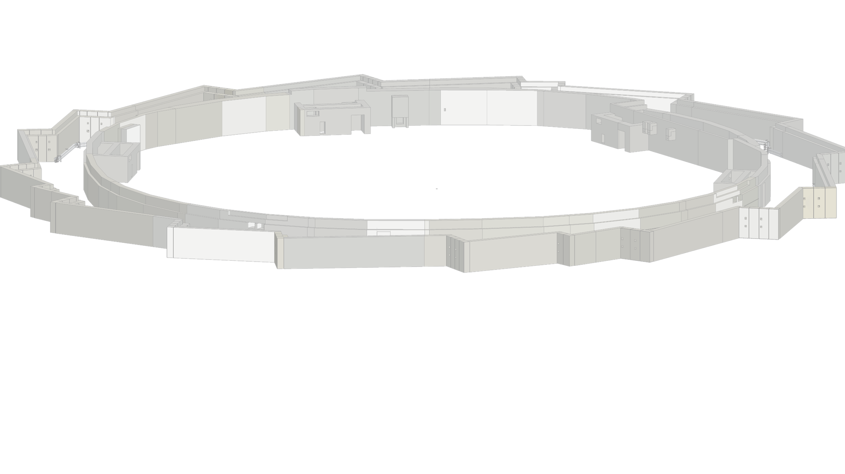
Introduction
ALBA II Storage Ring
268m circumference
16 arcs of 13m
5 girders per Arc: 80 girders
760 magnets
18mm diameter of Vacuum chamber
2026
2027
2028
2029
Testing PDR DDR CfT Contract Production Procurement

Slide 4
ALBA II alignment requirements and uncertainty
ALBA II Alignment requirements
Parameter | ALBA II |  | BESSY III | Diamond II | Diamond II | MAX 4U | MAX 4U | Soleil II | Petra IV | Soleil II | Units | Units
Girders
Girder-to-Girder Alignment | TBD* |  | 50 |  | 150 |  | 50 | 100 | 100 | 50 | μm rms | μm
Elements within a girder
Magnet to magnet | TBD* |  | 30 to 50 |  | 30 |  | 25 | 30 | 30 | 30 | μm rms | μm
Standard MPE for Vacuum and Diagnostic component alignment | TBD* |  | - |  | - |  | - |  | - | - |  | μm
Beam Dynamics determines how magnets and girders mechanical misalignments affect the beam quality and the machine performance. Alignment requirements define the maximum positioning errors that the accelerator optics can tolerate while still meeting performance goals (emittance, orbit stability, injection efficiency, dynamic aperture, etc.)
ALBA II alignment tolerances are being determined by introducing estimated alignment uncertainties. This provides a more realistic approach to simulate the alignment process itself instead of assigning arbitrary magnets and girders offsets.

Slide 5
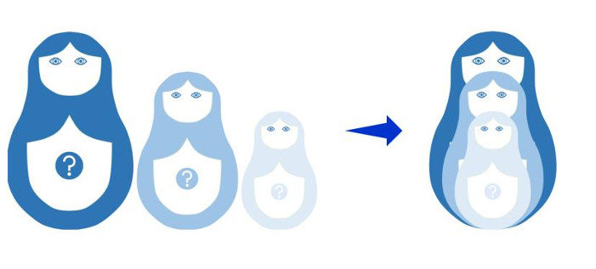
ALBA II alignment requirements and uncertainty
Alignment uncertainty
“Parameter characterizing the dispersion of the values being attributed to a measurand, based on the information used.” (IVM, 4th ed., 2021, JCGM GUM-1:2023)
Uncertainty propagation
Alignment is not a sequence of independent tasks, it is a chain in which uncertainty is propagated from component characterization to the final machine geometry.
Survey Network
Network geometry and distribution of monuments. Measurement uncertainty (Laser Tracker). Adjustment model. Deformation due to weight variation during installation. Environmental effects (temperature, air refraction index…).
Fiducialization
Magnetic center measurement (Stretched wire, rotating coil…). External references measurement (Laser tracker, probe repeatability). Mechanical tolerances. Coordinates transference between instruments.
Magnets assembly on girder
Adjustment system (pushers/shims/wedges). Adjustment resolution. Stability and rigidity. Open/close magnets. Thermal effects on the assembly lab. Transport effects.
Girders
Adjustment system (pushers/shims/wedges). Mechanical tolerances Stability and rigidity. Thermal effects. Transport effects.

Slide 6

ALBA II alignment strategy
Alignment strategy process flow
Offline components preparation
Tunnel preparation
Installation
1. Components characterization:
Metrology
Magnetic axis determination
5. Survey network preparation:
Observation with empty tunnel
7. Assembled girders installation
8. Survey network re-observation:
Survey network campaign after loaded slab
2. Components fiducialization:
Functional reference to external fiducials
6. Girder support elements:
Marking and alignment of base plates
9. Girders positioning:
Rough alignment before vacuum chamber installation
3. Magnet Assembly and Alignment on Girders:
  Daily/weekly Laser Tracker compensation
Multiple LT stations around each module
Relative alignment verification
10. Girders fine alignment
11. As built verification
4. Preinstallation verification:
As-built girder verification

Slide 7
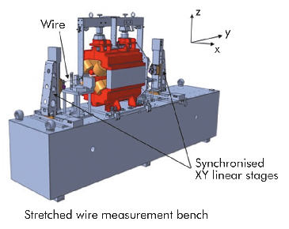
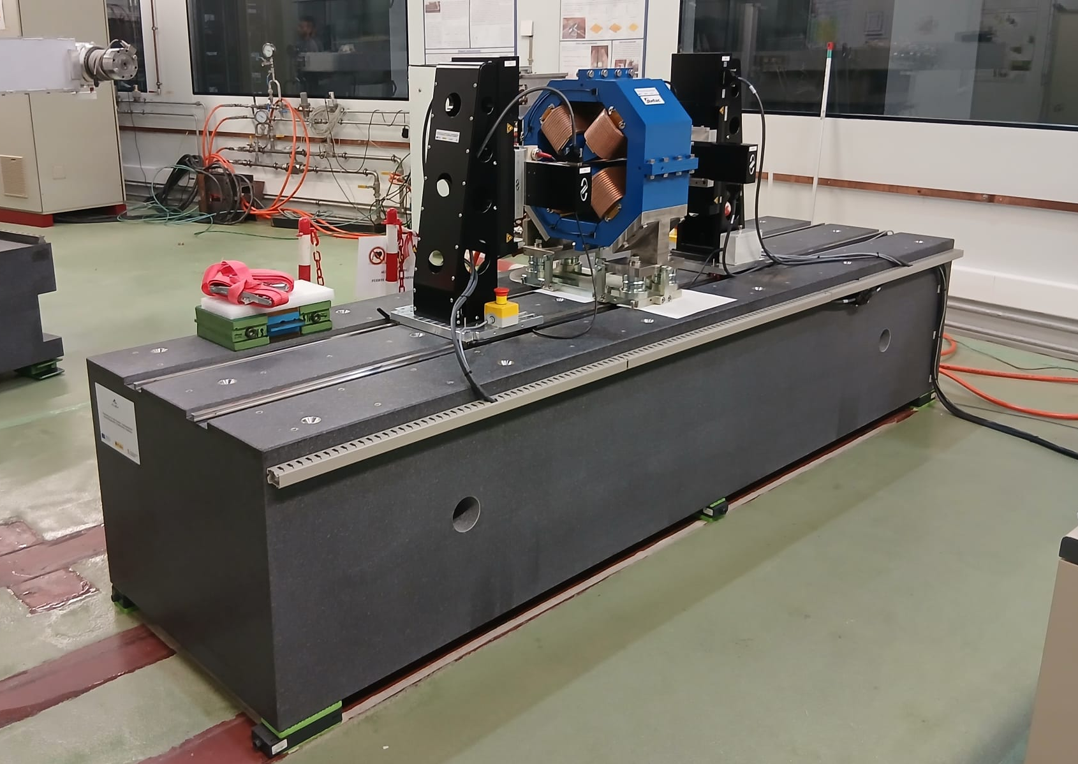
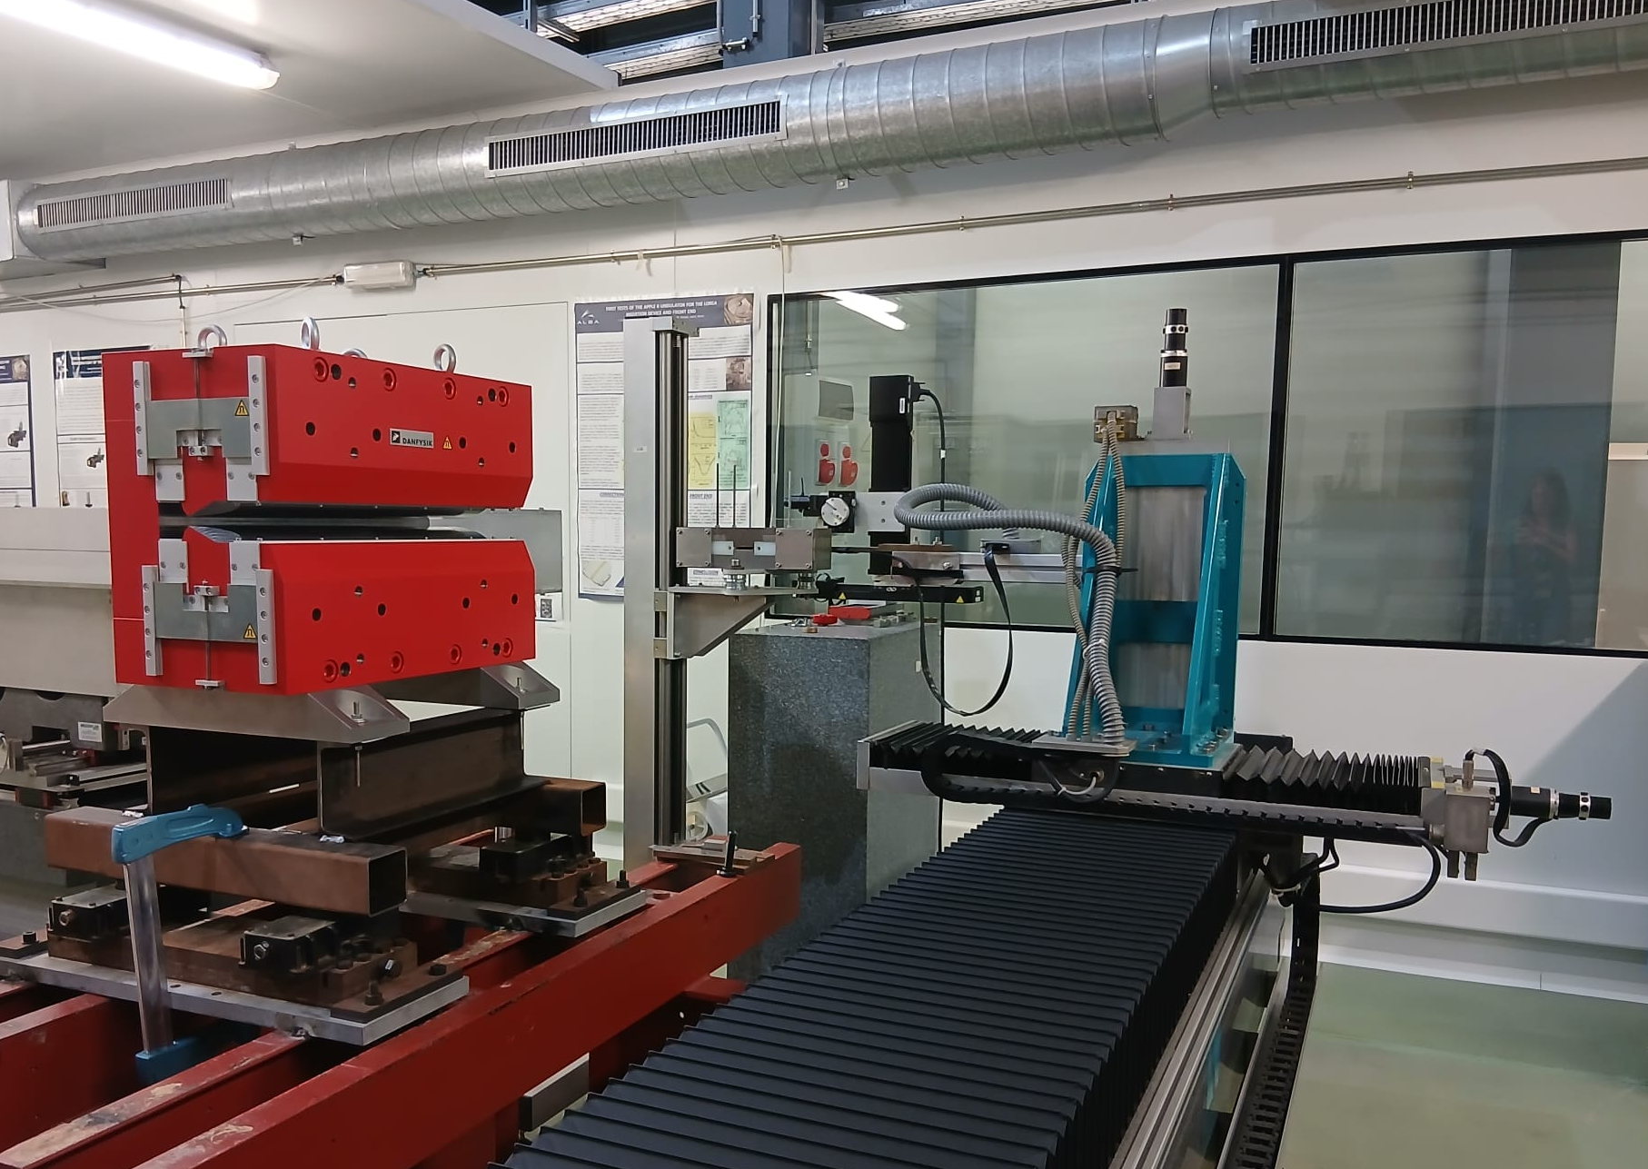
ALBA II alignment strategy - Magnets
Fiducialization
Fiducialization ( µm rms) | µm
Stretched wire position determination | 10
Magnetic axis determination | 15
Fiducials reproducibility | 5
Instrument uncertainty | 15
Instrument adjustment | 10
TOTAL | 26
Determines the relation between the effective axis or center of a component (magnetic or mechanical axis) and its external fiducials.
Fiducialization ensures that alignment is based on the functional geometry, rather than the mechanical geometry.
ALBA II Status
Currently performing first tests on ALBA II stretched wire bench with a recently arrived Q3 prototype. Magnet pre-alignment on bench and first wire position determination with respect magnet fiducials.
QDS - PM prototype is being aligned on the Hall probe measurement system.

Slide 8
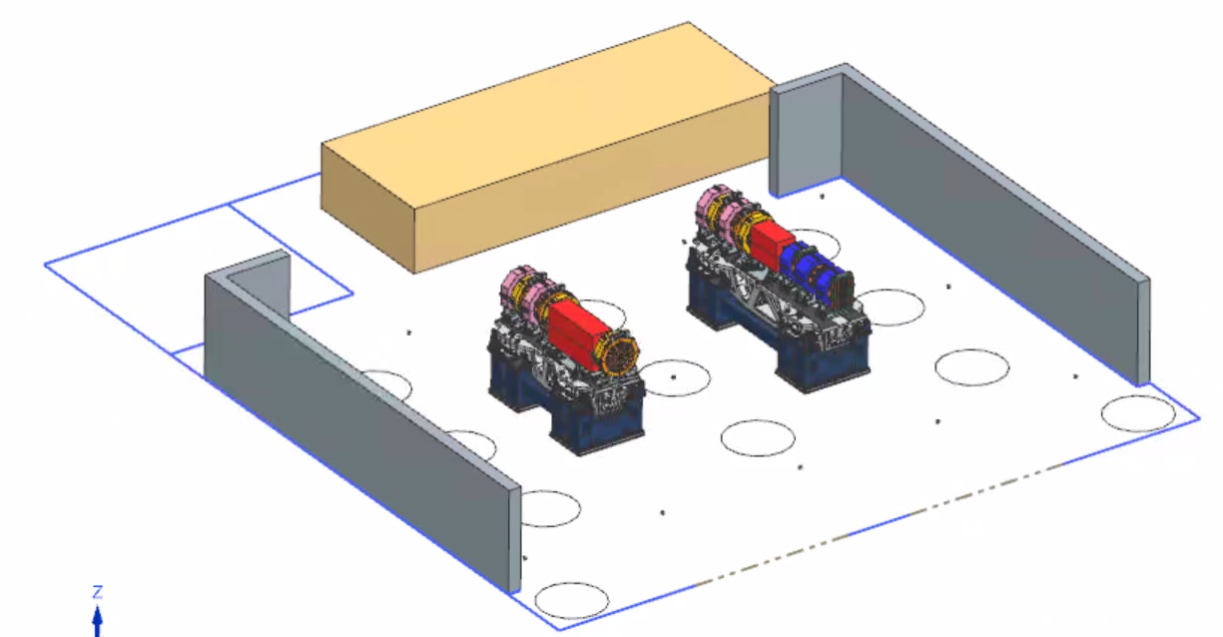
ALBA II alignment strategy - Girders
Girder assembly
Magnet to girder errors ( µm rms) | µm
Fiducialization | 26
Laser Tracker error (USMN) | 11
Alignment performance | 12
TOTAL | 31
Top surface planarity characterization, frame and axis definition.
Relative alignment of the magnets magnetic axes.
Define the relationship between aligned magnets and girder reference system.
Reduce the amount of adjustment required in tunnel.
ALBA II Status
Magnet storage
Module 2
Wall reference monuments
Assembly Lab technical specifications
Area | 131 m²
Crane load capacity | 7 Tn
Thermal stability | ± 0,5 C°
Area for LT compensation | Yes
Floor and walls reference monuments | Yes
Module 1
LT stationing for magnet to girder alignment
Floor reference monuments
LT stationing for compensation
Assembling area outline

Slide 9
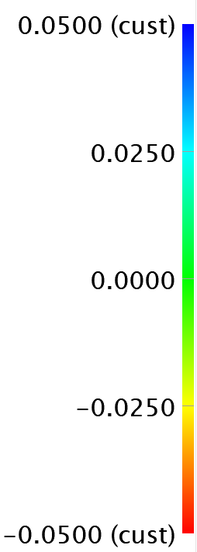
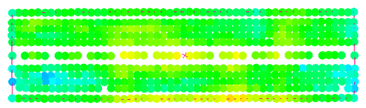
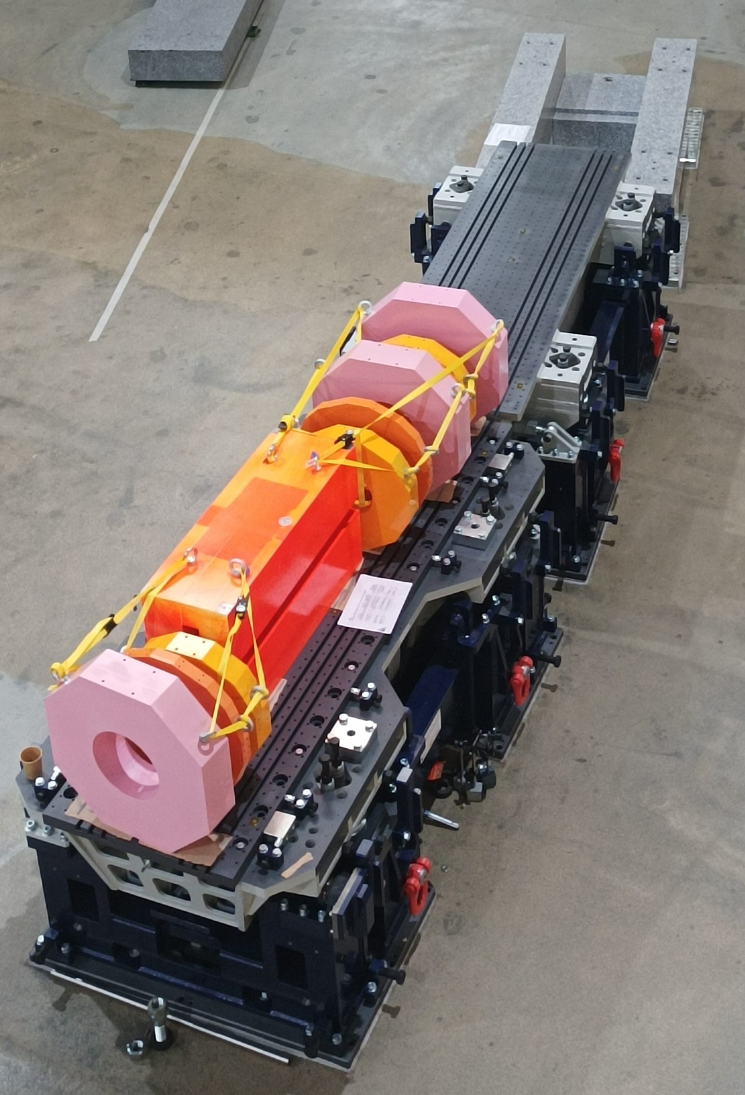
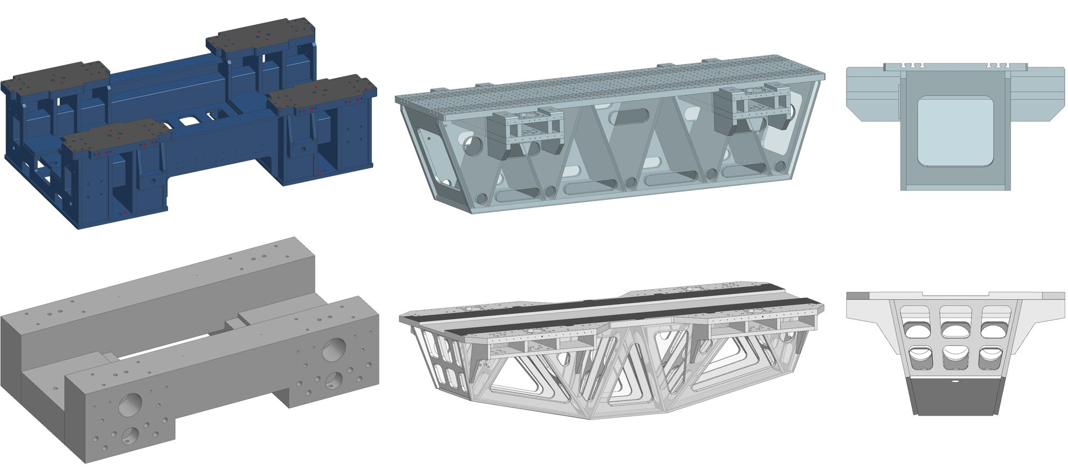
ALBA II alignment strategy - Girders
1st measurements campaign
Prototypes tests
Empty girders
Loaded girders (dummy magnets)
More measurements to be done with dummy magnets properly supported.
Validates girder design
Flatness
Adjustment mechanics
Stable architecture
Top plane planarity within specifications: flatness ≤ 0,1 mm
Adjustment mechanics movements test X, Y, Z: < 5 µm resolution
Stability test: There is a difference in modal response due to top frame different geometry of ~10%.
Top plane planarity: TBD
Adjustment mechanics movements test X, Y, Z: TBD
3. Stability test: Adding load to a girder to simulate operational conditions maintains the behavior of the modal response but reduce the Eigenmodes values by a 20%.

Slide 10
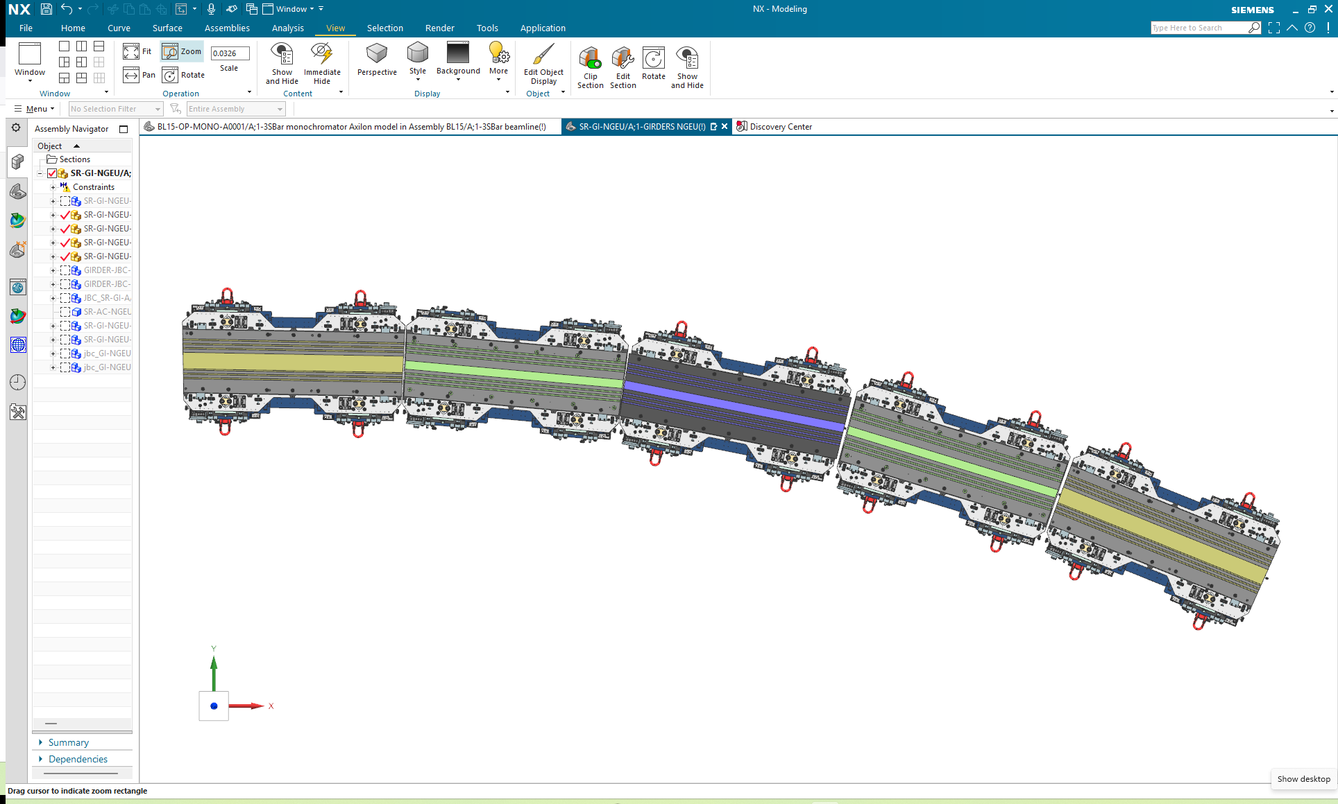
ALBA II alignment strategy - Girders
Absolute alignment (tunnel network)
The absolute alignment (survey network) of each girder can produce girder to girder mechanical discontinuities.
Relative alignment (girder to girder)
ID source points should be placed according new nominal machine circumference. Fixing SS upstream and downstream girders.
Girders between straight sections can be relative aligned.
Low spatial-frequency displacements in nearby girders.
1
2
3
2
1
B1
C
B2
A
A
Girder alignment errors ( µm rms) | A | B | C
Survey network calculation | 15 | - | -
Laser Tracker localization (to the network) | 50 | - | -
Laser Tracker localization (wrt A) | - | 20 | -
Laser Tracker localization (wrt B) | - | - | 20
Alignment error B wrt A | - | - | 37
Laser Tracker error (USMN) | 11 | 11 | 11
Alignment performance | 29 | 29 | 29
TOTAL | 61 | 37 | 52*
1. Girders A aligned wrt tunnel network
2. Girders B aligned wrt first and last cell girders
3. Girder C aligned wrt second and third cell girders
*Girder C alignment error expressed with respect to girders A. Girder C would have 37µm error with respect to girder B1 and B2.

Slide 11
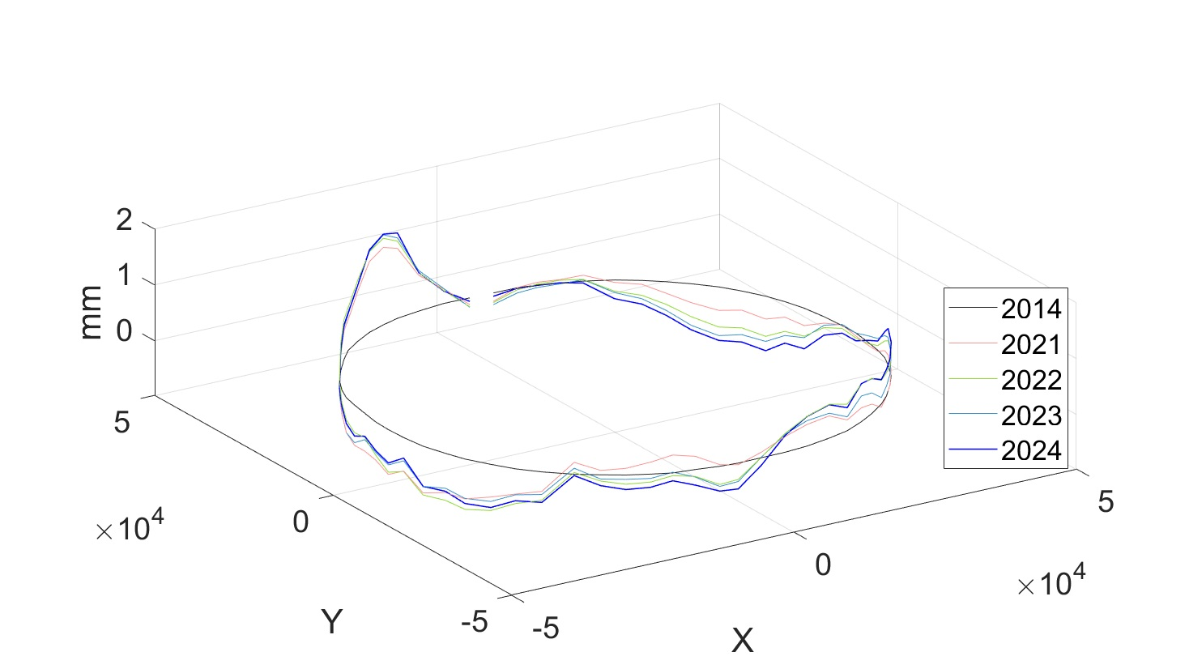
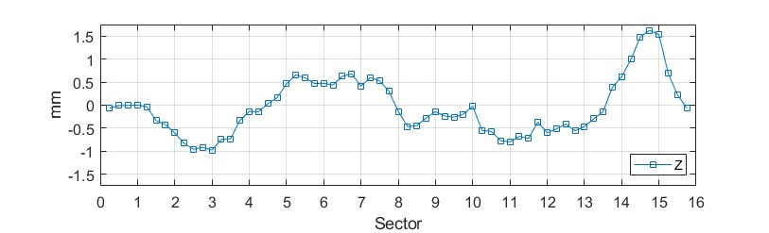
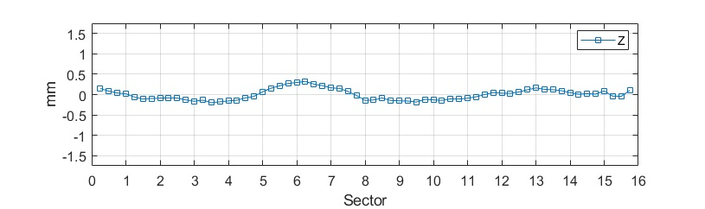
ALBA Long term drift
Tunnel slab vertical movements
Tunnel altimetric evolution
Annual Z deformation with respect to the slab averaged plane from 2014
No absolute reference
Sectors 14 and 15 vertical growth
Maximum deformation of ± 1.5 mm in Z in 10 years
Maximum deformation of ± 0.5 mm in Z in 1 year
Consistent profiles observed over the last decade and the current year performance, specially in sectors 4 to 8
2024 - 2014
2024 - 2023

Slide 12
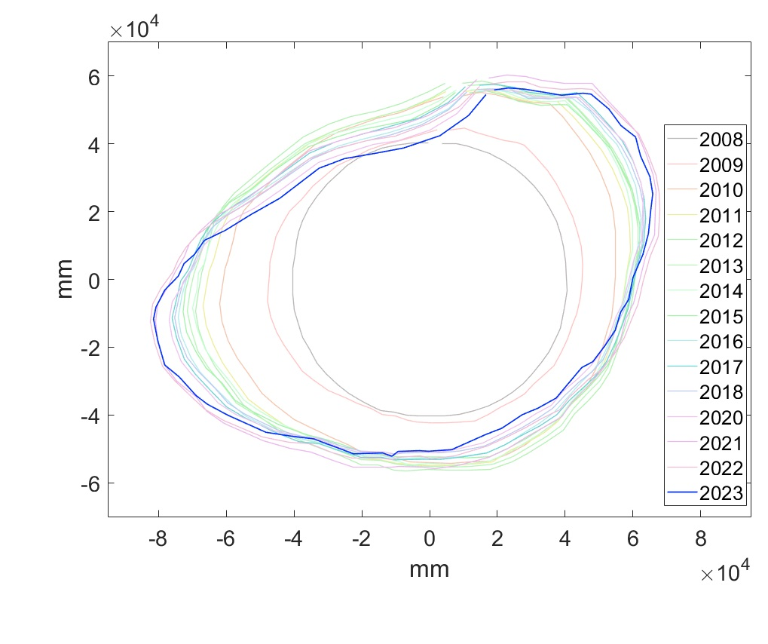
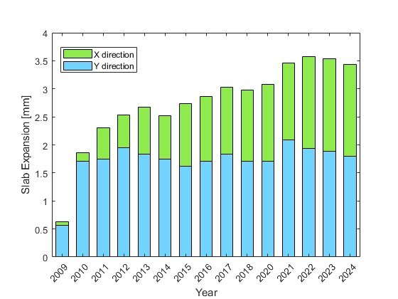
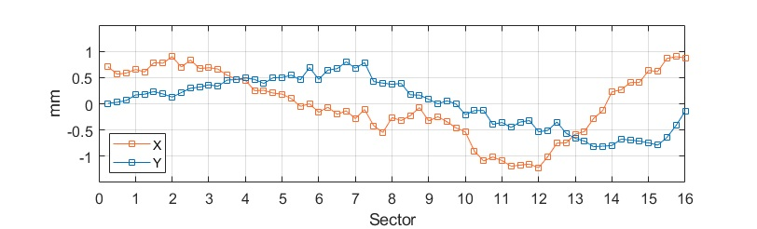
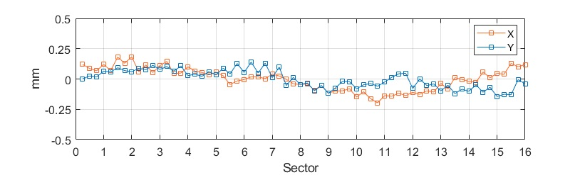
ALBA Long term drift
Long-term deformation impact on the perimeter enlargement of the Storage Ring
Maximum increase in radius of approximately 3.5 mm in X direction since 2008
During operation period (2012 – 2024), the slab has a maximum radius growth of 1 mm in the X direction
Perimeter growth fits with the SR radio frequency decreasing during last years
Tunnel slab horizontal movements
Tunnel planimetric evolution
Maximum horizontal movements
Maximum deformation of ± 1.5 mm in X and Y in 10 years
Maximum deformation of ± 0.3 mm in X and Y in 1 year
Consistent profiles observed over the last decade and the current year performance
2024 - 2014
2024 - 2023

Slide 13
Summary
ALBA II alignment strategy is being developed from alignment requirements down to installation procedures.
Uncertainty propagation is the common framework linking fiducialization, girder assembly, installation and long-term monitoring.
Prototype validation is providing the experimental basis to refine the final alignment strategy.

