Slide 1
HEPS ALIGNMENT STRATEGIES
Luyan ZHANG
On Behalf of Alignment System
14 JUL 2026
ALBA-HEPS Joint Workshop
2026-07-14

Slide 2
Content
Overview
Control network establishment
Pre-alignment in experimental hall
Alignment in tunnel
Insertion devices installation alignment
HLS operation
ALBA-HEPS Joint Workshop
2026-07-14

Slide 3
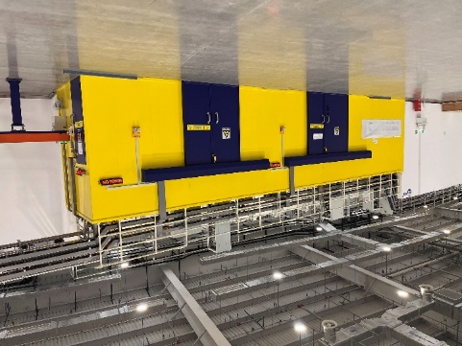
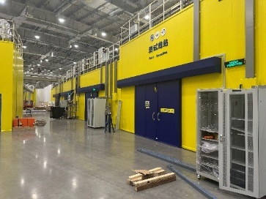
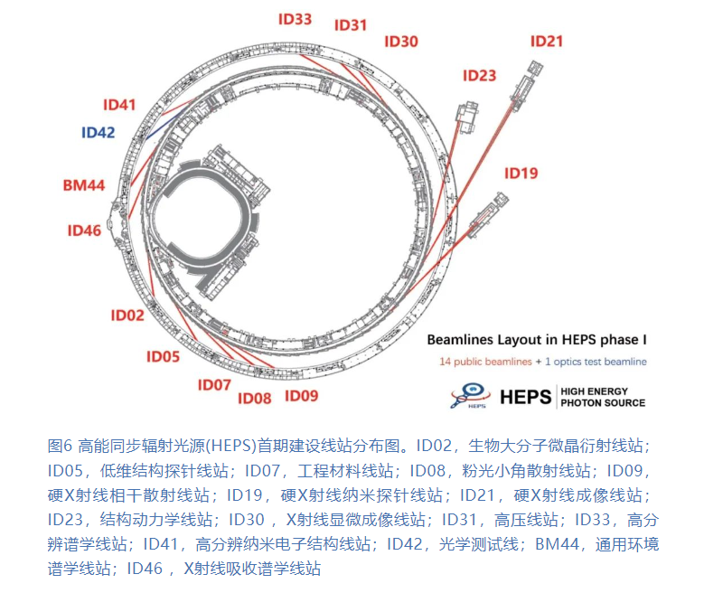
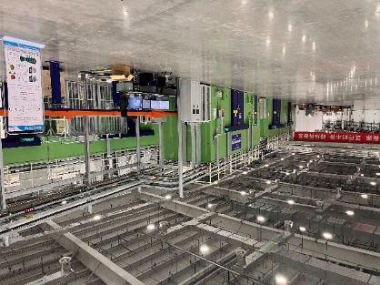
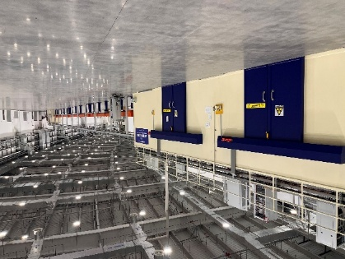
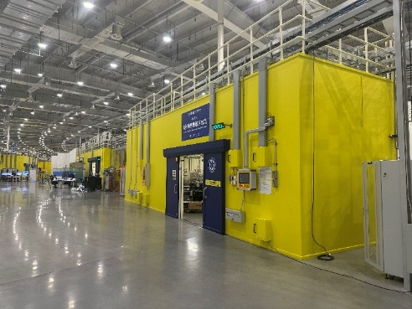
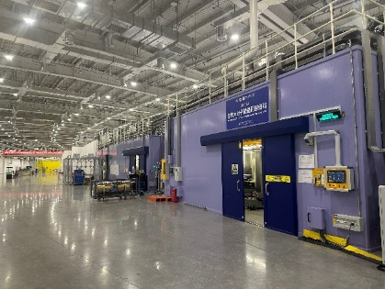
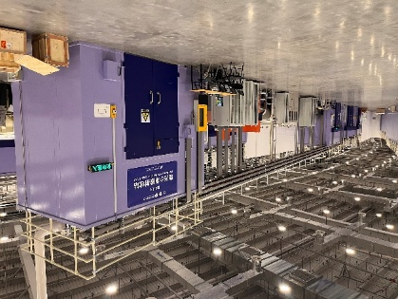
1. Overview
ALBA-HEPS Joint Workshop

Slide 4
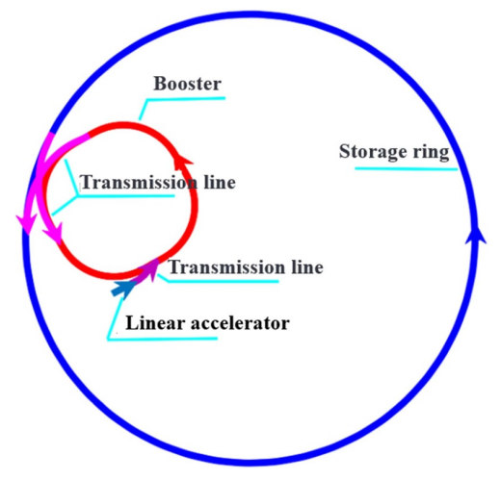
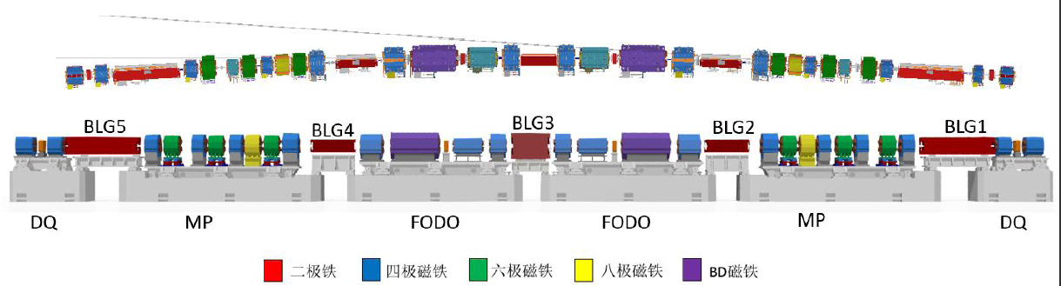
Overview
LINAC: 50 m
Booster: 440 m
Storage ring(SR): 1360 m
2 transmission lines and 15 beamlines
The SR consist of 48 hybrid-7BA cells.
Each cell contains 6 girders of three types: DQ、MP、FODO，and distribute in symmetry. The number of girders is 48*6=288.
ALBA-HEPS Joint Workshop
2026-07-14

Slide 5
Overview
The 4th photon source demand high accuracy to the alignment.
Photon Source | Tolerance of magnet to magnet within a girder/μm @ 1σ | Tolerance of girder to girder within the Ring/μm@ 1σ
MAX-IV | 20~30 | 100
BNL-NSLSII^{3rd} | 30 | 100
ANL-APSU | 30 | 100
ESRF-EBS | 50 | 50
LNLS- Sirius | 40 | 80
SPring8-II | 30 | 90
DESY-PETRA IV | 30 | 50
IHEP-HEPS | 30★ | 50★
ALBA-HEPS Joint Workshop
2026-07-14

Slide 6
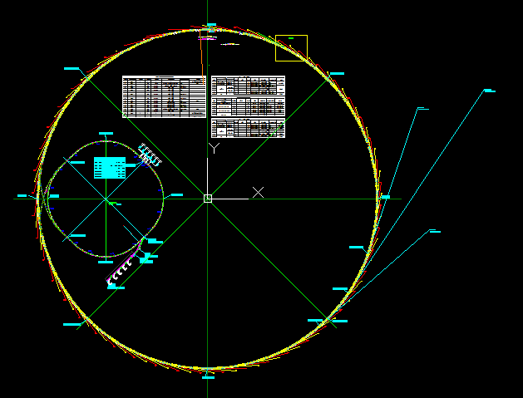
2. Control network establishment
ALBA-HEPS Joint Workshop

Slide 7
Control Network Establishment
The control network forms the basis of precision measurement and plays a critical role in mitigating cumulative errors during on-site equipment alignment.
Ground control network
Low quantity but high stability
Tunnel control network
Cover all facilities
LINAC
Booster
SR
Beamline stations
Experimental hall
ALBA-HEPS Joint Workshop
2026-07-14

Slide 8
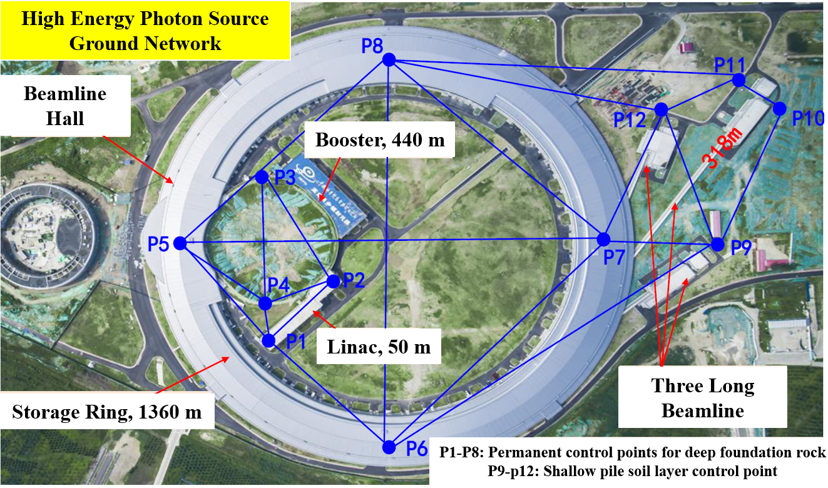
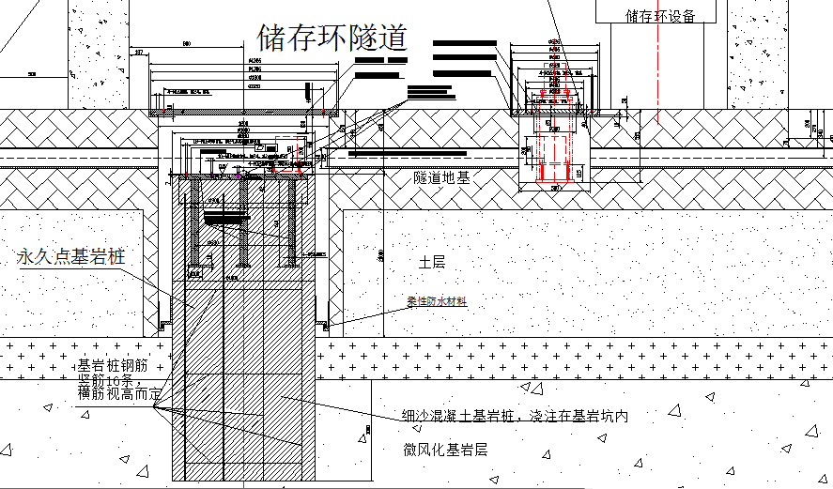
Control Network Establishment
Ground control network
P1-P2: LINAC - 20 m
P3-P4: Booster - 20 m
P5-P8: SR - 80 m
P9-P12: Long beamline - 10 m
One meter diameter, deep into bedrock
ALBA-HEPS Joint Workshop
2026-07-14

Slide 9
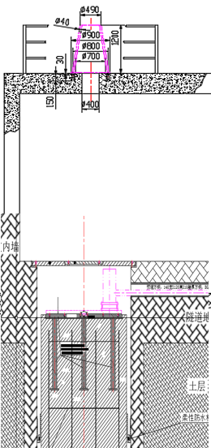
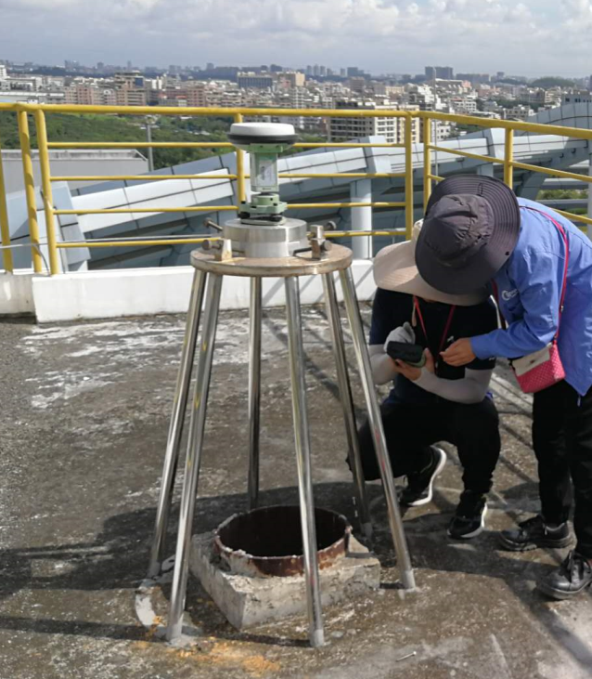
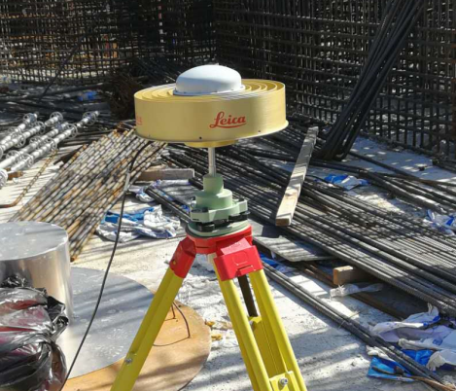
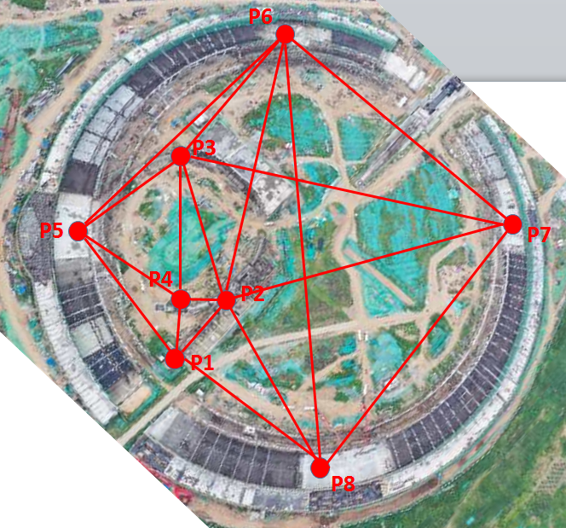
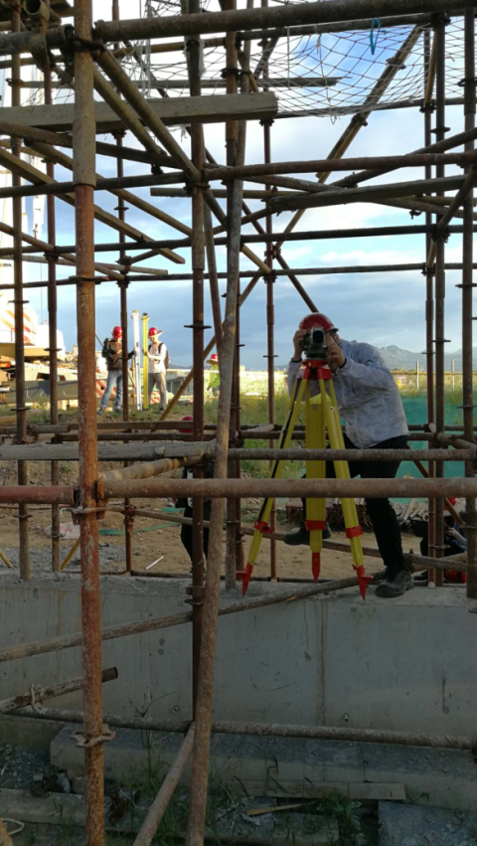
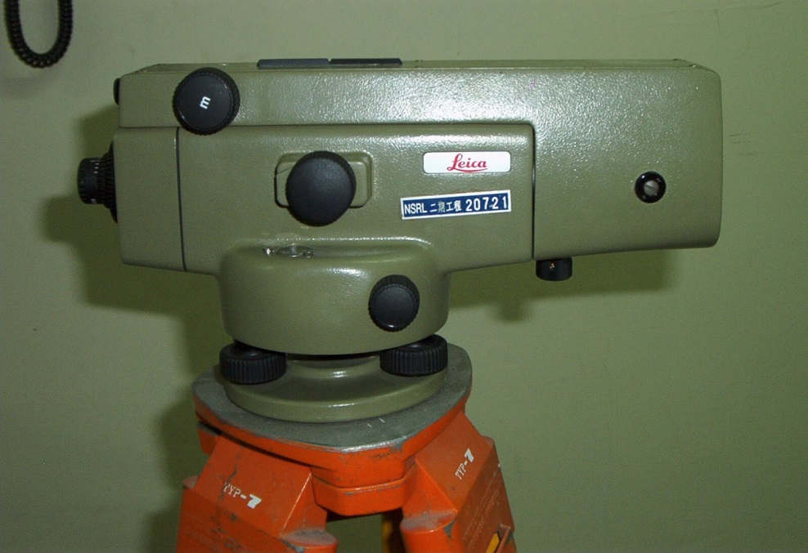
Control Network Establishment
Ground control network measurement
18 meters high
facing the permanent point
2 mm horizontal accuracy
5 mm elevation accuracy
GPS: Leica GS10
0.3 mm/km
NA2 level
ALBA-HEPS Joint Workshop
2026-07-14

Slide 10
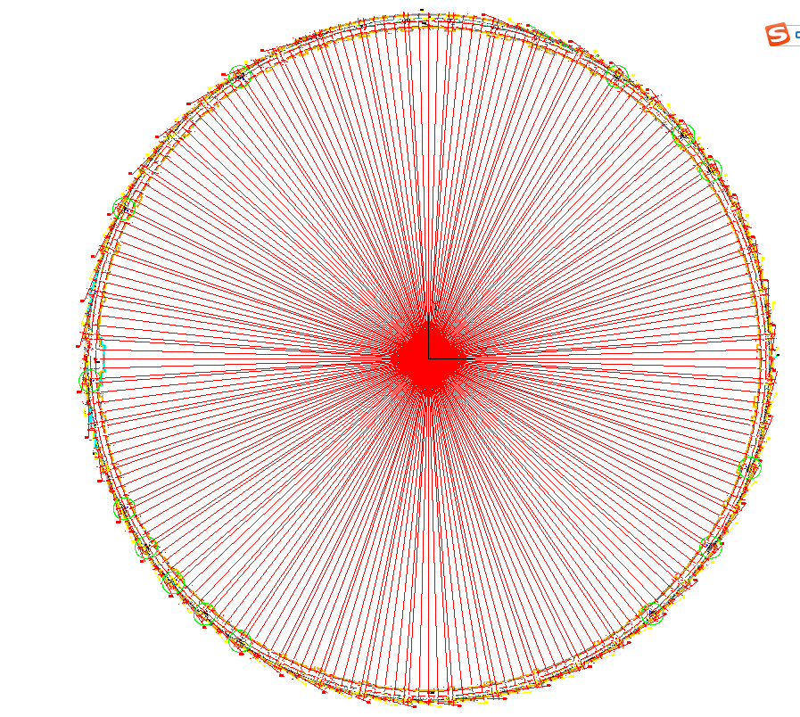
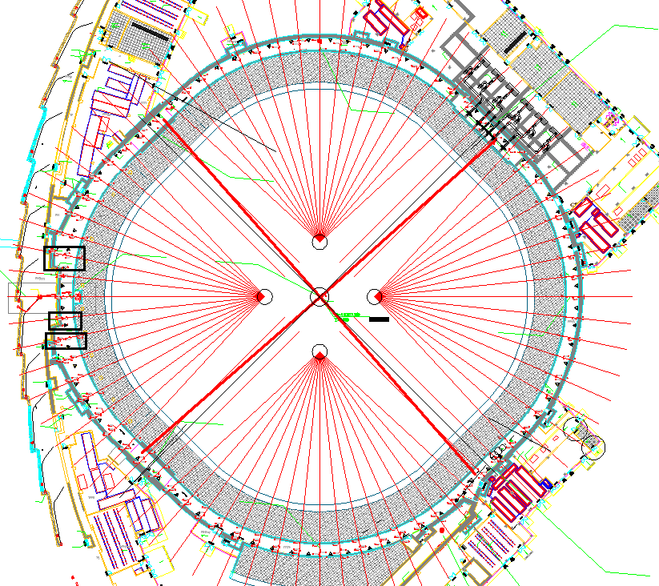
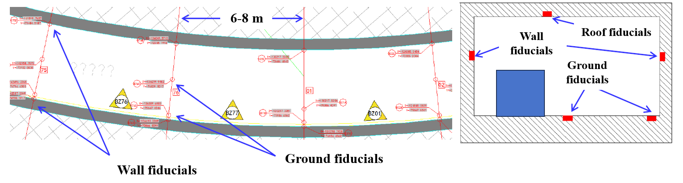
Control Network Establishment
Tunnel control network
240 segments in the SR
76 segments in the Booster
ALBA-HEPS Joint Workshop
2026-07-14

Slide 11
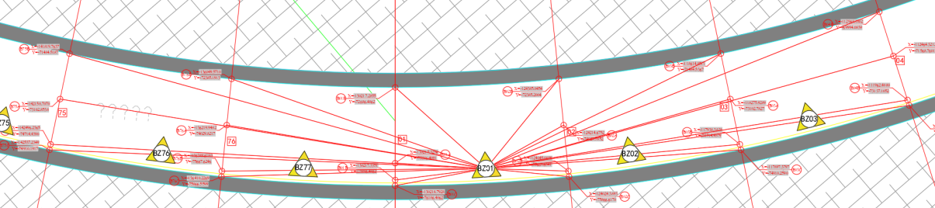
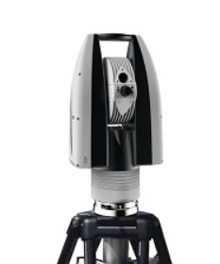
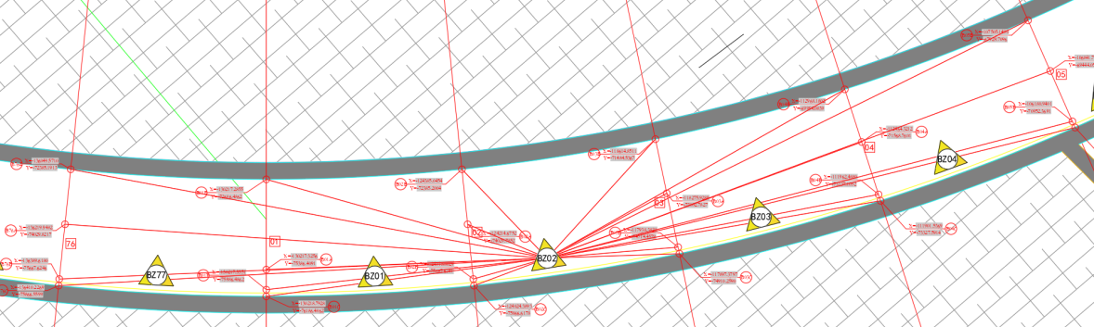
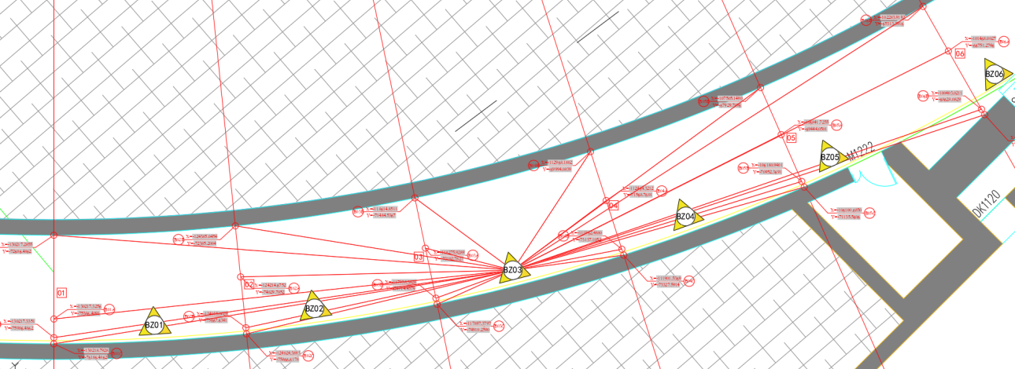
Control Network Establishment
Tunnel control network measurement
Laser tracker Leica AT403/AT930
15 μm + 6 μm/m
Set up measurement stations between each segments
The fitting accuracy of adjacent stations better than 60 μm
ALBA-HEPS Joint Workshop
2026-07-14

Slide 12
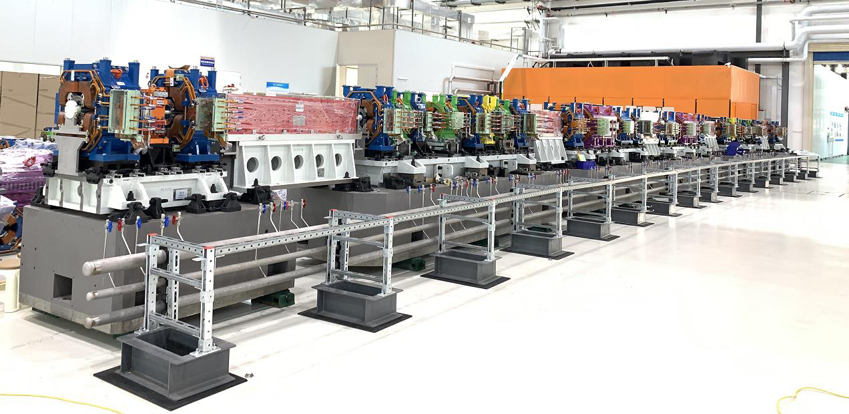
3. Pre-alignment in laboratory
ALBA-HEPS Joint Workshop
2026-07-14

Slide 13
Pre-alignment in laboratory
Pre-alignment includes 4 steps，each has specified strict requirements.
Procedure I | Tolerance requirement /μm | Steps | Specifications | Tolerance breakdown /μm
Magnets pre-alignment in temperature controlled room （25±0.1℃） | 30 | Fiducialisation | Fiducialisation of individual magnet by rotating coil and CMM system | 10
 |  | Positioning measurement | measurement by laser multilateral system in real time relative to the girder coordinate system during the adjustment | 10
 |  | Positioning adjustment | Magnet position adjustment offset | 10
 |  |  | Magnet displacement after locking | 10
 |  | Displacement and deformation | Open and close of magnet | 10
 |  |  | Displacement after transportation | 15
 |  |  | Deformation due to girder uneven supported on plinth in tunnel | 10
ALBA-HEPS Joint Workshop
2026-07-14

Slide 14
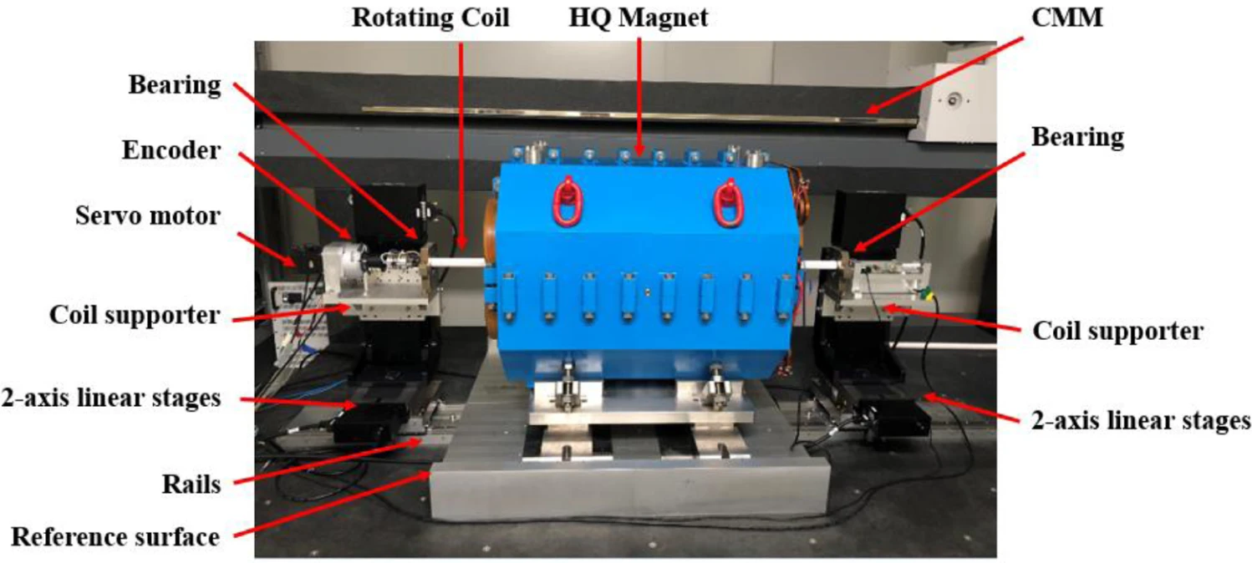
Pre-alignment in laboratory
1) Fiducialisation
For quadrupoles and octupoles, the fiducialisation based on magnetic center was implemented by rotating coil measurement system.
CMM (3.5 μm+ 3.5 ppm) was used to measure the rotating coil representing the magnetic center and the 4 fiducials on the top of the magnet.
The fiducialisation error was less than 10μm.
ALBA-HEPS Joint Workshop
2026-07-14

Slide 15
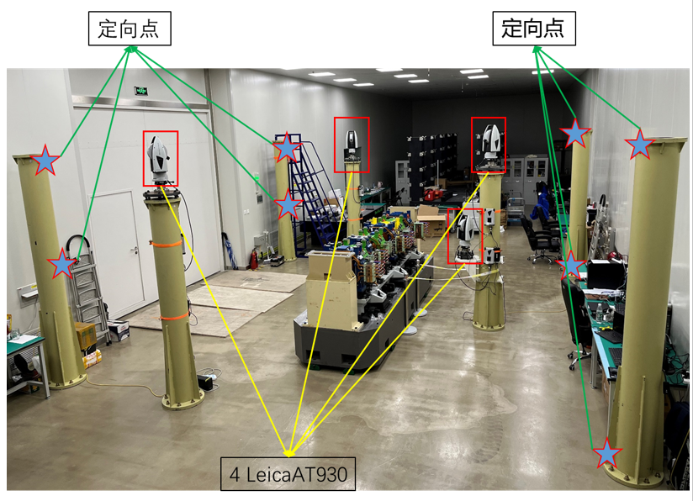
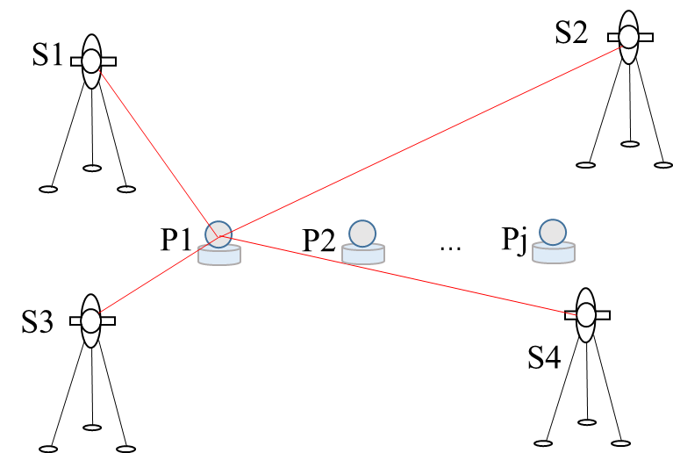
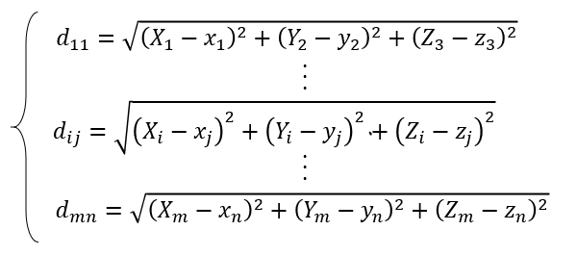
Pre-alignment in laboratory
2) Positioning measurement
In order to realize the 10 μm accuracy of the spatial coordinates, a multilateral measurement method based on 4 laser trackers network was adopted.
Achieve spatial measurement accuracy of 10μm.
ALBA-HEPS Joint Workshop
2026-07-14

Slide 16
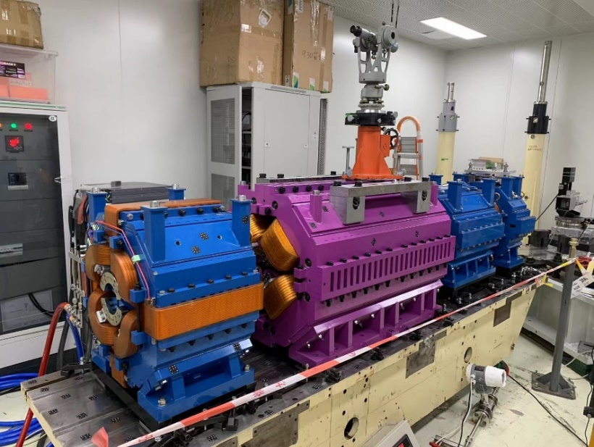
Pre-alignment in laboratory
3) Validation
Vibriation wire system(VWS) was established to validate the accuracy of pre-alignment.
First the mangets were pre-aligned into a straight line by the previous multilateral method, then VWS was used to measure the offset of the magnetic center. The result showed that both methods match well of 30 μm.
A FODO module measurement results
Entrance/Exit | X/mm | Y/mm
R29QF3EN | 0.023 | -0.017
R29QF3EX | 0.021 | -0.021
R29BD1EN | 0.000 | 0.000
R29BD1EX | 0.000 | 0.000
R29ABF2EN | 0.011 | -0.006
R29ABF2EX | 0.010 | -0.008
R29QD4EN | 0.008 | -0.028
R29QD4EX | 0.006 | -0.030
ALBA-HEPS Joint Workshop
2026-07-14

Slide 17
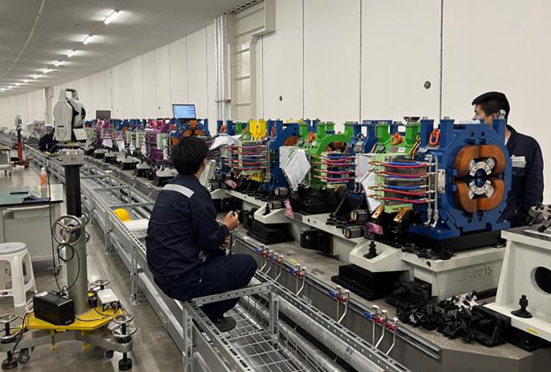
4. Alignment in tunnel
ALBA-HEPS Joint Workshop
2026-07-14

Slide 18
Alignment in tunnel
SR Beam commissioning
Started on 2024.07.23
2023.02.08—2023.09.19
Rough alignment
1、288 units;
2023.11.23—2024.06.26
Semi-precision alignment
1、288 units;
2、all vacuum chambers;
2024.06.15—2024.11.04
Smooth positions alignment
1、288 units; then start SR commissioning;
2、6 IDs;
3、15 beamlines;
2025.02.20—2025.06.12
Theoretical positions alignment
1、288 units;
2、19 IDs;
Commissioning and operation
ALBA-HEPS Joint Workshop
2026-07-14

Slide 19
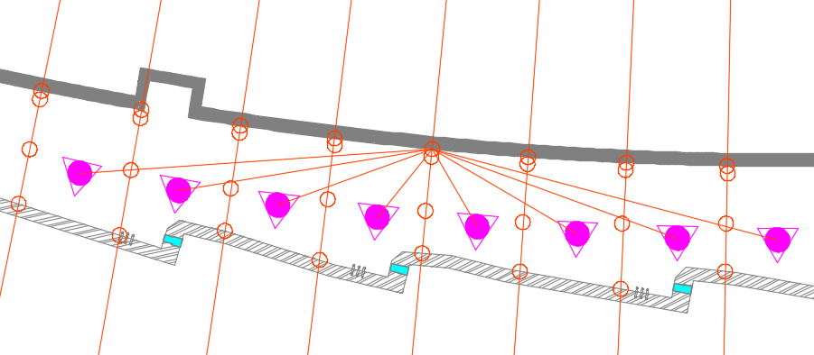
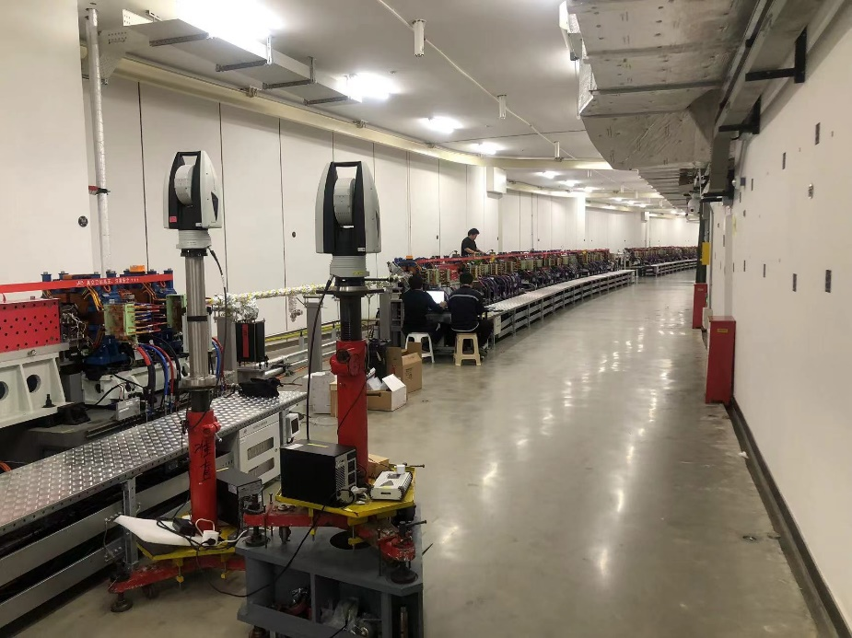
Alignment in tunnel
Alignment procedure:
Initial full survey
Absolute deviation prediction
Unit position adjustment
Final full survey
The full survey aimed to obtain the positions of all control points and magnets.
To ensure the reliability of observations, two independent teams carried out separate measurements and obtained two sets of measurement data.
Every point was measured by at least 8 stations
The intersection angle approaches 180°
ALBA-HEPS Joint Workshop
2026-07-14

Slide 20
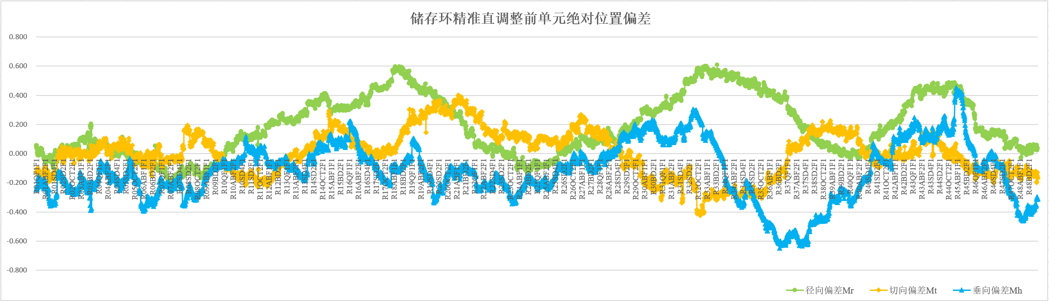
Alignment in tunnel
Initial full survey
Absolute deviations of all units of initial full survey
Deviation statistics | Radial MR/mm | Tangential MT/mm | Vertical MZ/mm
Maximum deviation | 0.608 | 0.401 | 0.454
Minimum deviation | -0.211 | -0.425 | -0.648
Overall RMS of deviations of all points | 0.276 | 0.155 | 0.229
Average deviation | 0.188 | 0.004 | -0.118
The self-developed program VECTOR was used for adjustment calculation. The two sets of survey measurement data from 480 stations were combined together to determine the coordinates of the points.
The absolute deviations of entry and exit points of each unit were calculated ,and the range was -0.21~0.61mm in radial, -0.65~0.45mm in vertical.
Radial deviations
Tangential deviations
Vertical deviations

Slide 21
Alignment in tunnel
Measurement uncertainty
Measurement uncertainty is calculated from coordinate differences between the two sets of measurement. The RMS of the coordinates differences were 0.18mm in radial and 0.17mm in vertical.
For 480 stations, point uncertainty equals half the RMS of coordinate differences from two independent sets of 240 measurements, which enables a more accurate statistical evaluation.
The point uncertainty of initial full survey was 0.09mm in radial and 0.08mm in vertical.
”
Point coordinate differences of two sets survey
Statistical analysis | Radial/mm | Tangential/mm | Vertical/mm
Maximum difference of all points | 0.356 | 0.231 | 0.313
Minimum difference of all points | -0.304 | -0.390 | -0.071
RMS of differences of all points | 0.175 | 0.172 | 0.168
Average difference of all points | 0.054 | -0.039 | 0.159
ALBA-HEPS Joint Workshop
2026-07-14

Slide 22
Alignment in tunnel
Absolute deviation prediction
Considering the achievable measurement uncertainty, recall that the RMS of the point uncertainty were 0.09mm in radial and 0.08mm in vertical. The adjustment offset was set to 15μm.
For the theoretical positions alignment, the best achievable result is as follows : the absolute deviation was 0.09mm in radial, 0.08mm in vertical. The maximum and minimum deviations are then estimated as 3 times the RMS.
”
$$RMS of absoulte deviations=\sqrt{{(point uncertainty)}^{2}+{(adjustment offset)}^{2}}$$
Absolute deviations prediction
Deviation statistics | Radial MR/mm | Tangential MT/mm | Vertical MZ/mm
Maximum deviation | 0.27 | 0.27 | 0.24
Minimum deviation | -0.27 | -0.27 | -0.24
Overall RMS of deviations of all points | 0.09 | 0.09 | 0.08
ALBA-HEPS Joint Workshop
2026-07-14

Slide 23
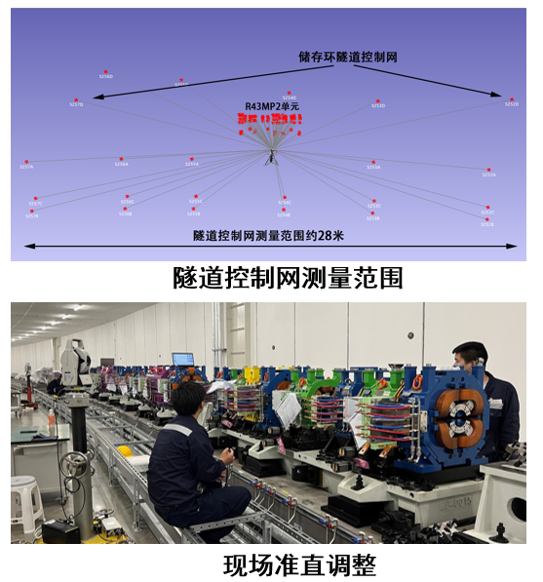
Alignment in tunnel
Theoretical position adjustment
Traditional adjustment method: The unit alignment in tunnel was measured by single laser tracker. The laser tracker was located by the surrounding control points, and measure the fiducials of magnets to guide the adjustment in real-time.
Shortcoming: Traditional methods rely on single-station observations of control points to locate the instrument. This differs from the global calculation from multi-stations in full surveys, and introduces slight instrument positioning errors that cannot meet the requirements for ultra-precision alignment.
New displacement adjustment method: A deviation‑displacement adjustment method is proposed for the first time. Independent of control network positioning, this method takes full advantage of the high ranging accuracy of laser tracker and directly performs displacement adjustment on the unit.
ALBA-HEPS Joint Workshop
2026-07-14

Slide 24
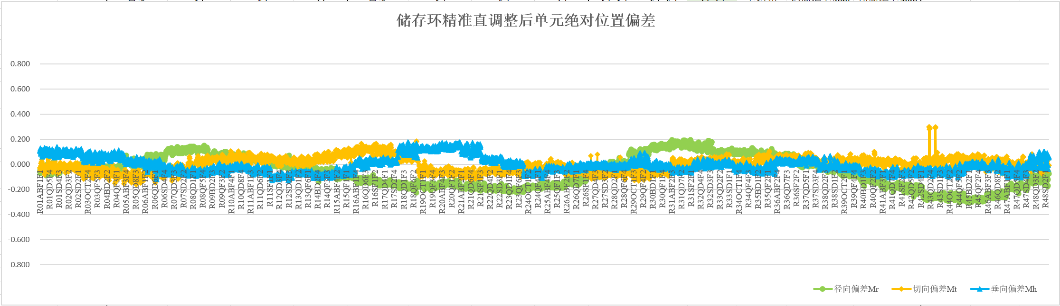
Alignment in tunnel
Final full survey
After displacement adjustment of all the units, a full survey was conducted with two independent measurements again to check the final results.
Alignment evaluating indicators after full survey:
1. Theoretical position deviations of units : Deviation of all units relative to the theoretical positions.
2. Smooth position deviations of units : Deviation of all units relative to the adjacent units.
3. Magnets deviations within unit: Mutual deviation between magnets contained within a unit.
Absolute deviations of final full survey
Deviation statistics | Radial MR/mm | Tangential MT/mm | Vertical MZ/mm
Maximum deviation | 0.200 | 0.294 | 0.169
Minimum deviation | -0.294 | -0.121 | -0.110
Overall RMS of deviations of all points | 0.137 | 0.056 | 0.061
Tangential deviations
Radial deviations
Vertical deviations
ALBA-HEPS Joint Workshop
2026-07-14

Slide 25
Alignment in tunnel
Absolute deviations of initial full survey
Deviation statistics | Radial MR/mm | Tangential MT/mm | Vertical MZ/mm
Maximum deviation | 0.608 | 0.401 | 0.454
Minimum deviation | -0.211 | -0.425 | -0.648
Overall RMS of deviations of all points | 0.276 | 0.155 | 0.229
Tangential deviations
Radial deviations
Initial full survey
Vertical deviations
Absolute deviations prediction
Deviation statistics | Radial MR/mm | Tangential MT/mm | Vertical MZ/mm
Maximum deviation | 0.27 | 0.27 | 0.24
Minimum deviation | -0.27 | -0.27 | -0.24
Overall RMS of deviations | 0.09 | 0.09 | 0.08
Achievements: the absolute position deviation obtained from the final full survey is basically consistent with the predicted deviation results.
Compared with the initial full survey, the RMS absolute position deviations have been reduced horizontally from 0.28 mm to 0.14 mm, vertically from 0.16 mm to 0.06 mm, verifying the success of the theoretical alignment method.
Prediction
Absolute deviations of final full survey
Deviation statistics | Radial MR/mm | Tangential MT/mm | Vertical MZ/mm
Maximum deviation | 0.200 | 0.294 | 0.169
Minimum deviation | -0.294 | -0.121 | -0.110
Overall RMS of deviations of all points | 0.137 | 0.056 | 0.061
Tangential deviations
Radial deviations
Final full survey
Vertical deviations
ALBA-HEPS Joint Workshop
2026-07-14

Slide 26
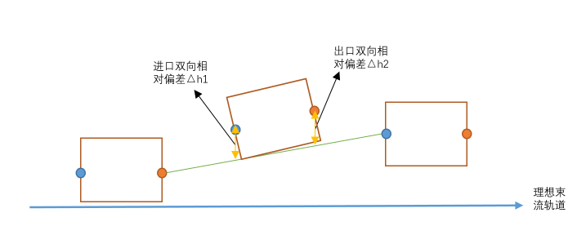
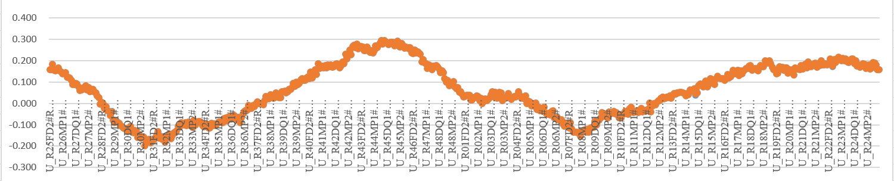
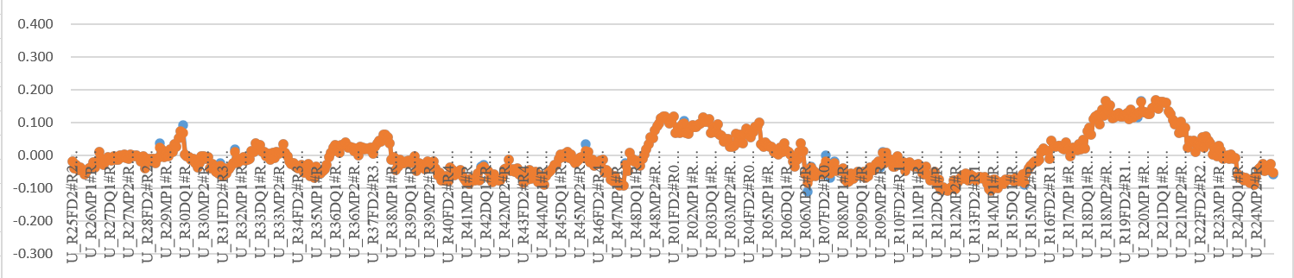
Alignment in tunnel
Smooth position deviations of units
After full survey, the entry and exit points of each girder were obtained. Based on the deviation of actual and nominal position of girders, smooth deviations called ‘Bidirectional difference’ were calculated.
Bidirectional difference: Based on the line connecting the upstream and downstream girders, calculate the differences δ1 of the entry and δ2 of the exit points of the current girder relative to the baseline.
The smooth deviations were within ±0.034mm in radial, and ±0.057mm in vertical.
Bidirectional difference δ1
Bidirectional difference δ2
theoretical beam
smooth deviations in radial
Smooth deviations
Deviation statistics | Radial/mm | Vertical/mm
Maximum deviation | 0.034 | 0.057
Minimum deviation | -0.033 | -0.054
RMS of deviations of all points | 0.013 | 0.016
Average deviation of all points | 0.000 | -0.001
smooth deviations in vertical
ALBA-HEPS Joint Workshop
2026-07-14

Slide 27
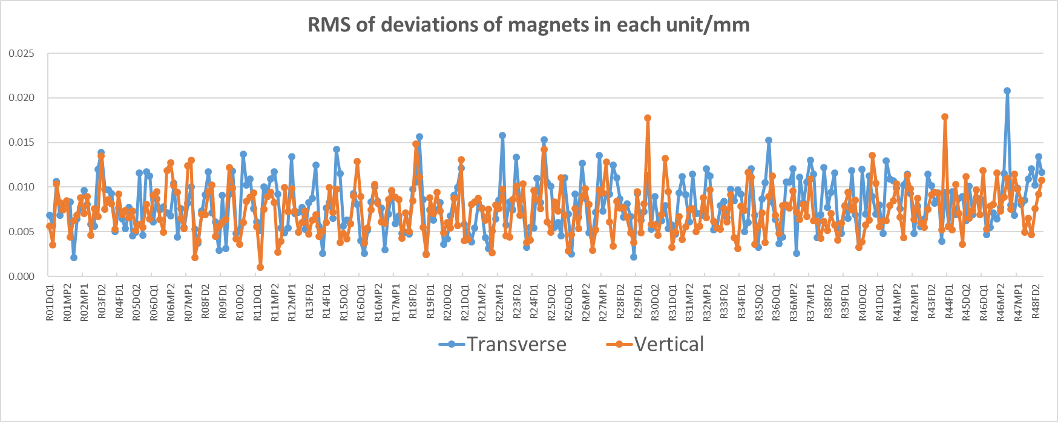
Alignment in tunnel
Magnets deviations within unit
To evaluate the pre-alignment status of each unit, it is necessary to analyze each unit individually and calculate the deviations of the magnets within each unit.
The RMS of the magnets deviations for all the units were almost below 0.02mm in both the radial and vertical direction.
ALBA-HEPS Joint Workshop
2026-07-14

Slide 28
5. Insertion devices installation alignment
ALBA-HEPS Joint Workshop
2026-07-14

Slide 29
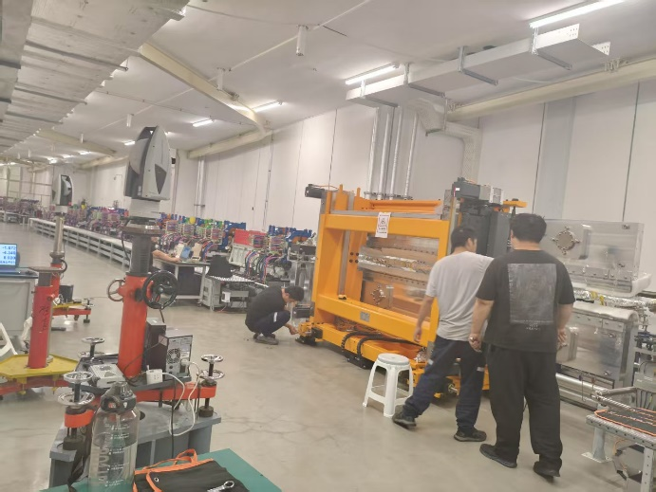
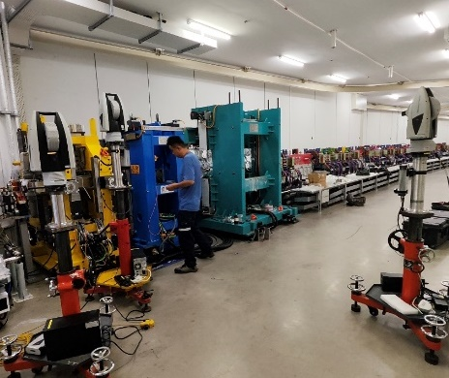
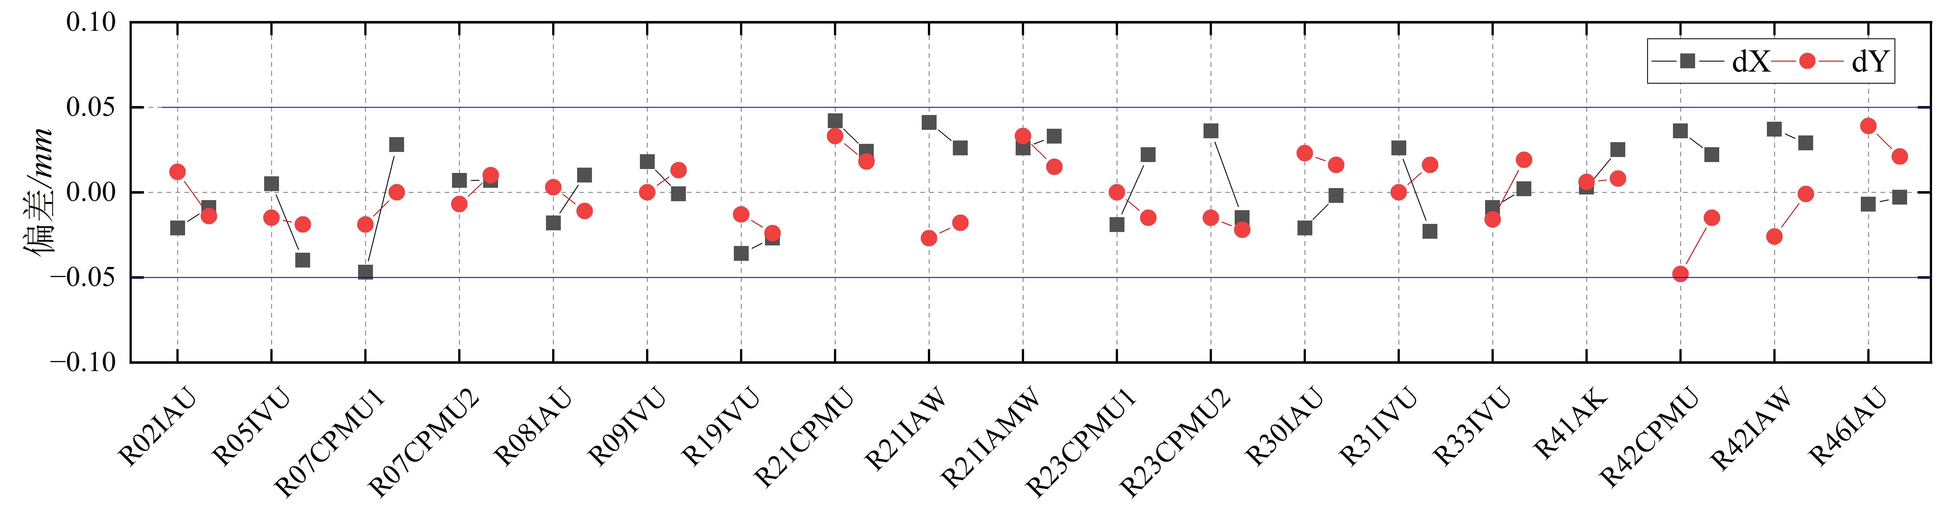
IDs installation alignment
Method: The points source and the angle of the beamlines are determined by the magnets of upstream and downstream, the IDs were aligned to the theoretical positions on the straight line between the entrance and exit of the adjacent DQ units.
Result: The relative position deviations of the 19 IDs after alignment are shown in the figure below. All deviations are within ±0.05 mm.
Statistics | Radial /mm | Vertical /mm | Tangential /mm
Maximum | 0.042 | 0.039 | 1.956
Minimum | -0.047 | -0.048 | -4.019
RMS | 0.025 | 0.019 | 1.029
ALBA-HEPS Joint Workshop
2026-07-14

Slide 30
6. HLS operation
ALBA-HEPS Joint Workshop
2026-07-14

Slide 31
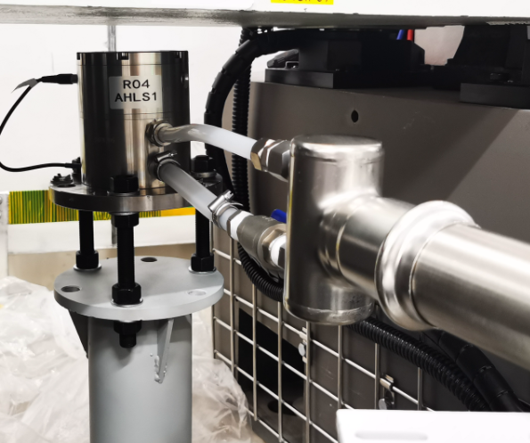
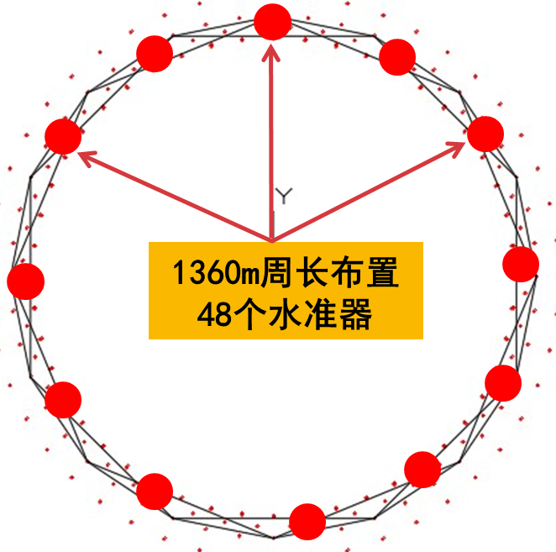
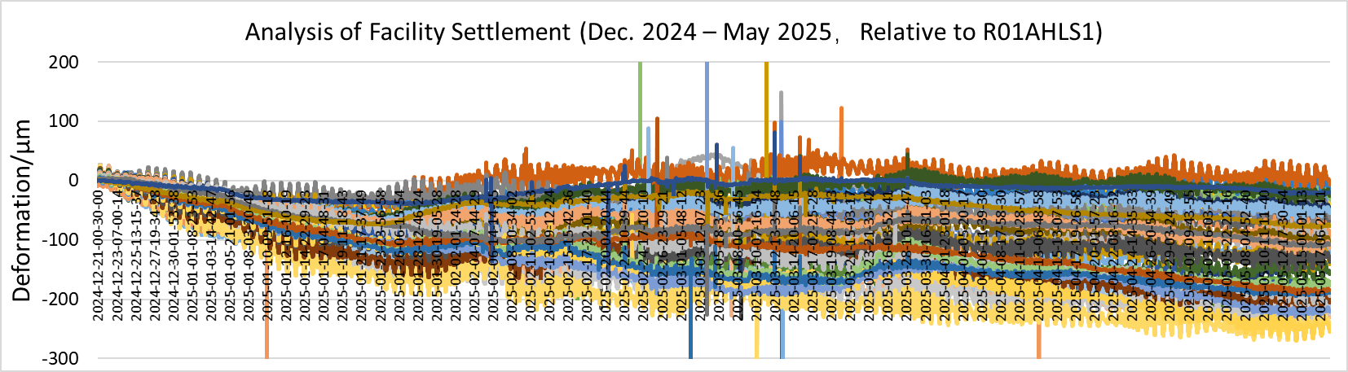
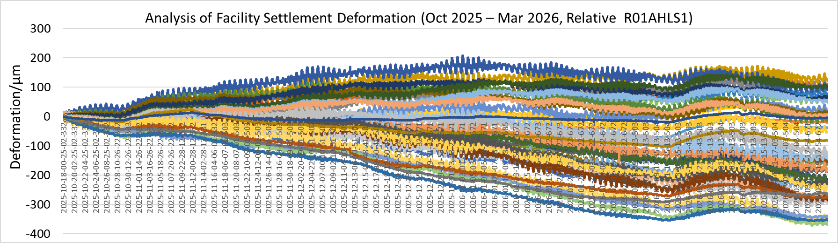
HLS operation
A total of 48 hydrostatic leveling sensors are deployed around the SR. Specifically, one hydrostatic leveling sensor was installed under the bending magnet in each unit.
Sensor type: Capacitive; Range：±5 mm; Precision: 5 μm;
Water pipeline：Press-fitted stainless steel pipe with a diameter of 50 mm;
Since the system was put into operation, two sets of monitoring data have been obtained in 2025.
From the data results, the maximum settlement in the elevation was 300μm. The settlement shows a relatively gentle downward trend, and more attention will be needed in the future.
ALBA-HEPS Joint Workshop
2026-07-14

Slide 32
Thanks for your attention!
ALBA-HEPS Joint Workshop
2026-07-14

