Slide 1



Vacuum system design and prototyping
ALBA-HEPS Workshop
Ricardo Parise, on behalf of the ALBA01-WP2 and the ALBAII WP20102 working groups
14/07/2026
rparise@cells.es

Slide 2
Table of contents
ALBA01 Prototyping: 6BA Lattice
Vacuum chambers prototypes
Vacuum chamber prototypes testing setup
ALBAII: Lattice A2L007c
Vacuum system overview
Dipole chamber design
Chamber cross section
Synchrotron power
14/07/2026
ALBA-HEPS Workshop

Slide 3
ALBA01 Prototyping: 6BA Lattice
Vacuum chambers prototypes
Short dipole chamber prototype
Long dipole chamber prototype
Vacuum chamber prototypes testing setup

Slide 4
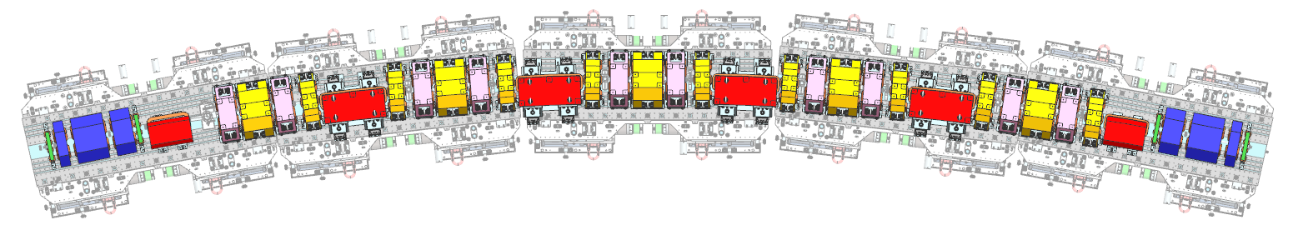
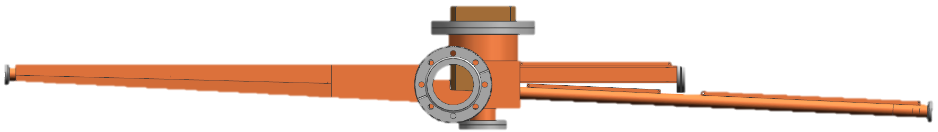
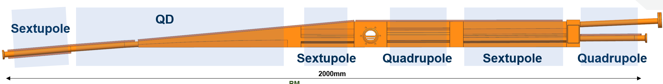
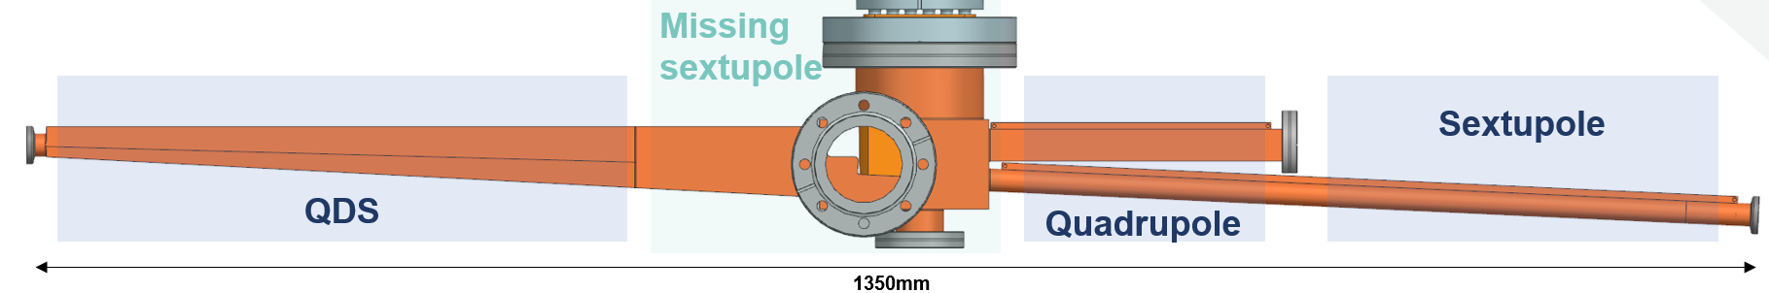
ALBA01 Prototyping: 6BA Lattice
Vacuum chamber prototypes status: Recapitulating…
ALBA-HEPS Workshop
14/07/2026
4

Slide 5
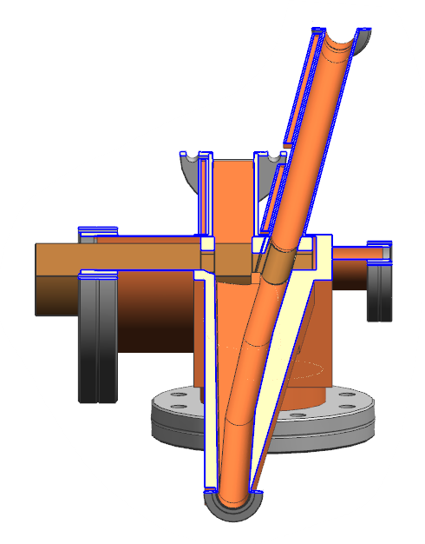
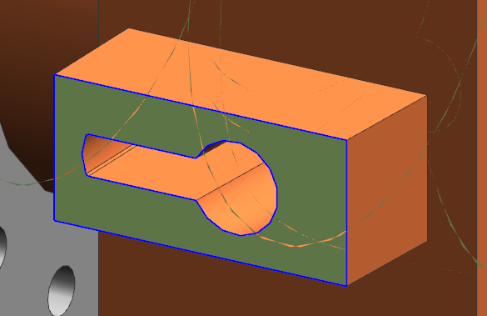
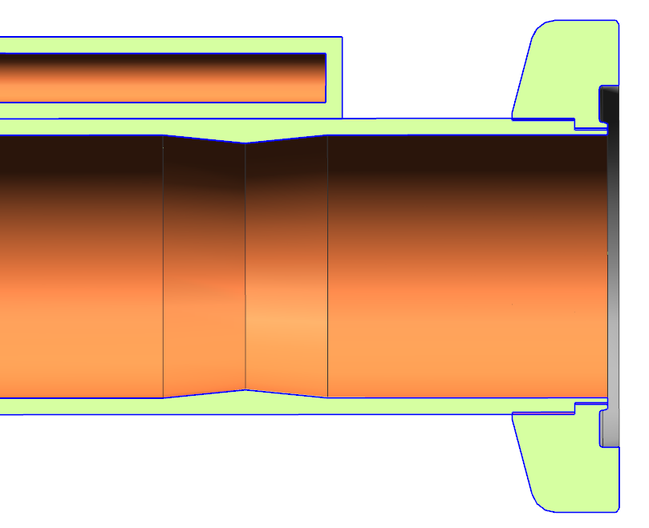
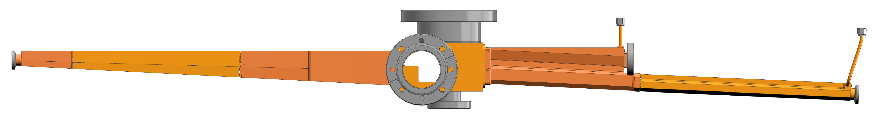
ALBA01 Prototyping: 6BA Lattice
Vacuum chamber prototypes: QDS
One aperture to fit them all: unified design for
all ID beamlines
"Straight-ish" electron beam path
7-8 mm vertical aperture: needed to extract the ID light
Conical absorber:
Shadows gaskets and BPM;
Smooth 1:10 slope
ALBA-HEPS Workshop
14/07/2026
6

Slide 6
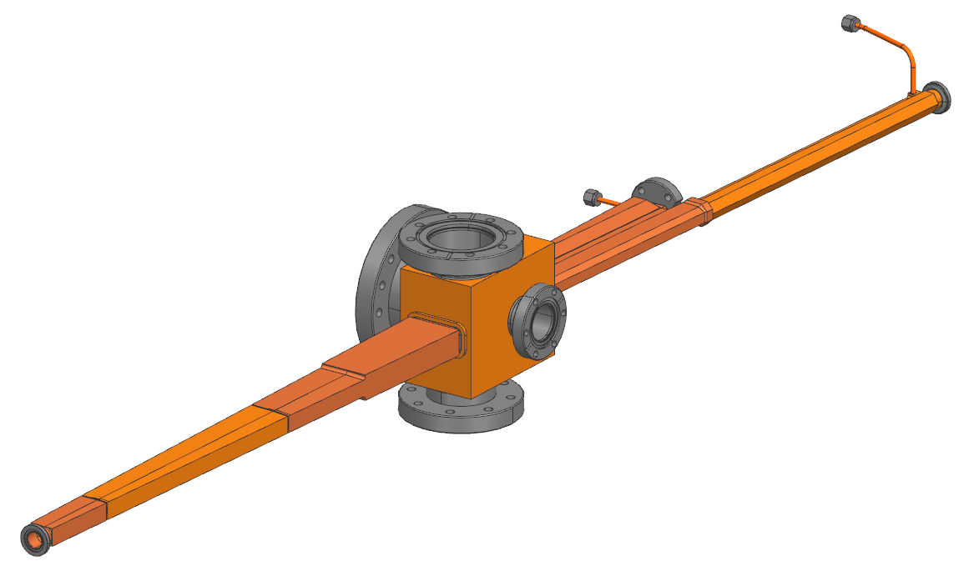
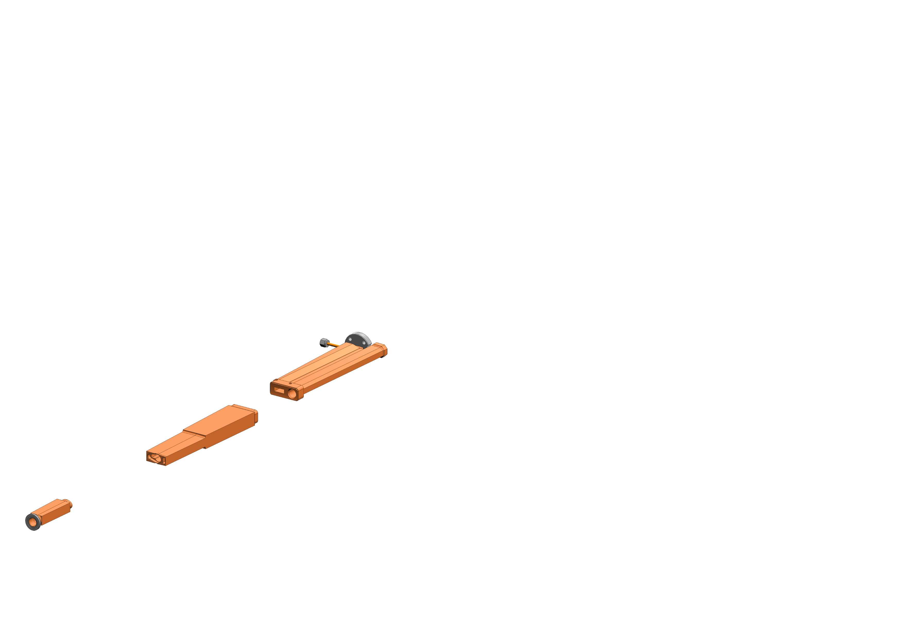
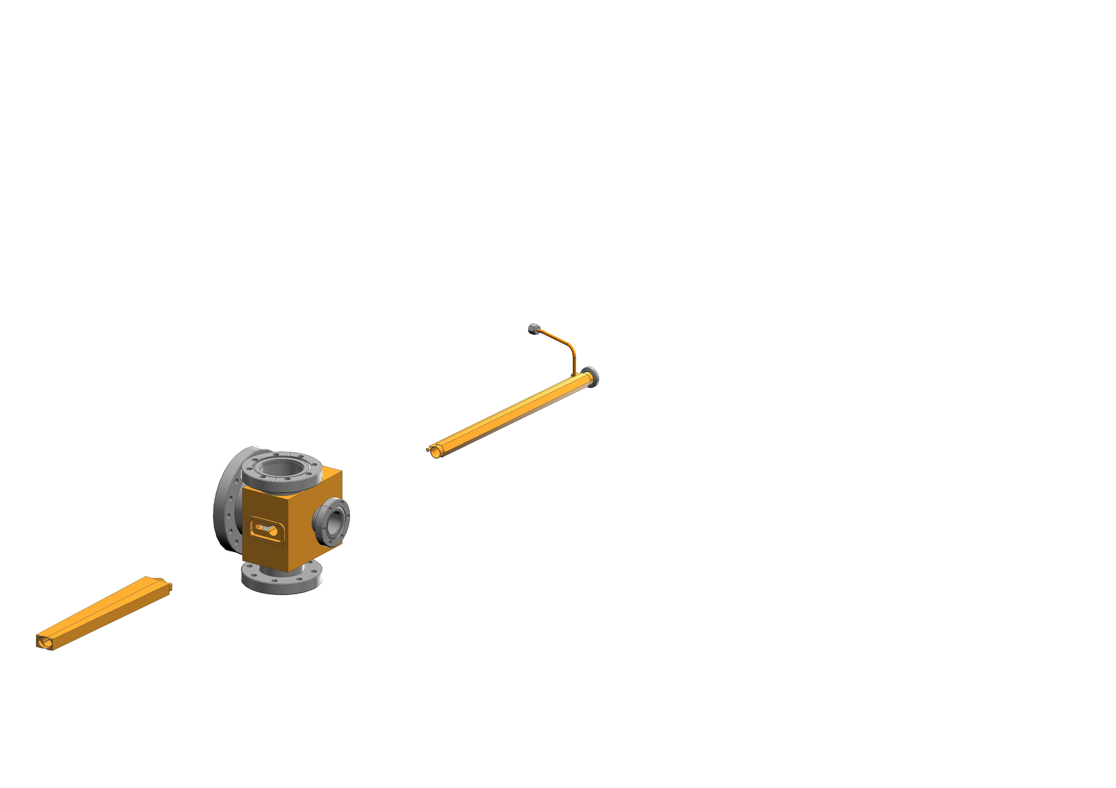
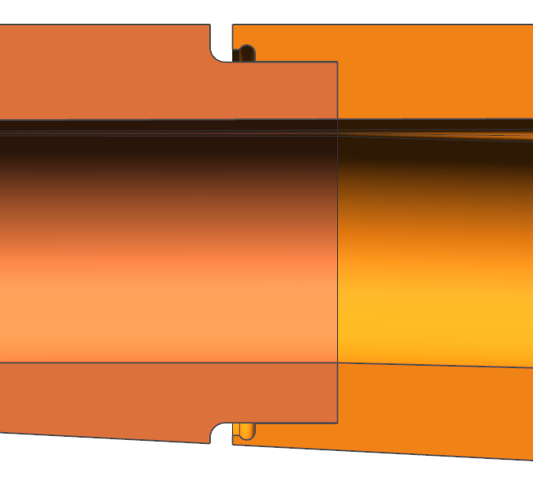
ALBA01 Prototyping: 6BA Lattice
Vacuum chamber prototypes: QDS
Brazing
Integrated cooling circuit
Solid machined parts
6
5
3
4
5
3
2
1
2
Solid machined parts
Designed to fit the magnets (Quad. and Sext.)
Integrated cooling circuit
1
4
6
Brazing joints detail
ALBA-HEPS Workshop
14/07/2026
6

Slide 7
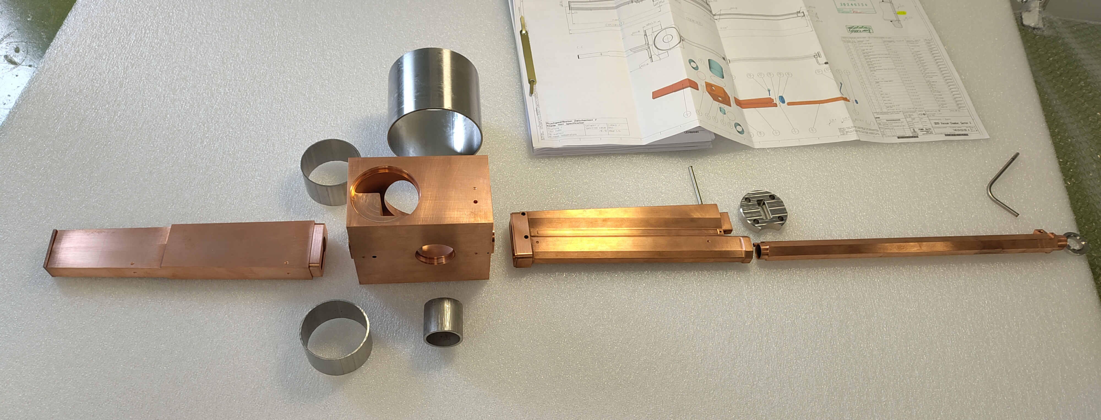
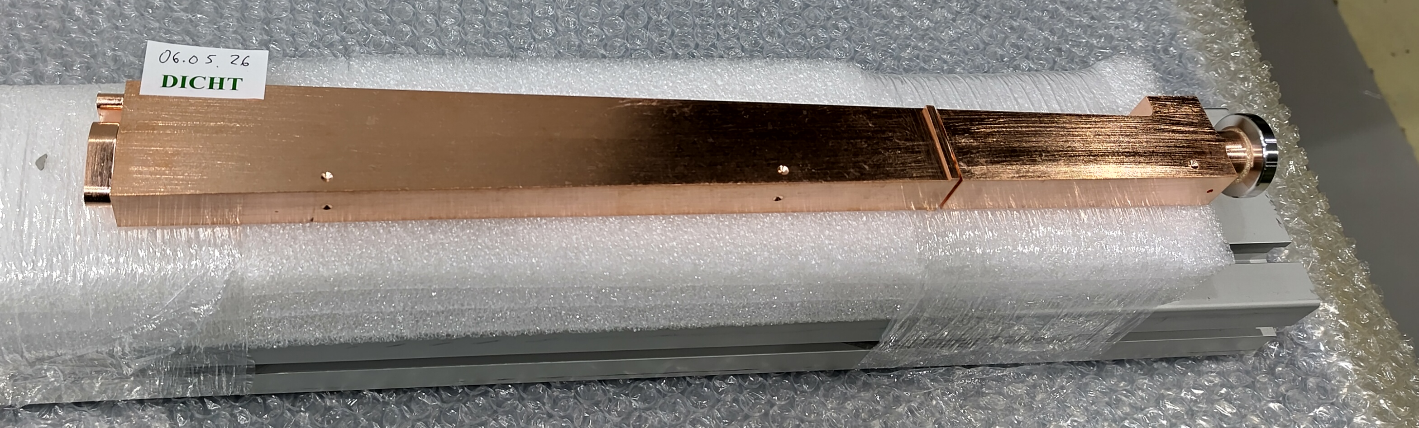
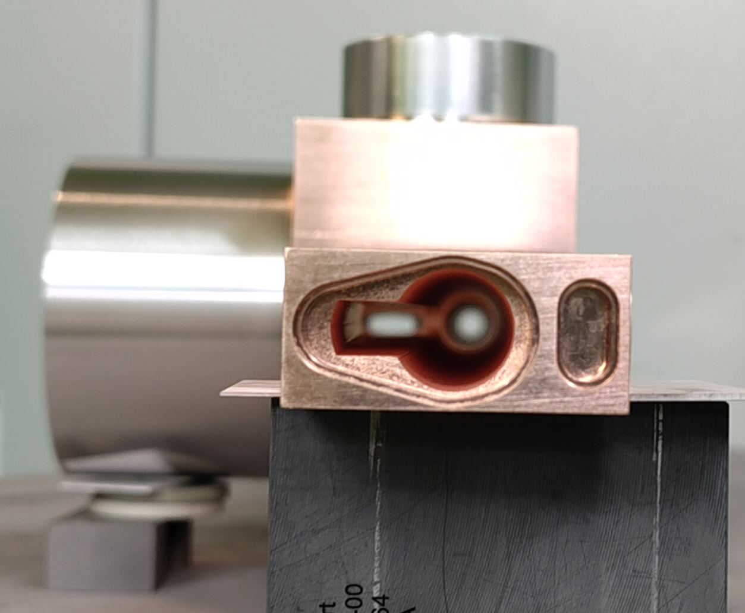
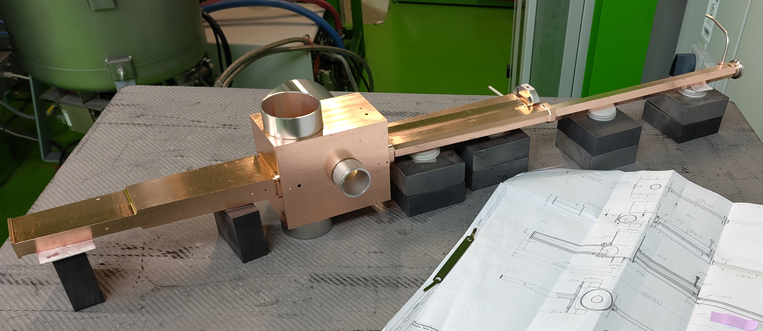
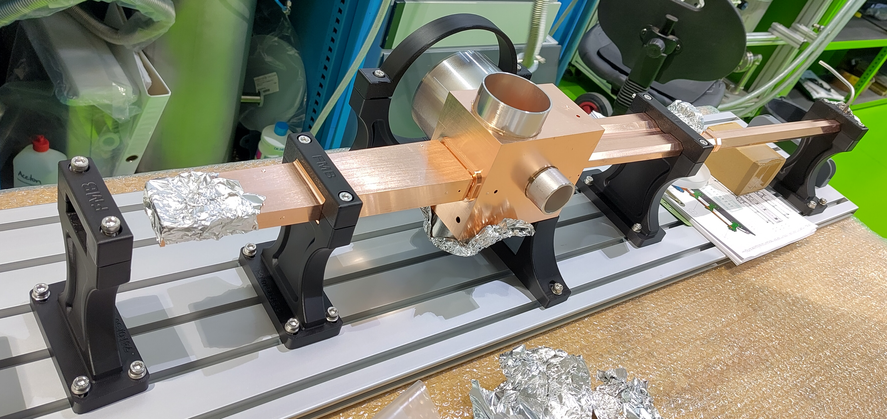
ALBA01 Prototyping: 6BA Lattice
Vacuum chamber prototypes: QDS
ALBA-HEPS Workshop
14/07/2026
6

Slide 8
ALBA01 Prototyping: 6BA Lattice
Vacuum chamber prototypes: QDS
Design phase Finished
FDR Approval Finished
Material procurement Finished
Manufacturing Finished – Issues during EDM
Brazing – 1st step Finished – Took longer that expected
Milling Finished
Brazing – 2nd step On going
TIG welding (flanges) Jul. 26
NEG coating Sep. 26
FAT Sep. 26
Delivery Oct. 26
SAT Nov. 26
QDS Chamber
OFHC-Cu
Brazed flanges
Conventional ABS
NEG coated
ALBA-HEPS Workshop
14/07/2026
5

Slide 9
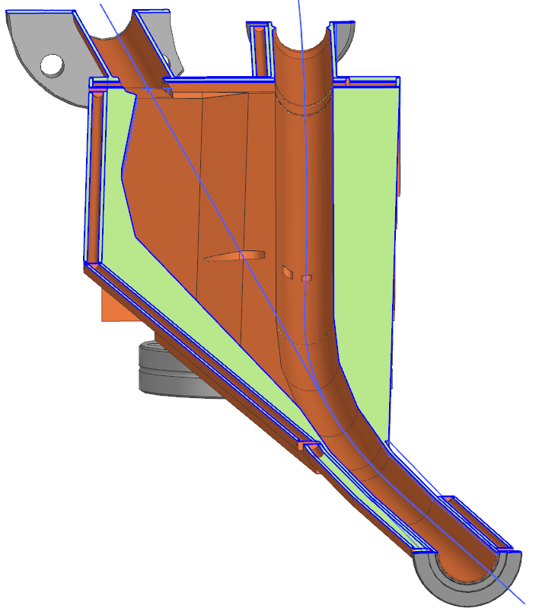
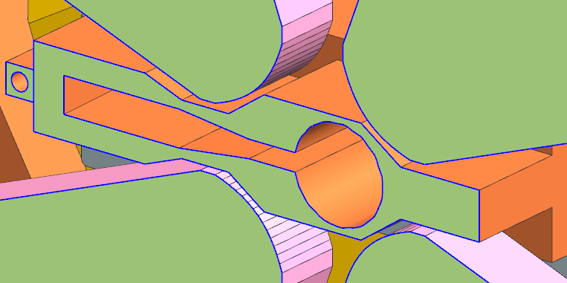
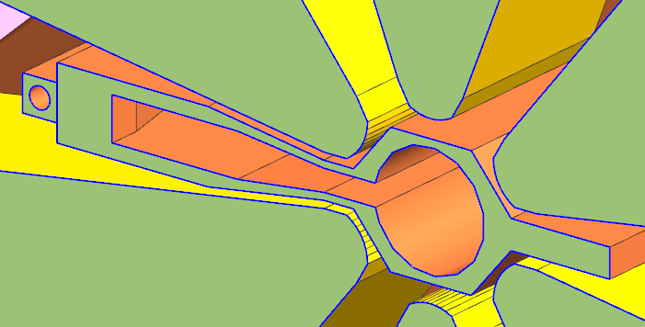
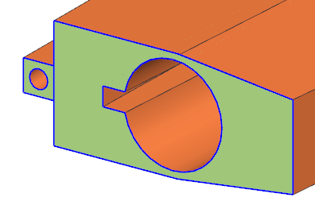
ALBA01 Prototyping: 6BA Lattice
Vacuum chamber prototypes: QD
Minimum material removal: making space for QF without losing much strength
Minimum 1mm wall thickness
Constant 3mm vertical aperture
Curved beam, straight path
Distributed cooling
Curved beam, polygonal path
6mm vertical antechamber
Distributed absorbers
Increasing wall thickness
ALBA-HEPS Workshop
14/07/2026
7

Slide 10
ALBA01 Prototyping: 6BA Lattice
Vacuum chamber prototypes: QD
Integrated cooling circuit
Cooling: Low-temperature brazing alloy + clamping
Round tube
EB Welding
Solid machined parts
ALBA-HEPS Workshop
14/07/2026
7

Slide 11
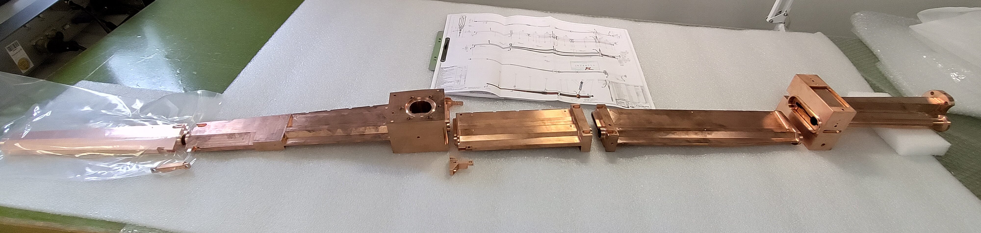
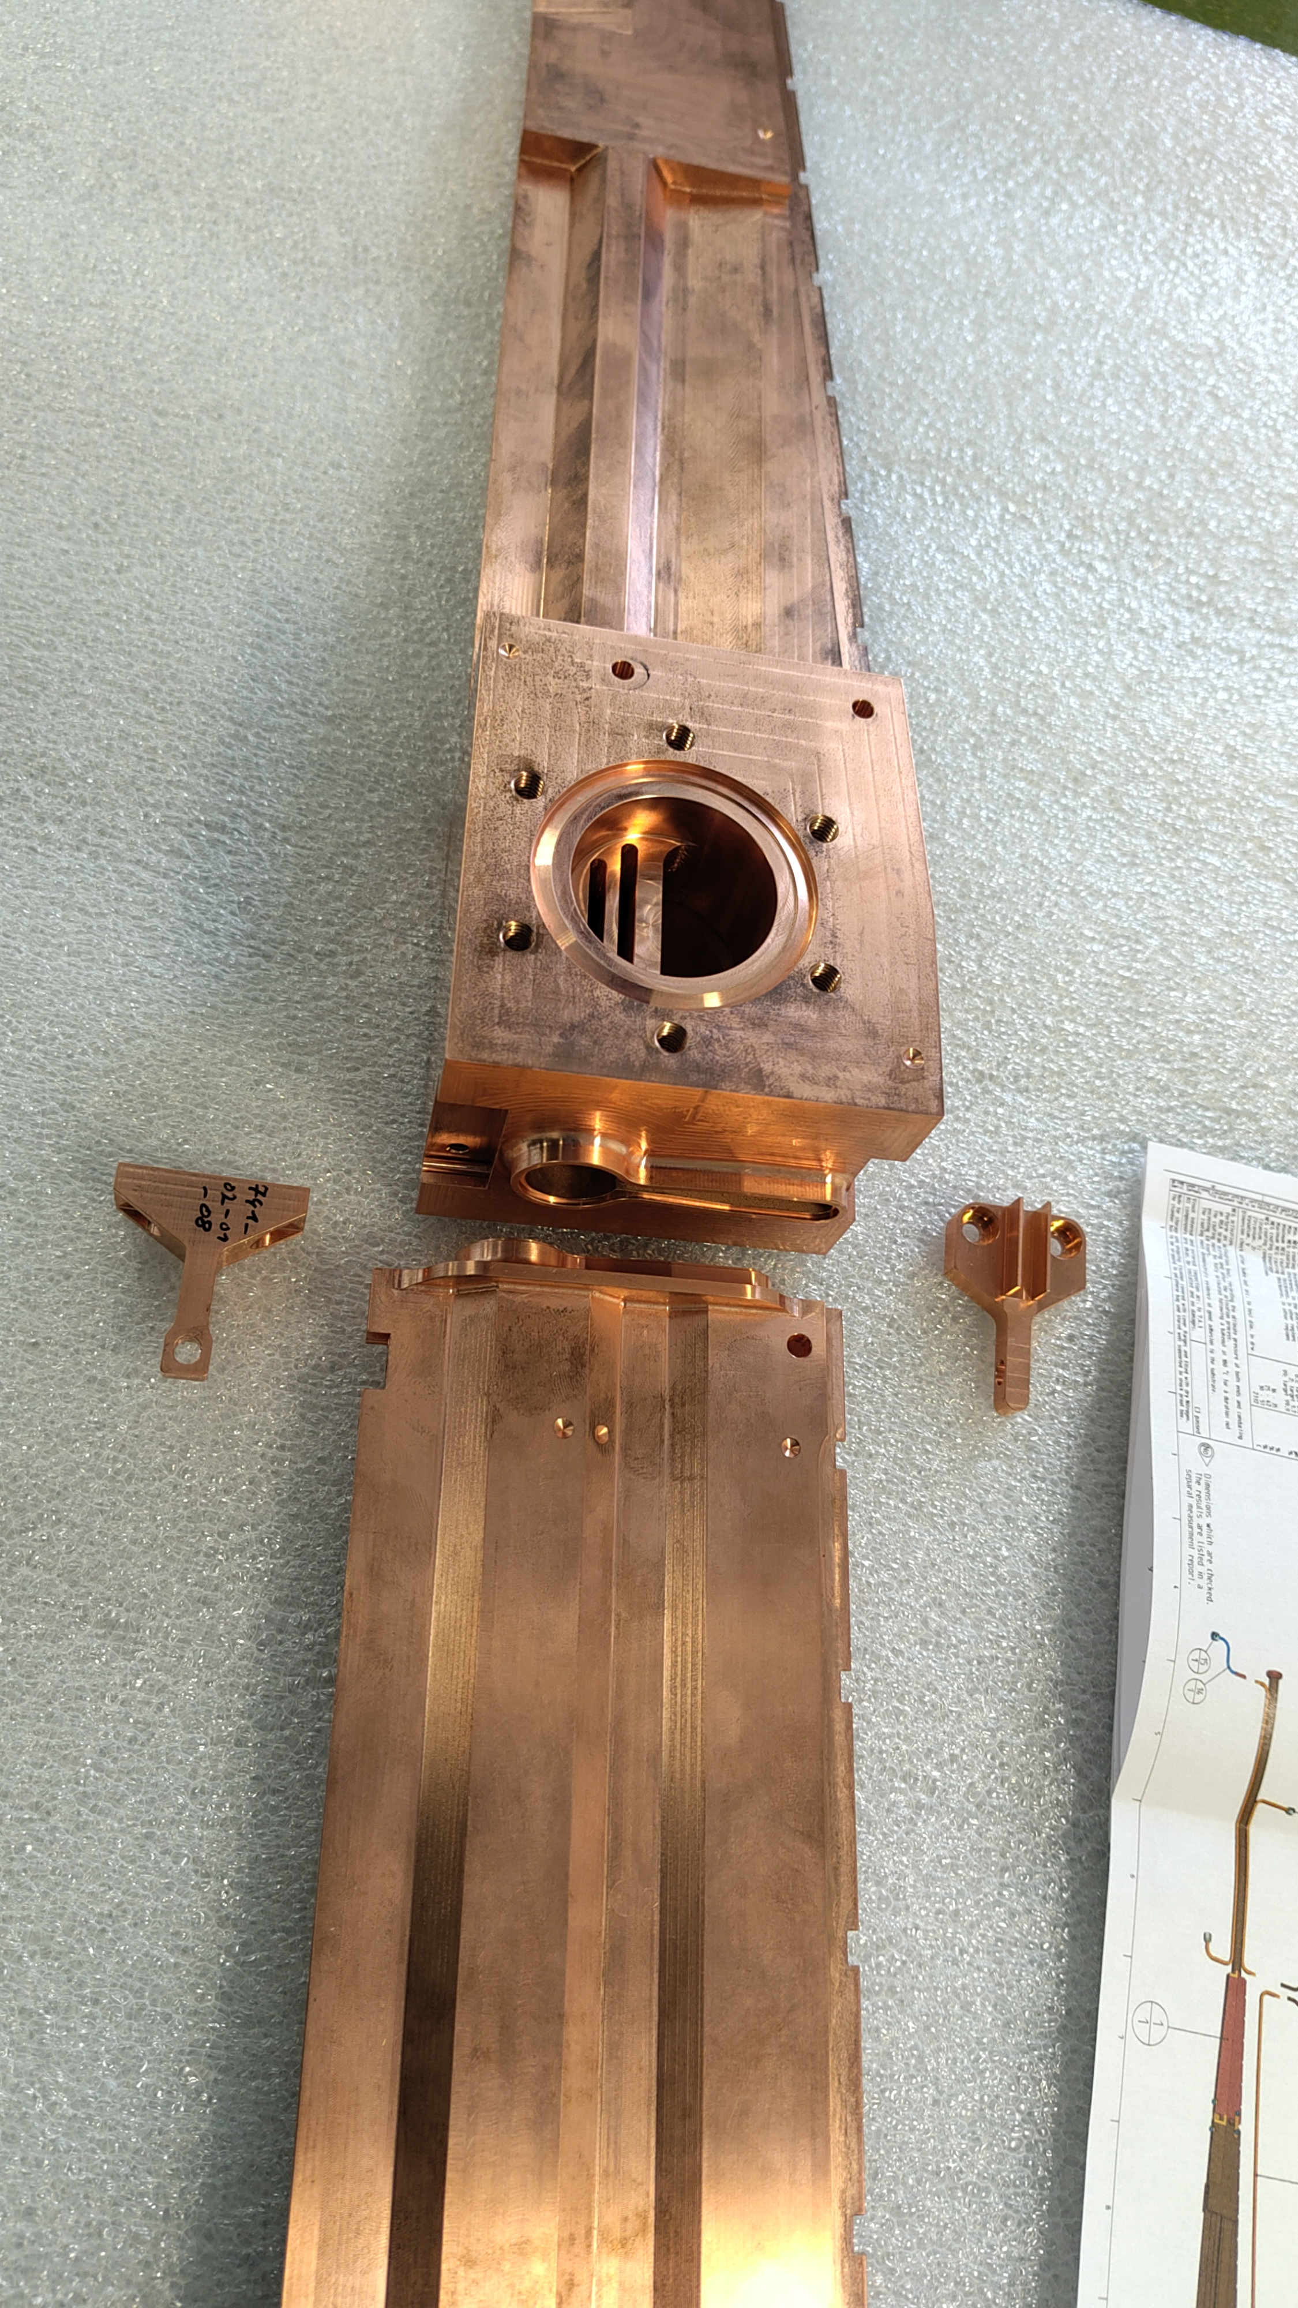
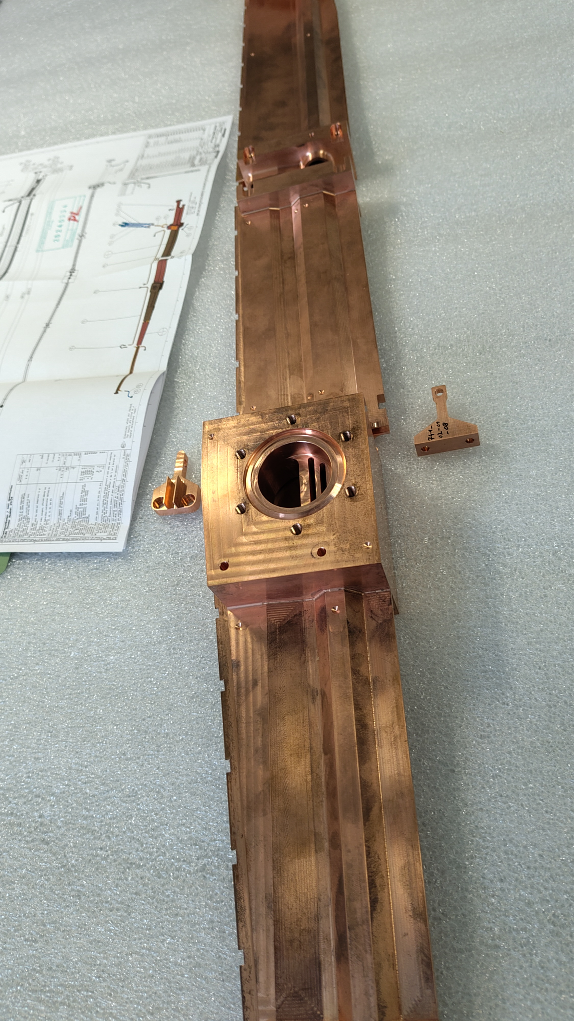
ALBA01 Prototyping: 6BA Lattice
Vacuum chamber prototypes: QD
ALBA-HEPS Workshop
14/07/2026
8

Slide 12
ALBA01 Prototyping: 6BA Lattice
Vacuum chamber prototypes: QD
Design phase Finished
FDR Approval Finished
Material procurement Finished
Manufacturing Finished
Cooling unit Finished
EB-Welding tests On going
EB-Welding Jul. 26
NEG coating Sep. 26
FAT Sep. 26
Delivery Oct. 26
SAT Nov. 26
QD Chamber
CuCrZr
No brazing
Integrated ABS
NEG coated
ALBA-HEPS Workshop
14/07/2026
7

Slide 13
ALBA01 Prototyping: 6BA Lattice
Vacuum chamber prototypes testing setup
By Juan Carlos Giraldo, from Project Office
ALBA-HEPS Workshop
14/07/2026
11

Slide 14
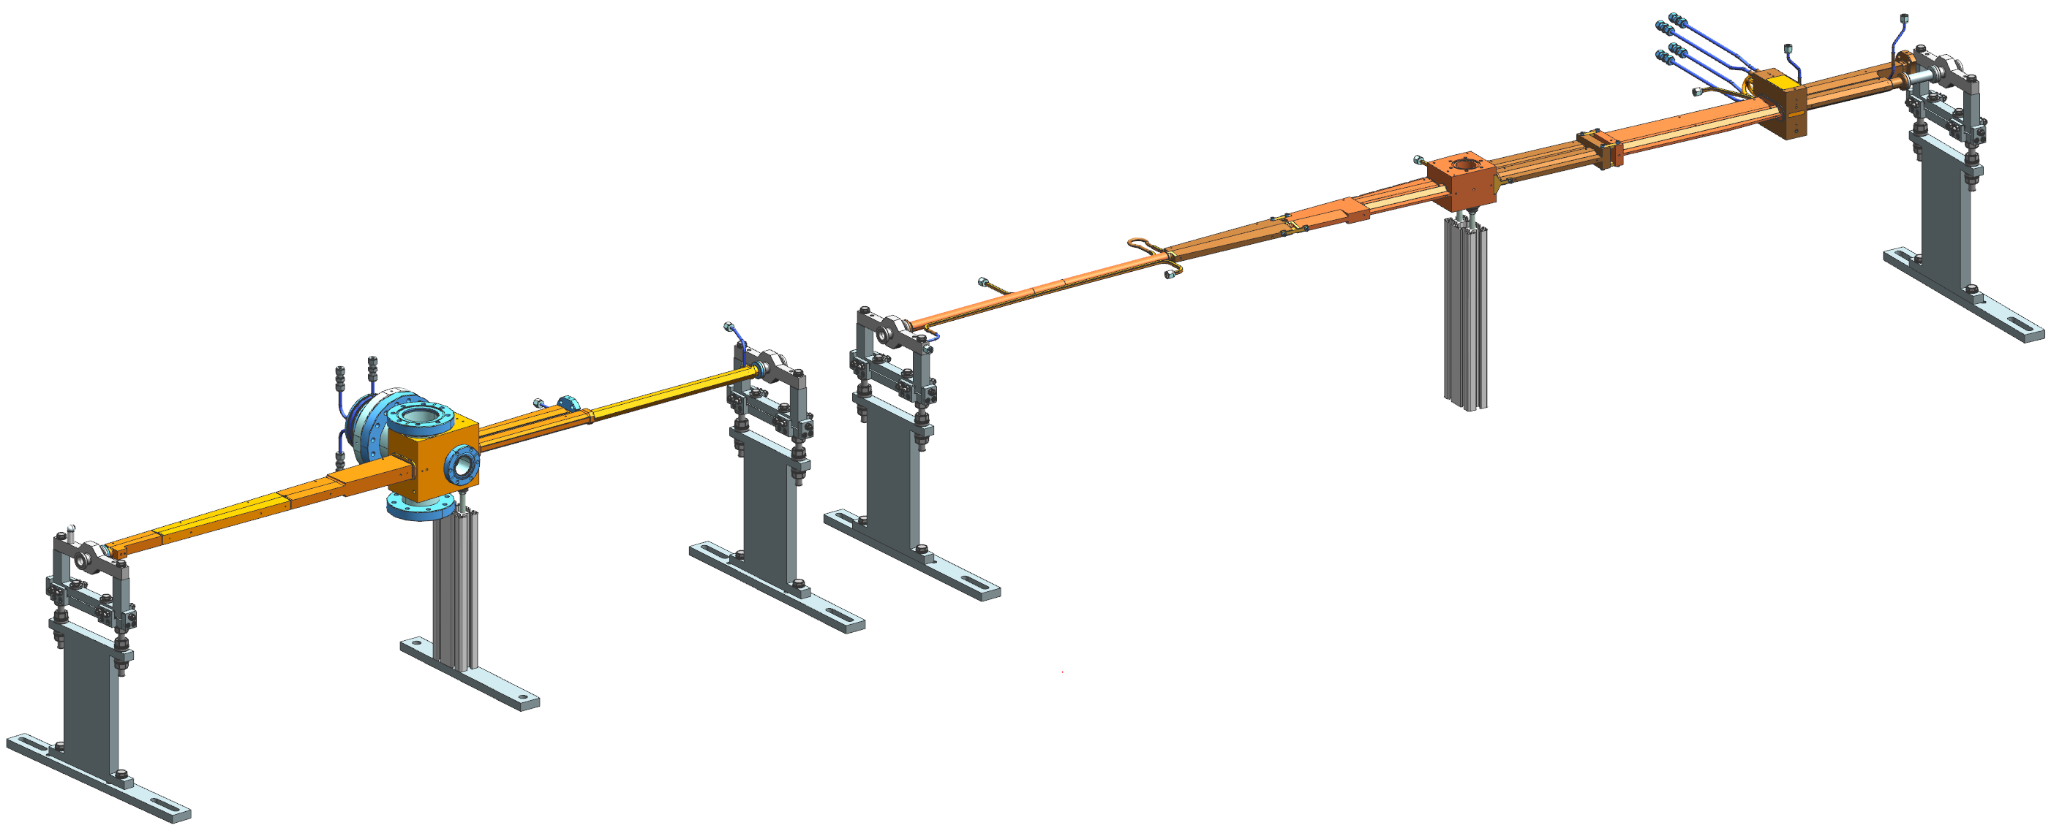
ALBA01 Prototyping: 6BA Lattice
Vacuum chamber prototypes integration setup
By José María Álvarez, from Project Office
ALBA-HEPS Workshop
14/07/2026
12

Slide 15
ALBAII: Lattice A2L007c
Vacuum system overview
Dipole chamber design
Chamber cross section
Synchrotron power

Slide 16
ALBAII: Lattice A2L007c
Vacuum system overview
Per arc:
1 vacuum section (2 gate valves)
5 dipole chambers in some Cu alloy, NEG coated, ex situ activation
5 pumping locations
5 crotch absorbers + distributed absorbers
11 BPMs
7 standalone (BPM + bellows)
4 integrated in the dipole chambers
Minimum one bellows between every two BPMs
ALBA-HEPS Workshop
14/07/2026
14

Slide 17
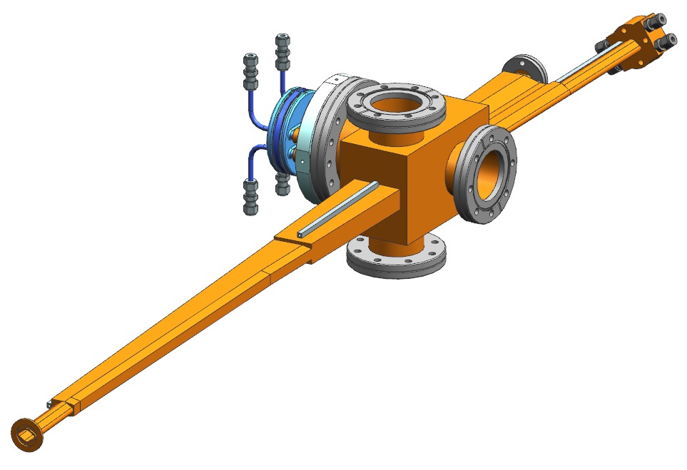
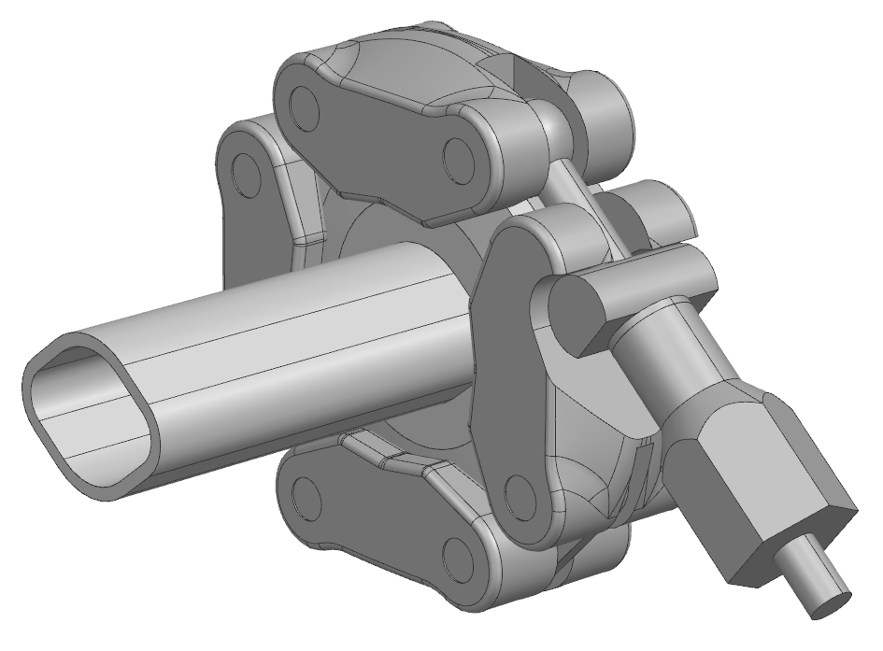
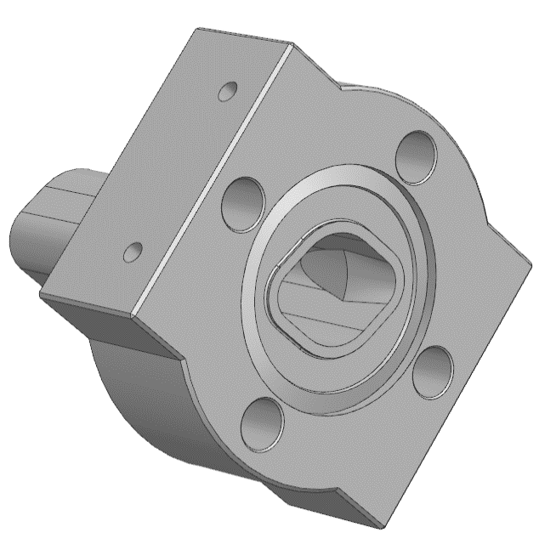
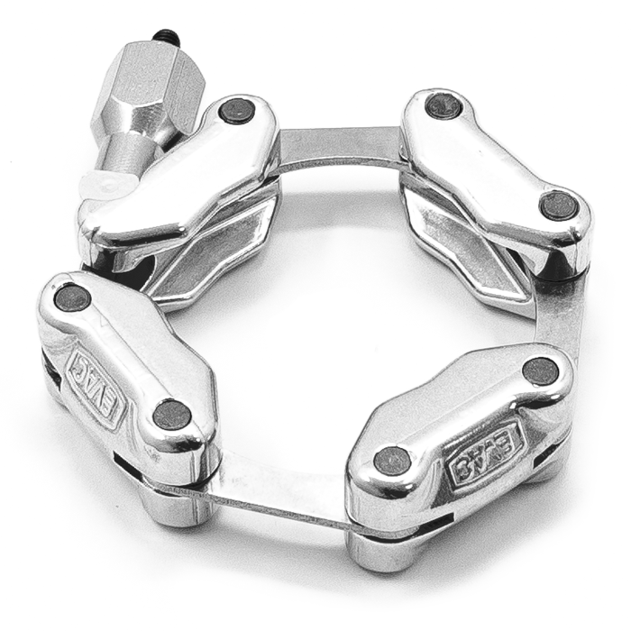
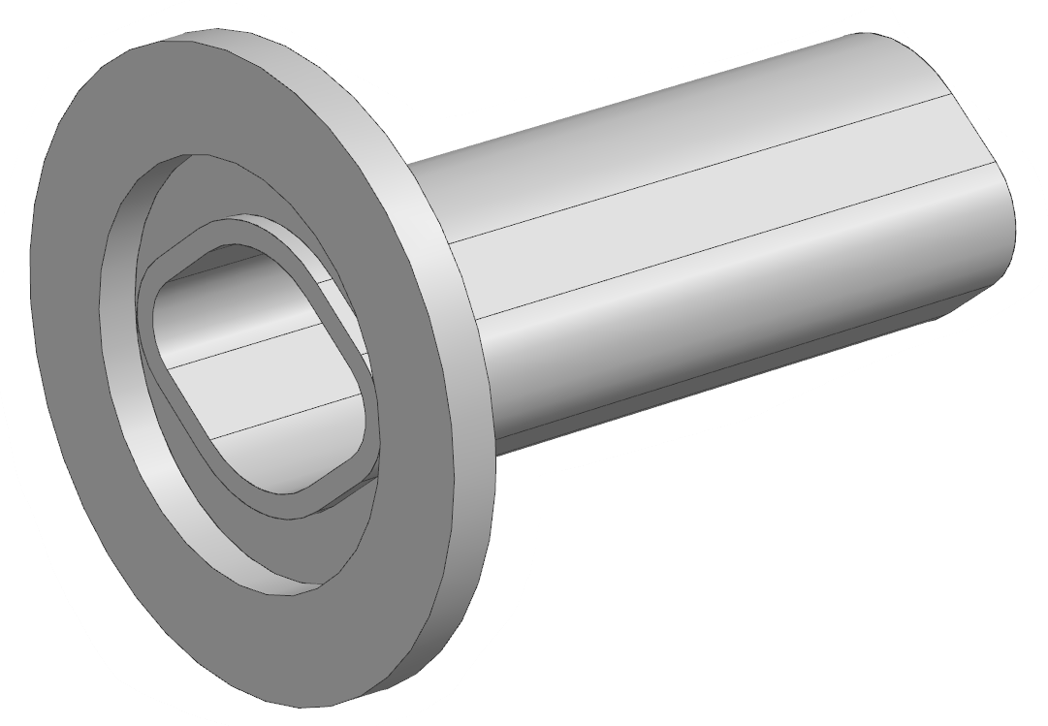
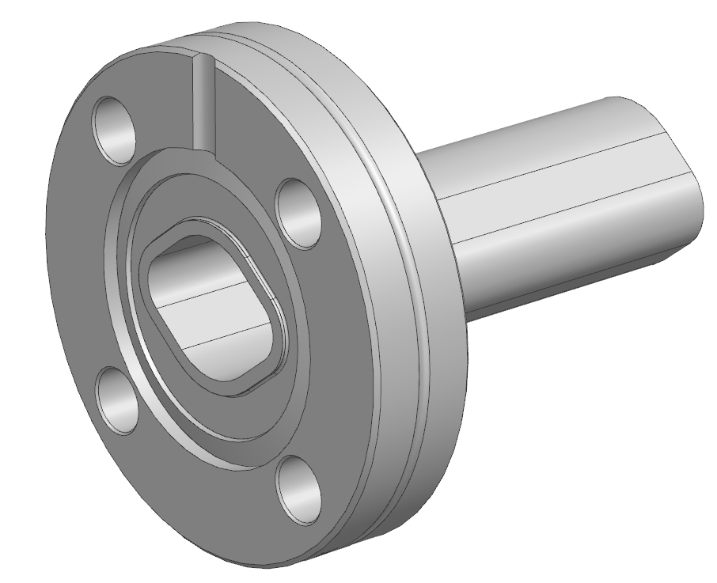
ALBAII: Lattice A2L007c
Vacuum chambers design
CF 25
with cooling
MO 25
Dipole chambers
Cu alloy: OFS-Cu, CuCrZr
Rhombic cross section
Integrated cooling and absorber
Integrated BPMs
Block for pumping + crotch absorber
MO and/or CF flanges
NEG coated
Ex situ activation
MO25
CF25
KF25 clamp
ALBA-HEPS Workshop
14/07/2026
18

Slide 18
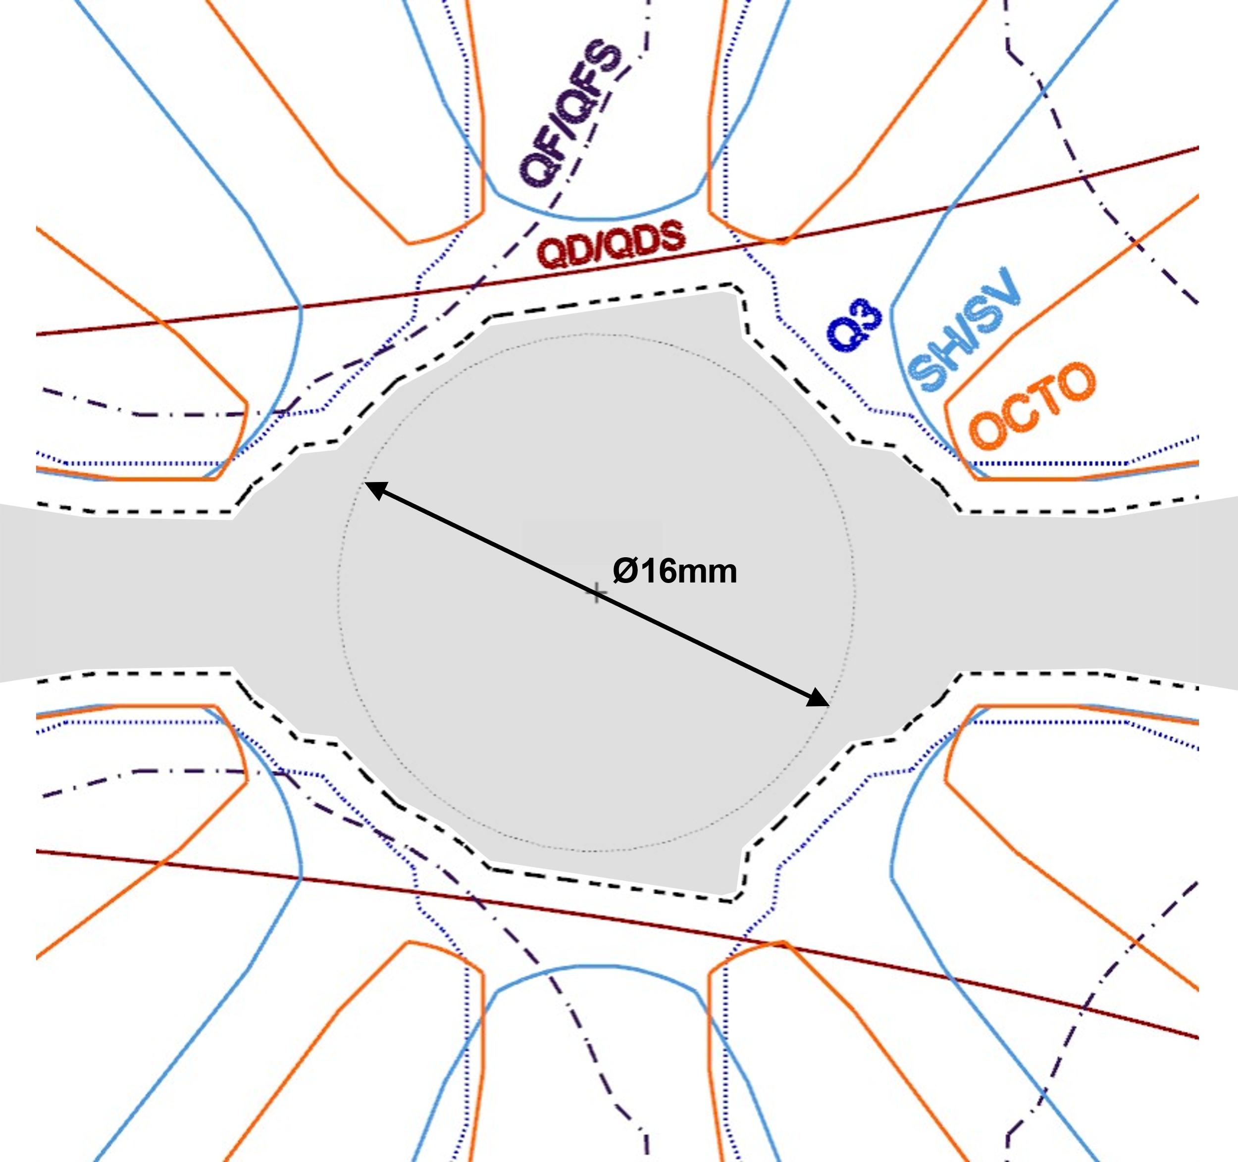
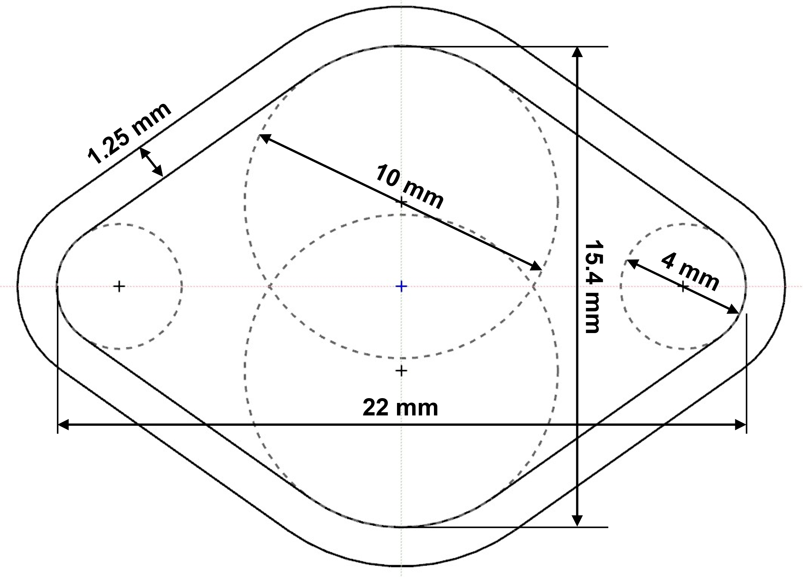
ALBAII: Lattice A2L007c
Chamber cross section
Previously planned:
16 mm circular aperture
Injection studies required larger horizontal aperture
Magnet poles remained fixed
Minimum 1 mm chamber-to-magnet clearance
Main geometric constraint: Available chamber envelope
ALBA-HEPS Workshop
14/07/2026
14

Slide 19
ALBAII: Lattice A2L007c
Synchrotron radiation total power
 |  | QDS | QD | QFS | QF
Energy | [GeV] | 3 | 3 | 3 | 3
Current | [mA] | 350
Field | [T] | 1,06 | 1,04 | 0,48 | 0,51
Length | [mm] | 605 | 1050 | 160 | 160
Angle | [deg] | 3,67 | 6,26 | 0,44 | 0,46
Power | [kW] | 2,71 | 4,54 | 0,15 | 0,16
 |  | Cell
# per cell |  | 2 | 3 | 4 | 4
Per magnet type | [kW] | 5,4 | 13,6 | 0,6 | 0,7
Total Power | [kW] | 20,3
 |  | Ring
# of cells |  | 16 | 13,8 | 0,6 | 0,7
Total power | [kW] | 324
How to deal with those power?
Antechamber and crotch absorber;
Distributed absorbers (chamber walls);
“Conical” absorbers
ALBA-HEPS Workshop
14/07/2026
19

Slide 20
rparise@cells.es

